Slide 1
Accelerating Mobile Applications through Flip-Flop Replication
Mark Gordon, David Ke Hong,
Peter M. Chen, Jason Flinn, Scott Mahlke, Z. Morley Mao

Slide 2
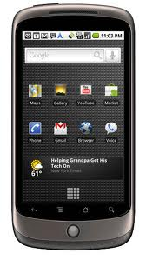
Challenges of offload
Use cloud resources to accelerate mobile apps
Get user input
UI phase
Compute phase
Display output

Slide 3
Challenges of offload
Use cloud resources to accelerate mobile apps
Get user input
Send inputs
Compute phase
Display output
Receive outputs

Slide 4
Challenges of offload
Use cloud resources to accelerate mobile apps
Challenges:
Need large compute chunks
Compute inputs/outputs must be small & predictable
Cannot safely offload chunks with external output
Must predict resource usage & supply
Get user input
UI phase
Compute phase
Display output

Slide 5
Don’t migrate – replicate!
Tango executes on both mobile and cloud
Ensures that both executions are the same
Can use output from either execution
Tango shows benefits for:
A broader set of compute-intensive segments
Network-intensive segments

Slide 6
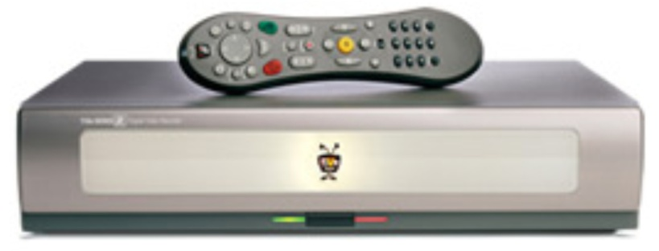
Deterministic replay
Record an execution, reproduce it later
Most parts of execution are deterministic
Just need to record/replay non-deterministic ones
Thread scheduling, network input, user input, etc.
Log
Recorded
Execution
Replayed
Execution
Non-Deterministic
Events

Slide 7
Compute-intensive application
Get user input
Display output
Get user input

Slide 8
Network-intensive application
Get user input
Query web service
Query web service
Query web service

Slide 9
Network-intensive application
Get user input
Query web service
Query web service
Query web service
Display output

Slide 10
Tango architecture
Async. Scheduling
Time
Dalvik VM
Dalvik VM
Rem. Native Code
Sensor I/O
Most Native Code
Most Native Code
User I/O
UI Stack
Storage Stack
UI Stack
Storage Stack
Network I/O

Slide 11
Leader switching
Implementation:
Leader pauses, sends switch request to follower
Follower either accepts or sends a NACK message
Only switch when follower is (almost) caught-up
Detect by observing lag between requests & responses
Only switch when application phase appropriate
Detect by observing amount of compute and I/O
Yes, we are doing some prediction
But, we are also hedging our bets with 2 replicas

Slide 12
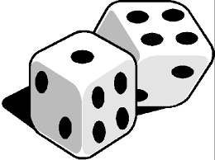
Fault tolerance
Problem: external output

Slide 13
Fault tolerance with Tango
Tango can tolerate a server stop-failure
Log-based rollback recovery
If cloud server is leader, before output:
Stores prior non-determinism on 2nd server
On server failure:
Mobile replicas is checkpoint of app state
Use stored log to roll forward to last output

Slide 14
Fault tolerance
Solution: Backup server keeps recovery log

Slide 15
Evaluation
Methodology
Samsung Galaxy S3 smartphone (Android 4.2.2)
Replay server (3.4GHz i5 processor, 4GB RAM)
2 compute-intensive apps, 5 network apps
Questions to answer:
Does Tango improve interactive performance?
What is Tango’s effect on client energy usage?

Slide 16
Interactive latency

Slide 17
Client energy usage

Slide 18
Conclusion
Don’t migrate - replicate!
Execute on both mobile client and server
Determinism ensures same output
Leadership moves between replicas
Can lead to 2-3x performance improvements
Questions?

Slide 19
Communication

Slide 20
Lessons learned
Hard to enforce determinism in Dalvik VM
Too many native methods
Too many interactions with system services
Support for JIT, ART possible, but a lot of work
Offload of network apps is promising
Need to think carefully about fault tolerance

Slide 21
Implementation
Dalvik VM mostly deterministic
Added deterministic thread scheduling
Leader decides timing of input, async events
Native methods
Default behavior: run once on mobile device
Optimization: make deterministic and replicate

Slide 22
External I/O
Natural affinity to one replica:
Mobile: UI, IPC, and sensors
Cloud: network
Proxy receives inputs, broadcasts to replicas
Leader decides when input events occur
Leader sends outputs to proxy

Slide 23
Internal non-determinism
Some components replicated & deterministic
UI Stack: Many low-level interactions
Storage: File system and DB accesses
Other components handled by leader:
Scheduling of asynchronous events
Time queries
Randomness (/dev/random)

Slide 24
Macrobenchmark
Computation-heavy apps: 2~3x speedup
Network apps: 0~2.6x speedup
Benchmark | Interaction | Network RTTs
Sudoku | Solving a Sudoku grid given a single cell | N/A
Poker | Compute winning probability from initial state | N/A
Hoot | Update Twitter given a keyword | 5
TapTu | Update Facebook feed | 4
Email | Update Email’s inbox | 4
Instagram | Update Instagram posts | 3
Pinterest | Update Pinterest boards | 2~8

