Slide 1
Race Detection for
Event-driven Mobile Applications
Chun-Hung Hsiao | University of Michigan
Jie Yu | University of Michigan / Twitter
Satish Narayanasamy | University of Michigan
Ziyun Kong | University of Michigan
Cristiano Pereira | Intel
Gilles Pokam | Intel
Peter Chen | University of Michigan
Jason Flinn | University of Michigan
Notes:
Hi everyone. This is Chun-Hung. I’m going to talk about my work: race detection for event-driven mobile applications. This work is collaborated with my advisor and colleagues in U-M and Intel.

Slide 2







Rise of Event-Driven Systems
Mobile apps
Web apps
Data-centers
Lack tools for finding concurrency errors in these systems
Notes:
Event-driven systems have been existing for a while, and nowadays they are more and more popular. These systems include billions of mobile platforms running Android, iOS, and windows, and we also have many web applications like google docs and Microsoft office writing in the new HTML5 standard, which incorporate a event-driven model. In the era of big data, we also have many data centers running asynchronous tasks every second.
But there’s a lack of tools for debugging the unique class of concurrency errors that manifest in these systems.
// spend more time

Slide 3

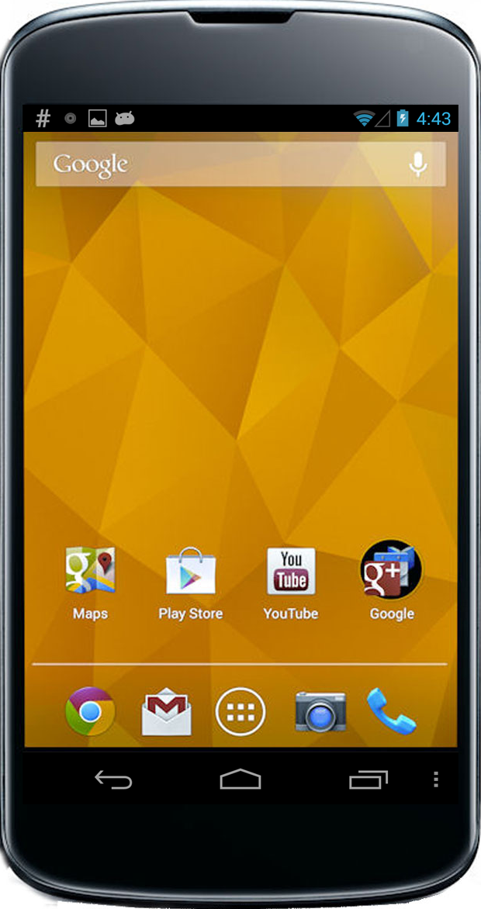

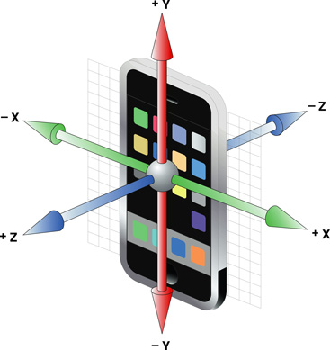




Why Event-Driven
Programming Model?
Need to process asynchronous input from a rich set of sources
Notes:
The unique class of concurrency bugs In event-driven systems are due to the asynchrony they need to process. For example, in a mobile platform, there are a lot of asynchronous input coming from a rich set of sensor arrays, such as the user action on the touch screen, the camera, the GPS signals, and so on. The unique class of concurrency errors appears when processing these asynchronous input.

Slide 4

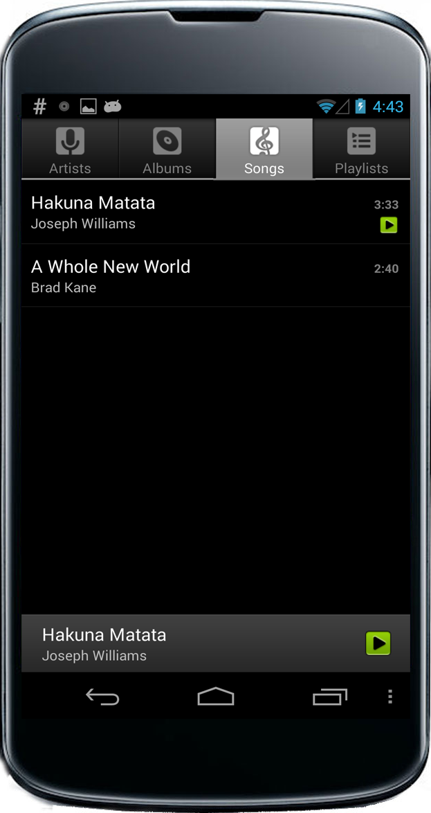

Events and Threads in Android
Looper Thread
Event Queue
Threads
Regular Threads
send( )
signal(m)
wr(x)
wait(m)
rd(x)
Notes:
Let’s take Android as an example.
In Android, an application consists of mulitple threads.
These threads may contain conventional synchronization operations,
As well as memory accesses to shared variables.
We also have events to process asynchronous input. An event can be generated by a sensor input,
And is associated with a code snippet called event handler.
When an event is generated, it would be put into the event queue.
Events can also be generated and by the programmer via an explicit send API call.
Among the threads in an application, there is a special thread called the Looper thread
That periodically check the queue to dequeue and execute the events in a FIFO order.

Slide 5
Conventional Race Detection
e.g., FastTrack [PLDI’09]
Looper Thread
Regular Threads
  Causal order: happens-before ( ) defined by synchronization operations
send( )
signal(m)
wr(x)
  Conflict: Read-Write or Write-Write data accesses to same location
wait(m)
rd(x)
  Race ( ): Conflicts that are not causally ordered
Notes:
To find race bugs in an Android application, a naïve approach is to run a conventional race detector.
In a conventional race detector, the causal order is defined by the synchronization operations,
And a conflict is a pair of accesses to the same memory location with at lease one write.
If there is a conflict whose accesses are not causally ordered, a race reported by the conventional detector, and that would imply a concurrency bug in the application.

Slide 6


Conventional Race Detection: Problem
Looper Thread
Regular Threads
NullPointerException!
Conventional race detectors cannot find such errors in Android
Problem: Causality model is too strict
Should not assume program order between events
Notes:
//
However, this naïve approach has a fundamental problem and cannot find a certain type of concurrency bugs that commonly happen in Android apps. Now I’m going to present one such bug, which is adapted from a bug in the Android Music app.
// emphasize that “the causal order need to be revised” // emphasize “extreme”
// put it into the slides
When the user click on a song in the music app, the onClick event would generate an onReceive event to update the UI
The onReceive event then dereference an internal pointer
Meanwhile, the user can terminate the app and generate an onDestroy event to reset the pointer
However, the order between onReceive and onDestroy is not enforced by the programmer,
So it is possible that in another execution, onDestroy would be executed before onReceive,
Resulting in a null pointer execution
There has been some related work to find races between events in a web application, but no existing tool to find such bugs in Android.

Slide 7
Model Events as Threads?
Event
Event
Event
Regular Threads
Race
Notes:
We can go the other extreme and …
From the previous example, we can see that although events are executed in the same thread, they can be logically concurrent and executed in any order. // emphasize this
// put “android guarantees certain properties”
So a second naïve approach is to treat these events a short-lived threads then run a race detector.
While this approach can find the bug shown earlier, it has it’s own problem: there are still some causal order between events, and they can may be missed in this model.
// There are rules that are not enforced by this model. Because Android enforces event orders, we have to account for the event order enforced by the event-based model.
// provide another send example

Slide 8
Events as Threads: Problem
Regular Threads
Event
send( )
Event
send( )
False race
Missing causal order!
Problem: Causality model is too weak
Android system guarantees certain causal orders
between events
Notes:
We can go the other extreme and …
From the previous example, we can see that although events are executed in the same thread, they can be logically concurrent and executed in any order. // emphasize this
// put “android guarantees certain properties”
So a second naïve approach is to treat these events a short-lived threads then run a race detector.
While this approach can find the bug shown earlier, it has it’s own problem: there are still some causal order between events, and they can may be missed in this model.
// There are rules that are not enforced by this model. Because Android enforces event orders, we have to account for the event order enforced by the event-based model.
// provide another send example

Slide 9
Challenge 1: Modeling Causality
Goal: Precisely infer causal order between events
that programmers can assume
Looper Thread
A
B
A → B
C || B
B
C
Notes:
To build a race detector, the first challenge is to infer the causal orders between events executed in the same thread. In this example, we need to be able to infer that A happens before B but C is concurrent to B. Since the existing model cannot serve our need, we need to develop a new causality model.

Slide 10
Challenge 2: Not All Races are Bugs
Races between events
(e.g., ~9000 in ConnectBot)
Atomicity violations
Order violations
Not a problem in Android events!
Events
Events
p = new T;
p = null;
*p;
p = null;
One looper thread executes all events non-preemptively
*p;
Solution: Commutativity analysis identifies races that cause order violations
Notes:
// Races indicates order violations and atomicity violations
But the problem is not solved yet. If we detect races based on our causality model, many races are benign races and indicate no bug. For example, we discovered about 9000 read-write or write-write races in the ConnectBot app and most of them are benign. Why doesn’t this approach work? Conventionally, races are good indications to two two categories of bugs.
The first one is order violation……
The second category is atomicity violations…
However, in Android, there is a looper thread to process all events in an event queue non-preemptively, so the atomicity is implied in the execution model….
If two events can be executed in any order, then races between them won’t cause any bug. We call them commutative events. The second challenge here is to determine if two events are commutative or not.
The “Order violation & atomicity v” argument.
Show Vann Diagram and explain atomiticy violation is false positive.
// make it more clear. Too vague.

Slide 11
Outline
Causality Model
Commutativity Analysis
Implementation & Results
Notes:
In the remaining of this talk, I’ll go through our causality model to solve challenge 1, then the commutative analysis for challenge 2, and our implementation and results.

Slide 12
Causality Model
Conventional causal order; Event atomicity; Event queue order
Android uses both thread-based and event-based models
Causal order is derived based on following rules:
  Conventional causal order in thread-based model
  Event atomicity
  Event queue order
Conventional causal order;
Event atomicity;
Event queue order
Notes:
Since Android is a mixture of a event-based model and a thread model, our causality model needs to account for
the conventional causal order,
As well as the order enforced by the event-based model, including event atomicity and event queuer order.

Slide 13
Conventional causal order; Event atomicity; Event queue order
Looper Thread
begin(A)
Fork-join
Regular Thread
fork(thread)
begin(thread)
Program order
end(A)
send(B)
fork(thread) → begin(thread)
end(thread) → join(thread)
signal(m) → wait(m)
send(event) → begin(event)
begin(B)
Send
signal(m)
Signal-wait
wait(m)
end(B)
Notes:
In the conventional causal order,
we first account for the program order. Unlike conventional race detectors, we relax the program order between events, since they are not enforced by the programmer. Besides, we also account for most conventional orders, such as
fork-join,
signal-and-wait, and
the order between event generation and execution.

Slide 14
Conventional causal order; Event atomicity; Event queue order
One looper thread executes all events non-preemptively
=> events are atomic
Looper Thread
begin(A)
Regular Thread
fork(thread)
begin(thread)
end(A)
Ordered due to event atomicity
send(B)
begin(A) → end(B)
end(A) → begin(B)
begin(B)
end(B)
Notes:
Within a thread, events are not preemptible, so an event is processed as a whole by the looper thread before processing another.
If any operation in A happens before any operation in B, for example, fork happens before begin(B),
then the whole event A must be executed before the whole event B.

Slide 15
Conventional causal order; Event atomicity; Event queue order
Looper Thread
Regular Thread
Event Queue
send(A)
A
send(B)
B
begin(A)
end(A)
send(A) → send(B)
end(A) → begin(B)
begin(B)
Ordered due to
FIFO queue order
end(B)
Notes:
The FIFO event queue also enforces causal orders between events.
If send(A) happens before send(B),
Then A must be enqueued earlier than B
Since the looper dequeue the events in the FIFO order,
A must happen before B.

Slide 16
It’s Not That Simple…
Conventional causal order; Event atomicity; Event queue order
Special send APIs can overrule the FIFO order
  Event with execution delay
  Prioritize an event
    sendAtFront(event): inserts event to queue’s front
  Special event queue rules handle these APIs.
  See paper for details.
Notes:
But Android provides special API to overrule the FIFO order, such as sending events with a delay, or sending events to the front of the queue.
Our causality model contains special event queue rules to deal with these operations. Please see the paper for details.

Slide 17
Event Orders due to External Input
Assume all events generated by the external environment are ordered
Looper Thread
A
B
B
C
Notes:
In additional to events generated in the app,
Some events are generated by the external input, and they may be causally ordered.
In our model, we conservatively assume that all events generated by the external environment are ordered.
// Because this assumption is conservative, we need to define what events are external

Slide 18
What is External Input?
External Environment
App
surfaceflinger
context_manager
IPC
system_server
Notes:
So we are not only track the event generated inside the app, but also “as many communications as possible”…
// put the names of the system_servers
But ordering the external events would introduce false negatives. To alleviate the problem we also track the synchronization operations in the system service processes that may communicate with the app, so we can infer the causal orders for events generated by these communications. Only the events generated outside the app and the system processes are considered external.

Slide 19
Outline
Causality Model
Commutativity Analysis
Implementation & Results
Notes:
Now I’m going to talk about the event commutativity analysis.

Slide 20
Problem: Not All Races are Bugs
Races between events
Atomicity violations
Order violations
Not a problem in Android events!
Notes:
// Remember our goal is to only report races with order violation
// order violation: one order is correct and another is wrong
// give an example of order violation
// define “order violation” and “commutative analysis”
// give an example of commutative events (in the next slide)
But the problem is not solved yet. If we detect races based on our causality model, many races are benign races and indicate no bug. For example, we discovered over 8000 read-write or write-write races in the ConnectBot app and most of them are benign.
If two events can be executed in any order, then races between them won’t cause any bug. We call them commutative events. The second challenge here is to determine if two events are commutative or not.
The “Order violation & atomicity v” argument.
Show Vann Diagram and explain atomiticy violation is false positive.
// make it more clear. Too vague.

Slide 21


Order Violations in Events
Looper Thread
Looper Thread
  Race between non-commutative events => order violation

Slide 22
Races in Commutative Events
Looper Thread
Looper Thread
  racy events are commutative
  => not a race bug
  Hard to determine if events are commutative!
Notes:
The second challenge we want to resolve is to figure out which races are bugs and which are benign ones. Here is an example of a benign race. In the ConnectBot app, the onLayout and onPause events are not causally ordered, and they use the same flag variable to set and check if the window can be resized. Apparently the accesses to the flag variable form a race.
But the race is not a bug since both execution orders generate programmer-intended results.
In other words, they are commutative events, and hence the race is not a bug.
But it is a very hard problem to decide if events are cummutative in general.

Slide 23
Solution: Commutativity Analysis
Report races between known non-commutative operations -- uses & frees
Looper Thread
A
B
  Heuristics to handle commutative events with uses and frees.
  See paper for details.
B
Use
C
Free
Notes:
To tackle this problem, we use a simple but effective strategy: we only focus on non-commutative operations in the events. In the current work, we focus on uses and frees of objects. Apparently uses and frees are not commutative, so we only report races for the accesses related to uses and frees to avoid benign races.
There are some cases that events containing uses and frees are still commutative. So we developed two heuristics to handle such cases. Please see our paper for details.

Slide 24
Outline
Causality Model
Commutativity Analysis
Implementation & Results
Notes:
Now I’m going to talk about our implementation. // combine implementation & results

Slide 25
CAFA: Race Detection Tool for Android
App
surfaceflinger
context_manager
Java Libs
Java Libs
system_server
Java Libs
Dalvik VM
Java Libs
Dalvik VM
Dalvik VM
Dalvik VM
Native Libs
Native Libs
Native Libs
Native Libs
CAFA
Analyzer
Android Kernel
CAFA
Analyzer
IPC Binder
IPC Binder
Logger
Logger
Also logs the system service processes for complete causality
Logger device in the kernel for trace collection
Offline race detector based on graph reachability test
Logs data access operations related to uses and frees
Logs synchronization operations for causality inference
Notes:
We implemented a use-free race detection tool called CAFA based on our causality model on Android. We instrumented Android such that we can run an uninstrumented app on our system for race detection. Our instrumentation involved several parts. // we are not going to go through the details.
First, we instrumented the Android Java libraries and the underlying native C++ libraries to log the synchronization operations.
Second, we also instrumented the Dalvik VM to log all reads and writes related to uses and frees.
We also instrumented the system service processes to capture the causalities due to the IPCs,
And introduce a logger device in the kernel for trace collection.
Finally, we implemented a offline analyzer based on graph reachability test to detect use-free races.

Slide 26
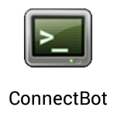









Tested Applications
Notes:
We tested CAFA on 10 open-source Android applications, including some popular ones such as web browsers and a barcode scanner.

Slide 27
Use-after-Free Races
115 races; 69 race bugs (67 unknown bugs)
32 benign races (27.8%):
Imprecise commutative
analysis
■ Races in conventional causality model
31 (27.0%)
■ Races in Android causality model
46 (40.0%)
13 (11.3%)
■ False positives
38 (33.0%)
25 (21.7%)
14 false races (12.2%):
Imprecise causal order:
-- Imperfect implementation
Notes:
Among the 10 applications, CAFA reported 115 races, and we found 67 unknown bugs and 2 known ones from these races. The reported races are classified into 3 categories.
The first category contained races that could be detected by a conventional race detector. We found 31 such races.
The second category contained races that happened between different threads but couldn’t be detected by a convenitonal detector. CAFA was able to detect them because we relaxed the program order between events in the same thread. We found 25 such races.
The third category contained races that happened between different events within the same thread. We found 13 such races.
And then we had a number of false positives. The false positives could be divided into 2 sets.
The first set contained 14 false races. We put a lot effort to capture the causalities due to the event listeners in Android, but there are still some missing causalities. We can potentially improve our implementation to reduce the false races in the future.
The second set contained 32 benign races because our heuristics cannot capture all commutative events. This is a hard problem and will be our future work.
// put “Conventional causality model”
// put “Android causality model” ****
// explain “intra-thread”

Slide 28
Performance Overhead
Trace collection
  2x to 6x; avg: ~3.2x
  Interactive performance is fair
Offline analysis
  Depends on number of events
  30 min. to 16 hrs. for analyzing ~3000 to ~7000 events
Notes:
CAFA brought about 2 times to 6 times overhead when running the apps to collect the execution traces. The offline analysis is not shown here. The analysis was slow because we didn’t put our effort to optimize it. We will address this in our future work.
// Use bullets instead. Include offline analysis.

Slide 29
Summary
Races due to asynchronous events is wide spread
Contributions
  Causality model for Android events
  Commutativity analysis identifies races that can cause order violations
  Found 67 unknown race bugs with 60% precision
Future work
  Commutativity analysis for finding a broader set of order violations
  Optimize performance
Notes:
In our work, we studied the unique class of race bugs due to the asynchrony in event-driven systems, and developed a causality model and an event commutativity analysis for Android applications. We built CAFA, a first tool to detect races on Android, and found 67 unknown race bugs with 60% precision.
// future work
// rise in event driven system
// races cannot detected by conventional detector
// causality model not complete
// we solved the problem

Slide 30
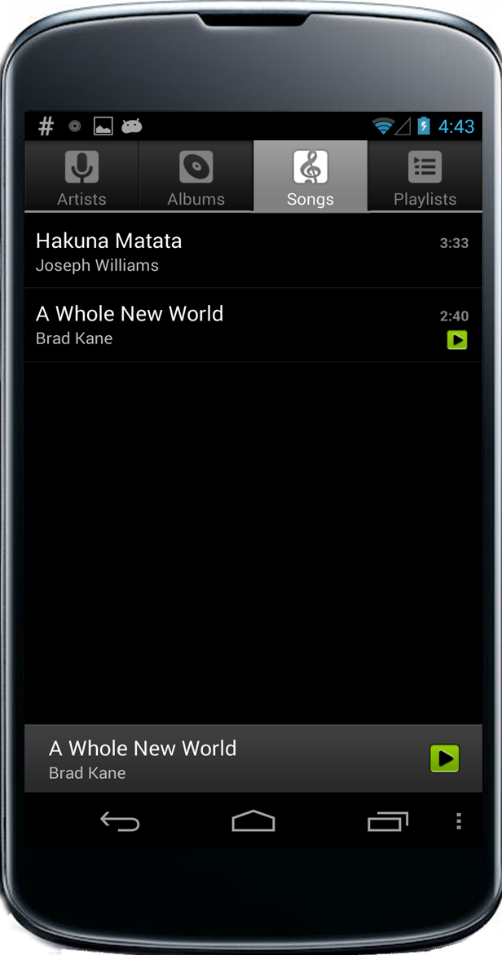
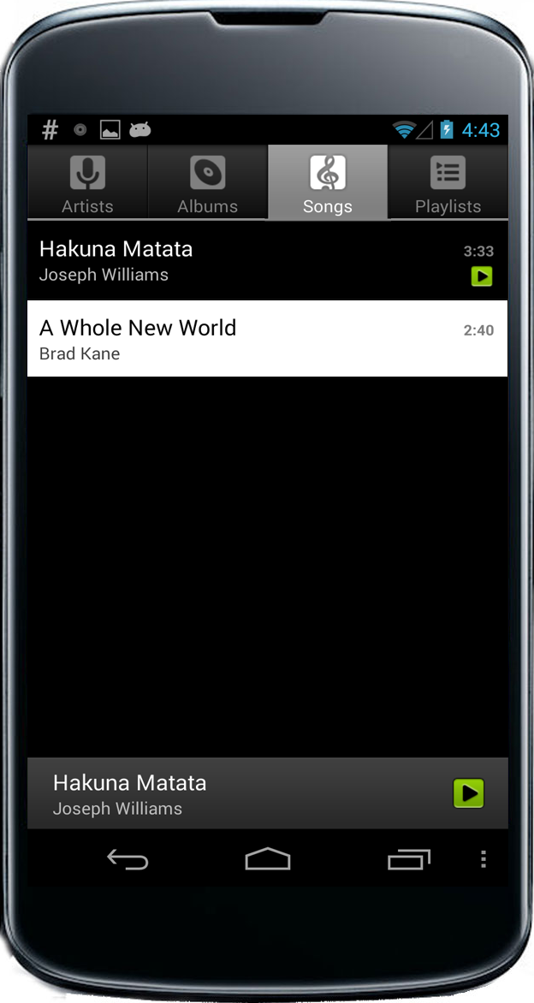

Event-Driven Execution Model
Looper Thread
Event Queue
Notes:
Here is a real concurrency error in the Android Music app.
During the execution, the user clicked a song on the Music app,
and the system generated an “onClick” event to process the action.
The “onClick” event was first placed into an event queue.
The event queue is associated with a looper thread, which periodically checked the queue and processed the events in a FIFO order.
This “onClick” then generated and enqueued an “onReceive” event to notify the UI to update the song list.
Meanwhile, the user terminated the app,
and generated an “onDestroy.”
The looper thread processed “onReceive,”
and then “onDestroy.” This is a typical correct execution. However, there might be a bug here.

Slide 31
A Race Bug within a Thread
Looper Thread
Event Queue
NullPointerException!
No existing concurrency tools can find such errors in Android
[Petrov, et. al., PLDI’12]
Notes:
If the user terminated the app before “onClick” got processed.
Then “onDestroy” would be enqueued earlier
than “onReceive.”
As a result, “onDestroy” would be processed first, and the internal “adapter” pointer would be set to null.
The pointer was then dereferenced in “onReceive,” and a null pointer exception would happen.
This type of bug is unique to the event-driven systems and the conventional race detectors cannot detect such bugs. Our goal is to design such a race detector for Android apps.
// simplify the animation

Slide 32
The Other Extreme: No Event Orders
Treat events as threads
Event
Event
Regular Threads
Event
Race bug
Problem: Will miss some causal order between events!
Notes:
We can go the other extreme and …
From the previous example, we can see that although events are executed in the same thread, they can be logically concurrent and executed in any order. // emphasize this
// put “android guarantees certain properties”
So a second naïve approach is to treat these events a short-lived threads then run a race detector.
While this approach can find the bug shown earlier, it has it’s own problem: there are still some causal order between events, and they can may be missed in this model.
// There are rules that are not enforced by this model. Because Android enforces event orders, we have to account for the event order enforced by the event-based model.
// provide another send example

Slide 33
Challenge 2: Not All Races are Bugs
8,918 races are found in
Order violations
Events
Atomicity violations
No problem in Android events!
p = null;
Events
*p;
p = new T;
p = null;
*p;
  racy events are commutative
  => not a race bug
Notes:
But the problem is not solved yet. If we detect races based on our causality model, many races are benign races and indicate no bug. For example, we discovered over 8000 read-write or write-write races in the ConnectBot app and most of them are benign.
If two events can be executed in any order, then races between them won’t cause any bug. We call them commutative events. The second challenge here is to determine if two events are commutative or not.
The “Order violation & atomicity v” argument.
Show Vann Diagram and explain atomiticy violation is false positive.
// make it more clear. Too vague.

Slide 34
Concurrency in a Mobile Application
But events in a thread may be logically concurrent
Races in logically concurrent events may lead to bugs
Events are processed serially in a looper thread
Looper Thread
A
B
C
A → B
C || B
Race bug
Notes:
Let’s understand the event-driven model more clearly.
First, events are processed by a looper thread,
as shown in this figure.
(pause)
However, our causality model should only infer the order enforced by the programmer.
In this example, the order between A and B is enforced by the programmer,
but the order between B and C is not.
So B and C are logically concurrent although they are executed in the same thread.
(pause)
A race in logically concurrent events may lead to a bug,
as shown in the example.

Slide 35
What is a Race?
Looper Thread
  Conflict: Read-Write or Write-Write data accesses to same location
  Race: Conflicts that are not causally ordered
A
B
C
Race
Notes:
Once we have derived the model, we can find concurrency bugs by finding races between events.
A race is defined as a conflict that is not ordered in the causality model, where a conflict is a pair of data accesses to the same location with at least one write.
The example we have shown contains a race between the concurrent events B and C.
// we used to think race are happen between

Slide 36
Events with Delays
Looper Thread
Event Queue
Worker Thread
A
B
C
time t
send(B, 3)
A
B becomes available
B is not available till time t+3
C is available immediately
time t+1
send(C, 0)
time t+2
time t+3
B
time t+4
time t+5
C
B executes before C

Slide 37
Events with Delays
Looper Thread
Event Queue
Worker Thread
A
A
B
C
time t
send(B, 3)
B becomes available
B is not available till time t+3
C is available immediately
time t+1
send(C, 0)
time t+2
C
time t+3
time t+4
B
B executes after C
No causal order between B and C can be assumed

Slide 38
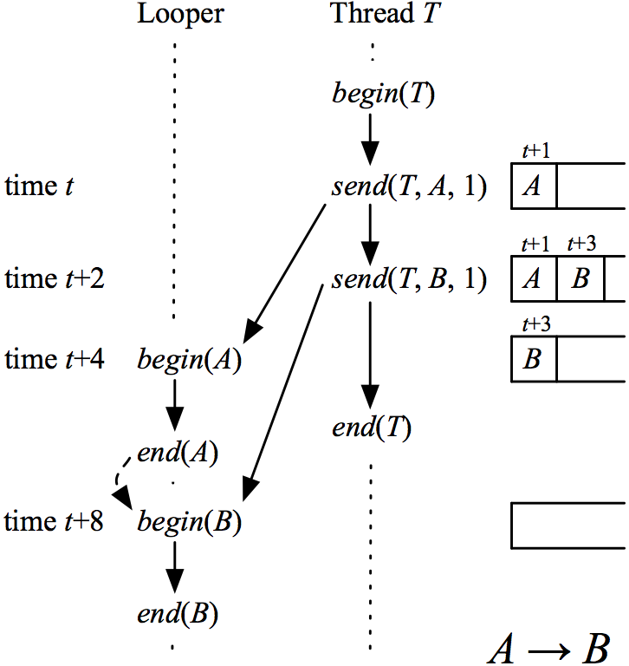
Revised Rule
Traditional causal order; Event atomicity; Event queue order
  send(A) → send(B) &&
  A.delay ≤ B.delay
=>
  end(A) → begin(B

Slide 39
Solution: Commutativity Analysis
Use heuristics to detect common programming patterns for commutative events
  If-Guard check
  Intra-event-allocation
Looper Thread
A
B
Guarded use
C
Free

Slide 40
Solution: Commutativity Analysis
Use heuristics to detect common programming patterns for commutative events
  If-Guard check
  Intra-event-allocation
Looper Thread
A
B
Allocated use
C
Free

Slide 41
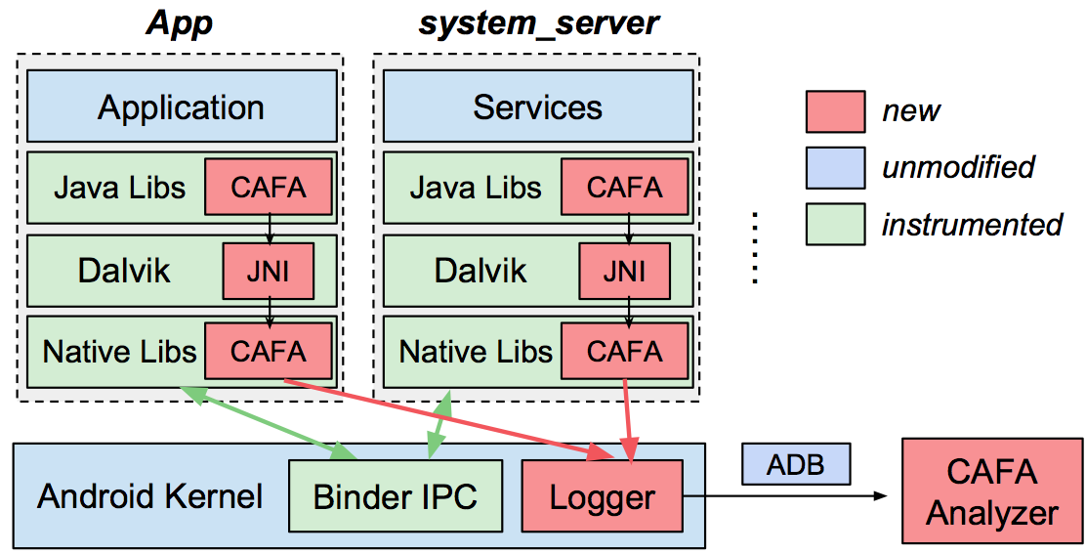
CAFA: Race Detection Tool for Android
Also logs the system service processes for complete causality
Logger device in the kernel for trace collection
Offline race detector based on graph reachability test
Logs data access operations related to uses and frees
Logs synchronization operations for causality inference
Notes:
We implemented a use-free race detection tool called CAFA based on our causality model on Android. We instrumented Android such that we can run an uninstrumented app on our system for race detection. Our instrumentation involved several parts. // we are not going to go through the details.
First, we instrumented the Android Java libraries and the underlying native C++ libraries to log the synchronization operations.
Second, we also instrumented the Dalvik VM to log all reads and writes related to uses and frees.
We also instrumented the system service processes to capture the causalities due to the IPCs,
And introduce a logger device in the kernel for trace collection.
Finally, we implemented a offline analyzer based on graph reachability test to detect use-free races.

