Slide 1
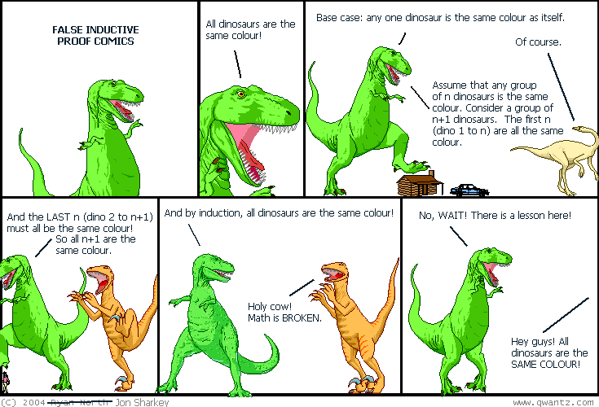
Mathematical Induction
EECS 203: Discrete Mathematics
Lecture 11
Spring 2016

Slide 2
Climbing the Ladder
We want to show that ∀n≥1 P(n) is true.
  Think of the positive integers as a ladder.
  1, 2, 3, 4, 5, 6, . . .
You can reach the bottom of the ladder:
  P(1)
From each ladder step, you can reach the next.
  P(1) → P(2), P(2) → P(3), . . .
  ∀k≥1 P(k) → P(k+1)
Then, by mathematical induction:
  ∀n≥1 P(n)

Slide 3
Mathematical Induction
How do we prove a universal statement about the positive integers:
  ∀n≥1 P(n)
Mathematical induction is an inference rule
  Base case: P(1)
  Inductive step: ∀k≥1 P(k) → P(k+1)
  Conclusion: ∀n≥1 P(n)
The inductive step requires proving an implication.

Slide 4

Simple Math Induction Example
Prove, for all n ∈ N,
Proof: We use induction. Let P(n) be:
Base case: P(0), because 0 = 0.

Slide 5
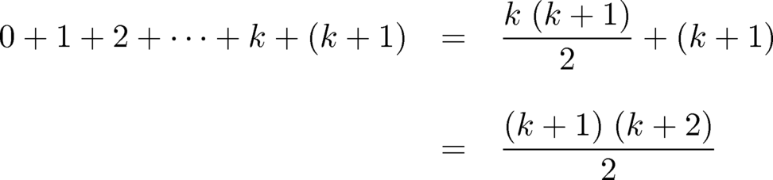
Simple Math Induction Example
Inductive step: Assume that P(k) is true, where k is an arbitrary natural number.

Slide 6
Simple Math Induction Example
Inductive step: Assume that P(k) is true, where k is an arbitrary natural number.
The first equality follows from P(k), and the second by simplification. Thus, P(k+1) is true.
By induction, P(n) is true for all natural numbers n. QED
  This shows how to write a clear inductive proof.

Slide 7
Question
Did you understand the proof by induction?
  (A) Yes, that’s really clever!
  (B) How can you start with P(0) instead of P(1)?
  (C) When do you use P(k) and when P(n)?
  (D) Isn’t it circular to assume P(k), when you are trying to prove P(n)?
  (E) I just don’t get it.

Slide 8
Divisibility Example (1)
Let’s try to prove ∀n∈N 3 | n³−n .
  First, we’ll work through the mathematics.
  Then we’ll structure a clear proof.
Base case: P(0) is easy: 3 | (0³−0)
  Everything divides zero, so it’s true.

Slide 9
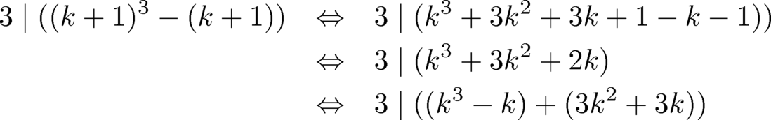
Divisibility Example (2)
  Inductive step: ∀k∈N P(k) → P(k+1)
  Assume P(k): 3 | (k³−k) (for arbitrary k)
  Can we prove P(k+1): 3 | ((k+1)³ – (k+1)) ?
Try multiplying it out:
  We know that 3 | (k³−k) and 3 | (3k²+3k).
  Conclude that 3 | ((k+1)³ – (k+1)), so P(k) → P(k+1).
Notes:
Clip out formulas for student notes.

Slide 10
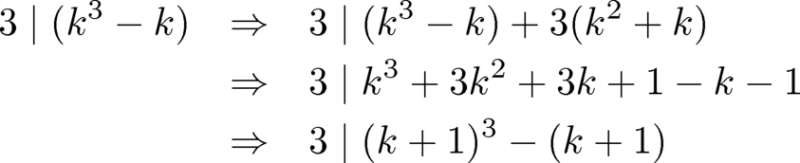
A Clear Divisibility Proof
Theorem: ∀n∈N 3 | (n³−n)
Proof: Use induction on P(n): 3 | (n³−n).
Base case: P(0) is true because 3 | (0³−0).
Inductive step: Assume P(k), for arbitrary natural number k. Then:
  The final statement is P(k+1), so we have proved that P(k) → P(k+1) for all natural numbers k.
By mathematical induction, P(n) is true for all n∈N.
QED

Slide 11
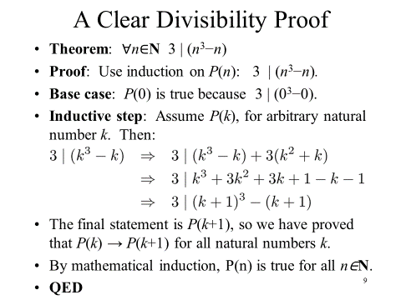
Notice: we had to go back and start by assuming P(k) and then showing it implied P(k+1).
  That first step isn’t at all clear unless you’ve done the math first!

Slide 12
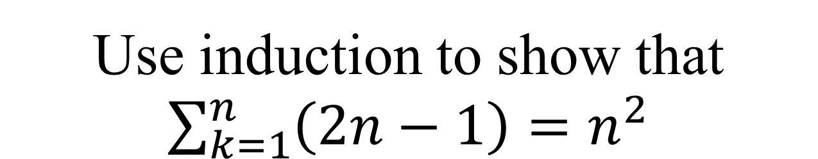
Use induction to show that $\sum_{k=1}^{n}{\left(2n−1\right)=n^{2}}$
Theorem:
Proof:
Base case:
Inductive step:

Slide 13
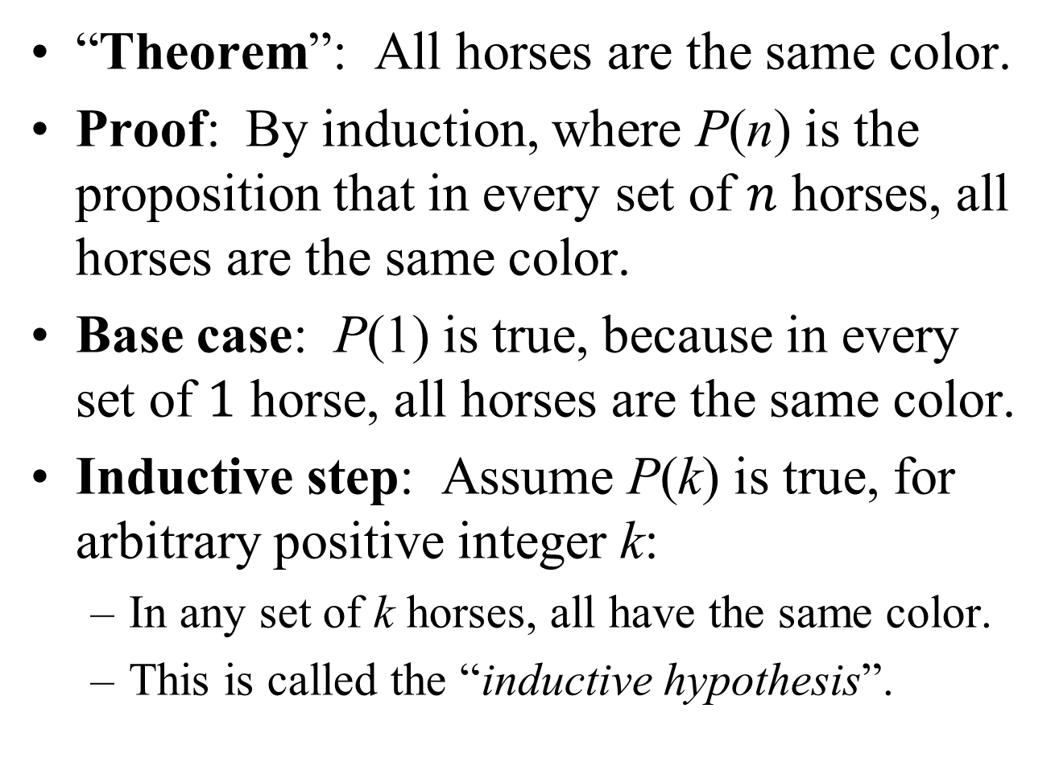
A False “Proof”
“Theorem”: All horses are the same color.
Proof: By induction, where P(n) is the proposition that in every set of $n$ horses, all horses are the same color.
Base case: P(1) is true, because in every set of $1$ horse, all horses are the same color.
Inductive step: Assume P(k) is true, for arbitrary positive integer k:
  In any set of k horses, all have the same color.
  This is called the “inductive hypothesis”.

Slide 14
False “Proof” (2)
  Inductive hypothesis P(k): In any set of k horses, all have the same color.
Now consider a set of k+1 horses
  h₁, h₂, . . . h_{k}, h_{k+1}
By P(k), the first k horses are all the same color
  h₁, h₂, . . . h_{k},
Likewise, the last k horses are also the same color
  h₂, . . . h_{k}, h_{k+1}
Therefore, all k+1 horses must have the same color
Thus, ∀k∈N P(k) → P(k+1)
  So, ∀n∈N P(n). What’s wrong?

Slide 15
Question
What’s wrong with that proof by induction?
  (A) Mathematical induction doesn’t apply to horses.
  (B) The Base Case is incorrect.
  (C) The Inductive Step is incorrect.
  (D) The Base Case and Inductive Step are correct, but you’ve put them together wrong.
  (E) It’s completely correct: all horses are the same color!

Slide 16


The Problem with the Horses
Inductive step: ∀k∈N P(k) → P(k+1)
  Now consider a set of k+1 horses
    h₁, h₂, . . . h_{k}, h_{k+1}
  By P(k), the first k horses are all the same color
    h₁, h₂, . . . h_{k},
  Likewise, the last k horses are also the same color
    h₂, . . . h_{k}, h_{k+1}
  Therefore, all k+1 horses must have the same color
Start with $k=1$
Then for $k=2$
A set of one horse with the same color
Another set of one horse with the same color

Slide 17
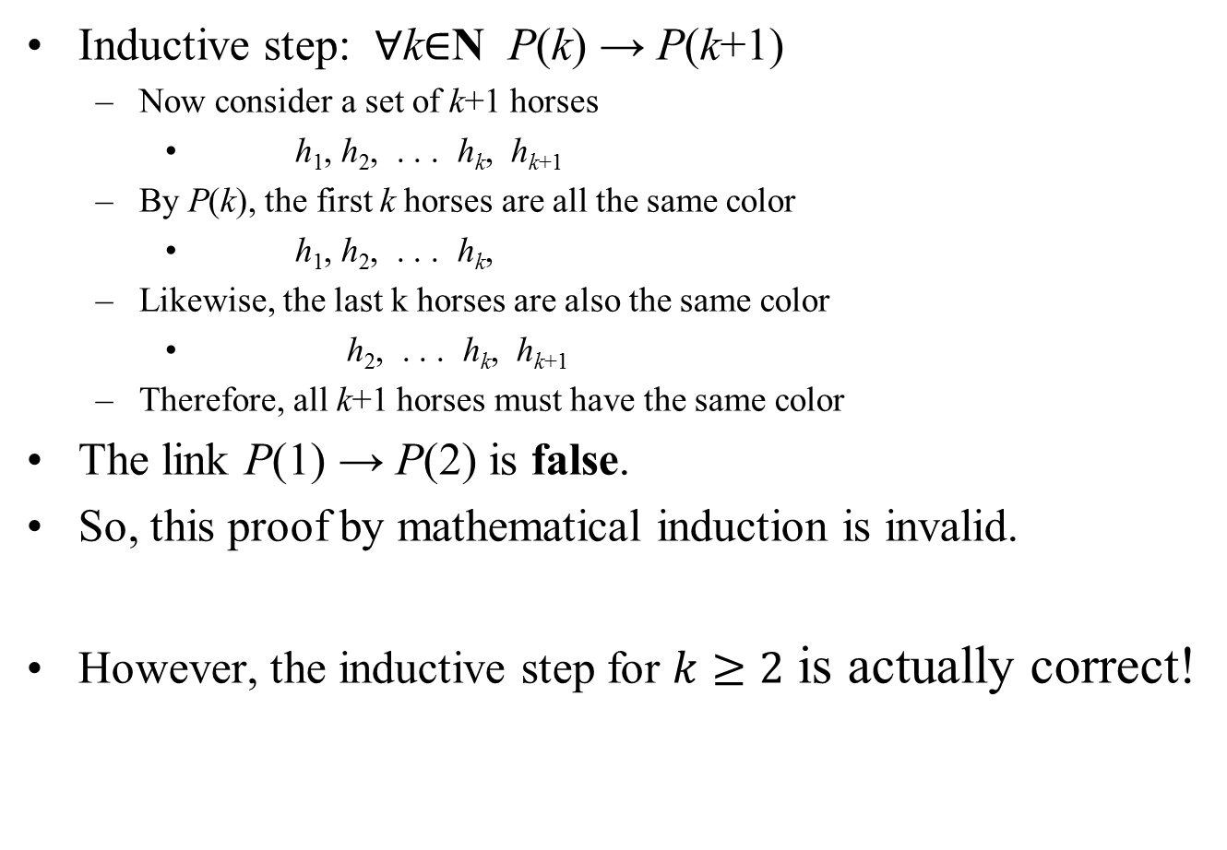
The Problem with the Horses
Inductive step: ∀k∈N P(k) → P(k+1)
  Now consider a set of k+1 horses
    h₁, h₂, . . . h_{k}, h_{k+1}
  By P(k), the first k horses are all the same color
    h₁, h₂, . . . h_{k},
  Likewise, the last k horses are also the same color
    h₂, . . . h_{k}, h_{k+1}
  Therefore, all k+1 horses must have the same color
The link P(1) → P(2) is false.
So, this proof by mathematical induction is invalid.
However, the inductive step for $k≥2$ is actually correct!

Slide 18


The Problem with the Horses
Inductive step: ∀k∈N P(k) → P(k+1)
  Now consider a set of k+1 horses
    h₁, h₂, . . . h_{k}, h_{k+1}
  By P(k), the first k horses are all the same color
    h₁, h₂, . . . h_{k},
  Likewise, the last k horses are also the same color
    h₂, . . . h_{k}, h_{k+1}
  Therefore, all k+1 horses must have the same color
Assume true for $k=2$
Then for $k=3$

Slide 19
The Problem with the Horses
Inductive step: ∀k∈N P(k) → P(k+1)
  Now consider a set of k+1 horses
    h₁, h₂, . . . h_{k}, h_{k+1}
  By P(k), the first k horses are all the same color
    h₁, h₂, . . . h_{k},
  Likewise, the last k horses are also the same color
    h₂, . . . h_{k}, h_{k+1}
  Therefore, all k+1 horses must have the same color
Assume true for $k=2$
Then for $k=3$
A group of two

Slide 20
The Problem with the Horses
Inductive step: ∀k∈N P(k) → P(k+1)
  Now consider a set of k+1 horses
    h₁, h₂, . . . h_{k}, h_{k+1}
  By P(k), the first k horses are all the same color
    h₁, h₂, . . . h_{k},
  Likewise, the last k horses are also the same color
    h₂, . . . h_{k}, h_{k+1}
  Therefore, all k+1 horses must have the same color
Assume true for $k=2$
Then for $k=3$
Another group of two

Slide 21
The Problem with the Horses
Inductive step: ∀k∈N P(k) → P(k+1)
  Now consider a set of k+1 horses
    h₁, h₂, . . . h_{k}, h_{k+1}
  By P(k), the first k horses are all the same color
    h₁, h₂, . . . h_{k},
  Likewise, the last k horses are also the same color
    h₂, . . . h_{k}, h_{k+1}
  Therefore, all k+1 horses must have the same color
Assume true for $k=2$
Then for $k=3$
But base step wasn’t true!

Slide 22

Tiling a Checkerboard (1)
For n≥1, consider a 2^{n}×2^{n} checkerboard.
Can we cover it with 3-square L-shaped tiles? No.
Remove any one of the squares. Can we tile it now?
Prove by induction: Let P(n) be the proposition:
  A 2^{n}×2^{n} checkerboard, minus any one of the squares, can be tiled with these L-shaped tiles.

Slide 23
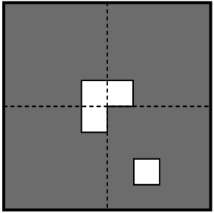
Tiling a Checkerboard (2)
Consider a 2^{k+1}×2^{k+1} checkerboard, minus any one square.
  Divide the checkerboard into four 2^{k}×2^{k} quadrants.
The missing square is in one quadrant.
  From the other three quadrants, remove the square closest to the center of the checkerboard.

Slide 24
Tiling a Checkerboard (3)
P(k) says that each quadrant (minus one square) can be tiled. One tile covers the three central squares.
Thus, P(k) → P(k+1), for arbitrary k≥1.
  By mathematical induction, ∀n≥1 P(n).

Slide 25



The Harmonic Series (1)
The Harmonic Numbers are the partial sums of the Harmonic Series:
We want to prove that:
This implies an important property of the Harmonic Series:

Slide 26



The Harmonic Series (2)
Theorem:
Proof: By induction, with P(n) being
Base case: P(0) is true because
Inductive step: The inductive hypothesis P(k) is
From that assumption, we want to prove P(k+1).

Slide 27
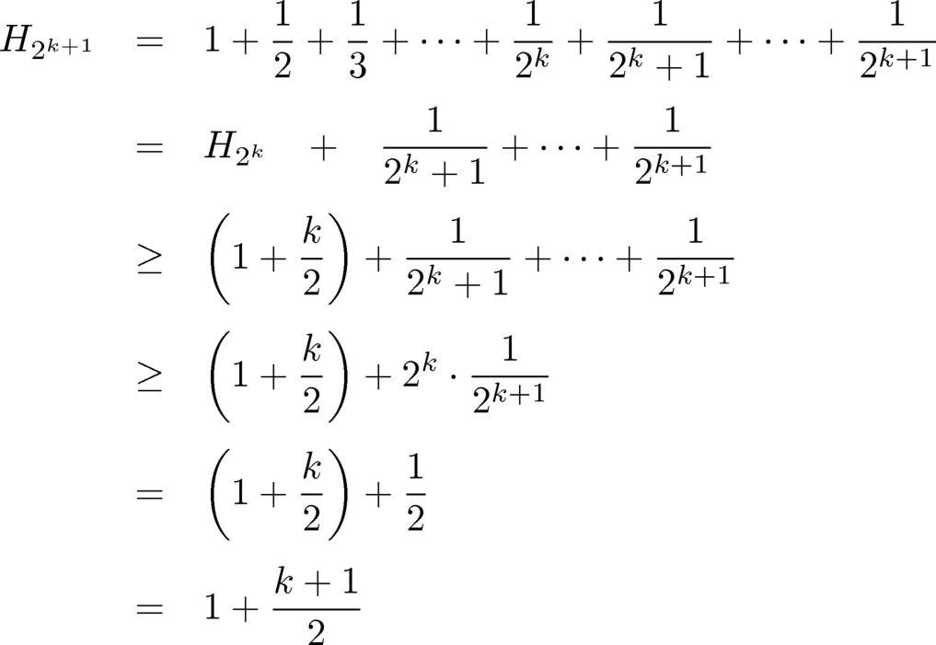
The Harmonic Series (3)
The inductive hypothesis P(k) is
This demonstrates P(k+1).
Notes:
1st step is definition
2nd step is grouping terms in order to use inductive hypothesis
3rd step is by inductive hypothesis
4th step says $\frac{1}{2^{k}+1}+\frac{1}{2^{k}+2}+⋯+\frac{1}{2^{k+1}}≥\frac{2^{k}}{2^{k+1}}$
This follows because there are $2^{k}$ terms in this summation
The smallest one is the last (with value $1/2^{k+1}$).
Therefore the sum is smaller than or equal to summing the smallest one $2^{k}$ times.
5th step is because $\frac{2^{k}}{2^{k+1}}=\frac{1}{2}$

Slide 28


The Harmonic Series (4)
This proves that P(k) → P(k+1) for arbitrary k.
Therefore, by mathematical induction, P(n) is true for all n ∈ N. QED.
  Theorem:
Let j = 2^{n} be some integer. Then n = log j.
  Therefore, the Harmonic series diverges, because
  But it diverges very slowly.

Slide 29
Prove that 6 divides n³ − n whenever n is a nonnegative integer.

