Slide 1
L14: Permutations, Combinations and Some Review
EECS 203: Discrete Mathematics

Slide 2
Last time we did a number of things
Looked at the sum, product, subtraction and division rules.
  Don’t need to know by name.
Spent a while on the Pigeonhole Principle
  Including the generalized version.
  Worked a few complex examples.
    They were tricky!
Started on Combinations and Permutations.

Slide 3
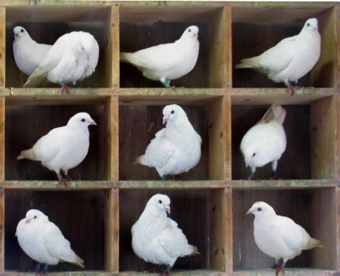
Review: Pigeonhole Principle
“Simple” problem:
  Prove that if you have 51 unique numbers 1 to 100 there exists a pair in that 51 which sum to 100.

Slide 4
Review: Pigeonhole Principle
“Old” problem
  Say we have five distinct points (x_{i}, y_{i}) for i= 1 to 5. And say all x and y values are integers. Now draw lines connecting each pair of points. Prove that the midpoint of at least one of those lines has an x,y location where both x and y are integers.

Slide 5
And a tricky one
Claim: Every sequence of n²+1 distinct real numbers contains a subsequence of length n+1 that is either strictly increasing or strictly decreasing
Example: Seq of 3²+1 numbers (3,1,0,2,6,5,4,9,8,7) has increasing subsequence of length 3+1 (0,2,6,9)
Proof using PP
  What are the pigeons?
  What are the holes?

Slide 6
Permutations & Combinations
n! = n⋅(n-1)⋅(n-2)⋅…⋅3⋅2⋅1
Permutations
  P(n,k) = Number of ways to choose k things (order counts!) out of n thingsngs in order: 6
  (brush, floss), (brush, gargle), (floss, brush), (floss, gargle), (gargle, brush), (gargle, floss)
  P(n,3) = #ways to do three things in order: 6
  (brush, floss, gargle), (brush, gargle, floss), (floss, brush, gargle), (floss, gargle, brush), (gargle, brush, floss), (gargle, floss, brush)

Slide 7
Permutations & Combinations
n! = n⋅(n-1)⋅(n-2)⋅…⋅3⋅2⋅1
Permutations
  P(n,k) = Number of ways to choose k things (order counts!) out of n things
  Example. n=3. Three things: {brush teeth, floss, gargle}
  P(n,1) = #ways to do one thing: 3
  (brush), (floss), (gargle)
  P(n,2) = #ways to do two things in order: 6
  (brush, floss), (brush, gargle), (floss, brush), (floss, gargle), (gargle, brush), (gargle, floss)
  P(n,3) = #ways to do three things in order: 6
  (brush, floss, gargle), (brush, gargle, floss), (floss, brush, gargle), (floss, gargle, brush), (gargle, brush, floss), (gargle, floss, brush)

Slide 8
Permutations & Combinations
n! = n⋅(n-1)⋅(n-2)⋅…⋅3⋅2⋅1
Permutations
  P(n,k) = Number of ways to choose k things (order counts!) out of n things
  P(n,k) = n⋅(n-1)⋅…⋅(n-k+1) =
n choices for
first thing
n-k+1 choices
for k^{th} thing
n-1 choices for
second thing

Slide 9
Permutations & Combinations
n! = n⋅(n-1)⋅(n-2)⋅…⋅3⋅2⋅1
Permutations
  P(n,k) = Number of ways to choose k things (order counts!) out of n things
Combinations
  C(n,k) = Number of ways to choose a set of k things (order doesn’t matter) out of n things
  Example: {brush, floss, gargle}
  C(n,1) = #ways to choose one thing: 3
  {brush}, {floss}, {gargle}
  C(n,2) = #ways to do choose two things: 3
  {brush, floss}, {brush, gargle}, {floss, gargle}
  C(n,3) = #ways to choose three things: 1
  {brush, floss, gargle}

Slide 10
Permutations & Combinations
n! = n⋅(n-1)⋅(n-2)⋅…⋅3⋅2⋅1
Permutations
  P(n,k) = Number of ways to choose k things (order counts!) out of n things
Combinations
  C(n,k) = Number of ways to choose a set of k things (order doesn’t matter) out of n things
  Example: n=3. Three things: {brush, floss, gargle}
  C(n,1) = #ways to choose one thing: 3
  {brush}, {floss}, {gargle}
  C(n,2) = #ways to choose two things: 3
  {brush, floss}, {brush, gargle}, {floss, gargle}
  C(n,3) = #ways to choose three things: 1
  {brush, floss, gargle}

Slide 11
Permutations & Combinations
n! = n⋅(n-1)⋅(n-2)⋅…⋅3⋅2⋅1
Permutations
  P(n,k) = Number of ways to choose k things (order counts!) out of n things
Combinations
  C(n,k) = Number of ways to choose a set of k things (order doesn’t matter) out of n things
  C(n,k) =
read “n choose k”

Slide 12
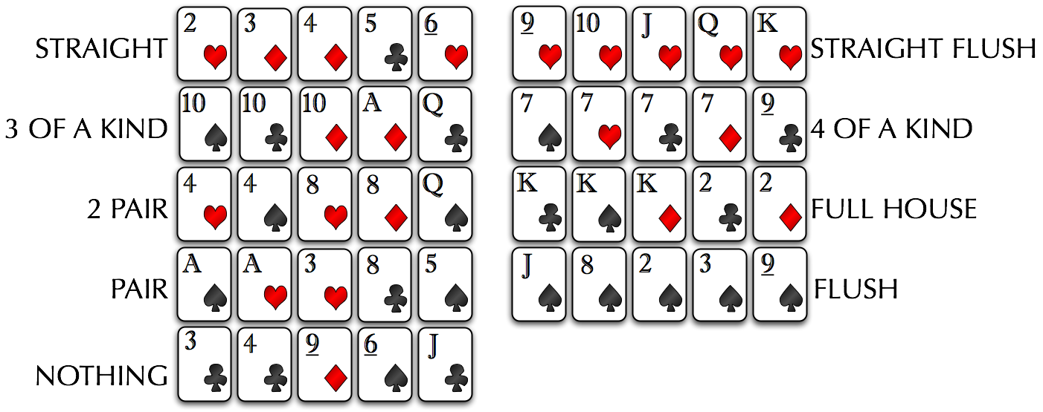
Poker Hands
Highest
How many ways to make a pair?
Number of different hands:
Lowest

Slide 13

Problem 2: How many ways to make a pair?
Select a hand with one pair in stages:
  Stage 1: Pair of what? Choose a number or face card
  Stage 2: Choose which suits (from stage 1)
  = 6 choices
  Stage 3: Choose third card (different than stage 1)
  (52-4) = 48 choices
  Stage 4: Choose fourth card (different than stages 1&3)
  (52-8) = 44 choices
  Stage 5: Choose fifth card (different than stages 1,3,4)
  (52-12) = 40 choices

Slide 14

Problem 2: How many ways to make a pair?
Select a hand with one pair in stages:
  Stage 1: Pair of what? Choose a number or face card
  13 choices
  Stage 2: Choose which suits (from stage 1)
  Stage 3: Choose third card (different than stage 1)
  (52-4) = 48 choices
  Stage 4: Choose fourth card (different than stages 1&3)
  (52-8) = 44 choices
  Stage 5: Choose fifth card (different than stages 1,3,4)
  (52-12) = 40 choices

Slide 15

Problem 2: How many ways to make a pair?
Select a hand with one pair in stages:
  Stage 1: Pair of what? Choose a number or face card
  13 choices
  Stage 2: Choose which suits (from stage 1)
  6 choices
  Stage 3: Choose third card (different than stage 1)
  Stage 4: Choose fourth card (different than stages 1&3)
  (52-8) = 44 choices
  Stage 5: Choose fifth card (different than stages 1,3,4)
  (52-12) = 40 choices

Slide 16


Problem 2: How many ways to make a pair?
Select a hand with one pair in stages:
  Stage 1: Pair of what? Choose a number or face card
  13 choices
  Stage 2: Choose which suits (from stage 1)
  6 choices
  Stage 3: Choose third card (different than stage 1)
  (52-4) = 48 choices
  Stage 4: Choose fourth card (different than stages 1&3)
  Stage 5: Choose fifth card (different than stages 1,3,4)

Slide 17
Problem 2: How many ways to make a pair?
Select a hand with one pair in stages:
  Stage 1: Pair of what? Choose a number or face card
  13 choices
  Stage 2: Choose which suits (from stage 1)
  6 choices
  Stage 3: Choose third card (different than stage 1)
  (52-4) = 48 choices
  Stage 4: Choose fourth card (different than stages 1&3)
  (52-8) = 44 choices
  Stage 5: Choose fifth card (different than stages 1,3,4)
  (52-12) = 40 choices
3! ways to arrange these

Slide 18
Problem 2: How many ways to make a pair?
Select a hand with one pair in stages:
  Stage 1: Pair of what? Choose a number or face card
  13 choices
  Stage 2: Choose which suits (from stage 1)
  6 choices
  Stage 3: Choose third card (different than stage 1)
  (52-4) = 48 choices
  Stage 4: Choose fourth card (different than stages 1&3)
  (52-8) = 44 choices
  Stage 5: Choose fifth card (different than stages 1,3,4)
  (52-12) = 40 choices
Number of ways: (13⋅6⋅48⋅44⋅40)/3! = 1,098,240
≈ 40% chance of getting a pair (and nothing better)

Slide 19
Problem 2: How many ways to make a pair?
Wikipedia has:
  C(13,1)*C(2,4)*C(3,12)*4³.
    Same number.
    Can you justify it?

Slide 20
What are the odds of making nothing?

Slide 21
What are the odds of making nothing?
All contain a pair
(or more)

Slide 22
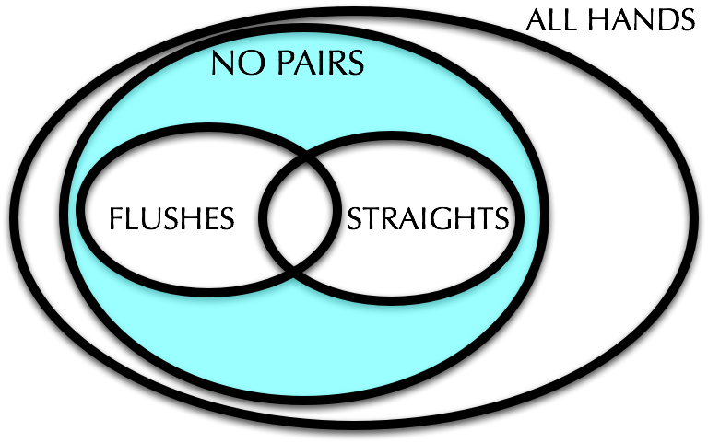
Problem 3: How many ways to make nothing?
We’re counting hands:
  (1) without pairs
  (2) that also do not contain straights or flushes

Slide 23
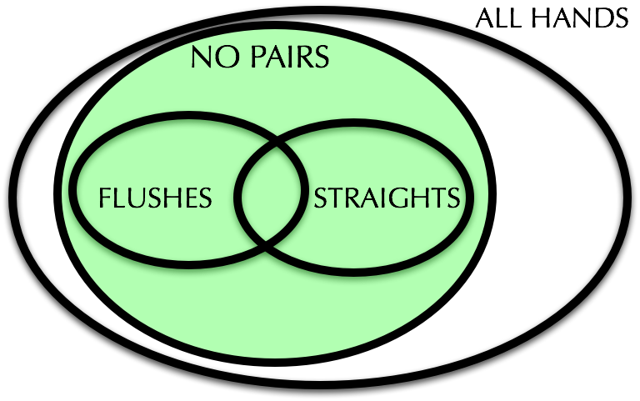
Counting hands without pairs
Pick a hand without a pair
  Stage 1: ??
  2nd card: 48 choices (not same number/face as 1st card)
  3rd card: 44 choices (different from 1st & 2nd)
  4th card: 40 choices (different from 1st,2nd,3rd)
  5th card: 36 choices (different from 1st,2nd,3rd,4th)
Division rule: Each hand could have been chosen in exactly 5! different ways.
Total = (52⋅48⋅44⋅40⋅36)/5! = 1,317,888

Slide 24
Counting hands without pairs
Pick a hand without a pair
  1st card:
  2nd card: 48 choices (not same number/face as 1st card)
  3rd card: 44 choices (different from 1st & 2nd)
  4th card: 40 choices (different from 1st,2nd,3rd)
  5th card: 36 choices (different from 1st,2nd,3rd,4th)
Division rule: Each hand could have been chosen in exactly 5! different ways.
Total = (52⋅48⋅44⋅40⋅36)/5! = 1,317,888

Slide 25
Counting hands without pairs
Pick a hand without a pair
  1st card: 52 choices
  2nd card: (not same number/face as 1st card)
  3rd card: 44 choices (different from 1st & 2nd)
  4th card: 40 choices (different from 1st,2nd,3rd)
  5th card: 36 choices (different from 1st,2nd,3rd,4th)
Division rule: Each hand could have been chosen in exactly 5! different ways.
Total = (52⋅48⋅44⋅40⋅36)/5! = 1,317,888

Slide 26
Counting hands without pairs
Pick a hand without a pair
  1st card: 52 choices
  2nd card: 48 choices (not same number/face as 1st card)
  3rd card: 44 choices (different from 1st & 2nd)
  4th card: 40 choices (different from 1st,2nd,3rd)
  5th card: 36 choices (different from 1st,2nd,3rd,4th)
Division rule: Each hand could have been chosen in exactly 5! different ways.
Total = (52⋅48⋅44⋅40⋅36)/5! = 1,317,888

Slide 27
Counting hands without pairs
Pick a hand without a pair
  1st card: 52 choices
  2nd card: 48 choices (not same number/face as 1st card)
  3rd card: 44 choices (different from 1st & 2nd)
  4th card: 40 choices (different from 1st,2nd,3rd)
  5th card: 36 choices (different from 1st,2nd,3rd,4th)
Division rule: Each hand could have been chosen in exactly 5! different ways.
Total = (52⋅48⋅44⋅40⋅36)/5! = 1,317,888
  Also C(13,5)*4⁵

Slide 28
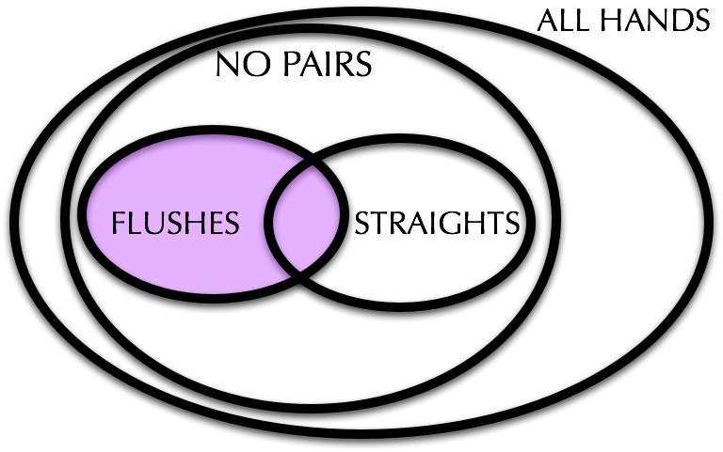
Counting flushes (that may be straights too)
Stage 1: ?
  4 choices
Stage 2: ?
  = 1,287 choices
Total = 5,148

Slide 29
Counting flushes (that may be straights too)
Stage 1: Pick a suit
Stage 2: Pick which 5 cards in the suit
Total =

Slide 30
Counting flushes (that may be straights too)
Stage 1: Pick a suit
  4 choices
Stage 2: Pick which 5 cards in the suit
  = 1,287 choices
Total = 4 x 1,287 = 5,148

Slide 31
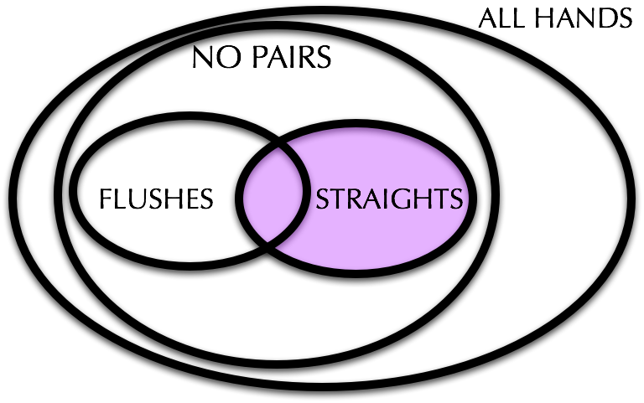
Counting straights (that may be flushes too)
Note: A2345 is a straight!
Stage 1: ??
  10 choices (A,2,3,4,5,6,7,8,9,10)
Stage 2: ??
.
.
.
Stage 6: Pick the 5th card: 4 choices
Total = 10⋅4⁵ = 10,240

Slide 32
Counting straights (that may be flushes too)
Stage 1: Pick the lowest card number
  10 choices (A,2,3,4,5,6,7,8,9,10)
Stage 2: Pick the 1st card: 4 choices
Stage 3: Pick the 2nd card: 4 choices
Stage 4: Pick the 3rd card: 4 choices
Stage 5: Pick the 4th card: 4 choices
Stage 6: Pick the 5th card: 4 choices
Total = 10⋅4⁵ = 10,240

Slide 33
Back to the Venn diagram
Ways to make “nothing”
= (#without pairs) - (#flushes) - (#straights) + (#straightflushes)
subtracted twice!

Slide 34
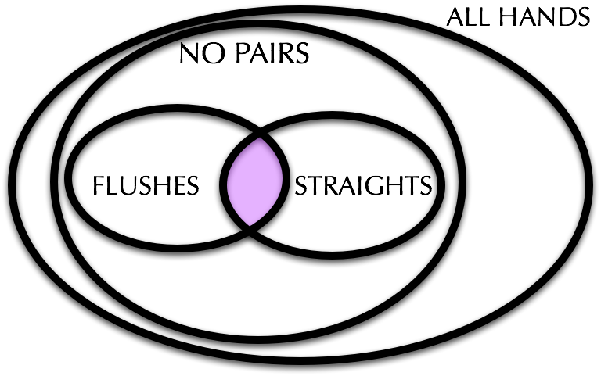
Counting straight flushes
Stage 1: ??
  4 choices
Stage 2: ?? 10 choices
  .
  .
  .

Slide 35
Counting straight flushes
Stage 1: Pick a suit
  4 choices
Stage 2: Pick the lowest numbered card (A,2,…,9,10)
  10 choices
Total = 40

Slide 36
Summing up
Ways to make “nothing”
= (#without pairs) - (#flushes) - (#straights) + (#straightflushes)
= 1,317,888 - 5,148 - 10,240 + 40
= 1,302,540
You get nothing ≈ 52% of the time

Slide 37
Quiz
How many cards must be selected from a standard deck of 52 cards to guarantee that at least 3 hearts are selected?
9
52
3
42
I have no idea
Notes:
Answer is D

Slide 38
Counting Recap
k-permutation: a sequence of k things (selected from n things)
k-combination: a set of k things (selected from n things)
Repetitions not allowed!

Slide 39
Counting Recap
k-permutation: a sequence of k things (selected from n things)
k-combination: a set of k things (selected from n things)
P(n,k) = number of k-permutations
C(n,k) = number of k-combinations

Slide 40
Permutations and Combinations with repetitions
So far today, we have assumed that we can select items without repetitions.
  We did look at selecting permutations with repetitions last time (dice)
  We’ve not looked at combinations with repetitions in any formal way.
But first, we turn to Binomial Coefficients and Pascal’s Triangle

Slide 41
The Binomial Theorem
often called a binomial coefficient
(x+y)² = x² + 2xy + y²
(x+y)³ = x³ + 3x²y + 3xy² + y³
…
(x+y)⁵ = (x+y)(x+y)(x+y)(x+y)(x+y)
= ?

Slide 42
The Binomial Theorem
often called a binomial coefficient
(x+y)² = x² + 2xy + y²
(x+y)³ = x³ + 3x²y + 3xy² + y³
…
(x+y)⁵ = (x+y)(x+y)(x+y)(x+y)(x+y)
= ?x⁵ + ?x⁴y + ?x³y² + ?x²y³ + ?xy⁴ + ?y⁵
number of ways to pick
3 y’s out of 5 possibilities
Or equivalently, number
of ways to pick 2 x’s out
of 5 possibilities

Slide 43
The Binomial Theorem
often called a binomial coefficient
Binomial Theorem: for any x and y
number of ways to choose k xs
out of the n factors (x+y)

Slide 44
Proving things with the binomial theorem
Binomial Theorem: for any x and y
Theorem:
  In other words ?
Proof: Set x = 1, y=1
Notes:
In other words, for a set of size n, the size of the power set is 2^n

Slide 45
Proving things with the binomial theorem
Binomial Theorem: for any x and y
Theorem:
  In other words?
Proof: Set x = -1, y=1
Notes:
In other words, the number of subsets of even size (0 is an even size) – number of subsets of odd size. These are equal.

Slide 46
Quick Exercise
What is ?
2^{n}
1.5^{n}
1
2.5^{n}
Notes:
Answer is (C)

Slide 47
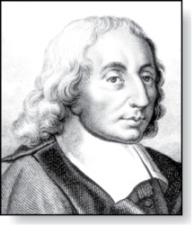
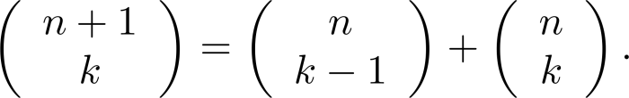
Pascal’s Identity
Blaise Pascal
(1623-1662)
Pascal’s Identity: If n and k are integers with
n ≥ k ≥ 0, then

Slide 48



Pascal’s Identity
Blaise Pascal
(1623-1662)
Pascal’s Identity: If n and k are integers with n ≥ k ≥ 0, then
Proof (combinatorial): Let T be a set where |T| = n + 1, a ∊T, and S = T − {a}. There are subsets of T containing k elements. Each of these subsets either:
  contains a with k − 1 other elements, or
  contains k elements of S and not a.
There are
  subsets of k elements that contain a, since there are subsets of k − 1 elements of S,
  subsets of k elements of T that do not contain a, because there are subsets of k elements of S.
Hence,

Slide 49
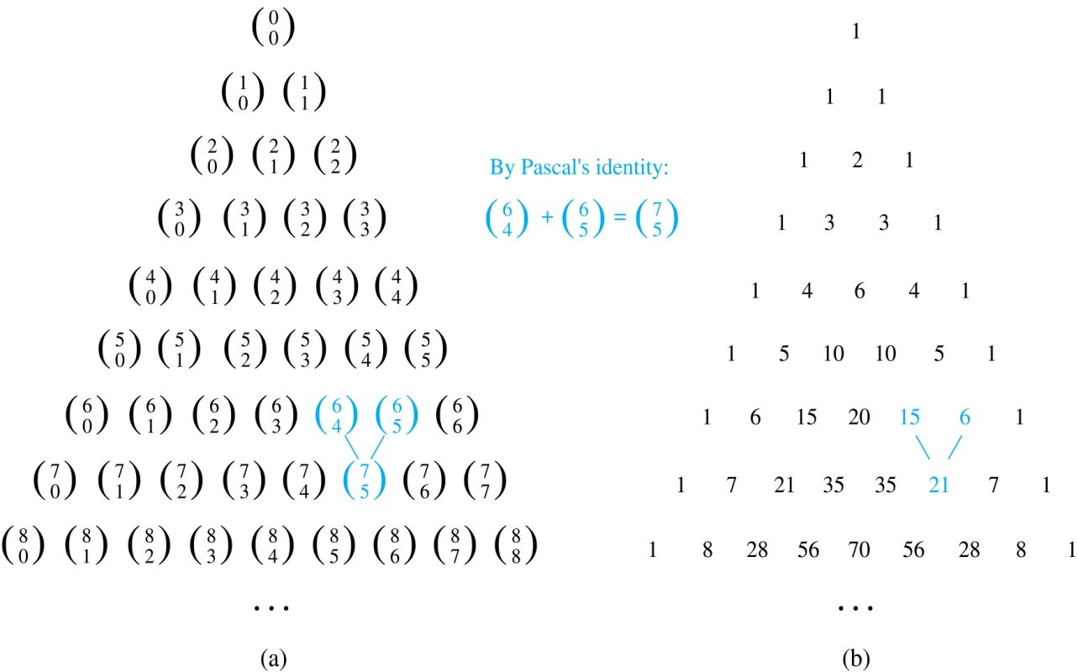
Pascal’s Triangle
The n^{th} row in the triangle consists of the binomial coefficients of C(n,k), k = 0,..,n
By Pascal’s identity, adding two adjacent bionomial coefficients results is the binomial coefficient in the next row between these two coefficients.

Slide 50
Review problem
If I have 9 books and plan on taking 4 on the plane with me, how many different sets of books could I bring?

Slide 51
Problem: Counting Bagels
A bagel shop has 8 kinds of bagels.
How many ways to buy a dozen bagels?
= Number of solutions to: (natural numbers only)
x₁ + x₂ + x₃ + x₄ + x₅ + x₆ + x₇ + x₈ = 12

Slide 52
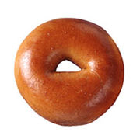
Problem: Counting Bagels
A bagel shop has 8 kinds of bagels.
How many ways to buy a dozen bagels?
= Number of solutions to: (natural numbers only)
x₁ + x₂ + x₃ + x₄ + x₅ + x₆ + x₇ + x₈ = 12

Slide 53
Problem: Counting Bagels
A bagel shop has 8 kinds of bagels.
How many ways to buy a dozen bagels?
= Number of solutions to: (natural numbers only)
x₁ + x₂ + x₃ + x₄ + x₅ + x₆ + x₇ + x₈ = 12
bit string with 12+7 bits. bagel = ‘0’, bar = ‘1’

Slide 54
The Stars ‘n’ Bars Theorem
The number of ways to choose k objects each of
n different types (with repetition) is
  Example. k=2, types = {apple,orange,pear}
  ⬆⬆|| 2 apples
  ⬆|⬆| 1 apple, 1 orange
  ⬆||⬆ 1 apple, 1 pear
  |⬆⬆| 2 oranges
  |⬆|⬆ 1 orange, 1 pear
  ||⬆⬆ 2 pears
Stars = #Objects; Bars = #Types-1
Notes:
N types of bagels
Make a bag with k bagels
OR k zeros and n-1 ones

Slide 55
Problem: Counting Bagels (with lower bounds)
A bagel shop has 8 kinds of bagels.
How many ways to buy a dozen bagels
with at least 1 of each kind?
= Number of solutions to: (natural numbers only)
x₁ + x₂ + x₃ + x₄ + x₅ + x₆ + x₇ + x₈ = 12
x_{i} ≥ 1 for 1≤i≤8

Slide 56
Problem: Counting Bagels (with lower bounds)
A bagel shop has 8 kinds of bagels.
How many ways to buy a dozen bagels
with at least 1 of each kind?
= Number of solutions to: (natural numbers only)
x₁ + x₂ + x₃ + x₄ + x₅ + x₆ + x₇ + x₈ = 4
x_{i} ≥ 1 for 1≤i≤8
eight bagels already determined
k = 4; n = 8

Slide 57
Problem: Counting Bagels (with upper bounds)
A bagel shop has 8 kinds of bagels.
How many ways to buy a dozen bagels with at most 4 onion and at most 2 poppy seed?
= Number of solutions to: (natural numbers only)
x₁ + x₂ + x₃ + x₄ + x₅ + x₆ + x₇ + x₈ = 12
x₁ ≤ 4, x₂ ≤ 2
U
A
B
x₁ > 4
x₂ > 2
aka: inclusion-exclusion princple

Slide 58
Problem: Counting Bagels (with upper bounds)
= Number of solutions to: (natural numbers only)
x₁ + x₂ + x₃ + x₄ + x₅ + x₆ + x₇ + x₈ = 12
x₁ ≤ 4, x₂ ≤ 2
All Solutions: 12 stars, 7 bars =
Solutions with x₁ > 4: 7 stars, 7 bars =
Solutions with x₂ > 2: 9 stars, 7 bars =
Solutions with x₁>4 and x₂>2: 4 stars, 7 bars =
Solutions with x₁≤4 and x₂≤2: (inclusion-exclusion principle)
Stars = #Objects; Bars = #Types-1

