Slide 1
EECS 203 Lecture 20
More Graphs

Slide 2
Admin stuffs
Last homework due today
Office hour changes starting Friday (also in Piazza)
  Friday 6/17: 2-5 Mark in his office.
  Sunday 6/19: 2-5 Jasmine in the UGLI.
  Monday 6/20: 10-12 Mark in his office.
  Monday 6/20: 5-7 Emily in the UGLI.
  Tuesday 6/21: 10-12 Emily in the Beyster Learning Center.
  Tuesday 6/21: 1-3 Mark in his office.
  Wednesday 6/22: 10-12 Emily in the Beyster Learning Center.
  Wednesday 6/22: 1:30-3 Mark in his office.
  Thursday: 6/23: 10-12 Emily in the Beyster Learning Center.
  Thursday 6/23: 1:30-3 Jasmine in the Beyster Learning Center.
Discussion is still on for Thursday and Friday.
Exam is Thursday 6/23 from 4-6
  Room information posted shortly (will be in EECS)

Slide 3
Last time…
Defined some terms
  G=(V,E)
  Directed vs undirected graph
  What it means to be connected
  Etc.
Did Dijkstra’s Algorithm
  Finds shortest path between a pair of nodes
  Didn’t analyze runtime though…
Started on induction proof about connectivity.

Slide 4
Today
Analyze Dijkstra’s Algorithm
Deal with induction proof we started on last time.
Look at a way of finding all-pairs shortest path distances
  Floyd-Warshall Algorithm
More terminology
  Path, cycle, Eulerian path, Eulerian cycle, other graph applications
(Time allowing)More terminology
  Trees, minimum-spanning trees (MST), planar graphs
  Brief overview of ideas associated with these things.

Slide 5
Let’s examine Dijkstra’s Algorithm
What is the worst-case run time on a graph with |V| nodes?

Slide 10
Today
Analyze Dijkstra’s Algorithm
Deal with induction proof we started on last time.
Look at a way of finding all-pairs shortest path distances
  Floyd-Warshall Algorithm
More terminology
  Path, cycle, Eulerian path, Eulerian cycle
More terminology
  Trees, minimum-spanning trees (MST), planar graphs
  Brief overview of ideas associated with these things.

Slide 11
From: http://www.sfu.ca/~mdevos/notes/graph/induction.pdf
There are a few nice observations about the proof there as
well as a few nice induction examples.

Slide 12
Today
Analyze Dijkstra’s Algorithm
Deal with induction proof we started on last time.
Look at a way of finding all-pairs shortest path distances
  Floyd-Warshall Algorithm
More terminology
  Path, Cycle, Eulerian path, Eulerian cycle
More terminology
  Trees, minimum-spanning trees (MST), planar graphs
  Brief overview of ideas associated with these things.

Slide 13
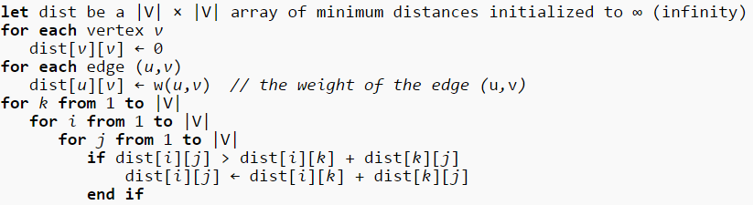
Floyd-Warshall Algorithm
What is it doing?
Why does it work?

Slide 14
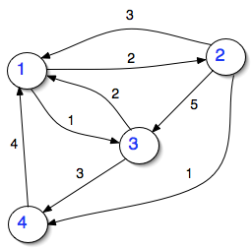
Floyd-Warshall Algorithm
Dist | 1 | 2 | 3 | 4
1 | 0
2 | 2
3 | 1
4 | ∞

Slide 15
Today
Analyze Dijkstra’s Algorithm
Deal with induction proof we started on last time.
Look at a way of finding all-pairs shortest path distances
  Floyd-Warshall Algorithm
More terminology
  Path, Cycle, Eulerian path, Eulerian cycle
More terminology
  Trees, minimum-spanning trees (MST), planar graphs
  Brief overview of ideas associated with these things.

Slide 16
Graphs
A graph G = (V,E) consists of
  a non-empty set V of vertices (or nodes),
  and a set E of edges.
  Each edge is associated with two vertices (possibly equal), which are its endpoints.
A path from u to v of length n is:
  a sequence of edges e₁, e₂, . . . e_{n} in E, such that
  there is a sequence of vertices u=v₀, v₁, . . . v_{n}=v
  such that each e_{i} has endpoints v_{i-1} and v_{i}.
A path is a circuit when u=v.
A graph is connected when there exists a path from every vertex to every other vertex.

Slide 17
Paths and Circuits
Given a graph G = (V,E):
  Is there a path/circuit that crosses each edge in E exactly once?
    If so, G is an Eulerian graph,
    and you have an Eulerian path, or an Eulerian circuit.
  Is there a path/circuit that visits each vertex in V exactly once?
    If so, G is a Hamiltonian graph,
    and you have a Hamiltonian path or circuit.

Slide 18
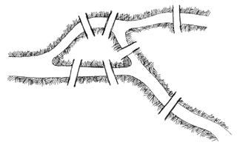
Leonhard Euler lived in Königsberg
He liked to take walks. A famous local puzzle was whether you could take a walk that would cross each bridge exactly once.
Euler solved this problem (in 1736) and thus founded graph theory.

Slide 19
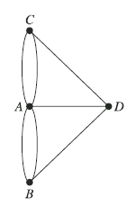
The Graph Abstraction
In the physical world:
  Each bridge connects exactly two land-masses.
  Each land-mass may have any number of bridges.
Suggests a graph abstraction:
  Represent a bridge by an edge in the graph.
  Represent a land-mass by a vertex.

Slide 20
Is there an Euler circuit/path?
A
A
A
A
A
B
D
B
B
B
D
B
D
C
C
C
C
C
C
E
E
E
E
E
Circuit
Path
Not Traversable

Slide 21
Does G have an Euler Path/Circuit?
Theorem: A connected multigraph has an Euler path iff it has exactly zero or two vertices of odd degree.
  Why?
  What if it has only one?
  When does it have an Euler circuit?
Notes:
A vertex of odd degree must be the start or end of a path.
The sum of degrees is always even, so this can’t happen.
If there are zero vertices of odd degree.

Slide 22
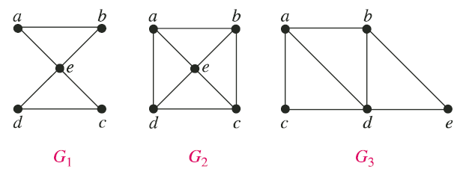
Examples
Do these graphs have Euler paths/circuits?
  Yes, it has a circuit.
  Yes, it has a path (but no circuit).
  No, it has neither path nor circuit.
Notes:
Three quick iClicker questions, one for each graph.

Slide 23
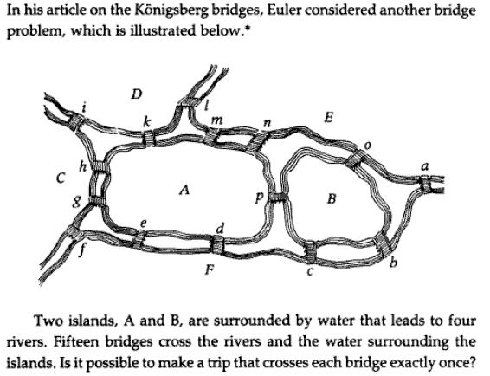
Does this have an Euler path?
M
O
N
P
(A) Yes (B) No
Notes:
D has odd degree and E has odd degree
So it should have an Euler Path

Slide 24
Applications of Euler Paths
Planning routes through graphs that provide efficient coverage of the edges in the graph, without multiple traversals.
  Postal delivery routes
  Snowplowing routes
  Testing network connections
    Utility transmission network
    Communication network

Slide 25
Eulerian Path vs. Hamiltonian Path
Eulerian:
  Traverse each edge exactly once
Hamiltonian
  Traverse each node exactly once

Slide 26
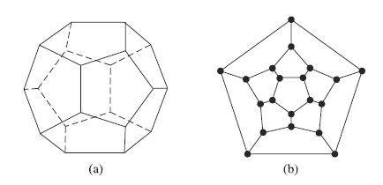
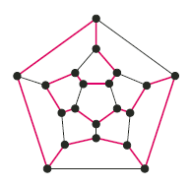
Hamiltonian Paths and Circuits
Given a graph, is there a path that passes through each vertex in the graph exactly once? (aka a Hamiltonian path)
dodecahedron
Isomorphic graph
solution

Slide 27
Hamilton circuit
Do these graphs have Hamilton circuits?
G H
Yes, both. (C ) G doesn’t, H does.
G does, H doesn’t. (D) No, neither.
3
4
6
1
2
5
Notes:
The correct answer is C. (G has no Hamilton circuit because there is no way to reach all vertices without passing through the middle vertex twice.)
1 -> 3 -> 4 -> 5 -> 6 -> 2 -> 1

Slide 28
Computational Complexity
Deciding whether a graph is Eulerian is a simple examination of the degrees of the vertices.
  Simple linear-time algorithms exist for finding the path or circuit.
Deciding whether a graph is Hamiltonian is, in general, much more difficult (“NP complete”).
  Finding a Hamiltonian path or circuit is equally hard.

Slide 29
Weighted graphs
A weighted graph has numbers (weights) assigned to each edge.
The length of a path is the sum of the weights in the path.
5
3
4
6
3
4

Slide 30
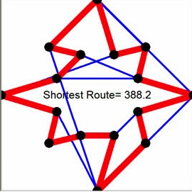
Traveling Salesperson’s Problem
What is the shortest route in a given map
  for a salesperson to visit every city exactly once
  and return home at the end?
Mathematically:
  Given an graph with weighted edges, what is the Hamiltonian circuit of least weight?
    Applies to both directed and undirected graphs.

Slide 31
The Traveling Salesman Problem
Problem: Given a graph G, find the shortest possible length for a Hamilton circuit.
What is the solution to TSP for the following graph?
(A) 16 (B) 17 (C ) 18 (D) 19 (E) 20
3
2
5
6
4
7
Notes:
The answer is (B) 17. (Simply exclude the top and bottom edges.)

Slide 32
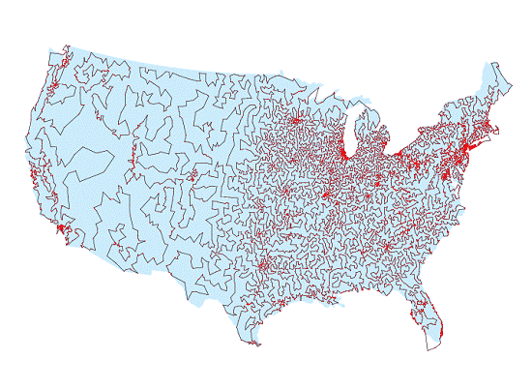
Traveling Salesperson’s Problem
The TSP is NP Complete: intractable in general.
  Very large instances have been solved with heuristics.
  An instance with 13,509 cities, solved in 2003.
Notes:
This was done at Rice University. The route visits every US city of population > 500.
(I don’t know how they verified that it was correct.)

Slide 33
Applications
The Traveling Salesperson’s Problem and the Hamilton Path/Circuit Problem have many applications.
  Planning and logistics (of course!)
  Manufacture of microchips
  DNA sequencing

