Slide 1
EECS 373
Design of Microprocessor-Based Systems
Website: www.eecs.umich.edu/courses/eecs373/
Ronald Dreslinski
University of Michigan
Lecture 1: Introduction, start on ARM ISA
September 7th 2016
Slides developed in part by
Prof. Dutta and Dr. Brehob

Slide 2
Folks
Prof. Ron Dreslinski
Matt Smith
  Head lab instructor
  Been doing 373 for about 15 years!
IAs:
  Yifan Hao haoyifan@umich.edu
  Daniel Synder snysly@umich.edu
  Jay Mulani jmulani@umich.edu
  Kevin Yang kbyang@umich.edu

Slide 3
What is an embedded system?

Slide 4
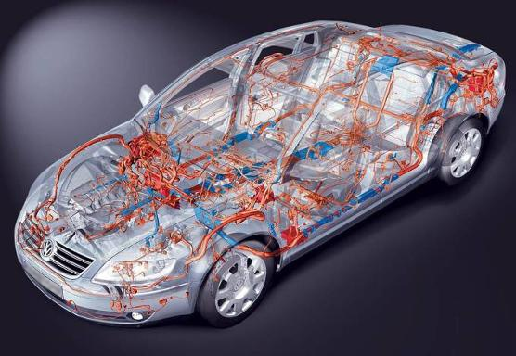
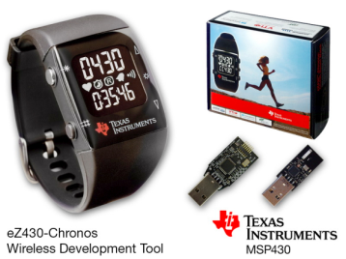
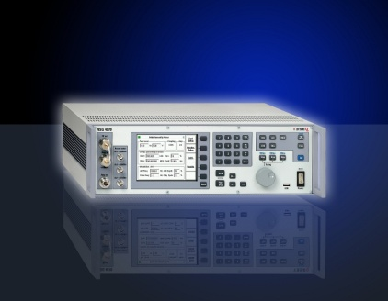
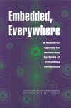
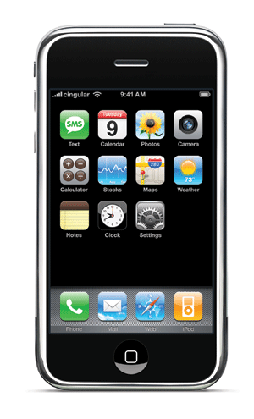
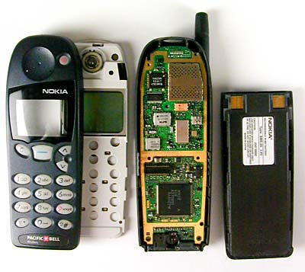
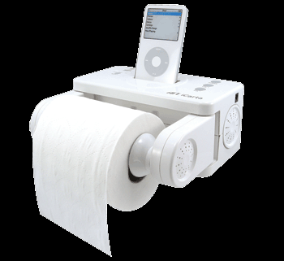
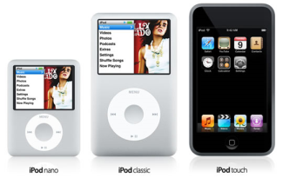
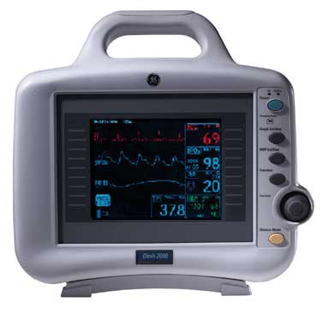
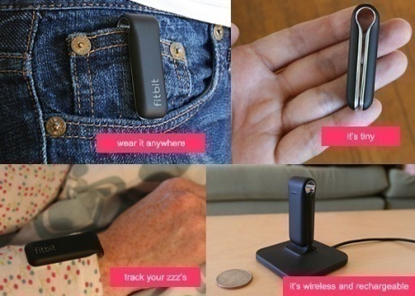
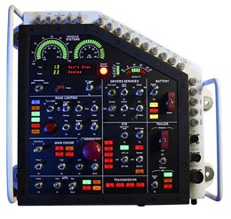
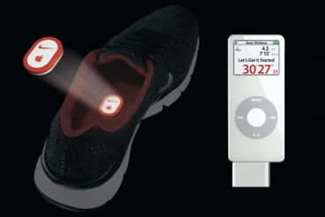
Embedded, everywhere
Notes:
Book was 2001.

Slide 5
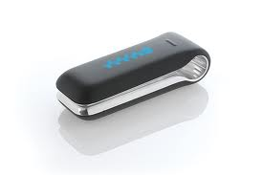
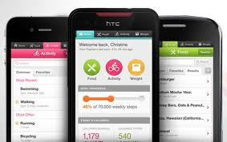
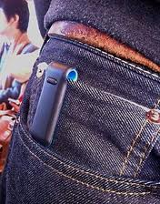
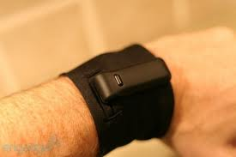
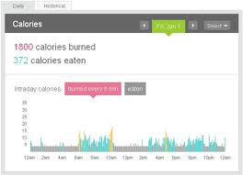
Embedded, Everywhere - Fitbit

Slide 6
What is driving the
embedded everywhere explosion?

Slide 7
Outline
Technology Trends
Course Description/Overview
Tools Overview/ISA start

Slide 8
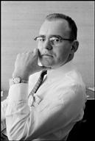
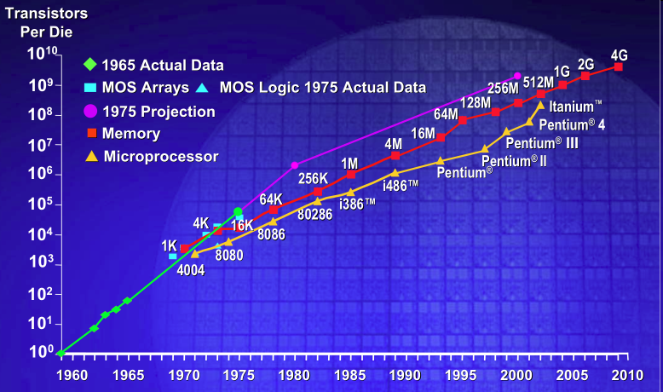
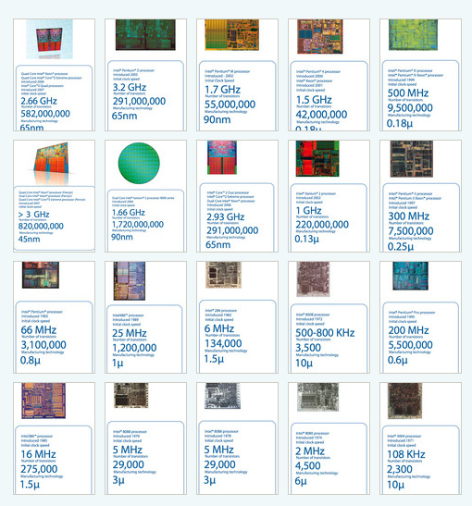
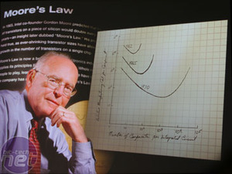
Moore’s Law (a statement about economics):
IC transistor count doubles every 18-24 mo
Photo Credit: Intel

Slide 9
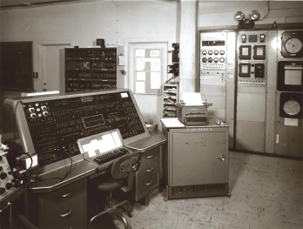
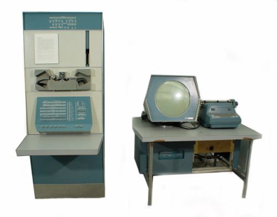
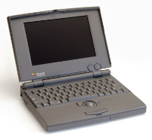
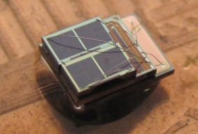

The number of computers per person grows
Mainframe
[Bell et al. Computer, 1972, ACM, 2008]
1 per Enterprise
Workstation
1 per Engineer
Laptop
1 per Professional
log (people per computer)
Smart Sensors
Mini Computer
Ubiquitous
1 per Company
Personal Computer
100 – 1000’s per person
1 per Family
1 per person
Smartphone

Slide 10
Computer volume shrinks by 100x every decade
Mainframe
1 per Enterprise
100x smaller every decade
Workstation
1 per Engineer
[Nakagawa08]
Laptop
1 per Professional
Smart Sensors
Mini Computer
Ubiquitous
1 per Company
Personal Computer
100 – 1000’s per person
1 per Family
1 per person
Smartphone

Slide 11
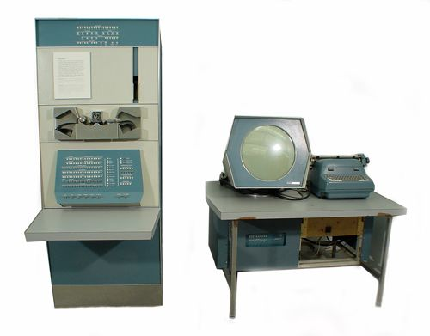
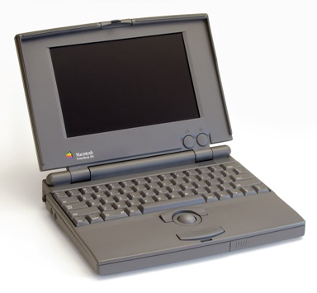

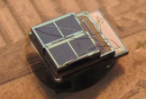
Price falls dramatically, and enables new applications
Mainframe
Workstation
Number Crunching
Data Storage
Laptop
productivity
interactive
Mini Computer
streaming
information
to/from the
physical
world
Smart Sensors
Personal Computer
Smartphone

Slide 12
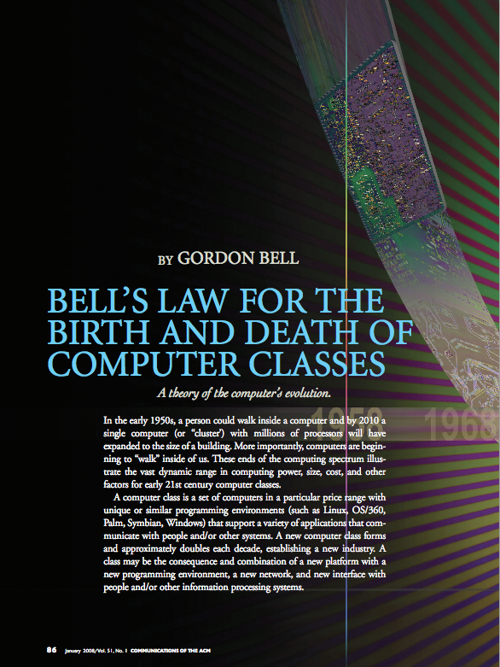
Bell’s Law: A new computer class every decade
“Roughly every decade a new, lower priced computer class forms based on a new programming platform, network, and interface resulting in new usage and the establishment of a new industry.”
- Gordon Bell [1972,2008]
12

Slide 13
What is driving Bell’s Law?
Technology Scaling
Technology Innovations
Moore’s Law
  Made transistors cheap
Dennard’s Scaling
  Made them fast
  And low-power
Result
  Holding #T’s constant
    Exponentially lower cost
    Exponentially lower power
  Small, cheap & low-power
    Microcontrollers
    Memory
    Radios
MEMS technology
  Micro-fabricated sensors
New memories
  New cell structures (11T)
  New tech (FeRAM, FinFET)
Near-threshold computing
  Minimize active power
  Minimize static power
New wireless systems
  Radio architectures
  Modulation schemes
Energy harvesting

Slide 14
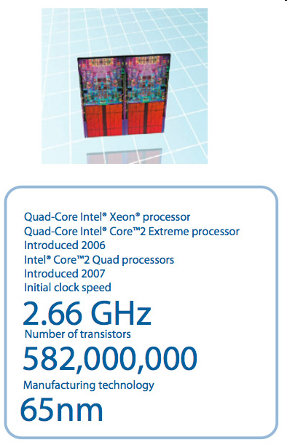
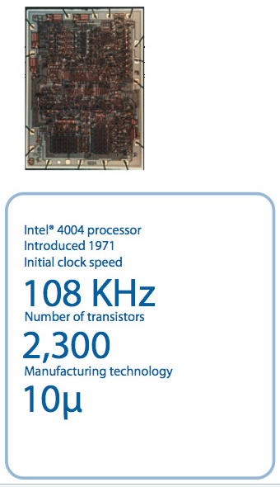
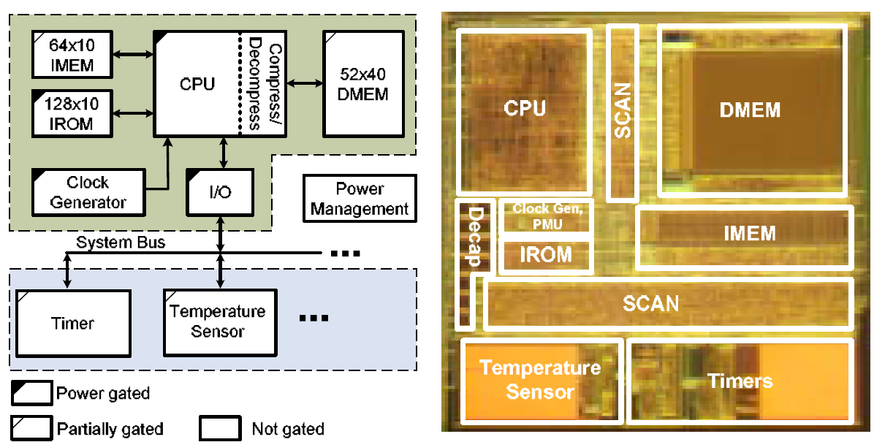
Corollary to Moore’s Law
15x size decrease
40x transistors
55x smaller λ
UMich Phoenix Processor
Introduced 2008
Initial clock speed
106 kHz @ 0.5V Vdd
Number of transistors
92,499
Manufacturing technology
0.18 µ
Photo credits: Intel, U. Michigan

Slide 15

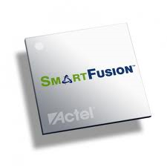
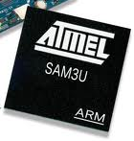


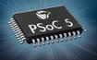
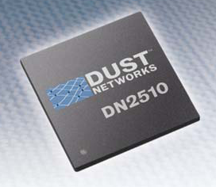


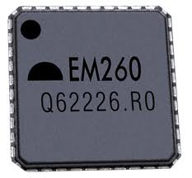



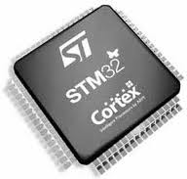
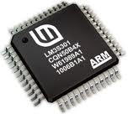
Broad availability of inexpensive, low-power, 32-bit MCUs
(with enough memory to do interesting things)

Slide 16
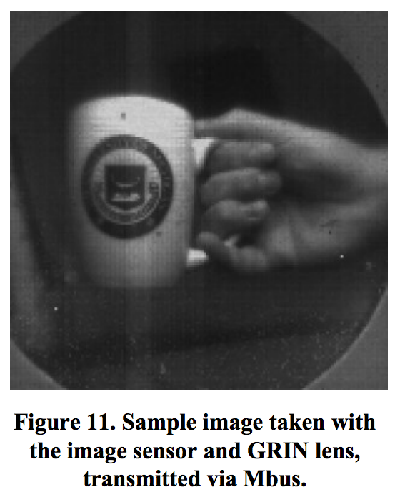
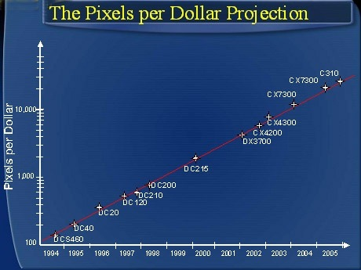
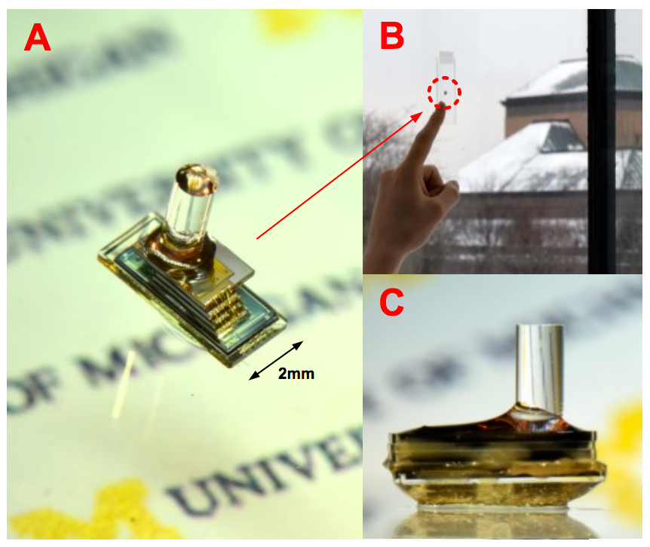
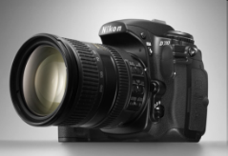



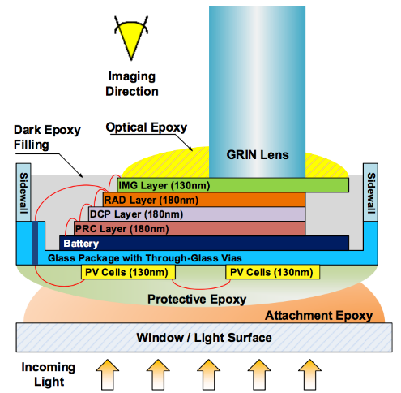
Hendy’s “Law”:
Pixels per dollar doubles annually
Keeping pixels fixed,
size, power, cost fall
Credit: Barry Hendy/Wikipedia
G. Kim, Z. Foo, Y, Lee, P. Pannuto, Y-S. Kuo, B. Kempke, M. Ghaed, S. Bang, I. Lee, Y. Kim, S. Jeong, P. Dutta, D. Sylvester, D. Blaauw,
“A Millimeter-Scale Wireless Imaging System with Continuous Motion Detection and Energy Harvesting,
In Symposium of VLSI Technology (VLSI’14), Jun. 2014.

Slide 17
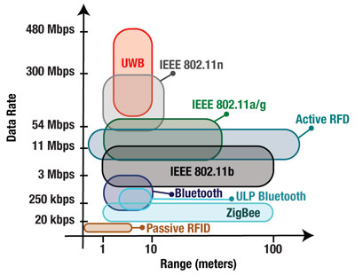
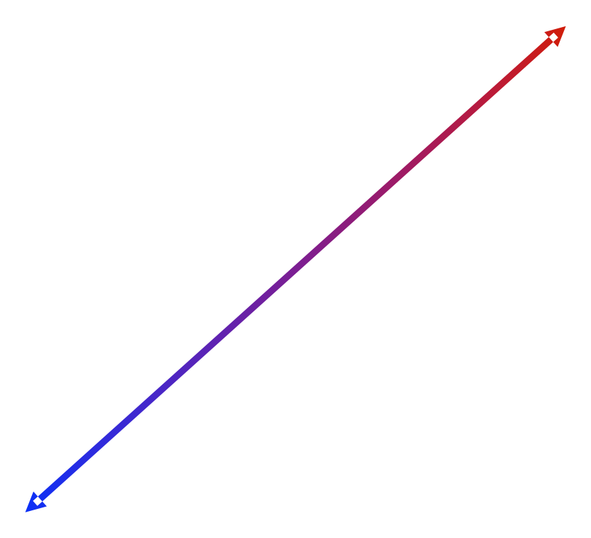

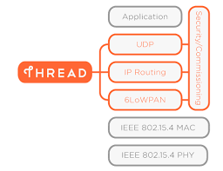
Radio technologies enabling pervasive computing, IoT
Higher Power
Lower Energy per
Atomic Operation
Source: Steve Dean, Texas Instruments
http://eecatalog.com/medical/2009/09/23/current-and-future-trends-in-medical-electronics/
Notes:
http://eecatalog.com/medical/2009/09/23/current-and-future-trends-in-medical-electronics/

Slide 18
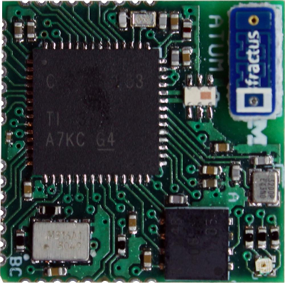
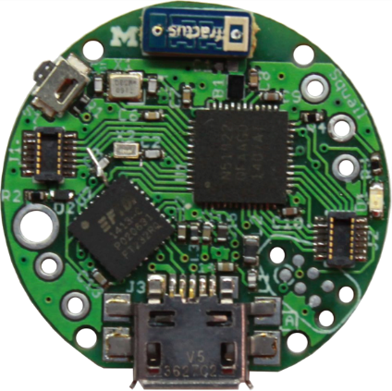
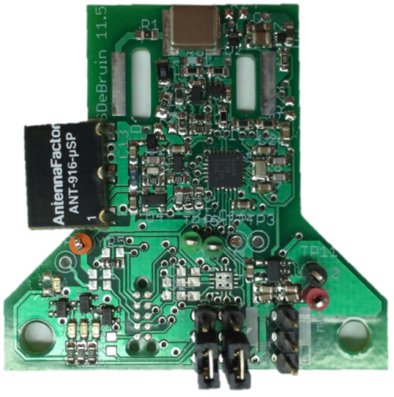
Established comms interfaces: 802.15.4, BLE, NFC
IEEE 802.15.4 (a.k.a. “ZigBee” stack)
  Workhorse radio technology for sensornets
  Widely adopted for low-power mesh protocols
  Middle (6LoWPAN, RPL) and upper (CoAP layers)
  Can last for years on a pair of AA batteries
Bluetooth Low-Energy (BLE)
  Short-range RF technology
  On phones and peripherals
  Can beacon for years on coin cells
Near-Field Communications (NFC)
  Asymmetric backscatter technology
  Small (mobile) readers in smartphones
  Large (stationary) readers in infrastructure
  New: ambient backscatter communications

Slide 19






Emerging Proximal Interfaces:
Ultrasonic, Visible Light, Vibration
Ultrasonic
  Small, low-power, short-range
  Supports very low-power wakeup
  Can support pairwise ranging of nodes
Visible Light
  Enabled by pervasive LEDs and cameras
  Supports indoor localization and comms
  Easy to modify existing LED lighting
Vibration
  Pervasive accelerometers
  Pervasive Vibration motors
  Bootstrap desktop area context

Slide 20



Non-volatile memory capacity & read/write bandwidth
Lower capacity but
Higher R/W speeds
*and*
Lower energy per
atomic operation
*and*
High write
endurance
Notes:
Source: http://www.maltiel-consulting.com/ISSCC-2013-Memory-trends-FLash-NAND-DRAM.html
“In the past decade significant focus has been put on the emerging memories field to find a possible alternative to floating gate nonvolatile memory (NVM). The emerging NVMs, such as phase-change memory (PRAM), ferroelectric RAM (FeRAM), magnetic spin-torque-transfer RAM (STT-MRAM), and resistive memory (ReRAM), are showing potential to achieve high cycling capability and lower power per bit for both read and write operations. Some commercial applications, such as cellular phones, have recently started to use PRAM, demonstrating that reliability and cost competitiveness in emerging memories is becoming a reality. Fast write speed and low read-access time are being achieved in many of these emerging memories. At ISSCC 2013, a 32Gb ReRAM cross-point array is demonstrated in 24nm technology. Figures 3 and 4 provide a summary on the scaling trends for both bandwidth and density in emerging memories.”

Slide 21






MEMS Sensors:
Rapidly falling price and power of accelerometers
O(mA)
[Analog Devices, 2009]
25 µA @ 25 Hz
ADXL345
Price
Power
10 µA @ 10 Hz @ 6 bits
[ST Microelectronics, annc. 2009]
ADXL362
1.8 µA @ 100 Hz @ 2V
300 nA wakeup mode
[Analog Devices, 2012]

Slide 22












Energy harvesting and storage:
Small doesn’t mean powerless…
RF [Intel]
Clare Solar Cell
Thin-film batteries
Shock Energy Harvesting
CEDRAT Technologies
Electrostatic Energy
Harvester [ICL]
Piezoelectric
[Holst/IMEC]
Thermoelectric Ambient
Energy Harvester [PNNL]

Slide 23
Why study 32-bit MCUs and FPGAs?

Slide 24

MCU-32 and PLDs are tied in embedded market share

Slide 25
What differentiates these
products from one another?
FPGA Microprocessor
===== =============

Slide 26



MPU FPGA

Slide 27

Modern FPGAs: best of both worlds!

Slide 28
Why study the ARM architecture
(and the Cortex-M3 in particular)?

Slide 29
Lots of manufacturers ship ARM products

Slide 30
ARM is the big player
ARM has a huge market share
  As of 2011 ARM has chips in about 90% of the world’s mobile handsets
  As of 2010 ARM has chips in 95% of the smartphone market, 10% of the notebook market
    Expected to hit 40% of the notebook market in 2015.
  Heavy use in general embedded systems.
    Cheap to use
      ARM appears to get an average of 8¢ per device (averaged over cheap and expensive chips).
    Flexible
      Spin your own designs.

Slide 31
Outline
Technology Trends
Course Description/Overview
Tools Overview/ISA start

Slide 32
Course goals
Learn to implement embedded systems including hardware/software interfacing.
Learn to design embedded systems and how to think about embedded software and hardware.
Have the opportunity to design and build non-trivial projects involving both hardware and software.

Slide 33
Prerequisites
EECS 270: Introduction to Logic Design
  Combinational and sequential logic design
  Logic minimization, propagation delays, timing
EECS 280: Programming and Intro Data Structures
  C programming
  Algorithms (e.g. sort) and data structures (e.g. lists)
EECS 370: Introduction to Computer Organization
  Basic computer architecture
  CPU control/datapath, memory, I/O
  Compiler, assembler

Slide 34
Topics
Memory-mapped I/O
  The idea of using memory addressed to talk to input and output devices.
    Switches, LEDs, hard drives, keyboards, motors
Interrupts
  How to get the processor to become “event driven” and react to things as they happen.
Working with Analog inputs
  The real world isn’t digital!
Common devices and interfaces
  Serial buses, timers, etc.

Slide 35

Example: Memory-mapped I/O
This is important.
  It means our software can tell the hardware what to do.
    In lab 3 you’ll design hardware on an FPGA which will can control a motor.
      But more importantly, that hardware will be designed so the software can tell the hardware exactly what to do with the motor. All by simply writing to certain memory locations!
  In the same way, the software can read memory locations to access data from sensors etc…

Slide 36



Example: Anatomy of a timer system
...
timer_t timerX;
initTimer();
...
startTimerOneShot(timerX, 1024);
...
stopTimer(timerX);
Application Software
Applications
Operating System
typedef struct timer {
timer_handler_t handler;
uint32_t time;
uint8_t mode;
timer_t* next_timer;
} timer_t;
Timer Abstractions and Virtualization
Low-Level Timer Subsystem Device Drivers
timer_tick:
ldr r0, count;
add r0, r0, #1
...
Software
Hardware
R/W
R/W
R/W
Compare
Counter
Capture
module timer(clr, ena, clk, alrm);
input clr, ena, clk;
output alrm;
reg alrm;
reg [3:0] count;
always @(posedge clk) begin
alrm <= 0;
if (clr) count <= 0;
else count <= count+1;
end
endmodule
Prescaler
Clock Driver
Internal
External
Xtal/Osc
I/O
I/O
Notes:
http://www.cse.nd.edu/courses/cse20221/www/handouts/L17_FSM%20Design%20Example%20with%20Verilog.pdf

Slide 37
Grades
Item Weight
====== =========
Labs (7) 25%
Project 25%
Exams 35% (15% midterm; 20% final)
HW /Guest talks 10%
Oral presentation 5%
Project and Exams tend to be the major differentiators.
Class median is generally a low B+.

Slide 38
Time
You’ll need to assume you are going to spend a lot of time in this class.
  2-3 hours/week in lecture (we cancel a few classes during project time)
  8-12 hours/week working in lab
    Expect more during project time; some labs are a bit shorter.
  ~20 hours (total) working on homework
  ~20 hours (total) studying for exams.
  ~8 hour (total) on your oral presentation
Averages out to about 15-20 hours/week pre-project and about 20 during the project…
  This is more than I’d like, but we’ve chosen to go with state-of-the-art tools, and those generally have a heck of a learning curve.

Slide 39
Labs
7 labs, 8 weeks, groups of 2
    FPGA + Hardware Tools
    MCU + Software Tools
    Memory + Memory-Mapped I/O
    Interrupts
    Timers and Counters
    Serial Bus Interfacing
    Data Converters (e.g. ADCs/DACs)
Labs are very time consuming.
  As noted, students estimated 8-12 hours per lab with one lab (which varied by group) taking longer.

Slide 40
Open-Ended Project
Goal: learn how to build embedded systems
  By building an embedded system
  Work in teams of 4
  You design your own project
The major focus of the last third of the class.
  Labs will be done and we will cancel some lectures and generally try to keep you focused.
Important to start early.
  After all the effort in the labs, it’s tempting to slack for a bit. The best projects are those that get going right away.

Slide 41
Homework
4-6 assignments
  A few “mini” assignments
    Mainly to get you up to speed on lab topics
  A few “standard” assignments
    Hit material we can’t do in lab.
Also a small part is for showing up to guest lecturer(s)
Start today, Homework 1 due on Wednesday

Slide 42
Looking for me?
Office Hours in 2637 BBB
  Tuesday 2-3pm
  Thursday 3:30-4:30pm
Email to schedule other times as needed

Slide 43
Outline
Technology Trends
Course Description/Overview
Tools overview/ISA start

Slide 44

We are using Actel’s SmartFusion Evaluation Kit

Slide 45

A2F200M3F-FGG484ES
  200,000 System FPGA gates, 256 KB flash memory, 64 KB SRAM, and additional distributed SRAM in the FPGA fabric and external memory controller
  Peripherals include Ethernet, DMAs, I²Cs, UARTs, timers, ADCs, DACs and additional analog resources
USB connection for programming and debug from Actel's design tools
USB to UART connection to UART_0 for HyperTerminal examples
10/100 Ethernet interface with on-chip MAC and external PHY
Mixed-signal header for daughter card support

Slide 46

FPGA work

Slide 47

“Smart Design” configurator

Slide 48

Eclipse-based “Actel SoftConsole IDE”

Slide 49

Debugger is GDB-based. Includes command line.
Works really quite well.

Slide 50
ARM ISA

Slide 51



Major elements of an Instruction Set Architecture
(registers, memory, word size, endianess, conditions, instructions, addressing modes)
32-bits
32-bits
mov r0, #1
ld r1, [r0,#5]
r1=mem((r0)+5)
bne loop
subs r2, #1
Endianess
Endianess

Slide 52

The endianess religious war: 284 years and counting!
Modern version
  Danny Cohen
  IEEE Computer, v14, #10
  Published in 1981
  Satire on CS religious war
Historical Inspiration
  Jonathan Swift
  Gulliver's Travels
  Published in 1726
  Satire on Henry-VIII’s split with the Church
    Now a major motion picture!
Little-Endian
  LSB is at lower address
Memory Value
Offset (LSB) (MSB)
====== ===========
uint8_t a = 1; 0x0000 01 02 FF 00
uint8_t b = 2;
uint16_t c = 255; // 0x00FF
uint32_t d = 0x12345678; 0x0004 78 56 34 12
Big-Endian
  MSB is at lower address
Memory Value
Offset (LSB) (MSB)
====== ===========
uint8_t a = 1; 0x0000 01 02 00 FF
uint8_t b = 2;
uint16_t c = 255; // 0x00FF
uint32_t d = 0x12345678; 0x0004 12 34 56 78

Slide 53


Addressing: Big Endian vs Little Endian (370 slide)
Endian-ness: ordering of bytes within a word
  Little - increasing numeric significance with increasing memory addresses
  Big – The opposite, most significant byte first
  MIPS is big endian, x86 is little endian

Slide 54

Instruction encoding
Instructions are encoded in machine language opcodes
Sometimes
  Necessary to hand generate opcodes
  Necessary to verify assembled code is correct
How?
Instructions
movs r0, #10
movs r1, #0
Register Value Memory Value
001|00|000|00001010 (LSB) (MSB)
(msb) (lsb) 0a 20 00 21
001|00|001|00000000
ARMv7 ARM
Notes:
Condition codes are simply a way of testing the ALU status flags.

Slide 55
Assembly example
data:
.byte 0x12, 20, 0x20, -1
func:
mov r0, #0
mov r4, #0
movw r1, #:lower16:data
movt r1, #:upper16:data
top: ldrb r2, [r1],1
add r4, r4, r2
add r0, r0, #1
cmp r0, #4
bne top

Slide 56
Instructions used
mov
  Moves data from register or immediate.
  Or also from shifted register or immediate!
    the mov assembly instruction maps to a bunch of different encodings!
  If immediate it might be a 16-bit or 32-bit instruction.
    Not all values possible
    why?
movw
  Actually an alias to mov.
    “w” is “wide”
    hints at 16-bit immediate.

Slide 57

From the ARMv7-M Architecture Reference Manual
(posted on the website under references)
There are similar entries for
move immediate, move shifted
(which actually maps to different
instructions) etc.

Slide 58
Directives
#:lower16:data
  What does that do?
  Why?

Slide 59


Slide 60
Loads!
ldrb?
ldrsb?

Slide 61
So what does the program _do_?
data:
.byte 0x12, 20, 0x20, -1
func:
mov r0, #0
mov r4, #0
movw r1, #:lower16:data
movt r1, #:upper16:data
top: ldrb r2, [r1],1
add r4, r4, r2
add r0, r0, #1
cmp r0, #4
bne top

Slide 62
Questions?
Comments?
Discussion?

