Slide 1
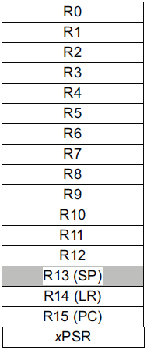
EECS 373
Design of Microprocessor-Based Systems
Ron Dreslinski
University of Michigan
Lecture 2: Architecture, Assembly, and ABI
Sept. 12, 2016
Slides developed in part by Prof. Dutta and Dr. Brehob

Slide 2
Admin Stuff
Website URL (again)
http://www.eecs.umich.edu/courses/eecs373/
HW1 Due on Wednesday
Schedule things:
Group formation meeting Monday 10/10 6:30-8:00
Midterm exam Monday 10/24 7:00-9:00 (sharp)
Tentative
373 Design Expo Monday 12/12
Time TBA (11am-2 most likely)
Final Exam, 12/21 1:30-3:30pm

Slide 3
Today…
ARM assembly example
Walk though of the ARM ISA
Lab tool flow
Start on Application Binary Interface (ABI)

Slide 4
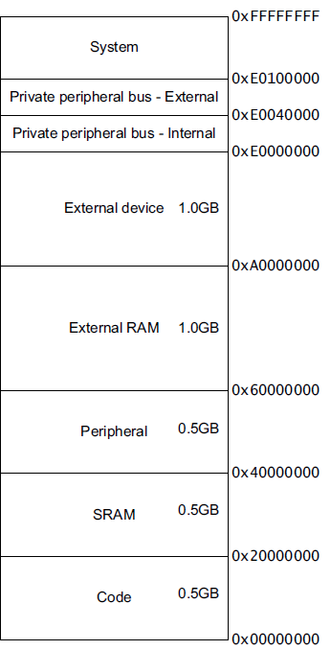
Major elements of an Instruction Set Architecture (registers, memory, word size, endianess, conditions, instructions, addressing modes)
32-bits
32-bits
mov r0, #1
ld r1, [r0,#5]
mem((r0)+5)
bne loop
subs r2, #1
Endianess
Endianess

Slide 5
The endianess religious war: 284 years and counting!
Modern version
Danny Cohen
IEEE Computer, v14, #10
Published in 1981
Satire on CS religious war
Historical Inspiration
Jonathan Swift
Gulliver's Travels
Published in 1726
Satire on Henry-VIII’s split with the Church
Now a major motion picture!
Little-Endian
LSB is at lower address
Memory Value
Offset (LSB) (MSB)
====== ===========
uint8_t a = 1; 0x0000 01 02 FF 00
uint8_t b = 2;
uint16_t c = 255; // 0x00FF
uint32_t d = 0x12345678; 0x0004 78 56 34 12
Big-Endian
MSB is at lower address
Memory Value
Offset (LSB) (MSB)
====== ===========
uint8_t a = 1; 0x0000 01 02 00 FF
uint8_t b = 2;
uint16_t c = 255; // 0x00FF
uint32_t d = 0x12345678; 0x0004 12 34 56 78

Slide 6
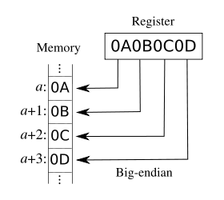
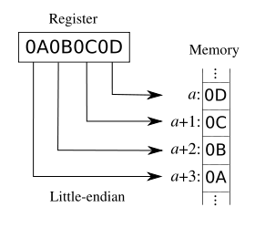
Addressing: Big Endian vs Little Endian (370 slide)
Endian-ness: ordering of bytes within a word
Little - increasing numeric significance with increasing memory addresses
Big – The opposite, most significant byte first
MIPS is big endian, x86 is little endian

Slide 7
Instruction encoding
Instructions are encoded in machine language opcodes
Sometimes
Necessary to hand generate opcodes
Necessary to verify assembled code is correct
How?
Instructions
movs r0, #10
movs r1, #0
Register Value Memory Value
001|00|000|00001010 (LSB) (MSB)
(msb) (lsb) 0a 20 00 21
001|00|001|00000000
ARMv7 ARM
Notes:
Condition codes are simply a way of testing the ALU status flags.

Slide 8
Assembly example
data:
.byte 0x12, 20, 0x20, -1
func:
mov r0, #0
mov r4, #0
movw r1, #:lower16:data
movt r1, #:upper16:data
top: ldrb r2, [r1],#1
add r4, r4, r2
add r0, r0, #1
cmp r0, #4
bne top

Slide 9
Instructions used
mov
Moves data from register or immediate.
Or also from shifted register or immediate!
the mov assembly instruction maps to a bunch of different encodings!
If immediate it might be a 16-bit or 32-bit instruction.
movw
Actually an alias to mov.
“w” is “wide”
hints at 16-bit immediate.

Slide 10
From the ARMv7-M Architecture Reference Manual (posted on the website under references)
There are similar entries for
move immediate, move shifted
(which actually maps to different
instructions) etc.

Slide 11
Directives
#:lower16:data
What does that do?
Why?

Slide 13
Loads!
ldrb -- Load register byte
Note this takes an 8-bit value and moves it into a 32-bit location!
Zeros out the top 24 bits.
ldrsb -- Load register signed byte
Note this also takes an 8-bit value and moves it into a 32-bit location!
Uses sign extension for the top 24 bits.

Slide 14
Addressing Modes
Offset Addressing
Offset is added or subtracted from base register
Result used as effective address for memory access
[<Rn>, <offset>]
Pre-indexed Addressing
Offset is applied to base register
Result used as effective address for memory access
Result written back into base register
[<Rn>, <offset>]!
Post-indexed Addressing
The address from the base register is used as the EA
The offset is applied to the base and then written back
[<Rn>], <offset>
Notes:
Condition codes are simply a way of testing the ALU status flags.

Slide 15
So what does the program _do_?
data:
.byte 0x12, 20, 0x20, -1
func:
mov r0, #0
mov r4, #0
movw r1, #:lower16:data
movt r1, #:upper16:data
top: ldrb r2, [r1],#1
add r4, r4, r2
add r0, r0, #1
cmp r0, #4
bne top

Slide 16
Today…
ARM assembly example
Walk though of the ARM ISA
Tool Flow
Start on Application Binary Interface (ABI)

Slide 17
An ISA defines the hardware/software interface
A “contract” between architects and programmers
Register set
Instruction set
Addressing modes
Word size
Data formats
Operating modes
Condition codes
Calling conventions
Really not part of the ISA (usually)
Rather part of the ABI
But the ISA often provides meaningful support.

Slide 18
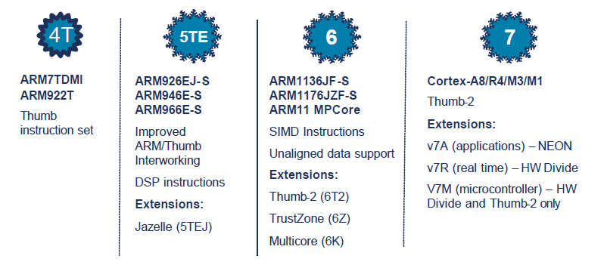
ARM Architecture roadmap

Slide 19
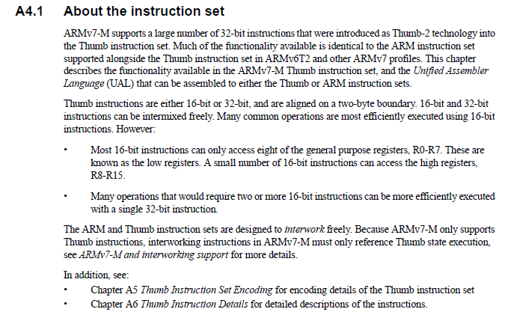
A quick comment on the ISA: From: ARMv7-M Architecture Reference Manual

Slide 20
ARM Cortex-M3 ISA
Instruction Set
Register Set
Address Space
Branching
Data processing
Load/Store
Exceptions
Miscellaneous
32-bits
32-bits
Endianess
Endianess

Slide 21
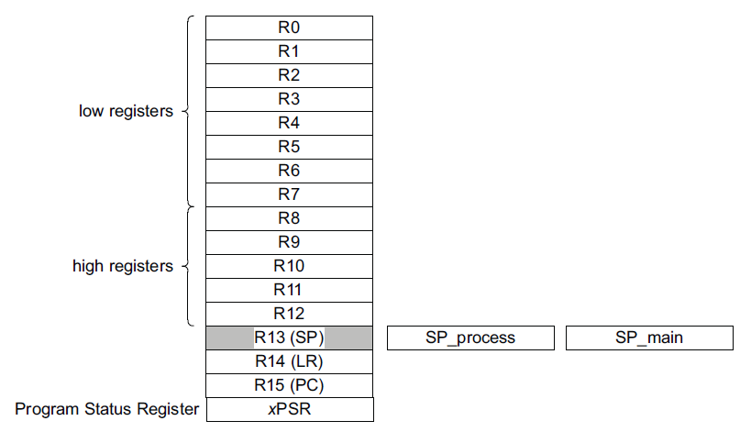
Registers
Mode dependent

Slide 22
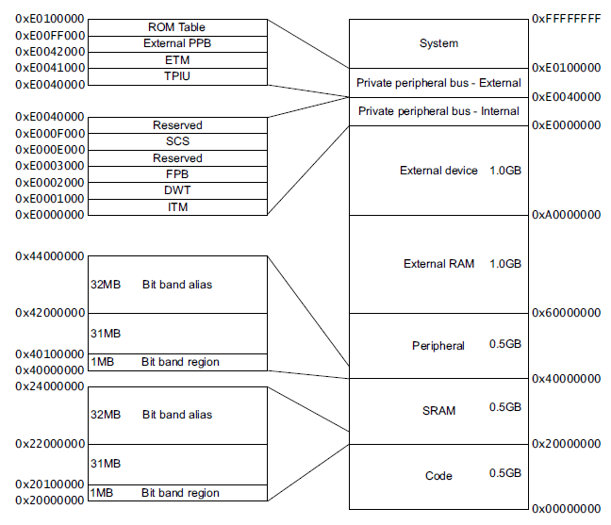
Address Space

Slide 23
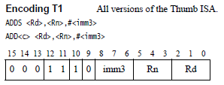
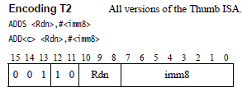
Instruction Encoding ADD immediate

Slide 24
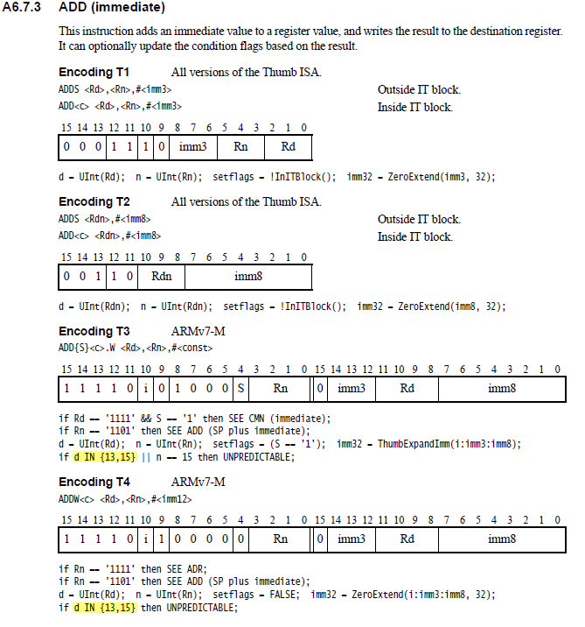

Slide 25
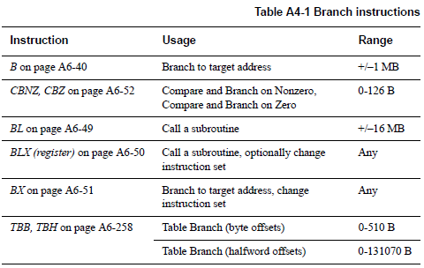
Branch

Slide 26
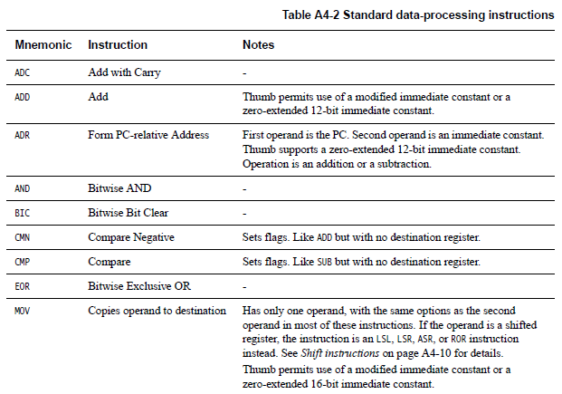
Data processing instructions
Many, Many More!

Slide 27
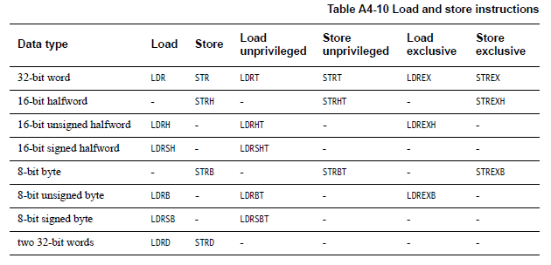
Load/Store instructions

Slide 28
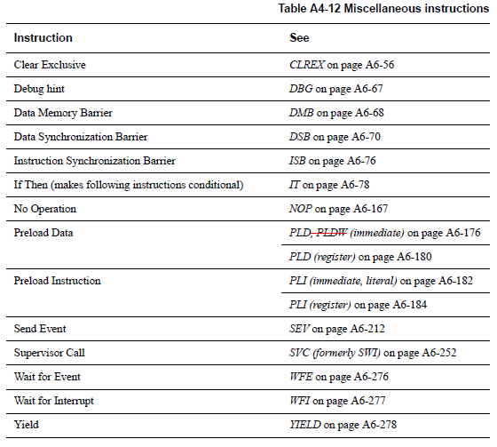
Miscellaneous instructions

Slide 29
Addressing Modes (again)
Offset Addressing
Offset is added or subtracted from base register
Result used as effective address for memory access
[<Rn>, <offset>]
Pre-indexed Addressing
Offset is applied to base register
Result used as effective address for memory access
Result written back into base register
[<Rn>, <offset>]!
Post-indexed Addressing
The address from the base register is used as the EA
The offset is applied to the base and then written back
[<Rn>], <offset>
Notes:
Condition codes are simply a way of testing the ALU status flags.

Slide 30
<offset> options
An immediate constant
#10
An index register
<Rm>
A shifted index register
<Rm>, LSL #<shift>
Lots of weird options…
Notes:
Condition codes are simply a way of testing the ALU status flags.

Slide 31
Application Program Status Register (APSR)
Notes:
Condition codes are simply a way of testing the ALU status flags.

Slide 32
Updating the APSR
SUB Rx, Ry
Rx = Rx - Ry
APSR unchanged
SUBS
Rx = Rx - Ry
APSR N, Z, C, V updated
ADD Rx, Ry
Rx = Rx + Ry
APSR unchanged
ADDS
Rx = Rx + Ry
APSR N, Z, C, V updated
Notes:
Condition codes are simply a way of testing the ALU status flags.

Slide 33
Overflow and carry in APSR
unsigned_sum = UInt(x) + UInt(y) + UInt(carry_in);
signed_sum = SInt(x) + SInt(y) + UInt(carry_in);
result = unsigned_sum<N-1:0>; // == signed_sum<N-1:0>
carry_out = if UInt(result) == unsigned_sum then ’0’ else ’1’;
overflow = if SInt(result) == signed_sum then ’0’ else ’1’;

Slide 34
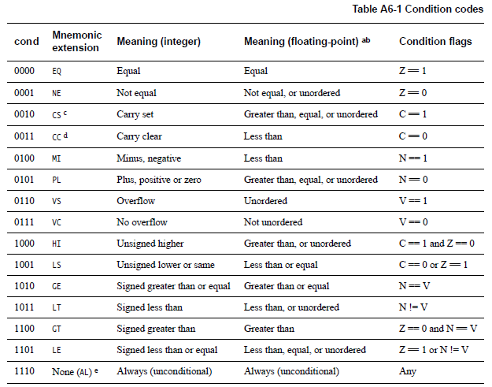
Conditional execution: Append to many instructions for conditional execution
Notes:
Condition codes are simply a way of testing the ALU status flags.

Slide 35
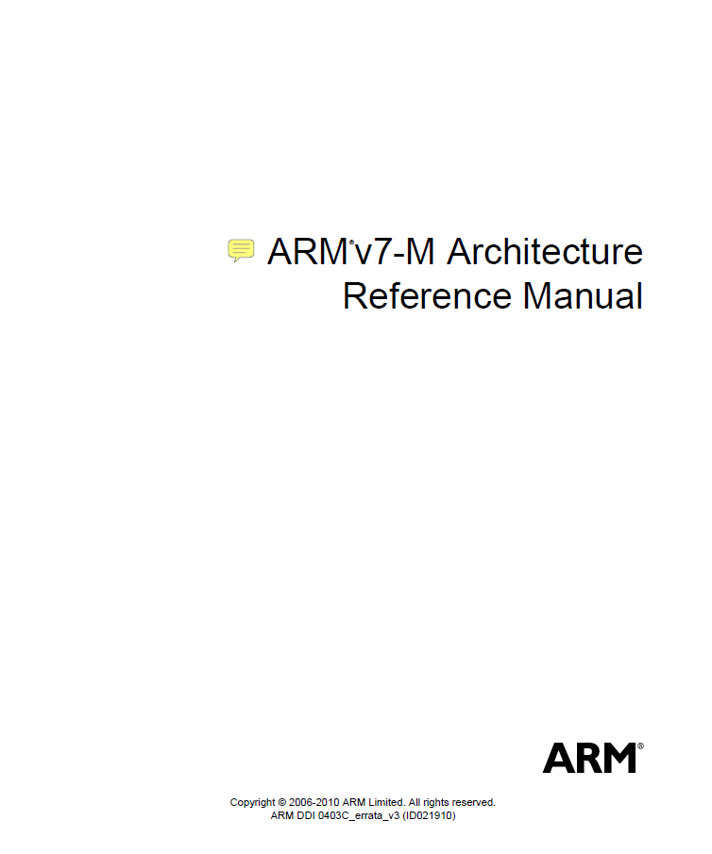
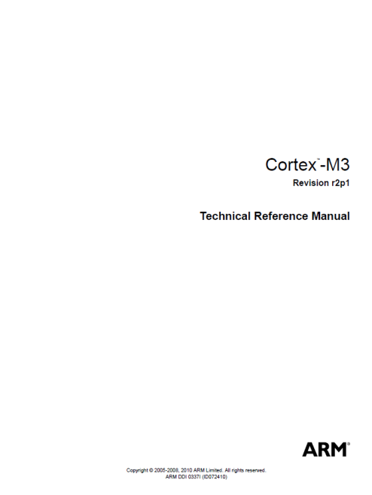
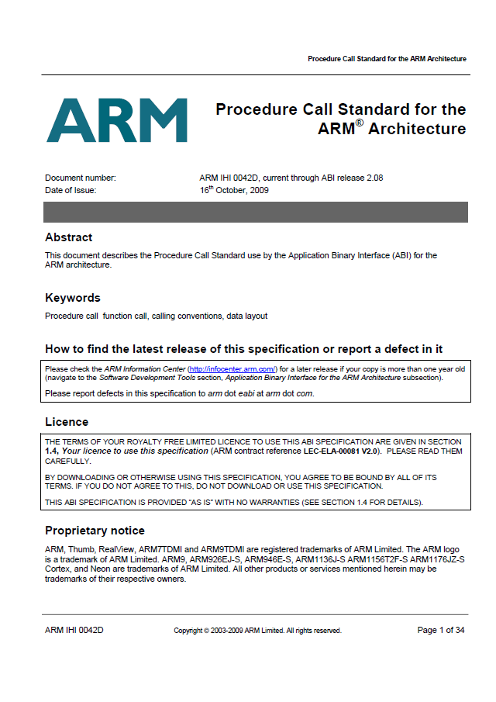
The ARM architecture “books” for this class

Slide 36
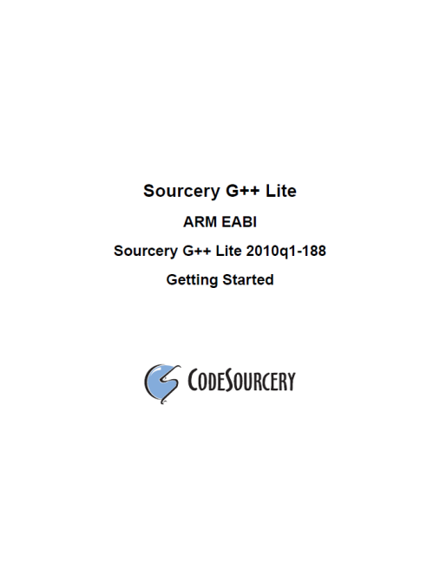
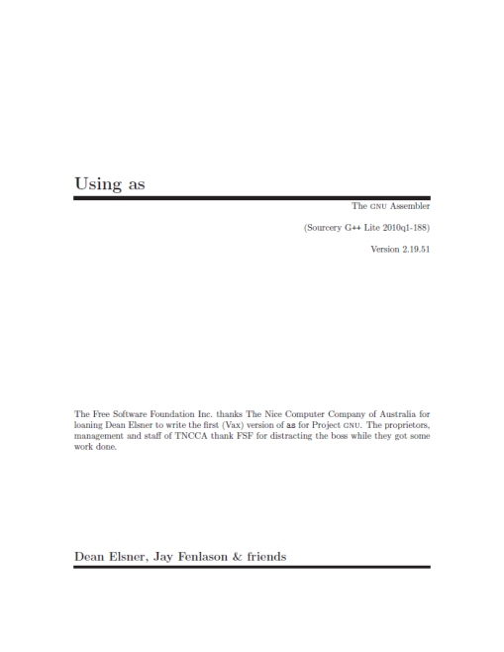
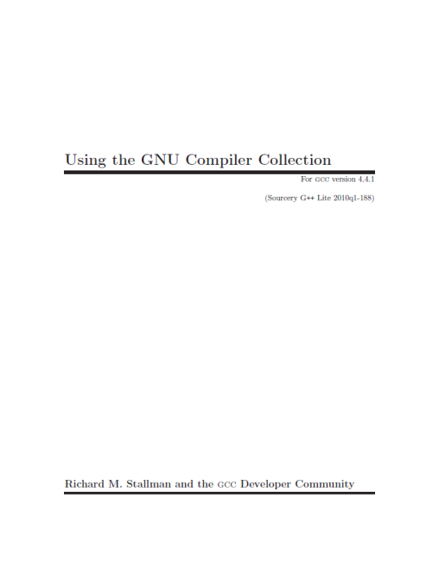
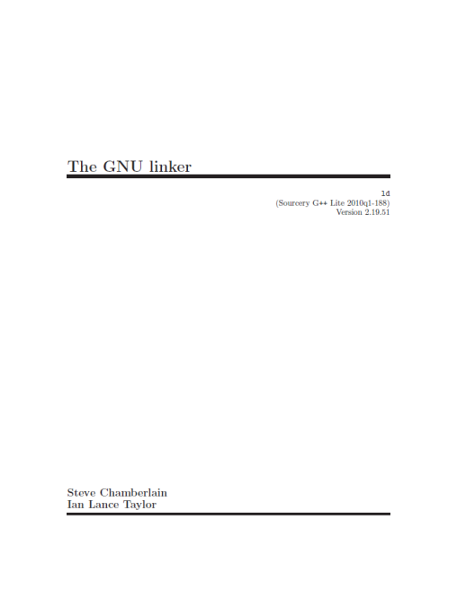
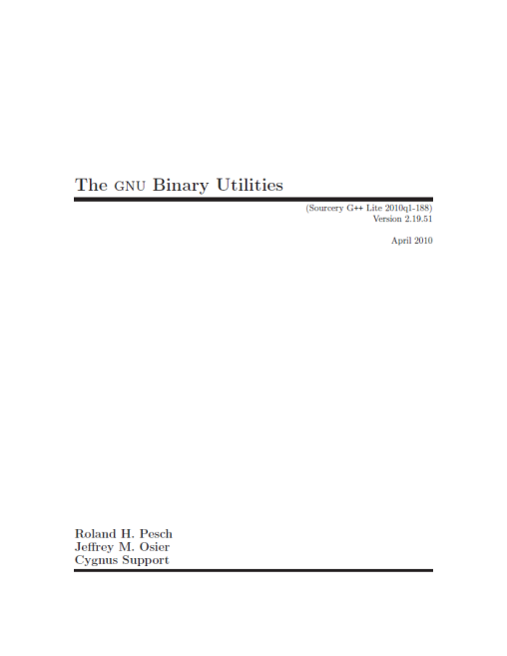
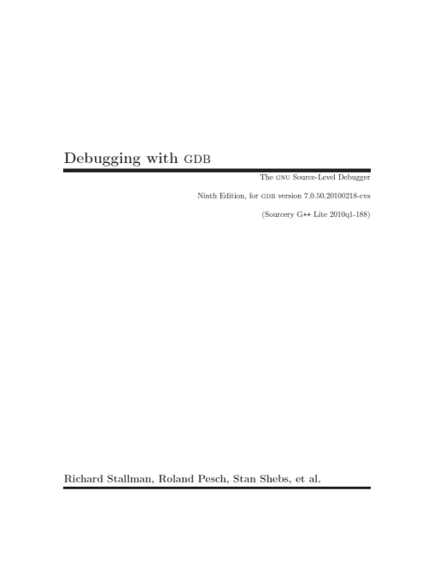
The ARM software tools “books” for this class

Slide 37
An ARM assembly language program for GNU
.equ STACK_TOP, 0x20000800
.text
.syntax unified
.thumb
.global _start
.type start, %function
_start:
.word STACK_TOP, start
start:
movs r0, #10
movs r1, #0
loop:
adds r1, r0
subs r0, #1
bne loop
deadloop:
b deadloop
.end

Slide 38
A simple Makefile
all:
arm-none-eabi-as -mcpu=cortex-m3 -mthumb example1.s -o example1.o
arm-none-eabi-ld -Ttext 0x0 -o example1.out example1.o
arm-none-eabi-objcopy -Obinary example1.out example.bin
arm-none-eabi-objdump -S example1.out > example1.list

Slide 39
An ARM assembly language program for GNU
.equ STACK_TOP, 0x20000800
.text
.syntax unified
.thumb
.global _start
.type start, %function
_start:
.word STACK_TOP, start
start:
movs r0, #10
movs r1, #0
loop:
adds r1, r0
subs r0, #1
bne loop
deadloop:
b deadloop
.end

Slide 40
Disassembled object code
example1.out: file format elf32-littlearm
Disassembly of section .text:
00000000 <_start>:
0: 20000800 .word 0x20000800
4: 00000009 .word 0x00000009
00000008 <start>:
8: 200a movs r0, #10
a: 2100 movs r1, #0
0000000c <loop>:
c: 1809 adds r1, r1, r0
e: 3801 subs r0, #1
10: d1fc bne.n c <loop>
00000012 <deadloop>:
12: e7fe b.n 12 <deadloop>

Slide 41
Today…
ARM assembly example
Walk though of the ARM ISA
Tool Flow
Start on Application Binary Interface (ABI)

Slide 42
How does an assembly language program get turned into a executable program image?
Binary program
file (.bin)
Assembly
files (.s)
Object
files (.o)
Executable
image file
objcopy
ld
(linker)
as
(assembler)
objdump
Memory
layout
Disassembled
code (.lst)
Linker
script (.ld)

Slide 43
What are the real GNU executable names for the ARM?
Just add the prefix “arm-none-eabi-” prefix
Assembler (as)
arm-none-eabi-as
Linker (ld)
arm-none-eabi-ld
Object copy (objcopy)
arm-none-eabi-objcopy
Object dump (objdump)
arm-none-eabi-objdump
C Compiler (gcc)
arm-none-eabi-gcc
C++ Compiler (g++)
arm-none-eabi-g++

Slide 44
A simple (hardcoded) Makefile example
all:
arm-none-eabi-as -mcpu=cortex-m3 -mthumb example1.s -o example1.o
arm-none-eabi-ld -Ttext 0x0 -o example1.out example1.o
arm-none-eabi-objcopy -Obinary example1.out example1.bin
arm-none-eabi-objdump -S example1.out > example1.lst

Slide 45
What information does the disassembled file provide?
all:
arm-none-eabi-as -mcpu=cortex-m3 -mthumb example1.s -o example1.o
arm-none-eabi-ld -Ttext 0x0 -o example1.out example1.o
arm-none-eabi-objcopy -Obinary example1.out example1.bin
arm-none-eabi-objdump -S example1.out > example1.lst
.equ STACK_TOP, 0x20000800
.text
.syntax unified
.thumb
.global _start
.type start, %function
_start:
.word STACK_TOP, start
start:
movs r0, #10
movs r1, #0
loop:
adds r1, r0
subs r0, #1
bne loop
deadloop:
b deadloop
.end
example1.out: file format elf32-littlearm
Disassembly of section .text:
00000000 <_start>:
0: 20000800 .word 0x20000800
4: 00000009 .word 0x00000009
00000008 <start>:
8: 200a movs r0, #10
a: 2100 movs r1, #0
0000000c <loop>:
c: 1809 adds r1, r1, r0
e: 3801 subs r0, #1
10: d1fc bne.n c <loop>
00000012 <deadloop>:
12: e7fe b.n 12 <deadloop>

Slide 46
What are the elements of a real assembly program?
.equ STACK_TOP, 0x20000800 /* Equates symbol to value */
.text /* Tells AS to assemble region */
.syntax unified /* Means language is ARM UAL */
.thumb /* Means ARM ISA is Thumb */
.global _start /* .global exposes symbol */
/* _start label is the beginning */
/* ...of the program region */
.type start, %function /* Specifies start is a function */
/* start label is reset handler */
_start:
.word STACK_TOP, start /* Inserts word 0x20000800 */
/* Inserts word (start) */
start:
movs r0, #10 /* We’ve seen the rest ... */
movs r1, #0
loop:
adds r1, r0
subs r0, #1
bne loop
deadloop:
b deadloop
.end

Slide 47
How are assembly files assembled?
$ arm-none-eabi-as
Useful options
-mcpu
-mthumb
-o
$ arm-none-eabi-as -mcpu=cortex-m3 -mthumb example1.s -o example1.o

Slide 48
How does a mixed C/Assembly program get turned into a executable program image?
C files (.c)
Binary program
file (.bin)
ld
(linker)
Assembly
files (.s)
Object
files (.o)
Executable
image file
objcopy
gcc
(compile
+ link)
as
(assembler)
objdump
Memory
layout
Disassembled
Code (.lst)
Library object
files (.o)
Linker
script (.ld)

Slide 49
Today…
ARM assembly example
Walk though of the ARM ISA
Tool Flow
Start on Application Binary Interface (ABI)

Slide 50
Outline
ARM Cortex-M3 ISA and example
Tool flow
ABI (intro)

Slide 51
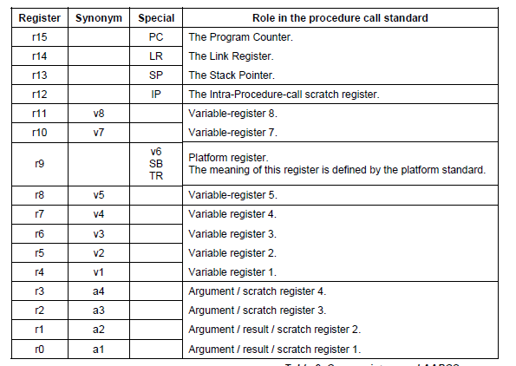

Slide 52
ABI quote
A subroutine must preserve the contents of the registers r4-r8, r10, r11 and SP (and r9 in PCS variants that designate r9 as v6).

Slide 53
Questions?
Comments?
Discussion?

