Slide 1
EECS 373
Design of Microprocessor-Based Systems
Ron Dreslinski
University of Michigan
Lecture 3: Toolchain, ABI, Memory Mapped I/O
September 14th, 2016
Slides developed in part by Prof. Dutta and Dr. Brehob

Slide 2
Announcements
HW2 Released on Friday, Due 9/26
Exam and Project Meeting Rooms/Times
Project Meeting: Monday October 10, 6:30-8pm, 1003 EECS
Midterm Exam: Monday October 24, 7-9pm, 1500 EECS
Want to learn more about hands-on embedded systems?
https://www.eecs.umich.edu/hub/
Lessons on Soldering, PCB design, and using simple boards (Arduino, etc.)
Office hours staffed by PhD students in embedded systems.
Useful for talking to about projects (either class or own).

Slide 3
Outline
Assembly wrap-up
Tool chain
ABI
Basic memory-mapped I/O

Slide 4
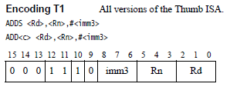
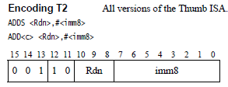


Instruction Encoding ADD immediate

Slide 5
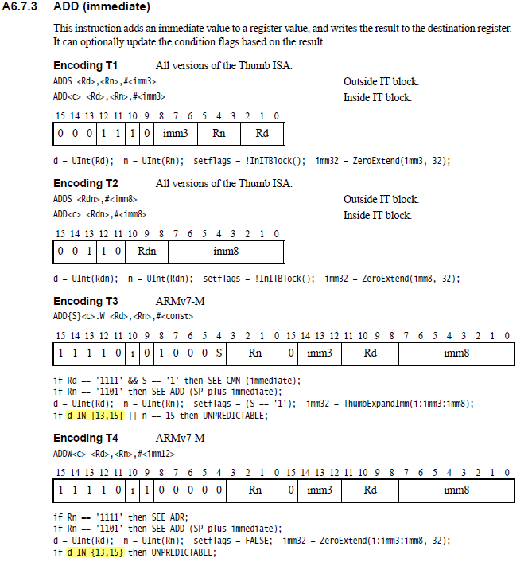

Slide 6
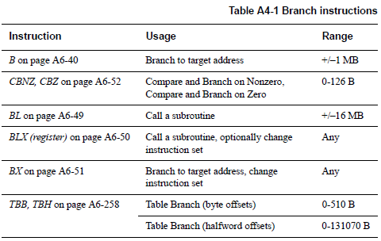
Branch

Slide 7
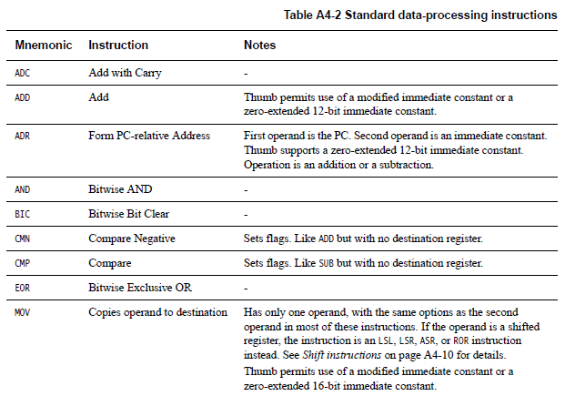
Data processing instructions
Many, Many More!

Slide 8
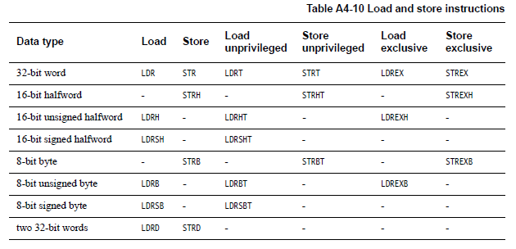
Load/Store instructions

Slide 9
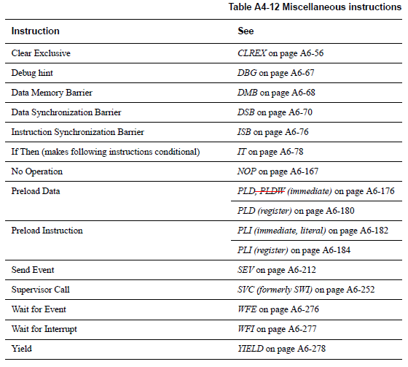
Miscellaneous instructions

Slide 10
Addressing Modes (again)
Offset Addressing
Offset is added or subtracted from base register
Result used as effective address for memory access
[<Rn>, <offset>]
Pre-indexed Addressing
Offset is applied to base register
Result used as effective address for memory access
Result written back into base register
[<Rn>, <offset>]!
Post-indexed Addressing
The address from the base register is used as the EA
The offset is applied to the base and then written back
[<Rn>], <offset>
Notes:
Condition codes are simply a way of testing the ALU status flags.

Slide 11
<offset> options
An immediate constant
#10
An index register
<Rm>
A shifted index register
<Rm>, LSL #<shift>
Lots of weird options…
Notes:
Condition codes are simply a way of testing the ALU status flags.

Slide 12
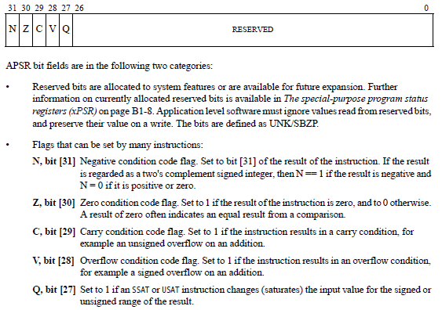
Application Program Status Register (APSR)
Notes:
Condition codes are simply a way of testing the ALU status flags.

Slide 13
Updating the APSR
SUB Rx, Ry
Rx = Rx - Ry
APSR unchanged
SUBS
Rx = Rx - Ry
APSR N, Z, C, V updated
ADD Rx, Ry
Rx = Rx + Ry
APSR unchanged
ADDS
Rx = Rx + Ry
APSR N, Z, C, V updated
Notes:
Condition codes are simply a way of testing the ALU status flags.

Slide 14
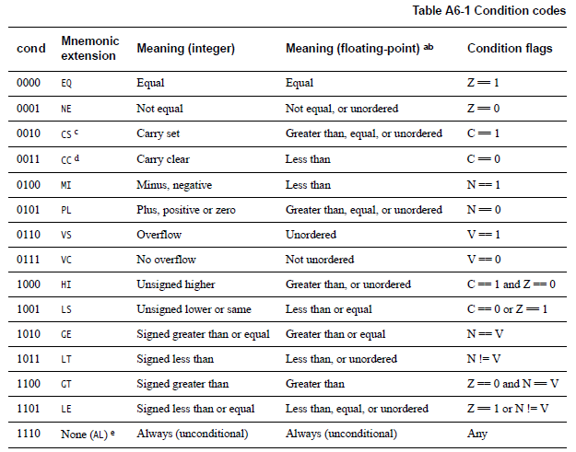
Conditional execution: Append to many instructions for conditional execution
Notes:
Condition codes are simply a way of testing the ALU status flags.

Slide 15
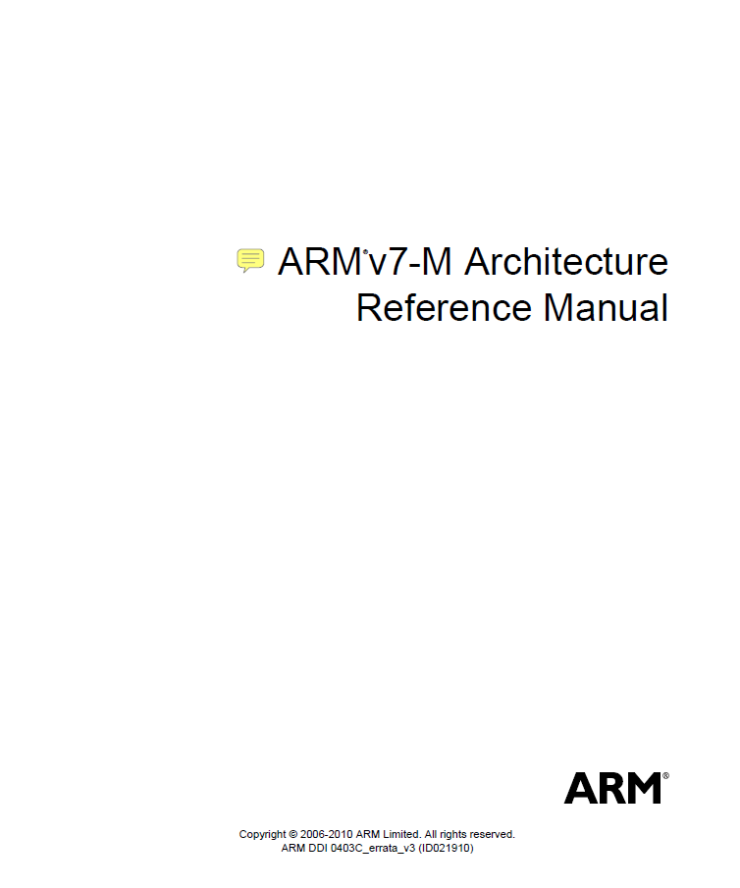
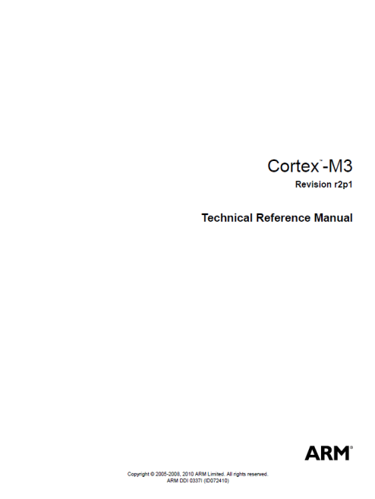
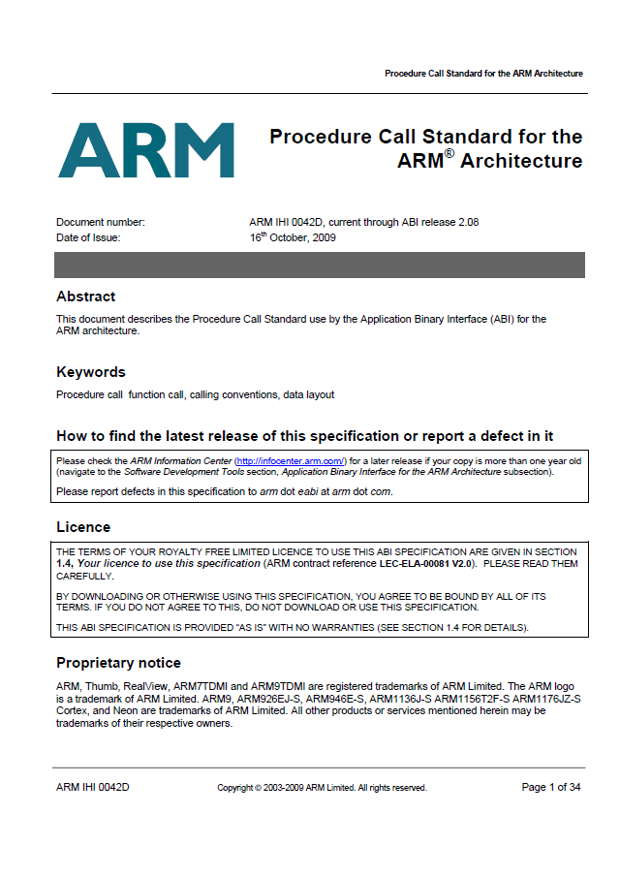



The ARM architecture “books” for this class

Slide 16
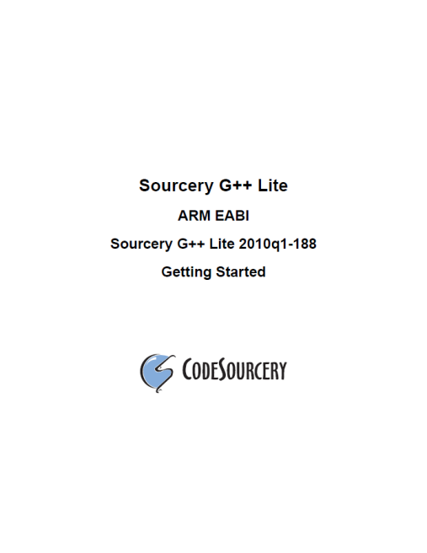
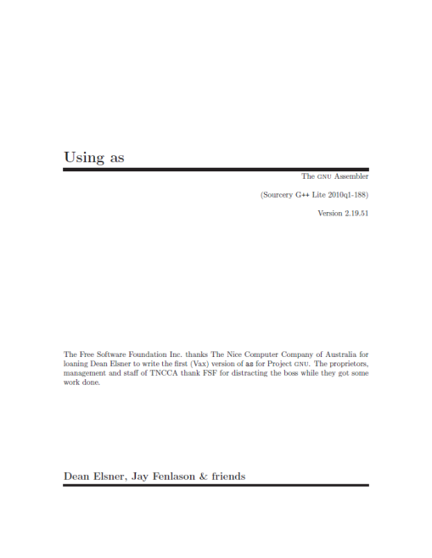
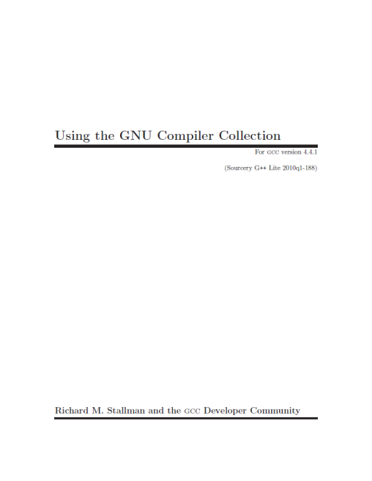
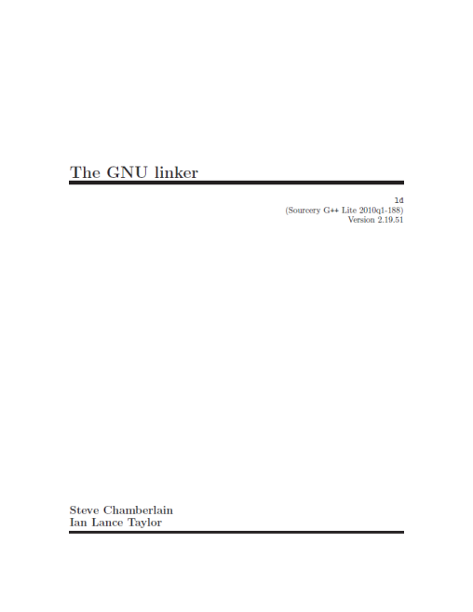
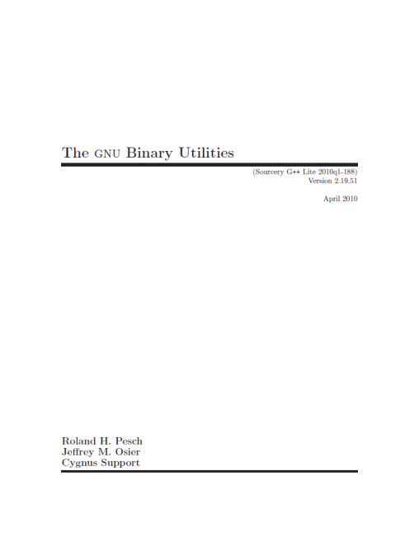
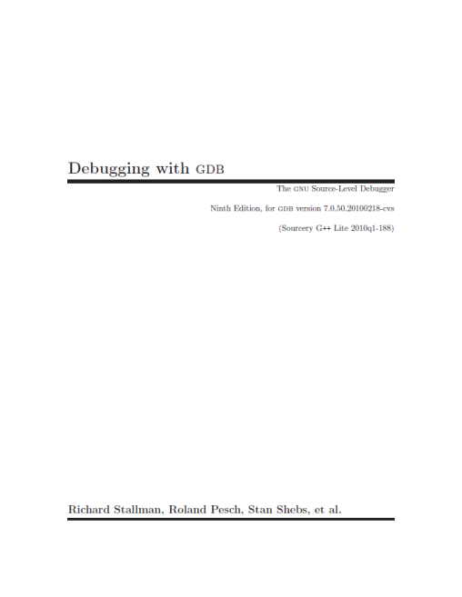
The ARM software tools “books” for this class

Slide 17
An ARM assembly language program for GNU
.equ STACK_TOP, 0x20000800
.text
.syntax unified
.thumb
.global _start
.type start, %function
_start:
.word STACK_TOP, start
start:
movs r0, #10
movs r1, #0
loop:
adds r1, r0
subs r0, #1
bne loop
deadloop:
b deadloop
.end

Slide 18
Disassembled object code
example1.out: file format elf32-littlearm
Disassembly of section .text:
00000000 <_start>:
0: 20000800 .word 0x20000800
4: 00000009 .word 0x00000009
00000008 <start>:
8: 200a movs r0, #10
a: 2100 movs r1, #0
0000000c <loop>:
c: 1809 adds r1, r1, r0
e: 3801 subs r0, #1
10: d1fc bne.n c <loop>
00000012 <deadloop>:
12: e7fe b.n 12 <deadloop>

Slide 19
Outline
Review
Tool chain
ABI
Basic memory-mapped I/O

Slide 20
A simple Makefile
all:
arm-none-eabi-as -mcpu=cortex-m3 -mthumb example1.s -o example1.o
arm-none-eabi-ld -Ttext 0x0 -o example1.out example1.o
arm-none-eabi-objcopy -Obinary example1.out example.bin
arm-none-eabi-objdump -S example1.out > example1.list

Slide 21
How does an assembly language program get turned into a executable program image?
Binary program
file (.bin)
Assembly
files (.s)
Object
files (.o)
Executable
image file
objcopy
ld
(linker)
as
(assembler)
objdump
Memory
layout
Disassembled
code (.lst)
Linker
script (.ld)

Slide 22
Linker script
OUTPUT_FORMAT("elf32-littlearm")
OUTPUT_ARCH(arm)
ENTRY(main)
MEMORY
{
/* SmartFusion internal eSRAM */
ram (rwx) : ORIGIN = 0x20000000, LENGTH = 64k
}
SECTIONS
{
.text :
{
. = ALIGN(4);
*(.text*)
. = ALIGN(4);
_etext = .;
} >ram
}
end = .;
Specifies little-endian arm in ELF format.
Specifies ARM CPU
Should start executing at label named “main”
We have 64k of memory starting at 0x20000000. You can read, write and execute out of it. We’ve named it “ram”
“.” is a reference to the current memory location
First align to a word (4 byte) boundry
Place all sections that include .text at the start (* here is a wildcard)
Define a label named _etext to be the current address.
Put it all in the memory location defined by the ram memory location.

Slide 23
What information does the disassembled file provide?
all:
arm-none-eabi-as -mcpu=cortex-m3 -mthumb example1.s -o example1.o
arm-none-eabi-ld -Ttext 0x0 -o example1.out example1.o
arm-none-eabi-objcopy -Obinary example1.out example1.bin
arm-none-eabi-objdump -S example1.out > example1.lst
.equ STACK_TOP, 0x20000800
.text
.syntax unified
.thumb
.global _start
.type start, %function
_start:
.word STACK_TOP, start
start:
movs r0, #10
movs r1, #0
loop:
adds r1, r0
subs r0, #1
bne loop
deadloop:
b deadloop
.end
example1.out: file format elf32-littlearm
Disassembly of section .text:
00000000 <_start>:
0: 20000800 .word 0x20000800
4: 00000009 .word 0x00000009
00000008 <start>:
8: 200a movs r0, #10
a: 2100 movs r1, #0
0000000c <loop>:
c: 1809 adds r1, r1, r0
e: 3801 subs r0, #1
10: d1fc bne.n c <loop>
00000012 <deadloop>:
12: e7fe b.n 12 <deadloop>

Slide 24
How does a mixed C/Assembly program get turned into a executable program image?
C files (.c)
Binary program
file (.bin)
ld
(linker)
Assembly
files (.s)
Object
files (.o)
Executable
image file
objcopy
gcc
(compile
+ link)
as
(assembler)
objdump
Memory
layout
Disassembled
Code (.lst)
Library object
files (.o)
Linker
script (.ld)

Slide 25
Outline
Review
Tool chain
ABI
Basic memory-mapped I/O

Slide 26
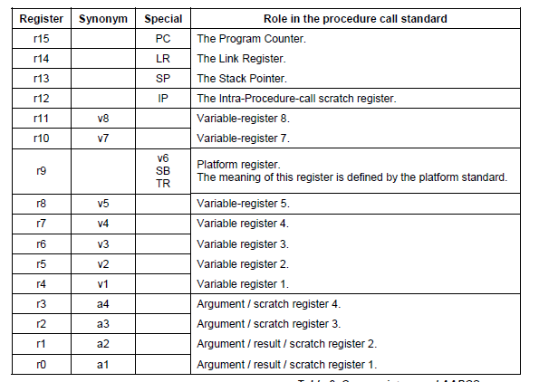

Slide 27
ABI Basic Rules
A subroutine must preserve the contents of the registers r4-11 and SP
Let’s be careful with r9 though.
Arguments are passed though r0 to r3
If we need more, we put a pointer into memory in one of the registers.
We’ll worry about that later.
Return value is placed in r0
r0 and r1 if 64-bits.
Allocate space on stack as needed. Use it as needed.
Put it back when done…
Keep word aligned.

Slide 28
Other useful factoids
Stack grows down.
And pointed to by “sp”
Address we need to go back to in “lr”
And useful things for the example
Assembly instructions
add adds two values
mul multiplies two values
bx branch to register

Slide 29
Let’s write a simple ABI routine
int bob(int a, int b)
returns a² + b²
Instructions you might need
add adds two values
mul multiplies two values
bx branch to register

Slide 30
Same thing, but for no good reason using the stack
int bob(int a, int b)
returns a² + b²

Slide 31
Some disassembly
0x20000490 <bob>: push {r7}
0x20000492 <bob+2>: sub sp, #20
0x20000494 <bob+4>: add r7, sp, #0
0x20000496 <bob+6>: str r0, [r7, #4]
0x20000498 <bob+8>: str r1, [r7, #0]
x=a*a;
0x2000049a <bob+10>: ldr r3, [r7, #4]
0x2000049c <bob+12>: ldr r2, [r7, #4]
0x2000049e <bob+14>: mul.w r3, r2, r3
0x200004a2 <bob+18>: str r3, [r7, #8]
y=b*b;
0x200004a4 <bob+20>: ldr r3, [r7, #0]
0x200004a6 <bob+22>: ldr r2, [r7, #0]
0x200004a8 <bob+24>: mul.w r3, r2, r3
0x
x=x+y;
0x200004ae <bob+30>: ldr r2, [r7, #8]
0x200004b0 <bob+32>: ldr r3, [r7, #12]
0x200004b2 <bob+34>: add r3, r2
0x200004b4 <bob+36>: str r3, [r7, #8]
0x200004ac <bob+28>: str r3, [r7, #12]
return(x);
0x200004b6 <bob+38>: ldr r3, [r7, #8]
}
0x200004b8 <bob+40>: mov r0, r3
0x200004ba <bob+42>: add.w r7, r7, #20
0x200004be <bob+46>: mov sp, r7
0x200004c0 <bob+48>: pop {r7}
0x200004c2 <bob+50>: bx lr
int bob(int a, int b)
{
int x, y;
x=a*a;
y=b*b;
x=x+y;
return(x);
}

Slide 32
Outline
Review
Tool chain
ABI
Basic memory-mapped I/O

Slide 33
Memory-mapped I/O
The idea is really simple
Instead of real memory at a given memory address, have an I/O device respond.
Huh?
Example:
Let’s say we want to have an LED turn on if we write a “1” to memory location 5.
Further, let’s have a button we can read (pushed or unpushed) by reading address 4.
If pushed, it returns a 1.
If not pushed, it returns a 0.

Slide 34
Now…
How do you get that to happen?
We could just say “magic” but that’s not very helpful.
Let’s start by detailing a simple bus and hooking hardware up to it.
We’ll work on a real bus next time!

Slide 35
Basic example
Discuss a basic bus protocol
Asynchronous (no clock)
Initiator and Target
REQ#, ACK#, Data[7:0], ADS[7:0], CMD
CMD=0 is read, CMD=1 is write.
REQ# low means initiator is requesting something.
ACK# low means target has done its job.

Slide 36
A read transaction
Say initiator wants to read location 0x24
Initiator sets ADS=0x24, CMD=0.
Initiator then sets REQ# to low. (why do we need a delay? How much of a delay?)
Target sees read request.
Target drives data onto data bus.
Target then sets ACK# to low.
Initiator grabs the data from the data bus.
Initiator sets REQ# to high, stops driving ADS and CMD
Target stops driving data, sets ACK# to high terminating the transaction

Slide 37
Read transaction
ADS[7:0]
CMD
Data[7:0]
REQ#
ACK#
??
0x24
??
??
0x55
??
A B C D E F G HI

Slide 38
A write transaction (write 0xF4 to location 0x31)
Initiator sets ADS=0x31, CMD=1, Data=0xF4
Initiator then sets REQ# to low.
Target sees write request.
Target reads data from data bus. (Just has to store in a register, need not write all the way to memory!)
Target then sets ACK# to low.
Initiator sets REQ# to high & stops driving other lines.
Target sets ACK# to high terminating the transaction

Slide 39
The push-button (if ADS=0x04 write 0 or 1 depending on button)
ADS[7]
ADS[6]
ADS[5]
Delay
ACK#
ADS[4]
ADS[3]
ADS[2]
ADS[1]
ADS[0]
Data[7]
REQ#
..
..
..
..
..
0
Button (0 or 1)
Data[0]
Button (0 or 1)

Slide 40
The push-button (if ADS=0x04 write 0 or 1 depending on button)
ADS[7]
ADS[6]
ADS[5]
Delay
ACK#
ADS[4]
ADS[3]
ADS[2]
ADS[1]
ADS[0]
Data[7]
REQ#
..
..
..
..
..
0
What about CMD?
Data[0]
Button (0 or 1)

Slide 41
The LED (1 bit reg written by LSB of address 0x05)
ADS[7]
ADS[6]
ADS[5]
Delay
ACK#
ADS[4]
ADS[3]
ADS[2]
ADS[1]
ADS[0]
Flip-flop which controls LED
D
REQ#
clock
DATA[7]
DATA[6]
DATA[5]
DATA[4]
DATA[3]
DATA[2]
DATA[1]
DATA[0]

Slide 42
Let’s write a simple assembly program Light on if button is pressed, off if not.
What if you wanted it to toggle each time the button was pressed?

