Slide 1
EECS 373
Design of Microprocessor-Based Systems
Ron Dreslinski
University of Michigan
Lecture 4: Bit of assembly, Memory-mapped I/O, APB
September 19, 2016

Slide 2
Admin
HW2 is now posted.
HW1 answers posted as well.

Slide 3
Today
Memory-mapped I/O
Bus Architectures
ARM AHB-Lite

Slide 4
Memory-mapped I/O
The idea is really simple
  Instead of real memory at a given memory address, have an I/O device respond.
    Huh?
Example:
  Let’s say we want to have an LED turn on if we write a “1” to memory location 5.
  Further, let’s have a button we can read (pushed or unpushed) by reading address 4.
    If pushed, it returns a 1.
    If not pushed, it returns a 0.

Slide 5
Now…
How do you get that to happen?
  We could just say “magic” but that’s not very helpful.
  Let’s start by detailing a simple bus and hooking hardware up to it.
We’ll work on a real bus next time!

Slide 6
Basic example
Discuss a basic bus protocol
  Asynchronous (no clock)
  Initiator and Target
  REQ#, ACK#, Data[7:0], ADS[7:0], CMD
    CMD=0 is read, CMD=1 is write.
    REQ# low means initiator is requesting something.
    ACK# low means target has done its job.

Slide 7
A read transaction
Say initiator wants to read location 0x24
  Initiator sets ADS=0x24, CMD=0.
  Initiator then sets REQ# to low. (why do we need a delay? How much of a delay?)
  Target sees read request.
  Target drives data onto data bus.
  Target then sets ACK# to low.
  Initiator grabs the data from the data bus.
  Initiator sets REQ# to high, stops driving ADS and CMD
  Target stops driving data, sets ACK# to high terminating the transaction.
  Bus is seen to be idle.

Slide 8
Read transaction
ADS[7:0]
CMD
Data[7:0]
REQ#
ACK#
??
0x24
??
??
0x55
??
A B C D E F G HI

Slide 9
A write transaction
(write 0xF4 to location 0x31)
  Initiator sets ADS=0x31, CMD=1, Data=0xF4
  Initiator then sets REQ# to low.
  Target sees write request.
  Target reads data from data bus. (Just has to store in a register, need not write all the way to memory!)
  Target then sets ACK# to low.
  Initiator sets REQ# to high & stops driving other lines.
  Target sets ACK# to high terminating the transaction

Slide 10
The push-button
(if ADS=0x04 write 0 or 1 depending on button)
ADS[7]
ADS[6]
ADS[5]
Delay
ACK#
ADS[4]
ADS[3]
ADS[2]
ADS[1]
ADS[0]
Data[7]
REQ#
..
..
..
..
..
0
Button (0 or 1)
Data[0]
Button (0 or 1)

Slide 11
The push-button
(if ADS=0x04 write 0 or 1 depending on button)
ADS[7]
ADS[6]
ADS[5]
Delay
ACK#
ADS[4]
ADS[3]
ADS[2]
ADS[1]
ADS[0]
Data[7]
REQ#
..
..
..
..
..
0
What about CMD?
Data[0]
Button (0 or 1)

Slide 12
The LED
(1 bit reg written by LSB of address 0x05)
ADS[7]
ADS[6]
ADS[5]
Delay
ACK#
ADS[4]
ADS[3]
ADS[2]
ADS[1]
ADS[0]
Flip-flop which controls LED
D
REQ#
clock
DATA[7]
DATA[6]
DATA[5]
DATA[4]
DATA[3]
DATA[2]
DATA[1]
DATA[0]

Slide 13
Let’s write a simple assembly program
Light on if button is pressed.

Slide 14
Outline
Finish up example
Bus Architectures
ARM AHB-Lite

Slide 15
What happens when this “instruction” executes?
#include <stdio.h>
#include <inttypes.h>
#define REG_FOO 0x40000140
main () {
uint32_t *reg = (uint32_t *)(REG_FOO);
*reg += 3;
printf(“0x%x\n”, *reg); // Prints out new value
}

Slide 16
“*reg += 3” is turned into a ld, add, str sequence
Load instruction
  A bus read operation commences
  The CPU drives the address “reg” onto the address bus
  The CPU indicated a read operation is in process (e.g. R/W#)
  Some “handshaking” occurs
  The target drives the contents of “reg” onto the data lines
  The contents of “reg” is loaded into a CPU register (e.g. r0)
Add instruction
  An immediate add (e.g. add r0, #3) adds three to this value
Store instruction
  A bus write operation commences
  The CPU drives the address “reg” onto the address bus
  The CPU indicated a write operation is in process (e.g. R/W#)
  Some “handshaking” occurs
  The CPU drives the contents of “r0” onto the data lines
  The target stores the data value into address “reg”

Slide 17
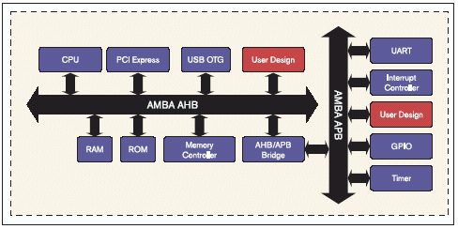
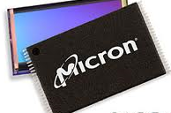

Details of the bus “handshaking” depend on the particular memory/peripherals involved
SoC memory/peripherals
  AMBA AHB/APB
NAND Flash
  Open NAND Flash Interface (ONFI)
DDR SDRAM
  JEDEC JESD79, JESD79-2F, etc.

Slide 18
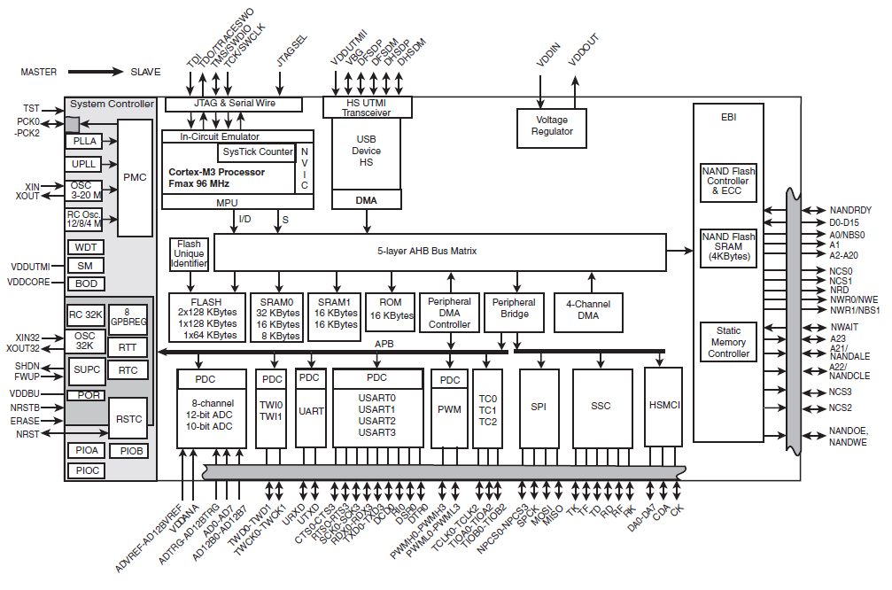
Modern embedded systems have multiple busses
Atmel SAM3U
Expanded
373 focus
Traditional
373 focus

Slide 19
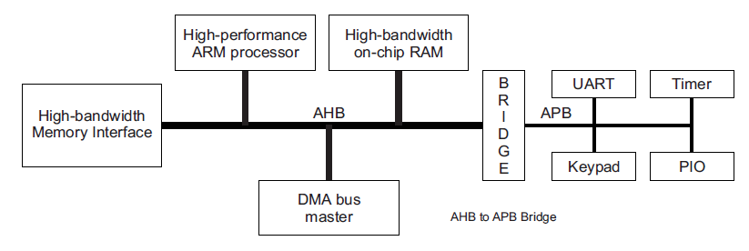
Advanced Microcontroller Bus Architecture (AMBA)
- Advanced High-performance Bus (AHB)
- Advanced Peripheral Bus (APB)
AHB
APB
High performance
Pipelined operation
Burst transfers
Multiple bus masters
Split transactions
Low power
Latched address/control
Simple interface
Suitable of many peripherals

Slide 20
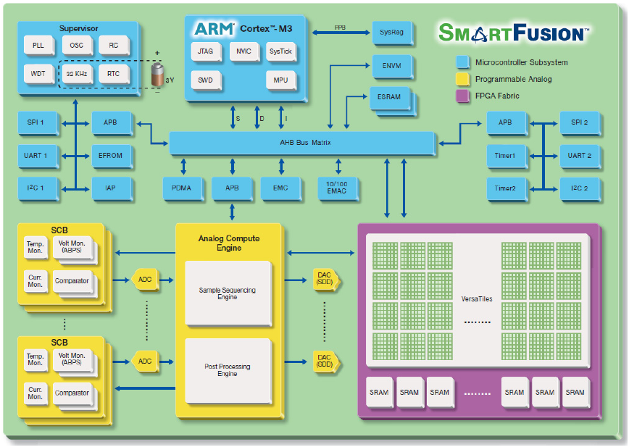
Actel SmartFusion system/bus architecture

Slide 21
Bus terminology
Any given transaction have an “initiator” and “target”
Any device capable of being an initiator is said to be a “bus master”
  In many cases there is only one bus master (single master vs. multi-master).
A device that can only be a target is said to be a slave device.
Some wires might be shared among all devices while others might be point-to-point connections (generally connecting the master to each target).

Slide 22
Driving shared wires
It is commonly the case that some shared wires might have more than one potential device that needs to drive them.
  For example there might be a shared data bus that is used by the targets and the initiator. We saw this in the simple bus.
  In that case, we need a way to allow one device to control the wires while the others “stay out of the way”
    Most common solutions are:
      using tri-state drivers (so only one device is driving the bus at a time)
      using open-collector connections (so if any device drives a 0 there is a 0 on the bus otherwise there is a 1)

Slide 23
Or just say no to shared wires.
Another option is to not share wires that could be driven by more than one device...
  This can be really expensive.
    Each target device would need its own data bus.
    That’s a LOT of wires!
  Not doable when connecting chips on a PCB as you are paying for each pin.
  Quite doable (though not pretty) inside of a chip.

Slide 24
Wire count
Say you have a single-master bus with 5 other devices connected and a 32-bit data bus.
  If we share the data bus using tri-state connections, each device has “only” 32-pins.
  If each device that could drive data has it’s own bus…
    Each slave would need _____ pins for data
    The master would need ______ pins for data
Again, recall pins==$$$$$$.

Slide 25
Outline
Finish up example
Bus Architectures
ARM APB

Slide 26
APB is a fairly simple bus designed to be easy to work with.
Low-cost
Low-power
Low-complexity
Low-bandwidth
Non-pipelined
Ideal for peripherals

Slide 27
Let’s just look at APB writes (Master writing to device) as a starting point.
We’ll add reads shortly.

Slide 28
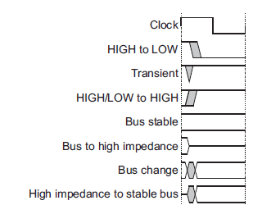
Notation

Slide 29
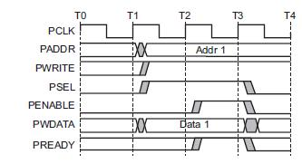
APB bus signals
PCLK
  Clock
PADDR
  Address on bus
PWRITE
  1=Write, 0=Read
PWDATA
  Data written to the I/O device. Supplied by the bus master/processor.

Slide 30
APB bus signals
PSEL
  Asserted if the current bus transaction is targeted to this device
PENABLE
  High during entire transaction other than the first cycle.
PREADY
  Driven by target. Similar to our #ACK. Indicates if the target is ready to do transaction.
  Each target has it’s own PREADY

Slide 31
So what’s happening here?

Slide 32
Example setup
For the next couple of slides, we will assume we have one bus master “CPU” and two slave devices (D1 and D2)
  D1 is mapped to address 0x00001000-0x0000100F
  D2 is mapped to 0x00001010-0x0000101F

Slide 33
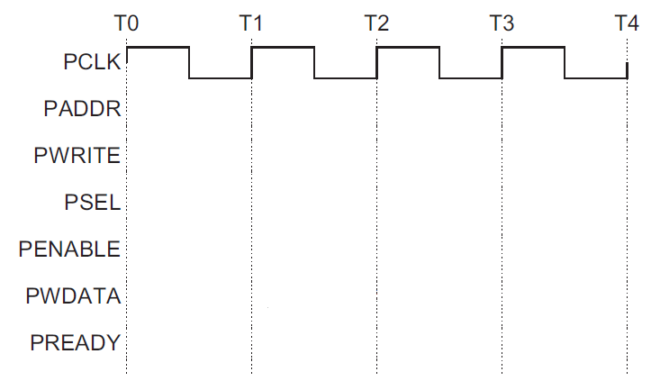
Say the CPU does a store to location 0x00001004 with no stalls
D1
D2

Slide 34
Design a device which writes to a register whenever any address in its range is written
What if we want to have the LSB of this register control an LED?
PWDATA[31:0]
PWRITE
PENABLE
PSEL
PADDR[7:0]
PCLK
PREADY
32-bit Reg
D[31:0]
Q[31:0]
EN
C
We are assuming APB only gets lowest 8 bits of address here…

Slide 35
Reg A should be written at address 0x00001000
Reg B should be written at address 0x00001004
PWDATA[31:0]
PWRITE
PENABLE
PSEL
PADDR[7:0]
PCLK
PREADY
32-bit Reg A
D[31:0]
Q[31:0]
EN
C
32-bit Reg B
D[31:0]
Q[31:0]
EN
C
We are assuming APB only gets lowest 8 bits of address here…

Slide 36
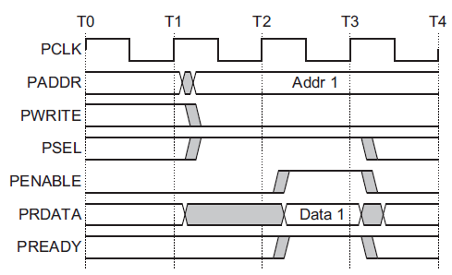
Reads…
The key thing here is that each slave device has its own read data (PRDATA) bus!
Recall that “R” is from the initiator’s viewpoint—the device drives data when read.

Slide 37
Let’s say we want a device that provides data from a switch on a read to any address it is assigned.
(so returns a 0 or 1)
PRDATA[31:0]
PWRITE
PENABLE
PSEL
PADDR[7:0]
PCLK
PREADY
Mr. Switch

Slide 38
Device provides data from switch A if address
0x00001000 is read from. B if address 0x00001004 is read from
PRDATA[31:0]
PWRITE
PENABLE
PSEL
PADDR[7:0]
PCLK
PREADY
Switch A
Switch B

Slide 39
All reads read from register, all writes write…
PWDATA[31:0]
PWRITE
PENABLE
PSEL
PADDR[7:0]
PCLK
PREADY
32-bit Reg
D[31:0]
Q[31:0]
EN
C
We are assuming APB only gets lowest 8 bits of address here…

Slide 40
Things left out…
There is another signal, PSLVERR (APB Slave Error) which we can drive high if things go bad.
  We’ll just tie that to 0.
Notice we are assuming that our device need not stall.
  We could stall if we needed.
    I can’t find a limit on how long, but I suspect at some point the processor would generate an error.

Slide 41
Verilog!

Slide 42
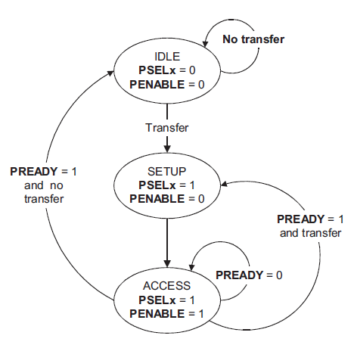
APB state machine
IDLE
  Default APB state
SETUP
  When transfer required
  PSELx is asserted
  Only one cycle
ACCESS
  PENABLE is asserted
  Addr, write, select, and write data remain stable
  Stay if PREADY = L
  Goto IDLE if PREADY = H and no more data
  Goto SETUP is PREADY = H and more data pending
We’ll spend a bit more time
on this next week…

Slide 43
Questions?
Comments?
Discussion?

