Slide 1
EECS 373
Design of Microprocessor-Based Systems
Ron Dreslinski
University of Michigan
Lecture 5: Memory-mapped I/O review, APB, start interrupts. Mostly APB though ☺
September 21st 2016

Slide 2
Reading
Read sections 8.1 and 12.1 of LeeSeshia (see references page)
  It’s a decent overview of processor types & scheduling
  Don’t worry about understanding their FIR filter example
    Just the idea why I might want specialized digitial signal processors.
The whole book is a very interesting take on embedded processors
  Focused on modeling and simulation

Slide 3
Today
Memory-mapped I/O and bus architecture review
ARM’s APB bus in detail
Start on interrupts

Slide 4
Memory-mapped I/O
The idea is really simple
  Instead of real memory at a given memory address, have an I/O device respond.
    Huh?
Example (this time word aligned)
  Let’s say we want to have an LED turn on if we write a “1” to memory location 8.
  Further, let’s have a button we can read (pushed or unpushed) by reading address 4.
    If pushed, it returns a 1.
    If not pushed, it returns a 0.

Slide 5
Write button pressed=LED on in C.
#define SW ((volatile uint32 *) 0x4)
#define LED ((volatile uint32 *) 0x8)
main(int argc, char * argv[])
{
while(1)
*LED=*SW;
}
What is uint32?
Why volatile? What does that do?
Could I get rid of the dereference in the code? Should I?

Slide 6
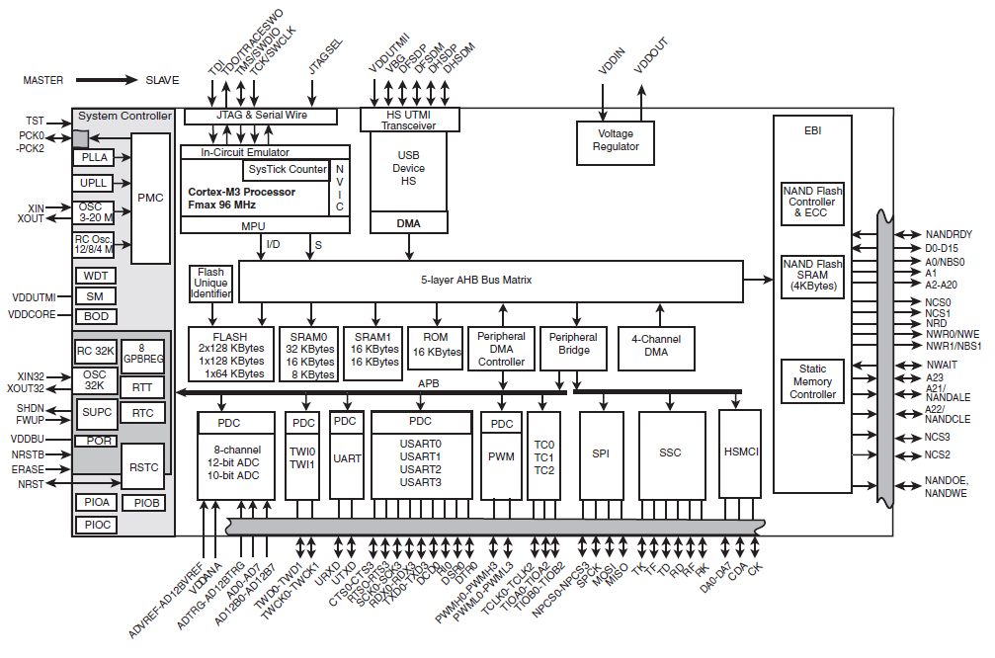
Modern embedded systems have multiple busses
Atmel SAM3U
Expanded
373 focus
Historical
373 focus

Slide 7
Bus terminology
Any given transaction have an “initiator” and “target”
Any device capable of being an initiator is said to be a “bus master”
  In many cases there is only one bus master (single master vs. multi-master).
A device that can only be a target is said to be a slave device.
Some wires might be shared among all devices while others might be point-to-point connections (generally connecting the master to each target).

Slide 8
Today
Memory-mapped I/O and bus architecture review
ARM’s APB bus in detail
Start on interrupts

Slide 9
APB is a fairly simple bus designed to be easy to work with.
Low-cost
Low-power
Low-complexity
Low-bandwidth
Non-pipelined
Ideal for peripherals

Slide 10
Let’s just look at APB writes (Master writing to device) as a starting point.
We’ll add reads shortly.

Slide 11
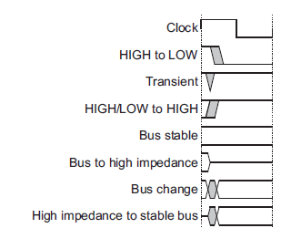
Notation

Slide 12
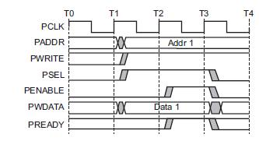
APB bus signals
PCLK
  Clock
PADDR
  Address on bus
PWRITE
  1=Write, 0=Read
PWDATA
  Data written to the I/O device. Supplied by the bus master/processor.

Slide 13
APB bus signals
PSEL
  Asserted if the current bus transaction is targeted to this device
PENABLE
  High during entire transaction other than the first cycle.
PREADY
  Driven by target. Similar to our #ACK. Indicates if the target is ready to do transaction.
  Each target has it’s own PREADY

Slide 14
Single Master, Multiple Slave Devices

Slide 15
So what’s happening here?

Slide 16
Example setup
For the next couple of slides, we will assume we have one bus master “CPU” and two slave devices (D1 and D2)
  D1 is mapped to address
  0x00001000-0x0000100F
  D2 is mapped to addresses
  0x00001010-0x0000101F

Slide 17
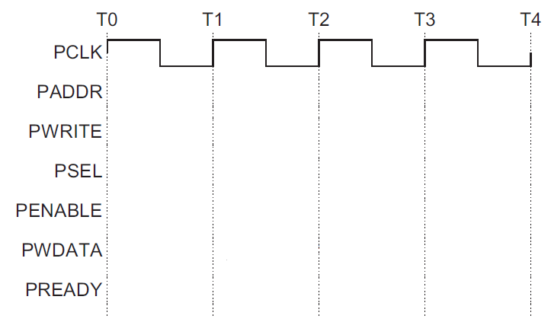
Say the CPU does a store to location 0x00001004 with no stalls
D1
D2

Slide 18
Design a device which writes to a register whenever any address in its range is written
What if we want to have the LSB of this register control an LED?
PWDATA[31:0]
PWRITE
PENABLE
PSEL
PADDR[7:0]
PCLK
PREADY
32-bit Reg
D[31:0]
Q[31:0]
EN
C
We are assuming APB only gets lowest 8 bits of address here…

Slide 19
Reg A should be written at address 0x00001000
Reg B should be written at address 0x00001004
PWDATA[31:0]
PWRITE
PENABLE
PSEL
PADDR[7:0]
PCLK
PREADY
32-bit Reg A
D[31:0]
Q[31:0]
EN
C
32-bit Reg B
D[31:0]
Q[31:0]
EN
C
We are assuming APB only gets lowest 8 bits of address here…

Slide 20
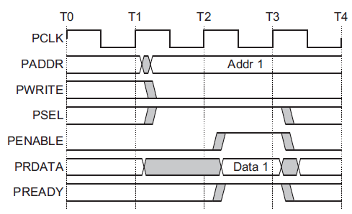
Reads…
The key thing here is that each slave device has its own read data (PRDATA) bus!

Slide 21
Let’s say we want a device that provides data from a switch on a read to any address it is assigned.
(so returns a 0 or 1)
PRDATA[31:0]
PWRITE
PENABLE
PSEL
PADDR[7:0]
PCLK
PREADY
Mr. Switch

Slide 22
Device provides data from switch A if address
0x00001000 is read from. B if address 0x00001004 is read from
PRDATA[31:0]
PWRITE
PENABLE
PSEL
PADDR[7:0]
PCLK
PREADY
Switch A
Switch B

Slide 23
All reads read from register, all writes write…
PWDATA[31:0]
PWRITE
PENABLE
PSEL
PADDR[7:0]
PCLK
PREADY
32-bit Reg
D[31:0]
Q[31:0]
EN
C
We are assuming APB only gets lowest 8 bits of address here…

Slide 24
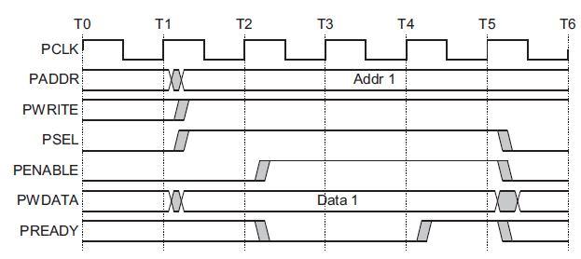
A write transfer with wait states
Setup phase begins
with this rising edge
Setup
Phase
Wait
State
Wait
State
Access
Phase

Slide 25
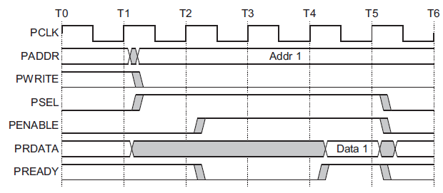
A read transfer with wait states
Setup phase begins
with this rising edge
Setup
Phase
Wait
State
Wait
State
Access
Phase

Slide 26
Things left out…
There is another signal, PSLVERR (APB Slave Error) which we can drive high if things go bad.
  We’ll just tie that to 0.
Notice we are assuming that our device need not stall.
  We could stall if we needed.
    I can’t find a limit on how long, but I suspect at some point the processor would generate an error.

Slide 27
Verilog!

Slide 28
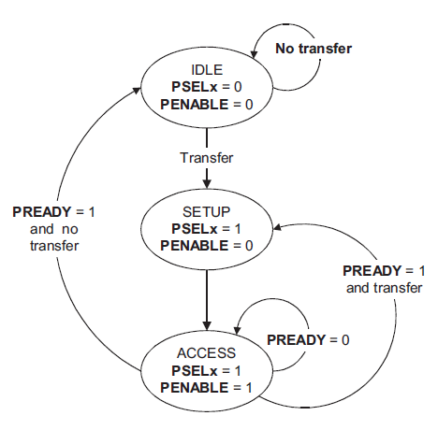
APB state machine
IDLE
  Default APB state
SETUP
  When transfer required
  PSELx is asserted
  Only one cycle
ACCESS
  PENABLE is asserted
  Addr, write, select, and write data remain stable
  Stay if PREADY = L
  Goto IDLE if PREADY = H and no more data
  Goto SETUP is PREADY = H and more data pending
We’ll spend a bit more time
on this next week…

Slide 29
Today
Memory-mapped I/O and bus architecture review
ARM’s APB bus in detail
Start on interrupts

Slide 30
Interrupts
Merriam-Webster:
  “to break the uniformity or continuity of”
Informs a program of some external events
Breaks execution flow
Key questions:
Where do interrupts come from?
How do we save state for later continuation?
How can we ignore interrupts?
How can we prioritize interrupts?
How can we share interrupts?

Slide 31
I/O Data Transfer
Two key questions to determine how data is transferred to/from a non-trivial I/O device:
  How does the CPU know when data is available?
    Polling
    Interrupts
  How is data transferred into and out of the device?
    Programmed I/O
    Direct Memory Access (DMA)

Slide 32
Interrupts
Interrupt (a.k.a. exception or trap):
An event that causes the CPU to stop executing the current program and begin executing a special piece of code called an interrupt handler or interrupt service routine (ISR). Typically, the ISR does some work and then resumes the interrupted program.
Interrupts are really glorified procedure calls, except that they:
  can occur between any two instructions
  are transparent to the running program (usually)
  are not explicitly requested by the program (typically)
  call a procedure at an address determined by the type of interrupt, not the program

Slide 33
Two basic types of interrupts
(1/2)
Those caused by an instruction
  Examples:
    TLB miss
    Illegal/unimplemented instruction
    div by 0
  Names:
    Trap, exception

Slide 34
Two basic types of interrupts
(2/2)
Those caused by the external world
  External device
  Reset button
  Timer expires
  Power failure
  System error
Names:
  interrupt, external interrupt

Slide 35
How it works
Something tells the processor core there is an interrupt
Core transfers control to code that needs to be executed
Said code “returns” to old program
Much harder then it looks.
  Why?

Slide 36
… is in the details
How do you figure out where to branch to?
How do you ensure that you can get back to where you started?
Don’t we have a pipeline? What about partially executed instructions?
What if we get an interrupt while we are processing our interrupt?
What if we are in a “critical section?”

Slide 37
Where
If you know what caused the interrupt then you want to jump to the code that handles that interrupt.
  If you number the possible interrupt cases, and an interrupt comes in, you can just branch to a location, using that number as an offset (this is a branch table)
  If you don’t have the number, you need to poll all possible sources of the interrupt to see who caused it.
    Then you branch to the right code

Slide 38
Get back to where you once belonged
Need to store the return address somewhere.
  Stack might be a scary place.
    That would involve a load/store and might cause an interrupt (page fault)!
  So a dedicated register seems like a good choice
    But that might cause problems later…

Slide 39
Snazzy architectures
A modern processor has many (often 50+) instructions in-flight at once.
  What do we do with them?
Drain the pipeline?
  What if one of them causes an exception?
Punt all that work
  Slows us down
What if the instruction that caused the exception was executed before some other instruction?
  What if that other instruction caused an interrupt?

Slide 40
Nested interrupts
If we get one interrupt while handling another what to do?
  Just handle it
    But what about that dedicated register?
    What if I’m doing something that can’t be stopped?
  Ignore it
    But what if it is important?
  Prioritize
    Take those interrupts you care about. Ignore the rest
    Still have dedicated register problems.

Slide 41
Critical section
We probably need to ignore some interrupts but take others.
  Probably should be sure our code can’t cause an exception.
  Use same prioritization as before.

Slide 42
Our processor
Over 100 interrupt sources
  Power on reset, bus errors, I/O pins changing state, data in on a serial bus etc.
Need a great deal of control
  Ability to enable and disable interrupt sources
  Ability to control where to branch to for each interrupt
  Ability to set interrupt priorities
    Who wins in case of a tie
    Can interrupt A interrupt the ISR for interrupt B?
      If so, A can “preempt” B.
All that control will involve memory mapped I/O.
  And given the number of interrupts that’s going to be a pain in the rear.

Slide 43
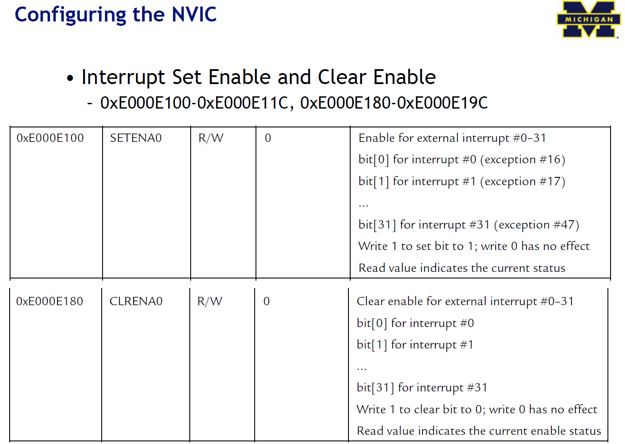
Enabling and disabling interrupt sources

Slide 44
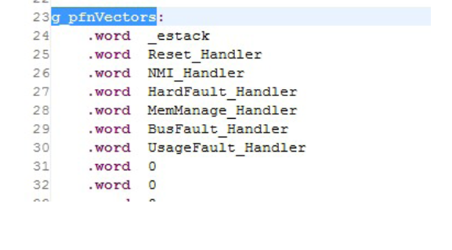
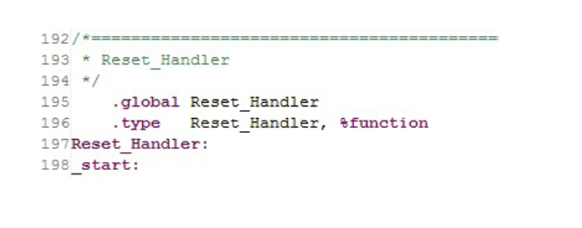
How to know where to go on an interrupt.

