Slide 1
EECS 373
Design of Microprocessor-Based Systems
Ron Dreslinski
University of Michigan
Lecture 6 & 7: Interrupts (end of slides on Wednesday)
September 26th & 28th
Exceptions, Traps, Faults & ARM’s Nested Vectored Interrupt Controller
Slides developed in part by Prabal Dutta and Mark Brehob

Slide 2
Administrative
HW2 Due Today
Prof. Dreslinski Office hours changed this week, they will be:
  Tuesday 2:30-3:30pm
  Wednesday 3-4pm
Fire Alarm Testing on Wednesday @1:30
  WE WILL HAVE CLASS

Slide 3
This Week: Interrupts, exceptions, traps, faults, & NVIC
traps &
exceptions
C
Assembly
Machine Code
CPU
EECS 370
Software
Hardware
ldr (read)
str (write)
ISA
SVC#
fault
INT#
interrupts
System Buses
AHB/APB
Interrupts
GPIO/INT
Timers
USART
DAC/ADC
Internal &
External
Memory
Internal
External
Input
I2C
SPI
ADC
DAC
EMC
Output
Capture
UART
Interrupt
Compare

Slide 4
Dealing with asynchronous events
Many sources of “events” during program execution
  Application makes a system call
  Software executes instruction illegally (e.g. divides by zero)
  Peripheral needs attention or has completed a requested action
How do we know that an event has occurred?
Broadly, two options to “detect” events
  Polling
    We can repeatedly poll the app/processor/peripherals
    When an event occurs, detect this via a poll and take action
  Interrupts
    Let the app/processors/peripheral notify us instead
    Take action when such a notification occurs (or shortly later)

Slide 5
Polling-Driven Application
Recall pushbutton-LED example
  mov r0, #0x4 % PBS MMIO address
  mov r1, #0x5 % LED MMIO address
  loop: ldr r2, [r0, #0] % Read value from switch [1 cycle]
  str r2 [r1, #0] % Save value to LED [1 cycle]
  b loop % Repeat these steps [1 cycle]
This is a polling-driven application
Software constantly loops, polling and (re)acting
However, it doesn’t do anything else useful!
Notes:
mov r0, #0x4 % PB
mov r1, #0x5 % LED
loop: ldr r2, [r0, #0]
str r2 [r1, #0]
b loop

Slide 6
The Problem with Polling
If we want to do other work, we might call a routine:
  mov r0, #0x4 % PBS MMIO address
  mov r1, #0x5 % LED MMIO address
  loop: ldr r2, [r0, #0] % Read value from switch [1 cycle]
  str r2 [r1, #0] % Save value to LED [1 cycle]
  bl do_some_work % Do some other work [100 cycles]
  b loop % Repeat these steps [1 cycle]
Polling affects the responsiveness of PBS ⬄ LED path!
  Whenever we’re “doing some work,” we not polling PBS
  And the more “other work” we do, the worse the latency gets
And it affects the efficiency of the processor
  The ldr/str values don’t change very either much
  So, the processor is mostly wasting CPU cycles (and energy)
Notes:
LDR % Assume PBS changes just after sampling, so latency = 1 cycle
STR % latency += 1 cycle
B % latency += 1 cycle
Delay? So LDR (1, just missed) + STR (1) + B (1) + LDR (1) + STR (1) ~ 5 cycles asymptotic worst case
Efficiency? Well, its basically zero since we’re not doing any useful work, so ~ 0%
LDR % Assume PBS changes just after sampling, so latency = 1 cycle
STR % latency += 1 cycle
BL % latency += 100 cycles
B % latency += 1 cycle
Delay? So LDR (1, just missed) + STR (1) + BL (100) + B (1) + LDR (1) + STR (1) ~ 105 cycles asymptotic worst case
Efficiency? BL (100) / [LDR (1) + STR (1) + BL (100) + B (1)] ~ 100/103, so ~ 97%

Slide 7
Polling trades off efficiency and responsiveness
mov r0, #0x4 % PBS MMIO address
mov r1, #0x5 % LED MMIO address
loop: ldr r2, [r0, #0] % Read value from switch [1 cycle]
str r2 [r1, #0] % Save value to LED [1 cycle]
bl do_some_work % Do some other work [100 cycles]
b loop % Repeat these steps [1 cycle]
Efficiency
  Minimizing useless work
  Maximizing useful work
  Saving cycles & energy
Responsiveness
  Minimizing latency
  Tight event-action coupling
Can we do better? Yes!
Efficiency
Responsiveness

Slide 8
Interrupts
Merriam-Webster:
  “to break the uniformity or continuity of”
Informs a program of some external events
Breaks execution flow
Key questions:
Where do interrupts come from?
How do we save state for later continuation?
How can we ignore interrupts?
How can we prioritize interrupts?
How can we share interrupts?

Slide 9
Interrupts
Interrupt (a.k.a. exception or trap):
An event that causes the CPU to stop executing current program
Begin executing a special piece of code
  Called an interrupt handler or interrupt service routine (ISR)
    Typically, the ISR does some work
    Then resumes the interrupted program
Interrupts are really glorified procedure calls, except that they:
  Can occur between any two instructions
  Are “transparent” to the running program (usually)
  Are not explicitly requested by the program (typically)
  Call a procedure at an address determined by the type of interrupt, not the program

Slide 10
Two basic types of interrupts
(1/2)
Those caused by an instruction
  Examples:
    TLB miss
    Illegal/unimplemented instruction
    div by 0
    SVC (supervisor call, e.g.: SVC #3)
  Names:
    Trap, exception

Slide 11
Two basic types of interrupts
(2/2)
Those caused by the external world
  External device
  Reset button
  Timer expires
  Power failure
  System error
Names:
  interrupt, external interrupt

Slide 12
External interrupt types
Two main types
  Level-triggered
  Edge-triggered

Slide 13
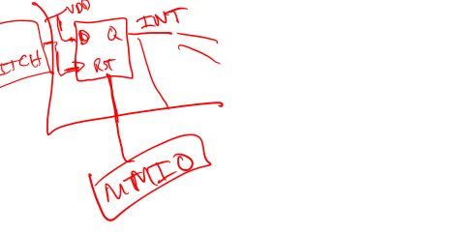
Level-triggered interrupts
Basics:
  Signaled by asserting a line low or high
  Interrupting device drives line low or high and holds it there until it is serviced
  Device deasserts when directed to or after serviced
    Requires some way to tell it to stop.
Sharing?
  Can share the line among multiple devices
  Often open-collector or HiZ
    Active devices assert the line, inactive devices let the line float
  Easy to share line w/o losing interrupts
  But servicing increases CPU load
  And requires CPU to keep cycling through to check
  Different ISR costs suggests careful ordering of ISR checks
  Can’t detect a new interrupt when one is already asserted
Notes:
PCI originally mandated level-triggered due to this

Slide 14

Edge-triggered interrupts
Basics:
  Signaled by a level *transition* (e.g. rising/falling edge)
  Interrupting device drives a pulse onto INT line
Sharing *is* possible
  INT line has a pull up and all devices are OC/OD.
  Could we miss an interrupt? Maybe...if close in time
  What happens if interrupts merge? Need one more ISR pass
  Easy to detect "new interrupts”
  Pitfalls: spurious edges, missed edges
Source of "lockups" in early computers
Notes:
PCI originally mandated level-triggered due to this

Slide 15

Exercise: Another case where polling is slow—sharing!
Assume you have
  n possible interrupt sources
  That all share a single interrupt line and/or handler
  That all fire at about the same rate on average
  And that require about the same amount of time to poll
The handler might look something like this
isr_handler: bl chk_interrupt_src_1 % 100 cycles
bl chk_interrupt_src_2 % 100 cycles
…
bl chk_interrupt_src_n % 100 cycles
bx lr
How does average interrupt processing time grow with n?
How would you order chk_interrupt_src if the interrupts fired at different rates or had different polling times?

Slide 16
Why are interrupts useful? Example: I/O Data Transfer
Two key questions to determine how data is transferred to/from a non-trivial I/O device:
  How does the CPU know when data are available?
    Polling
    Interrupts
  How are data transferred into and out of the device?
    Programmed I/O
    Direct Memory Access (DMA)

Slide 17
How it works
Something tells the processor core there is an interrupt
Core transfers control to code that needs to be executed
Said code “returns” to old program
Much harder then it looks.
  Why?

Slide 18
Devil is in the details
How do you figure out where to branch to?
How to you ensure that you can get back to where you started?
Don’t we have a pipeline? What about partially executed instructions (and OoO instructions)?
What if we get an interrupt while we are processing an interrupt?
What if we are in a “critical section?”

Slide 19
Where
If you know what caused the interrupt then you want to jump to the code that handles that interrupt.
  If you number the possible interrupt cases, and an interrupt comes in, you can just branch to a location, using that number as an offset (this is a branch table)
  If you don’t have the number, you need to poll all possible sources of the interrupt to see who caused it.
    Then you branch to the right code

Slide 20

Get back to where you once belonged
Need to store the return address somewhere.
  Stack might be a scary place.
    That would involve a load/store and might cause an interrupt (page fault)!
  So a dedicated register seems like a good choice
    But that might cause problems later…
    What happens if another interrupt happens?
      Could that overwrite the register?

Slide 21
Modern architectures
A modern processor has many (often 50+) instructions in-flight at once.
  What do we do with them?
Drain the pipeline?
  What if one of them causes an exception?
Punt all that work
  Slows us down
What if the instruction that caused the exception was executed before some other instruction?
  What if that other instruction caused an interrupt?

Slide 22
Nested interrupts
If we get one interrupt while handling another, what to do?
  Just handle it
    But what about that dedicated register?
    What if I’m doing something that can’t be stopped?
  Ignore it
    But what if it is important?
  Prioritize
    Take those interrupts you care about. Ignore the rest
    Still have dedicated register problems.

Slide 23
Critical section
We probably need to ignore some interrupts but take others.
  Probably should be sure our code can’t cause an exception.
  Use same prioritization as before.
What about instructions that shouldn’t be interrupted?
  Disable interrupts while processing an interrupt?

Slide 24
High-level review of interrupts
Why do we need them? Why are the alternatives unacceptable?
  Convince me!
What sources of interrupts are there?
  Hardware and software!
What makes them difficult to deal with?
  Interrupt controllers are complex: there is a lot to do!
    Enable/disable, prioritize, allow premption (nested interrupts), etc.
  Software issues are non-trivial
    Can’t trash work of task you interrupted
    Need to be able to restore state
    Shared data issues are a real pain

Slide 25
Our processor—ARM Cortex-M3
Over 100 interrupt sources
  Power on reset, bus errors, I/O pins changing state, data in on a serial bus etc.
Need a great deal of control
  Ability to enable and disable interrupt sources
  Ability to control where to branch to for each interrupt
  Ability to set interrupt priorities
    Who wins in case of a tie
    Can interrupt A interrupt the ISR for interrupt B?
      If so, A can “preempt” B.
All that control will involve memory mapped I/O.
  And given the number of interrupts that’s going to be a pain

Slide 26
Basic interrupt processing
The stack (PSP or MSP)
Stacking
  Automatically by CPU
  Maintains ABI semantics
  ISRs can be C functions
Vector Fetch
  We’ll see this next
Exit: update of SP, LR, PC
⇧
Higher Addresses
Previous
stacked
data
SP
xPSR
PC
LR
R12
R3
R2
R1
R0
Free
stack
space
Lower Addresses
⇧

Slide 27
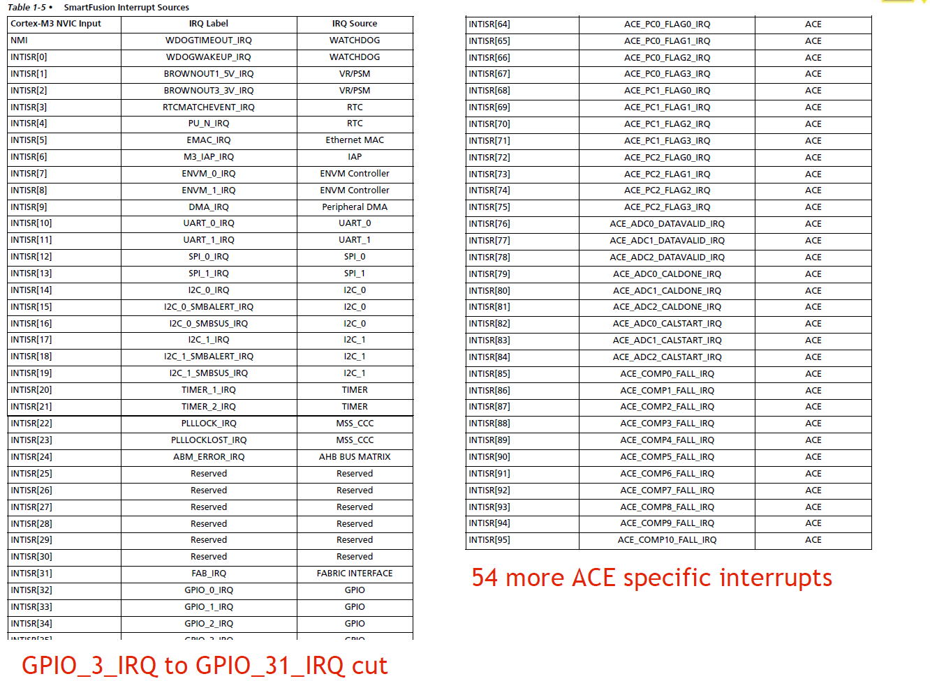
SmartFusion interrupt sources

Slide 28
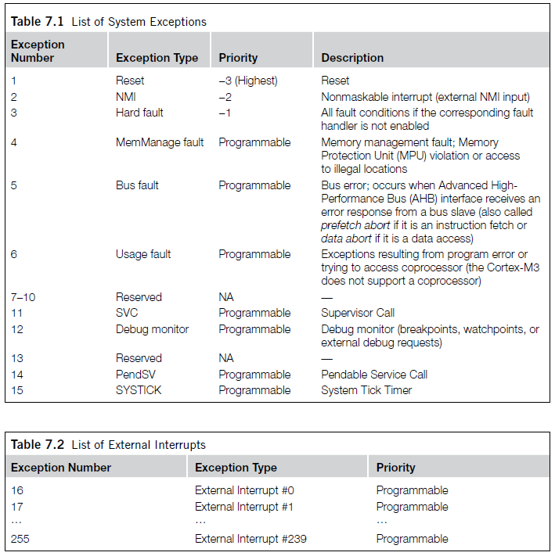

Slide 29
And the interrupt vectors
(in startup_a2fxxxm3.s found in CMSIS, startup_gcc)
g_pfnVectors:
.word _estack
.word Reset_Handler
.word NMI_Handler
.word HardFault_Handler
.word MemManage_Handler
.word BusFault_Handler
.word UsageFault_Handler
.word 0
.word 0
.word 0
.word 0
.word SVC_Handler
.word DebugMon_Handler
.word 0
.word PendSV_Handler
.word SysTick_Handler
.word WdogWakeup_IRQHandler
.word BrownOut_1_5V_IRQHandler
.word BrownOut_3_3V_IRQHandler
.............. (they continue)

Slide 30
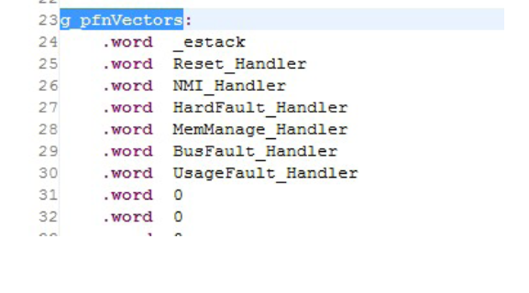
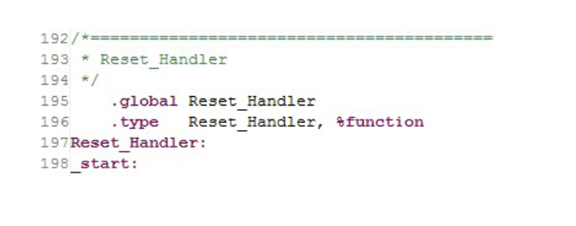
How to change where to go on an interrupt?
Answer: edit the interrupt vector table [IVT]

Slide 31
NVIC/Interrupt configuration registers
ICTR Interrupt Controller Type Register (RW)
ISER Interrupt Set-Enable Register (RW)
ICER Interrupt Clear-Enable Register (RW)
ISPR Interrupt Set-Pending Register (RW)
ICPR Interrupt Clear-Pending Register (RW)
IABR Interrupt Active Bit Register (RO)
IPR Interrupt Priority Register (RW)
AIRC Application Interrupt and Reset Control
Notes:
ICTR: shows the number of interrupt lines the NVIC supports (up to 240)
ISER/ICER: enable/disable external interrupts
ISPR/ICPR: Set and cleared by HW and/or SW
IABR: Set and cleared by hardware automatically (verify)
IPR: Sets priorities for the interrupts
AIRC: vector access key, priority group, reset request, etc.

Slide 32
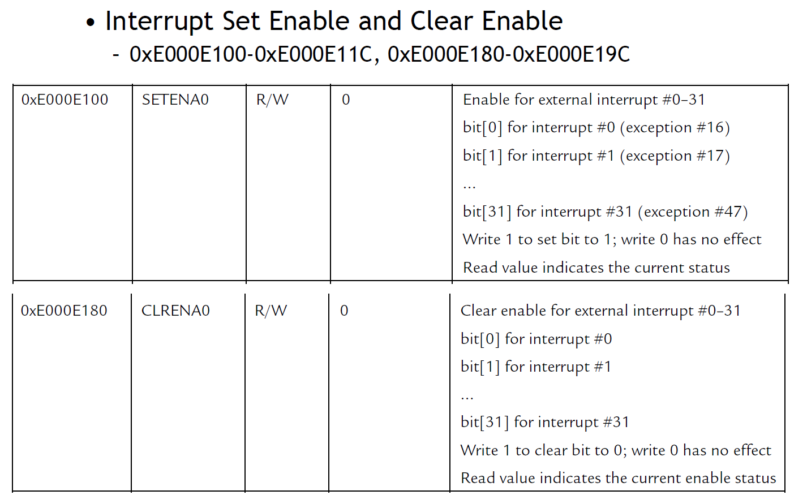
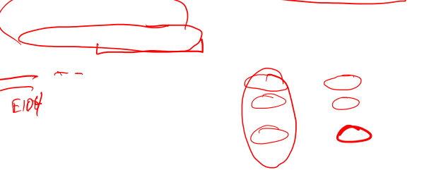
Enabling and disabling interrupt sources
Notes:
Set corresponding bit to

Slide 33
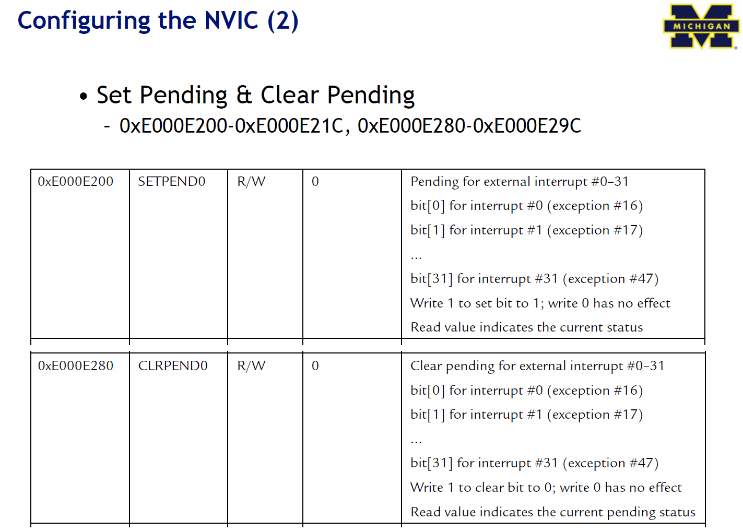

Slide 34
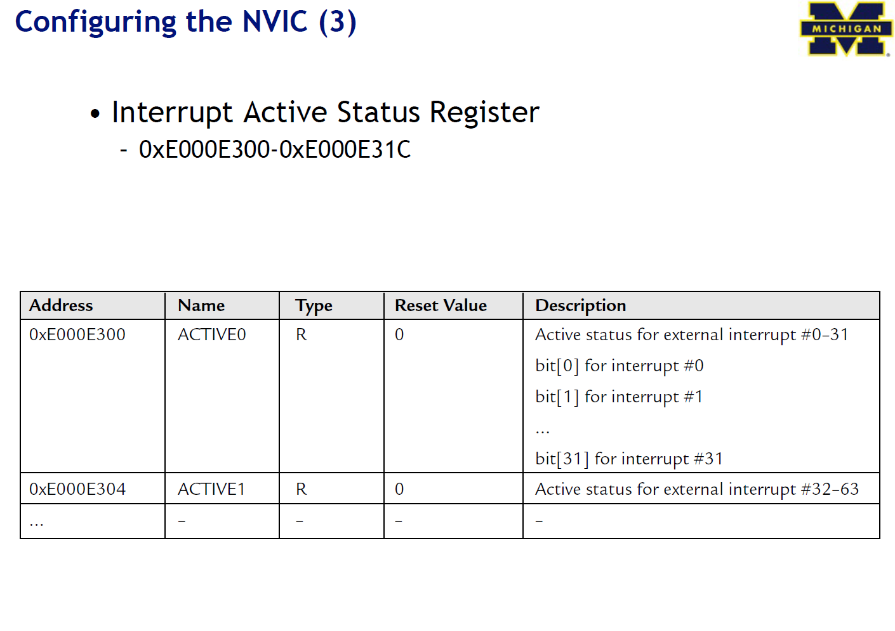

Slide 35
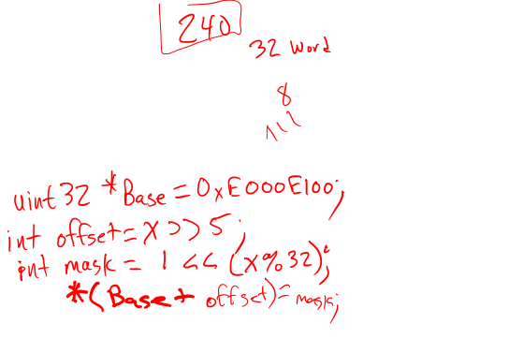
Exercise: Enabling interrupt sources
Implement the following function to enable external interrupt #x when called:
void enable_interrupt(int x) {
/* your code here */
}
Umm, so what do we have to do?
  Use top (32-5)=27 bits of x to select the word offset
  Offset from what, you ask? Base of ISER (0xE000E100)
  Use the bottom five bits of x to select bit position
  Write a ‘1’ to that bit position at memory addr=base+offset
  You’re done!
Notes:
Set corresponding bit to

Slide 36
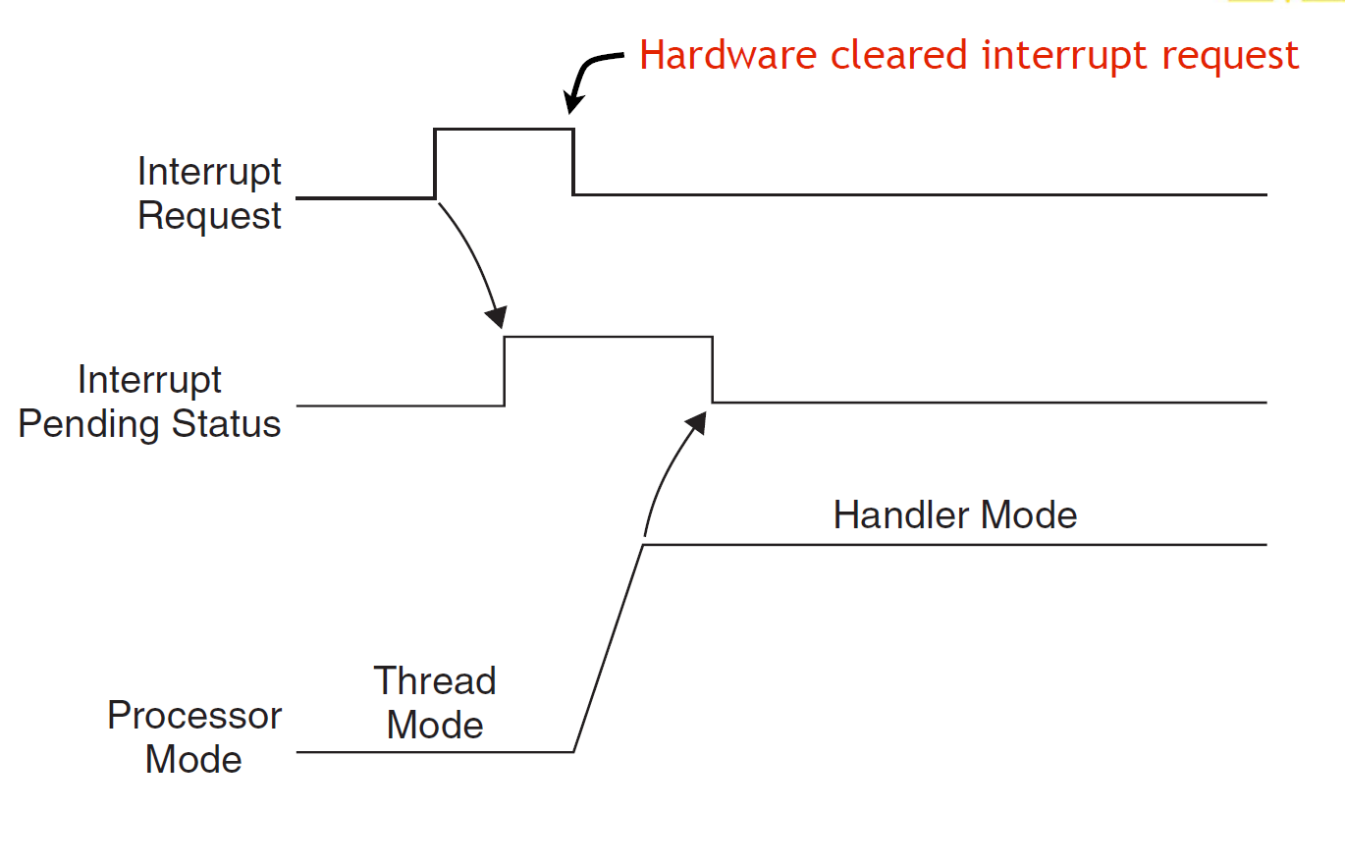
Pending interrupts
The normal case. Once Interrupt request is seen, processor puts it in
“pending” state even if hardware drops the request.
IPS is cleared by the hardware once we jump to the ISR.
This figure and those following are from The Definitive Guide to the ARM Cortex-M3, Section 7.4

Slide 37
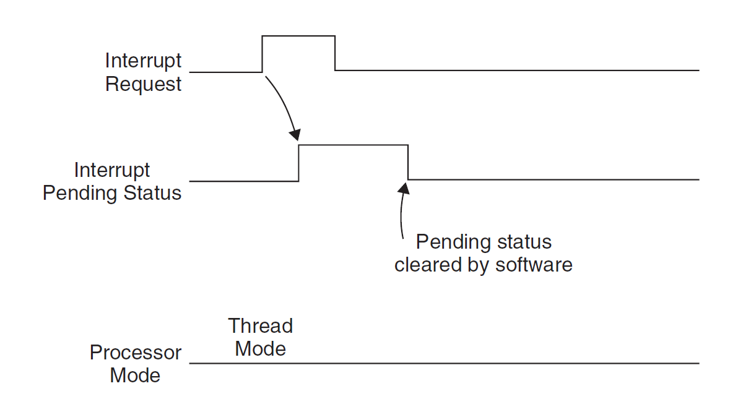
In this case, the processor never took the interrupt because we cleared the
IPS by hand (via a memory-mapped I/O register)

Slide 38
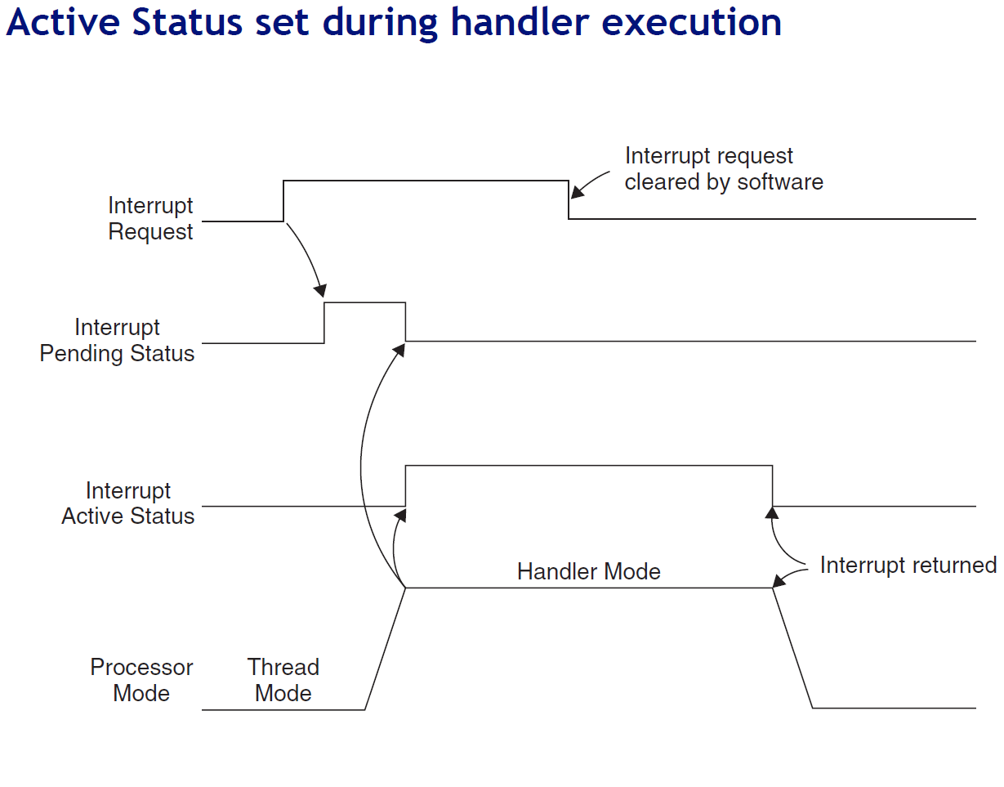

Slide 39
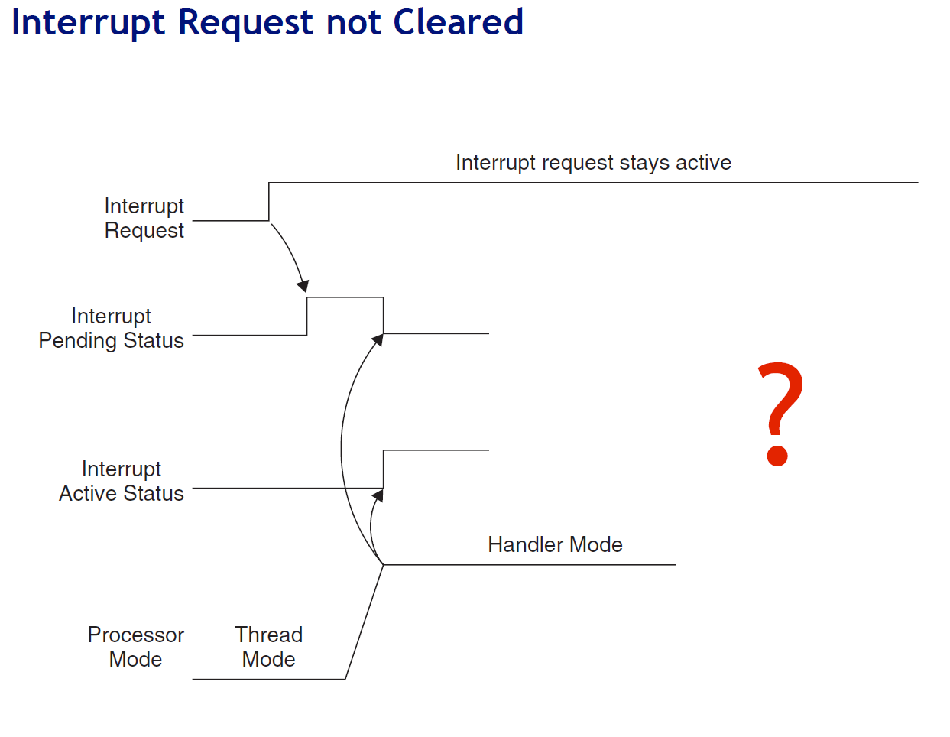

Slide 40
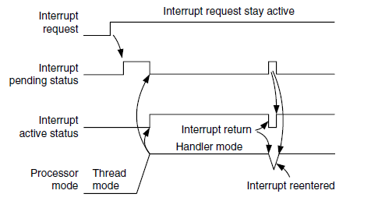

Answer

Slide 41
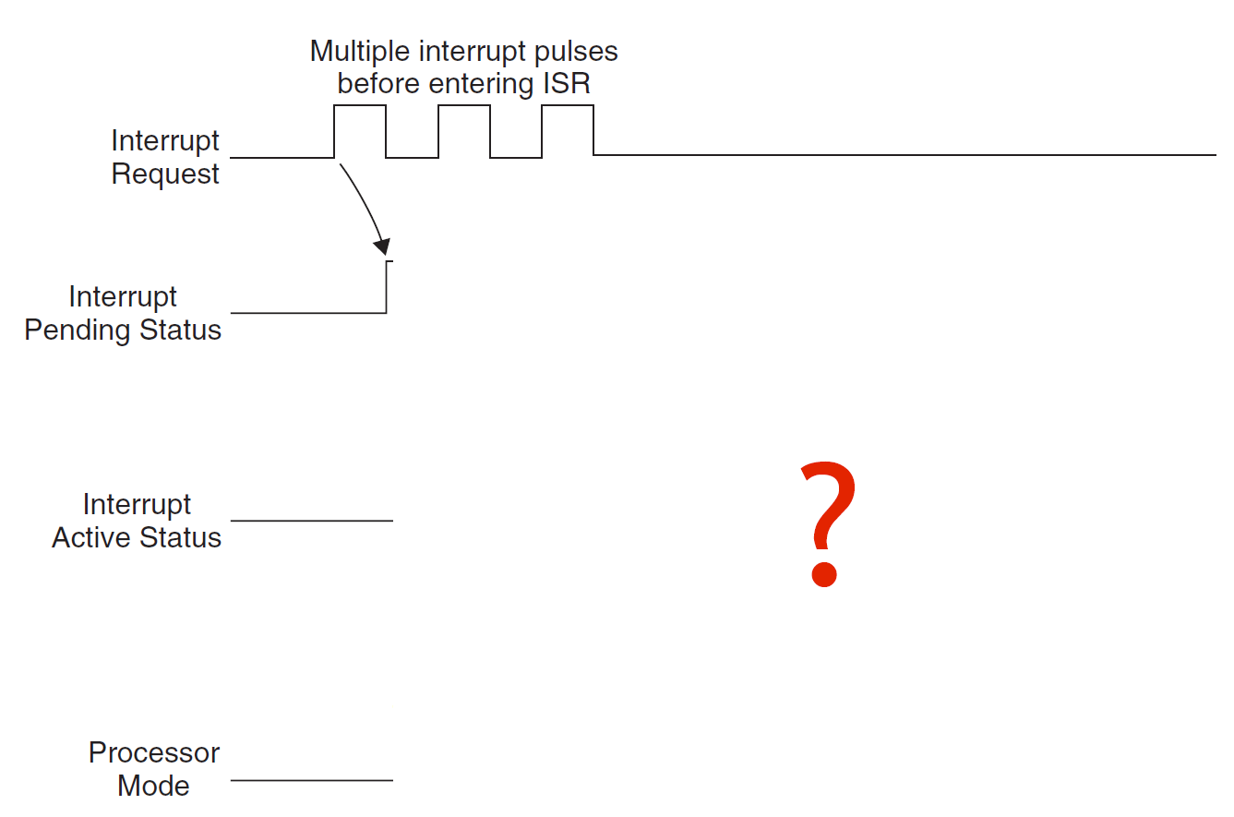
Interrupt pulses before entering ISR

Slide 42
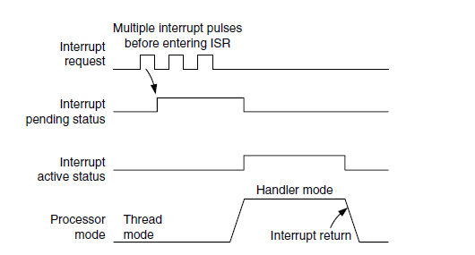
Answer

Slide 43
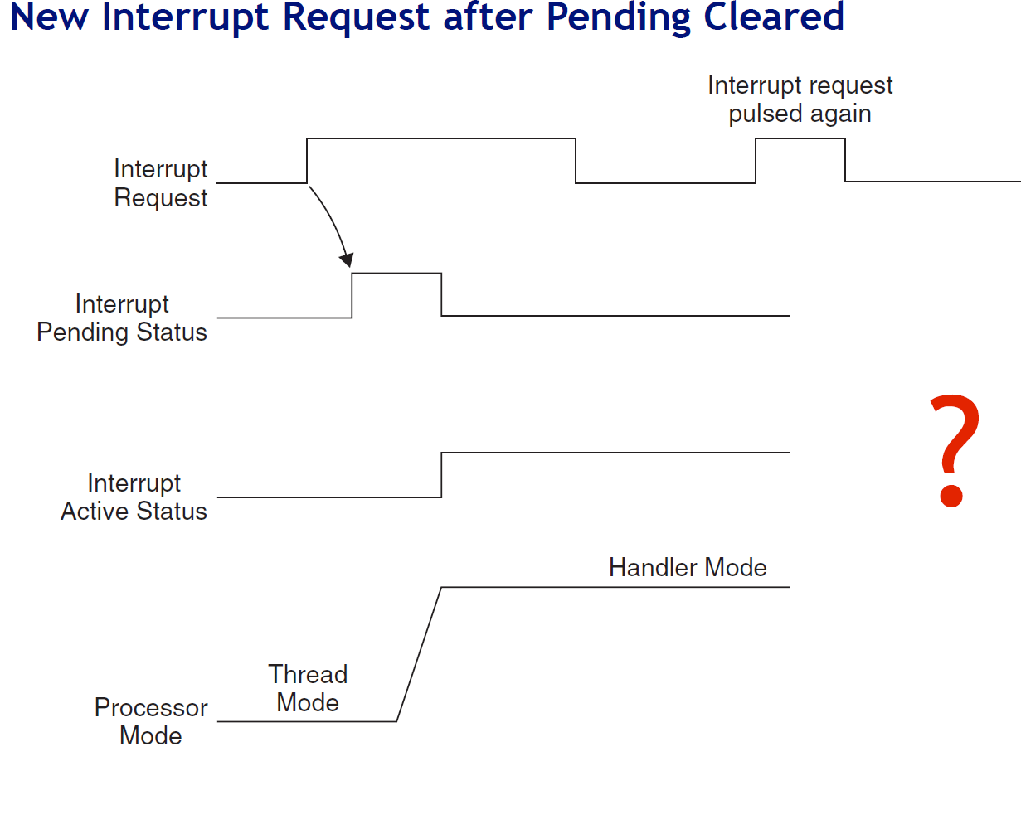


Slide 44
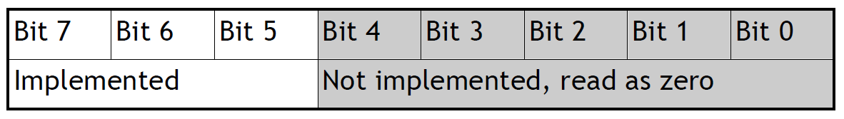

Interrupt Priority
What do we do if several interrupts arrive simultaneously?
NVIC allows priorities for (almost) every interrupt
3 fixed highest priorities, up to 256 programmable priorities
  128 preemption levels
  Not all priorities have to be implemented by a vendor
  SmartFusion has 32 priority levels, i.e. 0x00, 0x08, … , 0xF8
Higher priority interrupts can pre-empt lower priorities
Priority can be sub-divided into priority groups
  Splits priority register into two halves, preempt priority & subpriority
  Preempt priority: indicates if an interrupt can preempt another
  Subpriority: used to determine which is served first if two interrupts of same group arrive concurrently

Slide 45
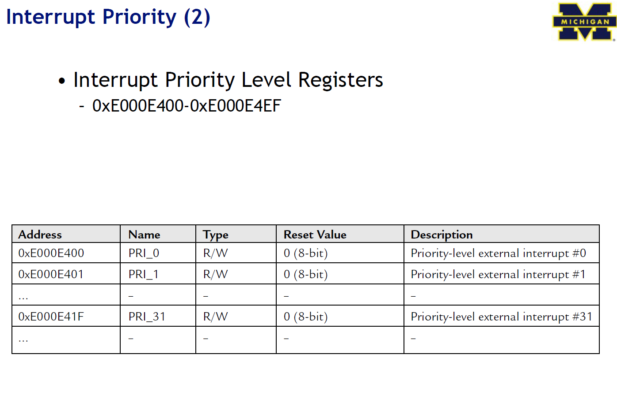
Interrupt Priority (2)
Interrupt priority level registers
  Range: 0xE000E400 to 0xE000E4EF

Slide 46
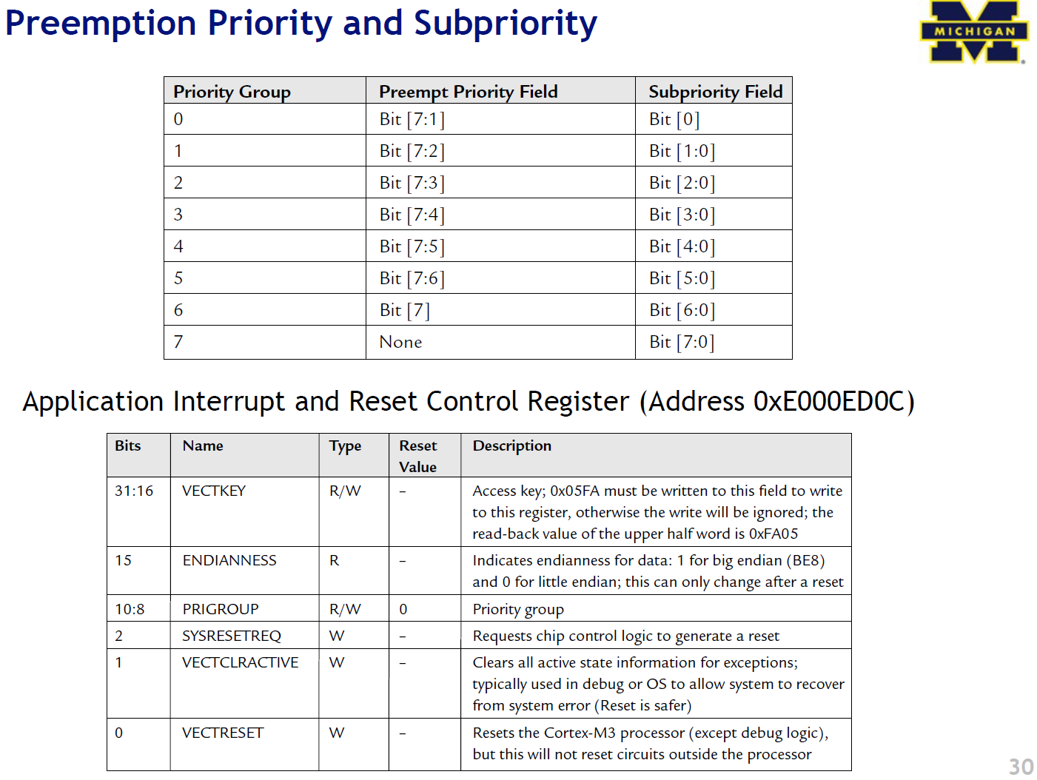

Preemption Priority and Subpriority

Slide 47
PRIMASK, FAULTMASK, and BASEPRI registers
What if we quickly want to disable all interrupts?
Write 1 into PRIMASK to disable all interrupts except NMI
  MOV R0, #1
  MSR PRIMASK, R0 ; MSR and MRS are special instructions
Write 0 into PRIMASK to enable all interrupts
FAULTMASK is the same as PRIMASK, but it also blocks hard faults (priority = -1)
What if we want to disable all interrupts below a certain priority?
Write priority into BASEPRI register
  MOV R0, #0x60
  MSR BASEPRI, R0

Slide 48
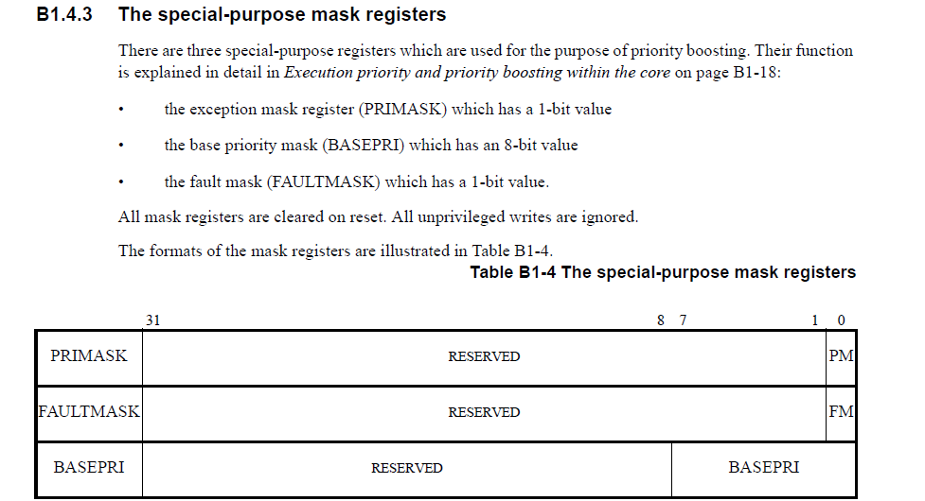
Masking

Slide 49
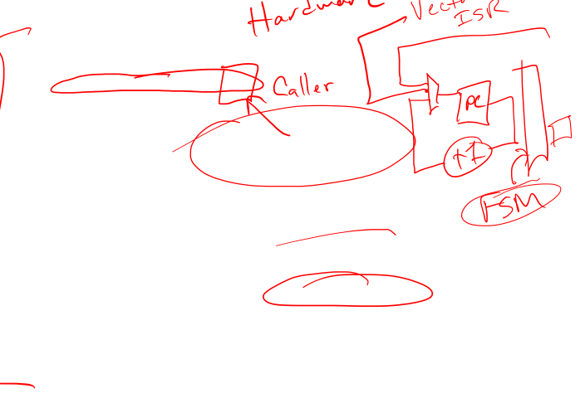
Interrupt Service Routines
Automatic saving of registers upon exception
  PC, PSR, R0-R3, R12, LR
  This occurs over data bus
While data bus busy, fetch exception vector
  i.e. target address of exception handler
  This occurs over instruction bus
Update SP to new location
Update IPSR (low part of xPSR) with exception new #
Set PC to vector handler
Update LR to special value EXC_RETURN
Several other NVIC registers gets updated
Latency can be as short as 12 cycles (w/o mem delays)

Slide 50
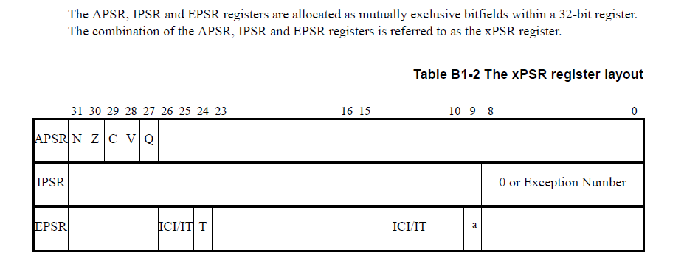

The xPSR register layout

Slide 51

ARM interrupt summary
We’ve got a bunch of memory-mapped registers that control things (NVIC)
  Enable/disable individual interrupts
  Set/clear pending
  Interrupt priority and preemption
We’ve got to understand how the hardware interrupt lines interact with the NVIC
And how we figure out where to set the PC to point to for a given interrupt source.

Slide 52
1. NVIC registers (example)

Slide 53
1. More registers (example)

Slide 54

1. Yet another part of the NVIC registers!

Slide 55
2. How external lines interact with the NVIC
The normal case. Once Interrupt request is seen, processor puts it in
“pending” state even if hardware drops the request.
IPS is cleared by the hardware once we jump to the ISR.
This figure and those following are from The Definitive Guide to the ARM Cortex-M3, Section 7.4

Slide 56

3. How the hardware figures out what to set the PC to
g_pfnVectors:
.word _estack
.word Reset_Handler
.word NMI_Handler
.word HardFault_Handler
.word MemManage_Handler
.word BusFault_Handler
.word UsageFault_Handler
.word 0
.word 0
.word 0
.word 0
.word SVC_Handler
.word DebugMon_Handler
.word 0
.word PendSV_Handler
.word SysTick_Handler
.word WdogWakeup_IRQHandler
.word BrownOut_1_5V_IRQHandler
.word BrownOut_3_3V_IRQHandler
.............. (they continue)

Slide 57

Discussion: So let’s say a GPIO pin goes high
- When will we get an interrupt?
- What happens if the interrupt is allowed to proceed?

Slide 58
What happens when we return from an ISR?
Interrupt exiting process
  System restoration needed (different from branch)
  Special LR value could be stored (0xFFFFFFFx)
Tail chaining
  When new exception occurs
  But CPU handling another exception of same/higher priority
  New exception will enter pending state
  But will be executed before register unstacking
  Saving unnecessary unstacking/stacking operations
  Can reenter hander in as little as 6 cycles
Late arrivals (ok, so this is actually on entry)
  When one exception occurs and stacking commences
  Then another exception occurs before stacking completes
  And second exception of higher preempt priority arrives
  The later exception will be processed first

Slide 59
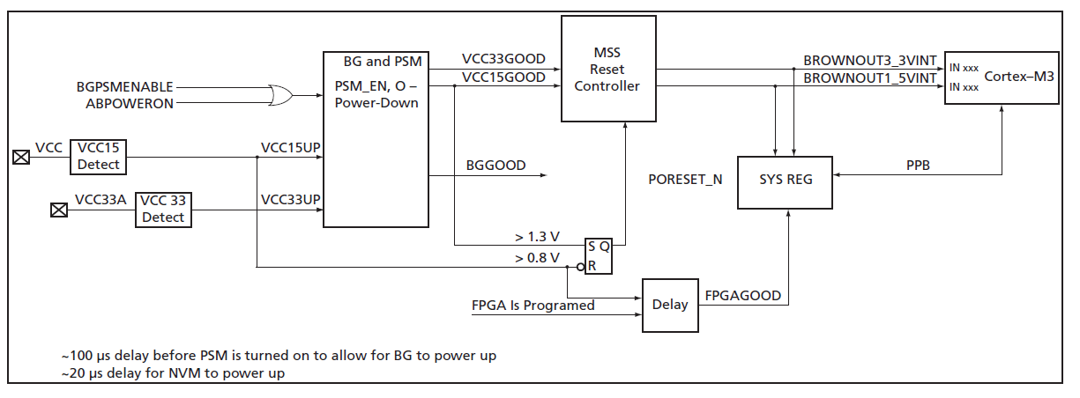
Example of Complexity: The Reset Interrupt
No power
System is held in RESET as long as VCC15 < 0.8V
  In reset: registers forced to default
  RC-Osc begins to oscillate
  MSS_CCC drives RC-Osc/4 into FCLK
  PORESET_N is held low
Once VCC15GOOD, PORESET_N goes high
  MSS reads from eNVM address 0x0 and 0x4

