Slide 1
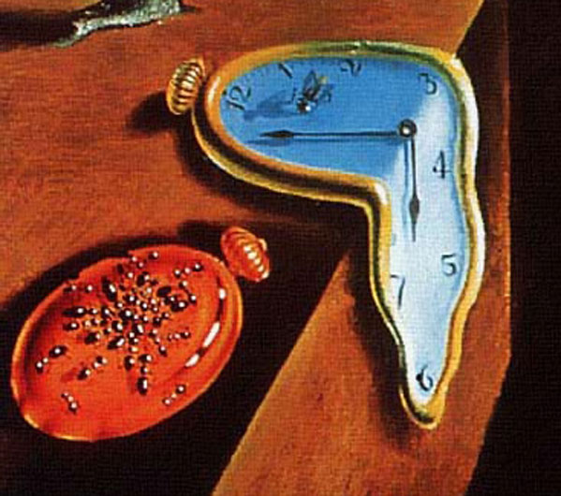
EECS 373
Design of Microprocessor-Based Systems
Ron Dreslinski
University of Michigan
Clocks, Counters, Timers, Capture, and Compare
Some slides by Mark Brehob, Prabal Dutta and Thomas Schmid

Slide 2
Announcements
HW3 Posted on web (Due Next Wednesday)
Project Meeting
Monday 10/10 @ 6:30pm
1003 EECS
Project Description Posted on Website this afternoon

Slide 3
What happens when we return from an ISR?
Interrupt exiting process
System restoration needed (different from branch)
Special LR value could be stored (0xFFFFFFFx)
Walkthrough a few examples, simplified system assumptions:
5 Interrupt Levels (0-4)
256 Priority Levels (0 Highest, 256 Lowest)
First time presenting, so errors in the animation are unintentional but may be present (lets find out together)

Slide 4
Single Interrupt
Interrupt on Level 4
HW
SW
Program
Execution Time
Priority Table
Pending
Program
Stack
4
0
0
1
2
3
4
8
0
0
0
0
0
10
5
Enabled
3
4
0
6
1
1
1
1
1
Base Priority
Active
4
0
256
0
0
0
0
0

Slide 5
Single Interrupt
Interrupt on Level 4
HW
SW
Stack
Program
Execution Time
Priority Table
Pending
Program
Stack
4
0
0
1
2
3
4
8
1
0
0
0
0
10
5
Enabled
PC
3
4
0
PSR
6
1
1
1
1
1
LR
Active
R0-R3, R12
Base Priority
4
0
6
0
0
0
0
0

Slide 6
Single Interrupt
Interrupt on Level 4
HW
SW
Stack
Program
ISR-LVL4
Execution Time
Priority Table
Pending
Program
Stack
4
0
0
1
2
3
4
8
0
0
0
0
0
10
5
Enabled
PC
3
4
0
PSR
6
1
1
1
1
1
LR
Active
R0-R3, R12
Base Priority
4
0
ISR-LVL4
Stack
6
1
0
0
0
0

Slide 7
Single Interrupt
Interrupt on Level 4
bx lr
HW
SW
Stack
Program
ISR-LVL4
Execution Time
Priority Table
Pending
Program
Stack
4
0
0
1
2
3
4
8
0
0
0
0
0
10
5
Enabled
PC
3
4
0
PSR
6
1
1
1
1
1
LR
Active
R0-R3, R12
Base Priority
4
0
6
1
0
0
0
0

Slide 8
Single Interrupt
Interrupt on Level 4
bx lr
HW
SW
Stack
Unstack
Program
ISR-LVL4
Execution Time
Priority Table
Pending
Program
Stack
4
0
0
1
2
3
4
8
0
0
0
0
0
10
5
Enabled
3
4
0
6
1
1
1
1
1
Base Priority
Active
4
0
6
0
0
0
0
0

Slide 9
Single Interrupt
Interrupt on Level 4
bx lr
HW
SW
Stack
Unstack
Program
ISR-LVL4
Program
Execution Time
Priority Table
Pending
Program
Stack
4
0
0
1
2
3
4
8
0
0
0
0
0
10
5
Enabled
3
4
0
6
1
1
1
1
1
Base Priority
Active
4
0
256
0
0
0
0
0

Slide 10
Nested Interrupts
When new exception occurs
And CPU handling another exception of lower priority (incoming request is higher priority)
New exception will interrupt the current ISR
Will generate a new ISR stack on the stack

Slide 11
Nested Interrupt
Interrupt on Level 4
Interrupt on Level 3
HW
SW
Stack
Program
ISR-LVL4
Execution Time
Program
Stack
Priority Table
Pending
PC
4
0
0
1
2
3
4
8
0
0
0
0
0
PSR
LR
10
R0-R3, R12
5
Enabled
3
4
0
ISR-LVL4
Stack
6
1
1
1
1
1
Base Priority
Active
4
0
6
1
0
0
0
0

Slide 12
Nested Interrupt
Interrupt on Level 4
Interrupt on Level 3
HW
SW
Stack
Stack
Program
ISR-LVL4
Execution Time
Program
Stack
Priority Table
Pending
PC
4
0
0
1
2
3
4
8
0
1
0
0
0
PSR
LR
10
R0-R3, R12
5
Enabled
3
4
0
ISR-LVL4
Stack
6
1
1
1
1
1
PC
Base Priority
Active
SP
4
0
LR
6
1
0
0
0
0
R0-R4, R12

Slide 13
Nested Interrupt
Interrupt on Level 4
Interrupt on Level 3
HW
SW
Stack
Stack
Program
ISR-LVL4
ISR-LVL3
Execution Time
Program
Stack
Priority Table
Pending
PC
4
0
0
1
2
3
4
8
0
0
0
0
0
PSR
LR
10
R0-R3, R12
5
Enabled
3
4
0
ISR-LVL4
Stack
6
1
1
1
1
1
PC
Base Priority
Active
PSR
4
0
LR
3
1
1
0
0
0
R0-R3, R12
ISR-LVL3
Stack

Slide 14
Nested Interrupt
Interrupt on Level 4
Interrupt on Level 3
bx lr
HW
SW
Stack
Stack
Unstack
Program
ISR-LVL4
ISR-LVL3
Execution Time
Program
Stack
Priority Table
Pending
PC
4
0
0
1
2
3
4
8
0
0
0
0
0
PSR
LR
10
R0-R3, R12
5
Enabled
3
4
0
ISR-LVL4
Stack
6
1
1
1
1
1
Base Priority
Active
4
0
6
1
0
0
0
0

Slide 15
Nested Interrupt
Interrupt on Level 4
Interrupt on Level 3
bx lr
bx lr
HW
SW
Stack
Stack
Unstack
Unstack
Program
ISR-LVL4
ISR-LVL3
ISR-LVL4
Execution Time
Program
Stack
Priority Table
Pending
4
0
0
1
2
3
4
8
0
0
0
0
0
10
5
Enabled
3
4
0
6
1
1
1
1
1
Base Priority
Active
4
0
256
0
0
0
0
0

Slide 16
Tail Chaining
When new exception occurs
But CPU handling another exception of same/higher priority (incoming request is lower priority)
New exception will enter pending state
But will be executed before register unstacking
Saving unnecessary unstacking/stacking operations
Can reenter hander in as little as 6 cycles

Slide 17
Tail-Chaining
Interrupt on Level 4
Interrupt on Level 1
HW
SW
Stack
Program
ISR-LVL4
Execution Time
Program
Stack
Priority Table
Pending
PC
4
0
0
1
2
3
4
8
0
0
0
1
0
PSR
LR
10
R0-R3, R12
5
Enabled
3
4
0
ISR-LVL4
Stack
6
1
1
1
1
1
Base Priority
Active
4
0
6
1
0
0
0
0

Slide 18
Tail-Chaining
Interrupt on Level 4
Interrupt on Level 1
bx lr
Don’t Unstack
HW
SW
Stack
Program
ISR-LVL4
Execution Time
Program
Stack
Priority Table
Pending
PC
4
0
0
1
2
3
4
8
0
0
0
1
0
PSR
LR
10
R0-R3, R12
5
Enabled
3
4
0
6
1
1
1
1
1
Base Priority
Active
4
0
6
0
0
0
0
0

Slide 19
Tail-Chaining
Interrupt on Level 4
Interrupt on Level 1
bx lr
HW
SW
Stack
Program
ISR-LVL4
ISR-LVL1
Execution Time
Program
Stack
Priority Table
Pending
PC
4
0
0
1
2
3
4
8
0
0
0
0
0
PSR
LR
10
R0-R3, R12
5
Enabled
3
4
0
ISR-LVL1
Stack
6
1
1
1
1
1
Base Priority
Active
4
0
10
0
0
0
1
0

Slide 20
Tail-Chaining
Interrupt on Level 4
Interrupt on Level 1
bx lr
bx lr
HW
SW
Stack
Unstack
Program
ISR-LVL4
ISR-LVL1
Program
Execution Time
Program
Stack
Priority Table
Pending
4
0
0
1
2
3
4
8
0
0
0
0
0
10
5
Enabled
3
4
0
6
1
1
1
1
1
Base Priority
Active
4
0
256
0
0
0
0
0

Slide 21
Late Arrival
Late arrivals (ok, so this is actually on entry)
When one exception occurs and stacking commences
Then another exception occurs before stacking completes
And second exception of higher preempt priority arrives
The later exception will be processed first

Slide 22
Late Arrival
Once stacking complete, find vector for highest priority pending
Interrupt on Level 4
Interrupt on Level 3
HW
SW
Stack
Program
Execution Time
Program
Stack
Priority Table
Pending
PC
4
0
0
1
2
3
4
8
1
1
0
0
0
PSR
LR
10
R0-R3, R12
5
Enabled
3
4
0
6
1
1
1
1
1
Base Priority
Active
4
0
256
0
0
0
0
0

Slide 23
Late Arrival
Interrupt on Level 4
Interrupt on Level 3
bx lr
HW
SW
Stack
Program
ISR-LVL3
Execution Time
Program
Stack
Priority Table
Pending
PC
4
0
0
1
2
3
4
8
1
0
0
0
0
PSR
LR
10
R0-R3, R12
5
Enabled
3
4
0
ISR-LVL3
Stack
6
1
1
1
1
1
Base Priority
Active
4
0
3
0
1
0
0
0

Slide 24
Late Arrival
Tail Chaining used to service lower priority request
Interrupt on Level 4
Interrupt on Level 3
bx lr
bx lr
HW
SW
Stack
Unstack
Program
ISR-LVL3
ISR-LVL4
Program
Execution Time
Program
Stack
Priority Table
Pending
4
0
0
1
2
3
4
8
0
0
0
0
0
10
5
Enabled
3
4
0
6
1
1
1
1
1
Base Priority
Active
4
0
256
0
0
0
0
0

Slide 25
Virtual Timers
You never have enough timers.
Never.
So what are we going to do about it?
How about we handle in software?

Slide 26
Virtual Timers
Simple idea.
Maybe we have 10 events we might want to generate.
Just make a list of them and set the timer to go off for the first one.
Do that first task, change the timer to interrupt for the next task.

Slide 27
Problems?
Only works for “compare” timer uses.
Will result in slower ISR response time
May not care, could just schedule sooner…

Slide 28
Implementation Issues
Shared user-space/ISR data structure.
Insertion happens at least some of the time in user code.
Deletion happens in ISR.
We need critical section (disable interrupt)
How do we deal with our modulo counter?
That is, the timer wraps around.
Why is that an issue?
What functionality would be nice?
Generally one-shot vs. repeating events
Might be other things desired though
What if two events are to happen at the same time?
Pick an order, do both…

Slide 29
Implementation Issues (continued)
What data structure?
Data needs be sorted
Inserting one thing at a time
We always pop from one end
But we add in sorted order.

Slide 30
Data structures

Slide 31
Some loose ends…glitches and all that

Slide 32
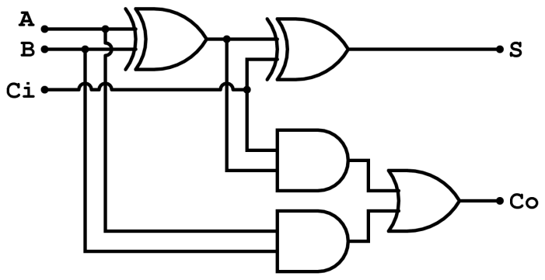
Timing delays and propagation
Assume
XOR delay = 0.2ns
AND delay = 0.1ns
OR delay = 0.1 ns
What is the worst case propagation delay for this circuit?
x
y
z
Full adder (from Wikipedia)

Slide 33
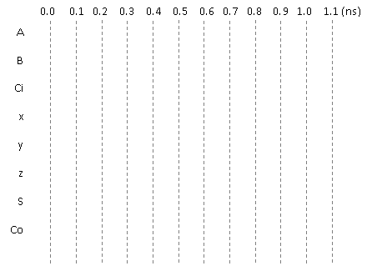
Glitches
x
Consider the adjacent circuit diagram. Assuming the XOR gates have
a delay of 0.2ns while AND and OR gates have a delay of 0.1ns, fill in
the following chart.
y
z
Full adder (from Wikipedia)
Only selected causality
arrows shown…

Slide 34
Glitching: a summary
When input(s) change
The output can be wrong for a time
However, that time is bounded
And more so, the output can change during this “computation time” even if the output ends up where it started!

Slide 35
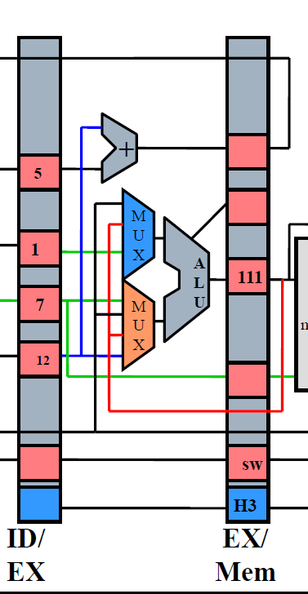
Effect of Glitches
Think back to EECS 370.
Why don’t glitches cause errors?
The trick is that the inputs all change at the same time
In this case, the ID/EX registers all change some time shortly after the rising edge of the clock.
And we’ve chosen the clock period such that the next edge doesn’t happen until the combinational logic has stopped glitching.
In fact, we use the worst-case combinational logic delay in the whole system when determining the clock period!
Notes:
Note the animation here. I didn’t want the text to show up on the printed slides.

Slide 36
So, how can glitches hurt us?
There are a handful of places:
Asynchronous resets
If you’ve got a flip-flop that has an asynchronous reset (or “preset”) you need to be sure the input can’t glitch.
That pretty much means you need a flip-flop driving the input (which means you probably should have used a sync. reset!)
Clocks
If you are using combinational logic to drive a clock, you are likely going to get extra clock edges.
Traditionally, CLR is used
to indicate async reset. “R”
or “reset” for sync. reset.
If clk is high and cond
glitches, you get extra
edges!

Slide 37
Design rules
X
Thou shalt not use asynchronous resets
Thou shalt not drive a clock with anything other than a clock or directly off of a flip-flop’s output
X

Slide 38
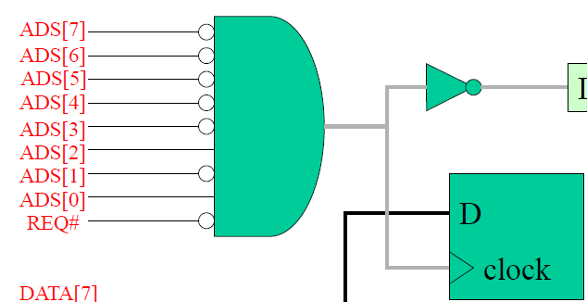
Really? Seriously?
People do use asynchronous resets and clock gating!
Yep. And people use goto in C programs.
Sometimes they are the right thing.
But you have to think really hard about them to insure that they won’t cause you problems.
Our “simple” bus used combinational logic for the clock
Works because REQ goes low only after everything else has stopped switching
So no glitch.
Not fun to reason about…
Avoid unless you must
Then think really carefully.

Slide 39
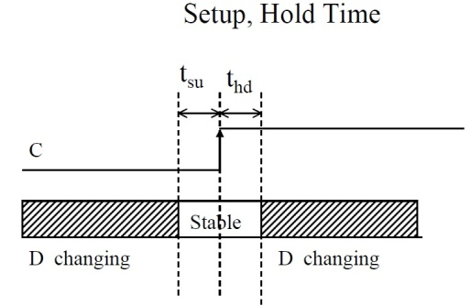
Setup and hold time
The idea is simple.
When the clock is changing if the data is also changing it is hard to tell what the data is.
Hardware can’t always tell
And you can get meta-stable behavior too (very unlikely but…)
So we have a “guard band” around the clock rising time during which we don’t allow the data to change.
See diagram. We call the time before the clock-edge “setup time” and the time after “hold time”
Notes:
Using dropping erasers thing. Drop 2 erasers, ask which hit first. The point being that it can be hard to tell even though they didn’t happen at the same time (no two things do). Makes sense we want some type of band around when the clock is changing so that the data isn’t so we grab the right thing.

Slide 40
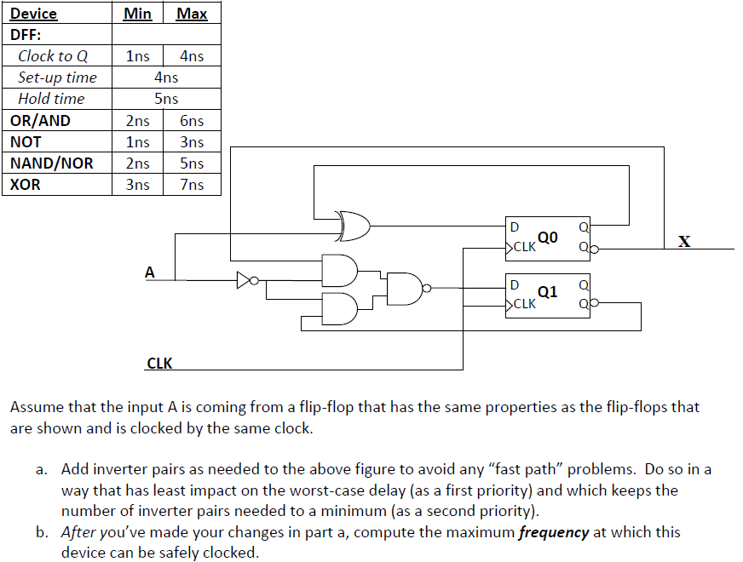
Example: Fast and slow paths; impact of setup and hold time
Notes:
From http://www.eecs.umich.edu/courses/eecs270/refs.html

Slide 41
So what happens if we violate set-up or hold time?
Often just get one of the two values.
And that often is just fine.
Consider getting a button press from the user.
If the button gets pressed at the same time as the clock edge, we might see the button now or next clock.
Either is generally fine when it comes to human input.
But bad things could happen.
The flip-flop’s output might not settle out to a “0” or a “1”
That could cause later devices to mess up.
More likely, if that input is going to two places, one might see a “0” the other a “1”
Important: don’t feed an async input to multiple places!

Slide 42
Example
A common thing to do is reset a state machine using a button.
User can “reset” the system.
Because the button transition could violate set-up or hold time, some state bits of the state machine might come out of reset at different times.
And you quickly end up at a wrong or illegal state.
Notes:
Insert story about the E100 here.

Slide 43
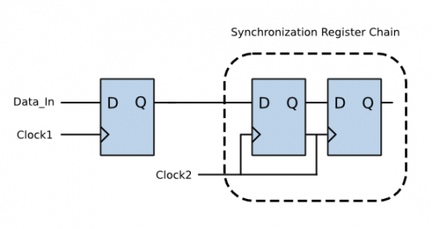
So…
Dealing with inputs not synchronized to our local clock is a problem.
Likely to violate setup or hold time.
That could lead to things breaking.
So we need a clock synchronization circuit.
First flip-flop might have problems.
Second should be fine.
Sometimes use a third if really paranoid
Safety-critical system for example.
Figure from http://www.eeweb.com/electronics-quiz/solving-metastability-design-issues, we use the same thing to deal with external inputs too!

Slide 44
Design rules
Thou shalt use a clock synchronization circuit when changing clock domains or using unclocked inputs!
✓
/* Synchonization of Asynchronous switch input */ always@(posedge clk) begin sw0_pulse[0] <= sw_port[0]; sw0_pulse[1] <= sw0_pulse[0]; sw0_pulse[2] <= sw0_pulse[1]; end
always @(posedge clk) SSELr <= {SSELr[1:0], SSEL};
Notes:
Code from lab 3 and from http://www.fpga4fun.com/SPI2.html

Slide 45
Questions?
Comments?
Discussion?

