Slide 1
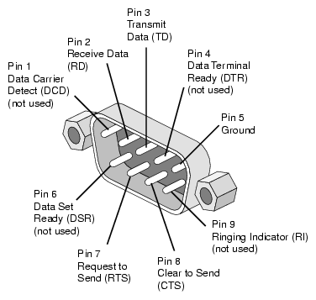
EECS 373
Design of Microprocessor-Based Systems
Ron Dreslinski
University of Michigan
Serial buses, digital design
Material taken from Brehob, Dutta, Le,
Ramadas, Tikhonov & Mahal

Slide 2
Timer
Program
//Setup Timer
Hardware Timer
Count:
Interrupt
-1
ISR
//Do Something

Slide 3
Virtual Timer
Virtual Event Queue
Program 1
//Setup Timer @3
//Setup Timer @5
Virtual Timer Code
//Update Event Queue
//Adjust Timer if needed
Hardware Timer
Count:
Interrupt
-1
Program 2
//Setup Timer @D2
Program 1-Handler
//Do Seomthing
Virtual ISR
//Figure out source
bl
bl
bl
bl
//Insert new event?
//Set new time
Program 3
//Setup Timer @D7
Program 2-Handler
//Do Something
Program 4
//Setup Timer @4
Program 3-Handler
//Do Something
Program 4 -Hanlder
//Do Something

Slide 4
Event Queue
Program 1
//Setup Timer @3
//Setup Timer @5
Head Ptr
Hardware Timer
Count:
Null
-1
Program 2
//Setup Timer @D2
Program 3
//Setup Timer @D7
Program 4
//Setup Timer @4

Slide 5
Event Queue
Program 1
//Setup Timer @3
//Setup Timer @5
Head Ptr
Hardware Timer
Count:
Time:
Delta:
Mode:
3
3
Program 2
//Setup Timer @D2
-1
Hdlr Ptr
One
Program 3
//Setup Timer @D7
Program 4
//Setup Timer @4

Slide 6
Event Queue
Program 1
//Setup Timer @3
//Setup Timer @5
Head Ptr
Hardware Timer
Count:
Time:
Delta:
Mode:
3
3
Program 2
//Setup Timer @D2
-1
Hdlr Ptr
One
Time:
Delta:
Mode:
5
Program 3
//Setup Timer @D7
-1
Hdlr Ptr
One
Program 4
//Setup Timer @4

Slide 7
Event Queue
Program 1
//Setup Timer @3
//Setup Timer @5
Head Ptr
Hardware Timer
Count:
Time:
Delta:
Mode:
3
3
Program 2
//Setup Timer @D2
-1
Hdlr Ptr
One
Time:
Delta:
Mode:
5
Program 3
//Setup Timer @D7
-1
Hdlr Ptr
One
Time:
Delta:
Mode:
2
Program 4
//Setup Timer @4
2
Hdlr Ptr
Delta

Slide 8
Event Queue
Program 1
//Setup Timer @3
//Setup Timer @5
Head Ptr
Hardware Timer
Count:
Time:
Delta:
Mode:
2
2
Program 2
//Setup Timer @D2
2
Hdlr Ptr
Delta
Time:
Delta:
Mode:
3
Program 3
//Setup Timer @D7
-1
Hdlr Ptr
One
Time:
Delta:
Mode:
5
Program 4
//Setup Timer @4
-1
Hdlr Ptr
One

Slide 9
Event Queue
Program 1
//Setup Timer @3
//Setup Timer @5
Head Ptr
Hardware Timer
Count:
Time:
Delta:
Mode:
2
2
Program 2
//Setup Timer @D2
2
Hdlr Ptr
Delta
Time:
Delta:
Mode:
3
Program 3
//Setup Timer @D7
-1
Hdlr Ptr
One
Time:
Delta:
Mode:
Time:
Delta:
Mode:
5
7
Program 4
//Setup Timer @4
-1
Hdlr Ptr
7
Hdlr Ptr
One
Delta

Slide 10
Event Queue
Program 1
//Setup Timer @3
//Setup Timer @5
Head Ptr
Hardware Timer
Count:
Time:
Delta:
Mode:
2
2
Program 2
//Setup Timer @D2
2
Hdlr Ptr
Delta
Time:
Delta:
Mode:
3
Program 3
//Setup Timer @D7
-1
Hdlr Ptr
One
Time:
Delta:
Mode:
Time:
Delta:
Mode:
Time:
Delta:
Mode:
4
5
7
Program 4
//Setup Timer @4
-1
Hdlr Ptr
-1
Hdlr Ptr
7
Hdlr Ptr
One
One
Delta

Slide 11
Event Queue
Program 1
//Setup Timer @3
//Setup Timer @5
Head Ptr
Hardware Timer
Count:
Time:
Delta:
Mode:
0
2
Program 2
//Setup Timer @D2
2
Hdlr Ptr
Delta
Time:
Delta:
Mode:
3
Program 3
//Setup Timer @D7
-1
Hdlr Ptr
One
Time:
Delta:
Mode:
Time:
Delta:
Mode:
Time:
Delta:
Mode:
4
5
7
Program 4
//Setup Timer @4
-1
Hdlr Ptr
-1
Hdlr Ptr
7
Hdlr Ptr
One
One
Delta

Slide 12
Event Queue
Program 1
//Setup Timer @3
//Setup Timer @5
Head Ptr
Hardware Timer
Count:
Time:
Delta:
Mode:
0
2
Program 2
//Setup Timer @D2
2
Hdlr Ptr
Delta
Virtual ISR
//Figure out source
//Remove head
//Insert new event?
//Set new time
Time:
Delta:
Mode:
3
Program 3
//Setup Timer @D7
-1
Hdlr Ptr
One
Time:
Delta:
Mode:
Time:
Delta:
Mode:
Time:
Delta:
Mode:
4
5
7
Program 4
//Setup Timer @4
-1
Hdlr Ptr
-1
Hdlr Ptr
7
Hdlr Ptr
One
One
Delta

Slide 13
Event Queue
Time:
Delta:
Mode:
2
2
Hdlr Ptr
Head Ptr
Delta
Program 1
//Setup Timer @3
//Setup Timer @5
Hardware Timer
Count:
0
Program 2
//Setup Timer @D2
Virtual ISR
//Figure out source
//Remove head
//Insert new event?
//Set new time
Time:
Delta:
Mode:
1
Program 3
//Setup Timer @D7
-1
Hdlr Ptr
One
Time:
Delta:
Mode:
Time:
Delta:
Mode:
Time:
Delta:
Mode:
2
3
5
Program 4
//Setup Timer @4
-1
Hdlr Ptr
-1
Hdlr Ptr
7
Hdlr Ptr
One
One
Delta

Slide 14
Event Queue
Program 1
//Setup Timer @3
//Setup Timer @5
Head Ptr
Hardware Timer
Count:
Time:
Delta:
Mode:
1
0
-1
Hdlr Ptr
Program 2
//Setup Timer @D2
One
Virtual ISR
//Figure out source
//Remove head
//Insert new event?
//Set new time
Time:
Delta:
Mode:
2
Program 3
//Setup Timer @D7
-1
Hdlr Ptr
One
Time:
Delta:
Mode:
Time:
Delta:
Mode:
Time:
Delta:
Mode:
2
3
5
Program 4
//Setup Timer @4
2
Hdlr Ptr
-1
Hdlr Ptr
7
Hdlr Ptr
Delta
One
Delta

Slide 15
Event Queue
Program 1
//Setup Timer @3
//Setup Timer @5
Head Ptr
Hardware Timer
Count:
Time:
Delta:
Mode:
1
1
-1
Hdlr Ptr
Program 2
//Setup Timer @D2
One
Virtual ISR
//Figure out source
//Remove head
//Insert new event?
//Set new time
Time:
Delta:
Mode:
2
Program 3
//Setup Timer @D7
-1
Hdlr Ptr
One
Time:
Delta:
Mode:
Time:
Delta:
Mode:
Time:
Delta:
Mode:
2
3
5
Program 4
//Setup Timer @4
2
Hdlr Ptr
-1
Hdlr Ptr
7
Hdlr Ptr
Delta
One
Delta

Slide 16
Event Queue - Caveats
Head Ptr
No new event added for one-shot
Handler may need to loop to handle multiple events at same time
Time:
Delta:
Mode:
1
-1
Hdlr Ptr
One
Time:
Delta:
Mode:
2
-1
Hdlr Ptr
One
Time:
Delta:
Mode:
Time:
Delta:
Mode:
Time:
Delta:
Mode:
2
3
5
2
Hdlr Ptr
-1
Hdlr Ptr
7
Hdlr Ptr
Delta
One
Delta

Slide 17
Agenda
Serial Buses
Introduction
UART
SPI
I2C
Glitches
Asynchronous resets and glitches
Design rules
Set-up and hold time.
Review
Dealing with external inputs
Design rules

Slide 18
Serial interfaces
traps &
exceptions
C
Assembly
Machine Code
CPU
EECS 370
Software
Hardware
ldr (read)
str (write)
ISA
SVC#
fault
INT#
interrupts
System Buses
AHB/APB
Interrupts
GPIO/INT
Timers
USART
DAC/ADC
Internal &
External
Memory
Internal
External
Input
I2C
SPI
ADC
DAC
EMC
Output
Capture
UART
Interrupt
Compare

Slide 19
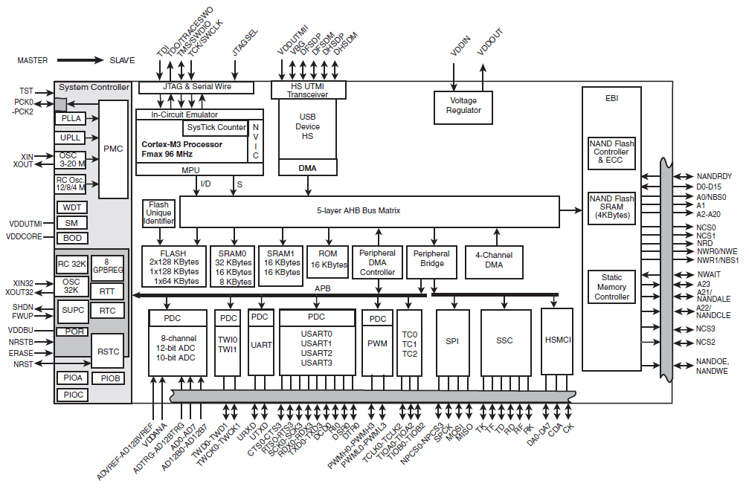
External memory attaches to the processor via the external memory controller and bus
Atmel SAM3U

Slide 20
UART
Universal Asynchronous Receiver/Transmitter
a type of "asynchronous receiver/transmitter", a piece of computer hardware that translates data between parallel and serial forms.
UARTs are commonly used in conjunction with communication standards such as EIA, RS-232, RS-422 or RS-485.
The universal designation indicates that the data format and transmission speeds are configurable and that the actual electric signaling levels and methods (such as differential signaling etc.) typically are handled by a special driver circuit external to the UART.
Most of the UART stuff (including images) Taken from Wikipedia!

Slide 21
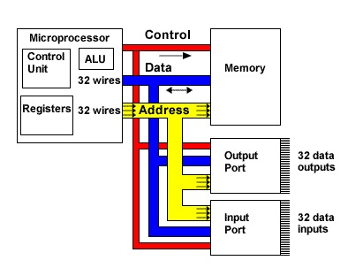
Fun with buses
A multidrop bus (MDB) is a computer bus in which all components are connected to the same set of electrical wires. (from Wikipedia)
In the general case, a bus may have more than one device capable of driving it.
That is, it may be a “multi-master” bus as discussed earlier.
Notes:
Figure from http://tek-electronics.blogspot.com/

Slide 22
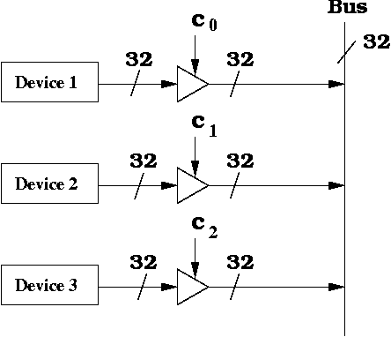
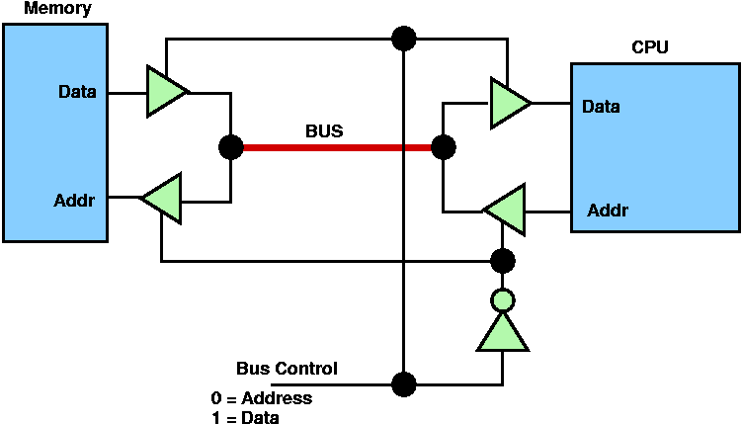
How can we handle multiple (potential) bus drivers? (1/3)
Tri-state devices, just have one device drive at a time. Everyone can read though
Pros:
Very common, fairly fast, pin- efficient.
Cons:
Tri-state devices can be slow.
Especially drive-to-tristate?
Need to be sure two folks not driving at the same time
Let out the magic smoke.
Most common solution (at least historically)
Ethernet, PCI, etc.
Notes:
Image from http://www.cs.umd.edu/class/sum2003/cmsc311/Notes/CompOrg/tristate.html

Slide 23
How can we handle multiple (potential) bus drivers? (2/3)
MUX
Just have each device generate its data, and have a MUX select.
That’s a LOT of pins.
Consider a 32-bit bus with 6 potential drivers.
Draw the figure.
How many pins needed for the MUX?
Not generally realistic for an “on-PCB” design as we’ll need an extra device (or a lot of pins on one device)
But reasonable on-chip
In fact AHB, APB do this.

Slide 24
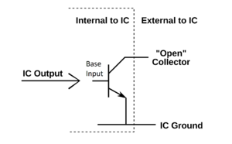
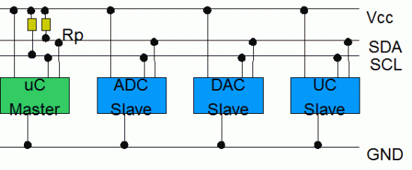
How can we handle multiple (potential) bus drivers? (3/3)
“pull-up” aka “open collector” aka “wired OR”
Wire is pulled high by a resistor
If any device pulls the wire low, it goes low.
Pros:
If two devices both drive the bus, it still works!
Cons:
Rise-time is very slow.
Constant power drain.
Used in I2C, CAN

Slide 25
Agenda
Serial Buses
Introduction
UART
SPI
I2C
Glitches
Asynchronous resets and glitches
Design rules
Set-up and hold time.
Review
Dealing with external inputs
Design rules

Slide 26
UART
Universal Asynchronous Receiver/Transmitter
Hardware that translates between parallel and serial forms
Commonly used in conjunction with communication standards such as EIA, RS-232, RS-422 or RS-485
The universal designation indicates that the data format and transmission speeds are configurable and that the actual electric signaling levels and methods (such as differential signaling etc.) typically are handled by a special driver circuit external to the UART.
Most of the UART stuff (including images) Taken from Wikipedia!

Slide 27
Protocol
Each character is sent as
a logic low start bit
a configurable number of data bits (usually 7 or 8, sometimes 5)
an optional parity bit
one or more logic high stop bits.
with a particular bit timing (“baud” or “baudrate”)
Examples
“9600-N-8-1” → <baudrate><parity><databits><stopbits>
“9600-8-N-1” → <baudrate><databits><parity><stopbits>

Slide 28
Variations and fun times
UART is actually a generic term that includes a large number of different devices/standards.
RS-232 is a standard that specifies
“electrical characteristics and timing of signals, the meaning of signals, and the physical size and pin out of connectors.

Slide 29
Signals (only most common)
The RXD signal of a UART is the signal receiving the data. This will be an input and is usually connected to the TXD line of the downstream device.
The TXD signal of a UART is the signal transmitting the data. This will be an output and is usually connected to the RXD line of the downstream device.
The RTS# (Ready to Send) signal of a UART is used to indicate to the downstream device that the device is ready to receive data. This will be an output and is usually connected to the CTS# line of the downstream device.
The CTS# (Clear to Send) signal of a UART is used by the downstream device to identify that it is OK to transmit data to the upsteam device. This will be an input and is usually connected to the RTS# line of the upstream device.

Slide 30
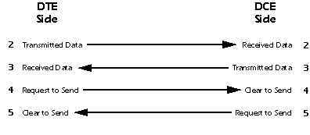
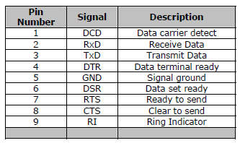
DB9 stuff
DTE vs DCE
Pinout of a DCE?
Common ground?
Noise effects?
Wiring a DTE device to a DCE device for communication is easy.
The pins are a one-to-one connection, meaning all wires go from pin x to pin x.
A straight through cable is commonly used for this application.
In contrast, wiring two DTE devices together requires crossing the transmit and receive wires.
This cable is known as a null modem or crossover cable.

Slide 31
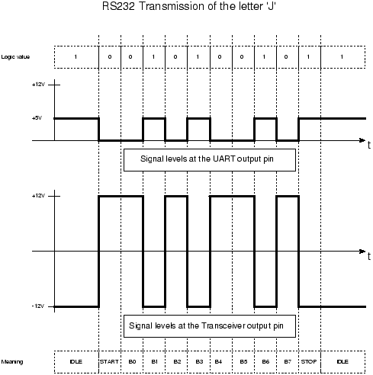
RS-232 transmission example

Slide 32
Agenda
Serial Buses
Introduction
UART
SPI
I2C
Glitches
Asynchronous resets and glitches
Design rules
Set-up and hold time.
Review
Dealing with external inputs
Design rules

Slide 33
Introduction
What is it?
Basic Serial Peripheral Interface (SPI)‏
Capabilities
Protocol
Pro / Cons and Competitor
Uses
Conclusion
Serial Peripheral Interface
http://upload.wikimedia.org/wikipedia/commons/thumb/e/ed/
SPI_single_slave.svg/350px-SPI_single_slave.svg.png

Slide 34
What is SPI?
Serial Bus protocol
Fast, Easy to use, Simple
Everyone supports it

Slide 35
SPI Basics
A communication protocol using 4 wires
Also known as a 4 wire bus
Used to communicate across small distances
Multiple Slaves, Single Master
Synchronized

Slide 36
Capabilities of SPI
Always Full Duplex
Communicating in two directions at the same time
Transmission need not be meaningful
Multiple Mbps transmission speed
Transfers data in 4 to 16 bit characters
Multiple slaves
Daisy-chaining possible

Slide 37
Protocol
Wires:
Master Out Slave In (MOSI)‏
Master In Slave Out (MISO)‏
System Clock (SCLK)‏
Slave Select 1…N
Master Set Slave Select low
Master Generates Clock
Shift registers shift in and out data

Slide 38
Wires in Detail
MOSI – Carries data out of Master to Slave
MISO – Carries data from Slave to Master
Both signals happen for every transmission
SS_BAR – Unique line to select a slave
SCLK – Master produced clock to synchronize data transfer

Slide 39
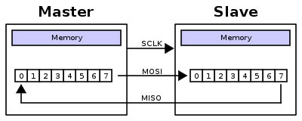
Shifting Protocol
Master shifts out data to Slave, and shift in data from Slave
http://upload.wikimedia.org/wikipedia/commons/thumb/b/bb/SPI_8-bit_circular_transfer.svg/400px-SPI_8-bit_circular_transfer.svg.png

Slide 40
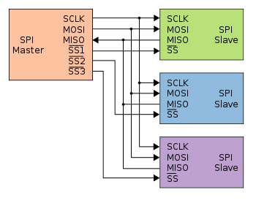
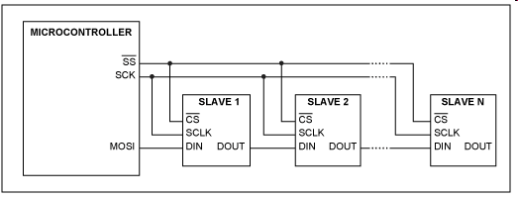
Diagram
Some wires have been renamed
Master and multiple daisy-chained slaves
http://www.maxim-ic.com/appnotes.cfm/an_pk/3947
Master and multiple independent slaves
http://upload.wikimedia.org/wikipedia/commons/thumb/f/fc/SPI_three_slaves.svg/350px-SPI_three_slaves.svg.png

Slide 41
Clock Phase (Advanced)‏
Two phases and two polarities of clock
Four modes
Master and selected slave must be in same mode
Master must change polarity and phase to communicate with slaves of different numbers

Slide 42
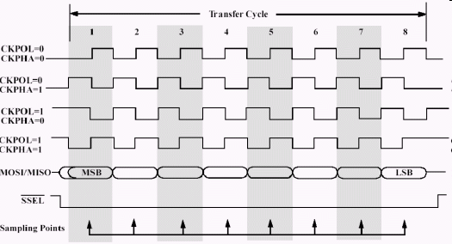
Timing Diagram
Timing Diagram – Showing Clock polarities and phases
http://www.maxim-ic.com.cn/images/appnotes/3078/3078Fig02.gif

Slide 43
Pros and Cons
Pros:
Fast and easy
Fast for point-to-point connections
Easily allows streaming/Constant data inflow
No addressing/Simple to implement
Everyone supports it
Cons:
SS makes multiple slaves very complicated
No acknowledgement ability
No inherent arbitration
No flow control

Slide 44
Uses
Some Serial Encoders/Decoders, Converters, Serial LCDs, Sensors, etc.
Pre-SPI serial devices

Slide 45
Summary
SPI – 4 wire serial bus protocol
MOSI MISO SS SCLK wires
Full duplex
Multiple slaves, One master
Best for point-to-point streaming data
Easily Supported

Slide 46
Agenda
Serial Buses
Introduction
UART
SPI
I2C
Glitches
Asynchronous resets and glitches
Design rules
Set-up and hold time.
Review
Dealing with external inputs
Design rules

Slide 59
Agenda
Serial Buses
Glitches
Asynchronous resets and glitches
Design rules
Set-up and hold time.
Review
Dealing with external inputs
Design rules

Slide 60
Glitches
Combinational logic can glitch
What is a glitch?
How do we normally deal with it?
Where can it hurt us?

Slide 61
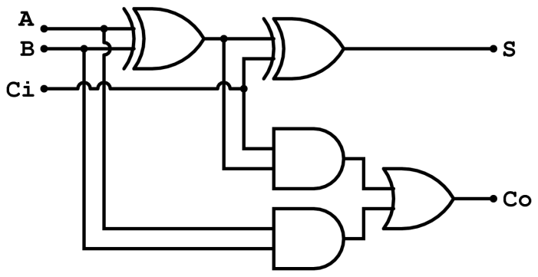
Timing
Assuming the XOR gates have a delay of 0.2ns while AND and OR gates have a delay of 0.1ns
What is the worst case propagation delay for this circuit?
x
y
z
Full adder (from Wikipedia)

Slide 62
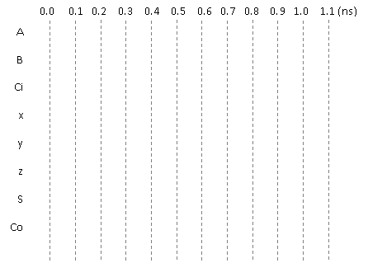
Glitches
x
y
Consider the adjacent circuit diagram. Assuming the XOR gates have
a delay of 0.2ns while AND and OR gates have a delay of 0.1ns, fill in
the following chart.
z
Full adder (from Wikipedia)
Only selected causality
arrows shown…

Slide 63
Glitching: a summary
When input(s) change, the output can be wrong for a time. However, that time is bound.
And more so, the output can change during this “computation time” even if the output ends up where it started!

Slide 64
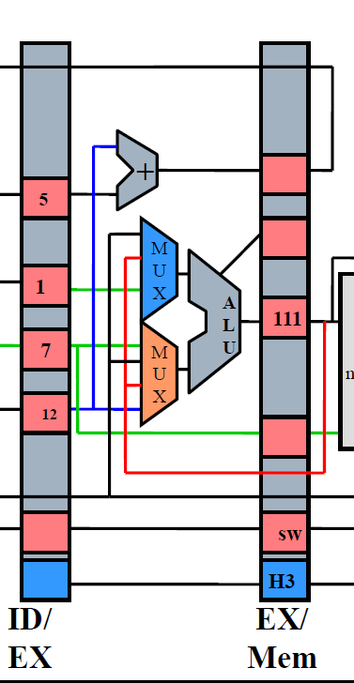
Effect of Glitches
Think back to EECS 370.
Why don’t glitches cause errors?
The trick is that the inputs all change at the same time
In this case, the ID/EX registers all change some time shortly after the rising edge of the clock.
And we’ve chosen the clock period such that the next edge doesn’t happen until the combinational logic has stopped glitching.
In fact, we use the worst-case combinational logic delay in the whole system when determining the clock period!
Notes:
Note the animation here. I didn’t want the text to show up on the printed slides.

Slide 65
So, how can glitches hurt us?
There are a handful of places:
Asynchronous resets
If you’ve got a flip-flop that has an asynchronous reset (or “preset”) you need to be sure the input can’t glitch.
That pretty much means you need a flip-flop driving the input (which means you probably should have used a sync. reset!)
Clocks
If you are using combinational logic to drive a clock, you are likely going to get extra clock edges.
Traditionally, CLR is used
to indicate async reset. “R”
or “reset” for sync. reset.
If clk is high and cond
glitches, you get extra
edges!

Slide 66
Design rules
X
Thou shall Not use asynchronous resets
Thou shall not drive a clock with anything other than a clock or directly off of a flip-flop’s output
X

Slide 67
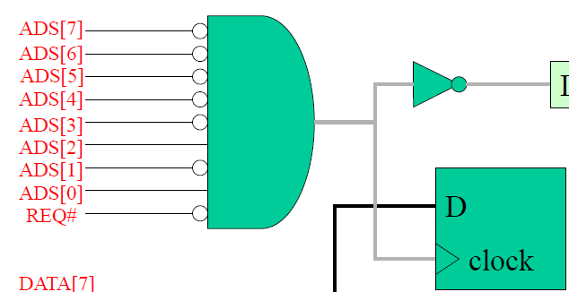
Really?
I mean people use asynchronous resets and clock gating!
Yep. And people use goto in C programs.
Sometimes they are the right thing.
But you have to think really hard about them to insure that they won’t cause you problems.
Our “simple” bus used combinational logic for the clock
Works because REQ goes low only after everything else has stopped switching
So no glitch.
Not fun to reason about…
Avoid unless you must
Then think really carefully.

Slide 68
Agenda
Serial Buses,
Glitches
Asynchronous resets and glitches
Design rules
Set-up and hold time.
Review
Dealing with external inputs
Design rules

Slide 69
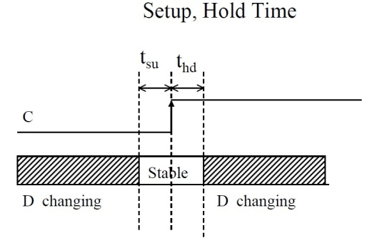
Setup and hold time
The idea is simple.
When the clock is changing if the data is also changing it is hard to tell what the data is.
Hardware can’t always tell
And you can get meta-stable behavior too (very unlikely but…)
So we have a “guard band” around the clock rising time during which we don’t allow the data to change.
See diagram. We call the time before the clock-edge “setup time” and the time after “hold time”
Notes:
Using dropping erasers thing. Drop 2 erasers, ask which hit first. The point being that it can be hard to tell even though they didn’t happen at the same time (no two things do). Makes sense we want some type of band around when the clock is changing so that the data isn’t so we grab the right thing.

Slide 70
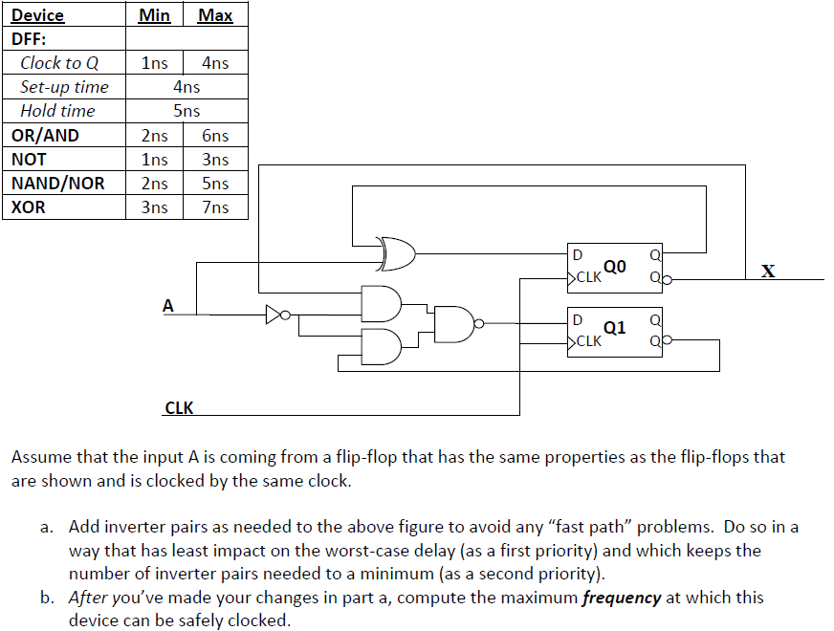
Example: Fast and slow paths; impact of setup and hold time
Notes:
From http://www.eecs.umich.edu/courses/eecs270/refs.html

Slide 71
So what happens if we violate set-up or hold time?
Often just get one of the two values.
And that often is just fine.
Consider getting a button press from the user.
If the button gets pressed at the same time as the clock edge, we might see the button now or next clock.
Either is generally fine when it comes to human input.
But bad things could happen.
The flip-flop’s output might not settle out to a “0” or a “1”
That could cause latter devices to mess up.
More likely, if that input is going to two places, one might see a “0” the other a “1”.

Slide 72
Example
A common thing to do is reset a state machine using a button.
User can “reset” the system.
Because the button transition could violate set-up or hold time, some state bits of the state machine might come out of reset at different times.
And you quickly end up at a wrong or illegal state.
Notes:
Insert story about the E100 here.

Slide 73
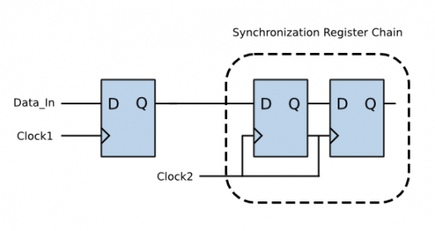
So…
Dealing with inputs not synchronized to our local clock is a problem.
Likely to violate setup or hold time.
That could lead to things breaking.
So we need a clock synchronization circuit.
First flip-flop might have problems.
Second should be fine.
Sometimes use a third if really paranoid
Safety-critical system for example.
Figure from http://www.eeweb.com/electronics-quiz/solving-metastability-design-issues, we use the same thing to deal with external inputs too!

Slide 74
Design rules
Thou shalt use a clock synchronization circuit when changing clock domains or using unclocked inputs!
/* Synchonization of Asynchronous switch input */ always@(posedge clk) begin sw0_pulse[0] <= sw_port[0]; sw0_pulse[1] <= sw0_pulse[0]; sw0_pulse[2] <= sw0_pulse[1]; end
always @(posedge clk) SSELr <= {SSELr[1:0], SSEL};
Notes:
Code from lab 3 and from http://www.fpga4fun.com/SPI2.html

