Slide 1
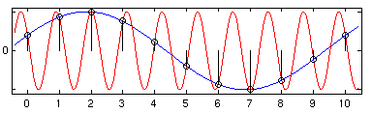
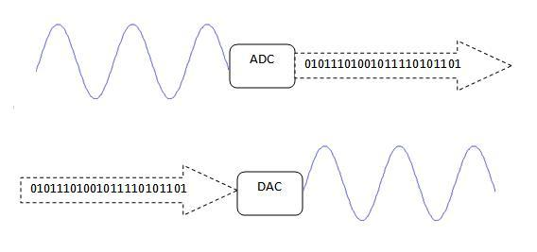
EECS 373
Design of Microprocessor-Based Systems
Ronald Dreslinski
University of Michigan
Sampling, ADCs, and DACs and more
Some slides adapted from Mark Brehob, Prabal Dutta, Jonathan Hui & Steve Reinhardt

Slide 2
Class Presentation Schedule
Group | Topic | Presentation Date | Practice Talk Date | Initial Meeting
Group 11 | Hbridges | November 14th | November 10th | November 4th
The Rock | Gyros/Accelerometers | November 14th | November 10th | November 4th
VRCar | Flex and Resistive Sensors | November 14th | November 10th | November 4th
Group CCK | Quadrature Encoders | November 14th | November 10th | November 4th
Recon | Xbee | November 16th | November 10th | November 4th
Group 4 | BLE / WII mote | November 16th | November 10th | November 4th
Group 9 | N64 Controller | November 16th | November 10th | November 4th
Group 6 | Touch Screens | November 16th | November 10th | November 4th
Group 5 | MIDI | November 21st | November 17th | November 4th
Team 8 | OpenCV | November 21st | November 17th | November 4th
Team 12 | Neural Networks | November 21st | November 17th | November 4th

Slide 3
Outline
Sampling
ADC
DAC

Slide 4
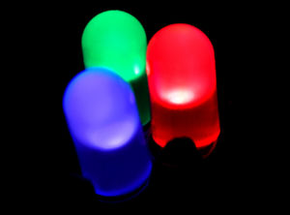
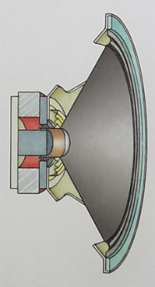
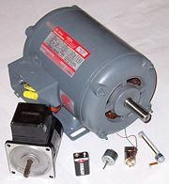
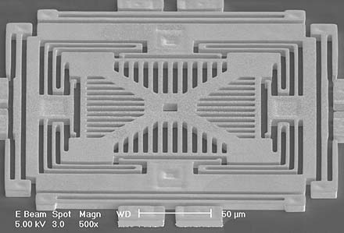
We live in an analog world
Everything in the physical world is an analog signal
  Sound, light, temperature, pressure
Need to convert into electrical signals
  Transducers: converts one type of energy to another
    Electro-mechanical, Photonic, Electrical, …
  Examples
    Microphone/speaker
    Thermocouples
    Accelerometers

Slide 5
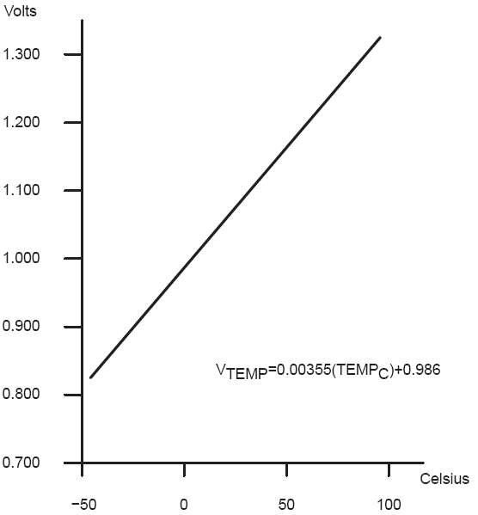
Transducers convert one form of energy into another
Transducers
  Allow us to convert physical phenomena to a voltage potential in a well-defined way.
A transducer is a device that converts one type of energy to another. The conversion can be to/from
electrical, electro-mechanical, electromagnetic, photonic, photovoltaic, or any other form of energy.
While the term transducer commonly implies use as a sensor/detector, any device which converts energy
can be considered a transducer. – Wikipedia.

Slide 6
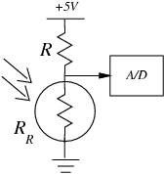
Convert light to voltage with a CdS photocell
V_{signal} = (+5V) R_{R}/(R + R_{R})
Choose R=R_{R} at median of intended range
Cadmium Sulfide (CdS)
Cheap, low current
t_{RC} = (R+R_{R})*C_{l}
  Typically R~50-200kΩ
  C~20pF
  So, t_{RC}~20-80uS
  f_{RC} ~ 10-50kHz
Source: Forrest Brewer

Slide 7
Many other common sensors (some digital)
Force
  strain gauges - foil, conductive ink
  conductive rubber
  rheostatic fluids
    Piezorestive (needs bridge)
  piezoelectric films
  capacitive force
    Charge source
Sound
  Microphones
    Both current and charge versions
  Sonar
    Usually Piezoelectric
Position
  microswitches
  shaft encoders
  gyros
Acceleration
  MEMS
  Pendulum
Monitoring
  Battery-level
    voltage
  Motor current
    Stall/velocity
  Temperature
    Voltage/Current Source
Field
  Antenna
  Magnetic
    Hall effect
    Flux Gate
Location
  Permittivity
  Dielectric
Source: Forrest Brewer

Slide 8
Going from analog to digital
What we want
How we have to get there
Physical
Phenomena
Engineering Units
Physical
Phenomena
Voltage or
Current
ADC Counts
Engineering Units
Sensor
ADC
Software

Slide 9
Representing an analog signal digitally
How do we represent an analog signal?
  As a time series of discrete values
  → On MCU: read the ADC data register periodically
V
Counts

Slide 10

Choosing the horizontal range
What do the sample values represent?
  Some fraction within the range of values
  → What range to use?
Range Too Small
Range Too Big
Ideal Range

Slide 11
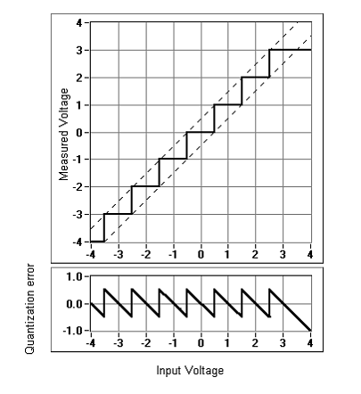
Choosing the horizontal granularity
Resolution
  Number of discrete values that represent a range of analog values
  MSP430: 12-bit ADC
    4096 values
    Range / 4096 = Step
  Larger range ➔ less information
Quantization Error
  How far off discrete value is from actual
  ½ LSB → Range / 8192
  Larger range ➔ larger error

Slide 12
Class Exercise
Lets say I have a temp sensor that has the transfer curve given as:
  Vtemp = 0.025*(Temp) + 0.1
I am interested in measuring a temperature range between 40 and 80 degrees, with a maximum error of 0.32 degrees (+/- 0.16).
What is the range of the ADC?
What does the quantization error need to be?
How many bits of resolution does the ADC need?

Slide 13
Choosing the sample rate
What sample rate do we need?
  Too little: we can’t reconstruct the signal we care about
  Too much: waste computation, energy, resources

Slide 14
Shannon-Nyquist sampling theorem
If a continuous-time signal contains no frequencies higher than , it can be completely determined by discrete samples taken at a rate:
Example:
  Humans can process audio signals 20 Hz – 20 KHz
  Audio CDs: sampled at 44.1 KHz

Slide 15
Converting between voltages,
ADC counts, and engineering units
Converting: ADC counts ⬄ Voltage
Converting: Voltage ⬄ Engineering Units

Slide 16
A note about sampling and arithmetic*
Converting values in fixed-point MCUs
  float vtemp = adccount/4095 * 1.5;
  float tempc = (vtemp-0.986)/0.00355;
  → vtemp = 0! Not what you intended, even when vtemp is a float!
  → tempc = -277 C
Fixed point operations
  Need to worry about underflow and overflow
Floating point operations
  They can be costly on the node
Notes:
$ cat arithmetic.c
#include <stdio.h>
int main() {
int adccount = 2048;
float vtemp;
float tempc;
vtemp = adccount/4095 * 1.5;
tempc = (vtemp-0.986)/0.00355;
printf("vtemp: %f\n", vtemp);
printf("tempc: %f\n", tempc);
}
$ gcc arithmetic.c
$ ./a.out
vtemp: 0.000000
tempc: -277.746490

Slide 17
Try it out for yourself…
$ cat arithmetic.c
#include <stdio.h>
int main() {
int adccount = 2048;
float vtemp;
float tempc;
vtemp = adccount/4095 * 1.5;
tempc = (vtemp-0.986)/0.00355;
printf("vtemp: %f\n", vtemp);
printf("tempc: %f\n", tempc);
}
$ gcc arithmetic.c
$ ./a.out
vtemp: 0.000000
tempc: -277.746490
Notes:
$ cat arithmetic.c
#include <stdio.h>
int main() {
int adccount = 2048;
float vtemp;
float tempc;
vtemp = adccount/4095 * 1.5;
tempc = (vtemp-0.986)/0.00355;
printf("vtemp: %f\n", vtemp);
printf("tempc: %f\n", tempc);
}
$ gcc arithmetic.c
$ ./a.out
vtemp: 0.000000
tempc: -277.746490

Slide 18
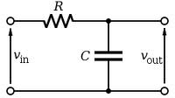
Use anti-aliasing filters on ADC inputs to ensure that Shannon-Nyquist is satisfied
Aliasing
  Different frequencies are indistinguishable when they are sampled.
Condition the input signal using a low-pass filter
  Removes high-frequency components
  (a.k.a. anti-aliasing filter)

Slide 19
Do I really need to condition my input signal?
Short answer: Yes.
Longer answer: Yes, but sometimes it’s already done for you.
  Many (most?) ADCs have a pretty good analog filter built in.
  Those filters typically have a cut-off frequency just above ½ their maximum sampling rate.
    Which is great if you are using the maximum sampling rate, less useful if you are sampling at a slower rate.

Slide 20
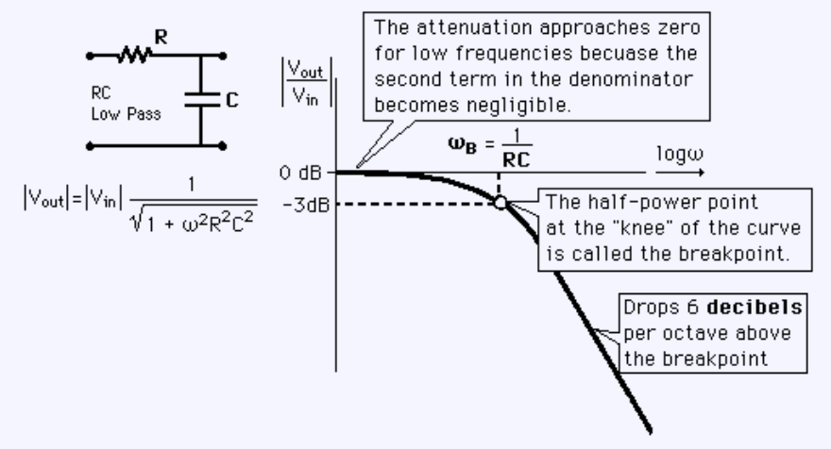
Designing the anti-aliasing filter
Note
  ω is in radians
  ω = 2πf
Exercise: Say you want the half-power point to be at 30Hz and you have a 0.1 μF capacitor. How big of a resistor should you use?
Notes:
R = 1/(w*C) = 1/(2*pi*f*C) = 1/(2*pi*30*0.1e-6) = 1/(0.00001884) = 53K
53K
0.5 = 1/sqrt [1 + (2*pi*30)^2 + R^2 * (0.1e-6)^2]
[1 + (2*pi*30)^2 + R^2 + (0.1e-6)^2] = 2
R = 1/[60*pi)^2 * (0.1e-6)^2] = 53K

Slide 21
Oversampling
One interesting trick is that you can use oversampling to help reduce the impact of quantization error.
  Let’s look at an example of oversampling plus dithering to get a 1-bit converter to do a much better job…

Slide 22
Oversampling a 1-bit ADC w/ noise & dithering (cont)
Voltage
Count
uniformly
distributed
random noise
±250 mV
“upper edge”
of the box
1
V_{thresh} = 500 mV
N₁ = 11
500 mV
375 mV
N₀ = 32
V_{rand} =
500 mV
0
0 mV
Note:
N₁ is the # of ADC counts that = 1 over the sampling window
N₀ is the # of ADC counts that = 0 over the sampling window

Slide 23
Oversampling a 1-bit ADC w/ noise & dithering (cont)
How to get more than 1-bit out of a 1-bit ADC?
Add some noise to the input
Do some math with the output
Example
  1-bit ADC with 500 mV threshold
  Vin = 375 mV → ADC count = 0
  Add ±250 mV uniformly distributed random noise to Vin
  Now, roughly
    25% of samples (N₁) ≥ 500 mV → ADC count = 1
    75% of samples (N₀) < 500 mV → ADC count = 0
  So, the “upper edge” of the box equals
    V_{thresh} + N1/(N1+N0) * V_{rand} = 0.5 + 11/(11+32)*0.5 = 0.628 V
  Middle of box (where our “signal” of 375 mV sits) equals
    0.628 V – V_{rand}/2 = 0.628 V – 0.25 = 0.378 V
  Real value is 0.375 V, so our estimate has < 1% error!

Slide 24
Lots of other issues
Might need anti-imaging filter
Cost and power play a role
Might be able to avoid analog all together
  Think PWM when dealing with motors…

Slide 25
DAC #1: Voltage Divider
Din
Fast
Size (transistors, switches)?
Accuracy?
Monotonicity?
Vref
2
2-to-4 decoder
R
R
R
Vout
R

Slide 26
DAC #2: R/2R Ladder
Vref
R
R
R
2R
2R
2R
2R
2R
Iout
D3 (MSB)
D2
D1
D0 (LSB)
Size?
Accuracy?
Monotonicity? (Consider 0111 -> 1000)

Slide 27
ADC #1: Flash
Vref
Vin
priority
encoder
R
+
_
3
R
+
_
2
2
Dout
R
+
_
1
R
Vcc
0

Slide 28
ADC #2: Single-Slope Integration
Vin
+
_
done
Vcc
I
C
EN*
n-bit counter
CLK
Start: Reset counter, discharge C.
Charge C at fixed current I until Vc > Vin . How should C, I, n, and CLK be related?
Final counter value is Dout.
Conversion may take several milliseconds.
Good differential linearity.
Absolute linearity depends on precision of C, I, and clock.
Notes:
DV = Vref / 2^n
DQ = C DV
I = DQ/DT
➔ I DT / C = Vref / 2^n

Slide 29
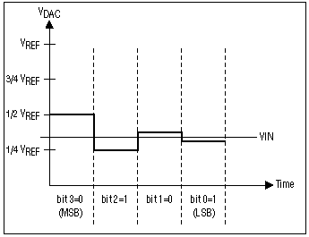
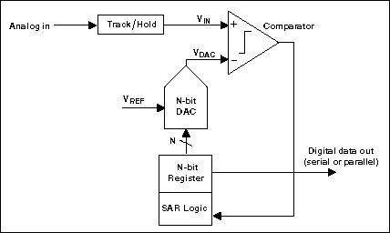
ADC #3: Successive Approximation (SAR)
1 Sample → Multiple cycles
Requires N-cycles per sample where N is # of bits
Goes from MSB to LSB
Not good for high-speed ADCs

Slide 30
Errors and ADCs
Figures and some text from:
  Understanding analog to digital converter specifications. By Len Staller
  http://www.embedded.com/showArticle.jhtml?articleID=60403334
Key concept here is that the specification provides worst case values.

Slide 31
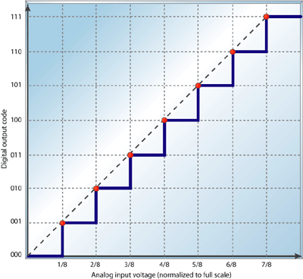

Slide 32
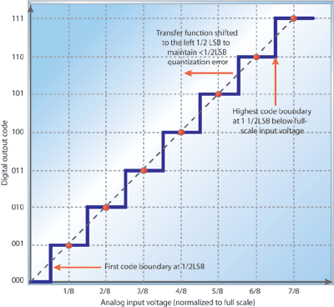

Slide 33
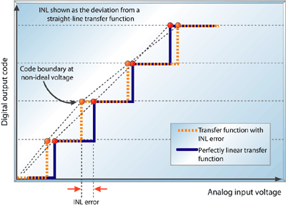
Integral nonlinearity
The integral nonlinearity (INL) is the deviation of an ADC's transfer function from a straight line.
This line is often a best-fit line among the points in the plot but can also be a line that connects
the highest and lowest data points, or endpoints. INL is determined by measuring the voltage
at which all code transitions occur and comparing them to the ideal. The difference between
the ideal voltage levels at which code transitions occur and the actual voltage is the INL error,
expressed in LSBs. INL error at any given point in an ADC's transfer function is the accumulation
of all DNL errors of all previous (or lower) ADC codes, hence it's called integral nonlinearity.

Slide 34
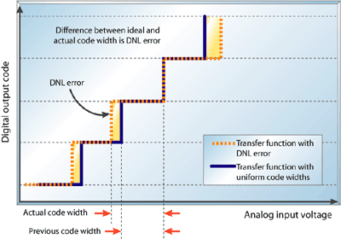
Differential nonlinearity
DNL is the worst cases variation of actual step size vs. ideal step size.
It’s a promise it won’t be worse than X.

Slide 35
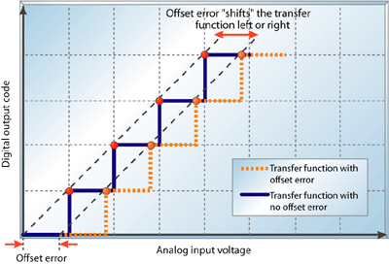
Sometimes the intentional ½ LSB shift is included here!

Slide 36
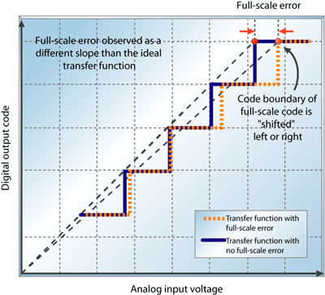
Full-scale error is also sometimes called “gain error”
full-scale error is the difference between the ideal code transition to the highest
output code and the actual transition to the output code when the offset error is zero.

Slide 37
Errors
Once again: Errors in a specification are worst case.
  So if you have an INL of ±.25 LSB, you “know” that the device will never have more than .25 LSB error from its ideal value.
  That of course assumes you are opperating within the specification
    Temperature, input voltage, input current available, etc.
INL and DNL are the ones I expect you to work with
  Should know what full-scale error is

