Slide 1
EECS 373
An very brief introduction to
Real-time systems
Real-time OSes
Chunks adapted from work by
Dr. Fred Kuhns of Washington University
and Farhan Hormasji

Slide 2
Announcements
Schedule for the remainder of the semester
Today, 12/5, (Last lecture)
Use remaining lecture time slots to work on projects
12/13 Design Expo
12/15 Project Write-up Due
12/18 Lab Clean-up complete
12/21 Final Exam
1:30-3:30pm in 1010/1018 DOW
Please fill out course evaluation online

Slide 3
What is a Real-Time System?
What is a RTS?
Real-time systems have been defined as: "those systems in which the correctness of the system depends not only on the logical result of the computation, but also on the time at which the results are produced";
J. Stankovic, "Misconceptions About Real-Time Computing," IEEE Computer, 21(10), October 1988.

Slide 4
Real-Time Characteristics
What is a RTS?
Pretty much your typical embedded system
Sensors & actuators all controlled by a processor.
The big difference is timing constraints (deadlines).
Those tasks can be broken into two categories¹
Periodic Tasks: Time-driven and recurring at regular intervals.
A car checking for a wall every 0.1 seconds;
An air monitoring system grabbing an air sample every 10 seconds.
Aperiodic: event-driven
That car having to react to a wall it found
The loss of network connectivity.
¹Sporadic tasks are sometimes also discussed as a third category. They are tasks similar to aperiodic tasks but activated with some known bounded rate. The bounded rate is characterized by a minimum interval of time between two successive activations.

Slide 5
Soft, Firm and Hard deadlines
What is a RTS?
The instant at which a result is needed is called a deadline.
If the result has utility even after the deadline has passed, the deadline is classified as soft, otherwise it is firm.
If a catastrophe could result if a firm deadline is missed, the deadline is hard.
Examples?
Definitions taken from a paper by Kanaka Juvva, not sure who originated them.

Slide 6
Why is this hard? Three major issues
What is a RTS?
We want to use as cheap ($$, power) a processor as possible.
Don’t want to overpay
There are non-CPU resources to worry about.
Say two devices both on an SPI bus.
So often can’t treat tasks as independent
Validation is hard
You’ve got deadlines you must meet.
How do you know you will?
Let’s discuss that last one a bit more

Slide 7
What is a real-time OS (RTOS)?
Well, an OS to manage to meet RT deadlines (duh).
While that’s all we need we’d like a lot more.
After all, we can meet RT deadlines fairly well on the bare metal (no OS)
But doing this is time consuming and difficult to get right as the system gets large.
We’d like something that supports us
Deadlines met
Interrupts just work
Tasks stay out of each others way
Device drivers already written (and tested!) for us
Portable—runs on a huge variety of systems
Oh, and nearly no overhead so we can use a small device!
That is a small memory and CPU footprint.

Slide 8
Detailed features we’d like
Deadlines met
Interrupts just work
All the tasks can run and stay out of each other’s way.
Interrupts are fast
So tasks with tight deadlines get service as fast as possible
Basically—rarely disable interrupts and when doing so only for a short time.
Don’t need to worry about saving/restoring registers
Which C just generally does for us anyways.
Interrupt prioritization easy to set.

Slide 9
Say you have “tasks” you want to do
Consider a car driving around by itself. Has a lot of things it needs to do
Read sensors
Read camera (yes, it’s a sensor, but lots more CPU)
Drive motors
Make high-level decisions about what actions to take.
For your project, you have probably found that “integration” is the hard part.
That is, each task isn’t so bad, but getting them all working together sucks.

Slide 10
Detailed features we’d like: Tasks stay out of each others way
This is actually remarkably hard
Clearly we need to worry about CPU utilization issues
scheduling algorithm
But we also need to worry about memory problems.
One task running awry shouldn’t take the rest of the system down.
So we want to prevent tasks from harming each other
This can be key. If we want mission critical systems sharing the CPU with less important things we have to do this.
Alternative it to have separate processors.
$$$$
The standard way to do this is with page protection.
If a process tries to access memory that isn’t its own, it fails.
Probably a fault.
This also makes debugging a LOT easier.
This generally requires a lot of overhead.
Need some sense of process number/switching
Need some kind of MMU in hardware
Most microcontrollers lack this…
So we hit some kind of minimum size.
Further reading on page protection (short) http://homepage.cs.uiowa.edu/~jones/security/notes/06.shtml

Slide 11
Hardware interfaces written (and tested!) for us
Ideally the RTOS has an interface for all the on-board peripherals.
It’s a lot easier to call a “configure_I2C()” function than to read the details of the device specification than to do the memory-mapped work yourself

Slide 12
Portable
RTOS runs on many platforms.
This is potentially incomputable with the previous slide.
It’s actually darn hard to do even without peripherals
Things like timers change and we certainly need timers.

Slide 13
A specific RTOS: FreeRTOS
One of the more popular (and free) RTOSes out there.
There are many commercial ones out there with lots of support and features.
But FreeRTOS is:
Free (as in beer and speech), complete with source
Well documented (somewhat free)
Easy to use
Does the basics well

Slide 14
Tasks
Each task is a function that must not return
So it’s in an infinite loop (just like you’d expect in an embedded system really, think Arduino).
You inform the scheduler of
The task’s resource needs (stack space, priority)
Any arguments the tasks needs
All tasks here must be of void return type and take a single void* as an argument.
You cast the pointer as needed to get the argument.
I’d have preferred var_args, but this makes the common case (one argument) easier (and faster which probably doesn’t matter).
Code examples mostly from Using the FreeRTOS Real Time Kernel (a pdf book), fair use claimed.

Slide 15
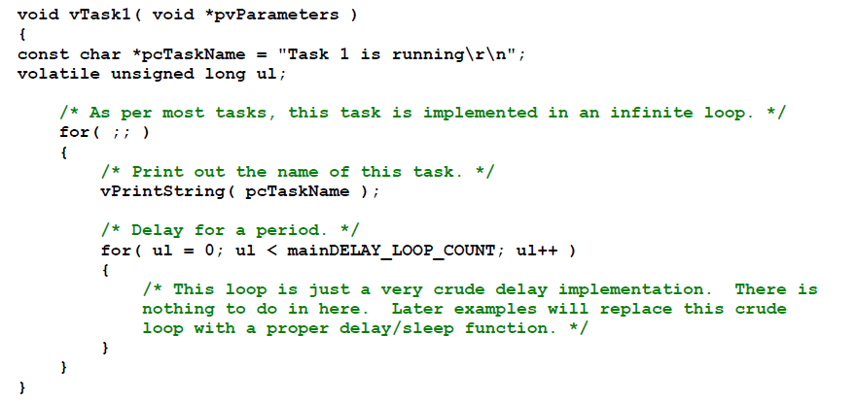
Example trivial task with busy wait (bad)

Slide 16
Task creation
portBASE_TYPE xTaskCreate(
pdTASK_CODE pvTaskCode,
const char * const pcName,
unsigned short usStackDepth,
void *pvParameters,
unsigned portBASE_TYPE uxPriority,
xTaskHandle *pvCreatedTask
);
Create a new task and add it to the list of tasks that are ready to run. xTaskCreate() can only be used to create a task that has unrestricted access to the entire microcontroller memory map. Systems that include MPU support can alternatively create an MPU constrained task using xTaskCreateRestricted().
pvTaskCode: Pointer to the task entry function. Tasks must be implemented to never return (i.e. continuous loop).
pcName: A descriptive name for the task. This is mainly used to facilitate debugging. Max length defined by tskMAX_TASK_NAME_LEN – default is 16.
usStackDepth: The size of the task stack specified as the number of variables the stack can hold - not the number of bytes. For example, if the stack is 16 bits wide and usStackDepth is defined as 100, 200 bytes will be allocated for stack storage.
pvParameters: Pointer that will be used as the parameter for the taskbeing created.
uxPriority: The priority at which the task should run. Systems that include MPU support can optionally create tasks in a privileged (system) mode by setting bit portPRIVILEGE_BIT of the priority parameter. For example, to create a privileged task at priority 2 the uxPriority parameter should be set to ( 2 | portPRIVILEGE_BIT ).
pvCreatedTask: Used to pass back a handle by which the created task can be referenced.
pdPASS: If the task was successfully created and added to a ready list, otherwise an error code defined in the file errors.h
From the task.h file in FreeRTOS

Slide 17
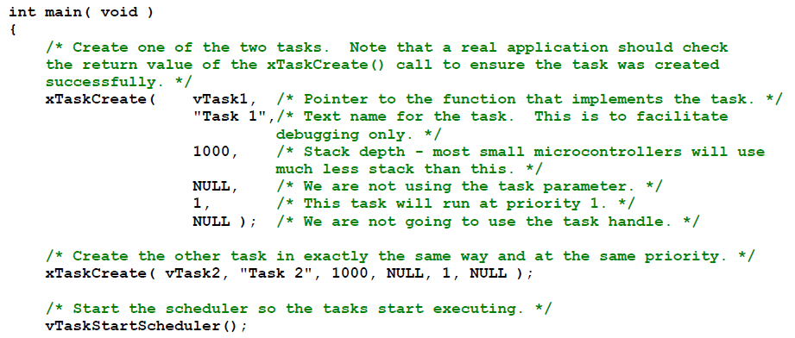
Creating a task: example

Slide 18
OK, I’ve created a task, now what?
Task will run if there are no other tasks of higher priority
And if others the same priority will RR.
But that begs the question: “How do we know if a task wants to do something or not?”
The previous example gave always wanted to run.
Just looping for delay (which we said was bad)
Instead should call vTaskDelay(x)
Delays current task for X “ticks”
There are a few other APIs for delaying…
Now we need an “under the hood” understanding

Slide 19
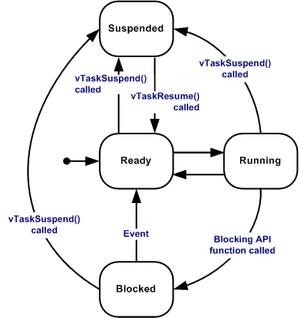
Task status in FreeRTOS
Running
Task is actually executing
Ready
Task is ready to execute but a task of equal or higher priority is Running.
Blocked
Task is waiting for some event.
Time: if a task calls vTaskDelay() it will block until the delay period has expired.
Resource: Tasks can also block waiting for queue and semaphore events.
Suspended
Much like blocked, but not waiting for anything.
Tasks will only enter or exit the suspended state when explicitly commanded to do so through the vTaskSuspend() and xTaskResume() API calls respectively.
Mostly from http://www.freertos.org/RTOS-task-states.html

Slide 20
Tasks: there’s a lot more
Can do all sorts of things
Change priority of a task
Delete a task
Suspend a task (mentioned above)
Get priority of a task.
Example on the right
But we’ll stop here…
void vTaskPrioritySet( xTaskHandle pxTask,
unsigned uxNewPriority );
Set the priority of any task.
pxTask: Handle to the task for which the priority is being set. Passing a NULL handle results in the priority of the calling task being set.
uxNewPriority: The priority to which the task will be set.

Slide 21
A RTOS needs to do a lot more…
Interrupts
Including deferred interrupts
Memory management
Standard I/O interfaces
Fast context switch
Locks
So only one task can use certain resources at a time.
FreeRTOS does each of those, some better than others.

