Slide 1
EECS 373
Design of Microprocessor-Based Systems
Website: www.eecs.umich.edu/courses/eecs373/
Ronald Dreslinski
University of Michigan
Midterm Review
Slides developed in part by Prof. Dutta and Dr. Brehob

Slide 2
What is an embedded system?

Slide 3
What is driving the
embedded everywhere explosion?

Slide 4
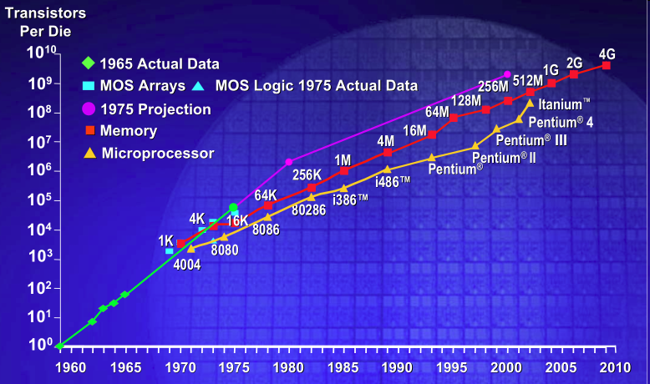
Moore’s Law (a statement about economics): IC transistor count doubles every 18-24 mo
Photo Credit: Intel

Slide 5
Bell’s Law: A new computer class every decade
“Roughly every decade a new, lower priced computer class forms based on a new programming platform, network, and interface resulting in new usage and the establishment of a new industry.”
- Gordon Bell [1972,2008]
5

Slide 6
What is driving Bell’s Law?
Technology Scaling
Technology Innovations
Moore’s Law
Made transistors cheap
Dennard’s Scaling
Made them fast
And low-power
Result
Holding #T’s constant
Exponentially lower cost
Exponentially lower power
Small, cheap & low-power
Microcontrollers
Memory
Radios
MEMS technology
Micro-fabricated sensors
New memories
New cell structures (11T)
New tech (FeRAM, FinFET)
Near-threshold computing
Minimize active power
Minimize static power
New wireless systems
Radio architectures
Modulation schemes
Energy harvesting

Slide 7
Why study 32-bit MCUs and FPGAs?

Slide 8
What differentiates these
products from one another?
FPGA Microprocessor
===== =============

Slide 9
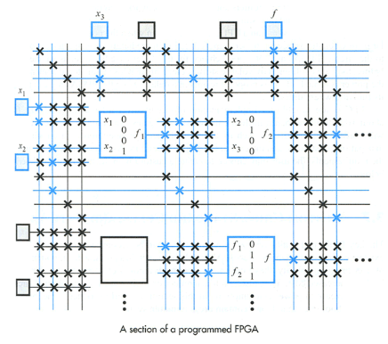
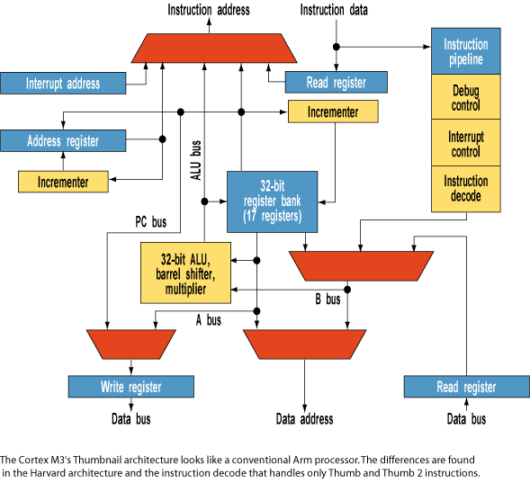
MPU FPGA

Slide 10
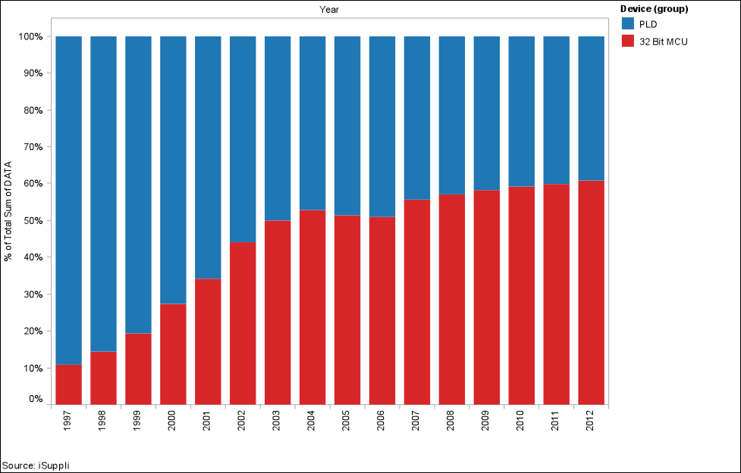
MCU-32 and PLDs are tied in embedded market share

Slide 11
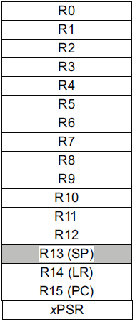
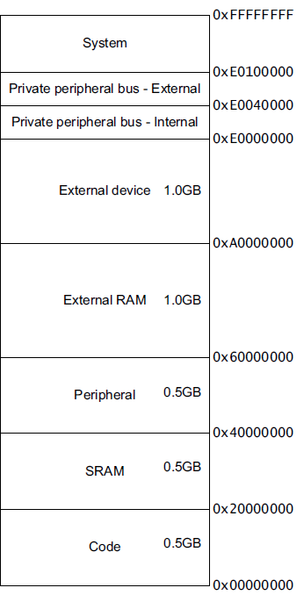
Major elements of an Instruction Set Architecture (registers, memory, word size, endianess, conditions, instructions, addressing modes)
32-bits
32-bits
mov r0, #1
ld r1, [r0,#5]
r1=mem((r0)+5)
bne loop
subs r2, #1
Endianess
Endianess

Slide 12
The endianess religious war: 284 years and counting!
Modern version
Danny Cohen
IEEE Computer, v14, #10
Published in 1981
Satire on CS religious war
Historical Inspiration
Jonathan Swift
Gulliver's Travels
Published in 1726
Satire on Henry-VIII’s split with the Church
Now a major motion picture!
Little-Endian
LSB is at lower address
Memory Value
Offset (LSB) (MSB)
====== ===========
uint8_t a = 1; 0x0000 01 02 FF 00
uint8_t b = 2;
uint16_t c = 255; // 0x00FF
uint32_t d = 0x12345678; 0x0004 78 56 34 12
Big-Endian
MSB is at lower address
Memory Value
Offset (LSB) (MSB)
====== ===========
uint8_t a = 1; 0x0000 01 02 00 FF
uint8_t b = 2;
uint16_t c = 255; // 0x00FF
uint32_t d = 0x12345678; 0x0004 12 34 56 78

Slide 13
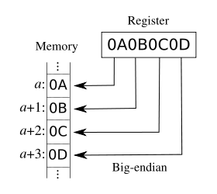
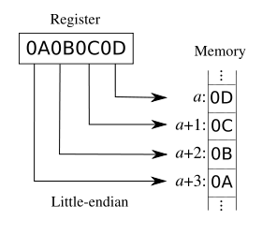
Addressing: Big Endian vs Little Endian (370 slide)
Endian-ness: ordering of bytes within a word
Little - increasing numeric significance with increasing memory addresses
Big – The opposite, most significant byte first
MIPS is big endian, x86 is little endian

Slide 14
Instruction encoding
Instructions are encoded in machine language opcodes
Sometimes
Necessary to hand generate opcodes
Necessary to verify assembled code is correct
How?
Instructions
movs r0, #10
movs r1, #0
Register Value Memory Value
001|00|000|00001010 (LSB) (MSB)
(msb) (lsb) 0a 20 00 21
001|00|001|00000000
ARMv7 ARM
Notes:
Condition codes are simply a way of testing the ALU status flags.

Slide 15
Assembly example
data:
.byte 0x12, 20, 0x20, -1
func:
mov r0, #0
mov r4, #0
movw r1, #:lower16:data
movt r1, #:upper16:data
top: ldrb r2, [r1],1
add r4, r4, r2
add r0, r0, #1
cmp r0, #4
bne top

Slide 16
An ISA defines the hardware/software interface
A “contract” between architects and programmers
Register set
Instruction set
Addressing modes
Word size
Data formats
Operating modes
Condition codes
Calling conventions
Really not part of the ISA (usually)
Rather part of the ABI
But the ISA often provides meaningful support.

Slide 17
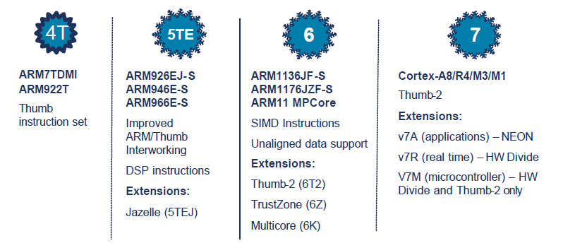
ARM Architecture roadmap

Slide 18
ARM Cortex-M3 ISA
Instruction Set
Register Set
Address Space
Branching
Data processing
Load/Store
Exceptions
Miscellaneous
32-bits
32-bits
Endianess
Endianess

Slide 19
Addressing Modes (again)
Offset Addressing
Offset is added or subtracted from base register
Result used as effective address for memory access
[<Rn>, <offset>]
Pre-indexed Addressing
Offset is applied to base register
Result used as effective address for memory access
Result written back into base register
[<Rn>, <offset>]!
Post-indexed Addressing
The address from the base register is used as the EA
The offset is applied to the base and then written back
[<Rn>], <offset>
Notes:
Condition codes are simply a way of testing the ALU status flags.

Slide 20
Application Program Status Register (APSR)
Notes:
Condition codes are simply a way of testing the ALU status flags.

Slide 21
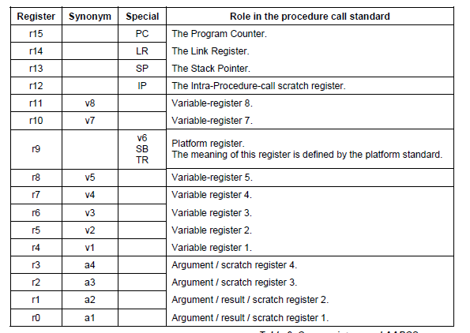

Slide 22
ABI quote
A subroutine must preserve the contents of the registers r4-r8, r10, r11 and SP (and r9 in PCS variants that designate r9 as v6).

Slide 23
ABI Basic Rules
A subroutine must preserve the contents of the registers r4-11 and SP
Let’s be careful with r9 though.
Arguments are passed though r0 to r3
If we need more, we put a pointer into memory in one of the registers.
We’ll worry about that later.
Return value is placed in r0
r0 and r1 if 64-bits.
Allocate space on stack as needed. Use it as needed.
Put it back when done…
Keep word aligned.

Slide 24
Other useful factoids
Stack grows down.
And pointed to by “sp”
Address we need to go back to in “lr”
And useful things for the example
Assembly instructions
add adds two values
mul multiplies two values
bx branch to register

Slide 25
Memory-mapped I/O
The idea is really simple
Instead of real memory at a given memory address, have an I/O device respond.
Huh?
Example:
Let’s say we want to have an LED turn on if we write a “1” to memory location 5.
Further, let’s have a button we can read (pushed or unpushed) by reading address 4.
If pushed, it returns a 1.
If not pushed, it returns a 0.

Slide 26
Now…
How do you get that to happen?
We could just say “magic” but that’s not very helpful.
Let’s start by detailing a simple bus and hooking hardware up to it.
We’ll work on a real bus next time!

Slide 27
Basic example
Discuss a basic bus protocol
Asynchronous (no clock)
Initiator and Target
REQ#, ACK#, Data[7:0], ADS[7:0], CMD
CMD=0 is read, CMD=1 is write.
REQ# low means initiator is requesting something.
ACK# low means target has done its job.

Slide 28
A read transaction
Say initiator wants to read location 0x24
Initiator sets ADS=0x24, CMD=0.
Initiator then sets REQ# to low. (why do we need a delay? How much of a delay?)
Target sees read request.
Target drives data onto data bus.
Target then sets ACK# to low.
Initiator grabs the data from the data bus.
Initiator sets REQ# to high, stops driving ADS and CMD
Target stops driving data, sets ACK# to high terminating the transaction

Slide 29
Read transaction
ADS[7:0]
CMD
Data[7:0]
REQ#
ACK#
??
0x24
??
??
0x55
??
A B C D E F G HI

Slide 30
A write transaction (write 0xF4 to location 0x31)
Initiator sets ADS=0x31, CMD=1, Data=0xF4
Initiator then sets REQ# to low.
Target sees write request.
Target reads data from data bus. (Just has to store in a register, need not write all the way to memory!)
Target then sets ACK# to low.
Initiator sets REQ# to high & stops driving other lines.
Target sets ACK# to high terminating the transaction

Slide 31
The push-button (if ADS=0x04 write 0 or 1 depending on button)
ADS[7]
ADS[6]
ADS[5]
Delay
ACK#
ADS[4]
ADS[3]
ADS[2]
ADS[1]
ADS[0]
Data[7]
REQ#
..
..
..
..
..
0
Button (0 or 1)
Data[0]
Button (0 or 1)

Slide 32
The push-button (if ADS=0x04 write 0 or 1 depending on button)
ADS[7]
ADS[6]
ADS[5]
Delay
ACK#
ADS[4]
ADS[3]
ADS[2]
ADS[1]
ADS[0]
Data[7]
REQ#
..
..
..
..
..
0
What about CMD?
Data[0]
Button (0 or 1)

Slide 33
The LED (1 bit reg written by LSB of address 0x05)
ADS[7]
ADS[6]
ADS[5]
Delay
ACK#
ADS[4]
ADS[3]
ADS[2]
ADS[1]
ADS[0]
Flip-flop which controls LED
D
REQ#
clock
DATA[7]
DATA[6]
DATA[5]
DATA[4]
DATA[3]
DATA[2]
DATA[1]
DATA[0]

Slide 34
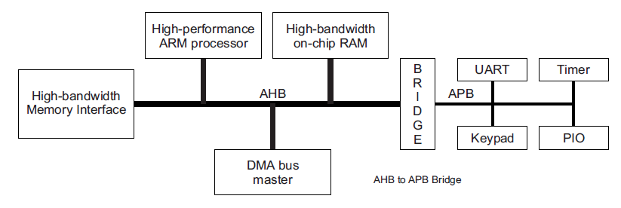
Advanced Microcontroller Bus Architecture (AMBA) - Advanced High-performance Bus (AHB) - Advanced Peripheral Bus (APB)
AHB
APB
High performance
Pipelined operation
Burst transfers
Multiple bus masters
Split transactions
Low power
Latched address/control
Simple interface
Suitable of many peripherals

Slide 35
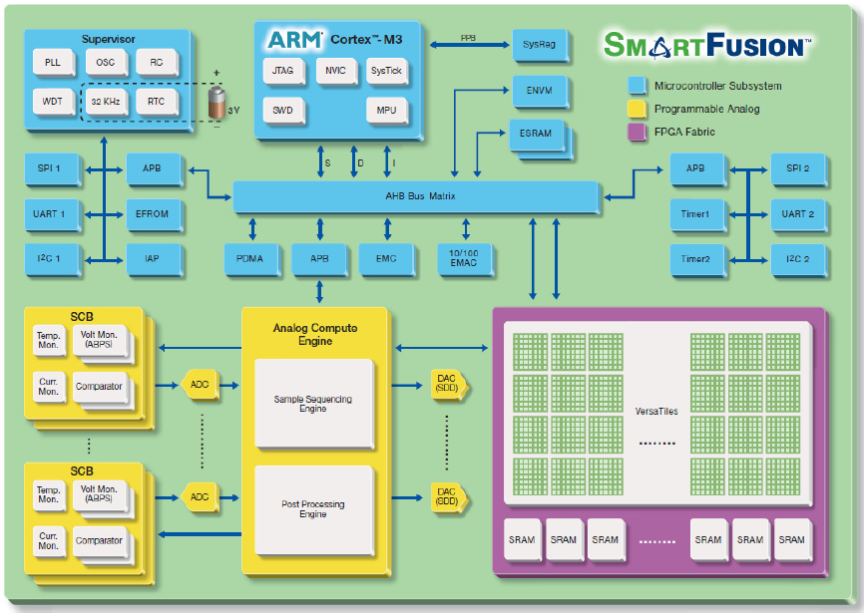
Actel SmartFusion system/bus architecture

Slide 36
Bus terminology
Any given transaction have an “initiator” and “target”
Any device capable of being an initiator is said to be a “bus master”
In many cases there is only one bus master (single master vs. multi-master).
A device that can only be a target is said to be a slave device.
Some wires might be shared among all devices while others might be point-to-point connections (generally connecting the master to each target).

Slide 37
Driving shared wires
It is commonly the case that some shared wires might have more than one potential device that needs to drive them.
For example there might be a shared data bus that is used by the targets and the initiator. We saw this in the simple bus.
In that case, we need a way to allow one device to control the wires while the others “stay out of the way”
Most common solutions are:
using tri-state drivers (so only one device is driving the bus at a time)
using open-collector connections (so if any device drives a 0 there is a 0 on the bus otherwise there is a 1)

Slide 38
Or just say no to shared wires.
Another option is to not share wires that could be driven by more than one device...
This can be really expensive.
Each target device would need its own data bus.
That’s a LOT of wires!
Not doable when connecting chips on a PCB as you are paying for each pin.
Quite doable (though not pretty) inside of a chip.

Slide 39
APB is a fairly simple bus designed to be easy to work with.
Low-cost
Low-power
Low-complexity
Low-bandwidth
Non-pipelined
Ideal for peripherals

Slide 40
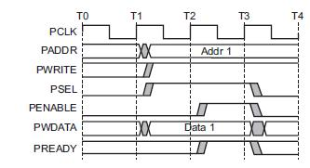
APB bus signals
PCLK
Clock
PADDR
Address on bus
PWRITE
1=Write, 0=Read
PWDATA
Data written to the I/O device. Supplied by the bus master/processor.

Slide 41
APB bus signals
PSEL
Asserted if the current bus transaction is targeted to this device
PENABLE
High during entire transaction other than the first cycle.
PREADY
Driven by target. Similar to our #ACK. Indicates if the target is ready to do transaction. Each target has it’s own PREADY

Slide 42
So what’s happening here?

Slide 43
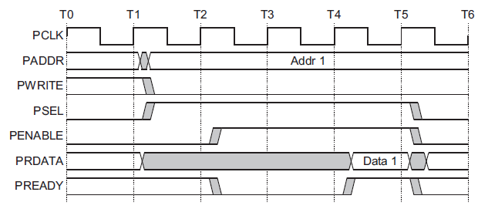
A read transfer with wait states
Setup phase begins
with this rising edge
Setup
Phase
Wait
State
Wait
State
Access
Phase

Slide 44
Interrupts
Interrupt (a.k.a. exception or trap):
An event that causes the CPU to stop executing the current program and begin executing a special piece of code called an interrupt handler or interrupt service routine (ISR). Typically, the ISR does some work and then resumes the interrupted program.
Interrupts are really glorified procedure calls, except that they:
can occur between any two instructions
are transparent to the running program (usually)
are not explicitly requested by the program (typically)
call a procedure at an address determined by the type of interrupt, not the program

Slide 45
Two basic types of interrupts (1/2)
Those caused by an instruction
Examples:
TLB miss
Illegal/unimplemented instruction
div by 0
Names:
Trap, exception

Slide 46
Two basic types of interrupts (2/2)
Those caused by the external world
External device
Reset button
Timer expires
Power failure
System error
Names:
interrupt, external interrupt

Slide 47
How it works
Something tells the processor core there is an interrupt
Core transfers control to code that needs to be executed
Said code “returns” to old program
Much harder then it looks.
Why?

Slide 48
… is in the details
How do you figure out where to branch to?
How do you ensure that you can get back to where you started?
Don’t we have a pipeline? What about partially executed instructions?
What if we get an interrupt while we are processing our interrupt?
What if we are in a “critical section?”

Slide 49
Where
If you know what caused the interrupt then you want to jump to the code that handles that interrupt.
If you number the possible interrupt cases, and an interrupt comes in, you can just branch to a location, using that number as an offset (this is a branch table)
If you don’t have the number, you need to poll all possible sources of the interrupt to see who caused it.
Then you branch to the right code

Slide 50
Enabling and disabling interrupt sources

Slide 51
Polling-Driven Application
Recall pushbutton-LED example
mov r0, #0x4 % PBS MMIO address
mov r1, #0x5 % LED MMIO address
loop: ldr r2, [r0, #0] % Read value from switch [1 cycle]
str r2 [r1, #0] % Save value to LED [1 cycle]
b loop % Repeat these steps [1 cycle]
This is a polling-driven application
Software constantly loops, polling and (re)acting
However, it doesn’t do anything else useful!
Notes:
mov r0, #0x4 % PB
mov r1, #0x5 % LED
loop: ldr r2, [r0, #0]
str r2 [r1, #0]
b loop

Slide 52
The Problem with Polling
If we want to do other work, we might call a routine:
mov r0, #0x4 % PBS MMIO address
mov r1, #0x5 % LED MMIO address
loop: ldr r2, [r0, #0] % Read value from switch [1 cycle]
str r2 [r1, #0] % Save value to LED [1 cycle]
bl do_some_work % Do some other work [100 cycles]
b loop % Repeat these steps [1 cycle]
Polling affects the responsiveness of PBS ⬄ LED path!
Whenever we’re “doing some work,” we not polling PBS
And the more “other work” we do, the worse the latency gets
And it affects the efficiency of the processor
The ldr/str values don’t change very either much
So, the processor is mostly wasting CPU cycles (and energy)
Notes:
LDR % Assume PBS changes just after sampling, so latency = 1 cycle
STR % latency += 1 cycle
B % latency += 1 cycle
Delay? So LDR (1, just missed) + STR (1) + B (1) + LDR (1) + STR (1) ~ 5 cycles asymptotic worst case
Efficiency? Well, its basically zero since we’re not doing any useful work, so ~ 0%
LDR % Assume PBS changes just after sampling, so latency = 1 cycle
STR % latency += 1 cycle
BL % latency += 100 cycles
B % latency += 1 cycle
Delay? So LDR (1, just missed) + STR (1) + BL (100) + B (1) + LDR (1) + STR (1) ~ 105 cycles asymptotic worst case
Efficiency? BL (100) / [LDR (1) + STR (1) + BL (100) + B (1)] ~ 100/103, so ~ 97%

Slide 53
Polling trades off efficiency and responsiveness
mov r0, #0x4 % PBS MMIO address
mov r1, #0x5 % LED MMIO address
loop: ldr r2, [r0, #0] % Read value from switch [1 cycle]
str r2 [r1, #0] % Save value to LED [1 cycle]
bl do_some_work % Do some other work [100 cycles]
b loop % Repeat these steps [1 cycle]
Efficiency
Minimizing useless work
Maximizing useful work
Saving cycles & energy
Responsiveness
Minimizing latency
Tight event-action coupling
Can we do better? Yes!
Efficiency
Responsiveness

Slide 54
Level-triggered interrupts
Basics:
Signaled by asserting a line low or high
Interrupting device drives line low or high and holds it there until it is serviced
Device deasserts when directed to or after serviced
Requires some way to tell it to stop.
Sharing?
Can share the line among multiple devices
Often open-collector or HiZ
Active devices assert the line, inactive devices let the line float
Easy to share line w/o losing interrupts
But servicing increases CPU load
And requires CPU to keep cycling through to check
Different ISR costs suggests careful ordering of ISR checks
Can’t detect a new interrupt when one is already asserted
Notes:
PCI originally mandated level-triggered due to this

Slide 55
Edge-triggered interrupts
Basics:
Signaled by a level *transition* (e.g. rising/falling edge)
Interrupting device drives a pulse onto INT line
Sharing *is* possible
INT line has a pull up and all devices are OC/OD.
Could we miss an interrupt? Maybe...if close in time
What happens if interrupts merge? Need one more ISR pass
Easy to detect "new interrupts”
Pitfalls: spurious edges, missed edges
Source of "lockups" in early computers
Notes:
PCI originally mandated level-triggered due to this

Slide 56
Basic interrupt processing
The stack (PSP or MSP)
Stacking
Automatically by CPU
Maintains ABI semantics
ISRs can be C functions
Vector Fetch
We’ll see this next
Exit: update of SP, LR, PC
⇧
Higher Addresses
Previous
stacked
data
SP
xPSR
PC
LR
R12
R3
R2
R1
R0
Free
stack
space
Lower Addresses
⇧

Slide 57
NVIC/Interrupt configuration registers
ICTR Interrupt Controller Type Register (RW)
ISER Interrupt Set-Enable Register (RW)
ICER Interrupt Clear-Enable Register (RW)
ISPR Interrupt Set-Pending Register (RW)
ICPR Interrupt Clear-Pending Register (RW)
IABR Interrupt Active Bit Register (RO)
IPR Interrupt Priority Register (RW)
AIRC Application Interrupt and Reset Control
Notes:
ICTR: shows the number of interrupt lines the NVIC supports (up to 240)
ISER/ICER: enable/disable external interrupts
ISPR/ICPR: Set and cleared by HW and/or SW
IABR: Set and cleared by hardware automatically (verify)
IPR: Sets priorities for the interrupts
AIRC: vector access key, priority group, reset request, etc.

Slide 58
Enabling and disabling interrupt sources
Notes:
Set corresponding bit to

Slide 61
Pending interrupts
The normal case. Once Interrupt request is seen, processor puts it in
“pending” state even if hardware drops the request.
IPS is cleared by the hardware once we jump to the ISR.
This figure and those following are from The Definitive Guide to the ARM Cortex-M3, Section 7.4

Slide 62
In this case, the processor never took the interrupt because we cleared the
IPS by hand (via a memory-mapped I/O register)

Slide 64
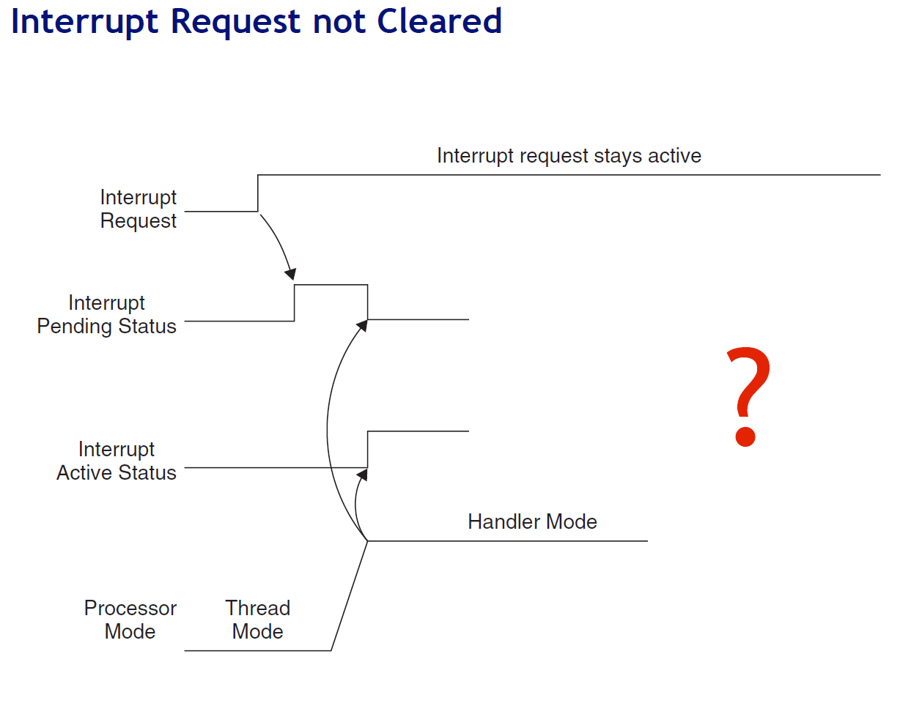

Slide 65
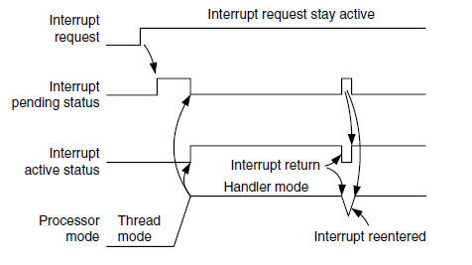
Answer

Slide 66
Interrupt pulses before entering ISR

Slide 67
Answer

Slide 69
Interrupt Priority
What do we do if several interrupts arrive simultaneously?
NVIC allows priorities for (almost) every interrupt
3 fixed highest priorities, up to 256 programmable priorities
128 preemption levels
Not all priorities have to be implemented by a vendor
SmartFusion has 32 priority levels, i.e. 0x00, 0x08, … , 0xF8
Higher priority interrupts can pre-empt lower priorities
Priority can be sub-divided into priority groups
Splits priority register into two halves, preempt priority & subpriority
Preempt priority: indicates if an interrupt can preempt another
Subpriority: used to determine which is served first if two interrupts of same group arrive concurrently

Slide 70
Interrupt Priority (2)
Interrupt priority level registers
Range: 0xE000E400 to 0xE000E4EF

Slide 71
Preemption Priority and Subpriority

Slide 72
PRIMASK, FAULTMASK, and BASEPRI registers
What if we quickly want to disable all interrupts?
Write 1 into PRIMASK to disable all interrupts except NMI
MOV R0, #1
MSR PRIMASK, R0 ; MSR and MRS are special instructions
Write 0 into PRIMASK to enable all interrupts
FAULTMASK is the same as PRIMASK, but it also blocks hard faults (priority = -1)
What if we want to disable all interrupts below a certain priority?
Write priority into BASEPRI register
MOV R0, #0x60
MSR BASEPRI, R0

Slide 73
Masking

Slide 74
Interrupt Service Routines
Automatic saving of registers upon exception
PC, PSR, R0-R3, R12, LR
This occurs over data bus
While data bus busy, fetch exception vector
i.e. target address of exception handler
This occurs over instruction bus
Update SP to new location
Update IPSR (low part of xPSR) with exception new #
Set PC to vector handler
Update LR to special value EXC_RETURN
Several other NVIC registers gets updated
Latency can be as short as 12 cycles (w/o mem delays)

Slide 75
The xPSR register layout

Slide 76
ARM interrupt summary
We’ve got a bunch of memory-mapped registers that control things (NVIC)
Enable/disable individual interrupts
Set/clear pending
Interrupt priority and preemption
We’ve got to understand how the hardware interrupt lines interact with the NVIC
And how we figure out where to set the PC to point to for a given interrupt source.

Slide 77
1. NVIC registers (example)

Slide 78
1. More registers (example)

Slide 79
1. Yet another part of the NVIC registers!

Slide 80
2. How external lines interact with the NVIC
The normal case. Once Interrupt request is seen, processor puts it in
“pending” state even if hardware drops the request.
IPS is cleared by the hardware once we jump to the ISR.
This figure and those following are from The Definitive Guide to the ARM Cortex-M3, Section 7.4

Slide 81
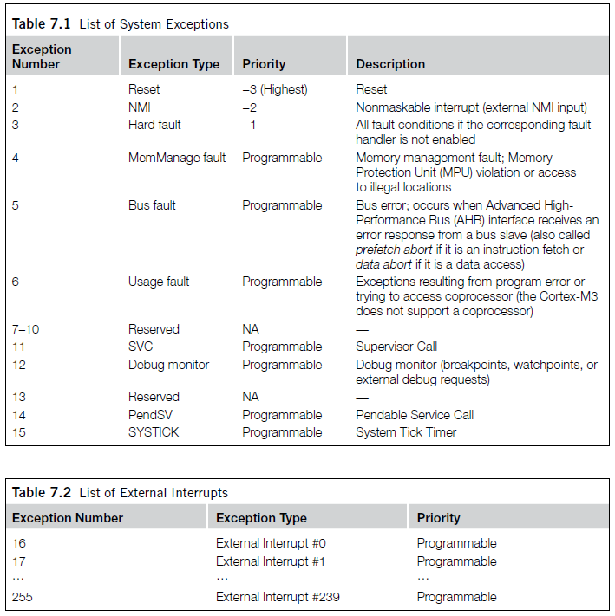
3. How the hardware figures out what to set the PC to
g_pfnVectors:
.word _estack
.word Reset_Handler
.word NMI_Handler
.word HardFault_Handler
.word MemManage_Handler
.word BusFault_Handler
.word UsageFault_Handler
.word 0
.word 0
.word 0
.word 0
.word SVC_Handler
.word DebugMon_Handler
.word 0
.word PendSV_Handler
.word SysTick_Handler
.word WdogWakeup_IRQHandler
.word BrownOut_1_5V_IRQHandler
.word BrownOut_3_3V_IRQHandler
.............. (they continue)

Slide 82
What happens when we return from an ISR?
Interrupt exiting process
System restoration needed (different from branch)
Special LR value could be stored (0xFFFFFFFx)
Tail chaining
When new exception occurs
But CPU handling another exception of same/higher priority
New exception will enter pending state
But will be executed before register unstacking
Saving unnecessary unstacking/stacking operations
Can reenter hander in as little as 6 cycles
Late arrivals (ok, so this is actually on entry)
When one exception occurs and stacking commences
Then another exception occurs before stacking completes
And second exception of higher preempt priority arrives
The later exception will be processed first

Slide 83
What happens when we return from an ISR?
Interrupt exiting process
System restoration needed (different from branch)
Special LR value could be stored (0xFFFFFFFx)
Walkthrough a few examples, simplified system assumptions:
5 Interrupt Levels (0-4)
256 Priority Levels (0 Highest, 256 Lowest)
First time presenting, so errors in the animation are unintentional but may be present (lets find out together)

Slide 84
Single Interrupt
Interrupt on Level 4
HW
SW
Program
Execution Time
Priority Table
Pending
Program
Stack
4
0
0
1
2
3
4
8
0
0
0
0
0
10
5
Enabled
3
4
0
6
1
1
1
1
1
Base Priority
Active
4
0
256
0
0
0
0
0

Slide 85
Single Interrupt
Interrupt on Level 4
HW
SW
Stack
Program
Execution Time
Priority Table
Pending
Program
Stack
4
0
0
1
2
3
4
8
1
0
0
0
0
10
5
Enabled
PC
3
4
0
PSR
6
1
1
1
1
1
LR
Active
R0-R3, R12
Base Priority
4
0
6
0
0
0
0
0

Slide 86
Single Interrupt
Interrupt on Level 4
HW
SW
Stack
Program
ISR-LVL4
Execution Time
Priority Table
Pending
Program
Stack
4
0
0
1
2
3
4
8
0
0
0
0
0
10
5
Enabled
PC
3
4
0
PSR
6
1
1
1
1
1
LR
Active
R0-R3, R12
Base Priority
4
0
ISR-LVL4
Stack
6
1
0
0
0
0

Slide 87
Single Interrupt
Interrupt on Level 4
bx lr
HW
SW
Stack
Program
ISR-LVL4
Execution Time
Priority Table
Pending
Program
Stack
4
0
0
1
2
3
4
8
0
0
0
0
0
10
5
Enabled
PC
3
4
0
PSR
6
1
1
1
1
1
LR
Active
R0-R3, R12
Base Priority
4
0
6
1
0
0
0
0

Slide 88
Single Interrupt
Interrupt on Level 4
bx lr
HW
SW
Stack
Unstack
Program
ISR-LVL4
Execution Time
Priority Table
Pending
Program
Stack
4
0
0
1
2
3
4
8
0
0
0
0
0
10
5
Enabled
3
4
0
6
1
1
1
1
1
Base Priority
Active
4
0
6
0
0
0
0
0

Slide 89
Single Interrupt
Interrupt on Level 4
bx lr
HW
SW
Stack
Unstack
Program
ISR-LVL4
Program
Execution Time
Priority Table
Pending
Program
Stack
4
0
0
1
2
3
4
8
0
0
0
0
0
10
5
Enabled
3
4
0
6
1
1
1
1
1
Base Priority
Active
4
0
256
0
0
0
0
0

Slide 90
Nested Interrupts
When new exception occurs
And CPU handling another exception of lower priority (incoming request is higher priority)
New exception will interrupt the current ISR
Will generate a new ISR stack on the stack

Slide 91
Nested Interrupt
Interrupt on Level 4
Interrupt on Level 3
HW
SW
Stack
Program
ISR-LVL4
Execution Time
Program
Stack
Priority Table
Pending
PC
4
0
0
1
2
3
4
8
0
0
0
0
0
PSR
LR
10
R0-R3, R12
5
Enabled
3
4
0
ISR-LVL4
Stack
6
1
1
1
1
1
Base Priority
Active
4
0
6
1
0
0
0
0

Slide 92
Nested Interrupt
Interrupt on Level 4
Interrupt on Level 3
HW
SW
Stack
Stack
Program
ISR-LVL4
Execution Time
Program
Stack
Priority Table
Pending
PC
4
0
0
1
2
3
4
8
0
1
0
0
0
PSR
LR
10
R0-R3, R12
5
Enabled
3
4
0
ISR-LVL4
Stack
6
1
1
1
1
1
PC
Base Priority
Active
SP
4
0
LR
6
1
0
0
0
0
R0-R4, R12

Slide 93
Nested Interrupt
Interrupt on Level 4
Interrupt on Level 3
HW
SW
Stack
Stack
Program
ISR-LVL4
ISR-LVL3
Execution Time
Program
Stack
Priority Table
Pending
PC
4
0
0
1
2
3
4
8
0
0
0
0
0
PSR
LR
10
R0-R3, R12
5
Enabled
3
4
0
ISR-LVL4
Stack
6
1
1
1
1
1
PC
Base Priority
Active
PSR
4
0
LR
3
1
1
0
0
0
R0-R3, R12
ISR-LVL3
Stack

Slide 94
Nested Interrupt
Interrupt on Level 4
Interrupt on Level 3
bx lr
HW
SW
Stack
Stack
Unstack
Program
ISR-LVL4
ISR-LVL3
Execution Time
Program
Stack
Priority Table
Pending
PC
4
0
0
1
2
3
4
8
0
0
0
0
0
PSR
LR
10
R0-R3, R12
5
Enabled
3
4
0
ISR-LVL4
Stack
6
1
1
1
1
1
Base Priority
Active
4
0
6
1
0
0
0
0

Slide 95
Nested Interrupt
Interrupt on Level 4
Interrupt on Level 3
bx lr
bx lr
HW
SW
Stack
Stack
Unstack
Unstack
Program
ISR-LVL4
ISR-LVL3
ISR-LVL4
Execution Time
Program
Stack
Priority Table
Pending
4
0
0
1
2
3
4
8
0
0
0
0
0
10
5
Enabled
3
4
0
6
1
1
1
1
1
Base Priority
Active
4
0
256
0
0
0
0
0

Slide 96
Tail Chaining
When new exception occurs
But CPU handling another exception of same/higher priority (incoming request is lower priority)
New exception will enter pending state
But will be executed before register unstacking
Saving unnecessary unstacking/stacking operations
Can reenter hander in as little as 6 cycles

Slide 97
Tail-Chaining
Interrupt on Level 4
Interrupt on Level 1
HW
SW
Stack
Program
ISR-LVL4
Execution Time
Program
Stack
Priority Table
Pending
PC
4
0
0
1
2
3
4
8
0
0
0
1
0
PSR
LR
10
R0-R3, R12
5
Enabled
3
4
0
ISR-LVL4
Stack
6
1
1
1
1
1
Base Priority
Active
4
0
6
1
0
0
0
0

Slide 98
Tail-Chaining
Interrupt on Level 4
Interrupt on Level 1
bx lr
Don’t Unstack
HW
SW
Stack
Program
ISR-LVL4
Execution Time
Program
Stack
Priority Table
Pending
PC
4
0
0
1
2
3
4
8
0
0
0
1
0
PSR
LR
10
R0-R3, R12
5
Enabled
3
4
0
6
1
1
1
1
1
Base Priority
Active
4
0
6
0
0
0
0
0

Slide 99
Tail-Chaining
Interrupt on Level 4
Interrupt on Level 1
bx lr
HW
SW
Stack
Program
ISR-LVL4
ISR-LVL1
Execution Time
Program
Stack
Priority Table
Pending
PC
4
0
0
1
2
3
4
8
0
0
0
0
0
PSR
LR
10
R0-R3, R12
5
Enabled
3
4
0
ISR-LVL1
Stack
6
1
1
1
1
1
Base Priority
Active
4
0
10
0
0
0
1
0

Slide 100
Tail-Chaining
Interrupt on Level 4
Interrupt on Level 1
bx lr
bx lr
HW
SW
Stack
Unstack
Program
ISR-LVL4
ISR-LVL1
Program
Execution Time
Program
Stack
Priority Table
Pending
4
0
0
1
2
3
4
8
0
0
0
0
0
10
5
Enabled
3
4
0
6
1
1
1
1
1
Base Priority
Active
4
0
256
0
0
0
0
0

Slide 101
Late Arrival
Late arrivals (ok, so this is actually on entry)
When one exception occurs and stacking commences
Then another exception occurs before stacking completes
And second exception of higher preempt priority arrives
The later exception will be processed first

Slide 102
Late Arrival
Once stacking complete, find vector for highest priority pending
Interrupt on Level 4
Interrupt on Level 3
HW
SW
Stack
Program
Execution Time
Program
Stack
Priority Table
Pending
PC
4
0
0
1
2
3
4
8
1
1
0
0
0
PSR
LR
10
R0-R3, R12
5
Enabled
3
4
0
6
1
1
1
1
1
Base Priority
Active
4
0
256
0
0
0
0
0

Slide 103
Late Arrival
Interrupt on Level 4
Interrupt on Level 3
bx lr
HW
SW
Stack
Program
ISR-LVL3
Execution Time
Program
Stack
Priority Table
Pending
PC
4
0
0
1
2
3
4
8
1
0
0
0
0
PSR
LR
10
R0-R3, R12
5
Enabled
3
4
0
ISR-LVL3
Stack
6
1
1
1
1
1
Base Priority
Active
4
0
3
0
1
0
0
0

Slide 104
Late Arrival
Tail Chaining used to service lower priority request
Interrupt on Level 4
Interrupt on Level 3
bx lr
bx lr
HW
SW
Stack
Unstack
Program
ISR-LVL3
ISR-LVL4
Program
Execution Time
Program
Stack
Priority Table
Pending
4
0
0
1
2
3
4
8
0
0
0
0
0
10
5
Enabled
3
4
0
6
1
1
1
1
1
Base Priority
Active
4
0
256
0
0
0
0
0

Slide 105
Virtual Timers
You never have enough timers.
Never.
So what are we going to do about it?
How about we handle in software?

Slide 106
Virtual Timers
Simple idea.
Maybe we have 10 events we might want to generate.
Just make a list of them and set the timer to go off for the first one.
Do that first task, change the timer to interrupt for the next task.

Slide 107
Problems?
Only works for “compare” timer uses.
Will result in slower ISR response time
May not care, could just schedule sooner…

Slide 108
Implementation Issues
Shared user-space/ISR data structure.
Insertion happens at least some of the time in user code.
Deletion happens in ISR.
We need critical section (disable interrupt)
How do we deal with our modulo counter?
That is, the timer wraps around.
Why is that an issue?
What functionality would be nice?
Generally one-shot vs. repeating events
Might be other things desired though
What if two events are to happen at the same time?
Pick an order, do both…

Slide 109
Implementation Issues (continued)
What data structure?
Data needs be sorted
Inserting one thing at a time
We always pop from one end
But we add in sorted order.

Slide 110
Data structures

Slide 111
Some loose ends…glitches and all that

Slide 112
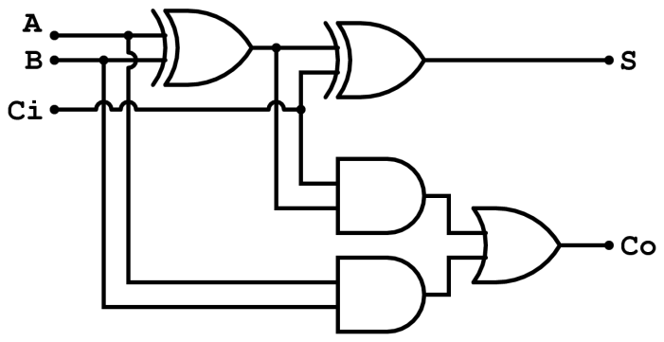
Timing delays and propagation
Assume
XOR delay = 0.2ns
AND delay = 0.1ns
OR delay = 0.1 ns
What is the worst case propagation delay for this circuit?
x
y
z
Full adder (from Wikipedia)

Slide 113
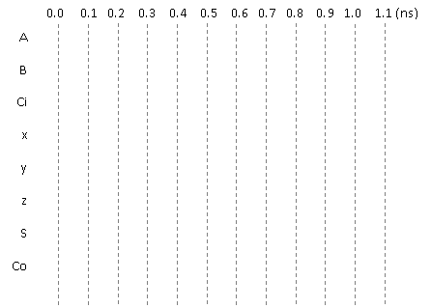
Glitches
x
Consider the adjacent circuit diagram. Assuming the XOR gates have
a delay of 0.2ns while AND and OR gates have a delay of 0.1ns, fill in
the following chart.
y
z
Full adder (from Wikipedia)
Only selected causality
arrows shown…

Slide 114
Glitching: a summary
When input(s) change
The output can be wrong for a time
However, that time is bounded
And more so, the output can change during this “computation time” even if the output ends up where it started!

Slide 115
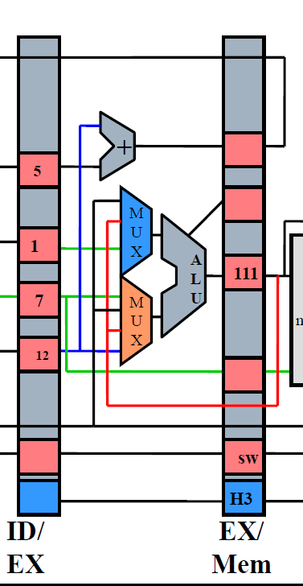
Effect of Glitches
Think back to EECS 370.
Why don’t glitches cause errors?
The trick is that the inputs all change at the same time
In this case, the ID/EX registers all change some time shortly after the rising edge of the clock.
And we’ve chosen the clock period such that the next edge doesn’t happen until the combinational logic has stopped glitching.
In fact, we use the worst-case combinational logic delay in the whole system when determining the clock period!
Notes:
Note the animation here. I didn’t want the text to show up on the printed slides.

Slide 116
So, how can glitches hurt us?
There are a handful of places:
Asynchronous resets
If you’ve got a flip-flop that has an asynchronous reset (or “preset”) you need to be sure the input can’t glitch.
That pretty much means you need a flip-flop driving the input (which means you probably should have used a sync. reset!)
Clocks
If you are using combinational logic to drive a clock, you are likely going to get extra clock edges.
Traditionally, CLR is used
to indicate async reset. “R”
or “reset” for sync. reset.
If clk is high and cond
glitches, you get extra
edges!

Slide 117
Design rules
X
Thou shalt not use asynchronous resets
Thou shalt not drive a clock with anything other than a clock or directly off of a flip-flop’s output
X

Slide 118
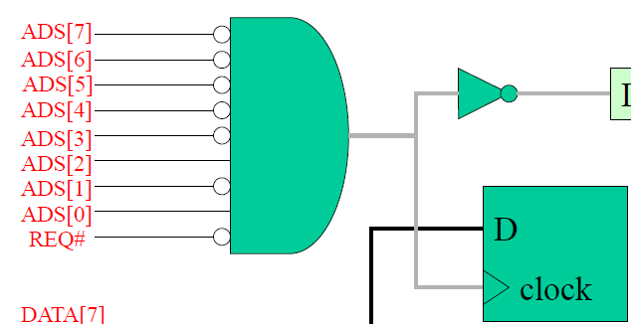
Really? Seriously?
People do use asynchronous resets and clock gating!
Yep. And people use goto in C programs.
Sometimes they are the right thing.
But you have to think really hard about them to insure that they won’t cause you problems.
Our “simple” bus used combinational logic for the clock
Works because REQ goes low only after everything else has stopped switching
So no glitch.
Not fun to reason about…
Avoid unless you must
Then think really carefully.

Slide 119
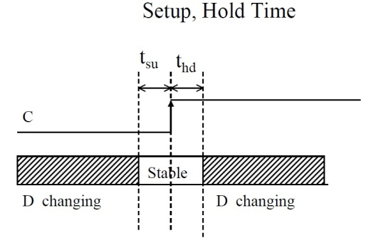
Setup and hold time
The idea is simple.
When the clock is changing if the data is also changing it is hard to tell what the data is.
Hardware can’t always tell
And you can get meta-stable behavior too (very unlikely but…)
So we have a “guard band” around the clock rising time during which we don’t allow the data to change.
See diagram. We call the time before the clock-edge “setup time” and the time after “hold time”
Notes:
Using dropping erasers thing. Drop 2 erasers, ask which hit first. The point being that it can be hard to tell even though they didn’t happen at the same time (no two things do). Makes sense we want some type of band around when the clock is changing so that the data isn’t so we grab the right thing.

Slide 120
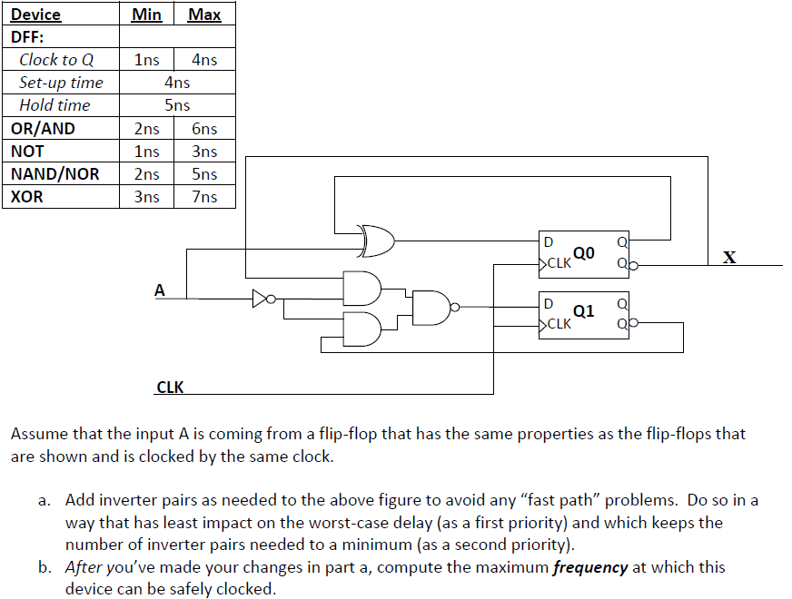
Example: Fast and slow paths; impact of setup and hold time
Notes:
From http://www.eecs.umich.edu/courses/eecs270/refs.html

Slide 121
So what happens if we violate set-up or hold time?
Often just get one of the two values.
And that often is just fine.
Consider getting a button press from the user.
If the button gets pressed at the same time as the clock edge, we might see the button now or next clock.
Either is generally fine when it comes to human input.
But bad things could happen.
The flip-flop’s output might not settle out to a “0” or a “1”
That could cause later devices to mess up.
More likely, if that input is going to two places, one might see a “0” the other a “1”
Important: don’t feed an async input to multiple places!

Slide 122
Example
A common thing to do is reset a state machine using a button.
User can “reset” the system.
Because the button transition could violate set-up or hold time, some state bits of the state machine might come out of reset at different times.
And you quickly end up at a wrong or illegal state.
Notes:
Insert story about the E100 here.

Slide 123
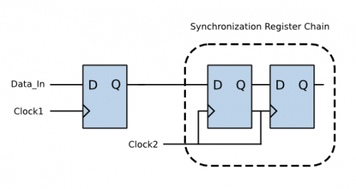
So…
Dealing with inputs not synchronized to our local clock is a problem.
Likely to violate setup or hold time.
That could lead to things breaking.
So we need a clock synchronization circuit.
First flip-flop might have problems.
Second should be fine.
Sometimes use a third if really paranoid
Safety-critical system for example.
Figure from http://www.eeweb.com/electronics-quiz/solving-metastability-design-issues, we use the same thing to deal with external inputs too!

Slide 124
Design rules
Thou shalt use a clock synchronization circuit when changing clock domains or using unclocked inputs!
✓
/* Synchonization of Asynchronous switch input */ always@(posedge clk) begin sw0_pulse[0] <= sw_port[0]; sw0_pulse[1] <= sw0_pulse[0]; sw0_pulse[2] <= sw0_pulse[1]; end
always @(posedge clk) SSELr <= {SSELr[1:0], SSEL};
Notes:
Code from lab 3 and from http://www.fpga4fun.com/SPI2.html

