Slide 1
welcome [Aswin Rao – aswins@ti.com aswins@umich.edu]

Slide 2
TI offers the broadest, most complete semiconductor portfolio

Slide 3
TI in it - Vehicles

Slide 4
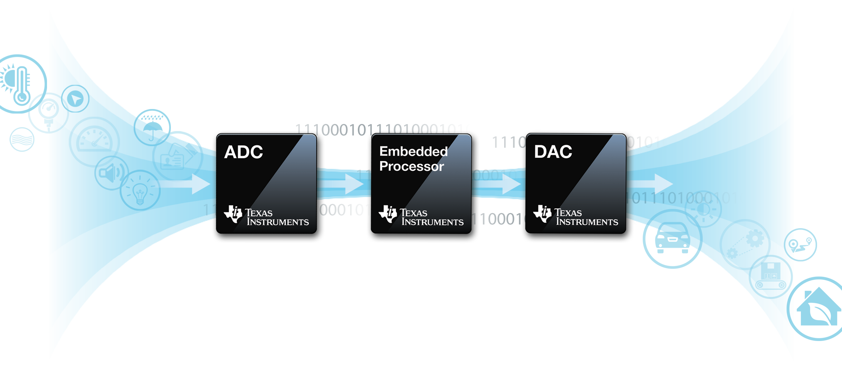
Analog & Embedded processors at work in the real world
Relay processed information back to the real world
Such as…
Real-time braking systems
Vibrant digital images
Precise efficient motors
Etc.
Gather analog information from
the real world
Temperature
Pressure
Position
Speed
Flow
Humidity
Sound
Light
Etc.
Convert
Process
Convert

Slide 5
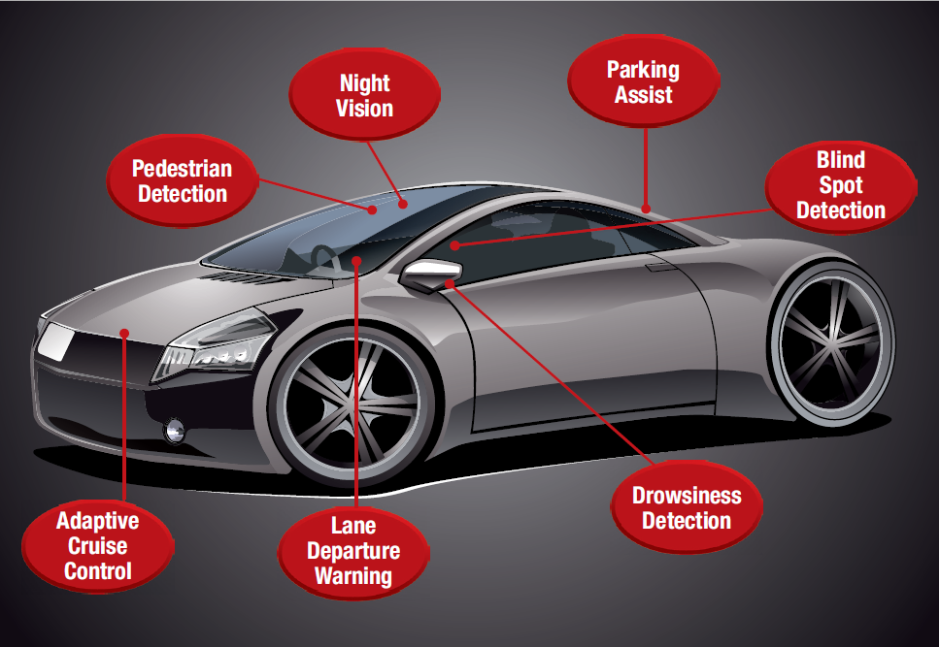
From headlights to taillights and all systems in between
DaVinci & DM81x, AEC-Q100 Video processors (parallel architectures for multiple vision algorithms, sub 3W power)
TI Embedded speech recognizer (TIesr) – fixed point APIs
Access Control (Biometrics) – fingerprint sensor CC5x ultra low power DSP (feature extraction)
Surveillance (SAVA) – C6000 DSPs or DaVinci DMVAx Video processors

Slide 6
Automotive Embedded Analytics
Embedded
Systems
Embedded
Analytics
Human
senses
Diverse algorithms
- mathematical, statistical, signal and image-processing techniques
- machine learning, pattern recognition etc
Fast processing, predictable latency
- real time processing
- time bounded and deterministic
Data throughput
- hierarchical memory organization, Advanced DMA
Low Power consumption
Cost

Slide 7
ADAS (Automatic Driver Assistance System) Camera system

Slide 8
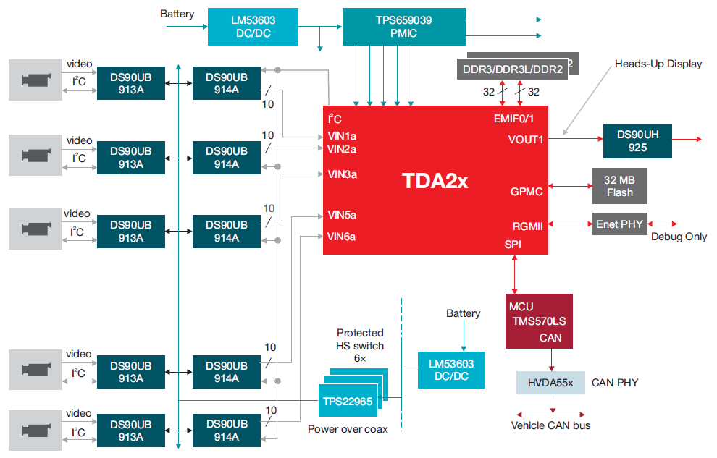
ADAS Implementation
RGB +v-sync +clock into 1 serial line (CML based FPD-Link II)

Slide 9
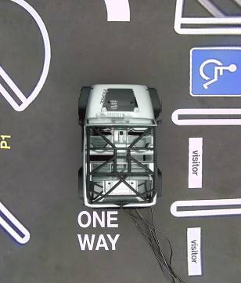
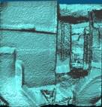
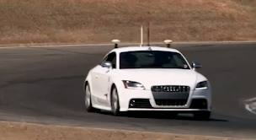
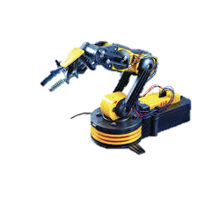
TI Perception Processing & Analytics Lab
SCENE
TDA3x
ADASLow
Auto-BU
TDA2x
J6
(Vayu)
Image
AR1xxx
NR1xxx
WCS
TDA4x
FC Next
Understand scenes
3D structure
Object locations
Object motions
Material properties
Assist humans
Visual information
Audio Warnings
Radar
MCU
-C2000
- MSP430
MCU
Automotive Processor
Ultrasonic
Analog
KeyStone II
66AK2Hx
(Hawking)
Time Of Flight/LIDAR
Catalog Processor
Situation smart
control of machines
Cars
Robots
Buildings
Health Diagnostics
Understand people
and objects
Locations
Actions
Health (vitals)
Thermal
MCU
-C2000
- MSP430
Other sensors
(i.e. DLP structured light)
MCU
TI has products in multiple 3D sensing technologies
EP has the broadest set of processors and MCUs
Leading applications in broad perception applications in automotive and industrial

Slide 10
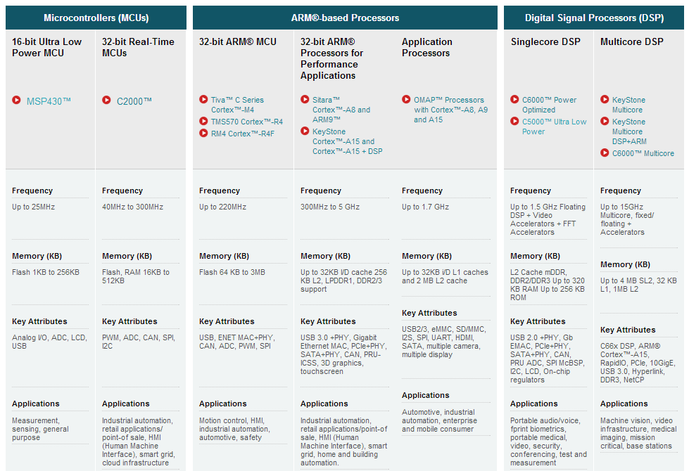
TI embedded processors
Intro to Programming
Digital Control and Power
Robotics / Mechatronics
Linux Programming
Signals & Systems
High Performance
Compute
Computer Science
Communications
MCU / Embedded Systems / MPU
Real-Time DSP
Bio Engr
Sensor Nets
Lighting and Renewables
Med.
Image Processing
Robotics / Vision Analytics
PROJECTS: Undergraduate, Masters, PhD
Code Composer Studio – One Install for All

Slide 11
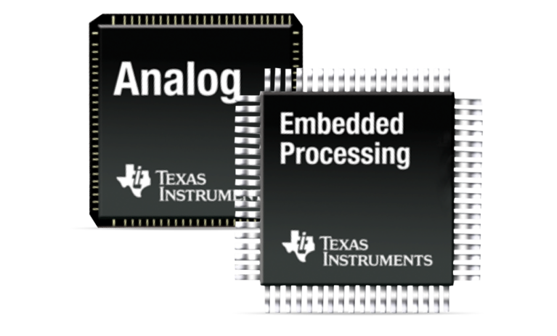
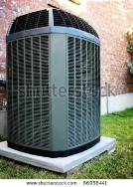
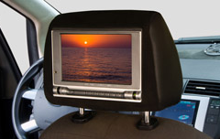
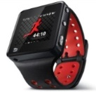
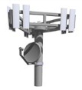
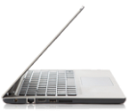
TI has presence over 100,000 products in multiple industries
TRANSPORTATION & AUTOMOTIVE
INDUSTRIAL
Hybrid
electric vehicles
Railway
systems
White goods & HVAC
Automation
Aviation
Infotainment
Drives & motion control
Human machine interface
Robotics
COMPUTING & COMMUNICATIONS
RENEWABLE ENERGY & SMART GRID
HEALTH & FITNESS
High-performance computing
Smart building controls
Solar and
wind power
inverters
Power line communication
Portable ultrasound
Wireless fitness monitoring
Blood pressure monitor
Thin client
Mobile
devices
Base
station
Portable mobile computing

Slide 12
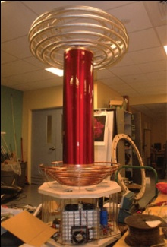
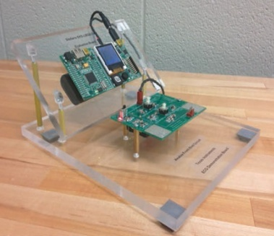
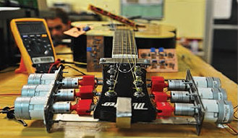
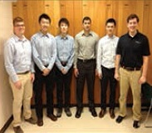
Texas Instruments Innovation Challenge 2015 North America design contest
Requirements
Use at least 3 TI analog ICs or 2 analog ICs and a TI processor
Undergrad & grad student teams from any university with an accredited engineering school in the U.S., Canada, and Mexico
Submit by May 24, 2015
Benefits
Chairman award –
$10,000 first prize,
$7,500 second
$5,000 third
Exposure to potential employers or a possible career at TI!
Free IC’s, $200 coupon toward evaluation modules, and contest t-shirts
Judging criteria
Originality/creativity
Complexity/quality
Level of engineering analysis
Description quality of how TI products benefited overall design
Usage of TI ICs
Video of working demo
www.ti.com/tiic-na
Notes:
12

Slide 13
Upcoming Events
UMICH TI TBP Info Session,
1014 Dow, 9/11/2014, 5:00 PM - 7:00 PM
UMICH TI Material Science Info Session,
1504 GG Brown, 9/12/2014, 11:30 to 12:30 PM
SWE/ TBP Career Fair 2014
9/22/2014, 10:00AM - 4:00PM

Slide 14
Other Information

Slide 15
Microcontroller architecture
TI has four unique microcontroller architectures that can be divided up into two main categories
TI-Proprietary cores
Application developed expertise around TI-based R&D
ARM-Based ores
Popular ARM Limited Cortex M- and Cortex R- microcontroller cores
MSP
(Low power)
C2000
(Rea- time control)
S2
Safety & security
Tiva
ARM Products
16-bit
32-bit
The Chip
MSP430
C2000
TMS570
Cortex R4
Cortex M3
Cortex M4F
<300Mhz
this can be either a micro-controller, digital signal processor, microprocessor or a combination of all these— referred to as an embedded processor
<25Mhz
<220Mhz
5Featured teaching platforms
2 Featured teaching platforms
NEW
3 Featured teaching platforms
Notes:
15

