Slide 1
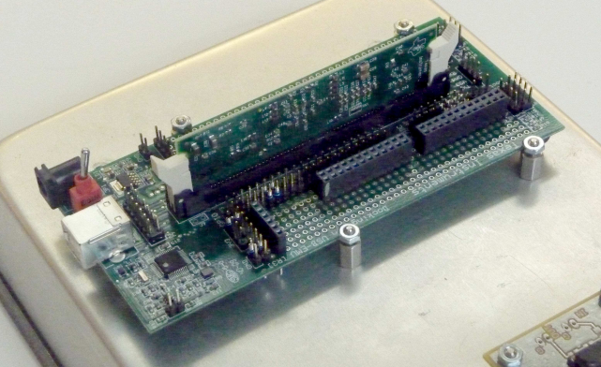
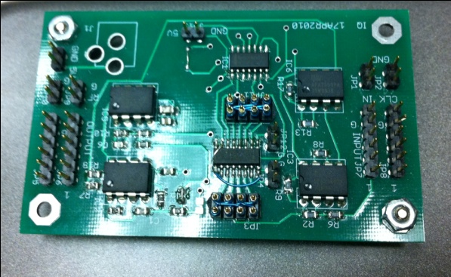
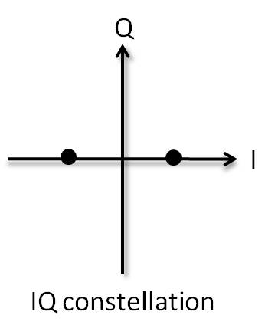
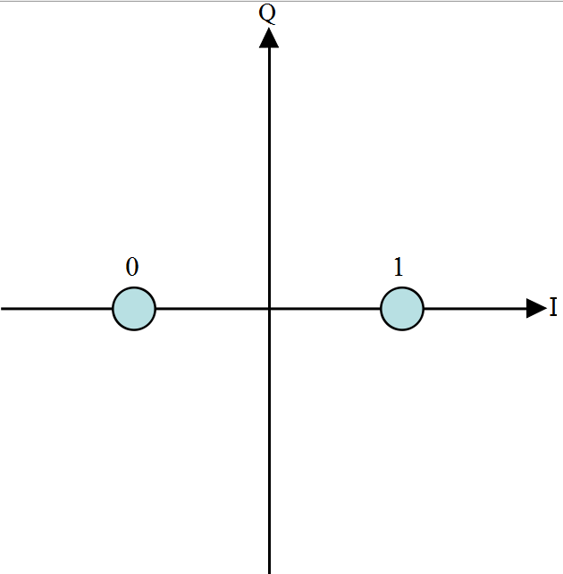
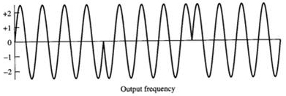
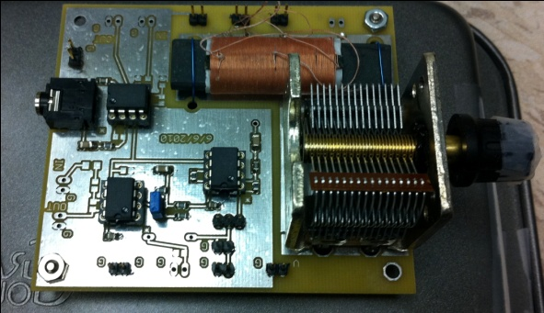
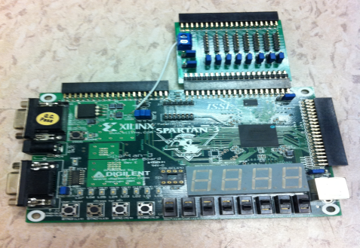
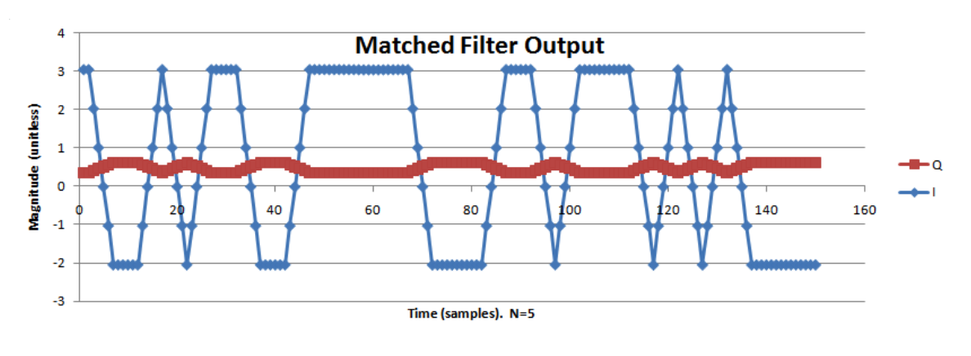
Software Defined Radio
Brad Freyberg, JunYong Lee, SungHo Yoon, Uttara Kumar, Tingting Zou
Project Description
System Design
Data Packet Structure
The goal of our project is to implement the communication modules, that constitute a traditional radio, in software and to successfully demonstrate wireless communication using our system. Software Defined Radio attempts to place much or most of the complex signal handling involved in communications receivers and transmitters into software. Doing this allows these radios to be configured ‘on-the-fly’ providing the much needed flexibility which is the growing demand of any modern communication system today.
Used for power calibration
Stuck in this mode until Tx sends
M-sequence
This field specifies the 15 bit correlation sequence which detects the start of the data packet .
Used for frequency, phase and timing calibration
Packet no. :
This field helps the receiver to keep track of the number of packets that are yet to arrive.
For eg. a 2 in this field would inform that receiver that 2 data packets are to follow the current one and a value 0 indicates end of transmission.
Data:
This field contains the actual data being sent from the transmitter.
Turn
On
Rx
Initial start up
12500 samples
Look for
M-seq
found m-seq
Phase correction
Frequency correction
128 bits
Data ( 15 bytes )
M-sequence
After GFX routine
is finished,
set mseq_found = 0
Receiving & decoding data
● Fill up character array(data)
(fixed length)
● Save I, Q decision samples
Packet no.
User triggers
1st m-seq
Print GFX
● Print character array
● Print full I, Q
●“animate” the drawing
15 bits
8 bits
packet countdown >0
Turn
On
Tx
Synchronization
Data array is filled
packet countdown =0
First byte after m-seq (packet countdown)is # of packets to expect
M-sequence Correlator
Hardware Components
Peaks representing sample boundaries are matched up.
Compare the slope with a threshold slope.
The slope threshold:
In the first 12500 samples (=2500 samples * 5 sec),the maximum value(power) is detected.
Based on this, we calculate attenuation factor by comparing with the maximum power of wired communications.
Slope threshold = Attenuation factor * MSEQ_SLOPE_THRESHOLD
If (current slope > predefined slope threshold), m-sequence is detected.
System Overview
TMS320F28335 DSC
All of our software modules are implemented on this 150 MHz floating point TI Digital Signal Controller
It has 2 on-chip 12 bit, 16 channel ADCs with 2 parallel sample and hold circuits ideal for IQ modulation
6 high resolution PWM pins combined with a low pass filter are configured as the DACs in our system
Binary Phase Shift Keying(BPSK)
Phase Offset
Phase-shift keying has information in the phase of sinusoidal waveform.
In BPSK , the phase of the RF carrier is shifted 180 degrees in accordance with a digital bit stream.
Conveys information using two distinct phases (π and 0)
Reason : No information of the transmitted signal’s phase at the receiver side
When the peak is found, we take the latest I,Q sample from the matched filter.
I, Q samples represent the last bits of m-sequence, so we correct the I, Q samples by measuring degree difference on the IQ plot.
Detected I,Q values
IQ modulator
This board essentially modulates the I and Q waveforms to carrier frequency of 500Mhz
Inputs : Clock, I and Q waveforms
Outputs: Modulated waveform to the antenna tuner board
Ɵ
Correct I,Q values
Modulation
Modulation is the process by which some characteristic (frequency, phase, amplitude, or combinations thereof) of a carrier frequency is varied in accordance with a digital signal.
Inphase-Quadrature modulation:
Transmit 2 carrier sinusoids phased shift by 90 degrees – Inphase component and Quadrature component.
Carriers modulate the digital data to produce the I and Q waveforms.
I
Filter
g(t)
Frequency Offset
Modulated Carrier
Reason : The frequency of the oscillators at the transmitter and receiver is not exactly same
When the peak is found, we take every alternate of the last samples of the m-sequence.
M-sequence:
[1, 0, 0, 0, 1, 0, 0, 1, 1, 0, 1, 0, 1, 1, 1]
Used Linear Regression Equation to estimate frequency offset per a bit:
Antenna Tuner Board
The RF front end that tunes the antenna to the carrier frequency
It has OpAmps on it for magnifying received signal
Q
Filter
g(t)
Matched Filter
Time varying IQ values
ΔƟ_total
Fixed IQ values
The signal at the receiver is affected by noise resulting in a low SNR.
Sampling this received waveform may result in a ‘0’ being interpreted as a ‘1’ or vice versa causing errors.
SOLUTION ?
Matched filter is an optimal linear filter that maximizes the signal-to-noise ratio(SNR) in AWGN channel
Concept behind it :
Calculate the correlation between the signal and filter → maximize the inner product → minimize the effect of channel noise → increase SNR
Spartan-3 FPGA
Connected directly to the DSC through SPI bus
Configured to graph the received data on the IQ constellation plot through a VGA display
I and Q waveforms passed through the Matched filter in our system

