Slide 1

EECS 470
Lecture 1
Computer Architecture
Winter 2024
Slides developed in part by Profs. Brehob, Austin, Falsafi, Hill, Hoe, Lipasti, Shen, Smith, Sohi, Tyson, Vijaykumar, Wenisch and probably others…

Slide 2
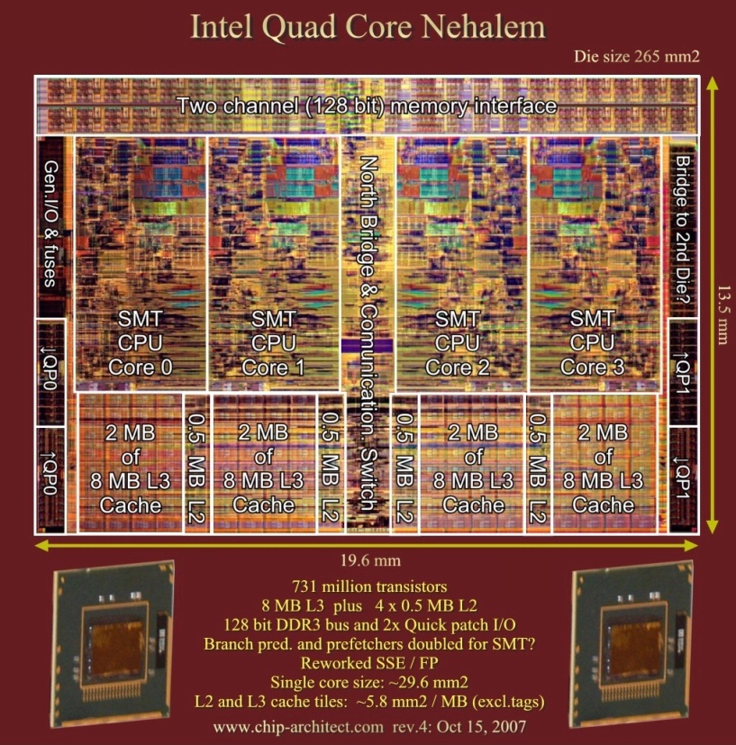
What Is Computer Architecture?
“The term architecture is used here to describe the attributes of a system as seen by the programmer, i.e., the conceptual structure and functional behavior as distinct from the organization of the dataflow and controls, the logic design, and the physical implementation.”
Gene Amdahl, IBM Journal of R&D, April 1964

Slide 3
Architecture as used here…
We use a wider definition
  The stuff seen by the programmer
    Instructions, registers, programming model, etc.
  Micro-architecture
    How the architecture is implemented.

Slide 4
Teaching Staff
Intro
Instructor
GSI/IAs
Dr. Mark Brehob, brehob
  Office hours
    Mondays 10:30-noon (4632 Beyster)
    Sunday 5:30-6:45pm (remote/Zoom)
  I’ll also be around after class for 10-15 minutes most days.
Bradley Schulz – GSI
Ian Wrzesinski – GSI
Mustafa Miyaziwala – IA
Their office hours will be posted shortly.

Slide 5
Lecture Today
Outline
Class intro (30 minutes)
  Class goals
  Your grade
  Work expected
Start review
  Fundamental concepts
  Pipelines
  Hazards and Dependencies (time allowing)
  Performance measurement (as reference only)

Slide 6
Class goals
Class goals
Provide a high-level understanding of many of the relevant issues in modern computer architecture
  Dynamic Out-of-order processing
  Static (complier based) out-of-order processing
  Memory hierarchy issues and improvements
  Multi-processor issues
  Power and reliability issues
Provide a low-level understanding of the most important parts of modern computer architecture.
  Details about all the functions a given component will need to perform
  How difficult certain tasks, such as caching, really are in hardware
Class/HW
& Reading
Project
& Reading

Slide 7
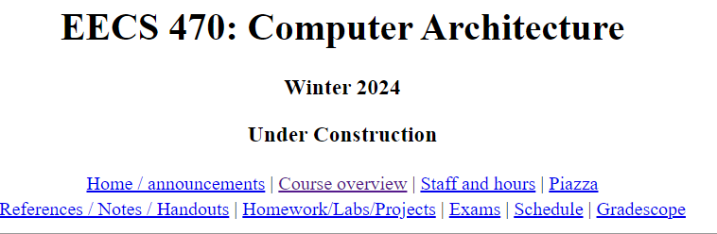
Communication
Website: http://www.eecs.umich.edu/courses/eecs470/
Piazza
  piazza.com/umich/fall2021/eecs470
Gradescope:
  https://piazza.com/umich/winter2024/eecs470
  Entry Code: 470rules
Lab
  Attend your assigned section
  You need to go!
  It does meet this week.

Slide 8
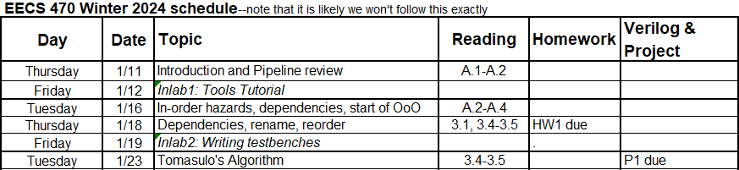
Course outline – near term
Class goals
HW1 and P1 will be posted tonight

Slide 9
Grading
Your grade
Grade weights are:
  Midterm – 22%
  Final Exam – 22%
  Homework/Quiz – 10%
    5 homeworks, 1 quiz, all equal. Drop the lowest grade.
  Verilog Programming assignments – 8%
    3 assignments worth 1%, 2%, and 5%
  In lab assignments – 3%
  Project – 35%
    Open-ended (group) processor design in Verilog
    Grades can vary quite a bit, so is a distinguisher.

Slide 10
Hours (and hours) of work
Work expected
Attend class & lab
  You really need to go to lab!
  5 hours/week
Read book & handouts – 2-3 hours/week
Do homework
  5 assignments at ~4 hours each/15 weeks
  1-2 hours/week
3 Programming assignments
  6, 6, 20 hours each = 32 hours/15 weeks
  ~2 hours/week
Verilog Project
  ~200 hours/15 weeks = 13 hours/week
General studying – ~ 1 hour/week
Total:
  ~25 hours/week, some students claim more...

Slide 11
“Key” concepts

Slide 12
Amdahl’s Law
Speedup= time_{without enhancement} / time_{with enhancement}
Suppose an enhancement speeds up a fraction f of a task by a factor of S
time_{new} = time_{orig}·( (1-f) + f/S )
S_{overall} = 1 / ( (1-f) + f/S )
time_{orig}
time_{orig}
time_{orig}
1
(1 - f)
f
(1 - f)
f
time_{new}
time_{new}
(1 - f)
(1 - f)
f/S
f/S
Notes:
12
Real life analogy: After driving through 60 minutes of traffic jam, how much time can you make up by speeding in the final mile?
Applications in Computer Architecture
RISC - Reduced Instruction Set Computer
Optimized to execute frequently used instructions quickly
Infrequently used instructions can take a long time, or even emulated by software
We should concentrate efforts on improving frequently occurring events or frequently used mechanisms

Slide 13
Parallelism: Work and Critical Path
Parallelism - the amount of independent sub-tasks available
Work=T₁ - time to complete a computation on a sequential system
Critical Path=T∞ - time to complete the same computation on an infinitely-parallel system
Average Parallelism
  P_{avg} = T₁ / T∞
For a p wide system
T_{p} ≥ max{ T₁/p, T∞ }
P_{avg}>>p ⇒ T_{p} ≈ T₁/p
x = a + b;
y = b * 2
z =(x-y) * (x+y)

Slide 14
Locality Principle
One’s recent past is a good indication of near future.
  Temporal Locality: If you looked something up, it is very likely that you will look it up again soon
  Spatial Locality: If you looked something up, it is very likely you will look up something nearby next
Locality == Patterns == Predictability
  Converse:
  Anti-locality : If you haven’t done something for a very long time, it is very likely you won’t do it in the near future either
Notes:
14
Real life analogy:
spatial locality - where you choose to sit in a room
temporal locality - will you be here again next week?
Examples in computer architecture:
Execution of program loops
spatial locality - after you execute an instruction, with very good probability, you will execute the next instruction
temporal locality - you are very likely to repeat the same instructions many times

Slide 15
Memoization
Dual of temporal locality but for computation
If something is expensive to compute, you might want to remember the answer for a while, just in case you will need the same answer again
Why does memoization work??
Examples
  Trace caches

Slide 16
Amortization
overhead cost : one-time cost to set something up
per-unit cost : cost for per unit of operation
total cost = overhead + per-unit cost x N
It is often okay to have a high overhead cost if the cost can be distributed over a large number of units
⇒ lower the average cost
average cost = total cost / N
= ( overhead / N ) + per-unit cost
Notes:
16
Real life analogy: Economy of Scale. Why is pasta sauce cheaper when bought by the gallon?
Examples in computer architecture:
Cache Access Latency
T_{miss}= 50 cycles
T_{hit} = 1 cycle
If on the average a cache line is reused n times before being ejected
T_{ave} = ( T_{miss}+ (n-1)T_{hit} ) / n  T_{miss} / n + T_{hit}
n = 50  T_{avg}  2
n = 2  T_{avg}  25

Slide 17
Trends in computer architecture

Slide 18

A Paradigm Shift In Computing
IEEE Computer—April 2001
T. Mudge
Limits on heat extraction
Stagnates performance growth
Limits on energy-efficiency of operations
Era of High Performance Computing Era of Energy-Efficient Computing
c. 2000
Notes:
----Data points generated from the following processors
VAX-11/780
VAX-11/785
VAX 8700
Sun-4/260
MIPS M/120
MIPS M2000
IBM RS6000/540
HP PA-RISC, 0.05 GHz
Alpha 21064, 0.2 GHz
PowerPC 604, 0.1 GHz
Alpha 21064A, 0.3 GHz
Alpha 21164, 0.3 GHz
Alpha 21164, 0.5 GHz
Alpha 21164, 0.6 GHz
Alpha 21264, 0.6 GHz
Alpha 21264A, 0.7 GHz
Intel Pentium III, 1.0 GHz
AMD Athlon, 1.6 GHz
Intel Pentium 4, 3.0 GHz
AMD Opteron, 2.2 GHz
Intel Xeon, 3.6 GHz
64-bit Intel Xeon, 3.6 GHz

Slide 19
The Memory Wall
Processor
Memory
Source: Hennessy & Patterson, Computer Architecture: A Quantitative Approach, 4th ed.
Today: 1 mem access ≈ 500 arithmetic ops

Slide 20
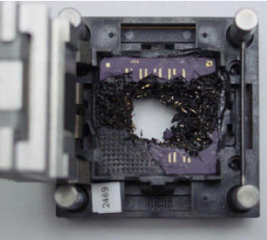
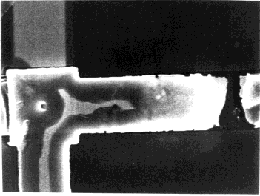
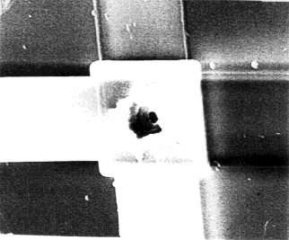
Reliability Wall
Transient faults
  E.g, high-energy particle strikes
Manufacturing faults
  E.g., broken connections
Wearout faults
  E.g., Electromigration
Device variability
(not all transistors created equal)
transients
burn-in
interconnect
via

Slide 21
Review of basic pipelining

Slide 22
Review of basic pipelining
Pipeline review
5 stage “RISC” load-store architecture
  About as simple as things get
    Instruction fetch:
      get instruction from memory/cache
    Instruction decode:
      translate opcode into control signals and read regs
    Execute:
      perform ALU operation
    Memory:
      Access memory if load/store
    Writeback/retire:
      update register file

Slide 23
Pipelined implementation
Break the execution of the instruction into cycles (5 in this case).
Design a separate datapath stage for the execution performed during each cycle.
Build pipeline registers to communicate between the stages.

Slide 24
Stage 1: Fetch
Design a datapath that can fetch an instruction from memory every cycle.
  Use PC to index memory to read instruction
  Increment the PC (assume no branches for now)
Write everything needed to complete execution to the pipeline register (IF/ID)
  The next stage will read this pipeline register.
  Note that pipeline register must be edge triggered

Slide 25
M
U
X
1
PC + 1
+
Rest of pipelined datapath
Instruction
Memory/
Cache
PC
en
Instruction
bits
en
IF / ID
Pipeline register

Slide 26
Stage 2: Decode
Design a datapath that reads the IF/ID pipeline register, decodes instruction and reads register file (specified by regA and regB of instruction bits).
  Decode can be easy, just pass on the opcode and let later stages figure out their own control signals for the instruction.
Write everything needed to complete execution to the pipeline register (ID/EX)
  Pass on the offset field and both destination register specifiers (or simply pass on the whole instruction!).
  Including PC+1 even though decode didn’t use it.

Slide 27
PC + 1
PC + 1
regA
Register File
Contents
Of regA
regB
Stage 1: Fetch datapath
Rest of pipelined datapath
Destreg
Contents
Of regB
Data
Instruction
bits
en
Control
Signals
IF / ID
Pipeline register
ID / EX
Pipeline register

Slide 28
Stage 3: Execute
Design a datapath that performs the proper ALU operation for the instruction specified and the values present in the ID/EX pipeline register.
  The inputs are the contents of regA and either the contents of RegB or the offset field on the instruction.
  Also, calculate PC+1+offset in case this is a branch.
Write everything needed to complete execution to the pipeline register (EX/Mem)
  ALU result, contents of regB and PC+1+offset
  Instruction bits for opcode and destReg specifiers

Slide 29
PC+1
+offset
PC + 1
+
Contents
Of regA
A
L
U
Alu
Result
Stage 2: Decode datapath
Rest of pipelined datapath
Contents
Of regB
M
U
X
contents
of regB
Control
Signals
Control
Signals
ID / EX
Pipeline register
EX/Mem
Pipeline register

Slide 30
Stage 4: Memory Operation
Design a datapath that performs the proper memory operation for the instruction specified and the values present in the EX/Mem pipeline register.
  ALU result contains address for ld and st instructions.
  Opcode bits control memory R/W and enable signals.
Write everything needed to complete execution to the pipeline register (Mem/WB)
  ALU result and MemData
  Instruction bits for opcode and destReg specifiers

Slide 31
This goes back to the MUX
before the PC in stage 1.
PC+1
+offset
MUX control
for PC input
Alu
Result
Alu
Result
Data Memory
Stage 3: Execute datapath
Rest of pipelined datapath
contents
of regB
Memory
Read Data
en R/W
Control
Signals
Control
Signals
EX/Mem
Pipeline register
Mem/WB
Pipeline register

Slide 32
Stage 5: Write back
Design a datapath that conpletes the execution of this instruction, writing to the register file if required.
  Write MemData to destReg for ld instruction
  Write ALU result to destReg for add or nand instructions.
  Opcode bits also control register write enable signal.

Slide 33
Alu
Result
Memory
Read Data
Stage 4: Memory datapath
This goes back to data
input of register file
M
U
X
Control
Signals
bits 0-2
This goes back to the
destination register specifier
M
U
X
bits 16-18
Mem/WB
Pipeline register
register write enable

Slide 34
What can go wrong?
Data hazards: since register reads occur in stage 2 and register writes occur in stage 5 it is possible to read the wrong value if is about to be written.
Control hazards: A branch instruction may change the PC, but not until stage 4. What do we fetch before that?
Exceptions: How do you handle exceptions in a pipelined processor with 5 instructions in flight?

Slide 35
Basic Pipelining
Fetch Decode Execute Memory WB
M
U
X
1
+
target
+
PC+1
PC+1
R0
0
eq?
regA
R1
ALU
result
Inst
mem
R2
Register file
PC
regB
valA
Data
memory
M
U
X
instruction
R3
A
L
U
R4
ALU
result
mdata
R5
valB
R6
M
U
X
R7
data
offset
dest
valB
Bits 0-2
dest
dest
dest
Bits 16-18
M
U
X
Bits 22-24
op
op
op
IF/
ID
ID/
EX
EX/
Mem
Mem/
WB

Slide 36
Basic Pipelining
Fetch Decode Execute Memory WB
M
U
X
1
+
target
+
PC+1
PC+1
R0
0
eq?
regA
R1
ALU
result
Inst
mem
R2
Register file
PC
regB
valA
Data
memory
M
U
X
instruction
R3
A
L
U
M
U
X
R4
ALU
result
mdata
R5
valB
R6
M
U
X
R7
data
offset
dest
valB
dest
dest
dest
op
op
op
IF/
ID
ID/
EX
EX/
Mem
Mem/
WB

Slide 37
Basic Pipelining
Fetch Decode Execute Memory WB
M
U
X
1
+
target
+
PC+1
PC+1
R0
0
eq?
regA
R1
ALU
result
Inst
mem
R2
Register file
PC
regB
valA
Data
memory
M
U
X
instruction
R3
A
L
U
M
U
X
R4
ALU
result
mdata
R5
valB
data
R6
M
U
X
R7
offset
valB
op
op
op
fwd
fwd
fwd
IF/
ID
ID/
EX
EX/
Mem
Mem/
WB

Slide 38
Measuring performance
This will likely not be covered in class but you need to read it.

Slide 39
Metrics of Performance
Time (latency)
  elapsed time vs. processor time
Rate (bandwidth or throughput)
  performance = rate = work per time
Distinction is sometimes blurred
  consider batched vs. interactive processing
  consider overlapped vs. non-overlapped processing
  may require conflicting optimizations
What is the most popular metric of performance?

Slide 40
The “Iron Law” of Processor Performance

Slide 41
MIPS
MIPS - Millions of Instructions per Second
MIPS =
When comparing two machines (A, B) with the same instruction set, MIPS is a fair comparison (sometimes…)
But, MIPS can be a “meaningless indicator of performance…”
instruction sets are not equivalent
different programs use a different instruction mix
instruction count is not a reliable indicator of work
  some optimizations add instructions
  instructions have varying work
# of instructions
benchmark
benchmark
total run time
X
1,000,000

Slide 42
MIPS (Cont.)
Example:
  Machine A has a special instruction for performing square root
    It takes 100 cycles to execute
  Machine B doesn’t have the special instruction
    must perform square root in software using simple instructions
    e.g, Add, Mult, Shift each take 1 cycle to execute
  Machine A: 1/100 MIPS = 0.01 MIPS
  Machine B: 1 MIPS

Slide 43
MFLOPS
MFLOPS = (FP ops/program) x (program/time) x 10⁻⁶
Popular in scientific computing
  There was a time when FP ops were much much slower than regular instructions (i.e., off-chip, sequential execution)
Not great for “predicting” performance because it
  ignores other instructions (e.g., load/store)
  not all FP ops are created equally
  depends on how FP-intensive program is
Beware of “peak” MFLOPS!

Slide 44
Comparing Performance
Often, we want to compare the performance of different machines or different programs. Why?
  help architects understand which is “better”
  give marketing a “silver bullet” for the press release
  help customers understand why they should buy <my machine>

Slide 45
Performance vs. Execution Time
Often, we use the phrase “X is faster than Y”
  Means the response time or execution time is lower on X than on Y
  Mathematically, “X is N times faster than Y” means
  Execution Time_{Y} = N
  Execution Time_{X}
  Execution Time_{Y} = N = 1/Performance_{Y} = Performance_{X}
  Execution Time_{X} 1/Performance_{X} Performance_{Y}
Performance and Execution time are reciprocals
  Increasing performance decreases execution time

Slide 46
By Definition
Machine A is n times faster than machine B iff
  perf(A)/perf(B) = time(B)/time(A) = n
Machine A is x% faster than machine B iff
  perf(A)/perf(B) = time(B)/time(A) = 1 + x/100
E.g., A 10s, B 15s
  15/10 = 1.5 → A is 1.5 times faster than B
  15/10 = 1 + 50/100 → A is 50% faster than B
  Remember to compare “performance”

Slide 47
Let’s Try a Simpler Example
Two machines timed on two benchmarks
Machine A Machine B
    Program 1 2 seconds 4 seconds
    Program 2 12 seconds 8 seconds
  How much faster is Machine A than Machine B?
  Attempt 1: ratio of run times, normalized to Machine A times
  program1: 4/2 program2 : 8/12
  Machine A ran 2 times faster on program 1, 2/3 times faster on program 2
  On average, Machine A is (2 + 2/3) /2 = 4/3 times faster than Machine B
It turns this “averaging” stuff can fool us; watch…

Slide 48
Example (con’t)
Two machines timed on two benchmarks
Machine A Machine B
    Program 1 2 seconds 4 seconds
    Program 2 12 seconds 8 seconds
  How much faster is Machine A than B?
  Attempt 2: ratio of run times, normalized to Machine B times
  program 1: 2/4 program 2 : 12/8
  Machine A ran program 1 in 1/2 the time and program 2 in 3/2 the time
  On average, (1/2 + 3/2) / 2 = 1
  Put another way, Machine A is 1.0 times faster than Machine B

Slide 49
Example (con’t)
Two machines timed on two benchmarks
Machine A Machine B
    Program 1 2 seconds 4 seconds
    Program 2 12 seconds 8 seconds
  How much faster is Machine A than B?
  Attempt 3: ratio of run times, aggregate (total sum) times, norm. to A
    Machine A took 14 seconds for both programs
    Machine B took 12 seconds for both programs
    Therefore, Machine A takes 14/12 of the time of Machine B
    Put another way, Machine A is 6/7 faster than Machine B

Slide 50
Which is Right?
Question:
  How can we get three different answers?
Solution
  Because, while they are all reasonable calculations…
  …each answers a different question
We need to be more precise in understanding and posing these performance & metric questions

Slide 51
Using a Weighted Sum
(or weighted average)
Machine A Machine B
    Program 1 2 seconds (20%) 4 seconds (20%)
    Program 2 12 seconds (80%) 8 seconds (80%)
    Total 10 seconds 7.2 seconds
    Allows us to determine relative performance 10/7.2 = 1.38
    --> Machine B is 1.38 times faster than Machine A

Slide 52
Summary
Performance is important to measure
  For architects comparing different deep mechanisms
  For developers of software trying to optimize code, applications
  For users, trying to decide which machine to use, or to buy
Performance metrics are subtle
  Easy to mess up the “machine A is XXX times faster than machine B” numerical performance comparison
  You need to know exactly what you are measuring: time, rate, throughput, CPI, cycles, etc
  You need to know how combining these to give aggregate numbers does different kinds of “distortions” to the individual numbers
  No metric is perfect, so lots of emphasis on standard benchmarks today

