Slide 1

EECS 470
Control Hazards and ILP
Lecture 3 – Fall 2024
Slides developed in part by Profs. Austin, Brehob, Falsafi, Hill, Hoe, Lipasti, Martin, Roth, Shen, Smith, Sohi, Tyson, Vijaykumar, and Wenisch of Carnegie Mellon University, Purdue University, University of Michigan, University of Pennsylvania, and University of Wisconsin.

Slide 2
Announcements
HW1 due Today @10pm
  I’ll be around after class to answer questions
Project 1 due Tuesday 1/23.
  Note: can submit multiple times, only last one counts.
    Feedback is minimal.
    New grader machine, could have issues.
HW2 posted early next week.

Slide 3
Today
Review and finish up control hazards. Examine other pipeline changes
Costs and Power
Instruction Level Parallelism (ILP) and Dynamic Execution

Slide 4
Three approaches to handling data hazards
Avoidance
  Make sure there are no hazards in the code
Detect and Stall
  If hazards exist, stall the processor until they go away.
Detect and Forward
  If hazards exist, fix up the pipeline to get the correct value (if possible)

Slide 5
Problems with each solution
Pipelining & Control Hazards
Avoidance (static)
  Predication
    Needs larger instruction encodings
    If the branch body is long, lots of noops
    CMOV reduces encoding issues, but increases useless ops.
Detect and Stall (dynamic)
  Stall on every branch
  Fair bit of hardware complexity
Speculate and squash (dynamic)
  Stall on every mispredicted branch
  More hardware complexity.

Slide 6
Avoidance Via Predication
if (a == b) {
x++;
y = n / d;
}
sub t1 ← a, b
jnz t1, PC+2
add x ← x, #1
div y ← n, d
sub t1 ← a, b
add(!t1) x ← x, #1
div(!t1) y ← n, d
sub t1 ← a, b
add t2 ← x, #1
div t3 ← n, d
cmov(!t1) x ← t2
cmov(!t1) y ← t3

Slide 7
Improving pipeline performance
Improving pipeline
performance
Add more stages
Widen pipeline

Slide 8
Adding pipeline stages
Improving pipeline
performance
Pipeline frontend
  Fetch, Decode
Pipeline middle
  Execute
Pipeline backend
  Memory, Writeback

Slide 9
Adding stages to fetch, decode
Improving pipeline
performance
Delays hazard detection
No change in forwarding paths
No performance penalty with respect to data hazards

Slide 10
Adding stages to execute
Improving pipeline
performance
Check for structural hazards
  ALU not pipelined
  Multiple ALU ops completing at same time
Data hazards may cause delays
  If multicycle op hasn't computed data before the dependent instruction is ready to execute
Performance penalty for each stall

Slide 11
Adding stages to memory, writeback
Improving pipeline
performance
Instructions ready to execute may need to wait longer for multi-cycle memory stage
Adds more pipeline registers
  Thus more source registers to forward
    More complex hazard detection
    Wider muxes
    More control bits to manage muxes

Slide 12
Wider pipelines
Improving pipeline
performance
fetch
decode
execute
mem
WB
fetch
decode
execute
mem
WB
More complex hazard detection
    2X pipeline registers to forward from
    2X more instructions to check
    2X more destinations (muxes)
    Need to worry about dependent
instructions in the same stage

Slide 13
Making forwarding explicit
Other pipelining
options
add r1 ← r2, EX/Mem ALU result
  Include direct mux controls into the ISA
  Hazard detection is now a compiler task
  New micro-architecture leads to new ISA
    Is this why this approach always seems to fail?
    (e.g., simple VLIW, Motorola 88k)
  Can reduce some resources
    Eliminates complex conflict checkers

Slide 14
Today
Review and finish up control hazards. Examine other pipeline changes
Costs and Power
Instruction Level Parallelism (ILP) and Dynamic Execution

Slide 15
Digital System Cost
The cost of computing…
$ and Watts
Cost is also a key design constraint
  Architecture is about trade-offs
  Cost plays a major role
Huge difference between Cost & Price
E.g.,
  Higher Price → Lower Volume → Higher Cost → Higher Price
  Direct Cost
  List vs. Selling Price
Price also depends on the customer
  College student vs. US Government
$
$$$$$$
Embedded
Portables
Desktops
Servers
Supercomputer
Notes:
15

Slide 16
Direct Cost
The cost of computing…
$ and Watts
Cost distribution for a Personal Computer
  Processor board 37%
    CPU, memory,
  I/O devices 37%
    Hard disk, DVD, monitor, …
  Software 20%
  Tower/cabinet 6%
Integrated systems account for a substantial fraction of cost
Notes:
16

Slide 17
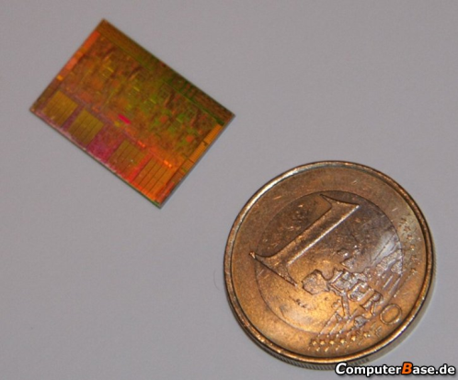
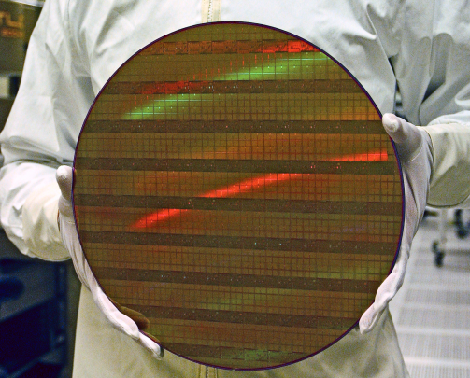
IC Cost Equation
The cost of computing…
$ and Watts
Die cost + Test cost + Packaging cost
IC cost =
Final test yield
Wafer cost
Die cost =
Dies/wafer x Die yield
Die yield = f(defect density, die area)
Notes:
17

Slide 18
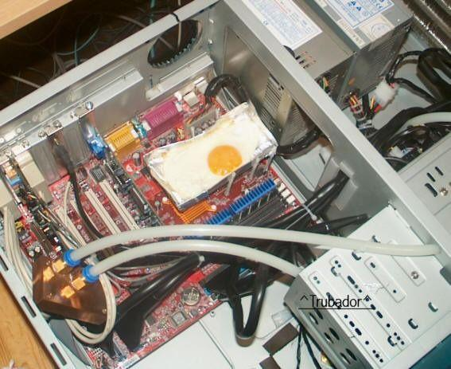
Why is power a problem in a μP?
The cost of computing…
$ and Watts
Power used by the μP, vs. system power
Dissipating Heat
  Melting (very bad)
  Packaging (to cool → $)
  Heat leads to poorer performance.
Providing Power
  Battery
  Cost of electricity
Introduction

Slide 19
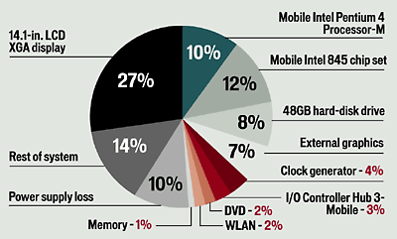
Where does the juice go in laptops?
The cost of computing…
$ and Watts
Others have measured ~55% processor increase under max load in laptops

Slide 20
Why worry about power dissipation?
The cost of computing…
$ and Watts
Battery
life
Why is power a problem?
Thermal issues: affect cooling, packaging, reliability, timing
Environment

Slide 21
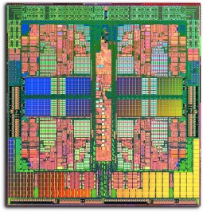
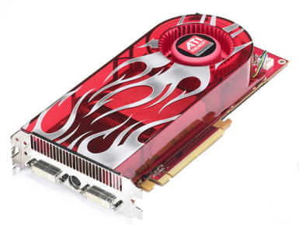

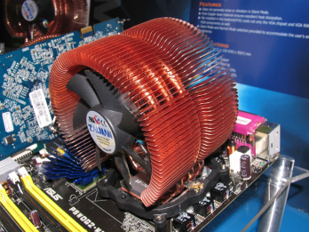



Power-Aware Computing Applications
The cost of computing…
$ and Watts
Temperature/Current-Constrained
Energy-Constrained Computing

Slide 22
Today
Review and finish up other options
Costs and Power
Instruction Level Parallelism (ILP) and Dynamic Execution

Slide 23
Limitations of Scalar Pipelines
Exploiting ILP:
Basics
Measuring ILP
Dynamic execution
Upper Bound on Scalar Pipeline Throughput
Limited by IPC=1 “Flynn Bottleneck”
Performance Lost Due to Rigid In-order Pipeline
Unnecessary stalls

Slide 24
Terms
Exploiting ILP:
Basics
Measuring ILP
Dynamic execution
Instruction parallelism
  Number of instructions being worked on
Operation Latency
  The time (in cycles) until the result of an instruction is available for use as an operand in a subsequent instruction. For example, if the result of an Add instruction can be used as an operand of an instruction that is issued in the cycle after the Add is issued, we say that the Add has an operation latency of one.
Peak IPC
  The maximum sustainable number of instructions that can be executed per clock.
# Performance modeling for computer architects, C. M. Krishna

Slide 25
Architectures for Exploiting
Instruction-Level Parallelism
Exploiting ILP:
Basics
Measuring ILP
Dynamic execution

Slide 26
Superscalar Machine
Exploiting ILP:
Basics
Measuring ILP
Dynamic execution

Slide 27
What is the real problem?
Exploiting ILP:
Basics
Measuring ILP
Dynamic execution
CPI of in-order pipelines degrades very sharply if the machine parallelism is increased beyond a certain point.
i.e., when NxM approaches average distance between dependent instructions
Forwarding is no longer effective
Pipeline may never be full due to frequent dependency stalls!

Slide 28
Missed Speedup in
In-Order Pipelines
Exploiting ILP:
Basics
Measuring ILP
Dynamic execution
 | 1 | 2 | 3 | 4 | 5 | 6 | 7 | 8 | 9 | 10 | 11 | 12 | 13 | 14 | 15 | 16
addf f0,f1,f2 | F | D | E+ | E+ | E+ | W
mulf f2,f3,f2 |  | F | D | d* | d* | E* | E* | E* | E* | E* | W
subf f0,f1,f4 |  |  | F | p* | p* | D | E+ | E+ | E+ | W
What’s happening in cycle 4?
  mulf stalls due to RAW hazard
    OK, this is a fundamental problem
  subf stalls due to pipeline hazard
    Why? subf can’t proceed into D because mulf is there
    That is the only reason, and it isn’t a fundamental one
Why can’t subf go into D in cycle 4 and E+ in cycle 5?

Slide 29
The Problem With
In-Order Pipelines
Exploiting ILP:
Basics
Measuring ILP
Dynamic execution
regfile
I$
D$
B
P
In-order pipeline
  Structural hazard: 1 insn register (latch) per stage
    1 instruction per stage per cycle (unless pipeline is replicated)
    Younger instr. can’t “pass” older instr. without “clobbering” it
Out-of-order pipeline
  Implement “passing” functionality by removing structural hazard

Slide 30
New Pipeline Terminology
Exploiting ILP:
Basics
Measuring ILP
Dynamic execution
regfile
I$
D$
B
P
In-order pipeline
  Often written as F,D,X,W (multi-cycle X includes M)
  Variable latency
    1-cycle integer (including mem)
    3-cycle pipelined FP

Slide 31
ILP:
Instruction-Level Parallelism
Exploiting ILP:
Basics
Measuring ILP
Dynamic execution
ILP is a measure of the amount of inter-dependencies between instructions
Average ILP = no. instruction / no. cyc required
code1: ILP = 1
  i.e. must execute serially
code2: ILP = 3
  i.e. can execute at the same time
code1: r1 ← r2 + 1
r3 ← r1 / 17
r4 ← r0 - r3
code2: r1 ← r2 + 1
r3 ← r9 / 17
r4 ← r0 - r10

Slide 32
Purported Limits on ILP
Exploiting ILP:
Basics
Measuring ILP
Dynamic execution
    Weiss and Smith [1984] 1.58
    Sohi and Vajapeyam [1987] 1.81
    Tjaden and Flynn [1970] 1.86
    Tjaden and Flynn [1973] 1.96
    Uht [1986] 2.00
    Smith et al. [1989] 2.00
    Jouppi and Wall [1988] 2.40
    Johnson [1991] 2.50
    Acosta et al. [1986] 2.79
    Wedig [1982] 3.00
    Butler et al. [1991] 5.8
    Melvin and Patt [1991] 6
    Wall [1991] 7
    Kuck et al. [1972] 8
    Riseman and Foster [1972] 51
    Nicolau and Fisher [1984] 90

Slide 33
Scope of ILP Analysis
Exploiting ILP:
Basics
Measuring ILP
Dynamic execution
r1 ⇐ r2 + 1
r3 ⇐ r1 / 17
r4 ⇐ r0 - r3
ILP=1
ILP=2
r11 ⇐ r12 + 1
r13 ⇐ r11 / 17
r14 ⇐ r13 - r20
ILP=1
Out-of-order execution exposes more ILP

Slide 34
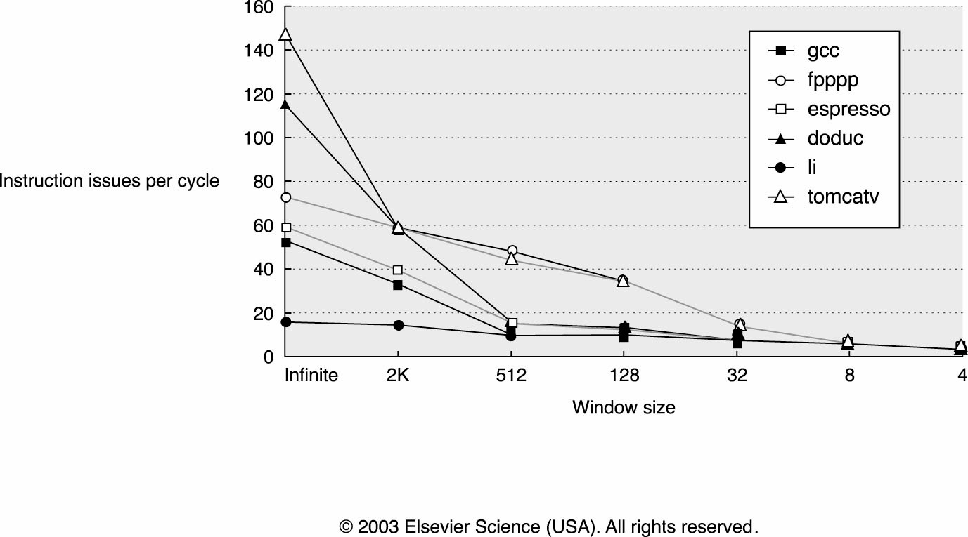
How Large Must the “Window” Be?
Exploiting ILP:
Basics
Measuring ILP
Dynamic execution

Slide 35
Dynamic Scheduling –
OoO Execution
Exploiting ILP:
Basics
Measuring ILP
Dynamic execution
Dynamic scheduling
  Totally in the hardware
  Also called “out-of-order execution” (OoO)
Fetch many instructions into instruction window
  Use branch prediction to speculate past (multiple) branches
  Flush pipeline on branch misprediction
Rename to avoid false dependencies (WAW and WAR)
Execute instructions as soon as possible
  Register dependencies are known
  Handling memory dependencies more tricky (much more later)
Commit instructions in order
  Any strange happens before commit, just flush the pipeline
Current machines: 100+ instruction scheduling window

Slide 36
Motivation for
Dynamic Scheduling
Exploiting ILP:
Basics
Measuring ILP
Dynamic execution
Dynamic scheduling (out-of-order execution)
  Execute instructions in non-sequential order…
    Reduce RAW stalls
    Increase pipeline and functional unit (FU) utilization
      Original motivation was to increase FP unit utilization
    Expose more opportunities for parallel issue (ILP)
      Not in-order → can be in parallel
  …but make it appear like sequential execution
    Important
      But difficult
    Next few lectures

Slide 37
Dynamic Scheduling: The Big Picture
add p2,p3,p4
sub p2,p4,p5
mul p2,p5,p6
div p4,4,p7
regfile
I$
insn buffer
D$
B
P
D
S
Ready Table
P2 | P3 | P4 | P5 | P6 | P7
Yes | Yes
Yes | Yes | Yes
Yes | Yes | Yes | Yes |  | Yes
Yes | Yes | Yes | Yes | Yes | Yes
add p2,p3,p4
t
and
sub p2,p4,p5
div p4,4,p7
mul p2,p5,p6
Instructions fetch/decoded/renamed into Instruction Buffer
  Also called “instruction window” or “instruction scheduler”
Instructions (conceptually) check ready bits every cycle
  Execute when ready

Slide 38
Going Forward:
What’s Next
Exploiting ILP:
Basics
Measuring ILP
Dynamic execution
We’ll build this up in steps over the next few weeks
  Register renaming to eliminate “false” dependencies
  “Tomasulo’s algorithm” to implement OoO execution
  Handling precise state and speculation
  Handling memory dependencies
Let’s get started!

Slide 39
Dependency vs. Hazard
Dynamic execution
A dependency exists independent of the hardware.
  So if Inst #1’s result is needed for Inst #1000 there is a dependency
  It is only a hazard if the hardware has to deal with it.
    So in our pipelined machine we only worried if there wasn’t a “buffer” of two instructions between the dependent instructions.

Slide 40
True Data dependencies
Dynamic execution
Hazards
Renaming
True data dependency
  RAW – Read after Write
    R1=R2+R3
    R4=R1+R5
True dependencies prevent reordering
  (Mostly) unavoidable

Slide 41
False Data Dependencies
Dynamic execution
Hazards
Renaming
False or Name dependencies
  WAW – Write after Write
    R1=R2+R3
    R1=R4+R5
  WAR – Write after Read
    R2=R1+R3
    R1=R4+R5
False dependencies prevent reordering
  Can they be eliminated? (Yes, with renaming!)

Slide 42
Data Dependency Graph:
Simple example
Dynamic execution
Hazards
Renaming
A
R1=MEM[R2+0] // A
R2=R2+4 // B
R3=R1+R4 // C
MEM[R2+0]=R3 // D
C
B
D
RAW WAW WAR

Slide 43
Data Dependency Graph:
More complex example
Dynamic execution
Hazards
Renaming
R1=MEM[R3+4] // A
R2=MEM[R3+8] // B
R1=R1*R2 // C
MEM[R3+4]=R1 // D
MEM[R3+8]=R1 // E
R1=MEM[R3+12] // F
R2=MEM[R3+16] // G
R1=R1*R2 // H
MEM[R3+12]=R1 // I
MEM[R3+16]=R1 // J
A
B
C
D
E
G
F
H
I
J
RAW WAW WAR

Slide 44
Dynamic execution
Hazards
Renaming
Eliminating False Dependencies
R1=MEM[R3+4] // A
R2=MEM[R3+8] // B
R1=R1*R2 // C
MEM[R3+4]=R1 // D
MEM[R3+8]=R1 // E
R1=MEM[R3+12] // F
R2=MEM[R3+16] // G
R1=R1*R2 // H
MEM[R3+12]=R1 // I
MEM[R3+16]=R1 // J
Well, logically there is no reason for F-J to be dependent on A-E. So…..
    ABFG
    CH
    DEIJ
  Should be possible.
But that would cause either C or H to have the wrong reg inputs
How do we fix this?
  Remember, the dependency is really on the name of the register
  So… change the register names!
A
B
C
D
E
G
F
H
I
J

Slide 45
Register Renaming Concept
Dynamic execution
Hazards
Renaming
  The register names are arbitrary
  The register name only needs to be consistent between writes.
    R1= …..
    …. = R1 ….
    ….= … R1
    R1= ….
The value in R1 is “alive” from when the value is
written until the last read of that value.

Slide 46
So after renaming, what happens to the dependencies?
Dynamic execution
Hazards
Renaming
P1=MEM[R3+4] //A
P2=MEM[R3+8] //B
P3=P1*P2 //C
MEM[R3+4]=P3 //D
MEM[R3+8]=P3 //E
P4=MEM[R3+12] //F
P5=MEM[R3+16] //G
P6=P4*P5 //H
MEM[R3+12]=P6 //I
MEM[R3+16]=P6 //J
A
B
F
G
C
H
D
E
I
J
RAW WAW WAR

Slide 47
Register Renaming Approach
Dynamic execution
Hazards
Renaming
Every time an architected register is written we assign it to a physical register
  Until the architected register is written again, we continue to translate it to the physical register number
  Leaves RAW dependencies intact
It is really simple, let’s look at an example:
  Names: r1,r2,r3
  Locations: p1,p2,p3,p4,p5,p6,p7
  Original mapping: r1→p1, r2→p2, r3→p3, p4–p7 are “free”
MapTable |  |  |  | FreeList |  | Orig. insns |  | Renamed insns
r1 | r2 | r3
p1 | p2 | p3 |  | p4,p5,p6,p7 |  | add r2,r3,r1 |  | add p2,p3,p4
p4 | p2 | p3 |  | p5,p6,p7 |  | sub r2,r1,r3 |  | sub p2,p4,p5
p4 | p2 | p5 |  | p6,p7 |  | mul r2,r3,r3 |  | mul p2,p5,p6
p4 | p2 | p6 |  | p7 |  | div r1,4,r1 |  | div p4,4,p7

Slide 48
Dynamic execution
Hazards
Renaming
R1=MEM[P7+4] // A
R2=MEM[R3+8] // B
R1=R1*R2 // C
MEM[R3+4]=R1 // D
MEM[R3+8]=R1 // E
R1=MEM[R3+12] // F
R2=MEM[R3+16] // G
R1=R1*R2 // H
MEM[R3+12]=R1 // I
MEM[R3+16]=R1 // J
P1=MEM[R3+4]
P2=MEM[R3+8]
P3=P1*P2
MEM[R3+4]=P3
MEM[R3+8]=P3
P4=MEM[R3+12]
P5=MEM[R3+16]
P6=P4*P5
MEM[R3+12]=P6
MEM[R3+16]=P6
Arch | V? | Physical
1 | 1
2 | 1
3 | 1

Slide 49
Terminology
There are a lot of terms and ideas in out-of-order processors.
  And because of lot of the work was done in parallel, there isn’t a standard set of names for things.
  Here we’ve called the table that maps the architected register to a physical register the “map table”. That is probably the most common.
    I generally use Intel’s term “Register Alias Table” or RAT.
    Also “rename table” isn’t an uncommon term for it.
I try to use a mix of terminology in this class so that you can understand others when they are describing something…
  It’s not as bad as it sounds, but it is annoying at first.

Slide 50
Register Renaming Hardware
Dynamic execution
Hazards
Renaming
Really simple table (rename table)
  Every time an instruction which writes a register is encountered assign it a new physical register number
But there is some complexity
  When do you free physical registers?

