Slide 1
EECS 470
Branches: Address prediction and recovery (And interrupt recovery too.)
Lecture 6 – Winter 2024
Slides developed in part by Profs. Austin, Brehob, Falsafi, Hill, Hoe, Lipasti, Martin, Roth, Shen, Smith, Sohi, Tyson, Vijaykumar, and Wenisch of Carnegie Mellon University, Purdue University, University of Michigan, University of Pennsylvania, and University of Wisconsin.

Slide 2
Warning: Crazy times coming
P2 due today!
HW2 due on Friday 2/2
Will do group formation and project materials on Tuesday 2/6.
Group formation will be done in class on Thursday 2/8
P3 is due on Sunday 2/9
It’s a lot of work (20 hours?)
Proposal is due on Tuesday 2/13
It’s not a lot of work (1 hour?) to do the write-up, but you’ll need to meet with your group and discuss things.
Don’t worry too much about getting this right. You’ll be allowed to change (we’ll meet the following Friday). Just a line in the sand. Will discuss on 2/6.
HW3 is due on Wednesday 2/14. No late homework. Answers posted right after it’s due!
Midterm is on Thursday 2/15 in the evening
Review session over that weekend (date/time TBA)
Q&A in class 2/15
Best way to study is look at old exams (posted on-line later this week)
20 minute proposal meetings on Friday 2/16 rather than lab

Slide 4
Announcements:
Combining Branch Predictors, S. McFarling, WRL Technical Note TN-36, June 1993.
On the website
Part of HW2.
Expect a (likely brief) question on the midterm.

Slide 5
Last time:
Started on branch predictors
Branch prediction consists of
Branch taken predictor
Address predictor
Mis-predict recovery.
Discussed direction predictors and started looking at some variations

Slide 6
Today
Predictors
Bimodal
Local history predictor
Global history predictor
Gshare
Tournament
Do detailed example
Start on the “P6 scheme”

Slide 7
What are the limitations of Tomasulo’s Algorithm?
Branches are a pain.
Instructions that might throw an exception are a pain.

Slide 8
Using history—bimodal
1-bit history (direction predictor)
Remember the last direction for a branch
branchPC
NT
T

Slide 9
Using history—bimodal
2-bit history (direction predictor)
branchPC
SN
NT
T
ST

Slide 10
Using History Patterns
~80 percent of branches are either heavily TAKEN or heavily NOT-TAKEN
For the other 20%, we need to look a patterns of reference to see if they are predictable using a more complex predictor
Example: gcc has a branch that flips each time
T(1) NT(0) 10101010101010101010101010101010101010

Slide 11
Local history
branchPC
Branch History
Table
Pattern History
Table
10101010
What is the prediction
for this BHT 10101010?
NT
T
When do I update the tables?

Slide 12
Local history
branchPC
Branch History
Table
Pattern History
Table
01010101
NT
T
On the next execution of this
branch instruction, the branch
history table is 01010101,
pointing to a different pattern
What is the accuracy of a flip/flop branch 0101010101010…?

Slide 13
Global history
Pattern History
Table
Branch History
Register
01110101
if (aa == 2)
aa = 0;
if (bb == 2)
bb = 0;
if (aa != bb) { …
How can branches interfere with each other?

Slide 14
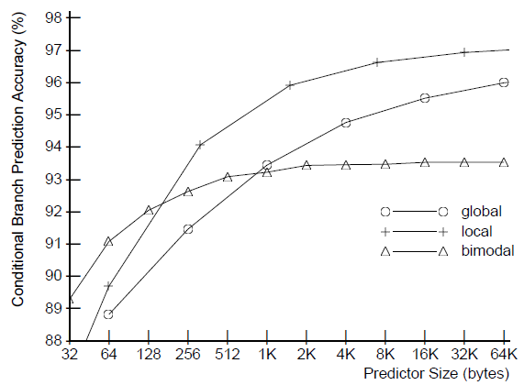
Relative performance (Spec ‘89)

Slide 15
Gshare predictor
branchPC
Pattern History
Table
Branch History
Register
xor
01110101
Must read!
Ref: Combining Branch Predictors

Slide 16
Hybrid predictors
Local predictor
(e.g. 2-bit)
Global/gshare predictor
(much more state)
Prediction
1
Prediction
2
Selection table
(2-bit state machine)
Prediction
How do you select which predictor to use?
How do you update the various predictor/selector?

Slide 17
“Trivial” example: Tournament Branch Predictor
Local
8-entry 3-bit local history table indexed by PC
8-entry 2-bit up/down counter indexed by local history
Global
8-entry 2-bit up/down counter indexed by global history
Tournament
8-entry 2-bit up/down counter indexed by PC

Slide 18
Local predictor 1st level table (BHT) 0=NT, 1=T
ADR[4:2] | History
0 | 001
1 | 101
2 | 100
3 | 110
4 | 110
5 | 001
6 | 111
7 | 101
Local predictor 2nd level table (PHT) 00=NT, 11=T
History | Pred. state
0 | 00
1 | 11
2 | 10
3 | 00
4 | 01
5 | 01
6 | 11
7 | 11
Tournament selector 00=local, 11=global
ADR[4:2] | Pred. state
0 | 00
1 | 01
2 | 00
3 | 10
4 | 11
5 | 00
6 | 11
7 | 10
Global predictor table 00=NT, 11=T
History | Pred. state
0 | 11
1 | 10
2 | 00
3 | 00
4 | 00
5 | 11
6 | 11
7 | 00
Branch
History
Register

Slide 19
Tournament selector 00=local, 11=global
ADR[4:2] | Pred. state
0 | 00
1 | 01
2 | 00
3 | 10
4 | 11
5 | 00
6 | 11
7 | 10
Local predictor 1st level table (BHT) 0=NT, 1=T
ADR[4:2] | History
0 | 001
1 | 101
2 | 100
3 | 110
4 | 110
5 | 001
6 | 111
7 | 101
Local predictor 2nd level table (PHT) 00=NT, 11=T
History | Pred. state
0 | 00
1 | 11
2 | 10
3 | 00
4 | 01
5 | 01
6 | 11
7 | 11
Global predictor table 00=NT, 11=T
History | Pred. state
0 | 11
1 | 10
2 | 00
3 | 00
4 | 00
5 | 11
6 | 11
7 | 00
r1=2, r2=6, r3=10, r4=12, r5=4
Address of joe =0x100 and each instruction is 4 bytes.
Branch History Register = 110
joe: add r1 r2 r3
beq r3 r4 next
bgt r2 r3 skip // if r2>r3 branch
lw r6 4(r5)
add r6 r8 r8
skip: add r5 r2 r2
bne r4 r5 joe
next: noop

Slide 20
Overriding Predictors
Big predictors are slow, but more accurate
Use a single cycle predictor in fetch
Start the multi-cycle predictor
When it completes, compare it to the fast prediction.
If same, do nothing
If different, assume the slow predictor is right and flush pipline.
Advantage: reduced branch penalty for those branches mispredicted by the fast predictor and correctly predicted by the slow predictor

Slide 21
Address
Prediction

Slide 22
BTB (Chapter 3.9)
Branch Target Buffer
Addresses predictor
Lots of variations
Keep the target of “likely taken” branches in a buffer
With each branch, associate the expected target.

Slide 23
BTB indexed by current PC
If entry is in BTB fetch target address next
Generally set associative (too slow as FA)
Often qualified by branch taken predictor
Branch PC | Target address
0x05360AF0 | 0x05360000
… | …
… | …
… | …
… | …
… | …

Slide 24
So…
BTB lets you predict target address during the fetch of the branch!
If BTB gets a miss, pretty much stuck with not-taken as a prediction
So limits prediction accuracy.
Can use BTB as a predictor.
If it is there, predict taken.
Replacement is an issue
LRU seems reasonable, but only really want branches that are taken at least a fair amount.
What branches will a BTB struggle with?
How to address that?

Slide 25
Pipeline recovery is pretty simple
Squash and restart fetch with right address
Just have to be sure that nothing has “committed” its state yet.
In our 5-stage pipe, state is only committed during MEM (for stores) and WB (for registers)

Slide 26
Tomasulo’s
Recovery seems really hard
What if instructions after the branch finish after we find that the branch was wrong?
This could happen. Imagine
R1=MEM[R2+0]
BEQ R1, R3 DONE ← Predicted not taken
R4=R5+R6
So we have to not speculate on branches or not let anything pass a branch
Which is really the same thing.
Branches become serializing instructions.
Note that can be executing some things before and after the branch once branch resolves.

Slide 27
What we need is:
Some way to not commit instructions until all branches before it are committed.
Just like in the pipeline, something could have finished execution, but not updated anything “real” yet.

Slide 28
Interrupt!!!

Slide 29
Interrupts
These have a similar problem.
If we can execute out-of-order a “slower” instruction might not generate an interrupt until an instruction in front of it has finished.
This sounds like the end of out-of-order execution
I mean, if we can’t finish out-of-order, isn’t this pointless?

Slide 30
Exceptions and Interrupts
Exception Type | Sync/Async | Maskable? | Restartable?
I/O request | Async | Yes | Yes
System call | Sync | No | Yes
Breakpoint | Sync | Yes | Yes
Overflow | Sync | Yes | Yes
Page fault | Sync | No | Yes
Misaligned access | Sync | No | Yes
Memory Protect | Sync | No | Yes
Machine Check | Async/Sync | No | No
Power failure | Async | No | No

Slide 31
Precise Interrupts
Implementation approaches
Don’t
E.g., Cray-1
Buffer speculative results
E.g., P4, Alpha 21264
History buffer
Future file/Reorder buffer
Instructions
Completely
Finished
Precise State
PC
No Instruction
Has Executed
At All
Speculative State

Slide 32
Precise Interrupts via the Reorder Buffer
@ Alloc
Allocate result storage at Tail
@ Sched
Get inputs (ROB T-to-H then ARF)
Wait until all inputs ready
@ WB
Write results/fault to ROB
Indicate result is ready
@ CT
Wait until inst @ Head is done
If fault, initiate handler
Else, write results to ARF
Deallocate entry from ROB
Any order
MEM
IF
ID
Alloc
Sched
EX
CT
In-order
In-order
ROB
ARF
PC
Dst regID
Dst value
Except?
Head
Tail
Reorder Buffer (ROB)
Circular queue of spec state
May contain multiple definitions of same register

Slide 33
Reorder Buffer Example
ROB
Code Sequence
f1 = f2 / f3
r3 = r2 + r3
r4 = r3 – r2
Initial Conditions
- reorder buffer empty
- f2 = 3.0
- f3 = 2.0
- r2 = 6
- r3 = 5
regID: r8
result: 2
Except: n
regID: f1
result: ?
Except: ?
H
T
regID: r8
result: 2
Except: n
regID: f1
result: ?
Except: ?
regID: r3
result: ?
Except: ?
Time
H
T
regID: r8
result: 2
Except: n
regID: f1
result: ?
Except: ?
regID: r3
result: 11
Except: N
regID: r4
result: ?
Except: ?
r3
H
T

Slide 34
Reorder Buffer Example
ROB
Code Sequence
f1 = f2 / f3
r3 = r2 + r3
r4 = r3 – r2
Initial Conditions
- reorder buffer empty
- f2 = 3.0
- f3 = 2.0
- r2 = 6
- r3 = 5
regID: r8
result: 2
Except: n
regID: f1
result: ?
Except: ?
regID: r3
result: 11
Except: n
regID: r4
result: 5
Except: n
H
T
regID: r8
result: 2
Except: n
regID: f1
result: ?
Except: y
regID: r3
result: 11
Except: n
regID: r4
result: 5
Except: n
Time
H
T
regID: f1
result: ?
Except: y
regID: r3
result: 11
Except: n
regID: r4
result: 5
Except: n
H
T

Slide 35
Reorder Buffer Example
ROB
Code Sequence
f1 = f2 / f3
r3 = r2 + r3
r4 = r3 – r2
Initial Conditions
- reorder buffer empty
- f2 = 3.0
- f3 = 2.0
- r2 = 6
- r3 = 5
H
T
first inst
of fault
handler
Time
H
T

Slide 36
There is more complexity here
Rename table needs to be cleared
Everything is in the ARF
Really do need to finish everything which was before the faulting instruction in program order.
What about branches?
Would need to drain everything before the branch.
Why not just squash everything that follows it?

Slide 37
And while we’re at it…
Does the ROB replace the RS?
Is this a good thing? Bad thing?

Slide 38
ROB
ROB
ROB is an in-order queue where instructions are placed.
Instructions complete (retire) in-order
Instructions still execute out-of-order
Still use RS
Instructions are issued to RS and ROB at the same time
Rename is to ROB entry, not RS.
When execute done instruction leaves RS
Only when all instructions in before it in program order are done does the instruction retire.

Slide 39
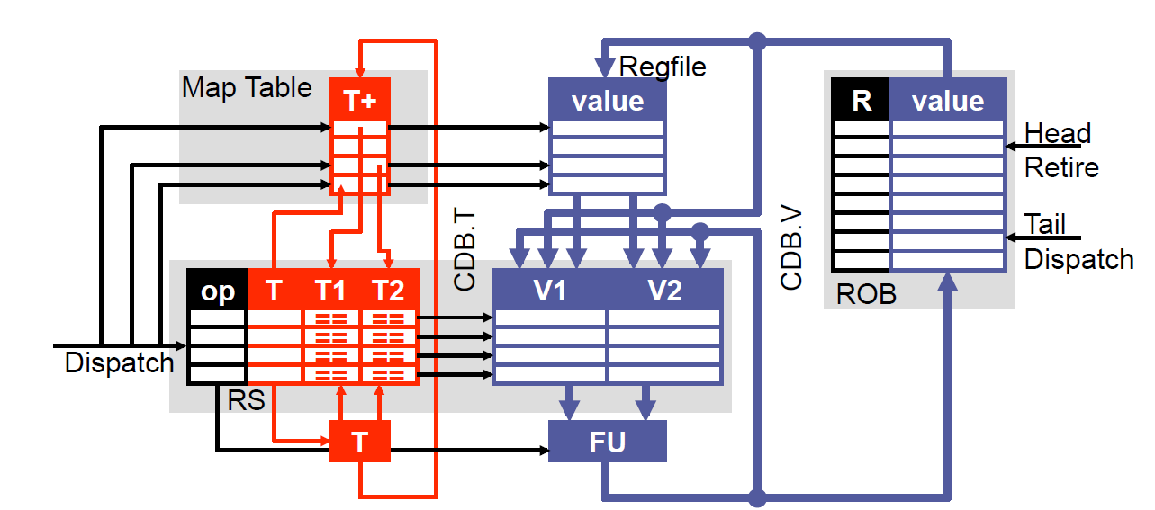
Adding a Reorder Buffer

Slide 40
Tomasulo Data Structures (Timing Free Example)
CDB
T | V
Map Table
Reg | Tag
r0
r1
r2
r3
r4
Reservation Stations (RS)
T | FU | busy | op | RoB | T1 | T2 | V1 | V2
1
2
3
4
5
ARF
Reg | V
r0
r1
r2
r3
r4
Instruction
r0=r1*r2
r1=r2*r3
Branch if r1=0
r0=r1+r1
r2=r2+1
Reorder Buffer (RoB)
RoB Number | 0 | 1 | 2 | 3 | 4 | 5 | 6
Dest. Reg.
Value

Slide 41
Review Questions
Could we make this work without a RS?
If so, why do we use it?
Why is it important to retire in order?
Why must branches wait until retirement before they announce their mispredict?
Any other ways to do this?

Slide 42
More review questions
What is the purpose of the RoB?
Why do we have both a RoB and a RS?
Yes, that was pretty much on the last page…
Misprediction
When to we resolve a mis-prediction?
What happens to the main structures (RS, RoB, ARF, Rename Table) when we mispredict?
What is the whole purpose of OoO execution?

Slide 43
Can We Add Superscalar?
Dynamic scheduling and multiple issue are orthogonal
E.g., Pentium4: dynamically scheduled 5-way superscalar
Two dimensions
N: superscalar width (number of parallel operations)
W: (number of reservation stations)
What do we need for an N-by-W Tomasulo?
RS: N tag/value w-ports (D), N value r-ports (S), 2N tag CAMs (W)
Select logic: W→N priority encoder (S)
MT: 2N read-ports (D), N write-ports (D)
RF: 2N read-ports (D), N write-ports (W)
CDB: N (W)
Which are the expensive pieces?

Slide 44
Superscalar Select Logic
Superscalar select logic: W→N priority encoder
Somewhat complicated (N² logW)
Can simplify using different RS designs
Split design
Divide RS into N banks: 1 per FU?
Implement N separate W/N→1 encoders
Simpler: N * logW/N
Less scheduling flexibility
FIFO design [Palacharla+]
Can issue only head of each RS bank
Simpler: no select logic at all
Less scheduling flexibility (but surprisingly not that bad)

