Slide 1
EECS 470
RS/ROB examples
True Physical Registers?
Project
Lecture 8 – Winter 2024
Slides developed in part by Profs. Austin, Brehob, Falsafi, Hill, Hoe, Lipasti, Martin, Roth, Shen, Smith, Sohi, Tyson, Vijaykumar, and Wenisch of Carnegie Mellon University, Purdue University, University of Michigan, University of Pennsylvania, and University of Wisconsin.

Slide 2
Today
RS/ROB
A bit more detail
True physical registers: Removing the ARF
How and why
Probably will only get started on this, we’ll see.
Project discussion
Help me to stop the above at 1pm.

Slide 3
Reminder
In the original Tomasulo’s algorithm you should only update the ARF if you overwrite the data in the RAT.
In the P6 scheme you always write to the ARF.

Slide 4
Tomasulo Data Structures (Timing Free Example, “P6 scheme”)
CDB
T | V
Map Table
Reg | Tag
r0
r1
r2
r3
r4
Reservation Stations (RS)
T | FU | busy | op | RoB | T1 | T2 | V1 | V2
1
2
3
4
5
ARF
Reg | V
r0
r1
r2
r3
r4
Instruction
r0=r1*r2
r1=r2*r3
Branch if r1=0
r0=r1+r1
r2=r2+1
Reorder Buffer (RoB)
RoB Number | 0 | 1 | 2 | 3 | 4 | 5 | 6
Dest. Reg.
Value

Slide 5
Review Questions
Could we make this work without the RS?
If so, why do we do that?
Why is it important to retire in order?
Why must branches wait until retirement before they announce their mispredict?
Any other ways to do this?

Slide 6
More review questions
What is the purpose of the RoB?
Why do we have both a RoB and a RS?
Yes, that was pretty much on the last page…
Misprediction
When to we resolve a mis-prediction?
What happens to the main structures (RS, RoB, ARF, Rename Table) when we mispredict?
What is the whole purpose of OoO execution?

Slide 7
And yet more review questions!
What is the purpose of the RoB?
Why do we have both a RoB and a RS?
Misprediction
When to we resolve a mis-prediction?
What happens to the main structures (RS, RoB, ARF, Rename Table) when we mispredict?
What is the whole purpose of OoO execution?

Slide 8
When an instruction is dispatched how does it impact each major structure?
Rename table?
ARF?
RoB?
RS?

Slide 9
When an instruction completes execution how does it impact each major structure?
Rename table?
ARF?
RoB?
RS?

Slide 10
When an instruction retires how does it impact each major structure?
Rename table?
ARF?
RoB?
RS?

Slide 11
Topic change
Why on earth are we doing this?
Why do we think it helps?
Homework 2 problems 5 and 6 made the argument.
Only need to obey true data dependencies.
Huge speedup potential.

Slide 12
Optimizing CPU Performance
Golden Rule: t_{CPU} = N_{inst}*CPI*t_{CLK}
Given this, what are our options
Reduce the number of instructions executed
Reduce the cycles to execute an instruction
Reduce the clock period
Our first focus: Reducing CPI
Approach: Instruction Level Parallelism (ILP)

Slide 13
Why ILP?
Requirements
Parallelism
Large window
Limited control deps
Eliminate “false” deps
Find run-time deps
Vs.

Slide 14
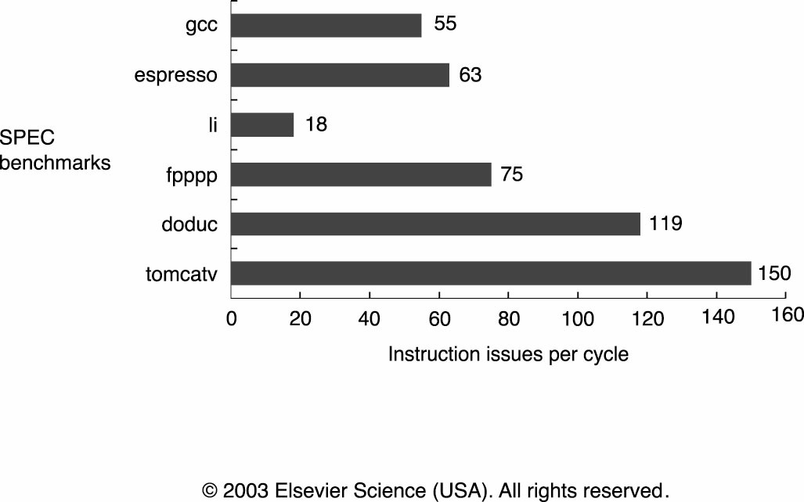
How Much ILP is There? (Chapter 3.10)

Slide 15
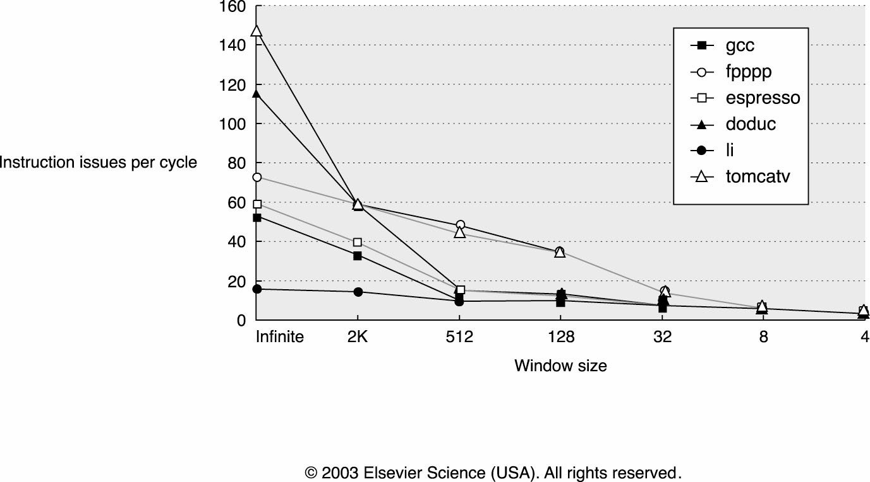
How Large Must the “Window” Be?

Slide 16
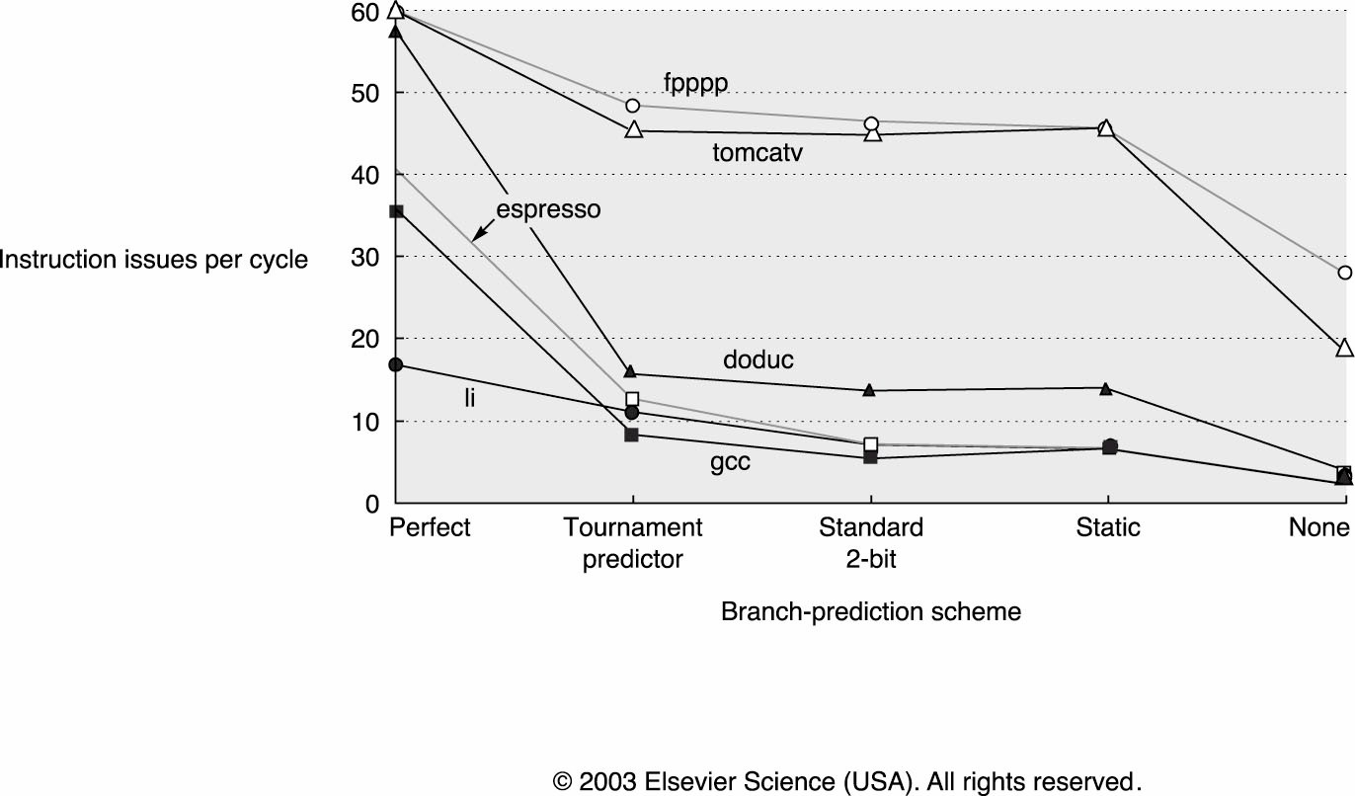
ALU Operation GOOD, Branch BAD
Expected Number of Branches
Between Mispredicts
E(X) ~ 1/(1-p)
E.g., p = 95%, E(X) ~ 20 brs, 100-ish insts

Slide 17
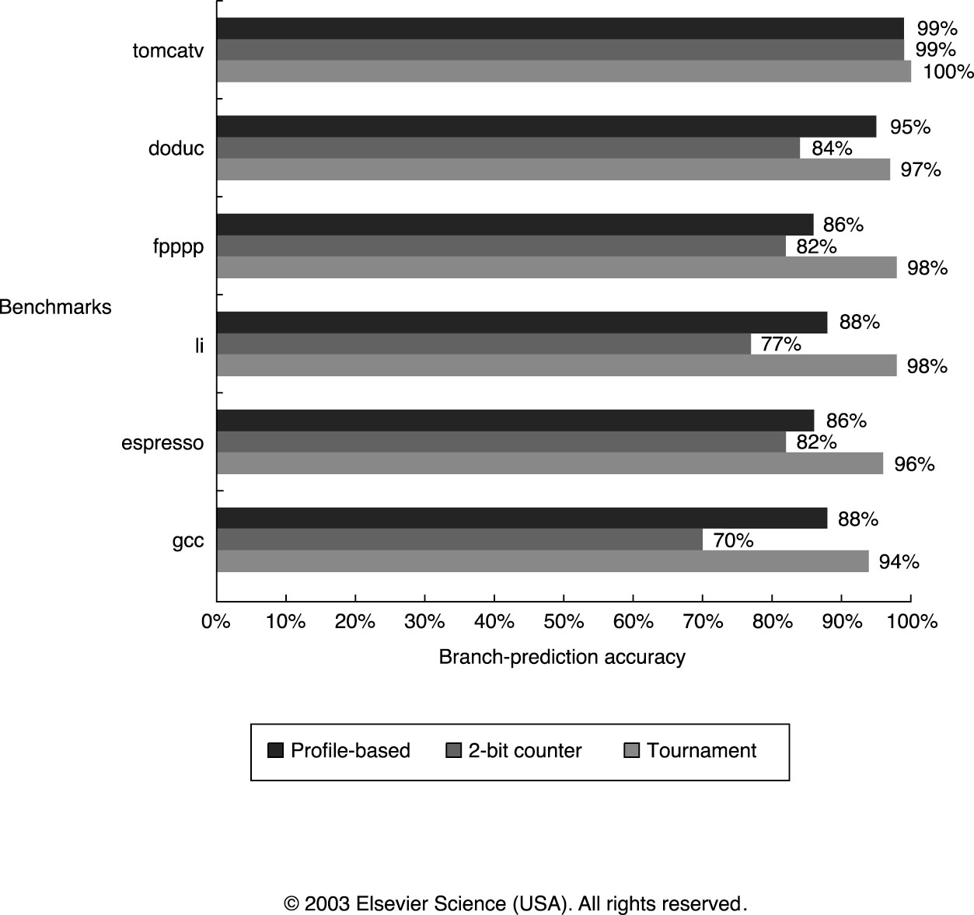
How Accurate are Branch Predictors?

Slide 18
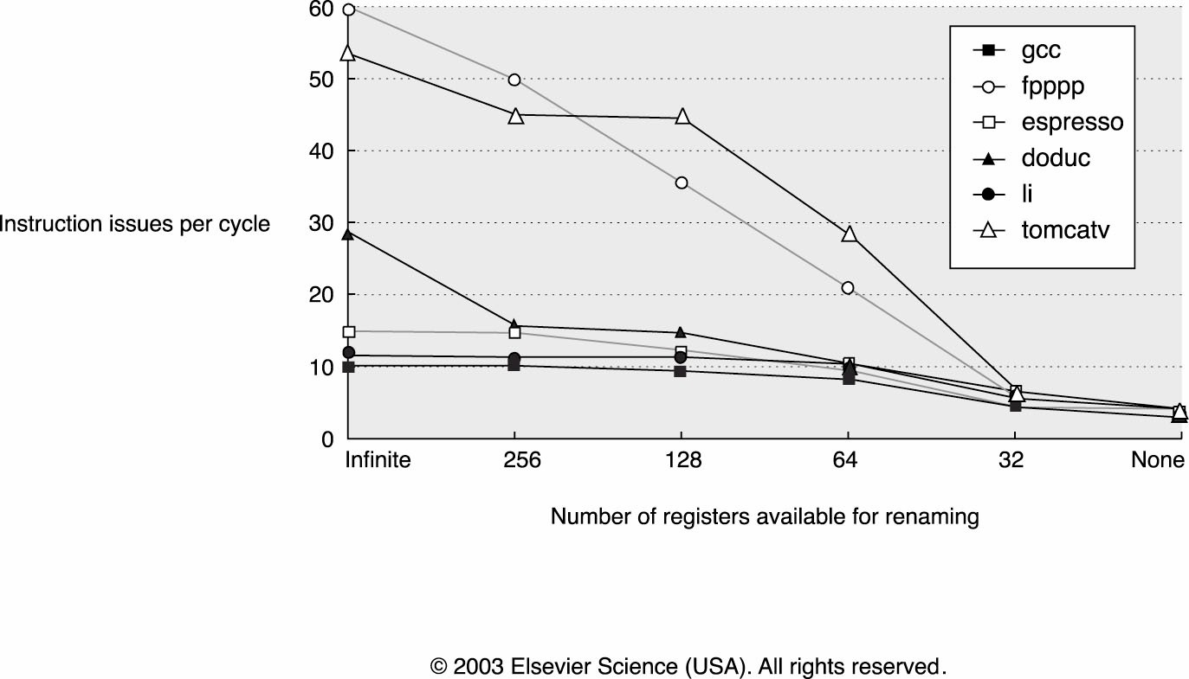
Impact of Physical Storage Limitations
Each instruction “in flight” must have storage for its result
Really worse than this because of mispeculation…

Slide 19
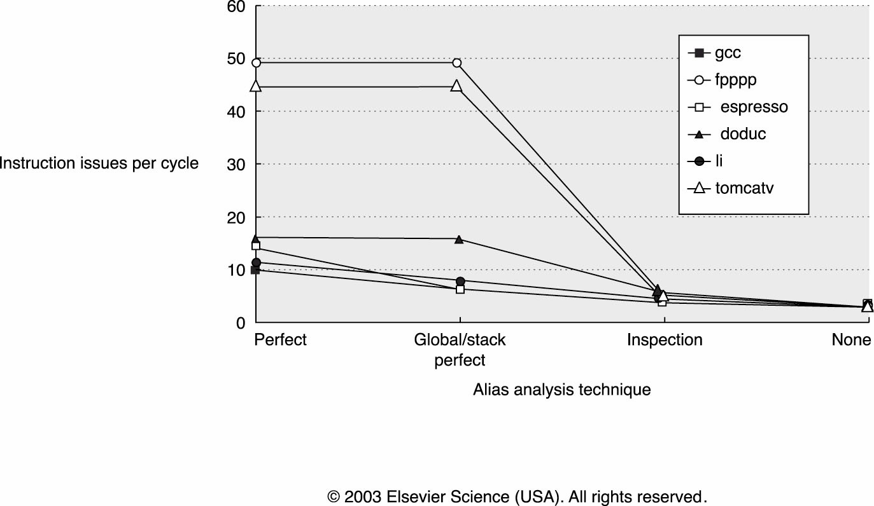
Registers GOOD, Memory BAD
Benefits of registers
Well described deps
Fast access
Finite resource
Memory loses these benefits for flexibility
*p = …
*q = …
… = *p
?

Slide 20
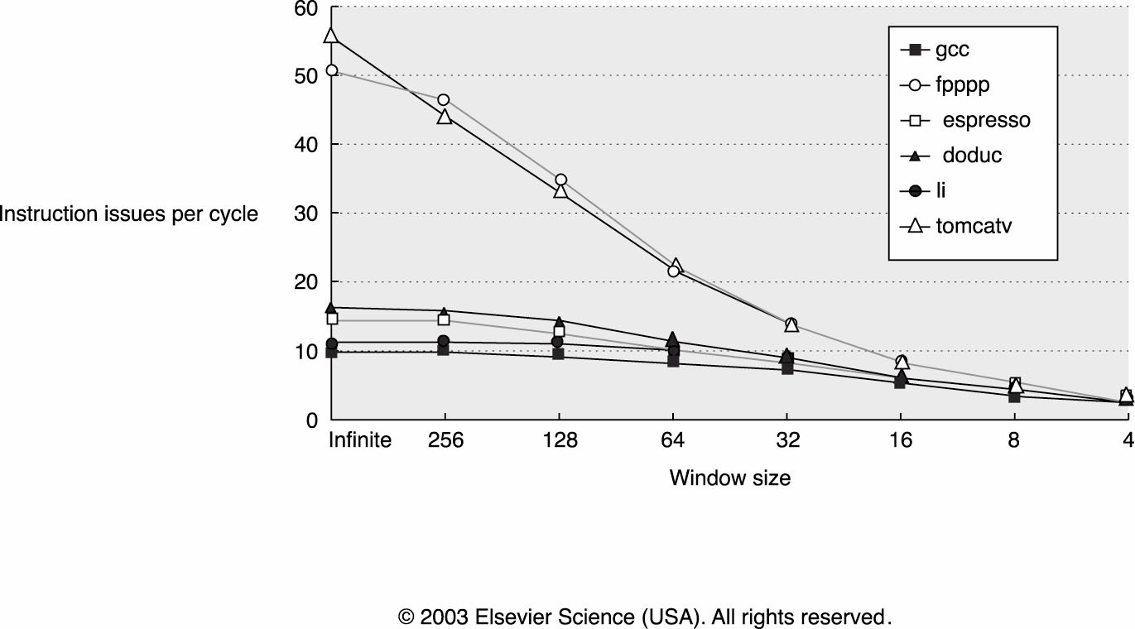
“Bottom Line” for an Ambitious Design

Slide 21
P6 reviewed
Steps are:
Dispatch to the OoO system
Issue to functional units
Wakeup
Select
Complete Execute
Retire

Slide 22
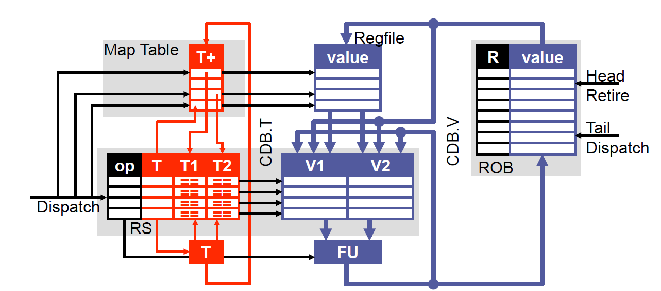
We added a Reorder Buffer

Slide 23
Let’s lose the ARF! (R10K scheme)
Why?
Currently have two structures that may hold values (ROB and ARF)
Need to write back to the ARF after every instruction!
Other motivations?
ROB currently holds result (which needs to be accessible to all) as well as other data (PC, etc.) which does not.
So probably two separate structures anyways
Many ROB entry result fields are unused (stores, branches)

Slide 24
Physical Register file Version 1.0
Keep a “Physical register file”
If you want to get the ARF back you need to use the RAT.
But the RAT has speculative information in it!
We need to be able to undo the speculative work!
How?

Slide 25
How?
Remove
The value field of the ROB
The whole ARF
Add
A “retirement RAT” (RRAT)
A “Physical Register File” (PRF)
Actions:
When you finish executing, send data to the PRF
When you retire, update the RRAT as if you were dispatching and updating the RAT.
(Other stuff we need to think about goes here.)
On a mis-predict, update the RAT with the RRAT when squashing.

Slide 26
RAT/RRAT Example
RAT
RRAT
AR | PR
0 | 1
1 | 2
2 | 3
3 | 4
4 | 10
AR | PR
0 | 1
1 | 2
2 | 3
3 | 4
4 | 10
Assembly
R1=R2*R3
R3=R1+R3

Slide 27
RAT/RRAT Example
RAT
RRAT
AR | PR
0 | 1
1 | 0
2 | 3
3 | 5
4 | 10
AR | PR
0 | 1
1 | 2
2 | 3
3 | 4
4 | 10
In-flight
Assembly
R1=R2*R3
R3=R1+R3
Renamed
P0=P3*P4
P5=P0+P4

Slide 28
This seems sorta okay but…
There seem to be some problems
When can I free a physical register?
If I’m writing to the physical register file at execute doesn’t that mean I committing at that point?
How do I squash instructions?
How do I recover architected state in the event of an exception?

Slide 29
Freedom
Freeing the PRF
How long must we keep each PRF entry?
Until we are sure no one else will read it before the corresponding Architected Register is again written.
Once the instruction overwriting the Architected Register commits we are certain safe.
So free the PR when the instruction which overwrites it commits.
In other words: when an instruction commits, it frees the PR it overwrites in the RRAT.
We could do better (?)
The value is dead once it is no longer needed.
Right now waiting until the AR is overwritten…
Freeing earlier would reduce the number of PRs needed.
But unclear how to do given speculation and everything else.

Slide 30
Sidebar
One thing that must happen with the PRF is that a “free list” must exist letting the processor know which physical registers are available.
Maintaining these free lists can be a pain!

Slide 31
RAT
A: R1=MEM[R2+0]
B: R2=R3/R1
C: R3=R2+R0
D: Branch (if R1!=0)
E: R3=R1+R3
F: R3=R3+R0
G: R3=R3+19
H: R1=R7+R6
RRAT
AR | Target
0 | 4
1 | 2
2 | 7
3 | 1
AR | Target
0
1
2
3
RoB
0 | 1 | 2 | 3 | 4 | 5 | 6 | 7 | 8 | 9
3 | 2 | 44 | 56 | 3 | 66 | 7 | 11 | 8 | 20
PRF

Slide 32
Resolving Branches Early: A variation
Keep a RAT copy for each branch in a RS!
If mis-predict, can recover RAT quickly.
Free lists also

Slide 33
Project Overview
Grade breakdown
22 points: Basics
Out-of-order and something works
20 points: Correctness
Measured by how many tests you pass.
17 points: Advanced features
20 points: Performance
Measured against your peers and previous semesters.
10 points: Analysis
Measuring something interesting. Ideally the impact of an advanced feature.
6 points: Documentation
You’ll do this at the end, don’t worry about it now.
3 points: Milestone 1
You’ll turn in some self-testing code. We’ll see if it does a good job.
2 points: Peer feedback
Do it on time & take it seriously you’ll get these points.

Slide 34
Advanced features
17 points of advanced feature stuff.
We suggest you consider one big thing in the core and a few small things outside of the core.
Superscalar execution (3-way*, arbitrary **)
Simultaneous Multi-threading (SMT) ***
Multi-core with a shared, coherent and consistent write-back L2 cache. ***
Exception handling?
Early branch resolution (before the branch hits the head of the RoB)
Multi-path execution on low-confidence branches (this may not help performance much…)

Slide 35
Non-core features
Much of this we haven’t covered yet.
Better caches
Associative, longer cache lines, etc.
Non-blocking caches
Harder than it looks
Better predictors
Gshare, tournament, etc.
Prefetching

Slide 36
Psuedo-core features
Adding instructions
Say cmov
This probably involves rewriting at least one benchmark.
Checkers
Tricky.

Slide 37
Wacky features
Think of something interesting and run with it.
We’ve had weird schedulers for EX units and other things..

Slide 38
Performance
Simple measure of how long it takes to finish a program.
Doesn’t include flushing caches etc.
Only get credit for right answers.
If you don’t synthisize, we can’t know your clock period, so few if any points here.
You’d like to pick your features so you double-dip.
Hint: Prefetching instructions is good.

Slide 39
Analysis
Think about what you want to measure.
Impact of a better cache?
How full your RoB is?
How much your early branch resolution helps.
Do a good job grabbing the data.
Be sure you can distinguish testbenches that are good for measuring performance vs. those that are good for correctness!

Slide 40
Report
Only thing to think about now is that we like things which show us how a feature works.
So having your debug data be readable could be handy.

Slide 41
Forming teams
We’ll post a signup sheet for teams tomorrow.
Teams are groups of 5
We may have one group of 6?
We’ll finish about 5 minutes early on Thursday to finish team formation.

