Slide 1
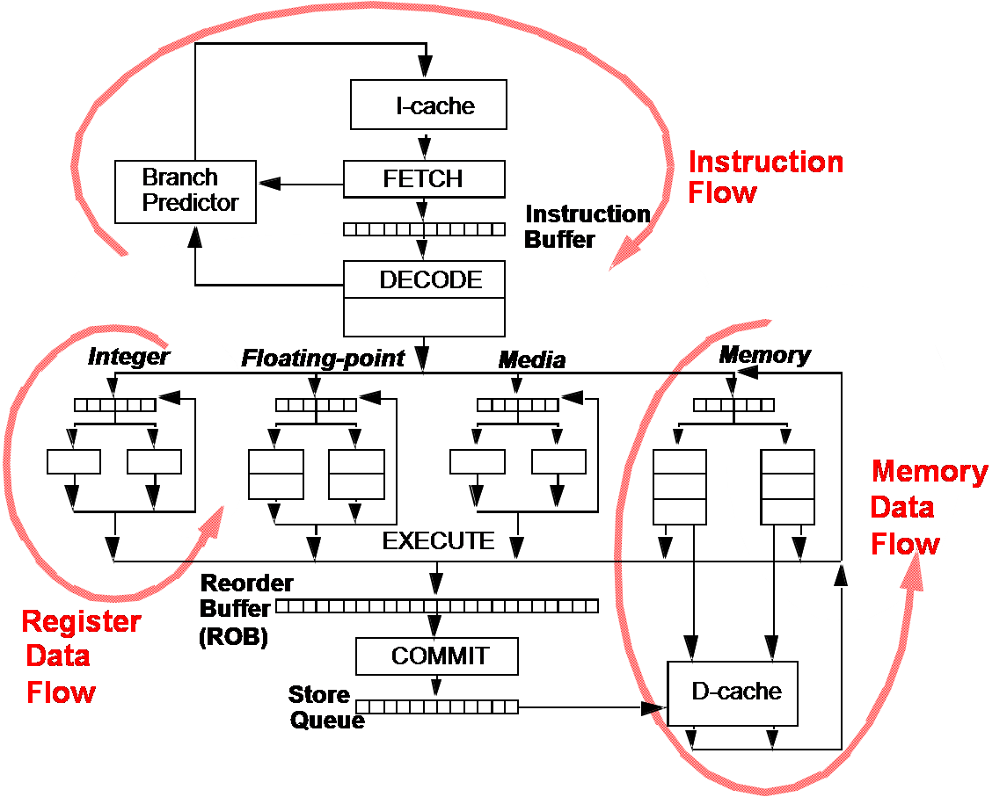
EECS 470
Memory Speculation
Winter 2024
Slides developed in part by Profs. Austin, Brehob, Falsafi, Hill, Hoe, Lipasti, Martin, Roth, Shen, Smith, Sohi, Tyson, Vijaykumar, Wenisch of Carnegie Mellon University, Purdue University, University of Michigan, Univerity of Pennsylvania, and University of Wisconsin.

Slide 2
Tomasulo-Style Scheduler Implementation
Results
Inputs
V
Tag
Value
Network
Control
Input/Result Networks
V
Tag
Value
Scheduler
Logic
Op
Flags
Valid
Bits
Reservation Stations
Synchronization managed by scheduler logic
Communication through input/output networks
Infrastructure geared towards register communication

Slide 3
Out-of-Order Memory Operations
Scheduling is straightforward in out-of-order…
Register inputs only
Register renaming captures all true dependences
Tags tell you exactly when you can execute
… except with loads and stores
Speculative stores cannot modify memory
Unless you can fix a mis-speculated store somehow!
Register renaming does not tell you all dependences for loads
There are some in memory
How do loads find older in-flight stores to same address (if any)?
Issue of finding if addresses match is called “memory disambiguation”

Slide 4
The Good: Register Communication
Directly specified dependencies (contained in inst)
Accurate description of communication
no false or missing dependency edges
permits realization of dataflow schedule
Early description of communication
know dependencies upon decode
allows scheduler logic to be pipelined without impacting speed of communication
Small communication name space (32-64 usually)
Fast access to communication storage
possible to map entire communication space (no tags)
possible to bypass communication storage
Forwarding

Slide 5
The Bad (and the ugly): Memory Scheduling
Recall how we handle dependencies in registers
We address false dependencies with register renaming.
We address true dependencies with the out-of-order machine
CDB broadcast and wakeup
Why can’t we do the same things with memory?
What would rename look like for memory?
Why might it be hard to pull off?
What about wakeup?
What’s tricky here?
Cannot directly use the same techniques
Indirectly specified memory dependencies
Large communication space (2³²⁻⁶⁴ bytes!)
Memory latency is variable
Complicates scheduling

Slide 6
Requirements for a Solution
Accurate description of memory dependencies
No (or few) missing or false dependencies
Permit realization of dataflow schedule
Early presentation of dependencies
Permit pipelining of scheduler logic
Fast access to communication space
Preferably as fast as register communication (zero cycles)

Slide 7
The Three Dependency “Flows”

Slide 8
Implementation
Several hardware realizations:
Unified LSQ (easier to understand, but nasty hardware)
Separate LQ* and SQ (more complicated, but fairly elegant)
We’ll start with a unified LSQ and move to separate LB and SQ.
*Likely would end up with a load buffer (LB) rather than a queue…

Slide 9
In-order Load/Store Scheduling
Idea: Schedule all loads and stores in program order
This cannot violate true data dependencies (non-speculative)
Capabilities/limitations:
Overly restrictive – likely to add many false dependencies
Early presentation of dependencies (no addresses)
Not fast, all communication through memory structures
Found in in-order issue pipelines
Dependencies
true
realized
st X
ld Y
program order
st Z
ld X
ld Z

Slide 10
Consider the LSQ cases
Slot | LSQ addresses (top is head)
A | Store 0x44
B | Load 0x20
C | Load 0x44
D | Store ????
E | Load 0x44
F | Store 0x20
G | Load 0x20
H | Load 0x60
Which of the loads are we sure we will fulfill via D$/Memory?
Which of the loads will we fulfill via load-to-store forwarding?
Which aren’t we sure of?
Identify what to do with each load.

Slide 11
Unified Load/Store Queue
Operates as a circular FIFO
Allocate on dispatch
De-allocate on retirement
Calc address in register dataflow order
A NxN comparator matrix detects memory address dependence (also considers relative age of entries)
Store ops are held until retirement
Load ops are issued when no dependency exists & all older store addresses known
=
=
=
=
=
=
=
=
=
=
=
=
=
=
=
=
=
=
=
=
=
=
=
=
=
=
=
=
=
=
=
=
=
=
=
=
=
=
=
=
=
=
=
=
=
=
=
=
=
=
address
calculation+
translation

Slide 12
Unified Load/Store Queue Questions
When do we search for store-to-load forwarding?
As soon as we have the load address
What could happen once we have the load address?
There is a store whose data we’ll use
There is no store whose data we’ll use
We aren’t sure which store’s data, if any, we’ll use.
What should we do for each of those three cases?

Slide 13
Split LQ and SQ
D$/TLB + structures to handle in-flight loads/stores
Performs four functions
In-order store retirement
Writes stores to D$ in order
Basic, implemented by store queue (SQ)
Store-load forwarding
Allows loads to read values from older un-retired stores
Data provided to LQ from SQ.
Memory ordering violation detection
Checks load speculation (more later)
Advanced, implemented by load queue (LQ)
Memory ordering violation avoidance
Advanced, implemented by dependence predictors

Slide 14
Simple Data Memory FU: D$/TLB + SQ
address
data in
data out
load position
Just like any other FU
2 register inputs (addr, data in)
1 register output (data out)
1 non-register input (load pos)?
Store queue (SQ)
In-flight store address/value
In program order (like ROB)
Addresses associatively searchable
Size heuristic: 15-20% of ROB
But what does it do?
Store Queue (SQ)
address
value
head
==
age
==
==
==
==
tail
==
==
==
D$/TLB

Slide 15
When should a load access memory?
When to go to memory?
Only at the head of the ROB (in order!)
Only no stores between it and head of LSQ/ROB
Only when there are no stores of the same address (or unknown address) between it and the head of the LSB/ROB.
Load goes to memory at address calculation, gets fixed if there is a conflicting store

Slide 16
When should a load go to the CDB?
Once you know you have the right data
Once you get some data
If you get this wrong, you need to squash it and all(?) following instructions.
Based on a confidence predictor or other additional information.
“Memory dependence prediction”

Slide 17
How to get data from stores?
Forwarding:
If there is a conflicting store, get the data from it.
This isn’t trivial.

Slide 18
Yet another idea…
Let’s use a predictor
Predict if a load is likely to be forwarding from a store
If not, get it from D$ and send it to the CDB
If so, wait.
Thoughts on cost/benefit of speculation?
How should that impact our predictor?
“Memory dependence prediction”

