Slide 1
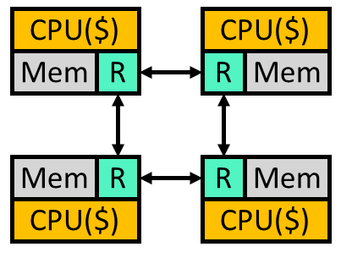
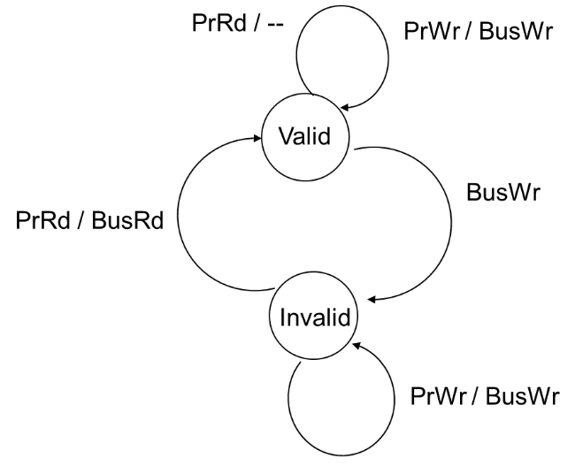
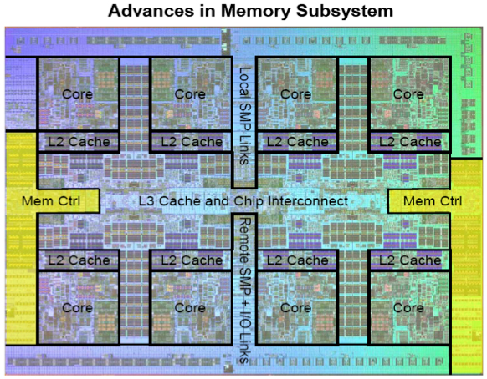
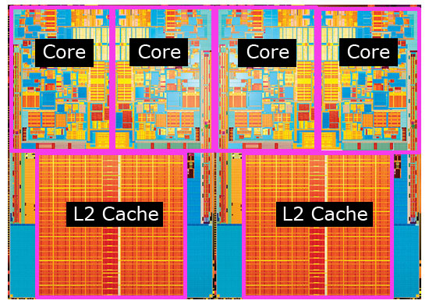
Multiprocessors continued
IBM's Power7 with eight cores and 32 Mbytes eDRAM
Quad-core Kentsfield package

Slide 2
Quick overview
Why do we have multi-processors?
What type of programs will work well? What type work poorly?

Slide 3
Overview of today’s lecture
Performance expectations
Amdahl’s law.
Review
Shared memory vs. message passing
Interconnection networks
Thread-level parallelism
Context
Bandwidth
Coherence
Directory-based consistency protocols
Consistency
Sequential (strong) consistency, weak consistency

Slide 4
Let’s (re)start at the top: Performance Expectations
Review
Amdahl's Law:
If a fraction P of your program can be sped up by a factor of S, then your performance is:
So if P=0.3 and S=2 we get (1/(.7+.15)) 1/.85 which is about 1.17.
Question:
If you have a program in which 10% can’t be done in parallel (i.e. must be serial) and you’ve got 64 processors, what’s the best speed up you could hope for?
Notes:
8.77, best possible is 10.

Slide 5
Review: Thread-Level Parallelism
Review: TLP
struct acct_t { int bal; };
shared struct acct_t accts[MAX_ACCT];
int id,amt;
if (accts[id].bal >= amt)
{
accts[id].bal -= amt;
spew_cash();
}
0: addi r1,accts,r3
1: ld 0(r3),r4
2: blt r4,r2,6
3: sub r4,r2,r4
4: st r4,0(r3)
5: call spew_cash
6: ... ... ...
Thread-level parallelism (TLP)
Collection of asynchronous tasks: not started and stopped together
Data shared loosely, dynamically
Example: database/web server (each query is a thread)
accts is shared, can’t register allocate¹ even if it were scalar
id and amt are private variables, register allocated to r1, r2
¹Keyword in C is “volatile”

Slide 6
Thread level parallelism (TLP)
Review: TLP
We exploited parallelism at the instruction level (ILP)
Hardware can’t find TLP.
Complier/programmer needs to find it (we lack the window size)
Compilers getting better at this.
But hardware can take advantage of TLP
Run on multiple cores
If data is shared, provide rules to the software about what it can assume about shared data.

Slide 7
Review: Why Shared Memory?
Review: Shared memory vs. message passing
Pluses:
For applications looks like multitasking uniprocessor
For OS only evolutionary extensions required
Easy to do communication without OS
Software can worry about correctness first then performance
Minuses:
Proper synchronization is complex
Communication is implicit so harder to optimize
Hardware designers must implement
Result:
Traditionally bus-based Symmetric Multiprocessors (SMPs), and now the CMPs are the most success parallel machines ever
And the first with multi-billion-dollar markets

Slide 8
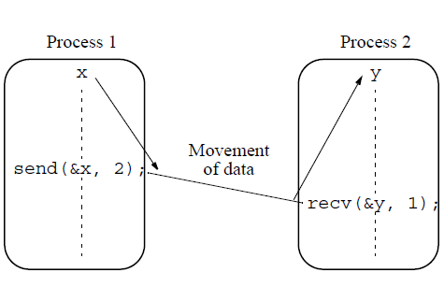
Alternative to shared memory?
Review: Shared memory vs. message passing
Explicit message passing
Rather difficult to code
We’ll not be doing anything with it
But while not a 470 topic, it is important.
Graduate level parallel programming class covers this in detail.

Slide 9
But shared memory systems have their own problems
Review: Shared memory vs. message passing
Two in particular
Cache coherence
Memory consistency model
Different solutions depending on interconnect
So let’s do interconnect now, and jump back to these two later.

Slide 10
Review: Interconnect
Review: Interconnect
There are many ways to connect processors.
Shared network
Bus-based
Crossbar
Point-to-point
More topologies than I want to think about
Mesh (in any amount of dimensionality)
Torus (in any amount of dimensionality)
nCube
Tree
etc. etc. etc. etc.
Notes:
8.77, best possible is 10.

Slide 11
Shared vs. Point-to-Point Networks
Review: Interconnect
Shared network: e.g., bus (left)
Low latency
Low bandwidth: doesn’t scale beyond ~8 processors
Shared property simplifies cache coherence protocols (later)
Point-to-point network: e.g., mesh or ring (right)
Longer latency: may need multiple “hops” to communicate
Higher bandwidth: scales to 1000s of processors
Cache coherence protocols are complex
CPU($)
CPU($)
CPU($)
CPU($)
CPU($)
CPU($)
Mem
R
R
Mem
Mem
R
Mem
R
Mem
R
Mem
R
Mem
R
R
Mem
CPU($)
CPU($)

Slide 12
Organizing Point-To-Point Networks
Review: Interconnect
Network topology: organization of network
Tradeoff performance (connectivity, latency, bandwidth) ↔ cost
Router chips
Networks that require separate router chips are indirect
Networks that use processor/memory/router packages are direct
Fewer components, “Glueless MP”
Point-to-point network examples
Indirect tree (left)
Direct mesh or ring (right)
R
CPU($)
CPU($)
Mem
R
R
Mem
R
R
Mem
R
Mem
R
Mem
R
Mem
R
Mem
R
R
Mem
CPU($)
CPU($)
CPU($)
CPU($)
CPU($)
CPU($)

Slide 13
Context: Bandwidth
Review: Bandwidth!
As in the uniprocessor we need caches
To reduce average memory latency.
But recall caches are also important for reducing bandwidth.
And now we’ve got (say) 4x as many requests
And the total amount of bandwidth is shrinking (why?)
We’ve probably got a bandwidth problem.
It’s important that caches work well!
CPU($)
CPU($)
CPU($)
CPU($)
Mem
R
Mem
R
Mem
R
Mem
R

Slide 14
Hardware Cache Coherence
Review: Coherence!
CPU
Coherence controller:
Examines bus traffic (addresses and data)
Executes coherence protocol
What to do with local copy when you see different things happening on bus
D$ data
CC
D$ tags
bus

Slide 15
Scalability problems of Snoopy Coherence
Coherence: Bus-based bandwidth issues
Prohibitive bus bandwidth
Required bandwidth grows with # CPUS…
… but available BW per bus is fixed
Adding busses makes serialization/ordering hard
Prohibitive processor snooping bandwidth
All caches do tag lookup when ANY processor accesses memory
Inclusion limits this to L2, but still lots of lookups
Upshot: bus-based coherence doesn’t scale beyond 8–16 CPUs

Slide 16
Scalable Cache Coherence
Review: Coherence!
Scalable cache coherence: two part solution
Part I: bus bandwidth
Replace non-scalable bandwidth substrate (bus)…
…with scalable bandwidth one (point-to-point network, e.g., mesh)
Part II: processor snooping bandwidth
Interesting: most snoops result in no action
Replace non-scalable broadcast protocol (spam everyone)…
…with scalable directory protocol (only spam processors that care)

Slide 17
Directory Coherence Protocols
Coherence: Directory-based
Observe: physical address space statically partitioned
Can easily determine which memory module holds a given line
That memory module sometimes called “home”
Can’t easily determine which processors have line in their caches
Bus-based protocol: broadcast events to all processors/caches
Simple and fast, but non-scalable
Directories: non-broadcast coherence protocol
Extend memory to track caching information
For each physical cache line whose home this is, track:
Owner: which processor has a dirty copy (I.e., M state)
Sharers: which processors have clean copies (I.e., S state)
Processor sends coherence event to home directory
Home directory only sends events to processors that care

Slide 18
Read Processing
Coherence: Directory-based
Node #1
Directory
Node #2
Read A (miss)
Read A
A: Shared, #1
Fill A

Slide 19
Write Processing
Coherence: Directory-based
Node #1
Directory
Node #2
Read A (miss)
Read A
A: Shared, #1
Fill A
ReadExclusive A
Invalidate A
A: Mod., #2
Fill A
Inv Ack A
Trade-offs:
Longer accesses (3-hop between Processor, directory, other Processor)
Lower bandwidth → no snoops necessary
Makes sense either for CMPs (lots of L1 miss traffic) or large-scale servers (shared-memory MP > 32 nodes)

Slide 20
Serialization and Ordering
Coherence: Directory-based
Let A and flag be initially 0
P1 P2
A += 5 while (flag == 0)
flag = 1 print A
Assume A and flag are in different cache blocks
What happens?
How do you implement it correctly?

Slide 21
Coherence vs. Consistency
Coherence vs. Consistency
Intuition says loads should return latest value
what is latest?
Coherence concerns only one memory location
Consistency concerns apparent ordering for all locations
A Memory System is Coherent if
can serialize all operations to that location such that,
operations performed by any processor appear in program order
program order = order defined program text or assembly code
value returned by a read is value written by last store to that location
Notes:
3

Slide 22
Why Coherence != Consistency
Coherence vs. Consistency
/* initial A = B = flag = 0 */
P1 P2
A = 1; while (flag == 0); /* spin */
B = 1; print A;
flag = 1; print B;
Intuition says printed A = B = 1
Coherence doesn’t say anything. Why?
Your uniprocessor ordering mechanisms (ld/st queue) hurts here. Why?
Notes:
4

Slide 23
Sequential Consistency (SC)
Consistency
processors
issue memory ops
in program order
P1
P2
P3
switch randomly set
after each memory op
provides single sequential
order among all operations
Memory
Notes:
5

Slide 24
Sufficient Conditions for SC
Consistency
Every proc. issues memory ops in program order
Memory ops happen (start and end) atomically
must wait for store to complete before issuing next memory op
after load, issuing proc waits for load to complete, before issuing next op
Easily implemented with a shared bus
Notes:
6

Slide 25
Relaxed Memory Models
Consistency
Motivation with Directory Protocols
Misses have longer latency (do cache hits to get to next miss)
Collecting acknowledgements can take even longer
Recall SC has
Each processor generates at total order of its reads and writes (R-->R, R-->W, W-->W, & W-->R)
That are interleaved into a global total order
Example Relaxed Models
PC: Relax ordering from writes to (other proc’s) reads
RC: Relax all read/write orderings (but add “fences”)

Slide 26
Locks
Locks

Slide 27
Lock-based Mutual Exclusion
Locks
xfer
Crit. sec
wait
No contention:
Want low latency
Contention:
Want low period
Low traffic
Fairness
release
Acquire starts
wait
xfer
Acquire done
Synchronization
period
Crit. sec
Release starts
release
Release done
xfer
Crit. sec

Slide 28
How Not to Implement Locks
Locks
LOCK
while (lock_variable == 1);
lock_variable = 1
UNLOCK
lock_variable = 0;
Context switch!

Slide 29
Solution: Atomic Read-Modify-Write
Locks
Test&Set(r,x)
{r=m[x]; m[x]=1;}
Fetch&Op(r1,r2,x,op)
{r1=m[x]; m[x]=op(r1,r2);}
Swap(r,x)
{temp=m[x]; m[x]=r; r=temp;}
Compare&Swap(r1,r2,x)
{temp=r2; r2=m[x]; if r1==r2 then m[x]=temp;}
r is register
m[x] is memory location x

Slide 30
Write a lock and unlock with test-and-set
Locks
Lock:
unlock:

Slide 31
Implementing RMWs
Locks
Bus-based systems:
Hold bus and issue load/store operations without any intervening accesses by other processors
Scalable systems
Acquire exclusive ownership via cache coherence
Perform load/store operations without allowing external coherence requests

Slide 32
Test-and-Set Spin Lock (T&S)
Locks
Lock is “acquire”, Unlock is “release”
acquire(lock_ptr):
while (true):
// Perform “test-and-set”
old = compare_and_swap(lock_ptr, UNLOCKED, LOCKED)
if (old == UNLOCKED):
break // lock acquired!
// keep spinning, back to top of while loop
release(lock_ptr):
store[lock_ptr] <- UNLOCKED
Performance problem
CAS is both a read and write; spinning causes lots of invalidations

Slide 33
Load Locked / Store Conditional (LL/SC)
Sometimes having an atomic read/modify/write operation isn’t viable.
Maybe your memory system just doesn’t support it
Maybe it involves a very expensive “lock out” that prevents any other memory operation until the lock finishes.
Still possible to manage with a two step process
Do a special load called a “load lock” or load “link”.
Works like a normal load but it tells the hardware to watch for a store to that same address.
Do a “store conditional” to the same address
If there was a store to that location since the load lock, the store “fails” and that failure is communicated to the programmer (store has a destination register)
Failed store doesn’t write to memory
Now we know if the load and store was effectively atomic.

Slide 34
Load-Locked Store-Conditional
Locks
Load-locked
Issues a normal load…
…and sets a flag and address field
Store-conditional
Checks that flag is set and address matches
If so, performs store and sets store register to 1.
Otherwise sets store register to 0.
Flag is cleared by
Invalidation
Cache eviction
Context switch
lock: lda r2, #1 ll r1, lock_variable
sc lock_variable, r2
beqz r2, lock
neqz r1, lock // branch not equal to zero
unlock:st lock_variable, #0

Slide 35
Next up: Static Optimizations
Why might we want to start loads early?
Moving loads to happen earlier is called “hoisting”
What three things limits a complier’s ability to hoist a load?

