Slide 1
Multithreading Processors and Static Optimization Review
Adapted from Bhuyan, Patterson, Eggers, probably others

Slide 2
Class stuff
CATME due today.
It’s probably the most points per unit effort in the class. Do it.
Quiz hopefully graded by tomorrow.
HW5 out tomorrow, pushing due date to 4/23
MS3 due Thursday 4/11
Meetings optional-ish.
Lecture schedule:
4/4: Multithreaded processors
4/9: ISA
4/11: Instruction scheduling (with a paper)
4/16: No lecture (probably)
4/18 Exam review
4/23 Oral Presentations

Slide 3
Today
Finish IA-64
Review Complier stuff
SMT

Slide 4
IA-64
128 64-bit registers
Use a register window similarish to SPARC
128 82 bit fp registers
64 1 bit predicate registers
8 64-bit branch target registers

Slide 5
Explicit Parallelism
Groups
Instructions which could be executed in parallel if hardware resources available.
Bundle
Code format. 3 instructions fit into a 128-bit bundle.
5 bits of template, 41*3 bits of instruction.
Template specifies what execution units each instruction requires.

Slide 6
Instructions
41 bits
4 high order specify opcode (combined with template for bundle)
6 low order bits specify predicate register number.
Every instruction is predicated!
Also NaT bits are used to handle speculated exceptions.

Slide 7
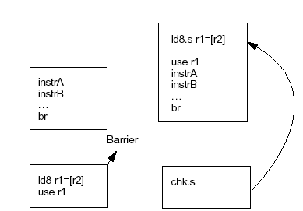
Speculative Load
Load instruction (ld.s) can be moved outside of a basic block even if branch target is not known
Speculative loads does not produce exception - it sets the NaT
Check instruction (chk.s) will jump to fix-up code if NaT is set
Traditional
IA-64

Slide 8
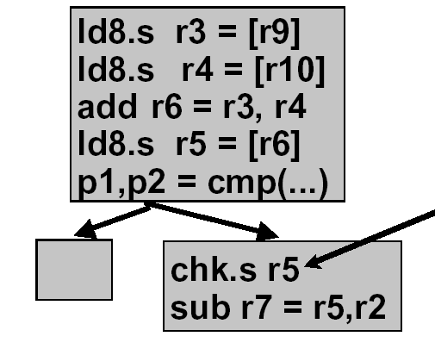
Propagation of NaT
Only single check required
NaT[reg] = NaT bit of reg
IF ( NaT[r3] || NaT[r4] ) THEN set NaT[r6]
IF ( NaT[r6] ) THEN set NaT[r5]
Require check on NaT[r5] only since the NaT is inherited
Reduce number of checks
Fix-up will execute the entire chain

Slide 9
Advanced loads
ld.a – Advanced load
Performs the load, puts it into the “ALAT”
If any following store writes to the same address, this is noted with a single bit.
When a ld.c is executed, if that bit is set, we refetch.
When chk.a is executed, if bit is set, fix up code is run. (Useful if load result already used.)
Both also cause any deferred exception to occur.

Slide 10
Software pipelining on IA-64
Lots of tricks
Rotating registers
Special counters
Often don’t need Prologue and Epilog.
Special counters and prediction lets us only execute those instructions we need to.

Slide 11
Static optimization and IA64 review
There are many important compiler techniques
We focused on hoisting loads.
But other include:
Register allocation (to reduce spills and fills)
Common sub-expression elimination
Wikipedia’s article on optimizing compliers provides a nice overview of standard optimizations.

Slide 12
How does static compare to dynamic?
Static
Has “a larger window” as it can see the whole program at once.
Can change the instructions executed.
Dynamic
Has dynamic information
“Can be wrong”

Slide 13
That said problems are similar
Static can reduce number of instructions, but for a given set of instructions, it is trying to optimize ILP just as dynamic does.
That will mean reordering instructions.
Suffers the same problems hardware does
Memory dependencies and branches.

Slide 14
Why can hoisting loads help?
add r15 = r2,r3 //A
mult r4 = r15,r2 //B
mult r4 = r4,r4 //C
st8 [r12] = r4 //D
ld8 r5 = [r15] //E
div r6 = r5,r7 //F
add r5 = r6,r2 //G
Assume latencies are:
add, store: +0
mult, div: +3
ld: +4
A:1
11
B:4
E:5
10
C:4
F:4
20
D:1
G:1

Slide 15
IA 64 support
Why is hoisting above a branch hard?
_____________________
IA64 solution?
Speculative load
Why is hoisting above a store hard?
__________________________
IA64 solution:
Advanced load
Notes:
could cause an exception if we execute a load that wasn’t going to really happen.
Could get wrong data from memory.

Slide 16
Other things we did
Software pipelining
Idea, example
Discussed register pressure
Idea, examples where optimization make it worse, IA64 “solution” (lots of registers…)
Briefly discussed caching
Code size increase is a common side effect of complier optimizations
Optimizing for locality is good.

Slide 17
On to multi-threading

Slide 18
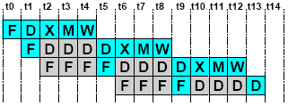
Pipeline Hazards
LW r1, 0(r2)
LW r5, 12(r1)
ADDI r5, r5, #12
SW 12(r1), r5
Each instruction may depend on the next
Without forwarding, need stalls
LW r1, 0(r2)
LW r5, 12(r1)
ADDI r5, r5, #12
SW 12(r1), r5
Bypassing/forwarding cannot completely eliminate interlocks or delay slots

Slide 19
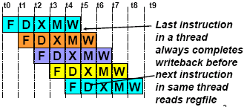
Multithreading
How can we guarantee no dependencies between instructions in a pipeline?
One way is to interleave execution of instructions from different program threads on same pipeline
Interleave 4 threads, T1-T4, on non-bypassed 5-stage pipe
T1: LW r1, 0(r2)
T2: ADD r7, r1, r4
T3: XORI r5, r4, #12
T4: SW 0(r7), r5
T1: LW r5, 12(r1)

Slide 20
CDC 6600 Peripheral Processors (Cray, 1965)
First multithreaded hardware
10 “virtual” I/O processors
fixed interleave on simple pipeline
pipeline has 100ns cycle time
each processor executes one instruction every 1000ns
accumulator-based instruction set to reduce processor state

Slide 21
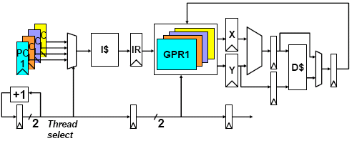
Simple Multithreaded Pipeline
Have to carry thread select down pipeline to ensure correct state bits read/written at each pipe stage

Slide 22
Multithreading Costs
Appears to software (including OS) as multiple slower CPUs
Each thread requires its own user state
GPRs
PC
Other costs?

Slide 23
Thread Scheduling Policies
Fixed interleave (CDC 6600 PPUs, 1965)
each of N threads executes one instruction every N cycles
if thread not ready to go in its slot, insert pipeline bubble
Software-controlled interleave (TI ASC PPUs, 1971)
OS allocates S pipeline slots amongst N threads
hardware performs fixed interleave over S slots, executing whichever thread is in that slot
Hardware-controlled thread scheduling (HEP, 1982)
hardware keeps track of which threads are ready to go
picks next thread to execute based on hardware priority
scheme

Slide 24
What “Grain” Multithreading?
So far assumed fine-grained multithreading
CPU switches every cycle to a different thread
When does this make sense?
Coarse-grained multithreading
CPU switches every few cycles to a different thread
When does this make sense?

Slide 25
Multithreading Design Choices
Context switch to another thread every cycle, or on hazard or L1 miss or L2 miss or network request
Per-thread state and context-switch overhead
Interactions between threads in memory hierarchy

Slide 26
Denelcor HEP (Burton Smith, 1982)
First commercial machine to use hardware threading in main CPU
120 threads per processor
10 MHz clock rate
Up to 8 processors
precursor to Tera MTA (Multithreaded Architecture)

Slide 27
Tera MTA Overview
Up to 256 processors
Up to 128 active threads per processor
Processors and memory modules populate a 3D torus interconnection fabric
Flat, shared main memory
No data cache
Sustains one main memory access per cycle per processor
50W/processor @ 260MHz

Slide 28
MTA Instruction Format
Three operations packed into 64-bit instruction word (short VLIW)
One memory operation, one arithmetic operation, plus one arithmetic or branch operation
Memory operations incur ~150 cycles of latency
Explicit 3-bit “lookahead” field in instruction gives number of subsequent instructions (0-7) that are independent of this one
c.f. Instruction grouping in VLIW
allows fewer threads to fill machine pipeline
used for variable- sized branch delay slots
Thread creation and termination instructions

Slide 29
MTA Multithreading
Each processor supports 128 active hardware threads
128 SSWs, 1024 target registers, 4096 general-purpose registers
Every cycle, one instruction from one active thread is launched into pipeline
Instruction pipeline is 21 cycles long
At best, a single thread can issue one instruction every 21 cycles
Clock rate is 260MHz, effective single thread issue rate is 260/21 = 12.4MHz

Slide 30
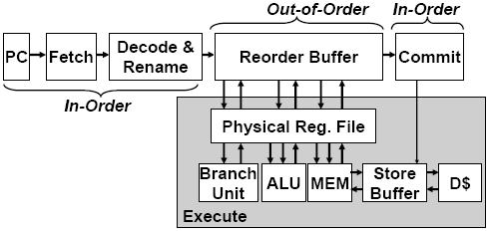
Speculative, Out-of-Order Superscalar Processor

Slide 31
P6 Performance: uops commit/clock
Average
0: 55%
1: 13%
2: 8%
3: 23%
Integer
0: 40%
1: 21%
2: 12%
3: 27%

Slide 32
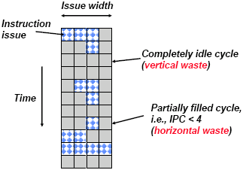
Superscalar Machine Efficiency
Why horizontal waste?
Why vertical waste?

Slide 33
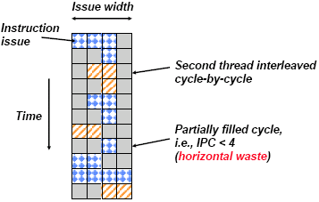
Vertical Multithreading
Cycle-by-cycle interleaving of second thread removes vertical waste

Slide 34
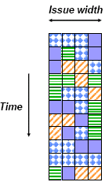
Ideal Multithreading for Superscalar
Interleave multiple threads to multiple issue slots with no restrictions

Slide 35
Simultaneous Multithreading
Add multiple contexts and fetch engines to wide out-of-order superscalar processor
[Tullsen, Eggers, Levy, UW, 1995]
OOO instruction window already has most of the circuitry required to schedule from multiple threads
Any single thread can utilize whole machine

Slide 36
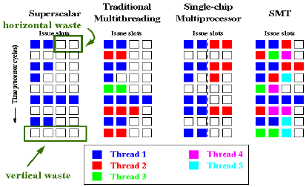
Comparison of Issue Capabilities Courtesy of Susan Eggers

Slide 37
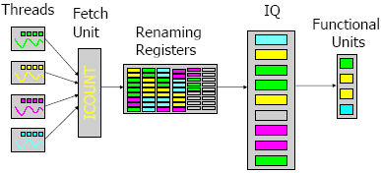
From Superscalar to SMT
SMT is an out-of-order superscalar extended with hardware to support multiple executing threads

Slide 38
From Superscalar to SMT
Small items
per-thread program counters
per-thread return address stacks
per-thread bookkeeping for instruction retirement, trap & instruction dispatch queue flush
thread identifiers, e.g., with BTB & TLB entries

Slide 39
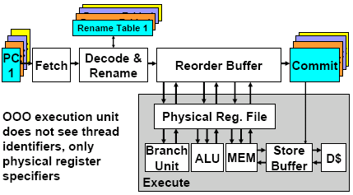
Simultaneous Multithreaded Processor

Slide 40
SMT Design Issues
Which thread to fetch from next?
Don’t want to clog instruction window with thread with many stalls → try to fetch from thread that has fewest insts in window
Locks
Virtual CPU spinning on lock executes many instructions but gets nowhere → add ISA support to lower priority of thread spinning on lock

Slide 41
Intel Pentium-4 Xeon Processor
Hyperthreading == SMT
Dual physical processors, each 2-way SMT
Logical processors share nearly all resources of the physical processor
Caches, execution units, branch predictors
Die area overhead of hyperthreading ~5 %
When one logical processor is stalled, the other can make progress
No logical processor can use all entries in queues when two threads are active
A processor running only one active software thread to run at the same speed with or without hyperthreading
“Death by 1000 cuts”

Slide 42
And things to think about: Wider in the front…
P6: (% instructions dispatched that do not commit)

