Slide 1
Instruction scheduling
Based on slides by Ilhyun Kim and Mikko Lipasti

Slide 2
Schedule of things to do
HW5 posted.
Due on 4/23 (last day of class) @10pm – 24 hours late with only 5% off.
MS3 Today
Project is due on Saturday 4/20 at 9pm.
Last synth job can still be running, but don’t rely on it.
No code changes after this.
Oral and written reports are due on Tuesday 4/23.
Brief directions for both posted shortly.
Final written report is due at 9pm on Piazza
Oral reports are during the day.
Will watch at least 2 other talks.
Can go to all if you wish.

Slide 3
Lecture (and review) schedule
4/11: (today) Instruction scheduling
4/16: (Tuesday) No class (work on projects)
4/18: (Thursday) Exam Q&A in class
4/23: (Tuesday) Project presentations
4/24: (Wednesday) Exam Q&A (what time?)
4/26: (Friday) Final exam 10:30-12:30

Slide 4
Today
Instruction scheduling overview
Scheduling atomicity
Speculative scheduling
Scheduling recovery
Other neat ideas…
Reading list

Slide 5
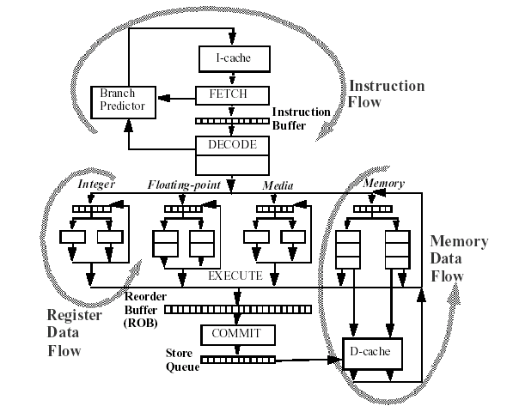
Register Dataflow
Scheduling review

Slide 6
Instruction scheduling
Instruction scheduling review
A process of mapping a series of instructions into execution resources
Decides when and where an instruction is executed
Data dependence graph
Mapped to two FUs
1
FU0
FU1
n
1
2
3
4
n+1
2
3
5
6
n+2
5
4
n+3
6

Slide 7
Instruction scheduling
Instruction scheduling review
A set of wakeup and select operations
Wakeup
Broadcasts the tags of parent instructions selected
Dependent instruction gets matching tags, determines if source operands are ready
Resolves true data dependences
Select
Picks instructions to issue among a pool of ready instructions
Resolves resource conflicts
Issue bandwidth
Limited number of functional units / memory ports

Slide 8
Scheduling loop
Instruction scheduling review
Basic wakeup and select operations
broadcast the tag of the selected instructions
tag W
…
tag 1
grant 0
request 0
OR
=
=
OR
scheduling
loop
=
=
grant 1
request 1
readyL
tagL
tagR
readyR
…
…
……
OR
=
=
OR
=
=
grant n
selected
readyL
tagL
tagR
readyR
issue
to FU
request n
ready - request
Select logic
Wakeup logic

Slide 9
Wakeup and Select
Instruction scheduling review
Ready inst
to issue
FU0
FU1
Wakeup / select
1
Select 1
Wakeup 2,3,4
n
1
1
2
3
4
Select 2, 3
Wakeup 5, 6
n+1
2
3
2, 3, 4
5
6
Select 4, 5
Wakeup 6
n+2
5
4
4, 5
n+3
6
6
Select 6

Slide 10
Scheduling Atomicity
Scheduling Atomicity
If we want to pipeline selection logic, we will latch the selection decision (it becomes a pipeline stage)
So we can’t wake up the next guy until the cycle after we are selected.
cycle
Atomic scheduling
Non-Atomic
2-cycle scheduling
n
select 1
wakeup 2, 3
select 1
1
1
n+1
Select 2, 3
wakeup 4
2
3
wakeup 2, 3
n+2
Select 4
4
select 2, 3
2
3
n+3
wakeup 4
n+4
select 4
4

Slide 11
Implication of scheduling atomicity
Scheduling Atomicity
Pipelining is a standard way to improve clock frequency
Hard to pipeline instruction scheduling logic without losing ILP
~10% IPC loss in 2-cycle scheduling
~19% IPC loss in 3-cycle scheduling
A major obstacle to building high-frequency microprocessors

Slide 12
Scheduler Designs
Scheduling Atomicity
Data-Capture Scheduler
Keep the most recent register value in reservation stations
Data forwarding and wakeup are combined to some extent
Early tag broadcast decouples this to some extent of course.
Register
File
Register update
Data-captured
scheduling window
(reservation station)
Forwarding
and wakeup
Functional Units

Slide 13
Scheduler Designs
Scheduling Atomicity
Non-Data-Capture Scheduler
Keep the most recent register value in RF (physical registers)
Data forwarding and wakeup are cleanly decoupled
Non-data-capture
scheduling
window
wakeup
Register
File
Update & Forwarding
Functional Units

Slide 14
Mapping to pipeline stages
Scheduling Atomicity
AMD K7 (data-capture)
Data
Data /
wakeup
Pentium 4 (non-data-capture)
wakeup
Data

Slide 15
Scheduling atomicity & non-data-capture scheduler
Scheduling Atomicity
Multi-cycle scheduling loop
Scheduling atomicity is not maintained
Separated by extra pipeline stages (Disp, RF)
Unable to issue dependent instructions consecutively
➔ solution: speculative scheduling
Fetch
Fetch
Fetch
Fetch
Fetch
Fetch
Fetch
Fetch
Decode
Decode
Decode
Decode
Decode
Decode
Decode
Decode
Sched
/Exe
Schedule
Schedule
Schedule
Schedule
Schedule
Schedule
Schedule
Writeback
Dispatch
Dispatch
Dispatch
Dispatch
Dispatch
Dispatch
Dispatch
Commit
RF
RF
RF
RF
RF
RF
RF
Exe
Exe
Exe
Exe
Exe
Exe
Exe
Writeback
Writeback
Writeback
Writeback
Writeback
Writeback
Writeback
Commit
Commit
Commit
Commit
Commit
Commit
Commit
Wakeup
/Select
Wakeup
/Select
wakeup/
select
Atomic Sched/Exe

Slide 16
Speculative Scheduling
Speculative Scheduling
Speculatively wakeup dependent instructions even before the parent instruction starts execution
Keep the scheduling loop within a single clock cycle
But, nobody knows what will happen in the future
Source of uncertainty in instruction scheduling: loads
Cache hit / miss
Store-to-load aliasing
➔ eventually affects timing decisions
Scheduler assumes that all types of instructions have pre-determined fixed latencies
Load instructions are assumed to have a common case (over 90% in general) $DL1 hit latency
If incorrect, subsequent (dependent) instructions are replayed

Slide 17
Speculative Scheduling
Speculative Scheduling
Overview
Speculatively issued instructions
Speculatively issued instructions
Speculatively issued instructions
Speculatively issued instructions
Speculatively issued instructions
Speculatively issued instructions
Speculatively issued instructions
Speculatively issued instructions
Speculatively issued instructions
Fetch
Fetch
Fetch
Fetch
Fetch
Fetch
Fetch
Fetch
Fetch
Decode
Decode
Decode
Decode
Decode
Decode
Decode
Decode
Decode
Schedule
Schedule
Schedule
Schedule
Schedule
Schedule
Schedule
Schedule
Schedule
Dispatch
Dispatch
Dispatch
Dispatch
Dispatch
Dispatch
Dispatch
Dispatch
Dispatch
RF
RF
RF
RF
RF
RF
RF
RF
RF
Exe
Exe
Exe
Exe
Exe
Exe
Exe
Exe
Exe
Writeback
/Recover
Writeback
/Recover
Writeback
/Recover
Writeback
/Recover
Writeback
/Recover
Writeback
/Recover
Writeback
/Recover
Writeback
/Recover
Writeback
/Recover
Commit
Commit
Commit
Commit
Commit
Commit
Commit
Commit
Commit
Latency Changed!!
Invalid input value
Spec wakeup
/select
Spec wakeup
/select
Re-schedule
when latency mispredicted
Re-schedule
when latency mispredicted
Re-schedule
when latency mispredicted
Re-schedule
when latency mispredicted
Re-schedule
when latency mispredicted
Re-schedule
when latency mispredicted
Re-schedule
when latency mispredicted
Re-schedule
when latency mispredicted
Unlike the original Tomasulo’s algorithm
Instructions are scheduled BEFORE actual execution occurs
Assumes instructions have pre-determined fixed latencies
ALU operations: fixed latency
Load operations: assumes $DL1 latency (common case)
Notes:
This is a very generic out-of-order pipeline that is based on original Tomasulo’s algorithm. In the algorithm, it assumes that ‘as soon as’ the result value becomes available, it wakes up dependent instructions and issues them atomically so that back-to-back execution is possible. However, today’s microprocessors have deeper pipeline to get the higher clock speed and throughput and the distance between writeback stage and the issue stage gets longer. So if we execute two dependent instructions in this pipeline based on the original scheme, we cannot do back-to-back execution and we’ll lose lots of ILP.
So, instead of waking up instructions from writeback stage, there’s a feed back loop where issued instructions speculatively wake up dependent instructions based on the instruction latency. So the previous instruction is issued. it speculatively wakes up dependent instruction, and finally they can execute in back-to-back cycles. If, for example, the first instruction is a load and we found that a cache miss occurred, which means this instruction do not have the correct memory value and it needs more cycles to get the value from memory, so the instruction and the dependent instruction are put again into the scheduler and waiting for the next issue slot.
Unlike the atomic wakeup and select scheduling, speculative scheduling assumes a fixed latency of instruction and schedules dependent instructions based on that.
And also, since resource uses are determined at scheduled time, for instance, even though we found that this load does not have to access the cache in the execution stage, it is impossible to deallocate that scheduled port and use it for other load instructions.

Slide 18
Scheduling replay
Speculative Scheduling—recovery
Speculation needs verification / recovery
There’s no free lunch
If the actual load latency is longer (i.e. cache miss) than what was speculated
Best solution (disregarding complexity): replay data-dependent instructions issued under load shadow
Cache miss
detected
Fetch
Decode
Rename
Rename
Queue
Sched
Disp
Disp
RF
RF
Exe
Retire
/ WB
Commit
instruction flow
verification flow

Slide 19
Wavefront propagation
Speculative Scheduling—recovery
speculative execution
wavefront
real execution
wavefront
dependence
linking
Data
linking
Fetch
Decode
Rename
Rename
Queue
Sched
Disp
Disp
RF
RF
Exe
Retire
/ WB
Commit
instruction flow
verification flow
Speculative execution wavefront
speculative image of execution (from scheduler’s perspective)
Both wavefront propagates along dependence edges at the same rate (1 level / cycle)
the real wavefront runs behind the speculative wavefront
The load resolution loop delay complicates the recovery process
scheduling miss is notified a couple of clock cycles later after issue

Slide 20
Issues in scheduling replay
Speculative Scheduling—recovery
Sched
/ Issue
Exe
checker
cycle n
cache miss
signal
cycle n+1
cycle n+2
cycle n+3
Cannot stop speculative wavefront propagation
Both wavefronts propagate at the same rate
Dependent instructions are unnecessarily issued under load misses

Slide 21
Requirements of scheduling replay
Propagation of recovery status should be faster than speculative wavefront propagation
Recovery should be performed on the transitive closure of dependent instructions
Conditions for ideal scheduling replay
All mis-scheduled dependent instructions are invalidated instantly
Independent instructions are unaffected
Multiple levels of dependence tracking are needed
e.g. Am I dependent on the current cache miss?
Longer load resolution loop delay → tracking more levels
load
miss

Slide 22
Scheduling replay schemes
Speculative Scheduling—recovery
Alpha 21264: Non-selective replay
Replays all dependent and independent instructions issued under load shadow
Analogous to squashing recovery in branch misprediction
Simple but high performance penalty
Independent instructions are unnecessarily replayed
Sched
Disp
RF
Exe
Retire
LD
miss
resolved
LD
LD
LD
LD
ADD
ADD
Cache
miss
ADD
ADD
ADD
OR
OR
OR
OR
OR
AND
AND
AND
AND
AND
BR
BR
BR
BR
BR
Invalidate & replay ALL instructions in the load shadow

Slide 23
Position-based selective replay
Speculative Scheduling—recovery
SLL
AND
0 0
0 0
0 1
0 0
0 0
1 0
0 1
0 0
merge
matices
Sched
SLL
AND
Disp
OR
XOR
tag / dep info
broadcast
Cycle n
RF
ADD
LD
ADD
OR
XOR
Kill bus
tagL
=
ReadyL
tag bus
Exe
LD
0 0
0 0
0 1
0 0
0 0
0 0
0 1
0 0
0 0
1 0
0 0
0 0
tagR
=
dependence info bus
Retire
ReadyR
Integer pipeline
Mem pipeline
(width 2)
1 0
0 1
0 0
1 0
invalidate if bits match
in the last row
Sched
Cache miss
Detected
bit merge
& shift
Disp
SLL
AND
Cycle n+1
killed
killed
killed
killed
RF
OR
XOR
ADD
OR
XOR
SLL
AND
Exe
ADD
LD
0 0
0 0
0 0
0 1
0 0
0 0
0 0
0 1
0 0
0 0
1 0
0 0
0 0
0 0
0 0
0 1
0 0
0 0
1 0
0 1
Retire
LD
Ideal selective recovery
replay dependent instructions only
Dependence tracking is managed in a matrix form
Column: load issue slot, row: pipeline stages
kill bus broadcast

Slide 24
We could also do something more radical
Misc. “Neat ideas”
Greatly simplify scheduling in some way.

Slide 25
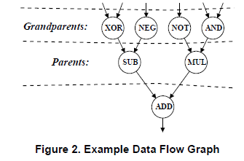
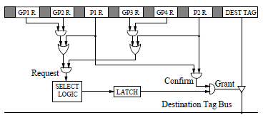
Another scheduling idea: Grandparents
Misc. “Neat ideas”
Schedule based on grandparents
J. Stark, M.D. Brown, and Y.N. Patt. “On pipelining dynamic instruction scheduling logic,” ISCA 2000

Slide 26
Low-complexity scheduling techniques
Misc. “Neat ideas”
FIFO (Palacharla, Jouppi, Smith, 1996)
Replaces conventional scheduling logic with multiple FIFOs
Steering logic puts instructions into different FIFOs considering dependences
A FIFO contains a chain of dependent instructions
Only the head instructions are considered for issue

Slide 27
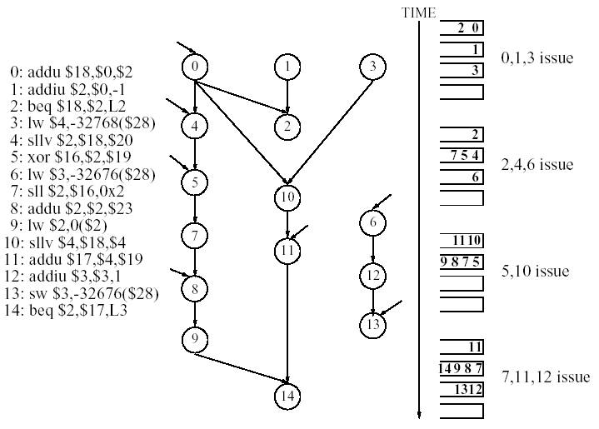
FIFO (cont’d)
Misc. “Neat ideas”
Scheduling example

Slide 28
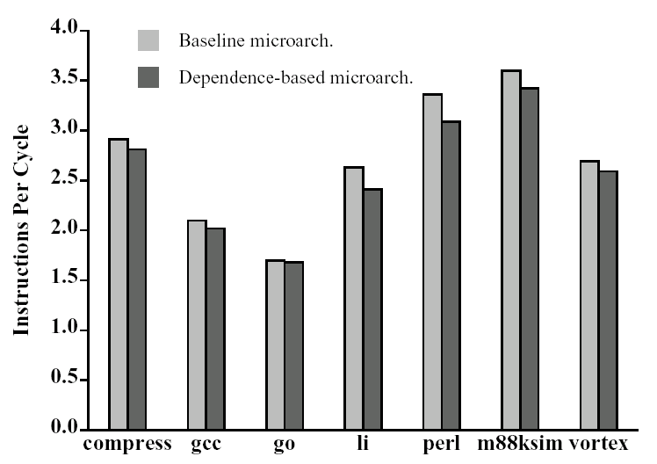
FIFO (cont’d)
Misc. “Neat ideas”
Performance
Comparable performance to the conventional scheduling
Reduced scheduling logic complexity
Many related papers on clustered microarchitecture
Can in-order clusters provide high performance?

Slide 29
Key Challenge: MLP (Memory-Level Parallelism)
Misc. “Neat ideas”
Tolerate/overlap memory latency
Once first miss is encountered, find another one
Naïve solution
Implement a very large ROB, LSQ
Power/area/delay make this infeasible
Build virtual instruction window
How to do this?

Slide 30
Check point
Misc. “Neat ideas”
Key notion is we need to be able to recover when we get a mis-speculation (or exception or other nuke situation)
How about just storing a check point every X instructions (say 100).
If there is a nuke, back up to check point and move forward with either
Knowledge of issue (predict correctly this time) OR
Carefully (in-order?).
Don’t let stores write to memory until get to next check point.

Slide 31
Sources and Further Reading
I. Kim and M. Lipasti, “Understanding Scheduling Replay Schemes,” in Proceedings of the 10th International Symposium on High-performance Computer Architecture (HPCA-10), February 2004.
Srikanth Srinivasan, Ravi Rajwar, Haitham Akkary, Amit Gandhi, and Mike Upton, “Continual Flow Pipelines”, in Proceedings of ASPLOS 2004, October 2004.
Ahmed S. Al-Zawawi, Vimal K. Reddy, Eric Rotenberg, Haitham H. Akkary, “Transparent Control Independence,” in Proceedings of ISCA-34, 2007.
T. Shaw, M. Martin, A. Roth, “NoSQ: Store-Load Communication without a Store Queue, ” in Proceedings of the 39th Annual IEEE/ACM International Symposium on Microarchitecture, 2006.
Andrew Hilton, Santosh Nagarakatte, Amir Roth, "iCFP: Tolerating All-Level Cache Misses in In-Order Processors," Proceedings of HPCA 2009.
J. Stark, M.D. Brown, and Y.N. Patt. “On pipelining dynamic instruction scheduling logic,” ISCA 2000

