Slide 1
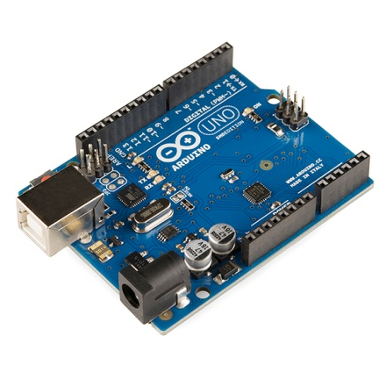
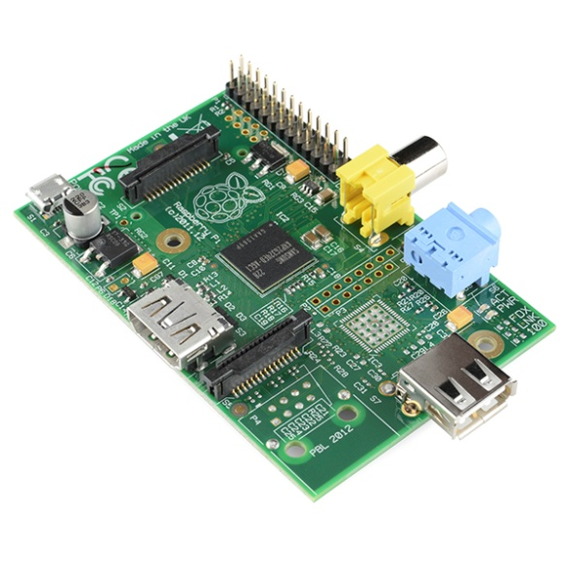
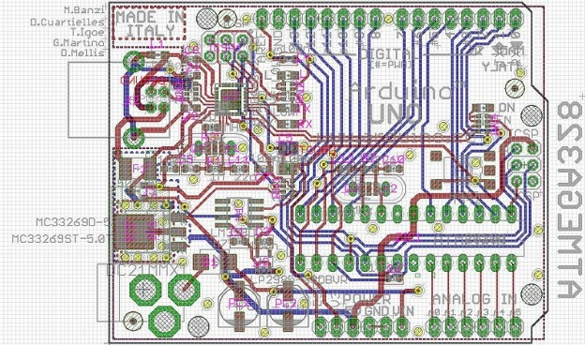
EECS 473 Advanced Embedded Systems
Lecture 1:
Class introduction
Design in this class
Creating software interfaces to hardware

Slide 2
Welcome
Overview/ Welcome
This is a class on embedded systems. We will be…
Learning more about embedded systems
Lecture, labs, and, homework.
Gaining experience working as a group…
…but also working by yourself on researching and learning material without an instructor’s guidance
Learning (more?) about the design cycle
Both theory in lecture and by doing a paper-to-prototype-to-project design.

Slide 3
Who am I?
Overview/ Welcome
Dr. Mark Brehob
Prefer “Mark”, “Dr. Brehob” is okay too.
Full-time teacher (lecturer)
Been here for 20+ years and I’ve taught a wide variety of courses (100, 101, 203, 270, 281, 370, 373, 376, 452, 470, 473)
PhD is in the intersection of computer architecture and theoretical computer science as it relates to caches.
See http://web.eecs.umich.edu/~brehob/

Slide 4
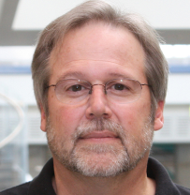
Staff
Senior Engineer
Matt Smith
Runs 270/373/473 labs
GSIs:
Guthrie Tabios
Alan Tonkryk
Andrew (Andy) Zaloudek

Slide 5
On-line resources for the class
Web site (primary location for course materials)
http://www.eecs.umich.edu/courses/eecs473/
Includes all labs, handouts, old exams, etc.
Links to Piazza and Gradescope pages at the top.
Gradscope
Entry code: WB3ZRW
All assignments will be turned in there.
All graded assignments and exams will be posted there.
Piazza
https://piazza.com/umich/fall2023/eecs473
Class forum. Please feel free to answer each others questions.
Link to join is also on the website.

Slide 6
Today
Overview/ Welcome
Class intro
Grading, schedule, etc.
A bit on design
Design requirements, engineering specifications, etc.
Start on hardware interfaces
I’ve got a lot more slides than I expect to use
Hope to get through the breakout room stuff.
The Arudino stuff at the end is just reference.

Slide 7
Class Introduction
Class overview
Learning more about embedded systems
You’ll do 5 labs in 5 weeks
Labs 1 and 2 are microcontroller/rapid prototyping/interfacing
Lab 3 covers real-time operating systems (RTOS)
Lab 4 introduces embedded Linux and writing Linux device drivers
Lab 5 gives an introduction to PCB design
For the first 4 weeks, lecture will be mostly about supporting lab.
But will then focus on other issues including PCB power, embedded wireless, and DSP as (the) example of application-specific CPUs.
Homework
Give you more practice working with technical documents related to embedded systems
Review material learned in lecture

Slide 8
We will be…
Class overview
Gaining experience working as a group…
This is more-or-less the other side of your Engineering 100 experience.
We want you to use the technical knowledge you’ve learned in the last few years to make it through the whole engineering cycle with a team design.
Your labs will be in groups of 2
Your projects will be in groups of 4 to 5 (mostly 5)
Your group will make a schedule, create a budget, and divide up the work.

Slide 9
We will be…
Class overview
…but also working by yourself on researching and learning material without an instructor’s guidance
The project will be done without lecture to guide you.
Each group will be doing something different and your group will be more expert than any of us on the topic (at least by the time you are done…)

Slide 10
We will be…
Class overview
Learning (more?) about the design cycle
Both theory in lecture and by doing a paper-to-prototype-to-project design.
Back to Engin 100 principles but with your engineering knowledge and 373 experience to provide context.

Slide 11
Prerequisites
Class overview
You must have a background in
Embedded design
Memory-mapped I/O, interrupts, serial bus interfacing, etc. (EECS 373)
Digital logic, C and assembly programming
Pointers, Verilog/VHDL, etc. (EECS 280, 270, 370)
And either
A solid programming background (EECS 281)
Or a reasonable circuits background (EECS 215)

Slide 12
Warning
If you don’t have 281
Lab 3 and 4 are going to be rough.
If you don’t have any circuits or electromagnetics background (EECS 215 or Physics 240)
About 2 weeks of lecture are going to be very difficult.
Come to office hours.
If you’ve never taken an embedded systems class before
You’re in the wrong place.
Also, you’d ideally have some soldering experience including surface mount work. If not, we hope to have some lessons available in the next few weeks.

Slide 13
Class structure
Class overview
We will meet for 3 hours/week as a class
Weekly labs for the first 5 weeks
Though the last lab is a bit shorter and different.
During the first 4 weeks
we are going to “overstaff” the labs.
2 of us in the lab.
And have about 10 hours/week of lab office hours.
After week 4 we’ll spread out support more
Open lab
Schedulable times (“reserve a GSI”)

Slide 14
Office hours
Class overview
Instructor
Lab folks (in lab, 2334 EECS)
Mark Brehob
Monday 4:00-5:30pm
4632 Beyster
Thursday 5:00-6:00pm
In lab (2334 EECS)
I also will be available after lecture, generally in the hallway or outside (turn left as you leave the classroom)
Alan
Wednesday 9:30-10:30pm
Thursday 9:30-10:30pm
Friday 1-3pm
Guthrie
Tuesdays 12-3pm
Andy
Monday 12-3
Friday 12-1
We are double staffing lab during September. Once lab is over, the GSIs will be changing hours and adding “flex hours”.

Slide 15
Work/grades
Work/Grades
20% Labs
5% Homework and guest speaker
attendance
17% Midterm
18% Final exam
40% Final Project

Slide 16
Labs
Work/Grades
There are 5 labs
2 Prototyping with Arduino, 1 RTOS, 1 Embedded Linux, 1 PCB
Pre-labs are done individually and are worth ~25% of the lab grade.
They are due before lab starts
In-labs and post-labs are done in groups of two.
They have two parts: a “sign-off” part and a “question” part.
The post-labs are just an extension of the “question” part of the in-lab
They are due before the start of the next lab.
Late labs lose 10% per school day late.
Lab 5 is done entirely individually.
Can be done outside of the lab.

Slide 17
Project (1/2)
Work/Grades
You will work in groups of 4-5 on designing and building an embedded system of your choosing
Significant budget
~$200/student
Sponsorship from Infineon!
There will be an emphasis on having a reliable system in place.
If you have an external group that wants something made and is willing to pay for it.
I’m open to discussion

Slide 18
Project (2/2)
Work/Grades
There will be a number of due dates (proposal, milestones, final project)
There will be a significant degree of formalism in your reports and presentations.
Your project will be presented at the CoE design expo on Thursday November 30th.
You have significant design freedom.
The only real restrictions are that it has to use a processor, be doable in the time given, be technically interesting, and do something useful or interesting.
We expect groups will make a PCB.
As you think of ideas, please feel free to run them past me.

Slide 19
Exams
Work/Grades
A bit after the 5 labs are done, there will be an exam. It will cover the lab/class material up to that point.
Midterm is planned to be on Wednesday 10/18 at 6pm
This may change, should know a few days after the Internet problems go away.

Slide 20
Homework
Work/Grades
You will have three homework assignments.
The first is to propose project ideas (HW0)
Already sent out
The other two will be used to reinforce classroom material or to give you a chance to drill down a bit farther on topics then we can in class/lab.

Slide 21
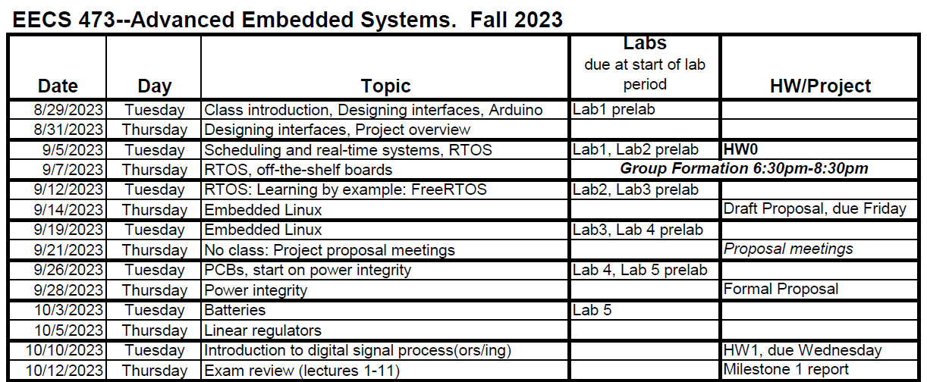
Schedule

Slide 22
A (Very Brief) Introduction to Design
Thinking about how to think about building things.
(yes, it’s that abstract, but also critical)

Slide 23
What is the design process?
Brief design overview
Unlike the material in 95% of your engineering classes, this question is a matter of opinion.
There are tons of books on the topic, and they all use different words and emphasize different things.
That said, they (almost) all have similar ideas.

Slide 24
The stages of design
Brief design overview
Where design ends is debated.
Pretty much everyone agrees that identifying a problem to be solved is the first step.
Though some have some pretty significant steps to be taken here (requirements gathering, user surveys, marketing analysis etc.)
But is the last step:
Handing off the design to be manufactured?
Dealing with manufacturing issues?
Supporting users of the design?
Dealing with end-of-life issues?

Slide 25
Design stages in this class (1/4)
Brief design overview
Identifying the purpose*
Identifying a problem
Design requirements
What characteristics does the device need?
This should be things like “light-weight” or “easy to use” rather than “less than 8oz” or “iPhone-like interface”
*There is often a research step between this step and developing the design
requirements. What are current solutions/workarounds? What do people really want? What is doable in this space?

Slide 26
Design stages in this class (2/4)
Brief design overview
Engineering specification
The design requirements turned into measurable outcomes.
“8 oz or less”
“New users can start measurement in less than 10 seconds on the average”
“48-hour battery life in the worst case”

Slide 27
Design stages in this class (3/4)
Brief design overview
Work out possible solutions
Identify a few ways to solve this problem
Pick a solution
Find the one you like best.
Prototyping
Building a prototyped device
Likely not the right form-factor etc.
Probably on a breadboard, but mechanical issues also need to be addressed.
Let’s you see what’s doable.
Also gives you a testbed to develop your solution

Slide 28
Design stages in this class (4/4)
Brief design overview
Implement your design
For us this involves ordering and assembling a PCB and getting your software up and running.
Test and debug
Get everything working
Test to see if engineering requirements are met.

Slide 29
Design and this class
Brief design overview
This class is about getting a useful design done.
Following the steps of the design process helps a lot more than you might think.
Though we have such a time crunch that they will have to overlap a bit.

Slide 30
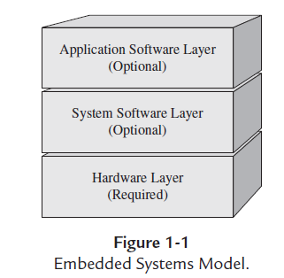
Creating good interfaces to hardware
Figure from Embedded Systems Architecture by Tammy Noergaard

Slide 31
What is a hardware interface?
Interfaces
A hardware interface is a set of functions, macros, or other programming constructs which allows the programmer to not worry about how exactly the hardware works.
It creates a level of abstraction so the programmer only needs to think about a subset of the problem.
This is creates a nice boundary where high-level code can be handed off.
Also extremely useful even when you are the only programmer!

Slide 32
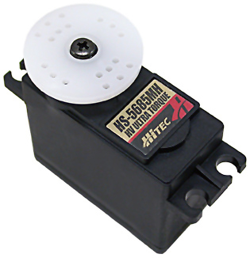
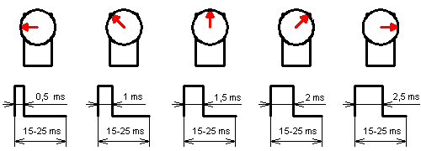
Servos
Interfaces: example
Pulse Width Modulation (PWM)
We Provide:
+5VDC
PWM Signal
Ground
We Get:
0-180 Degree
Range of Motion

Slide 33
Talking directly to the servo
Interfaces: example
In fact we probably aren’t talking to the servo.
Instead there is (hopefully) a timer that supports PWM.
We can specify a period by writing a register
or more likely a series of registers (prescalar, clock select, etc.)
We can specify the duty cycle in a similar way
Generally a single register where the duty cycle is in terms of clock ticks
We probably need to configure the timer to do PWM

Slide 34
What should the interface be for a servo?
Interfaces: example
What I want you to do is to discuss:
What basic functions you want.
What the interface to those functions should be like.
Try to get a formal description of as much as you can.
You will have about 5 minutes.
Do it yourself—no web searches.
Notes:
Initialization stuff: Where to connect the servo to (which pin), someway to indicate pulsewidth and perhaps period expected (period is somewhat standard). Might want to have voltage level options?
Use it stuff: setAngle, setPulseWidth, readAngle, readPulseWidth. Perhaps way to change settings from init?
Remove stuff (may not need): Undo initialization stuff, free pin.

Slide 35
Discuss ideas

Slide 36
Things change…
Interfaces: example
Might get a new servo
So period and duty cycle might be different
Might get a new processor
So timer configuration might change.
Might need additional functionality
Perhaps want to include stepper motors

Slide 37
…but in 373 we didn’t…
Interfaces: why?
Most of you didn’t create any meaningful interfaces in 373*
Exposed the low-level details to the programmer
After all you were the programmer and interface design takes time.
Plus you often don’t yet know what you’re going to need.
This makes it easy to do boneheaded things.
Wrong MMIO address, lots of replicated code, etc.
It also makes it hard to write good code.
You are worrying about too many things at once.
Keep worrying about things like bounds checking when interface should do that.
*Though some did. Often the more successful groups had well-defined and reasonably well-documented interfaces.

Slide 38
Stepping back
Interfaces: why?
Can think of an interface as a single way to talk to a class of hardware devices.
Each application uses the interface.
Each target “just” needs to support the interface.
What is the alternative?
Now that we have a sense of what an interface is, let us look at what makes a good one.
Various applications
Interface
Different hardware
platforms/targets
Notes:
Alternative is to have each application support each platform. Many more arrows (n*m rather than n+m)!

Slide 39
Creating interfaces to hardware
Interfaces: why?
A good hardware interface has three main goals:
It is easy to understand and use (useable)
It is efficient
It is portable to other hardware platforms.
Those three things are often at odds.
And sometimes one matters a lot more than the others.
If the plan is to only use one hardware platform, portability matters little (though it matters a bit, as often plans change!)
Examples?
If the plan is that you are the only one who will use it, easy is less important.
That plan changes more than any IME
And easy is still powerful even if you are the only user.

Slide 40
What makes an interface easy to understand and use?
Interfaces
Notes:
Interface abstracts away programming issues exposing (only?) user issues.
Interface still allows low-level access to stuff where appropriate.
Interface is simple, with “common-case” stuff as simple as possible while leaving options for more advanced users.

Slide 41
What does an interface have to do with efficiency?
Interfaces: efficiency
On the silly side:
One could imagine our servo interface having only a “turn 1 degree” function (direction specified)
Covers all functionality
But big turns require a lot of code to run.
On the less silly side
If we use angles (in degrees) as the basis for the interface, that is going to require some math in the interface itself to convert to a register value.
Perhaps the programmer could skip a lot of that.
Other places we might see inefficiency for our servo?

Slide 42
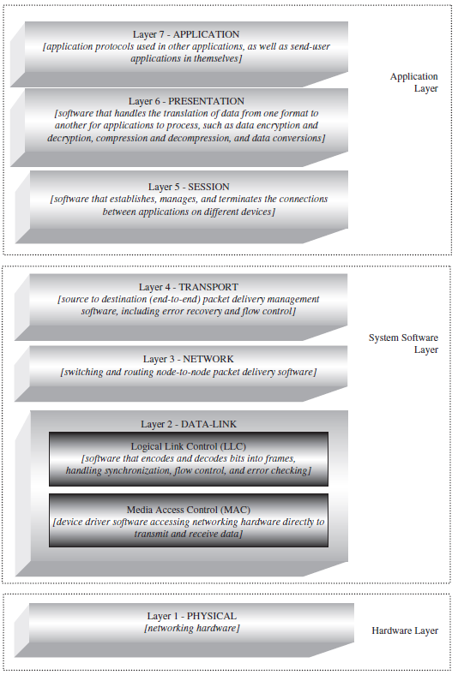
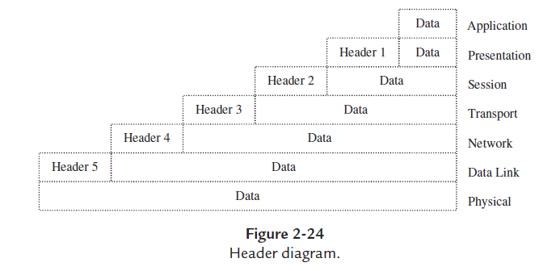
Look at Open Systems Interconnect (OSI)
Interfaces: efficiency
This degree of layering is considered largely necessary, but it clearly creates a lot of overhead (inefficiencies)
Figures from Embedded Systems Architecture by Tammy Noergaard

Slide 43
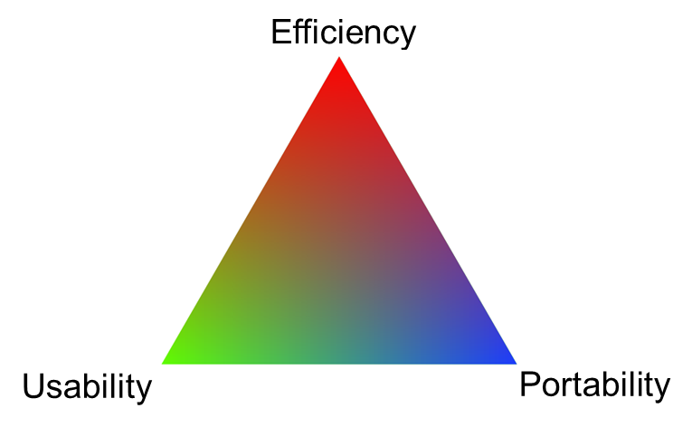
So what makes hardware-interface design difficult?
Interfaces
Mainly the three competing requirements of usability, efficiency and portability.
As discussed, they often fight with each other.
But there are a few other things…

Slide 44
Software in parallel with hardware (1/2)
Interfaces
When developing an embedded system, it is often necessary to select hardware and start on software in parallel.
Not just because of time constraints. Hardware side needs a solid understanding of software’s needs before picking a processor
Memory and CPU requirements etc.
Certain peripherals might greatly reduce CPU needs
e.g. Don’t need to bit-bang for a servo if you have PWM support. But if CPU otherwise idle, bit-banging might be okay.
Might want/need more than one processor
More on that later…

Slide 45
Software in parallel with hardware (2/2)
Interfaces
Developing software, or even specifying interfaces, while selecting hardware is tricky.
Often some of the functionality will be impacted by hardware/component choices.
Can buttons detect level of pressure? Do we have multi-touch support? Does our processor have enough SPI busses that we can support a second ADC?
But it’s common to do software design before hardware is selected.
Scheduling pressure
HR issues (software people are otherwise idle)
Hardware people need answers from software folks

Slide 46
Terminology
Interfaces
There is a lot of terminology wrapped around hardware interfacing.
Terms like: HAL (hardware abstraction layer), Middleware, and Device Driver are all related to hardware interfacing.
And it’s not unusual to see different people use those terms differently.
We’ll try to take a look at that terminology later on.
I’ll generally use “device driver” or “system software layer”

Slide 47
Summary
Interfaces
It’s a good idea to have at least one layer between applications and hardware.
Hardware interface
Hardware interfaces have three main goals
Efficiency
Usability
Portability
And those three things are often at odds.

Slide 48
Hardware/software co-design
Interfaces: Bonus topic
While a bit outside of the scope of this class, this is a good time to discuss hardware/software co-design
This phrase generically means “designing software and hardware a the same time”
But often used to describe automatic methods or tools to do the partitioning.
Might end up with an ISA/architecture for a CPU and application-specific code to run on it for example
HP has been doing this for printers for a while apparently
Might end up with three processors and code “done for you” once the problem is specified.
There is a lot of literature dating back decades on the topic.

Slide 49
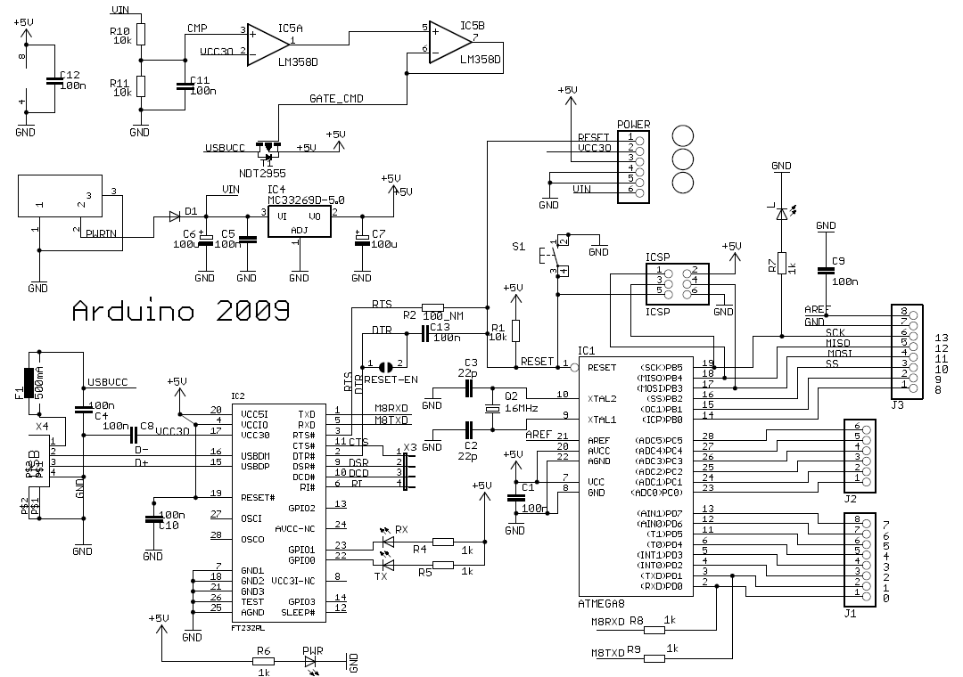
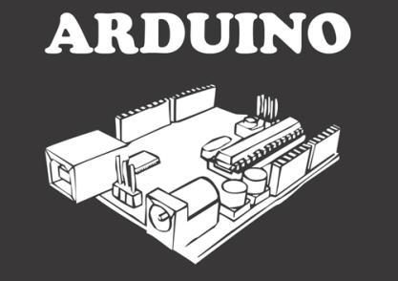
Introduction to Arduino
Stolen from Chris Meyer
(CC-SA)
http://www.danielandrade.net/

Slide 50
Arduino
ARRRR, like a pirate /
/ DWEE, just say "do we“ fast /
/ NO, as in no.
”ARRR-DWEE-NO”
http://www.arduino.cc/cgi-bin/yabb2/YaBB.pl?num=1191602549%3Bstart=all

Slide 51
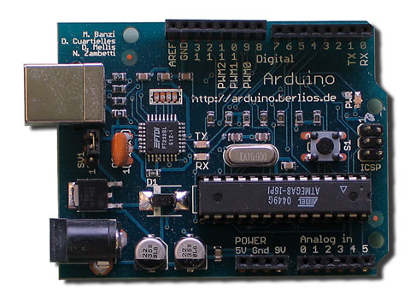
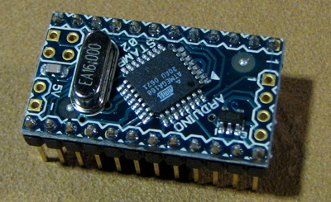
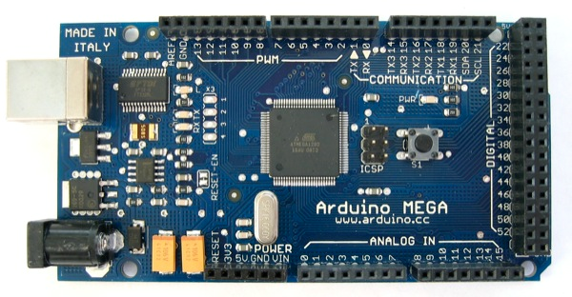
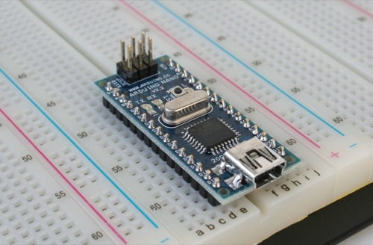
What is Arduino?
Open Source Hardware Development Platform
USB Programmable Microcontroller (MCU)
$30 Investment!

Slide 52
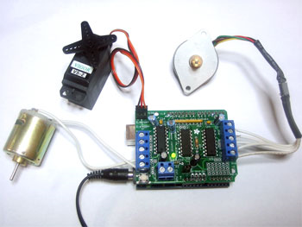
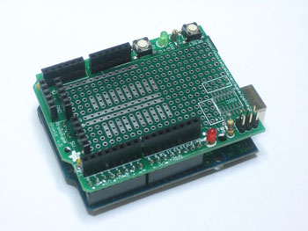
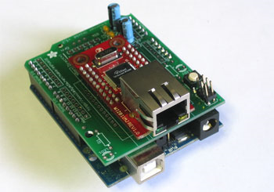
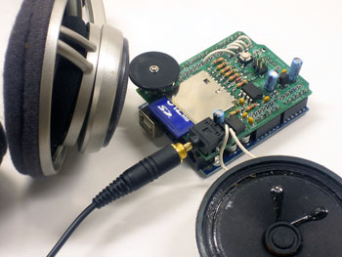
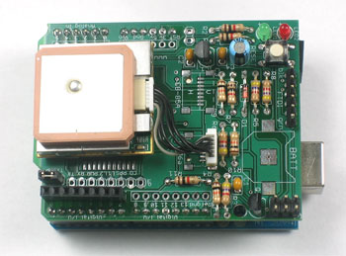
Shields?
Shields break-out/wire-up
additional components to MCU
Servo/Stepper/DC Motors
Ethernet
Prototyping
GPS
Audio / MP3

Slide 53
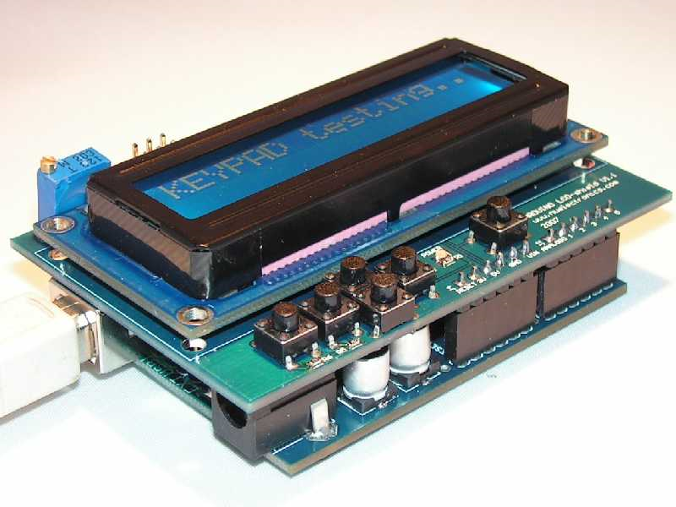
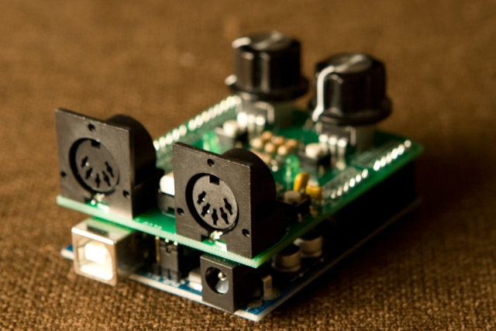
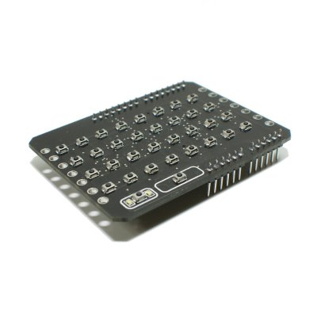
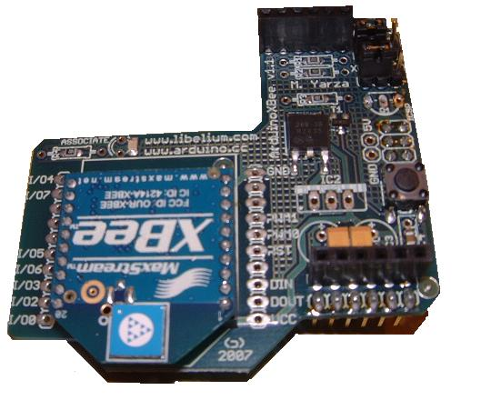
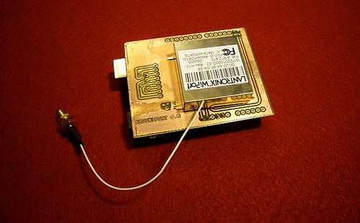
More Shields!
LCD
MIDI
LED Display
Zigbee
WIFI

Slide 54
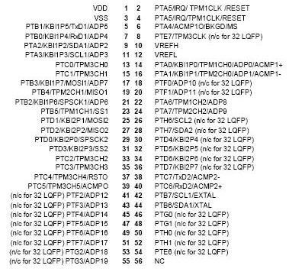
So What?
Previously, MCU’s were very difficult to learn to use
Required learning libraries, specialized protocols, timings, code minimization, 1,000+ page documentation

Slide 55
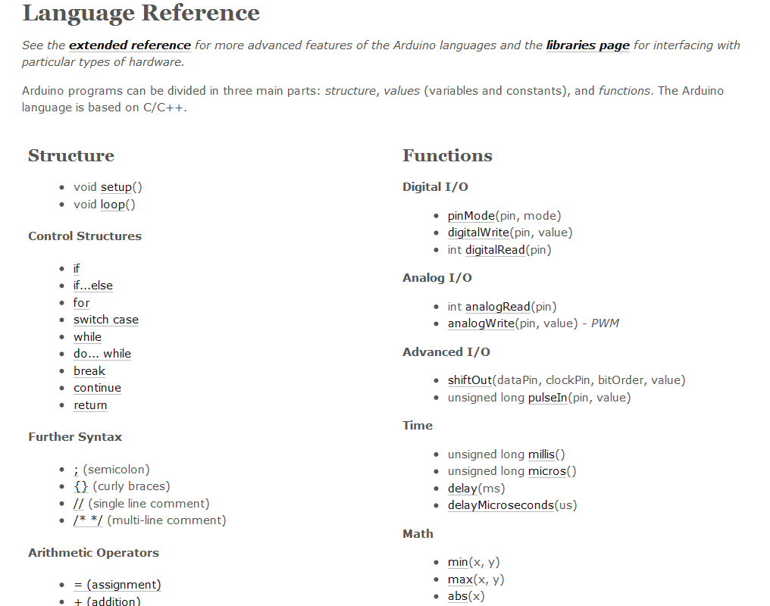
Arduino makes it Easy!
@Arduino.cc

Slide 56
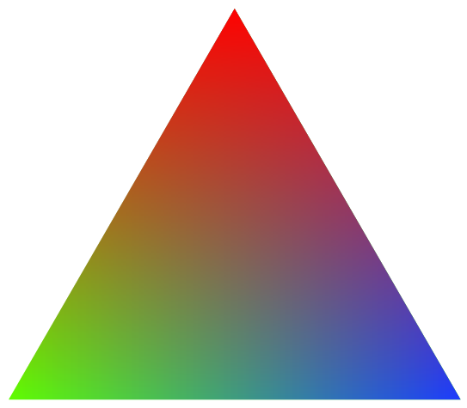
Question
If hardware interface design involves tradeoffs between three things, where in the triangle would you suspect Arduino was targeted?
Efficiency
Usability
Portability

