Slide 1
EECS 473
Lecture 2
More on interfacing
Project overview
(Maybe) Start on Real time and RM scheduling

Slide 2
Today
Review and expand on hardware interfacing
  Some questions using different devices. Compare to Arduino.
  Discuss top and bottom of interface diagram.
Projects
  What’s doable, when things are expected.
Introduction to real-time systems
  I doubt we’ll get to this today, but maybe a bit.

Slide 3
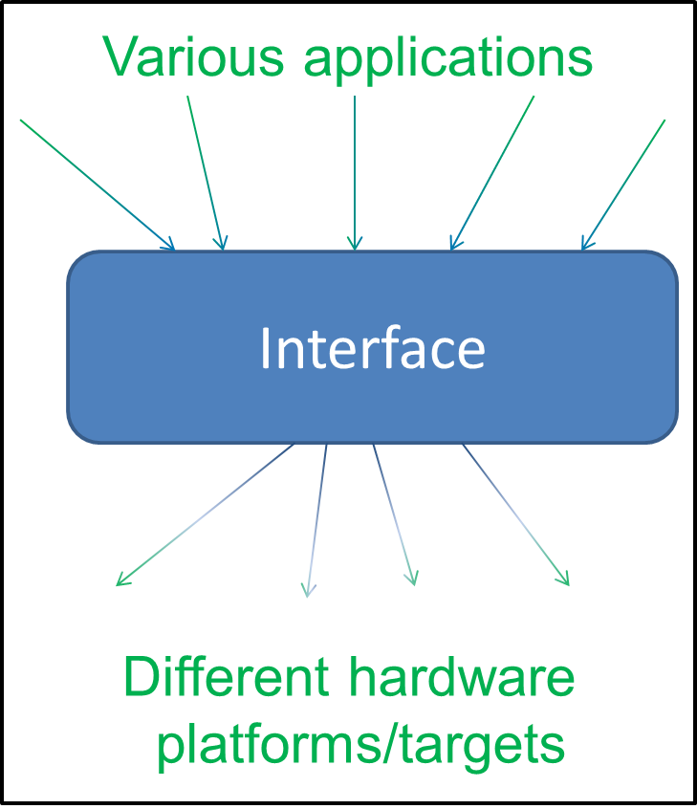
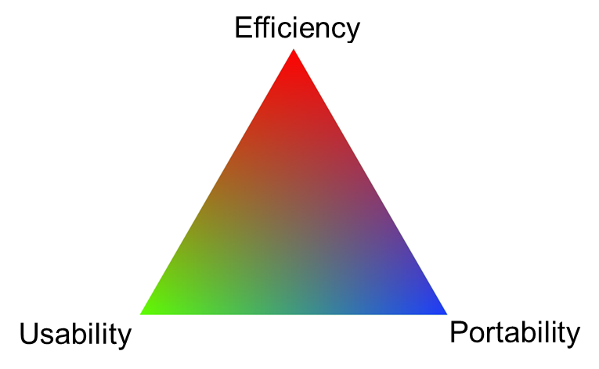
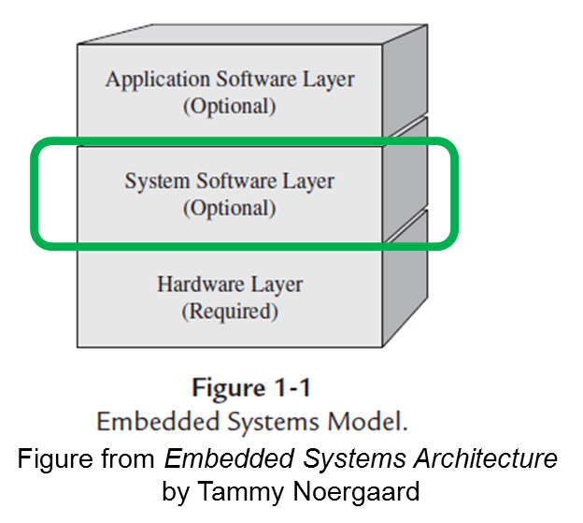
Hardware
Interfacing

Slide 4
What should the interface be for a servo?
Interfaces: example
What I wanted you to do was to discuss:
  What basic functions you want.
  What the interface to those functions should be like.
  Try to get a formal description of as much as you can.
  You will have about 5 minutes.
  Do it yourself—no web searches.
Notes:
Initialization stuff: Where to connect the servo to (which pin), someway to indicate pulsewidth and perhaps period expected (period is somewhat standard). Might want to have voltage level options?
Use it stuff: setAngle, setPulseWidth, readAngle, readPulseWidth. Perhaps way to change settings from init?
Remove stuff (may not need): Undo initialization stuff, free pin.

Slide 5
Discuss ideas
Use OO (struct/class) for interface.
  SetAngle
  SetAngle (with speed)
  Initialize servo (what info?)
  GetAngle

Slide 6
Things change…
Interfaces: example
Might get a new servo
  So period and duty cycle might be different
Might get a new processor
  So timer configuration might change.
Might need additional functionality
  Perhaps want to include stepper motors

Slide 7
…but in 373 we didn’t…
Interfaces: why?
Most of you didn’t create any meaningful interfaces in 373*
  Exposed the low-level details to the programmer
    After all you were the programmer and interface design takes time.
      Plus you often don’t yet know what you’re going to need.
  This makes it easy to do boneheaded things.
    Wrong MMIO address, lots of replicated code, etc.
  It also makes it hard to write good code.
    You are worrying about too many things at once.
    Keep worrying about things like bounds checking when interface should do that.
*Though some did. Often the more successful groups had well-defined and reasonably well-documented interfaces.

Slide 8
Stepping back
Interfaces: why?
Can think of an interface as a single way to talk to a class of hardware devices.
  Each application uses the interface.
  Each target “just” needs to support the interface.
  What is the alternative?
Now that we have a sense of what an interface is, let us look at what makes a good one.
Various applications
Interface
Different hardware
platforms/targets
Notes:
Alternative is to have each application support each platform. Many more arrows (n*m rather than n+m)!

Slide 9
Creating interfaces to hardware
Interfaces: why?
A good hardware interface has three main goals:
  It is easy to understand and use (useable)
  It is efficient
  It is portable to other hardware platforms.
Those three things are often at odds.
  And sometimes one matters a lot more than the others.
    If the plan is to only use one hardware platform, portability matters little (though it matters a bit, as often plans change!)
      Examples?
    If the plan is that you are the only one who will use it, easy is less important.
      That plan changes more than any IME
      And easy is still powerful even if you are the only user.

Slide 10
What makes an interface easy to understand and use?
Interfaces
Notes:
Interface abstracts away programming issues exposing (only?) user issues.
Interface still allows low-level access to stuff where appropriate.
Interface is simple, with “common-case” stuff as simple as possible while leaving options for more advanced users.

Slide 11
What does an interface have to do with efficiency?
Interfaces: efficiency
On the silly side:
  One could imagine our servo interface having only a “turn 1 degree” function (direction specified)
    Covers all functionality
    But big turns require a lot of code to run.
On the less silly side
  If we use angles (in degrees) as the basis for the interface, that is going to require some math in the interface itself to convert to a register value.
    Perhaps the programmer could skip a lot of that.
  Other places we might see inefficiency for our servo?

Slide 12
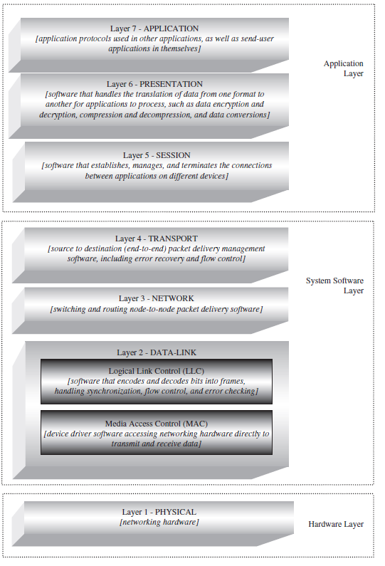
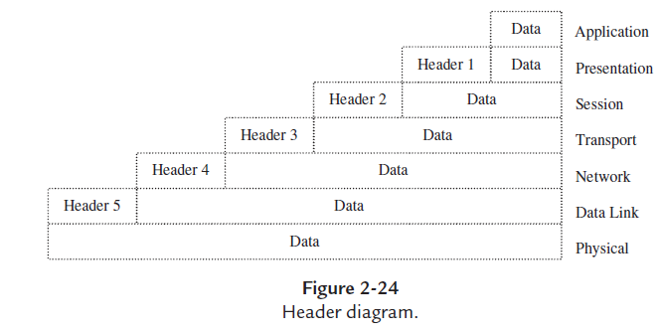
Look at Open Systems Interconnect
(OSI)
Interfaces: efficiency
This degree of layering is considered largely necessary, but it clearly creates a lot of overhead (inefficiencies)
Figures from Embedded Systems Architecture
by Tammy Noergaard

Slide 13
So what makes hardware-interface design difficult?
Interfaces
Mainly the three competing requirements of usability, efficiency and portability.
  As discussed, they often fight with each other.
But there are a few other things…

Slide 14
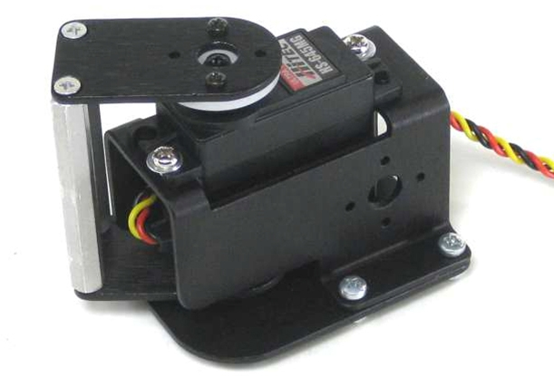
Not a trivial task
Interfaces: Servo example
Trying to be able to work with all applications, targets, and platforms is hard.
  Lots of coding effort
  Can hurt efficiency and/or usability.
Examples:
  Some servos may need to be “linearized”.
    That is their angle isn’t exactly proportional to the pulse width
  Some servos do continuous rotation
    Pulse width determines speed and direction, not angle.
  Servos can (often?) “freewheel”
    Apply no pulse, it provides no resistance to turning.

Slide 15
Arduino interface for servos
Interfaces: Servo example
attach() Attaches a servo motor to an i/o pin
read() Gets the servo motor position
write() Sets the servo motor position angle
attached() Returns if there is a servo attached
detach() Detaches a servo motor from an i/o pin
writeMicroseconds()
Sets the servo pulse width in microseconds
readMicroseconds()
Gets the last written servo pulse width in microseconds*
*Documentation doesn’t mention this, but it exists?!

Slide 16
detach()
Interfaces: Servo example
Description
  Detach the Servo variable from its pin. If all Servo variables are detached, then pins 9 and 10 can be used for PWM output with analogWrite().
Syntax
  servo.detach()
Parameters
servo: a variable of type Servo

Slide 17
So?
Interfaces: Servo example
Examples: (same as last page)
  Some servos may need to be “linearized”.
    That is their angle isn’t exactly proportional to the pulse width
  Some servos do continuous rotation
    Pulse width determines speed and direction, not angle
  Servos can (often?) “freewheel”
    Apply no pulse, it provides no resistance to turning.
      Sometimes useful to an application.
  Some servos provide angle they are actually at.
How can supporting those things cause us difficulties?
  Too many functions?
  Too much computation?
And that doesn’t even account for having to support different processors and timers.
  Yes, some processors have multiple types of timers.
    Pretty common actually.

Slide 18
attach()
Interfaces: Servo example
servo.attach(pin)
servo.attach(pin, min, max)
Parameters
servo A variable of type Servo
pin pin number servo attached to
min min value in microseconds
defaults to 544
max max value in microseconds
defaults to 2400
Example:
#include "Servo.h"
Servo myservo;
void setup() {
// attaches a servo
// connected to pin 2
myservo.attach(2);
}
void loop() {
// position the servo angle
// at 90 degrees
myservo.write(90);
}

Slide 19
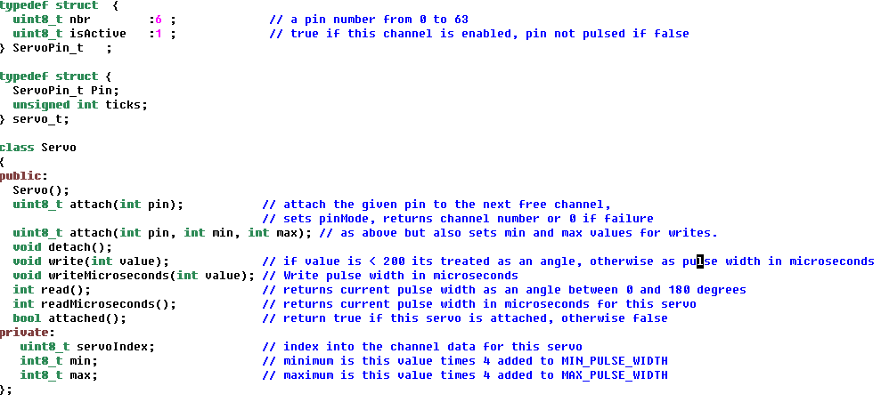
Interfaces: Servo example

Slide 20
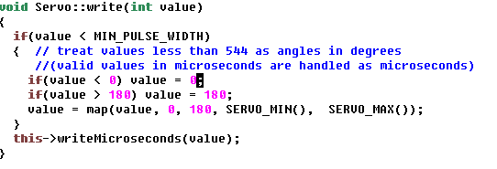

Interfaces: Servo example
Best I can find— integer division is about 15 microseconds on an Arduino.

Slide 21
Code to keep it portable
Initializing the ISR
Interfaces: Servo example
static void initISR(timer16_Sequence_t timer)
{
#if defined (_useTimer1)
if(timer == _timer1) {
TCCR1A = 0; // normal counting mode
TCCR1B = _BV(CS11); // set prescaler of 8
TCNT1 = 0; // clear the timer count
#if defined(__AVR_ATmega8__)|| defined(__AVR_ATmega128__)
TIFR |= _BV(OCF1A); // clear any pending interrupts;
TIMSK |= _BV(OCIE1A) ; // enable the output compare interrupt
#else
// here if not ATmega8 or ATmega128
TIFR1 |= _BV(OCF1A); // clear any pending interrupts;
TIMSK1 |= _BV(OCIE1A) ; // enable the output compare interrupt
#endif
#if defined(WIRING)
timerAttach(TIMER1OUTCOMPAREA_INT, Timer1Service);
#endif
}
#endif
#if defined (_useTimer3)
if(timer == _timer3) {
TCCR3A = 0; // normal counting mode
TCCR3B = _BV(CS31); // set prescaler of 8
TCNT3 = 0; // clear the timer count
#if defined(__AVR_ATmega128__)
TIFR |= _BV(OCF3A); // clear any pending interrupts;
ETIMSK |= _BV(OCIE3A); // enable the output compare // interrupt
#else
TIFR3 = _BV(OCF3A); // clear any pending interrupts;
TIMSK3 = _BV(OCIE3A) ; // enable the output compare interrupt
#endif
#if defined(WIRING)
timerAttach(TIMER3OUTCOMPAREA_INT, Timer3Service);
// for Wiring platform only
#endif
}
#endif
#if defined (_useTimer4)
if(timer == _timer4) {
TCCR4A = 0; // normal counting mode
TCCR4B = _BV(CS41); // set prescaler of 8
TCNT4 = 0; // clear the timer count
TIFR4 = _BV(OCF4A); // clear any pending interrupts;
TIMSK4 = _BV(OCIE4A) ; // enable the output compare interrupt
}
#endif
#if defined (_useTimer5)
if(timer == _timer5) {
TCCR5A = 0; // normal counting mode
TCCR5B = _BV(CS51); // set prescaler of 8
TCNT5 = 0; // clear the timer count
TIFR5 = _BV(OCF5A); // clear any pending interrupts;
TIMSK5 = _BV(OCIE5A) ; // enable the output compare interrupt
}
#endif
}
Entire library is 337 lines (including comments)

Slide 22
Conclusions?
Interfaces: Servo example
Hardware interfacing isn’t trivial
  Having to deal with multiple platforms can at the least make the code more complex.
Efficiency issues exist
  Uses a significant amount of CPU time if specify things in degrees.
    Might not matter—if CPU is otherwise fairly idle who cares?
  Efficiency issue hidden from application writer.
    That’s a common problem and happens here.
OSI model really gets at just how complex things can get.

Slide 23
Terminology
Interfaces: wrap-up
There is a lot of terminology wrapped around hardware interfacing.
  Terms like: HAL (hardware abstraction layer), Middleware, and Device Driver are all related to hardware interfacing.
    And it’s not unusual to see different people use those terms differently.
  We’ll try to take a look at that terminology later on.
    I’ll generally use “device driver” or “system software layer”

Slide 24
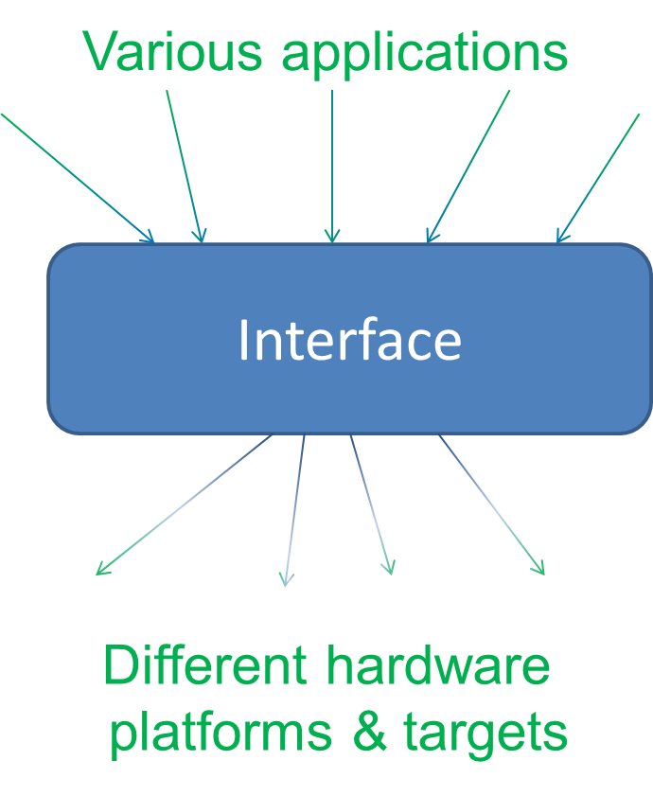
Hardware interfacing summary
Interfaces: wrap-up
Hardware Interfaces:
  Create a standard “driver” interface where you can abstract the interface to a device from the tasks the processor needs to perform.
  Ideally covers most use cases (applications)
  Ideally a single interface covers a wide variety of parts/targets and platforms.
Advantages:
  Ideally application software can be written independent of platform & target.
  Application programmer can think at the application level and not the device/MMIO level.
    Abstraction is good and makes for code that is easier to write, debug and maintain.

Slide 25
Interfaces: wrap-up

Slide 26
Projects
What’s reasonable
What’s expected when

Slide 27
What is a reasonable project?
Required
  Entire embedded system with a realistic use
    Design allows for that realistic use (not an unusable prototype)
  Doable in the semester
  Design and population of a PCB with a processor (or maybe FPGA).
  Design and implementation of hardware interfaces
Suggested
  Not “barebones” programming
    Use RTOS, Linux, or something else
    Barebones might make sense if software fairly trivial
  Stay away from switching power supplies

Slide 28
Projects in the past:
Baby Monitor
What it does
  Watches for SIDS
  Sets alarm on board and wirelessly to base station if problem detected.
Main issues
  Easy to use
    Easy to place on baby correctly, easy to recharge, no complex interface
  Resilient
    Water-resistant, can be dropped, easily cleaned.
  Cheap
    Very low-cost target.
  Testing that it works
    Need baby?

Slide 29
Projects in the past:
Triathlon monitor
What it does:
  Monitor location, heart rate, and strides
  Display on watch, record to dump to PC later
Issues
  Weight
  Waterproof
  Getting data in (GPS, heart rate, strides)
  Getting data out (to watch, stored and to PC)

Slide 30
Projects in the past:
Bike helmet (Hail-met)
What it does:
  Bluetooth
    Voice, etc. Can make calls or listen to music
  Turn signals and tail light
  Basic heads-up display (signals, call info)
  Solar recharge
Issues
  Weight
  Waterproof
  Safety

Slide 32
Project dates next 30 days
Sept. 5th:
  Project ideas pdf turned in by 11pm (on Gradescope shortly)
Sept 6th:
  All ideas posted, probably not until late in the day.
Sept. 7th^{th}:
  Forming groups 6:30-8:30pm (Room TBA)
  Each person will have a chance to speak for about 30 seconds about what they’d like to do
  Wander around and form groups.
Sept. 15th:
  Draft proposal due (3% of project grade)
Sept 21nd
  Required meeting with staff to discuss proposal*
    No class that day.
  After meeting most groups can (and should) start ordering parts!
Sept 28th
  Formal proposal due. (12% of project grade).
*You should have met with various 473 staff members well before this!

Slide 33
Milestones: What are they?
What’s due?
Report to us about how things are going and some demonstrations.
What’s due:
  A short report (1-2 pages)
    Due a few days before the meeting
  Demonstrate to GSIs that you’ve meet your “objectively demonstrable” deliverables.
    Needs to be done the day before the meeting at the latest.
In general, these should take 30-60 minutes to write unless things are in really bad shape.
  There is a docx template you are to use.

Slide 34
Milestone 1
(Can start ordering parts on Sept 21nd after meeting)
Oct 12th
  Device interfaces designed and working
    Might need some refinement, but in good shape
  Prototype largely working
    Probably devboard (maybe breadboard, but avoid if possible!)
    Can talk to all devices via interfaces
    Can more-or-less do the task
  Have identified solutions to each major issue.
Started on PCB
  Perhaps just barely, but at least have patterns done

Slide 35
Milestone 1 Example: Baby
Have interface to GPS, flash (for storage), and variable resistor (for checking breathing) written useable.
Not yet sure on chest cavity movement of infant.
  Flash still a bit buggy—erasing not always working.
    Otherwise demonstrated
  GPS association working, (time is 3 minutes, but worst case probably acceptable for application)
    Demonstrated

Slide 36
Milestone 1 Example: Baby
Prototype on Arduino
  Each interface works
  When done together GPS (serial) interrupt messing with timer interrupt for resistor monitoring

Slide 37
PCB deadline
All PCBs must be ordered by Oct 31st
  Worst case, you need to respin the PCB later but we want them all out by this date.
    Depending on budget for PCB, should have back in 7-10 days.
  Should target earlier—hopefully most groups have PCB out by Oct 21st

Slide 38
Milestone 2
November 7th
  PCB back and assembled, still may be debugging last issue or two
  Final plans for all “extras”
    Enclosure (if needed)
    Special documentation
    ?????

Slide 39
November 20th
Everything should be done, just final testing and debug of a largely working system.
Start on design expo things and final report by 11/26.
  Setup, poster, etc.
  Discussion in class about posters etc. on 11/21
  Ideally get much of the report written before the expo.
Testing, testing, testing

Slide 40
Design Expo
December November 30th
  Working and clearly presented demo
  Hopefully exciting
    Not all projects will be and that’s okay.
  Shirt and tie or equivalent required.

Slide 41
December 3rd
Final report due.
  This report and the associated documentation is 15% of of your project grade.
  With the proposal document done, you have a solid starting point.

Slide 42
EECS 473
Advanced Embedded Systems
An introduction to real time systems and scheduling
Chunks adapted from work by
Dr. Fred Kuhns of Washington University
and Farhan Hormasji

Slide 43
What is a Real-Time System?
What is a RTS?
Real-time systems have been defined as: "those systems in which the correctness of the system depends not only on the logical result of the computation, but also on the time at which the results are produced";
  J. Stankovic, "Misconceptions About Real-Time Computing," IEEE Computer, 21(10), October 1988.

Slide 44
Soft, Firm and Hard deadlines
What is a RTS?
The instant at which a result is needed is called a deadline.
  If the result has utility even after the deadline has passed, the deadline is classified as soft, otherwise it is firm.
  If a catastrophe could result if a firm deadline is missed, the deadline is hard.
Examples?
Definitions taken from a paper by Kanaka Juvva, not sure who originated them.

Slide 45
Why is this hard?
Three major issues
What is a RTS?
We want to use as cheap ($$, power) a processor as possible.
  Don’t want to overpay
There are non-CPU resources to worry about.
  Say two devices both on an SPI bus.
  So often can’t treat tasks as independent
Validation is hard
  You’ve got deadlines you must meet.
    How do you know you will?
Let’s discuss that last one a bit more

Slide 46
Validating a RTS is hard
What is a RTS?
Validation is simply the ability to be able to prove that you will meet your constraints
  Or for a non-hard time system, prove failure is rare.
This is a hard problem just with timing restrictions
  How do you know that you will meet all deadlines?
    A task that needs 0.05s of CPU time and has a deadline 0.1s after release is “easy”.
    But what if three such jobs show up at the same time?
  And how do you know the worst-case for all these applications?
    Sure you can measure a billion instances of the program running, but could something make it worse?
      Caches are a pain here.
And all that ignores non-CPU resource constraints!
We need some formal definitions to make progress here…

Slide 47
Real-Time Characteristics
What is a RTS?
Pretty much your typical embedded system
  Sensors & actuators all controlled by a processor.
  The big difference is timing constraints (deadlines).
Those tasks can be broken into two categories¹
  Periodic Tasks: Time-driven and recurring at regular intervals.
    A car checking for a wall every 0.1 seconds;
    An air monitoring system grabbing an air sample every 10 seconds.
  Aperiodic: event-driven
    That car having to react to a wall it found
    The loss of network connectivity.
  ¹Sporadic tasks are sometimes also discussed as a third category. They are tasks similar to aperiodic tasks but activated with some
  known bounded rate. The bounded rate is characterized by a minimum interval of time between two successive activations.

Slide 48
Some Definitions
What is a RTS?
Timing constraint:
  Constraint imposed on timing behavior of a job: hard, firm, or soft.
Release Time:
  Instant of time job becomes available for execution.
Deadline:
  Instant of time a job's execution is required to be completed.
Response time:
  Length of time from release time to instant job completes.

Slide 49

Example Using the Definitions:
Periodic jobs
Consider a processor where you have two different tasks.
  We’ll call them τ₁ and τ₂.
  It is commonly the case that the period of a task is the same as the time you have to complete the task.
    So if τ₁ needs to run every 5 seconds, you just need to finish a given instance of τ₁ before the next one is to start.
Consider the following:
Assuming all tasks are first released at time 0:
  What is the deadline of the first instance of τ₁?
  What is the release time of the second instance of τ₁?
  What is the deadline of the second instance of τ₁?
Notes:
7, 7, 14.

Slide 50
Properties for Scheduling tasks
What is a RTS?
Priority
  If two tasks are both waiting to run at the same time, one will be selected. That one is said to have the higher priority.
Fixed/Dynamic priority tasks
  In priority driven scheduling, assigning the priorities can be done statically or dynamically while the system is running
Preemptive/Non-preemptive tasks
  Execution of a non-preemptive task is to be completed without interruption once it is started
  Otherwise a task can be preempted if another task of higher priority becomes ready
Multiprocessor/Single processor systems
  In multiprocessor real-time systems, the scheduling algorithms should prevent simultaneous access to shared resources and devices.

Slide 51
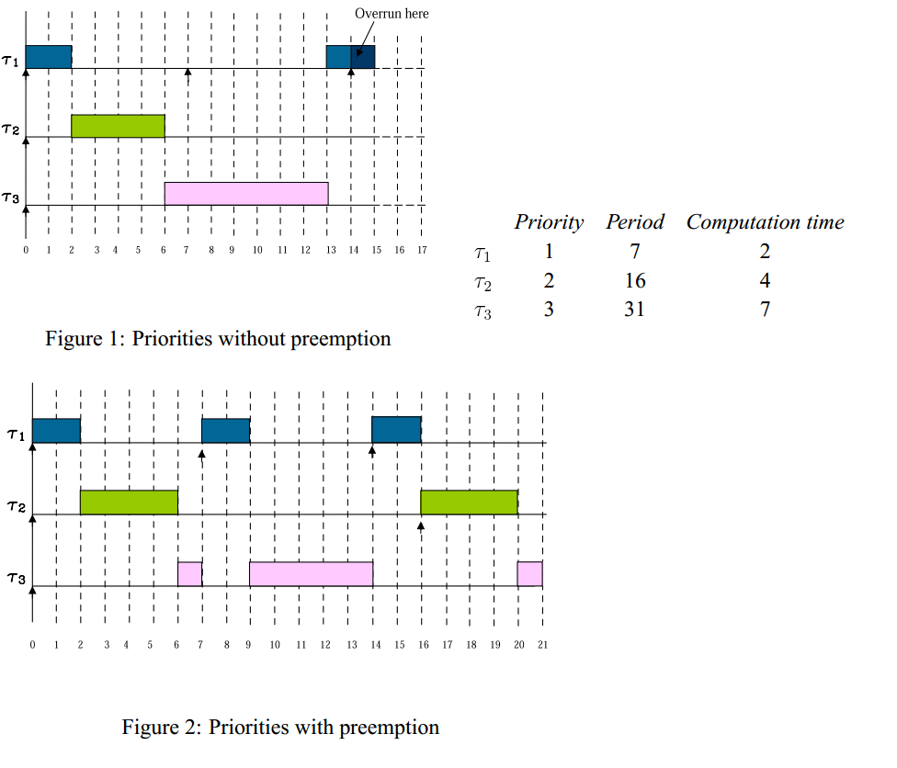
Preemption
What it is and how it helps
What is a RTS?
Assume all tasks are released at time 0.
Mohammadi, Arezou, and Selim G. Akl. "Scheduling Algorithms for Real-Time Systems." (2005)

Slide 52
Scheduling algorithms
A scheduling algorithm is a scheme that selects what job to run next.
  Can be preemptive or non-preemptive.
  Dynamic or static priorities
  Etc.

Slide 53
Two scheduling schemes
Rate monotonic
(RM)
  Static priority scheme
  Simple to implement
  Nice properties
Earliest deadline first (EDF)
  Dynamic priority scheme
  Harder to implement
  Very nice properties

Slide 54
RM and EDF assumptions
No task has any non-preemptable section and the cost of preemption is negligible.
Only processing requirements are significant; memory, I/O, and other resource requirements are negligible.
All tasks are independent; there are no precedence constraints.
Notes:
These are not very realistic in that none of them are generally strictly true. But most of the time they are pretty good approximations.

Slide 55


Terms and definitions
Execution time of a task - time it takes for a task to run to completion
Period of a task - how often a task is being called to execute; can generally assume tasks are periodic although this may not be the case in real-world systems
CPU utilization - the percentage of time that the processor is being used to execute a specific scheduled task
  where e_{i} is the execution time of task i, and P_{i} is its period
Total CPU utilization - the summation of the utilization of all tasks to be scheduled

Slide 56
RM Scheduling
RM scheduling
It is a static-priority preemptive scheme involving periodic tasks only.
  Well, it mumbles about non-periodic tasks, but…
Basic idea:
  Priority goes to the task with the lowest period.
Mohammadi, Arezou, and Selim G. Akl. "Scheduling Algorithms for Real-Time Systems." (2005)

Slide 57
How well does RMS work?
RM scheduling
Surprisingly well actually.
  Let n be the number of tasks.
  If the total utilization is less than n(2^{1/n}-1), the tasks are schedulable.
    That’s pretty cool.
      At n=2 that’s ~83.3%
      At n=∞ that’s about 69.3%
  This means that our (extremely) simple algorithm will work if the total CPU utilization is less than 2/3!
    Still, don’t forget our assumptions (periodic being the big one)
Also note, this is a sufficient, but not necessary condition
  Tasks may still be schedulable even if this value is exceeded.
    But not if utilization is over 100% of course…
http://cn.el.yuntech.edu.tw/course/95/real_time_os/present%20paper/Scheduling%20Algorithms%20for%20Multiprogramming%20in%20a%20Hard-.pdf

Slide 58
What if the sufficiency bound is not met?
RM scheduling
Critical instant analysis
  The worst case for RMS is that all tasks happen to start at the exact same time.
    If RM can schedule the first instance of each such task, the tasks are schedulable.
With RM scheduling we can always jump to doing the critical instant analysis
Mohammadi, Arezou, and Selim G. Akl. "Scheduling Algorithms for Real-Time Systems." (2005)
Notes:
It may be that there is no critical instant when all tasks start. That’s unusual, but not impossible (say 2 tasks both with period 5 where the first instance of task 1 starts at time 2 and the first instance of task 2 starts at time 0. Not something we actually worry about!

Slide 59
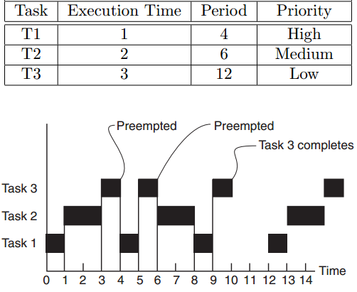
Example #1
RM scheduling
http://www.idsc.ethz.ch/Courses/embedded_control_systems/Exercises/SWArchitecture08.pdf

Slide 60
Example #2
RM scheduling
Task | Execution Time | Period | Priority
T1 | 1 | 3 | High
T2 | 1.5 | 4 | Low
Notes:
1/3+3/8=

Slide 61
Example #3
RM scheduling
Task | Execution Time | Period | Priority
T1 | 1 | 3 | High
T2 | 2.1 | 4 | Low

Slide 62
Example #4
RM scheduling
Task | Execution Time | Period | Priority
T1 | 1 | 2 | High
T2 | 2 | 5 | Low

Slide 63
Easy?
RM scheduling
Fixed priorities are pretty easy.
  Scheduler easy to write.
  Could, in theory, use interrupt priorities from a timer to do this
    But that’s probably dumb (why?)

