Slide 1
EECS 473
Review etc.

Slide 2
HW2 date
Homework 2 is due 12/8 @7pm
  Answers will be posted 12/9 by noon.

Slide 3
Schedule
We’ll have some office hours to answer exam questions (plus Piazza) starting Thursday.
  Details out tomorrow.
Project reports will be graded by the exam time.
Final project grades will be out by 12/12 or before.

Slide 4
Returning stuff etc.
Project disposal
We do need you to return equipment purchased and anything Matt thinks we could reuse (ask him after your demo).
  Put that stuff in the lab, in a box (you supply) with your group name on it.
Also, all reimbursement stuff due 12/12 unless you work something else out.
  12/14 at the very latest.

Slide 5
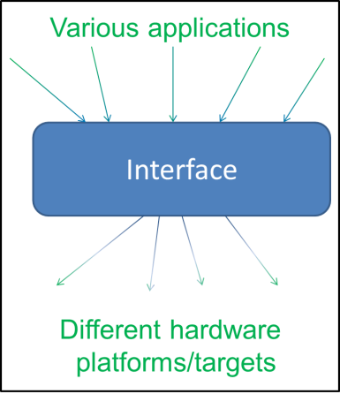
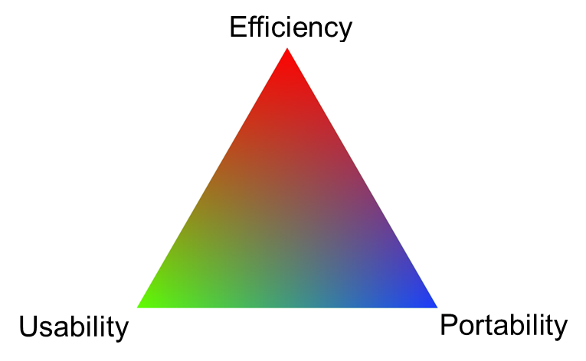
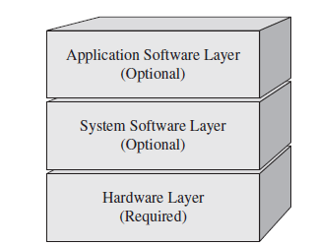
Topics: Interfacing
Writing software interfaces for hardware
  Ideally have a standard interface for
  both hardware and programmer.
    Makes it easy to port software.
    Also means it’s obvious what hardware control to provide.
  Like any interface, standardization here is very powerful, but comes at a cost. Abstracting away interface issues makes things less efficient.
        Examples?

Slide 6
Real-time systems and scheduling
"those systems in which the correctness of the system depends not only on the logical result of the computation, but also on the time at which the results are produced";
Time matters
  Hard, soft, firm deadlines
Validation if very difficult
  How do you know the worst case timing?
    Really difficult to prove worst case. Cache misses, branch prediction, etc. make for a very complex situation.
    For safety critical things, even a “large engineering margin” isn’t enough.
      Need to actually figure it out.

Slide 7
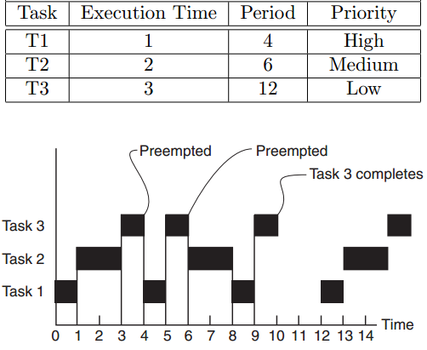
Real-time systems and scheduling
Rate monotonic scheduling
  Static priority scheme
  Assumes “all” tasks are periodic.
    Give priority to tasks with lower period.
  Total utilization helps figure if schedulable.
    If is less than n(2^{1/n}-1) (n=number of tasks) it is schedulable.
    If over 100% not schedulable
    If neither is true, do critical
    instant analysis.
EDF
  Requires dynamic priorities
  Works if less than 100% utilization

Slide 8
Licensing
What a viral license is
  Why it matters in embedded perhaps more than elsewhere.
    LKM
    Impact on business model
    Hardware people tend to use a lot of other people’s code (legally).
      Vendor’s driver code etc.
  Libraries.

Slide 9
Topic: Software platform
Embedded OS
We covered three or four basic platforms for software development for an embedded system.
  Barebones
    Write everything yourself
  Barebones plus libraries
    Import some useful libraries but otherwise write it all yourself.
  RTOS
    Basic scheduler with a lot of control
    Generally a fair bit of support.
      I/O devices, memory management, etc.
    Fast interrupts processing possible/reasonable/”easy”
  Full OS
    Give up a lot of control
    Have to deal with a very complex system
    Get lots (and lots) of software support
      Vision, databases, etc.

Slide 10
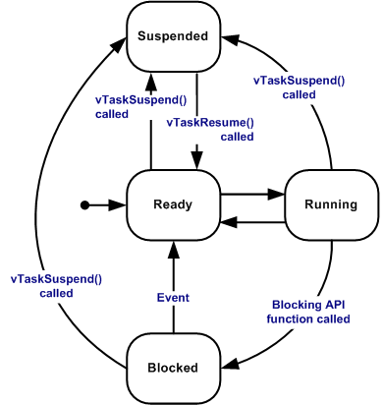
Free RTOS
Embedded OS
Tasks and scheduling
  Creating tasks (xTaskCreate)
  Semaphores
  Deferred interrupt processing.
  Can dynamically change priority.

Slide 11
FreeRTOS
Embedded OS
Likely your final design problem will involve using FreeRTOS in some way.
  Review lab 4
We’ll provide sample code and/or basic functions
  You don’t need to memorize syntax, but you do need to understand.

Slide 12
Embedded Linux
Embedded OS
What limitations on realtime you might have
Can be fairly small footprint (not much memory)
  Things like busybox help
I/O has a standard interface
  File model
    Not always ideal.
But there is a lot of complexity here
  We spent a fair bit of time writing drivers.

Slide 13
Sample OS question
Embedded OS
What are the pros and cons of using a “full” OS (Linux, Windows etc.) in an embedded application? Give an example where you would certainly want to use such an OS and where you certainly would not want to.

Slide 14
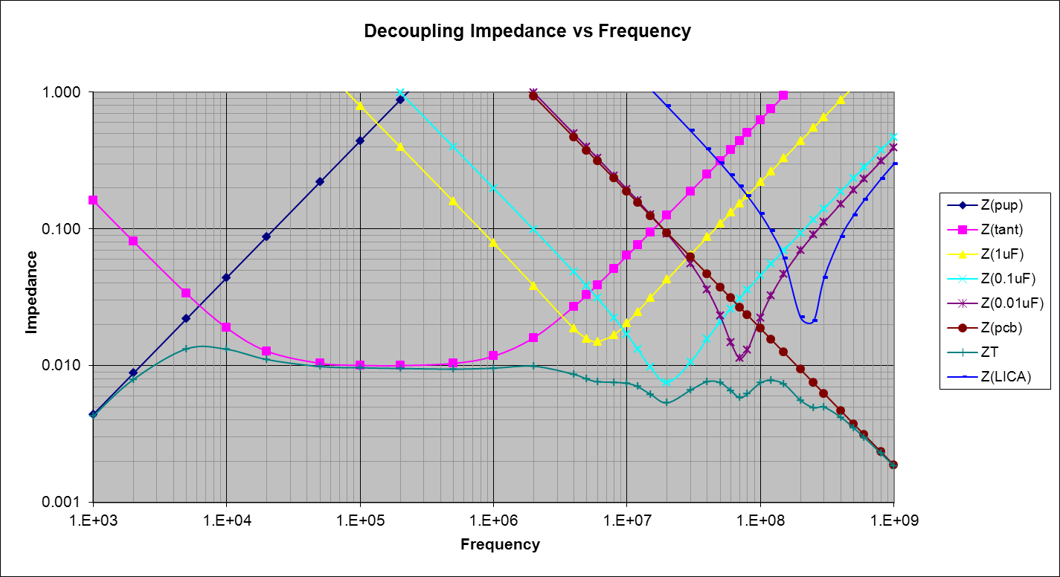
Power integrity
Discuss keeping Vcc/GND constant as possible.
  Recognize that our devices can generate current draw variations at a huge number of frequencies.
  Spikes or droops could break our device.
Need caps.
  Small and large
  Get right values

Slide 15
Batteries
Understand mAh
  Understand that mAh will be less if draw too quickly.
  Be able to work basic math using specific battery properties.

Slide 16
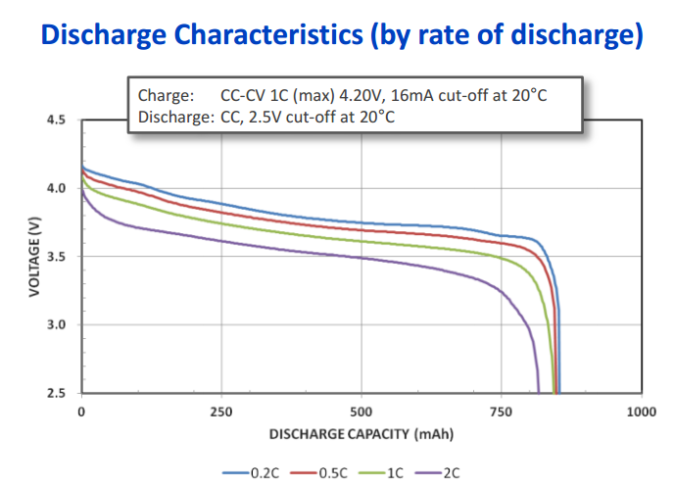
Example
800mAh battery.
  If we need 3.5V (or more) how long will this battery last at a 1.6A draw?

Slide 17
DSP
We covered this for three reasons
  To give you a sense of what digital signal processing involves
      What are the characteristics of
  To make it clear that there can be specialized computational engines out there.
      What are some common special-purpose processors we discussed?
  An excuse to show fixed-point.

Slide 18
DSP and FPGA
Example (utterly unfair) question:
  Consider the structure on the right.
    If a flip-flop has a delay of 1ns
    A multiply has a delay of 10ns
    An add has a delay of 2ns
  What is the lowest clock period you could get for a 64-tap (64 multiplies) implementation of the structure on the right?
    (Yes, this involves 270 stuff)
Notes:
This is a tricky question and too open-ended to be a good exam question. But it does drive home a number of points.
Basic answer is that the worst case involves 1 FF delay, 1 multiplication, and 64 additions. So 1+10+128=139ns.
Another answer would be that the additions can clearly be done as a tree. So 1+10+6*2=23ns
Another answer is to move to from “direct form” to “transposed form” which gets us to 12ns (adder and multiplier!)
The point here is that while we can optimize things, domain-specific knowledge often does better than the generic solution.

Slide 19
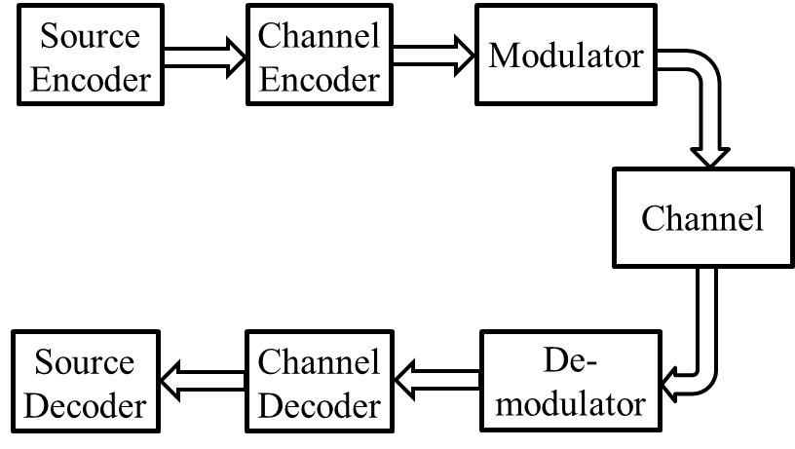
Wireless

Slide 20
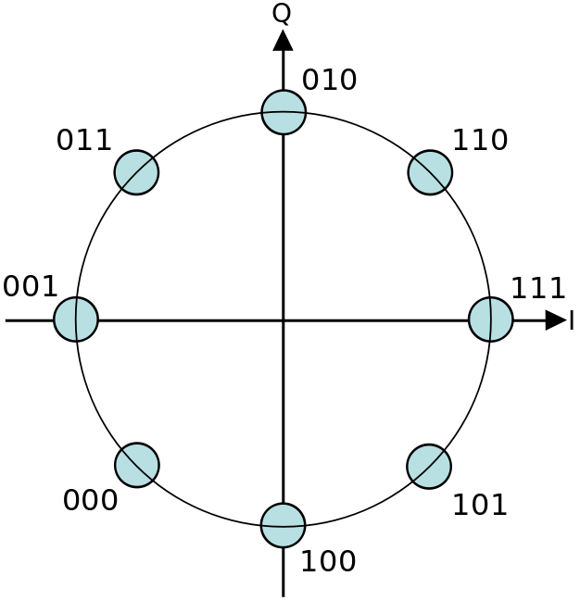
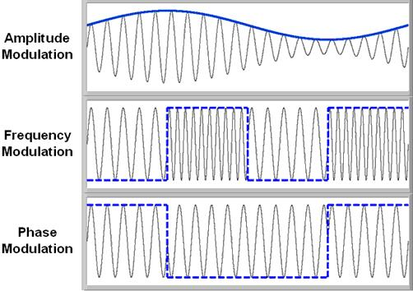
Modulation
Of frequency, phase and amplitude modulation, which are used in the above constellation?

Slide 21

Shannon–Hartley theorem
We’ll use a different version of this called the Shannon-Hartley theorem.
C is the channel capacity in bits per second;
B is the bandwidth of the channel in hertz
S is the total received signal power measured in Watts or Volts²
N is the total noise, measured in Watts or Volts²
Adapted from Wikipedia.

Slide 22
Sample questions for wireless
Notes:
S/N=3, so log2(4)=2. 50Mhz*2=100Mbit/sec.

Slide 23

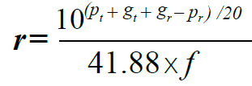
Power received vs. power sent.
The Friis Transmission Formula tells us how much power we’ll receive. It is:
Where:
  P_{t} is the radiated power
  P_{r} is the received power
  G_{t} is the gain of the transmitting antenna
  G_{r} is the gain of the receiving antenna
  λ is the wavelength
  R is the distance between antennas
However, many of those terms aren’t easily available from real spec. sheets.
Instead we do some algebra and get the following equation:
Where f is the frequency in MHz, p_{t} and p_{r} are in dBm and g_{t} and g_{r} are in dBi. r is in km.
  As a note, this is a theoretic result. In reality we often divide by 4 or more.
https://webbrain.com/attach?brain=C0ABA1EA-DC45-635E-40CA-C0636235A853&attach=226&type=1

Slide 24
Questions
dBi
  What is it exactly?
  What do we use it for?
What is dBm?
  Why use dBm instead of dB or mW?
Do lower or higher frequency signals go farther?

