Slide 1
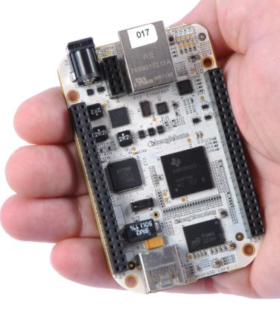
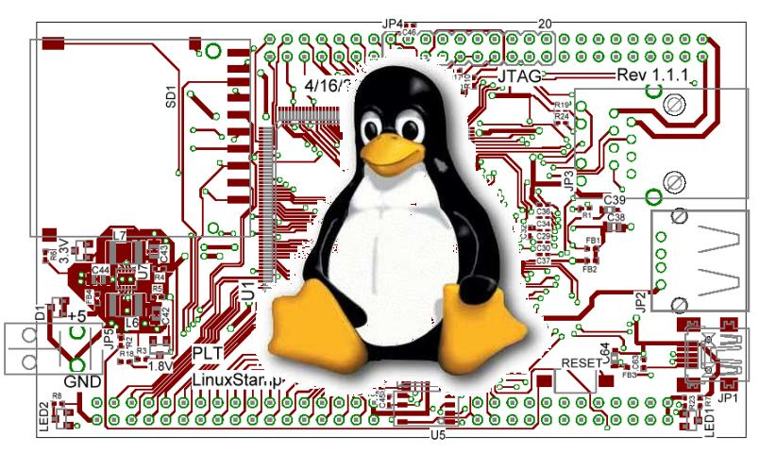
Copyright and Software and You

Slide 2
What is copyright?
The Copyright Act of 1976 prevents the unauthorized copying of a work of authorship.
  However, only the copying of the work is prohibited--anyone may copy the ideas contained within a work.
Copyrights can be registered in the Copyright Office in the Library of Congress, but newly created works do not need to be registered.
  In fact, it is no longer necessary to even place a copyright notice on a work for it to be protected by copyright law.
http://www.bitlaw.com/copyright/

Slide 3
Fair use
So when can you use someone else’s work?
  I mean I just used findlaw’s text!
Four factors (taken from the law itself)
  the purpose and character of the use, including whether such use is of commercial nature or is for nonprofit educational purposes;
  the nature of the copyrighted work;
  the amount and substantiality of the portion used in relation to the copyrighted work as a whole; and
  the effect of the use upon the potential market for or value of the copyrighted work.

Slide 4
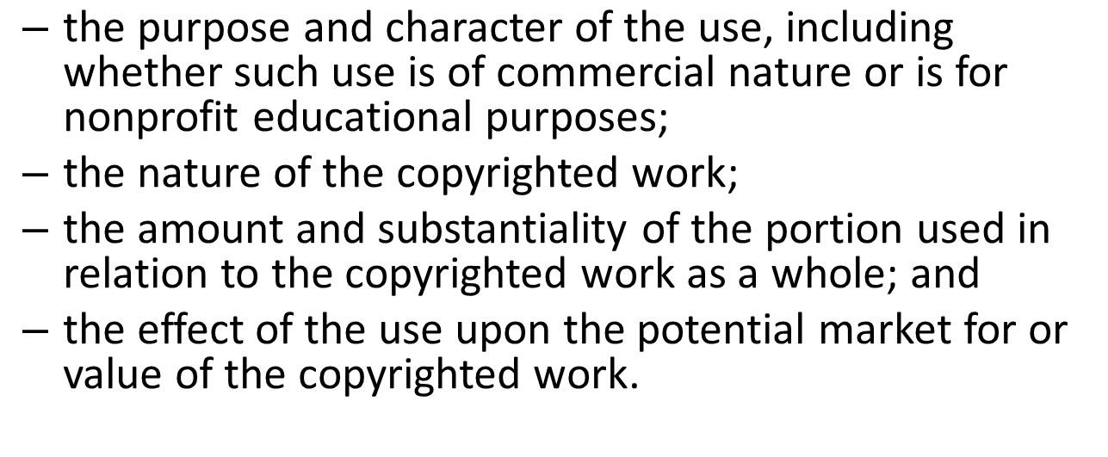
Consider my use of findlaw’s text

Slide 5
Why does copyright law exist?
“the Congress shall have power . . . to promote the progress of science and useful arts, by securing for limited times to authors and inventors the exclusive right to their respective writings and discoveries.”

Slide 6
Consider “The Right to Read”
Hopefully you all read that short story.
  https://www.gnu.org/philosophy/right-to-read.html
Thoughts?

Slide 7

Linux?
A POSIX-compliant and widely deployed desktop/server operating system licensed under the GPL
  POSIX
    Unix-like environment (shell, standard programs like awk etc.)
  Desktop OS
    Designed for users and servers
    Not designed for embedded systems
  GPL
    Gnu Public License. May mean you need to make source code available to others.
      First “copyleft” license.
    Linux is licensed under GPL-2, not GPL-3.
Many figures and text in this section taken from Embedded Linux Primer, second edition
We (kind of) have on-line access to the book.

Slide 8
“Copyleft”
The idea here is to make it so that software is free and can’t be made non-free.

Slide 9
GPL in three slides (1/3)
A licensee of GPL v2-licensed software can:
  copy and distribute the program's unmodified source code
  modify the program's source code and distribute the modified source
  distribute compiled versions of the program, both modified and unmodified
Provided that:
  all distributed copies (modified or not) carry a copyright notice and exclusion of warranty
  all modified copies are distributed under the GPL v2
  all compiled versions of the program are accompanied by the relevant source code, or a viable offer to make the relevant source code available
Largely taken from http://www.oss-watch.ac.uk/resources/gpl.xml

Slide 10
GPL in three slides (2/3)
Some points
  If you don’t redistribute the code, you don’t need to share the source.
  You can bundle software with GPL-ed software and not have to license the bundled software.
    “Mere aggregations” aren’t impacted.
  Loadable Kernel Modules are tricky though
    Often we need device drivers for our application (we’ll be writing them later)
    But they touch the Linux code in a non-trivial way.
      There is some debate about if a LKM is an aggregation or a modification of the original kernel.
      In general there are proprietary drivers out there and even open source groups that help support said drivers.
General theme:
  Be sure you understand the law before you use software licensed under the GPL on a proprietary project.
    Using gcc to compile or ddd to debug is fine, but when you are modifying the code of software licensed under the GPL you might be obligated to release your code.
Read: The Cathedral and the Bazaar

Slide 11
GPL in three slides (3/3)
GPL v3
  Prevents using GPL on hardware that won’t run other code (“Tivoization”)
    Though only for consumer hardware (IBM has a business model here?)
  Addresses patents
    Can’t sue for (software?) patent on code you release.
Lesser GPL
  Mainly for libraries/APIs.
  Makes it clear can use libraries in proprietary code without having to release proprietary code.

Slide 12
Next—CSE big ideas.

