Slide 1
Overview of Autonomous Robotics Concepts: A Quick Guide
Welcome to the session
Overview of key topics
How these concepts interconnect
Notes:
Greet the audience. Introduce the main pillars of robotics: Path Planning, Computer Vision, Graph Theory, and Design Space. Emphasize their interconnections.

Slide 2
Learning Objectives
1. Understand Path Planning fundamentals and algorithms
2. Gain a high-level overview of Computer Vision in robotics
3. Recognize the importance of Graph Theory and Mathematical Formalization
4. Appreciate Design Space trade-offs
Notes:
By the end of this presentation, the audience should be able to explain the basics of each concept and see how they relate in a complete robotics system.

Slide 3
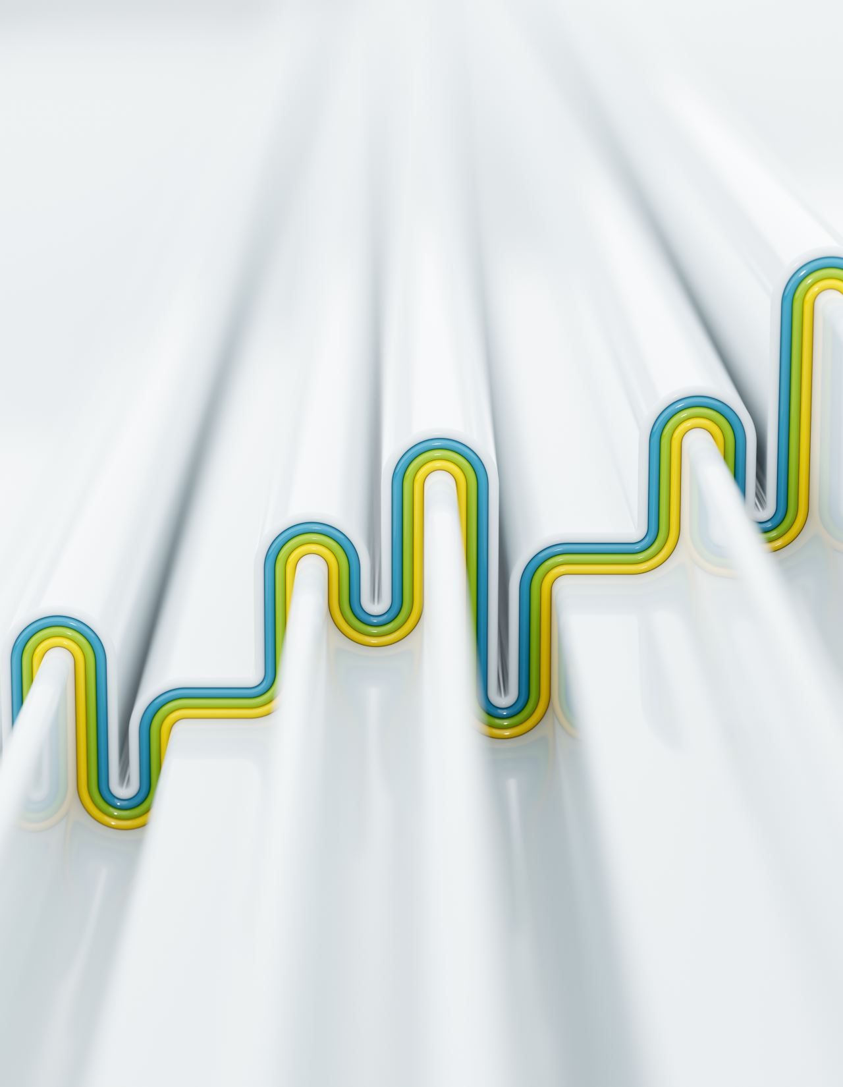
The Robotics Pipeline
Perception → Planning → Control
  Autonomy really fits into the “planning” part
Role of each concept in this pipeline
Common robotics stack
Notes:
Explain how a typical robotics system flows from perception (sensors, vision) to planning (path planning) to control (actuators, feedback loops). Briefly mention how design choices affect each stage.

Slide 4

Part I: Computer Vision and 3D Modeling
Notes:
Transition slide to introduce Computer Vision concepts.

Slide 5
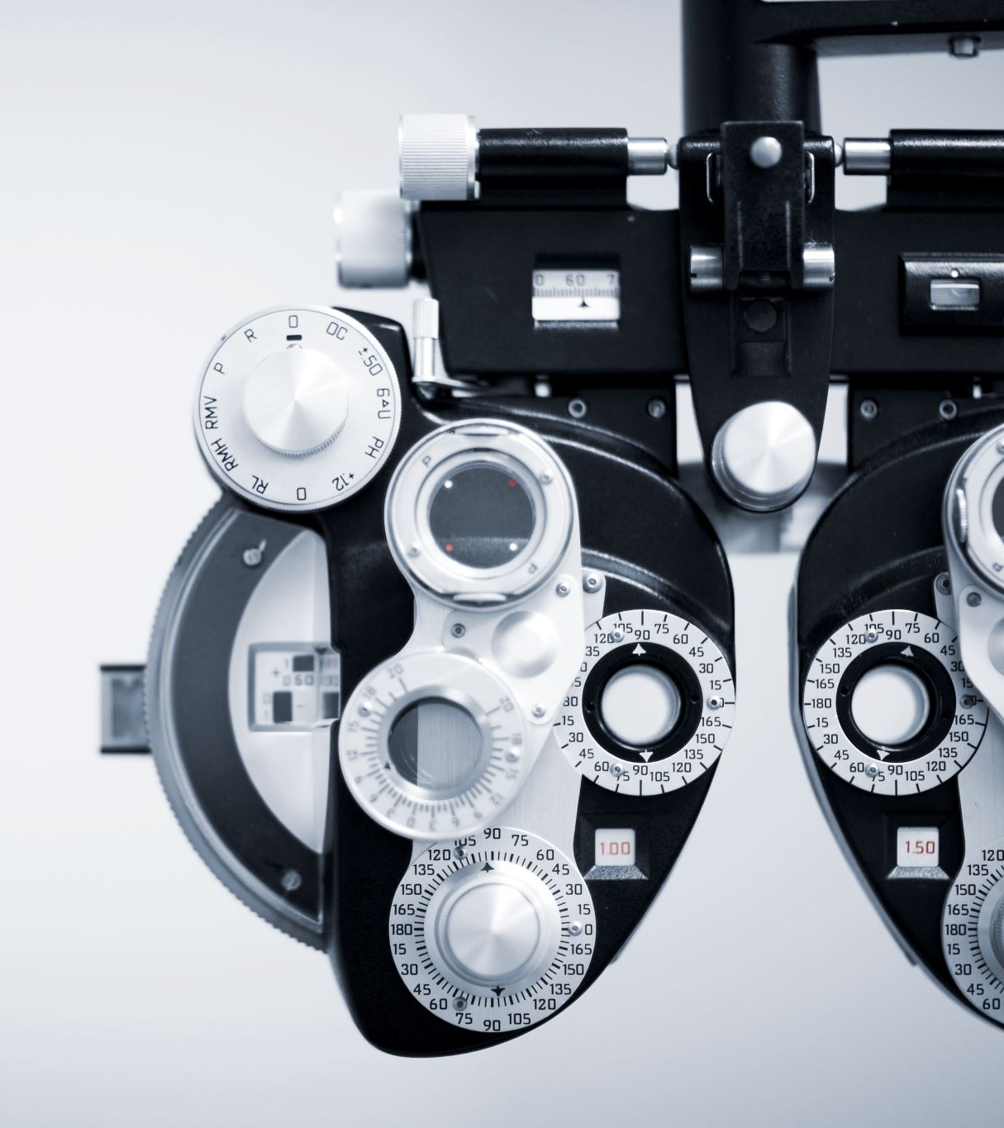
Role of Computer Vision in Robotics
Perception: the 'eyes' of the robot
Tasks: object detection, localization, mapping, 3d modeling
Sensors: cameras (RGB, stereo, depth), LiDAR
Notes:
Explain the significance of perception for autonomous decision-making. Mention how sensor choice aligns with different tasks and budgets.

Slide 6
Core Steps in Computer Vision
Image Acquisition
Preliminary Processing (minimizing noise, enhancing quality)
Feature Extraction (detecting edges, corners)
Sophisticated Analysis (object recognition, segmentation)
Notes:
A traditional pipeline approach. Modern approaches often combine these steps with deep neural networks. Each step refines the raw sensor data toward understanding.

Slide 7
Applications & Techniques
Camera Calibration & Stereo Vision (depth estimation)
SLAM (Simultaneous Localization and Mapping)
Object Detection & Tracking (CNN-based: YOLO, SSD)
  YOLO: you only look once (single pass regression model)
  SSD: Single Shot Detection (bounding box using levels of detail)
Pose Estimation
  Ultralytics
Notes:
Highlight key computer vision methods in robotics. SLAM is a crucial link between vision and path planning. Object detection/tracking crucial for dynamic environments.

Slide 8
Python
Python has quickly become the language of choice
  Can run embedded, lightweight
  Most of the packages we mentioned are available and “easy” to invoke
  ChatGPT and other LLMs can readily give boilerplate code
    Also helpful in getting started
Computer vision packages you can try at home
  https://docs.ultralytics.com/ (image recognition)

Slide 9
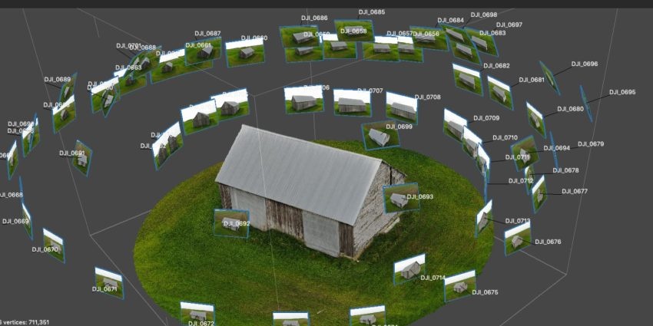
Photogrammetry and measuring the world

Slide 10
Photogrammetry
RealityScan available in Unreal
https://learnopencv.com/3d-gaussian-splatting/ (opencv)
Can you speed this up perhaps with object detection?

Slide 11
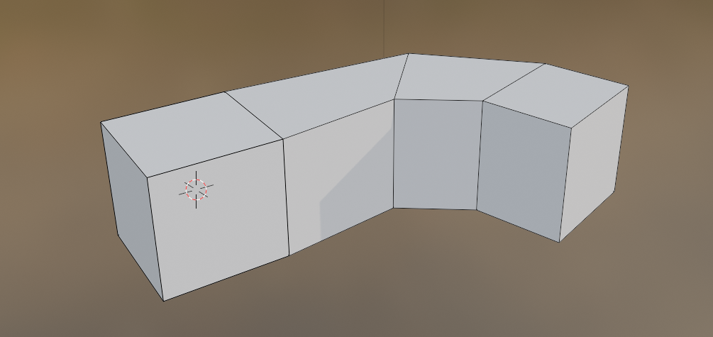
3D Modeling and Representation
Software
  Blender (https://www.blender.org/download/releases/)
    Steep learning curve
  Fusion 360
Representations
  Edges, faces, vertices
  Solid modeling (e.g., sphere)
  Voxels

Slide 12

Part II: Path Planning
Notes:
Transition slide to emphasize we are now focusing on Path Planning.

Slide 13
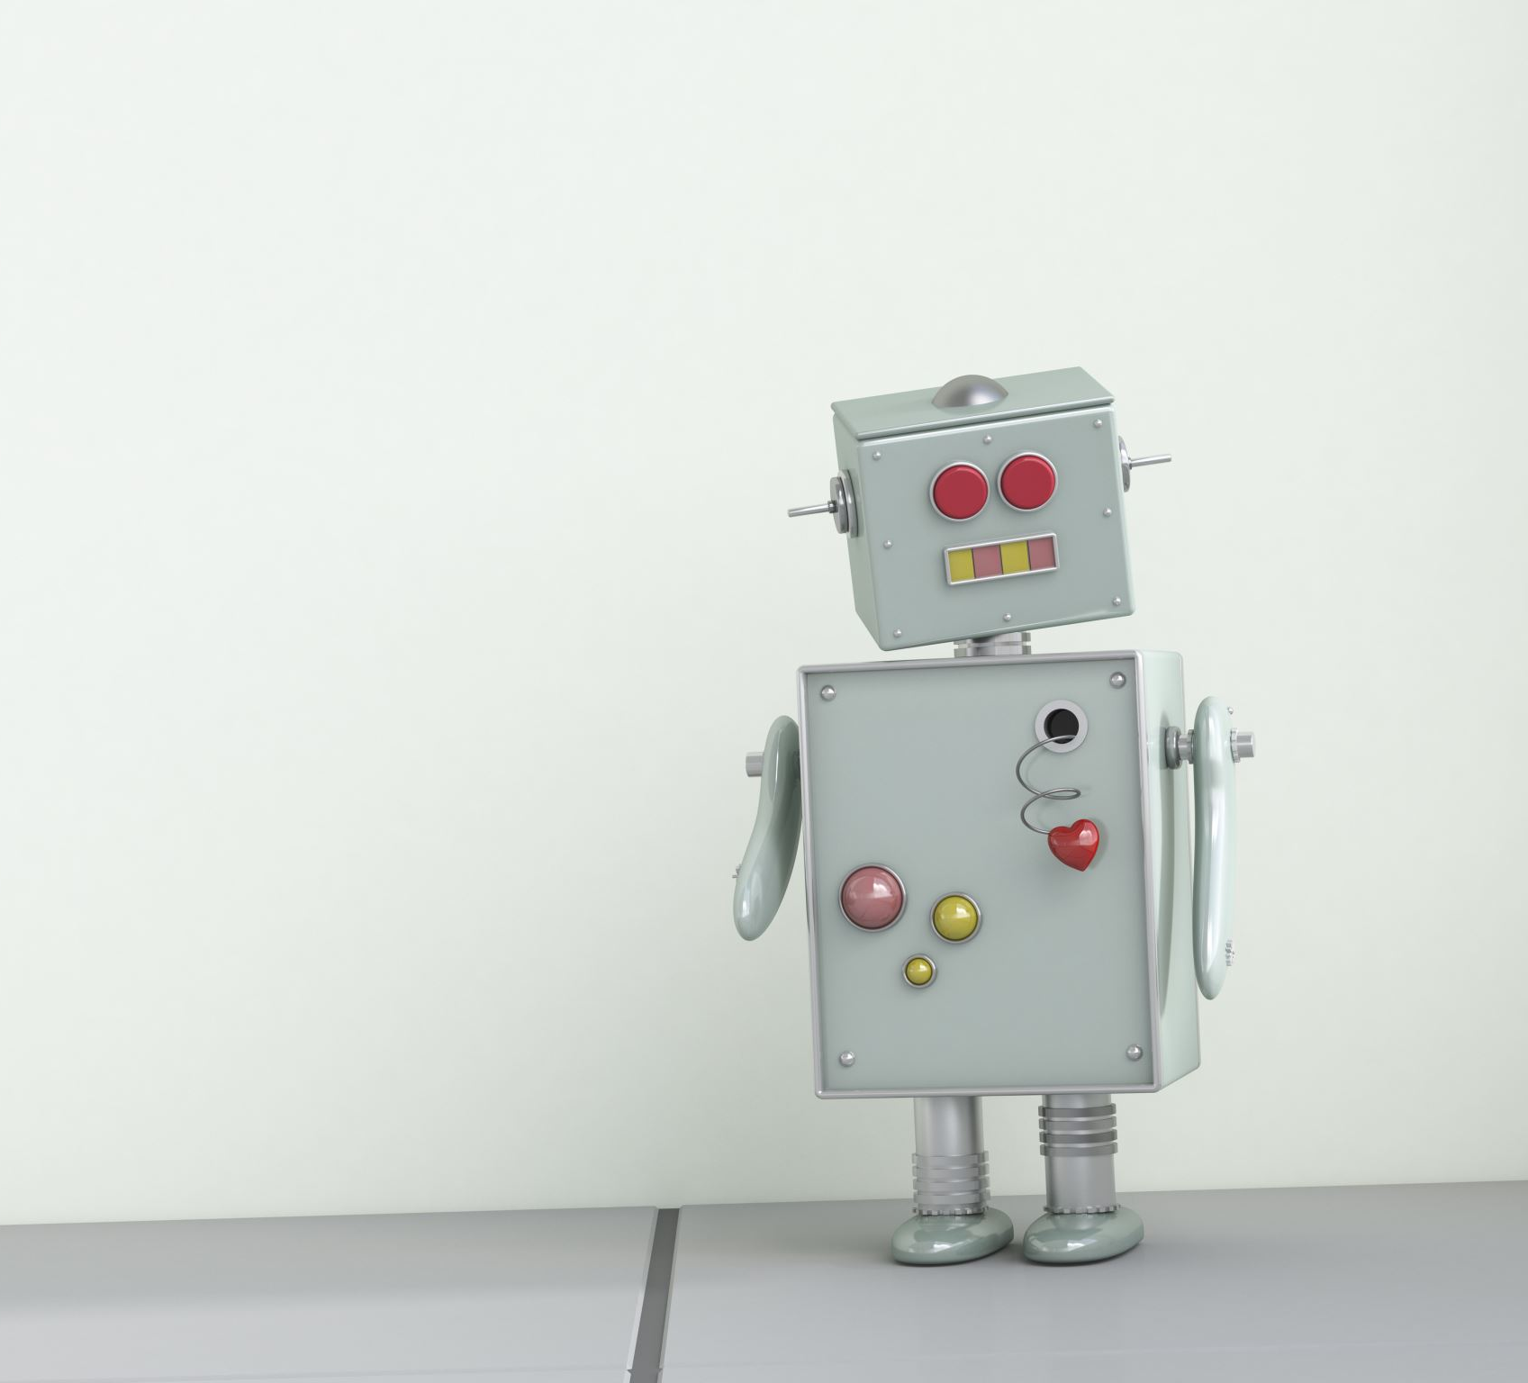
Robot recognizes world/things/ now what?

Slide 14
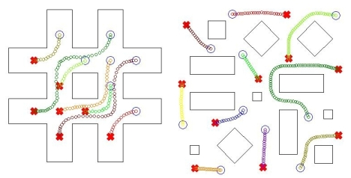
What is Path Planning?
Definition: Finding a continuous path from start to goal without collisions
Common constraints (obstacle avoidance, dynamic environments, optimization goals)
Applications: self-driving cars, mobile robots, drones
Notes:
Path planning is essential for any robot that moves in the world. Discuss how constraints like environment obstacles, kinematic limits, or performance metrics shape the planning approach.

Slide 15
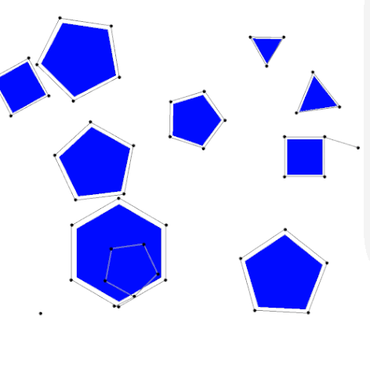

Classical Path Planning Methods
Graph-based Search: BFS, DFS, Dijkstra’s, A*
  Dijkstra’s algorithm visualizer
Sampling-based:
  PRM (Probabilistic Roadmap),
  RRT (Rapidly-exploring Random Tree)
Notes:
Graph-based methods work well in discrete grids or explicit graphs. Sampling-based approaches excel in high-dimensional or continuous spaces.

Slide 16
Much is for future coursework…
Programming Algorithms and Datastructures: 281
Dijkstra’s algorithm, BFS, DFS
Still, you can do some simple things in this course
Follow the right wall (standard maze approach)

Slide 17
Advanced Planning Approaches
Dynamic Planning (updating/refining):
  D* (A* with updates/dynamic objects),
  Anytime A*,
  RRT*
Optimization-based: Trajectory optimization, Model Predictive Control (MPC)
AI/ML-based: Reinforcement learning for path planning
Notes:
Discuss how advanced techniques tackle dynamic or uncertain environments. Optimization-based planning uses cost functions, while AI methods learn policies through interaction.

Slide 18
So, we have an idea of path planning
Path planning is a core functionality in an autonomous vehicle
What do we need to get there?
  Know where we are in the world
    Computer vision, SLAM (Simultaneous Localization and Mapping), sensor fusion
  Represent the world
    Mathematical formulations, graph theory, abstraction

Slide 19
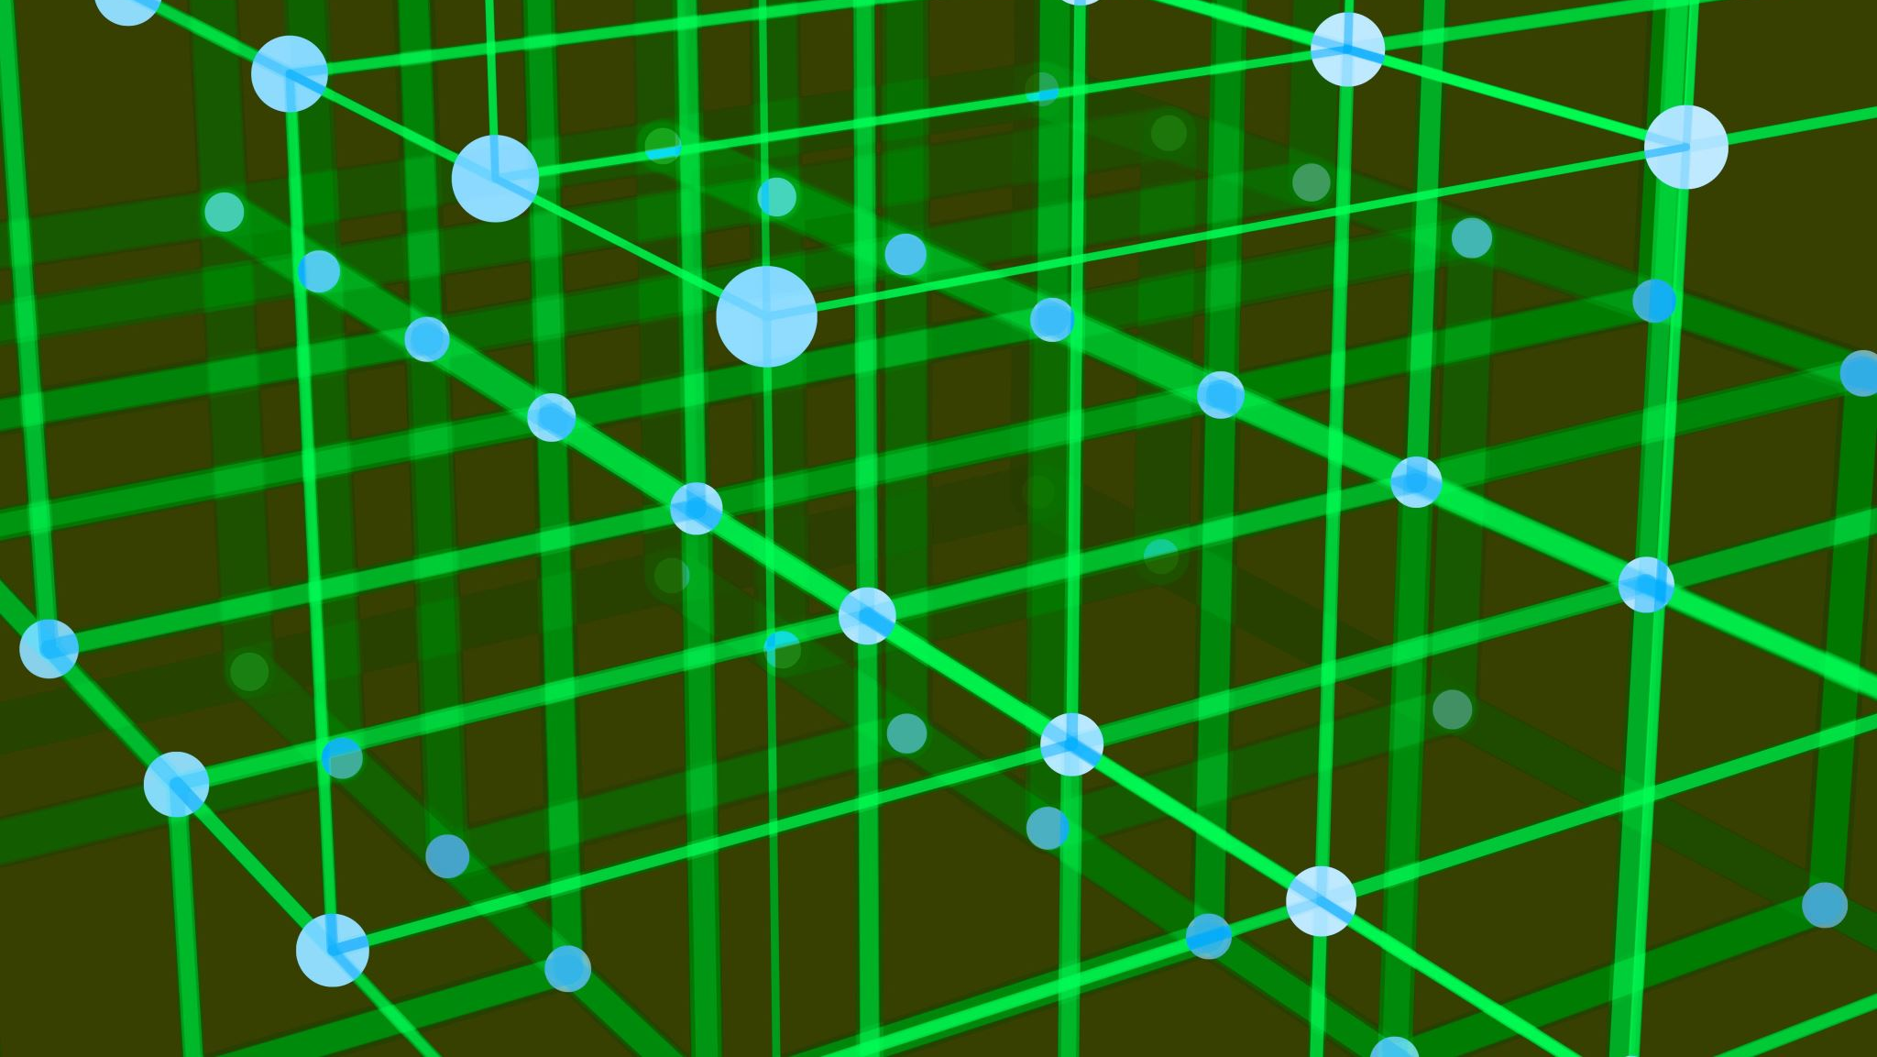
Part III: Graph Theory and Mathematical Formalization
Notes:
Transition slide to emphasize Graph Theory in robotics.

Slide 20

Representing the real world mathematically
Why?
Continuous mathematics
Good for signals, actuators, controls
Differential equations, vectors, fields
E.g., balancing a robot
Discrete mathematics
Higher level, useful for path-planning, prioritizing objectives
Also, stochastic representations (probability and statistics)
Bayes law, inferencing, belief refinement, sampling

Slide 21

Graph Theory Basics
Graph = vertices (nodes) + edges
Key properties: directed/undirected, weighted/unweighted
Robotics applications: navigation, network optimization, multi-robot coordination
  How do you represent the world?
Notes:
Introduce fundamental graph definitions and how they map to robotics contexts. Nodes can represent positions/states, edges represent transitions or connections.

Slide 22
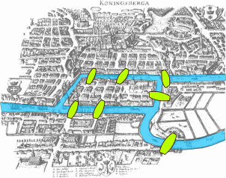
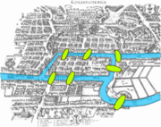
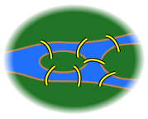
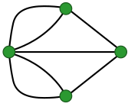
Some motivation
Euler’s Königsberg bridge problem
→ →
Notes:
Widely considered the beginning of modern graph theory

Slide 23
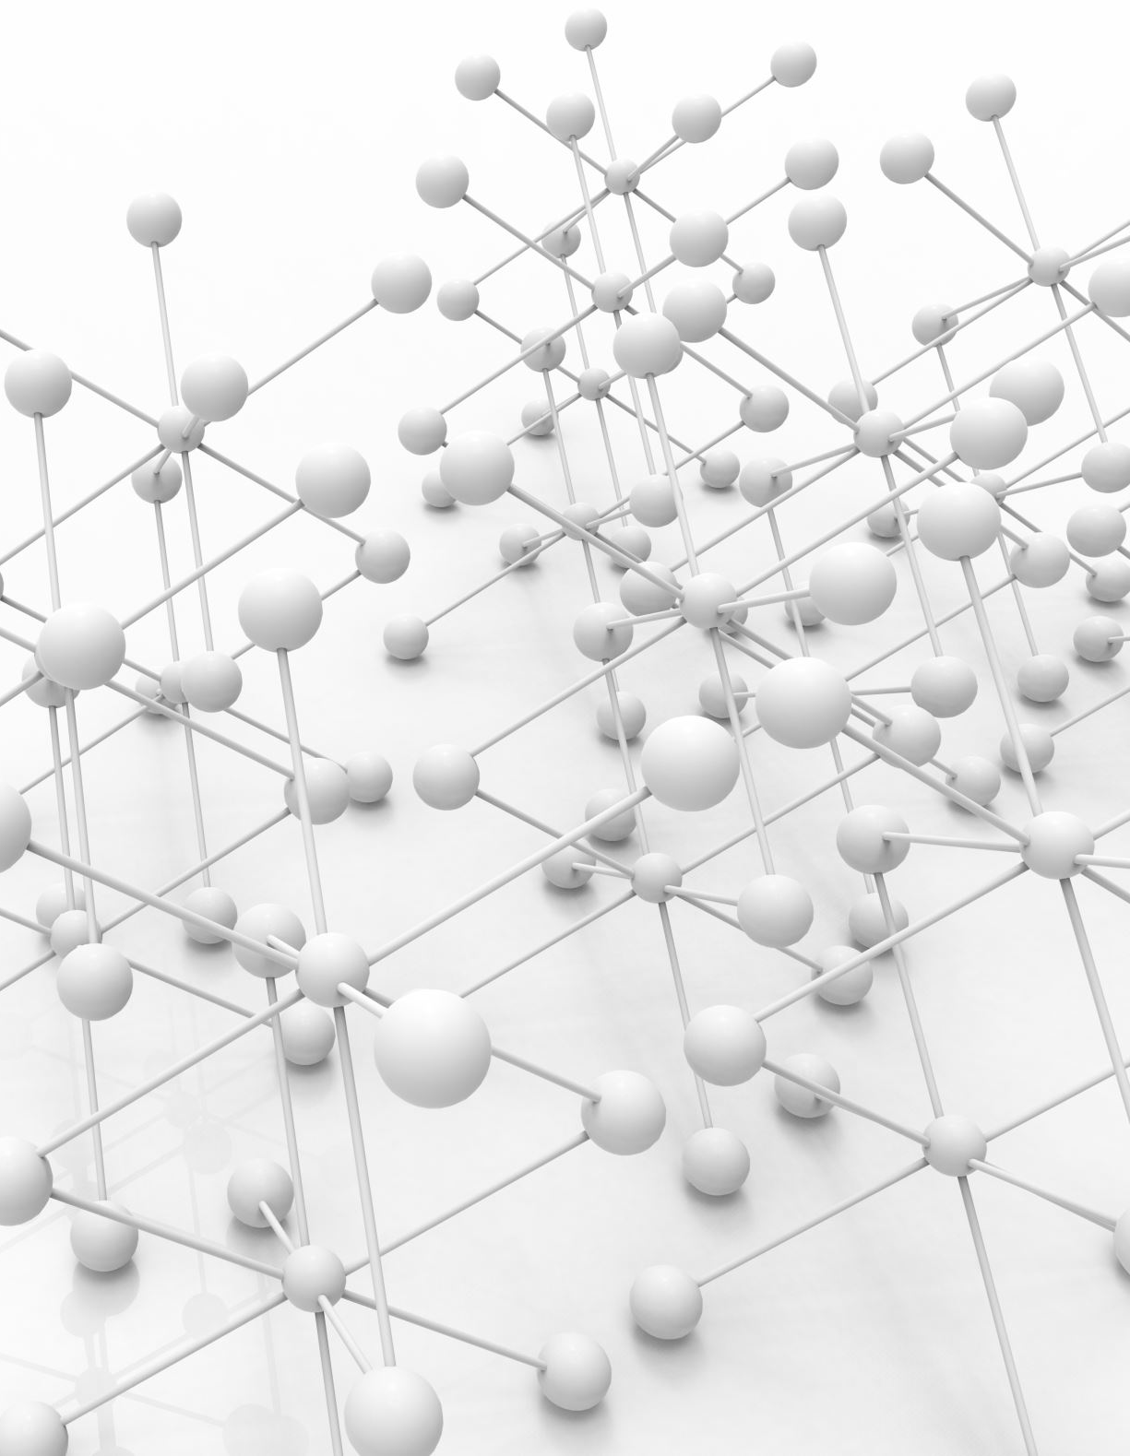
Graph Theory Concepts for Robotics
Connectivity & Components
  Reduce world to vertices and edges
  Assign weights and attributes
Shortest Path (Dijkstra, A*)
Tree Structures (RRT, MST)
Cycles & Loop Closure in SLAM
  Revisit same area again
  Align models
Notes:
These concepts form the basis for many robotics algorithms. Shortest paths for navigation, trees for sampling-based planners, loop closure for SLAM.

Slide 24
Practical Use Cases
Topological Navigation (rooms, corridors as nodes)
Roadmaps (PRM) in high-dimensional configuration spaces
Distributed Robotics: Graph-based coordination
Notes:
Real-world examples: building topological maps for indoor navigation, sampling-based roadmaps for complex arms, and multi-robot tasks requiring graph algorithms for coverage or path optimization.

Slide 25

Part IV: Design Space
Notes:
Transition slide to discussing the broader Design Space in robotics.

Slide 26
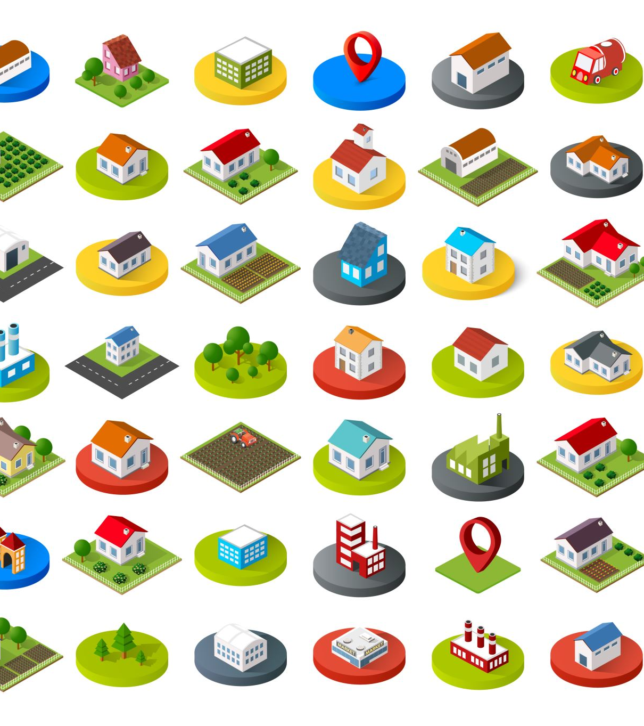
Defining the Design Space
Set of possible solutions/architectures
Factors: mechanics, electronics, control, software, environment
Constraints: size, cost, power, time, etc.
Notes:
Explain that the design space is a multi-dimensional realm of possible robot designs. Every design decision affects constraints and future choices.

Slide 27

Major Trade-Offs
Mechanical Design: DoF vs. complexity
Sensor Selection: cost vs. accuracy
Actuation & Control: torque, speed, motor type
Computation & AI: onboard vs. cloud, latency
Energy Constraints: battery life vs. performance
Notes:
Use real-world examples of these trade-offs (e.g., heavier batteries give more runtime but increase weight). No single solution is best for all applications.

Slide 28

Integration & Testing
System Integration: hardware + software + algorithms
Simulation Tools:
Webots: more education focused simulation tool
https://cyberbotics.com/doc/guide/installing-webots
Unreal and Unity engine simulators starting to integrate robotics
Iterative Prototyping: test, refine, repeat
https://www.unrealengine.com/en-US
https://unity.com/
More for gaming, but simulation can be used with ArduPilot
Notes:
Emphasize that building a robot is not just picking parts, but ensuring they work together seamlessly. Simulations reduce cost and risk before real-world tests.

Slide 29
Summary & Future Directions
Path Planning, Computer Vision, Graph Theory, Design Space
  Computer Vision: EECS 442
  Graph theory and mathematical formulations: EECS 203, 281
    Also a number of MATH courses
  Path planning: ROB 520 and related
  Machine Learning: EECS 553, sometimes advanced topics courses
Future Trends:
  Deep Reinforcement Learning: EECS 598
  Edge Computing
  Swarm Robotics
Notes:
Summarize the major takeaways from the presentation. Encourage learners to keep up with current research trends.

Slide 30
Resources & References
Books:
• Principles of Robot Motion – Choset et al.
• Probabilistic Robotics – Thrun et al.
• Robotics, Vision and Control – Peter Corke
Notes:
Point to recommended materials for deeper study. Encourage exploring open-source frameworks like ROS and OpenCV.

Slide 31
Q&A
Questions and Discussion
Brainstorming next
Notes:
Open the floor for audience questions. Suggest a small project or next steps, e.g., a simple path-planning demo in ROS.

Slide 32

How to generate ideas
Oftentimes it starts with an idea you have been having in the back of your mind
Use the context to help narrow the space
Start with a problem
With the list of initial problems
  Do a feasibility pass
  What is a minimal demonstration
    Minimal viable product (MVP)
  Can you demonstrate within the time limit

