Slide 2
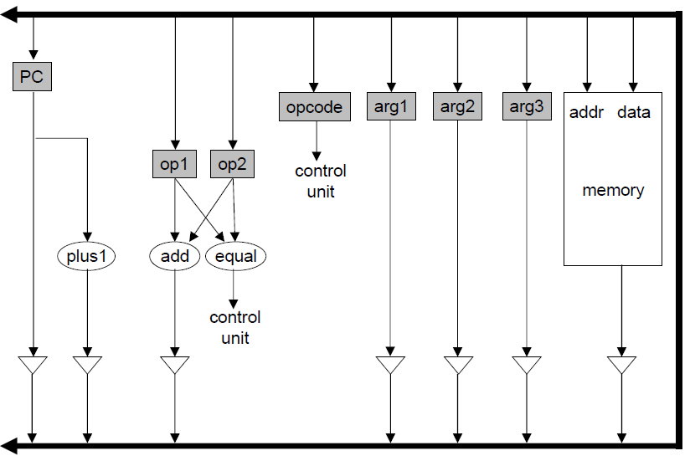
Fetch
state | next_state | pc_drive | plus1_drive | add_drive | arg1_drive | arg2_drive | arg3_drive | mem_drive | pc_write | op1_write | op2_write | opcode_write | arg1_write | arg2_write | arg3_write | address_write | mem_write
reset | fetch1
fetch1 | fetch2
fetch2 | fetch3
fetch3 | fetch4
fetch4 | fetch5
fetch5 | fetch6
fetch6 | fetch7
fetch7 | fetch8
fetch8 | decode

Slide 3
add
state | opcode_out | equal_out | next_state | pc_drive | plus1_drive | add_drive | arg1_drive | arg2_drive | arg3_drive | mem_drive | pc_write | op1_write | op2_write | opcode_write | arg1_write | arg2_write | arg3_write | address_write | mem_write
decode |  |  | add1

Slide 4
branch equal
state | opcode_out | equal_out | next_state | pc_drive | plus1_drive | add_drive | arg1_drive | arg2_drive | arg3_drive | mem_drive | pc_write | op1_write | op2_write | opcode_write | arg1_write | arg2_write | arg3_write | address_write | mem_write
decode |  |  | be1

Slide 5
Call/return example
Mem[20] call 500 100 0
Mem[24] //next instruction
Mem[100] 0
Mem[500] //start of function
Mem[???] ret 100

Slide 6
max = 0; /* assume no negative numbers */
i = 0;
while (i != 16) {
if (memory[i] > max) {
max = memory[i];
}
i++;
}

