Slide 1
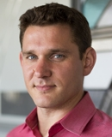
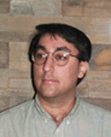
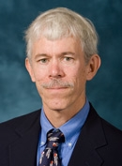
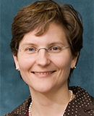
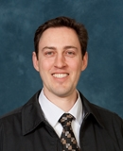
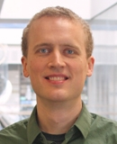
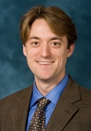
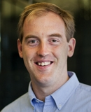
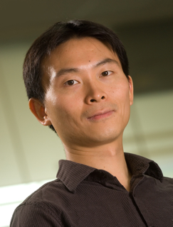
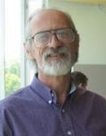
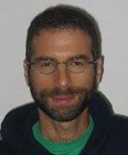
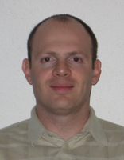
Theoretical Computer Science at Michigan Panel and discussion Friday, November 14, 4:00 to 5:30 pm, 1360 East Hall
The panel (above; most in person, some by proxy) will discuss opportunities for research collaborations between theoretical computer scientists and mathematicians at the University of Michigan, as well as on-going theoretical computer science research and classes that may be of interest to mathematicians. Opportunities for Math advanced undergrads, graduate students and postdocs will be emphasized. Followed by “take your prof to dinner,” compliments of the EECS dept.

