Slide 1
Persistency for Synchronization-Free Regions
Vaibhav Gogte, Stephan Diestelhorst$, William Wang$, Satish Narayanasamy, Peter M. Chen, Thomas F. Wenisch
PLDI 2018
06/20/2018
$

Slide 2
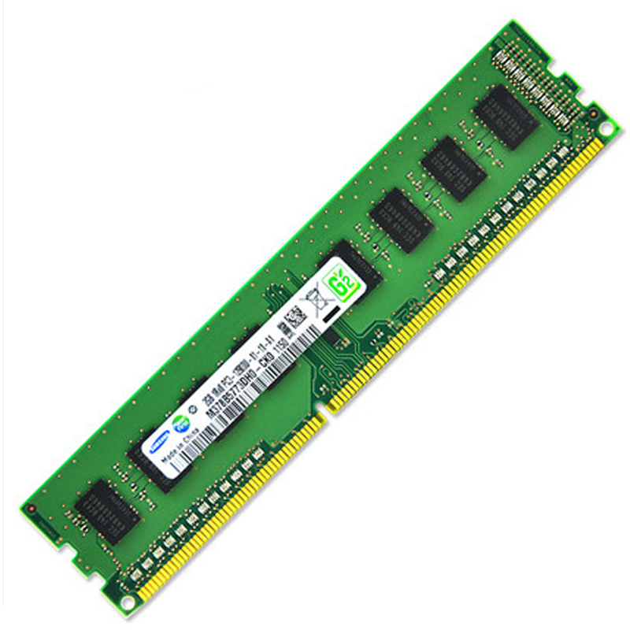
Promise of persistent memory (PM)
Performance
*
“Optane DC Persistent Memory will be offered in packages of up to 512GB per stick.”
Density
“… expanding memory per CPU socket to as much as 3TB.”
Non-volatility
* Source: www.extremetech.com
Byte-addressable, load-store interface to storage

Slide 3
Persistent memory system
Core-1
Core-2
Core-3
Core-4
L1 $
L1 $
L1 $
L1 $
LLC
Recovery
DRAM
Persistent Memory (PM)
Recovery can inspect the data-structures in PM to restore system to a consistent state

Slide 4
Memory persistency models
Provide guarantees required for recoverable software
Academia [Condit ‘09][Pelley ‘14][Joshi ‘15][Kolli ‘17] …
Industry [Intel ‘14][ARM ‘16]
Define the program state that recovery observes post failure
Key primitives:
Ensure failure atomicity for a group of persists
Govern ordering constraints on memory accesses to PM

Slide 5
Contributions
Persistency model using synchronization-free regions
Define precise state of the program post failure
Employ existing synchronization primitives in C++
Provide semantics as a part of language implementation
Build compiler pass that emits logging code for persistent accesses
Propose two implementations: Coupled-SFR and Decoupled-SFR
Achieve 65% better performance over state-of-the-art tech.

Slide 6
Outline
Design space for language-level persistency models
Our proposal: Persistency for SFRs
Coupled-SFR implementation
Decoupled-SFR implementation
Evaluation

Slide 7
Language-level persistency models [Chakrabarti ’14][Kolli ’17]
Enables writing portable, recoverable software
Extend language memory-model with persistency semantics
Persistency model guarantees:
Atomic_begin()
A = 100;
B = 200;
Atomic_end()
A = 100;
L1.rel();
L1.acq();
A = 200;
St(A) <_{p} St(B)
Failure-atomicity:
Which group of stores persist atomically?
Ordering:
How can programmers order accesses?

Slide 8
Why failure-atomicity?
Task: Fill node and add to linked list, safely
In-memory data
Initial linked-list
fillNewNode()
Fence
updateTailPtr()

Slide 9
Why failure-atomicity?
Task: Fill node and add to linked list, safely
In-memory data
Atomic
updateTailPtr()
fillNewNode()
Failure-atomicity → Persistent memory programming easier

Slide 10
Semantics for failure-atomicity
Assures that either all or none of the updates visible post failure
Guaranteed by hardware, library or language implementations
Design space for semantics
Individual persists
Outer critical-sections
Existing mechanisms provide unsatisfying semantics or suffer high performance overhead

Slide 11
Granularity of failure-atomicity - I
L1.lock();
x -= 100;
y += 100;
L2.lock();
a -= 100;
b += 100;
L2.unlock();
L1.unlock();
Individual persists
[Condit ‘09][Pelley ‘14][Joshi ‘16][Kolli ‘17]
Mechanisms ensure atomicity of individual persists
Non-sequentially consistent state visible to recovery → Need additional custom logging

Slide 12
Granularity of failure-atomicity - II
L1.lock();
x -= 100;
y += 100;
L2.lock();
a -= 100;
b += 100;
L2.unlock();
L1.unlock();
Outer critical sections
[Chakrabarti ‘14][Boehm ‘16]
Guarantees recovery to observe SC state
→ Easier to build recovery code
Require complex dependency tracking between logs
→ > 2x performance cost
Do not generalize to certain sync. constructs
→ eg. condition variables

Slide 13
Our proposal: Failure-atomic SFRs
l1.acq();
x -= 100;
y += 100;
l2.acq();
a -= 100;
b += 100;
l2.rel();
l1.rel();
Synchronization free regions (SFR)
SFR1
Thread regions delimited by synchronization operations or system calls
SFR2
Enable precise post-failure state with low performance overhead

Slide 14
Guarantees by failure-atomic SFRs
Thread 1
Thread 2
Intra-thread guarantees
Ensure failure-atomicity of updates within SFR
Define precise points for post-failure program state
Inter-thread guarantees
Order SFRs using synchronizing acq and rel ops
Serialize ordered SFRs in PM
l1.acq();
x -= 100;
y += 100;
l1.rel();
SFR 1
l1.acq();
x += 100;
y -= 100;
l1.rel();
SFR 2
Two logging impl. → Coupled-SFR and Decoupled-SFR

Slide 15
Undo-logging for SFRs
persistUndoLog (L)
L1.acq();
x = 100;
L1.rel();
mutateData (M)
Failure-atomic
SFR1
persistData (P)
commitLog (C)
SFR1
Need to ensure the ordering of steps in undo-logging for SFRs to be failure-atomic

Slide 16
Impl. 1: Coupled-SFR
Thread 1
Thread 2
Thread 1
Thread 2
L1.acq();
x = 100;
L1.rel();
L1
ACQ2
SFR1
M1
L2
L1.acq();
x = 200;
L1.rel();
SFR1
SFR2
P1
M2
SFR2
+ Persistent state lags execution by at most one SFR → Simpler implementation, latest state at failure
- Need to flush updates at the end of each SFR → High performance cost
C1
P2
REL1
C2

Slide 17
Impl. 2: Decoupled-SFR
Thread 1
Thread 2
Thread 1
Thread 2
L1.acq();
x = 100;
L1.rel();
L1
ACQ2
SFR1
SFR1
M1
L2
L1.acq();
x = 200;
L1.rel();
SFR2
SFR2
P1
M2
Key idea: Persist updates and commit logs in background
C1
P2
REL1
C2
Require recording order of log creation

Slide 18
Log ordering in Decoupled-SFR
Init x = 0
Thread 1
Header
Thread 2
Header
Thread 1
Thread 2
x = 100;
L1.rel();
Sequence Table
Store X
x_{old} = 0
Acq L1
Seq = 1
→ 1
L1 0
L1.acq();
x = 200;
Rel L1
Seq = 0
Store X
x_{old} = 100
Sequence numbers record inter-thread order of log creation
Background threads commit logs using recorded sequence nos.
In paper: Racing sync. operations, commit optimizations etc.

Slide 19
Evaluation setup
Designed our logging approaches in LLVM v3.6.0
Instruments stores and sync. ops. to emit undo logs
Creates log space for managing per-thread undo-logs
Launches background threads to flush/commit logs in Decoupled-SFR
Workloads: write-intensive micro-benchmarks
12 threads, 10M operations
Performed experiments on Intel E5-2683 v3
2GHz, 12 physical cores, 2-way hyper-threading

Slide 20
Performance evaluation
[Chakrabarti ’14]
65%
Better
Decoupled-SFR performs 65% better than state-of-the-art ATLAS design

Slide 21
Performance evaluation
[Chakrabarti ’14]
Better
Coupled-SFR performs better that Decoupled-SFR when fewer stores/SFR

Slide 22
Conclusion
Failure-atomic synchronization-free regions
Persistent state moves from one sync. operation to the next
Extends clean SC semantics to post-failure recovery
Coupled-SFR
Easy to reason about PM state after failure; high performance cost
Decoupled-SFR
Persistent state lags execution; performs 65% better than ATLAS

Slide 23
Persistency for Synchronization-Free Regions
Vaibhav Gogte,
Stephan Diestelhorst$,
William Wang$,
Satish Narayanasamy,
Peter M. Chen,
Thomas F. Wenisch
$
If the surgery proves unnecessary, we’ll revert your architectural state at no charge.*
*Source: Paul Kocher, ISCA 2018

