Slide 1
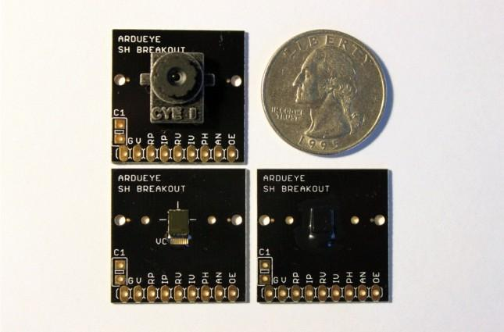
EECS 373
Design of Microprocessor-Based Systems
George Basil, William Beyer, Joshua Cronk
University of Michigan
Image Sensors
November 27, 2012
Notes:
George (everyone says their name)

Slide 2
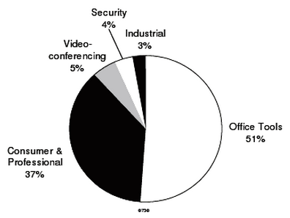
What are Image Sensors?
Device that converts optical images into an electronic signal
Performance varies widely based on application
Come in many different sizes, pixel densities, etc..
Example Applications
Consumer cameras
Medical imaging
Security
(Hausken, 2004, [1])
Notes:
George

Slide 3
How do image sensors work?
Image sensors typically use CCD or CMOS technology
CCD: Charge-coupled device
Light strikes chip and is held as a small electrical charge in each photo sensor
Charges then converted to voltages
Voltages sampled, converted to digital values, and stored for use
CMOS: Complementary metal-oxide-semiconductor
Array of pixel sensors made up of photodetectors and amplifiers
Converts light energy to a voltage then to digital data
Notes:
George

Slide 4
Comparison of CCD and CMOS
CCD was once the dominant type, CMOS making leaps and becoming viable
CCD
More mature technology
Uses global shutter to capture image
Susceptible to vertical smear from bright light (overloads sensitivity of a sensor)
CMOS
Can use fewer components, less power, provide faster readouts over CCD
Less expensive to manufacture
Uses rolling shutter to capture image
Susceptible to skew, wobble, partial exposure
Notes:
Bill

Slide 5
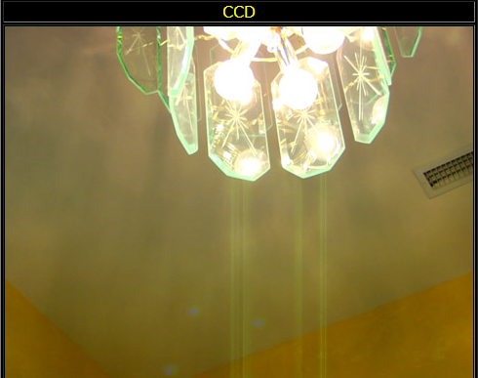
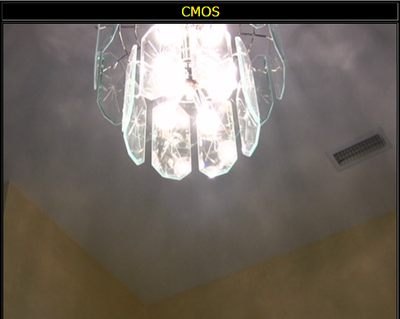
Comparison of CCD and CMOS - Vertical Smear
Vertical smear can be seen via the greenish lines at the bottom of the CCD frame.
(Green, n.d. [2])
Notes:
Bill

Slide 6
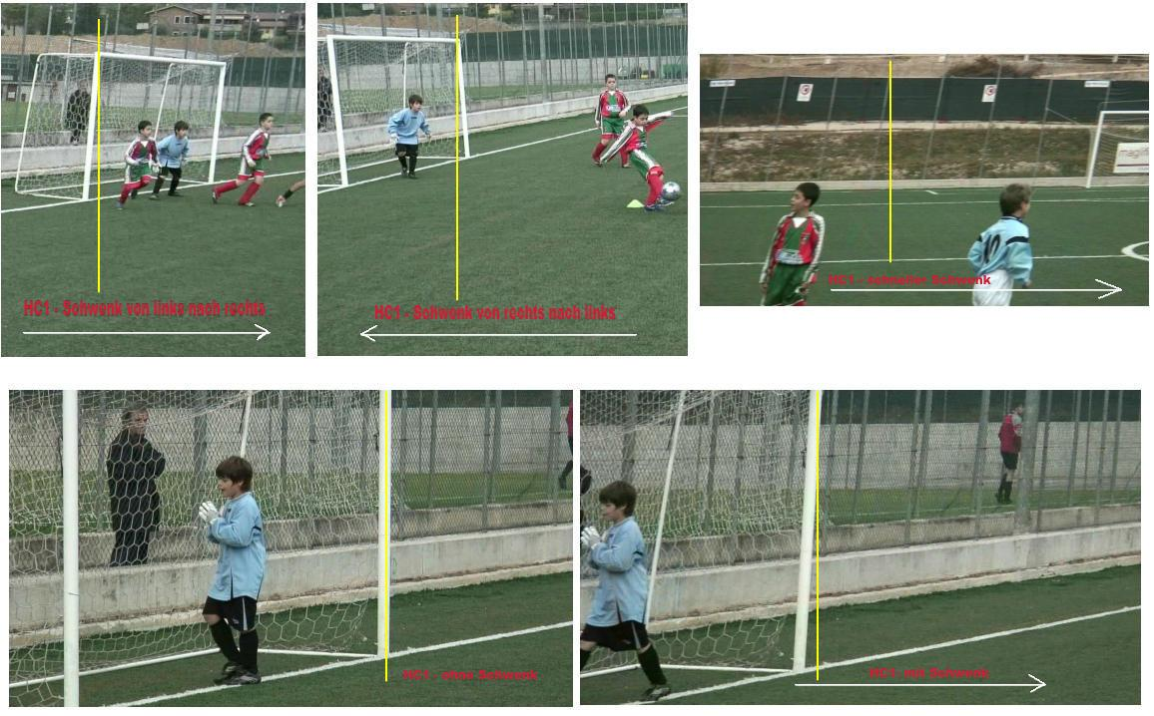
Comparison of CCD and CMOS - Skew
Skew can be seen on the goal posts of the soccer nets above. As the camera is moved during a picture, the goal posts appear to be leaning in a particular direction.
(Green, n.d. [2])
Notes:
Bill

Slide 7
Comparison of CCD and CMOS - Wobble
Wobble can be seen in the video above. The CMOS image sensor is moved back and forth quickly and results in a distortion of the captured image.
(Youtube, 2008 [3])
Notes:
Bill

Slide 8
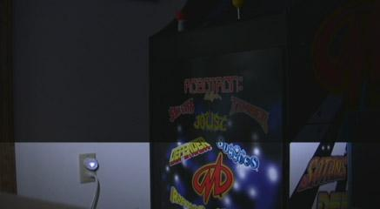
Comparison of CCD and CMOS - Partial Exposure
Partial exposure can be seen in the images above. The rolling shutter captures different areas of a picture under different lighting conditions when a flash is used.
(Green, n.d. [2])
Notes:
Bill

Slide 9
Image Sensor Attributes
Aspect ratio: ratio of width and height of an image taken by the sensor
Pixel count: number of light intensity recording pixels on a sensor
Higher value indicates a higher quality image
Depends on pixel density of viewing screen however
Frame rate: rate at which the sensor is able to capture and store a new image
Notes:
Bill

Slide 10
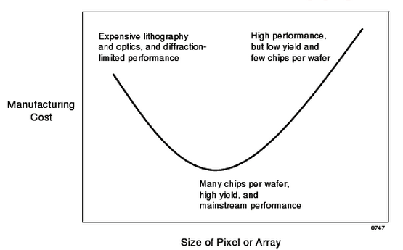
Image Sensor Attributes
(Hausken, 2004 [1])
Notes:
Bill

Slide 11
Image Sensor Attributes
Power consumption: rate at which the image sensor consumes power
Typically measured in mW
Can vary based on frame rate used
Chroma: color spectrum of the image sensor
Mono: grayscale or some other single tone
RGB: mixes red, green, and blue lights to create other colors
Notes:
Josh

Slide 12
Image Sensor Attributes
Dynamic range: ratio between largest and smallest capturable quantity of light
A larger dynamic range means the camera can be used in a variety of lighting situations
Signal-to-Noise ratio: compares level of desired signal to level of background noise
Ratio of signal power to noise power
Higher ratio means more signal than noise
Responsivity: measure of luminous exposure, the amount of light applied to the lens during a given exposure time
Notes:
Josh

Slide 13
Application: Consumer Cameras
Desired attributes for consumer cameras
High resolution for quality photos
Or low resolution for power saving
Varying resolutions for video capture
Low power consumption for use in mobile applications
Potential cameras
Camera | Pixels | Frames / Sec | Power | Size
Aptina MT9P006 | 5 MP | 15 - 60 fps | < 366 mW | 10mm x 10mm
Foveon X3 4.5 | 4.5 MP | 7 - 30 fps | < 200 mW | 14mm x 14mm
Foveon X3 10.2 | 10.2 MP | 4.4 - 30 fps | < 50 mW | 36mm x 28mm
Centeye Stonyman | 0.012 MP | ASYNC | 1.8 mW - 4mW | 2.8mm x 2.8mm
Notes:
Josh

Slide 14
Application: Medical Imaging
Desirable Attributes for Medical Imaging
High Resolution for detailed images
Size for specific procedures
High speed
High Sensitivity
Potential cameras
Camera | Pixels | Frames / Sec | Size
Teledyne FTF9168M | 60 MP | 1.4 fps | 53.7mm x 40.2mm
Teledyne FTF6080M | 48 MP | 1.6 fps | 36mm x 48mm
Teledyne FT50M | 1 MP | 100 fps | 5.73mm x 5.73mm
Given Imaging PillCam | 65 kP | 2 - 18 fps | 11mm x 26mm(Pill)
Notes:
Josh

Slide 15
Application: Surveillance
Desired attributes for surveillance cameras
Low power requirements
Excellent low-light sensitivity
High resolution to capture minute details
Potential cameras
Camera | Pixels | Frames / Sec | Power | Size
Aptina MT9P031 | 5 MP | 15 fps | < 381 mW | 12mm x 12mm
Aptina MT9D131 | ~2 MP | 15 - 30 fps | < 223 - 348 mW | 12mm x 12mm
Notes:
Josh

Slide 16
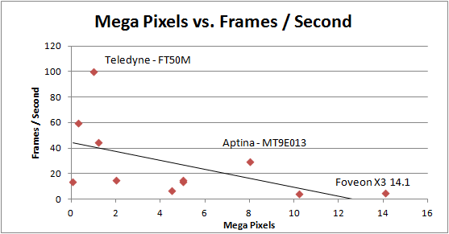
Choosing a Sensor
Notes:
Bill

Slide 17
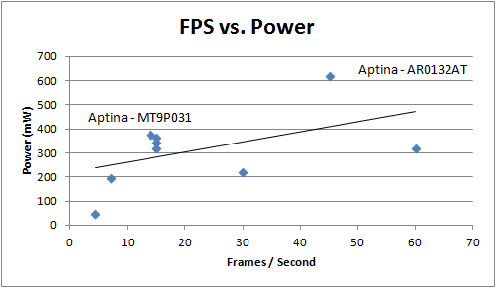
Choosing a Sensor
Notes:
George

Slide 18
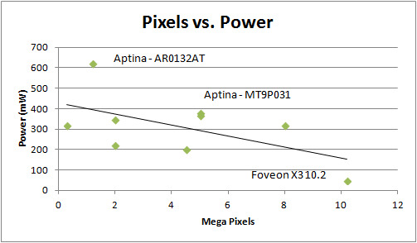
Choosing a Sensor
Notes:
George

Slide 19
Summary
Image sensors can be used for a wide variety of applications
Large variety of image sensors on the market
20+ major companies, each make a variety of sensors
Many different attributes to consider for any given application
Technology is constantly evolving
CMOS becoming comparable with CCD sensors
A user must weigh the important attributes for the application when deciding the best camera to use
Notes:
George

Slide 20
Bibliography
1. Hausken, Tom. (2004). The Image Sensor Market [Powerpoint Slides]. Retrieved from https://docs.google.com/viewer?a=v&q=cache:
ecPaPDY2Eb8J:asia.stanford.edu/events/Spring04/slides/hauskenSlides.pdf+&hl=en&gl=us&pid=bl&srcid=ADGEESjViOQy_0YJACKEg822NWVnNbNFI05Y5K4Djgv-
2. Green, B. (n.d.). CMOS Rolling Shutter.DVXuser.com :: The online Community for digital filmmaking. Retrieved November 26, 2012, from http://dvxuser.com/jason/CMOS-CCD/
3. Nikon D90 wobble test - YouTube. (2008, September 30).YouTube. Retrieved November 26, 2012, from http://www.youtube.com/watch?v=KcycneFY9lw
Notes:
George

Slide 21
Thank You
Any Questions?
Notes:
George

