Slide 1
EECS 373
Design of Microprocessor-Based Systems
Nathan Heidt
Jonathan Bendes
Paul Doerr
University of Michigan
Quadcopter systems
November 27, 2012
*

Slide 2
Outline
Why do we care?
What is a quadcopter
How does it work
Quadcopter systems
Choosing a quadcopter's parts
Looking Forward
*

Slide 3
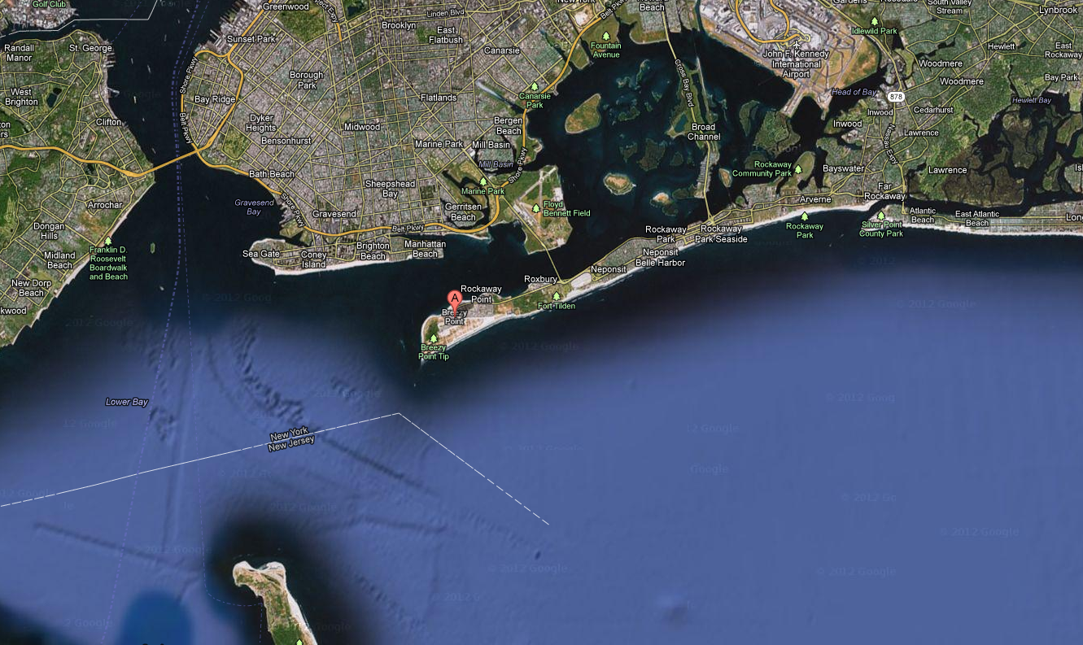
Why do we care?
*

Slide 4
Why do we care?
*

Slide 5
Why do we care?
*

Slide 6
What is a quadcopter
"A quadrotor, also called a quadrotor helicopter or quadcopter, is a multicopter that is lifted and propelled by four rotors."
- Wikipedia
Similar to a standard single rotor helicopter
Very stable design
Simpler control from standard helicopter
Good for radio and autonomous control

Slide 7
What is a quadcopter

Slide 8
What is a quadcopter

Slide 9
Quadcopter Sub-Systems
Motors
Sensors
Propellors
Airframe
Controllers

Slide 10
Quadcopter Construction
Arm - Part that holds the motors
Center plate - main support: holds arms, batteries, and controllers
Landing Skid - attached to the arms, cushions landings

Slide 11
How does it work - basic physics
Adjacent Rotors spin opposite directions to maintain constant heading
4 points of lift allow for control of roll, pitch, yaw, and height
Enables quadrotors to maneuver in 3 dimensions
Simple physics allows for simple flight controller
Increased stability allows for higher level
robotics (Autonomy)

Slide 12
How does it work - control systems
Closed-loop controllers - use feedback data from IMU to control each rotor
PID controller - uses the error between current position data and desired position to drive outputs
P - proportional
I - integral
D - derivative
Nonlinear controllers - more complex, could lead to more precise control
radhesh.wordpress.com

Slide 13
How does it work - PID Gone Wrong

Slide 14
How does it work - Sensors
IMU - combination gyro/accelerometer
Collects data for 6 degrees of freedom
9 DOF IMUs add 3 degree magnetometer
Camera
Useful for radio control, analyzing
environment
LIDAR
Uses laser to find distance to closest obstacles
Expensive, invaluable for autonomous control
Use SLAM to map surroundings

Slide 15
How does it work – SLAM

Slide 16
How does it work - Level Flight Waypoint Following

Slide 17
Choosing quadcopter parts - body of quadcopter
Choose between two configurations x and +
take into account payloads
i.e. batteries, sensors, control systems, etc
Choose a proper size for the application
larger size means bigger motors are necessary
smaller means more maneuverable but unable to carry as much
Materials
wood is cheap but not as durable as other materials
carbon fibre is strong and incredibly light but expensive
Aluminum is durable and cheap but can be heavier than other materials
*
Notes:
1. push {r7, lr} => pushes the {register list} onto the stack
2. mov.w r3, #40 ; 0x28 =>
*

Slide 18
Choosing quadcopter parts - body of quadcopter cont.
Choosing the right balance of parts is important to manage three essential elements
cost, weight, and durability
Each element has a tradeoff
The higher the price, often the lighter and more durable
A large quadcopter is going to be heavier and will require larger motors
This in turn requires larger or better batteries
Heavier quadrotors tend to run for shorter amounts of time on standard systems
The primary things to consider are the size and weight of the payload as well as the budget allocated to the project
*
Notes:
1. push {r7, lr} => pushes the {register list} onto the stack
2. mov.w r3, #40 ; 0x28 =>
*

Slide 19
Choosing quadcopter parts - motors and ESC
Typically brushless motors
ESC depends on motor ratings i.e. kV and max current
Motors must have sufficient thrust to lift the quadrotor
kV = RPM/V at no load
Total max thrust should be double the weight
ESC current supply rating must be higher than that of the motor
typically given by: ESC = 1.2-1.5 x max amp rating of motor
*
Notes:
1. push {r7, lr} => pushes the {register list} onto the stack
2. mov.w r3, #40 ; 0x28 =>
*

Slide 20
Choosing quadcopter parts - Sensors
IMU's are a large consideration for stability
Important factors include refresh rate and degrees of freedom (DOF)
6DOF vs 9DOF
6DOF contains an accelerometer and a gyrometer
9DOF has the addition of a magnetometer
Large range of quality (i.e. mems to fiber-optic gyro)
The added magnetometer is beneficial for navigation
Noise becomes an issue
*
Notes:
1. push {r7, lr} => pushes the {register list} onto the stack
2. mov.w r3, #40 ; 0x28 =>
*

Slide 21
Choosing quadcopter parts - Additional Sensors
Ultrasonic sensors (obstacles and height feedback)
Downwards facing cameras for hovering stability
GPS for navigation
Radio for control
*
Notes:
1. push {r7, lr} => pushes the {register list} onto the stack
2. mov.w r3, #40 ; 0x28 =>
*

Slide 22
Choosing a quadcopter
There are several pre made quadcopters and kits available
many are well designed and priced
Considerations to make between buying a pre made and building a custom quadcopter include:
customizeability
budget
intended use
When buying a pre made quadcopter or a kit look at the specifications
*
Notes:
1. push {r7, lr} => pushes the {register list} onto the stack
2. mov.w r3, #40 ; 0x28 =>
*

Slide 23
Looking forward
Quadcopters are a very popular robotics platform
There are hundreds of designs to choose from and more to create
There is a range of prices they can be purchased for
low end models can be less than 200$
Many practical applications
Straightforward design and control
*
Notes:
1. push {r7, lr} => pushes the {register list} onto the stack
2. mov.w r3, #40 ; 0x28 =>
*

Slide 24
Questions?
Comments?
Discussion?
*

Slide 25
Sources
http://www.towerhobbies.com/products/heli-max/hmxe0835/hmxe0835_550.jpg
http://thequadcopterguy.blogspot.com/p/choosing-your-parts.html
http://en.wikipedia.org/wiki/Quadrotor
http://radhesh.wordpress.com
http://upload.wikimedia.org/wikipedia/commons/thumb/f/fa/6DOF_en.jpg/330px-6DOF_en.jpg
http://static.geekbeat.tv/wp-content/uploads/2012/02/ardrone2.0.png
http://www.rcmodelpart.com/images/v/201209/13470012980.jpg
http://www.hobbytronics.co.uk/image/data/sparkfun/imu_fusion_imu3000.jpg
http://www.kvh.com/~/media/Images/KVH/Product/Gyros%20IMUs/TG6000%20IMU/prod_tg6000.ashx?bc=white
http://www.parallax.com/Portals/0/Images/Prod/2/280/28015-M.jpg
http://zedomax.com/image/200611/parallax_gps.gif

