Slide 1
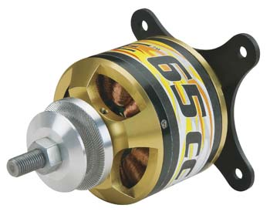
EECS 373
Design of Microprocessor-Based Systems
Student Presentations
Tianhua Zheng and Jason Shintani
Motor control
November 27th, 2012

Slide 2
Announcements
Today is a good day!
Motors are awesome!

Slide 3
Outline
Minute quiz
Announcements
Special purpose motors (servos, steppers, actuators)
H-bridge
CEMF

Slide 4
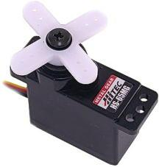
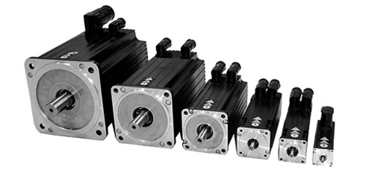
Servo Motors
A motor that has an on-board electric circuit for controlling the direction of rotation, as well as the position, of the output shaft.
Typical rotation range: 90 degrees or 180 degrees
Typical price range: $10 to 10’s of $1,000.
Notes:
http://embedded-lab.com/blog/?p=4653
http://www.lirtex.com/robotics/servo-motors-information-and-control/

Slide 5
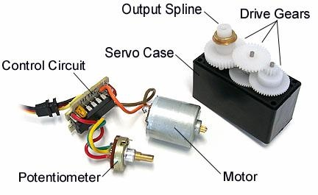
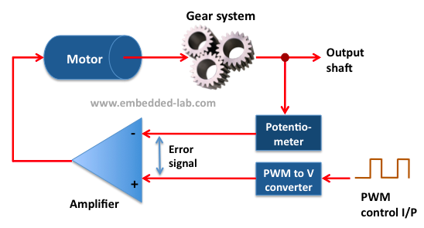
Servo Motor Control
Closed loop control
Measure the exact position of the motor head
Fix the gaps from the desired position by controlling the motor
Control signal: PWM
Operate between 4.8V and 6V
Generally @ 50Hz

Slide 6
Example PWM for servo
The position of the motor is not determined by duty cycle but the high time. Typically 1.5ms high corresponds to the neutral position.

Slide 7
Usage of Servo Motors
Used in a wide variety of application
Robotic arms
Toy-cars, air-planes and helicopters
Industrial machinery
Easy to control
Only need PWM signal
Low energy consumption
Works in closed loop
Small Size
As small as several inches squared

Slide 8
Torque vs. cost

Slide 9
Stepper Motor
A brushless DC electric motor that divides a full rotation into a number of equal steps
Offers precise rotation control and relatively high rotational speed
Generally can turn in 0.9 to 1.8 degree in each direction
Unipolar and Bipolar, or Hybrid
Difference in the way the electromagnets are connected
Different control methods

Slide 10
Stepper Motor Control
“Single-Step” controlling method
“Double-Step” controlling method
“Half-Step” stepping method

Slide 11
Stepper Motor Control
Need controller to generate waveform to drive the stepper motor
Discrete Transitions

Slide 12
Usage of Stepper Motor
Used in a wide variety of application in industry
Computer Peripherals
Business Machines
And also in everyday life
BBQ grill
Stage intelligent light systems
Power windows and power seats
High positioning accuracy, large torque, reliability.

Slide 13
Torque vs. cost

Slide 14
Outline
Minute quiz
Announcements
Special purpose motors (servos, steppers, actuators)
H-bridge
CEMF

Slide 15
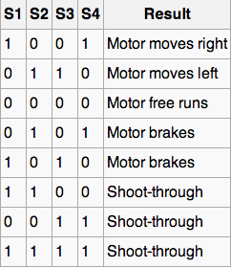
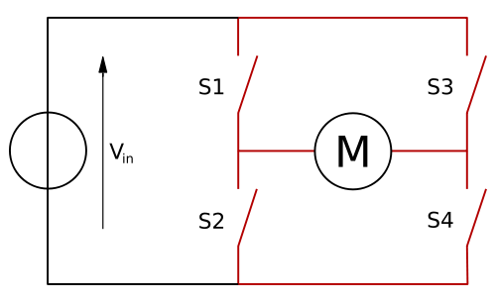
H-bridge
A set of four switches, mechanical or solid-state, with series pairs in parallel.
Used to provide direction control for DC motors.
Often found in IC packages.
DC brushed motors

Slide 16
H-bridge speed control
Control signal: PWM
Unlike servos, H-bridges use PWM to regulate power supplied to the motor.
This can be correlated to speed if the mechanical load is know or thru closed-loop feedback from a quadrature encoder.
50,000Hz – 60,000Hz
PWM generation
The PWM signal is generated by switching one of the two switches that have current flowing.
For example, if the motor from the previous slide was running right, 1001, PWM’ing S1 would limit the current to the motor.

Slide 17
1001 - Forward

Slide 18
0110 - Reverse

Slide 19
1100, 0011, 1111 – Shoot thru

Slide 20
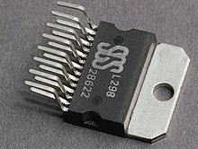
H-bridge components and application
A motor controller that supports power (speed) control is made of four MOSFET’s or BJT’s.
Typically, N-Channel MOSFET’s are chosen because of their low source to drain resistance.
Solid-state switches are chosen because they allow for higher switching frequencies and wear less on each individual throw (no sparks).
Mechanical switches are much cheaper but do not allow for effective power (speed) control.

Slide 21
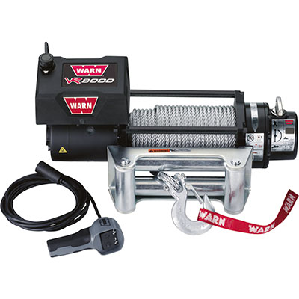
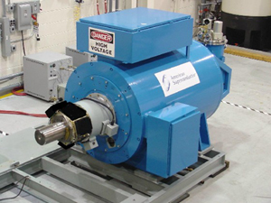
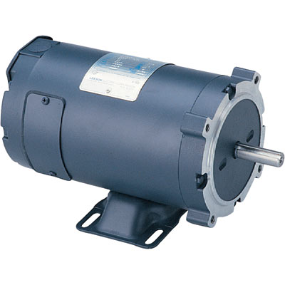
H-bridge application

Slide 22
Non H-bridge applications
Servos
Stepper motors
Non-reversible configurations
AC motors
DC brushless motors

Slide 23
Outline
Minute quiz
Announcements
Special purpose motors (servos, steppers, actuators)
H-bridge
CEMF

Slide 24
Counter-electromotive force (CEMF)
When dealing with high-current DC motors CEMF must be considered.
CEMF is a product of Faraday’s Law of Induction and Lenz’s Law.
The CEMF is created by the spinning armatures.
The CEMF is how motors are also generators.
Why is this important?
Because large motors will generate large CEMF induced currents.
If the H-bridge goes into a breaking state care must be taken to properly divert and dissipate the current.
CEMF can also be used to sense speed and load.

Slide 25
0101 - Break

Slide 26
0110 1100 - Possible break circuit

Slide 27
Thank You!

Slide 28
Servo Motor VS. Stepper Motor

Slide 29
DC brushless motor
Notes:
Note the CEMF

Slide 30
