Slide 1
EECS 373
Design of Microprocessor-Based Systems
Prabal Dutta
University of Michigan
Lecture 6: AHB-Lite, Interrupts (1) September 18, 2014
Slides developed in part by Mark Brehob

Slide 2
Today
Announcements
ARM AHB-Lite
Start on interrupts

Slide 3
Announcements
HW2 assigned; Due on 9/23
Questions
Synchronizers
Why separate read/write busses on APB?

Slide 4
Today
Announcements
ARM AHB-Lite
Start on interrupts

Slide 5
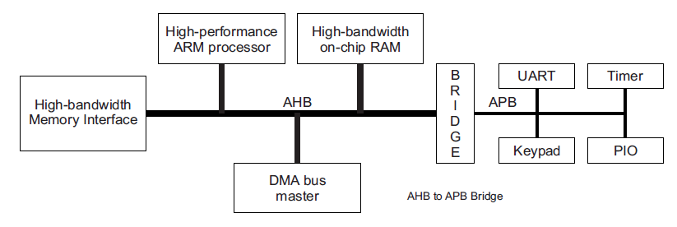
Advanced Microcontroller Bus Architecture (AMBA) - Advanced High-performance Bus (AHB) - Advanced Peripheral Bus (APB)
AHB
APB
High performance
Pipelined operation
Burst transfers
Multiple bus masters
Split transactions
Low power
Latched address/control
Simple interface
Suitable of many peripherals

Slide 6
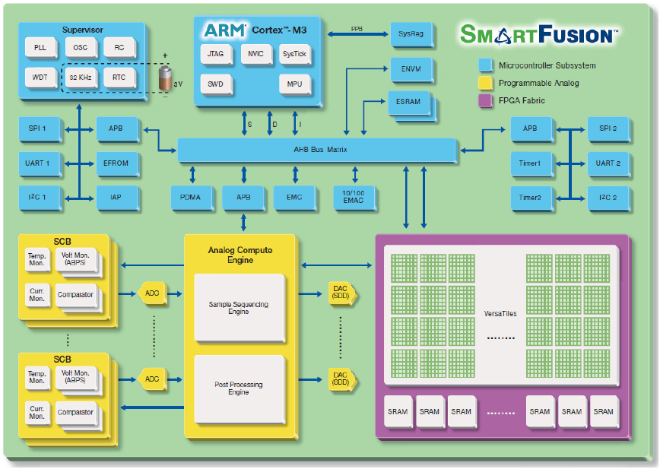
Actel SmartFusion system/bus architecture

Slide 7
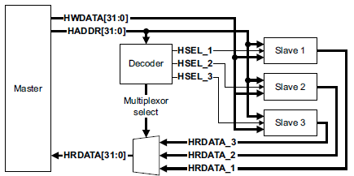
AHB-Lite supports single bus master and provides high-bandwidth operation
Burst transfers
Single clock-edge operation
Non-tri-state implementation
Configurable bus width

Slide 8
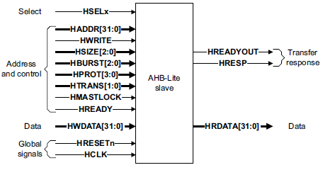
AHB-Lite bus master/slave interface
Global signals
HCLK
HRESETn
Master out/slave in
HADDR (address)
HWDATA (write data)
Control
HWRITE
HSIZE
HBURST
HPROT
HTRANS
HMASTLOCK
Slave out/master in
HRDATA (read data)
HREADY
HRESP

Slide 9
AHB-Lite signal definitions
Global signals
HCLK: the bus clock source (rising-edge triggered)
HRESETn: the bus (and system) reset signal (active low)
Master out/slave in
HADDR[31:0]: the 32-bit system address bus
HWDATA[31:0]: the system write data bus
Control
HWRITE: indicates transfer direction (Write=1, Read=0)
HSIZE[2:0]: indicates size of transfer (byte, halfword, or word)
HBURST[2:0]: indicates single or burst transfer (1, 4, 8, 16 beats)
HPROT[3:0]: provides protection information (e.g. I or D; user or handler)
HTRANS: indicates current transfer type (e.g. idle, busy, nonseq, seq)
HMASTLOCK: indicates a locked (atomic) transfer sequence
Slave out/master in
HRDATA[31:0]: the slave read data bus
HREADY: indicates previous transfer is complete
HRESP: the transfer response (OKAY=0, ERROR=1)

Slide 10
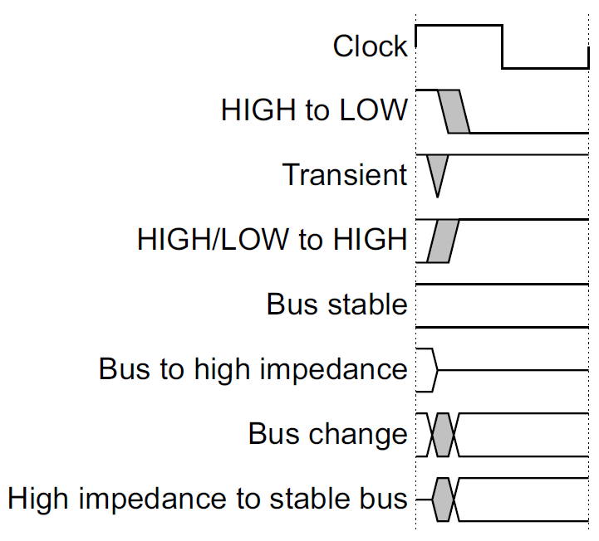
Key to timing diagram conventions
Timing diagrams
Clock
Stable values
Transitions
High-impedance
Signal conventions
Lower case ‘n’ denote active low (e.g. RESETn)
Prefix ‘H’ denotes AHB
Prefix ‘P’ denotes APB

Slide 11
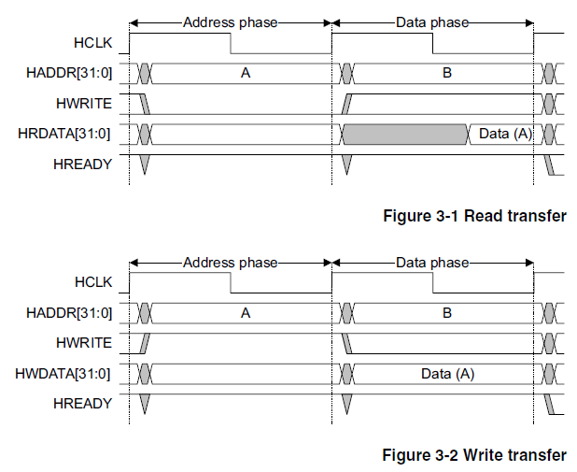
Basic read and write transfers with no wait states
Pipelined
Address
& Data
Transfer

Slide 12
Read transfer with two wait states
Two wait states
added by slave
by asserting
HREADY low
Valid data
produced

Slide 13
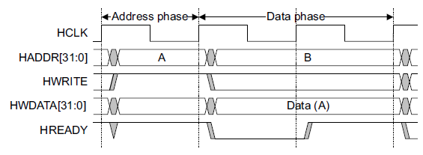
Write transfer with one wait state
One wait state
added by slave
by asserting
HREADY low
Valid data
held stable

Slide 14
Wait states extend the address phase of next transfer
Address stage of
the next transfer
is also extended
One wait state
added by slave
by asserting
HREADY low

Slide 15
Transfers can be of four types (HTRANS[1:0])
IDLE (b00)
No data transfer is required
Slave must OKAY w/o waiting
Slave must ignore IDLE
BUSY (b01)
Insert idle cycles in a burst
Burst will continue afterward
Address/control reflects next transfer in burst
Slave must OKAY w/o waiting
Slave must ignore BUSY
NONSEQ (b10)
Indicates single transfer or first transfer of a burst
Address/control unrelated to prior transfers
SEQ (b11)
Remaining transfers in a burst
Addr = prior addr + transfer size

Slide 16
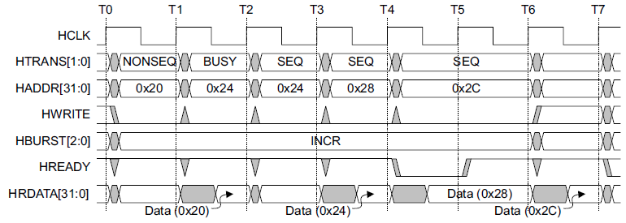
A four beat burst with master busy and slave wait
Master busy
indicated by
HTRANS[1:0]
One wait state
added by slave
by asserting
HREADY low

Slide 17
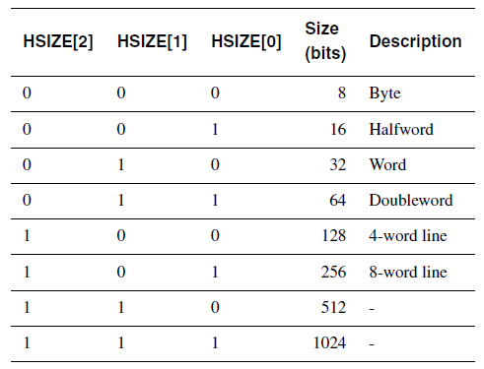
Controlling the size (width) of a transfer
HSIZE[2:0] encodes the size
The cannot exceed the data bus width (e.g. 32-bits)
HSIZE + HBURST is determines wrapping boundary for wrapping bursts
HSIZE must remain constant throughout a burst transfer

Slide 18
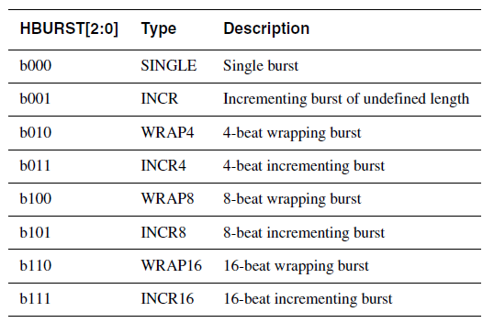
Controlling the burst beats (length) of a transfer
Burst of 1, 4, 8, 16, and undef
HBURST[2:0] encodes the type
Incremental burst
Wrapping bursts
4 beats x 4-byte words wrapping
Wraps at 16 byte boundary
E.g. 0x34, 0x38, 0x3c, 0x30,…
Bursts must not cross 1KB address boundaries

Slide 19
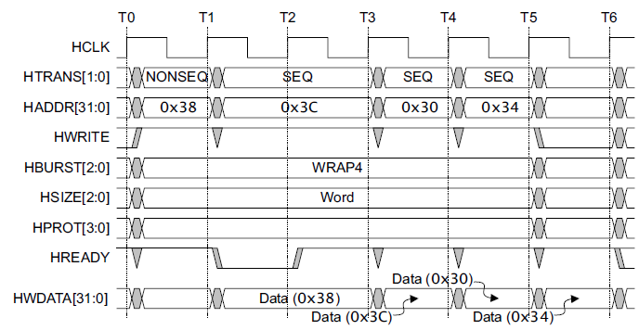
A four beat wrapping burst (WRAP4)

Slide 20
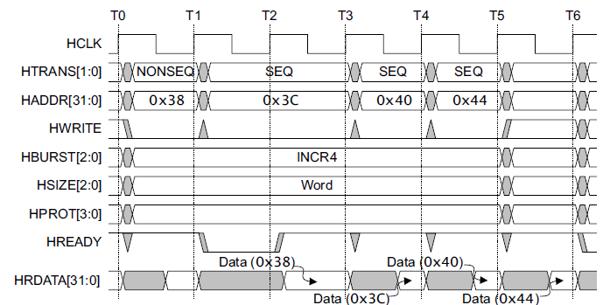
A four beat incrementing burst (INCR4)

Slide 21
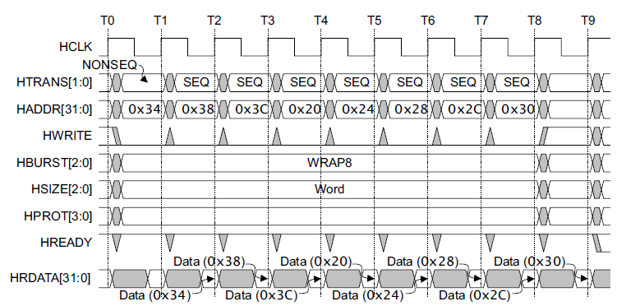
An eight beat wrapping burst (WRAP8)

Slide 22
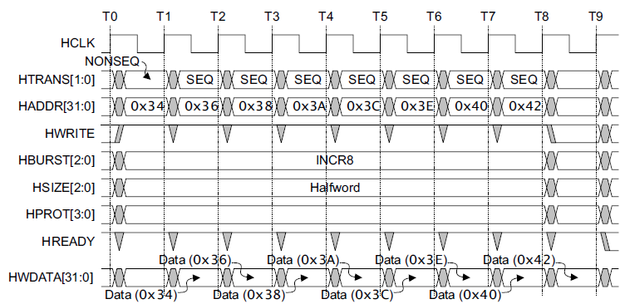
An eight beat incrementing burst (INCR8) using half-word transfers

Slide 23
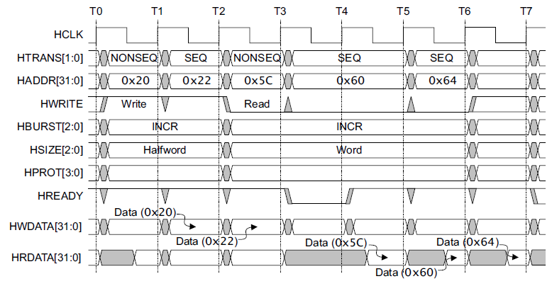
An undefined length incrementing burst (INCR)

Slide 24
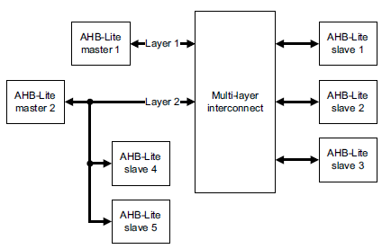
Multi-master AHB-Lite requires a multi-layer interconnect
AHB-Lite is single-master
Multi-master operation
Must isolate masters
Each master assigned to layer
Interconnect arbitrates slave accesses
Full crossbar switch often unneeded
Slaves 1, 2, 3 are shared
Slaves 4, 5 are local to Master 1

Slide 25
Today
Announcements
ARM AHB-Lite
Start on interrupts

Slide 26
Interrupts
Merriam-Webster:
“to break the uniformity or continuity of”
Informs a program of some external events
Breaks execution flow
Key questions:
Where do interrupts come from?
How do we save state for later continuation?
How can we ignore interrupts?
How can we prioritize interrupts?
How can we share interrupts?

Slide 27
I/O Data Transfer
Two key questions to determine how data is transferred to/from a non-trivial I/O device:
How does the CPU know when data is available?
Polling
Interrupts
How is data transferred into and out of the device?
Programmed I/O
Direct Memory Access (DMA)

Slide 28
Interrupts
Interrupt (a.k.a. exception or trap):
An event that causes the CPU to stop executing the current program and begin executing a special piece of code called an interrupt handler or interrupt service routine (ISR). Typically, the ISR does some work and then resumes the interrupted program.
Interrupts are really glorified procedure calls, except that they:
can occur between any two instructions
are transparent to the running program (usually)
are not explicitly requested by the program (typically)
call a procedure at an address determined by the type of interrupt, not the program

Slide 29
Two basic types of interrupts (1/2)
Those caused by an instruction
Examples:
TLB miss
Illegal/unimplemented instruction
div by 0
Names:
Trap, exception

Slide 30
Two basic types of interrupts (2/2)
Those caused by the external world
External device
Reset button
Timer expires
Power failure
System error
Names:
interrupt, external interrupt

Slide 31
How it works
Something tells the processor core there is an interrupt
Core transfers control to code that needs to be executed
Said code “returns” to old program
Much harder then it looks.
Why?

Slide 32
… is in the details
How do you figure out where to branch to?
How to you ensure that you can get back to where you started?
Don’t we have a pipeline? What about partially executed instructions?
What if we get an interrupt while we are processing our interrupt?
What if we are in a “critical section?”

Slide 33
Where
If you know what caused the interrupt then you want to jump to the code that handles that interrupt.
If you number the possible interrupt cases, and an interrupt comes in, you can just branch to a location, using that number as an offset (this is a branch table)
If you don’t have the number, you need to poll all possible sources of the interrupt to see who caused it.
Then you branch to the right code

Slide 34
Get back to where you once belonged
Need to store the return address somewhere.
Stack might be a scary place.
That would involve a load/store and might cause an interrupt (page fault)!
So a dedicated register seems like a good choice
But that might cause problems later…

Slide 35
Snazzy architectures
A modern processor has many (often 50+) instructions in-flight at once.
What do we do with them?
Drain the pipeline?
What if one of them causes an exception?
Punt all that work
Slows us down
What if the instruction that caused the exception was executed before some other instruction?
What if that other instruction caused an interrupt?

Slide 36
Nested interrupts
If we get one interrupt while handling another what to do?
Just handle it
But what about that dedicated register?
What if I’m doing something that can’t be stopped?
Ignore it
But what if it is important?
Prioritize
Take those interrupts you care about. Ignore the rest
Still have dedicated register problems.

Slide 37
Critical section
We probably need to ignore some interrupts but take others.
Probably should be sure our code can’t cause an exception.
Use same prioritization as before.
What about instructions that shouldn’t be interrupted?

Slide 38
Our processor
Over 100 interrupt sources
Power on reset, bus errors, I/O pins changing state, data in on a serial bus etc.
Need a great deal of control
Ability to enable and disable interrupt sources
Ability to control where to branch to for each interrupt
Ability to set interrupt priorities
Who wins in case of a tie
Can interrupt A interrupt the ISR for interrupt B?
If so, A can “preempt” B.
All that control will involve memory mapped I/O.
And given the number of interrupts that’s going to be a pain in the rear.

Slide 39
Enabling and disabling interrupt sources

Slide 40
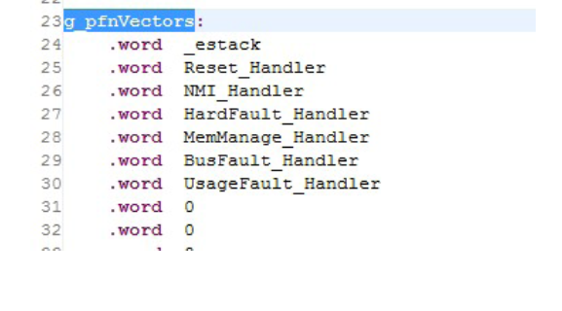
How to know where to go on an interrupt.

