Slide 1
EECS 598: Literature Review
Ali Besharatian
March 16, 2008

Slide 2
First Paper
A HARPSS Polysilicon Vibrating Ring Gyroscope
Farrokh Ayazi and Khalil Najafi
University of Michigan
2001

Slide 3
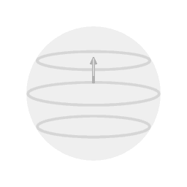
What is a Gyroscope?
A gyroscope is a device for measuring or maintaining orientation,
It senses angular velocity,
Based on principles of conservation of angular momentum.
A macroscale gyro is essentially a spinning wheel or disk whose axle is free to take any orientation.
A gyroscope in operation with freedom in all three axes. The rotor will maintain its spin axis direction regardless of the orientation of the outer frame.
Foucault Pendulum, a device demonstrating the effect of the Earth's rotation, by rotating 360º in its plane, every 24 hours: This is because plane of the pendulum's swing, like a gyroscope, tends to keep a fixed direction in space, while the Earth rotates under it.

Slide 4
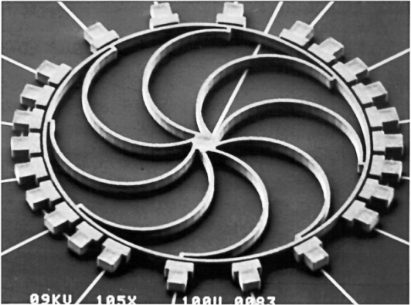
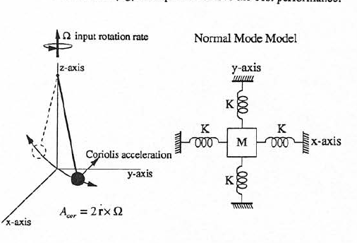
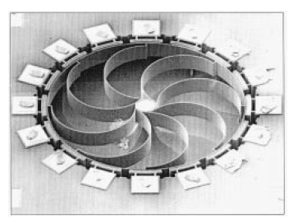
MEMS Ring Gyros
No Moving parts! (It doesn’t rotate!)
Based on the same principle: conversion of angular momentum.
Applications:
Traction control,
Ride stabilization,
Roll-over detection,
Digital camera stabilization
Automotive applications (bias stability of 0.5 deg/s)
Guidance of missiles (improved performance)
Coriolis Force (the same as Foucault Pendulum) is generated in case of rotation.
The 1st MEMS Ring Gyro (Electroplated Nickel on Silicon)
Fully Silicon Ring Gyro

Slide 5
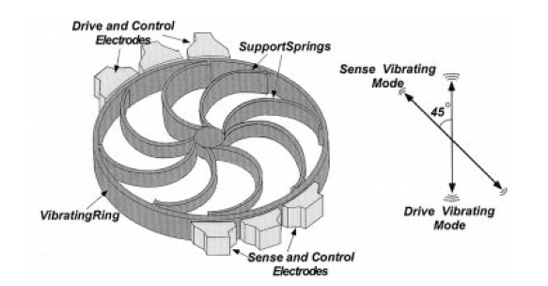
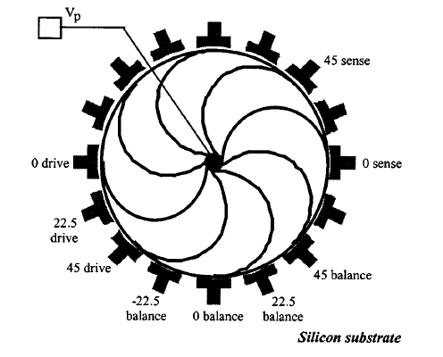
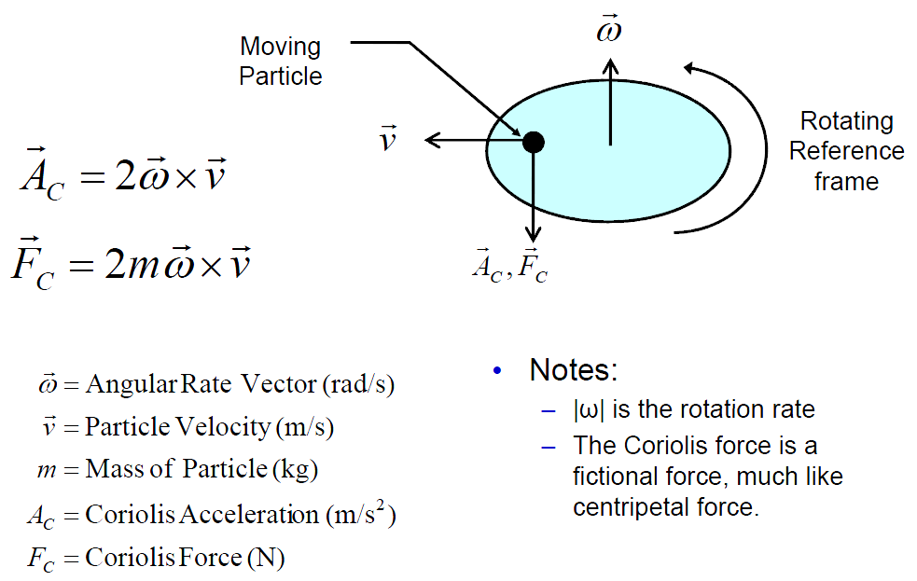
MEMS Ring Gyros: Principle of Operation
Forced resonance by drive electrodes
In case of angular momentum,
Coriolis force transfers energy from primary mode to secondary flexural mode
This causes secondary resonance in another axis (usually 45º apart)
Can be sensed by change in capacitance
Advantages are:
Symmetry
Vertical Capacitors => Very large
Sensitivity is amplified by Q
Low temperature sensitivity (both modes experience the same expansion)
Ease of control and compensation: electronic tuning
The drawback is small effective mass
Eight Springs:
Symmetric with 2 identical elliptical resonance modes
Anchor
Anchor
Drive mode
Sense mode

Slide 6
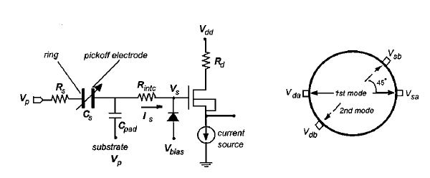
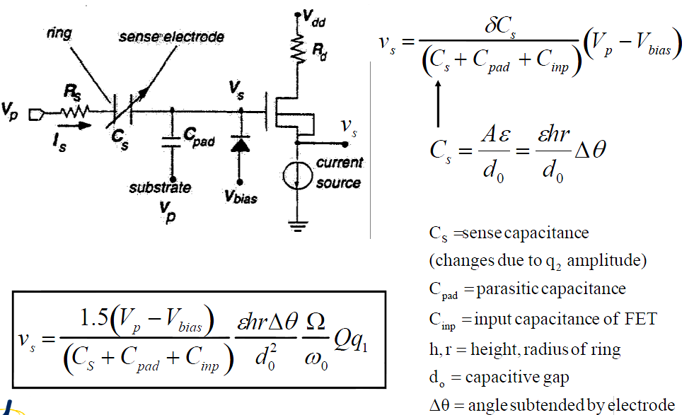
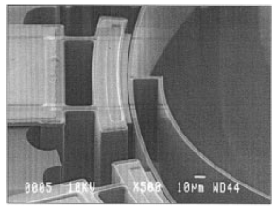
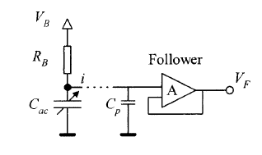
Capacitive read-out
Should be maximized
Concept: Change in capacitance based on change in gap, overlap or both.
Here: Change in gap for vertical electrodes.
Parasitic capacitance is the drawback.
To reduce the electronic noise floor:
Reduce the gap
Increase the height and radius
Increase Q
Reduce ω_{o,} but keep it
beyond env. interferences
and below Brownian noise floor
Minimize the input referred noise of the interface circuit
Increase the drive amplitude (q_{d})
But only below nonlinear effects
Increase the polarization voltage
Should be minimized

Slide 7
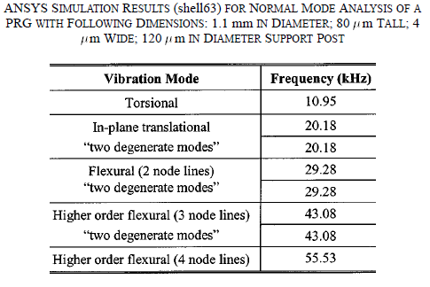
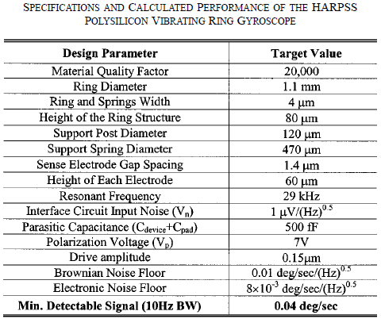
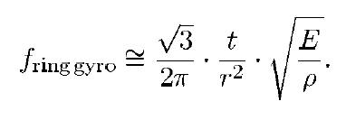
Estimated/Simulated Parameters
Resonant Frequency
Material Quality Factor:
M = Effective Mass
D = Damping Coefficient
k = Spring Constant

Slide 8
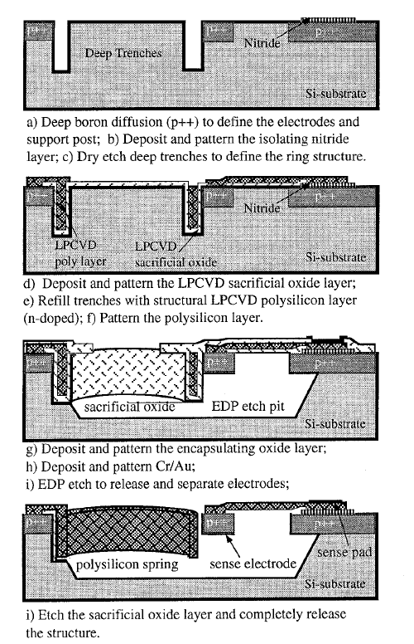
Fabrication Process (HARPSS)
High Aspect Ratio combined Poly and Single Crystal Silicon
A combination of BULK and SURFACE micromachining
Steps:
Deep Boron Doping (P⁺⁺)
Deep Etching (20:1 – 80um)
Trench Refill
Oxide Deposition
Poly-Silicon Deposition
Metallization
EDP Etch
Sacrificial Oxide Etch (Release)

Slide 9
Advantages
Single wafer
Simpler than Nickel gyro (i.e. electroplated)
No bonding
Stress Cancelation by touching Poly-Silicon films
Fully Silicon
Low TCE mismatch,
No bonding
Poly-Si springs:
High Q (Cos4θ mismatch is caused by crystal asymmetry of SC Si.)
Orientation independent
Better material properties than Ni (higher Q)
Tall structures (100s of um):
Large capacitances for measurement
By changing the oxide thickness, the gap can be controlled easily from sub- to 10s of um.
Large capacitances for measurement

Slide 10
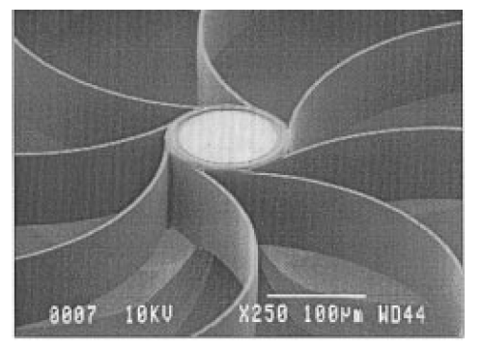
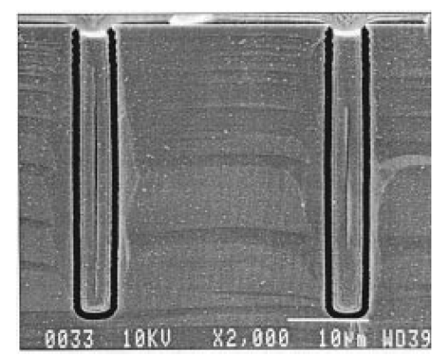
Challenges
Void in poly-silicon trench refill process can be a source of energy loss (lower Q)
Excessive undercut of the Si substrate may cause the be soft and dissipates more energy.
voids

Slide 11
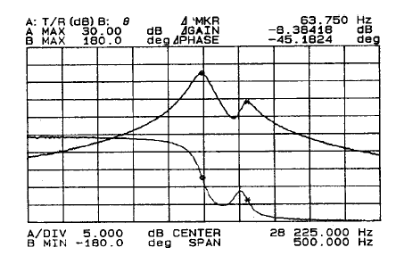
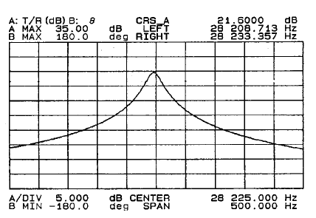
Compensation (Tuning)
By applying a CMOS level DC voltage the degenerate frequency can be canceled:
0.9V at 22.5º axis
0 at 45º axis
(this would be 15.5V for the Ni gyro)

Slide 12
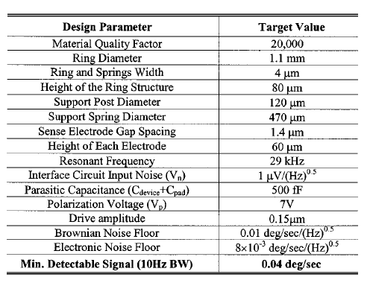
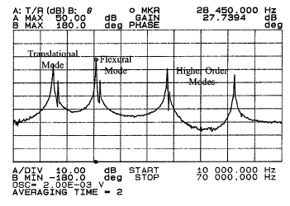
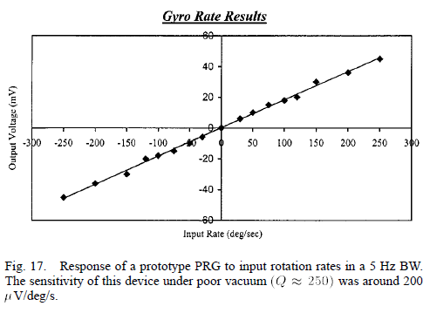
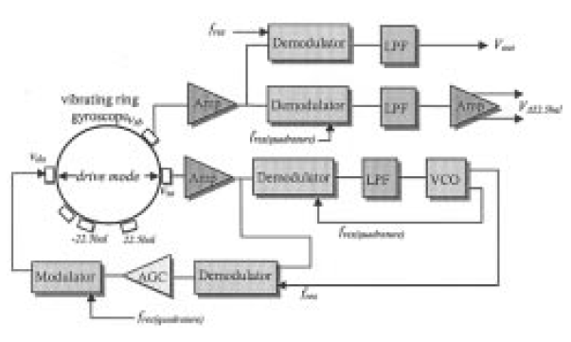
Test Results
Vacuum (1mTorr)
Q = 6000 (lower due to voids)
Modification in etch/refill process increases Q to 10000-20000 range. (up to 85000)
Open Loop (low vac – off chip circuit):
Q = 250 (poor vacuum – 10 times reduce)
Measured Capacitance: 500fF
Parasitic Capacitance: 2pF (output affected by 4 times)
Drive Amp: 150nm
200uV/deg/sec
Resolution <1deg/s (BW: 1Hz)
Limitation: Ckt Noise
Dynamic range: ±250deg/sec (BW: 5Hz)
Future Work:
Parasitic Capacitance Elimination
0.01 deg/s/(Hz)^{0.5} for next generations

Slide 13
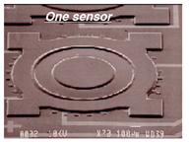
Second Paper
Batch-Processed Vacuum-Sealed Capacitive Pressure Sensors
Abhijeet Chavan and Kensal D. Wise
University of Michigan
2001

Slide 14
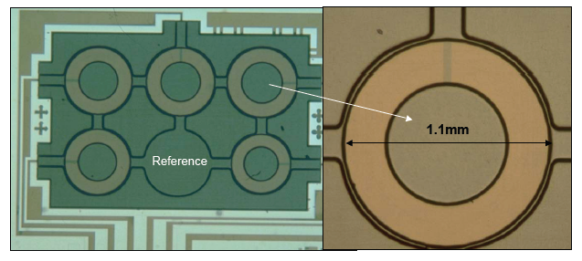
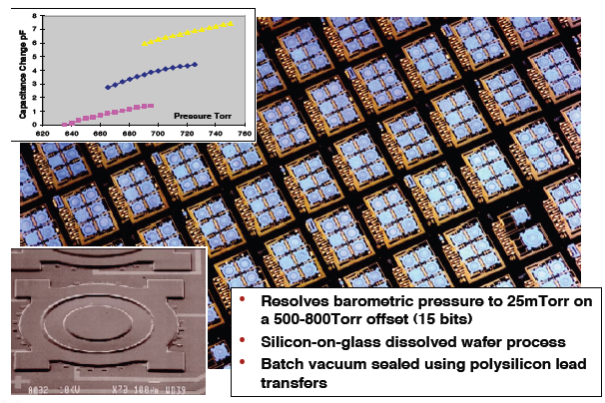
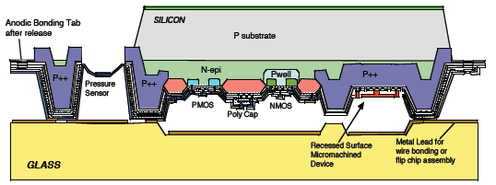
General Device Info.
Diameter:
920-1100um
Capacitive sensing (~2pF change)
Advantages:
High Pressure Sensitivity
Low Temperature Sensitivity
Low Power
Vac. sealed ref. cavity:
Lower trapped gas effects
Wider BW (low damping)
No Stiction
Applications:
Automotive,
Environmental
Medical
Industrial Proc. Control
Distributed Weather Forecasting Networks
Different curves for different operating points
500-800Torr
Res: 25mTorr (1ft!)
Tensile Stress (~25MPa)
~3um
~10um

Slide 15
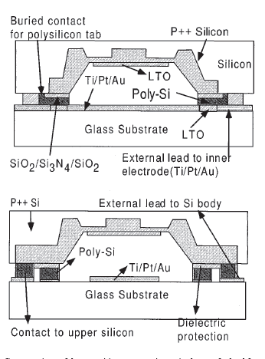
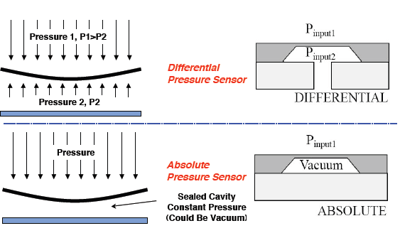
Barometric Pressure Sensors
Two fabricated devices:
Single lead (metal on glass)
Multiple leads (better parasitic cancelation)
Barometric (absolute) pressure sensors.
Both hermetically sealed with Poly-Si / Glass bonding
Poly is used for lead transfer

Slide 16
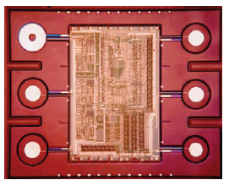
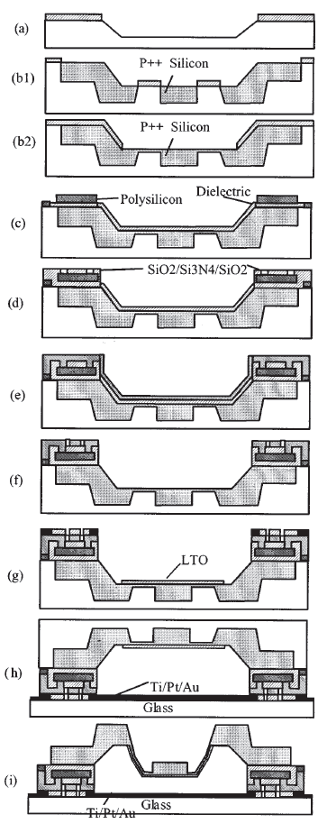
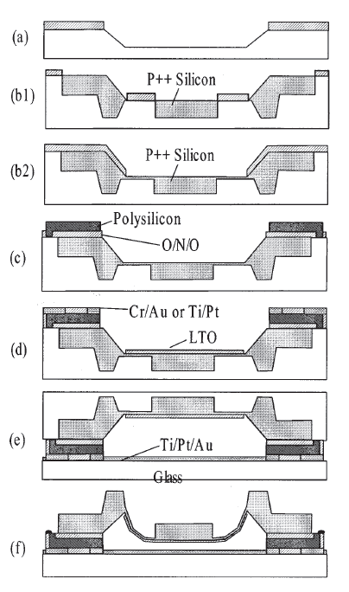
Fabrication Process
DWP Process
Anodically bonded to a glass wafer.
Std. CMOS - Wafer Level!
Fully integrated ckt possible!
Single Lead Detail:
8 masks:
Recess Etching (KOH)
P++ Boron Doping
ONO Deposition
Poly-Si Deposition and lightly doping (lower temp)
Optional CMP
Metal Connections (lift-off)
Metal On the glass
Anodic Bonding
EDP Release
Optional parylene coating
Since the bonding is done in vacuum, membrane is deflected upon release.
Single Lead
Multiple Leads

Slide 17
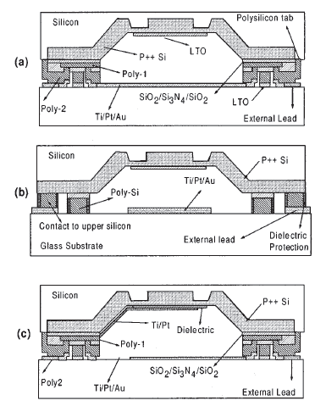
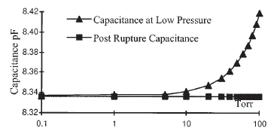
Multi Lead Device
2 levels of poly
Leads: between second poly and glass
Ti/Pt on glass getters out diffusing oxygen.
Leak rate < 1.1e-8 atm.cm³/s
Lead Transfer: Glass electrode / poly1/poly2 / poly1/external-metal
Poly ring is isolated => tests needed to verify.

Slide 18
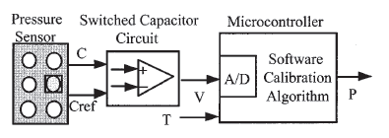
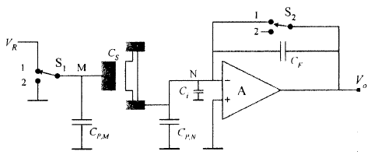
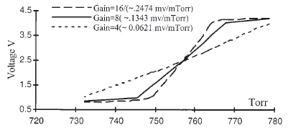
Switched Capacitor Sensing
C_{S} and C_{F} can exchange their roles: output will be inversely proportional to C_{S}, resulting in linear measurement!

Slide 19
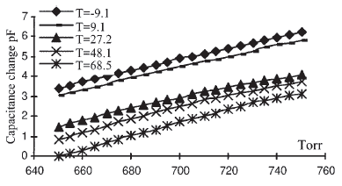
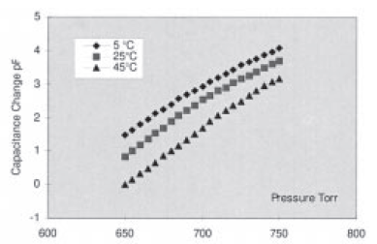
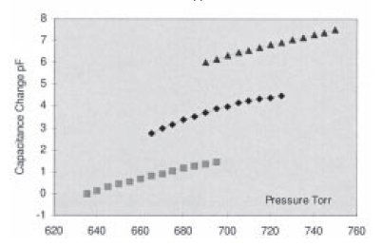
Test Results
 |  |  | Single Lead | Multi Lead
Sensitivity (fF/torr) |  |  | 27 | 39
TCO (ppm/ºC) |  |  | 3969 | 1350
TCS (ppm/ºC) |  |  | 1000 | 1000
Resistivity (ohms) |  |  | 46 – 100 | 50
TCO (ppm/ºC) |  |  | 1200 - 1600 | ?
Parasitic Cap. (%) |  |  | 25-50 | 5
Resolution (mtorr) |  |  | 25 | 25
Range | (torr/sensor) |  | 50 | 50
 | Total |  | 3.5V/5V | ?
Resolution Needed (bits) |  |  | 12 | 12
Residual Pressure (mtorr) |  |  | <200 | ?
Durability (2 years) |  | C_{o} | ? | -22 fF
 |  | Sensitivity | ? | 30-50 ppm/mmHg
 |  | Offset | ? | -800 ppm/year
TCO: thermal coefficient of Offset
TCS: Thermal Coefficient of Sensitivity
C_{o} = 12pF
Single Lead
Multi Lead

Slide 20
Thanks for Your Attention!
Questions?

