Slide 1
Nighthawk: Transparent System Introspection from Ring -3
ESORICS 2019
${Lei Zhou}^{1 2 ∗}$, ${Jidong Xiao}^{3}$, ${Kevin Leach}^{4}$, ${Westley Weimer}^{4}$,
${Fengwei Zhang}^{5 2 ∗∗}$, ${Guojun Wang}^{6}$
$${}^{1 }Central South University, China$$
$${}^{2 }Wayne State University, USA$$
$${}^{3 } Boise State University, USA$$
$${}^{4 } University of Michigan, USA$$
$${}^{5 } SUSTech, China$$
$${}^{6 } Guangzhou University, China$$
* Work was done while visiting COMPASS lab at WSU; ** The corresponding author

Slide 2
Outline
Introduction and Background
Architecture of Nighthawk
Design and Implementation
Evaluation: Effectiveness and Performance
Conclusion
Notes:
The computer system may be attacked by kinds of virus or rootkits in different layers, the security mechanism designed in same layer as the attacks may lost its ability in a high probability.

Slide 3
Privilege Layers
Ring 3 User mode virus
Ring 0 Kernel mode rootkits
Ring -1 Hypervisor rootkits
Ring -2 SMM rootkits (SMM reload)
Notes:
The computer system may be attacked by kinds of virus or rootkits in different layers, the security mechanism designed in same layer as the attacks may lost its ability in a high probability.

Slide 4
Defense Mechanism
How to defend against the attacks in each layer?
Notes:
So there is a question, how to defense against the attacks in each layers.

Slide 5
Defense Mechanism
How to defend against the attacks in each layer?
Deploy a defense at the a more privileged layer !
Notes:
To avoid the interruption from the same level system attacks, security mechanism should be implemented in low-level and more privileged layer, That means, the lower level attacks unable to compromise the security mechanism, even more, it unable to detect the introspection from low-level security mechanism.

Slide 6
Existing Malware Detection
Virtualization based defensive approach (ring -1)
Advantages ---- Full control of VM.
Limitations ---- High performance overhead and more likely to be a new target of attack.
Notes:
For the high level Malware in runtime application, it has been proposed various of approaches to detect. Those approaches basically has the whole understanding about the runtime application, from the runtime state to resource scheduling. Safe guarders are easy to find the attacks once the know the virus’s feature.
However, for low-level malware, generally in kernel level or lower, security mechanism may be bypassed by such attacks, even is worse situation, attacks compromised the security mechanism.
So, if the operate system is compromised, We will consider other approaches which can detect the whole system without interruption.
Thanks for virtualization technology, the VMM is about to detect the VM state, even the runtime information in VM kernel through some addition approaches, like libvirt.
It has its advantages ….. and limitations…..

Slide 7
Existing Malware Detection
Virtualization based defensive approach (ring -1)
Advantages ---- Full control of VM.
Limitations ---- High performance overhead and more likely to be a new target of attack.
Hardware based defensive approach (ring -2)
Advantages ---- Small TCB and lower layer.
Limitations ---- Additional monitoring device or disturbing the normal system execution.
Notes:
Hardware based defensive approach is an effective method to solve the weakness existing in Virtualization based approaches. The advantages … . However, according to the existing approaches, like Hypercheck, based on SMM which disturbing the normal system execution (other hardware based but not ring -2, like Copilot, need an extra devices, cause more problem) .
Excluding the performance, Virtualization and Hardware based performance are both affected by some level attacks.

Slide 8
How to better defend against low-level attacks?
Notes:
The question…….

Slide 9
How to better defend against low-level attacks?
“Ring -3” ?
Notes:
The answer should be implementing a more low level defense. We named it ring -3, but what kind of technology can be regard as ring -3

Slide 10
Higher Privilege System In Intel Architecture
Applications
User mode
Supervisor mode
Intel ME system:
Provide assistance protection for Host
Hypervisor
kernel
Intel AMT
Software
Hardware
DRAM
SMRAM
ME UMA
SPI Flash Memory
Intel ME system:
Strong Isolation but integrate into motherboard
Main CPU
Intel Chipset
ME CPU
Understanding DMA Malware (DIMVA 2012)
Notes:
We focus on the Intel ME, a novel technology proposed by Intel, and used in most of intel chipsets. It has the independent cpu and runtime environment and main cpu unable to access the ME.

Slide 11
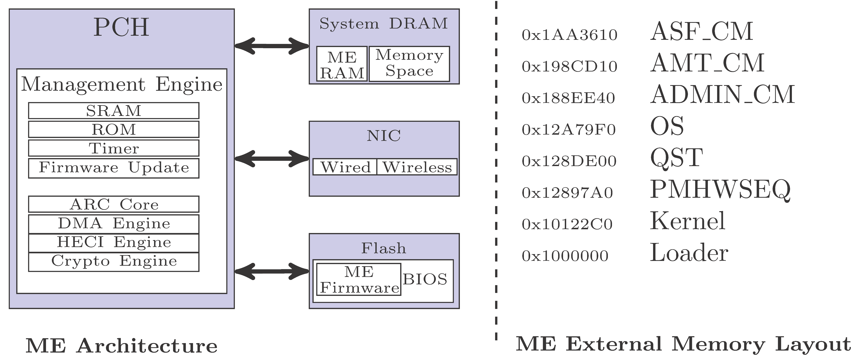
Intel Management Engine
No Extra Hardware Needed
Full Privilege
Small TCB
Transparency and low performance overhead
Notes:
The details about the Intel ME architecture and its features, those features are better to design the security mechanism for host. But it also has its disadvantages

Slide 12
Intel Management Engine
No Extra Hardware Needed
Full Privilege
Small TCB
Transparency and low performance overhead
However, IME related resources are not public to users
Notes:
The largest issue is the IME related resources are not open, we can say the AMT interface in bios setting, but we know little about source code in ME system.
Other issues like sematic gaps between Host and ME, the way to access ME system, etc., are also should be considered in research.

Slide 13
Location
Microcontroller embedded in the PCH (older version in MCH)
Notes:
The ME location in Intel chipset.

Slide 14
Outline
Introduction and Background
Architecture of Nighthawk
Design and Implementation
Evaluation: Effectiveness and Performance
Conclusion
Notes:
The computer system may be attacked by kinds of virus or rootkits in different layers, the security mechanism designed in same layer as the attacks may lost its ability in a high probability.

Slide 15
High-level Architecture of the Nighthawk
Introspection &
Forensics
Introspection
modules
Compromised
Memory
Assist Analyzing
DMA-based Checking
IME
Target Host
Remote Machine
Target Machine
If we are able to add introspection code into IME system, we can check arbitrary host physical memory.
Notes:
We design the Nighthawk system based on IME, also we has a remote machine for assist analyzing. So we can see the main architecture about the Nighthawk, It has two machines with three objects.

Slide 16
Details of Components in Nighthawk
Notes:
This is the details of the components in Nighthawk, including each functional module in those three modules. We will leverage features to construct a completed introspection system.

Slide 17
Outline
Introduction and Background
Architecture of Nighthawk
Design and Implementation
Evaluation: Effectiveness and Performance
Conclusion
Notes:
The computer system may be attacked by kinds of virus or rootkits in different layers, the security mechanism designed in same layer as the attacks may lost its ability in a high probability.

Slide 18
Nighthawk Design & Implementation
Preparing the Target Machine
Target Host Reconnaissance
Measuring Integrity via Custom IME
Command from Remote Machine
Notes:
The workflow about design the Nighthawk, and the process about how to use to introspection target host.

Slide 19
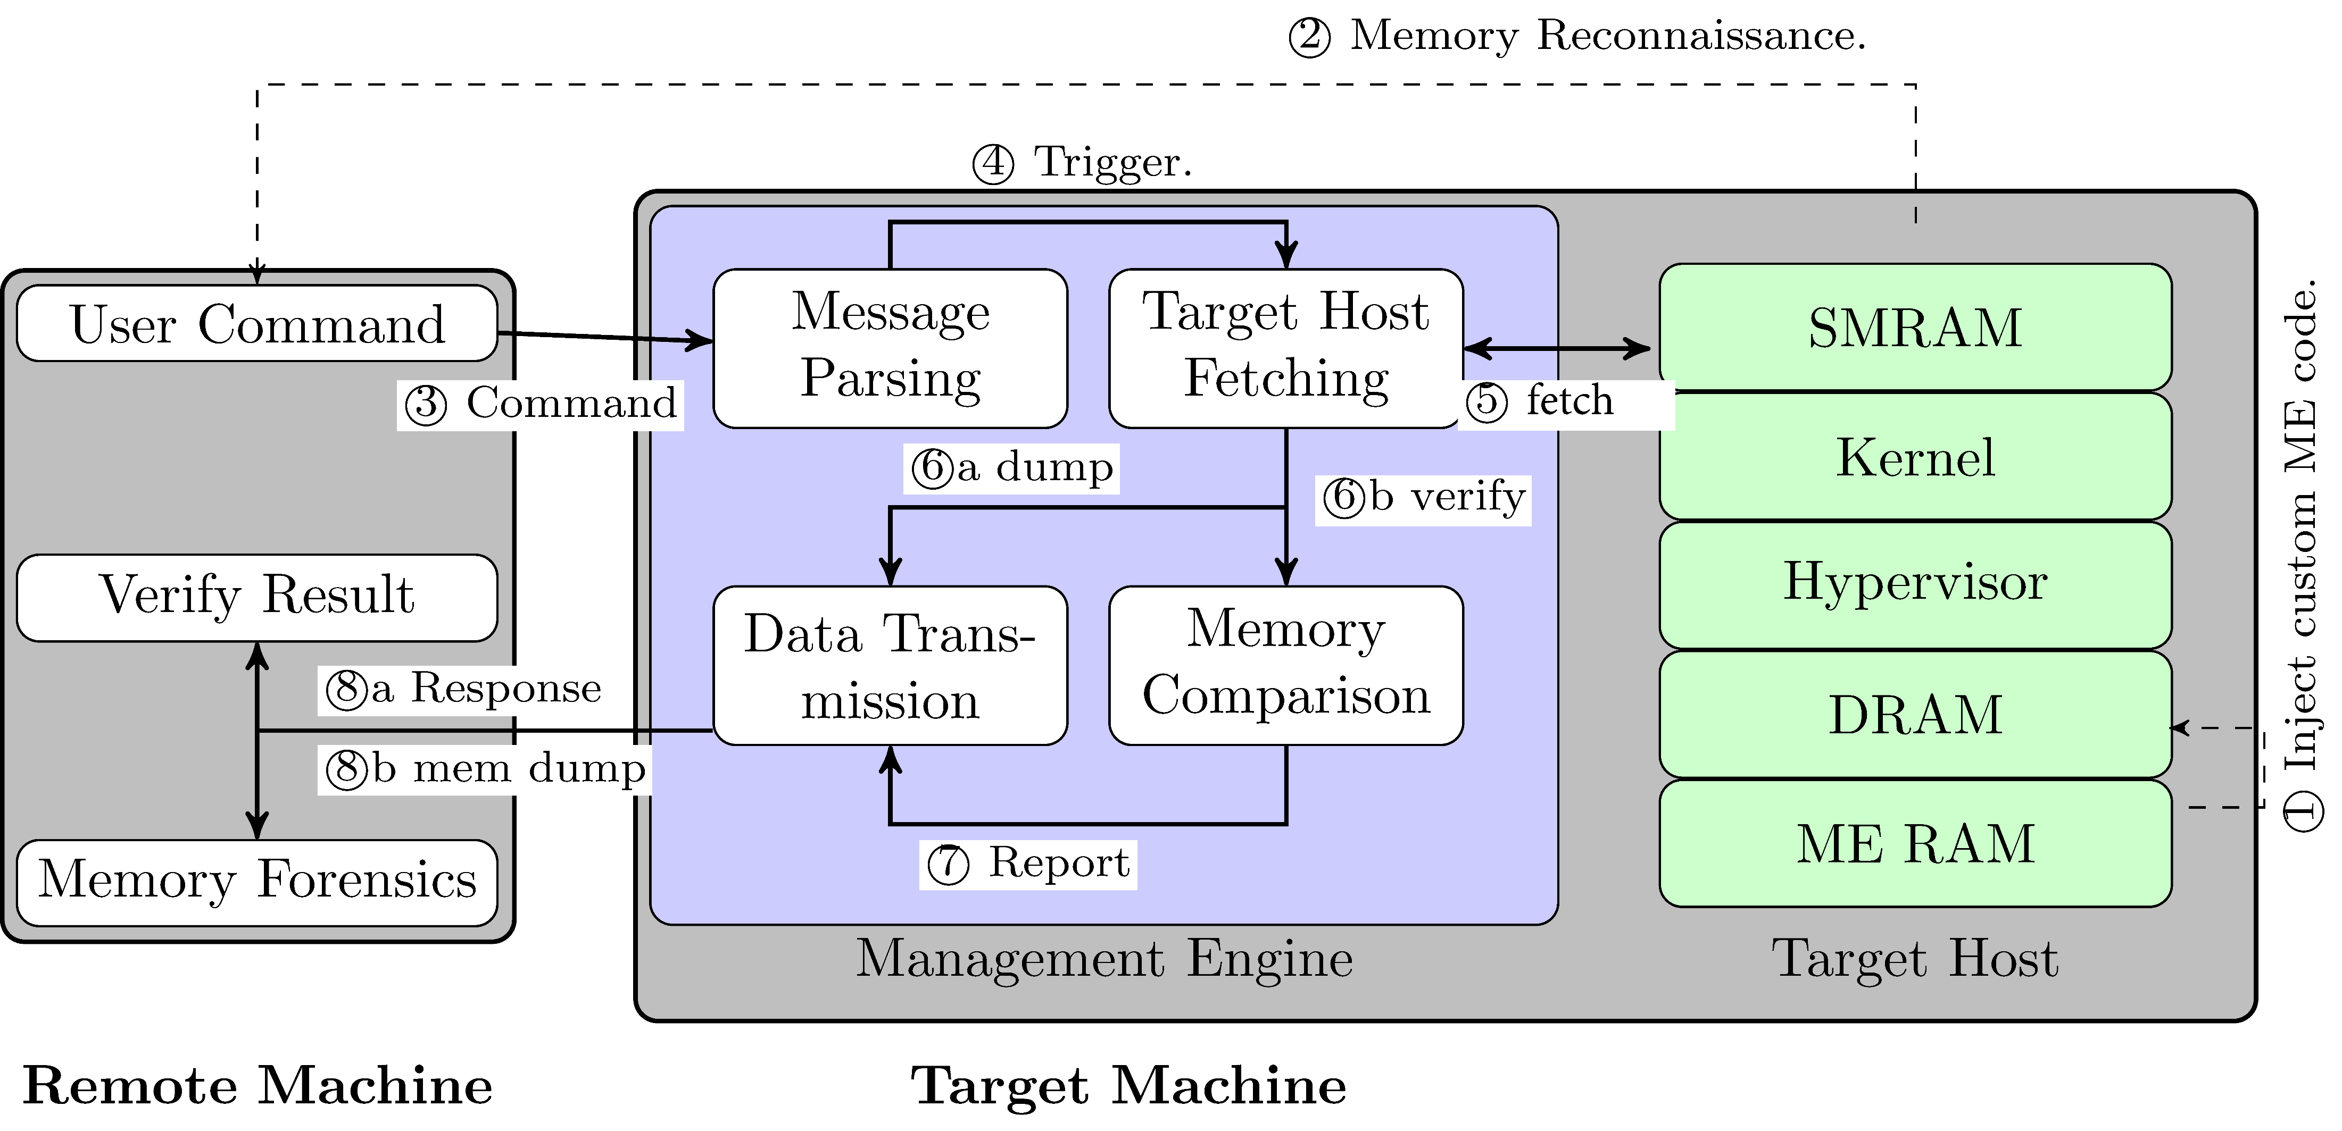
High-level Overview of the Implementation
Notes:
With the numbered arrows, we can see the workflow of introspection process through each components in whole system.

Slide 20
Nighthawk Design & Implementation
Preparing the Target Machine
Target Host Reconnaissance
Measuring Integrity via Custom IME
Command from Remote Machine
Notes:
Since Nighthawk is not a formal application in IME, we need to construct such a introspection environment before the system executing.

Slide 21
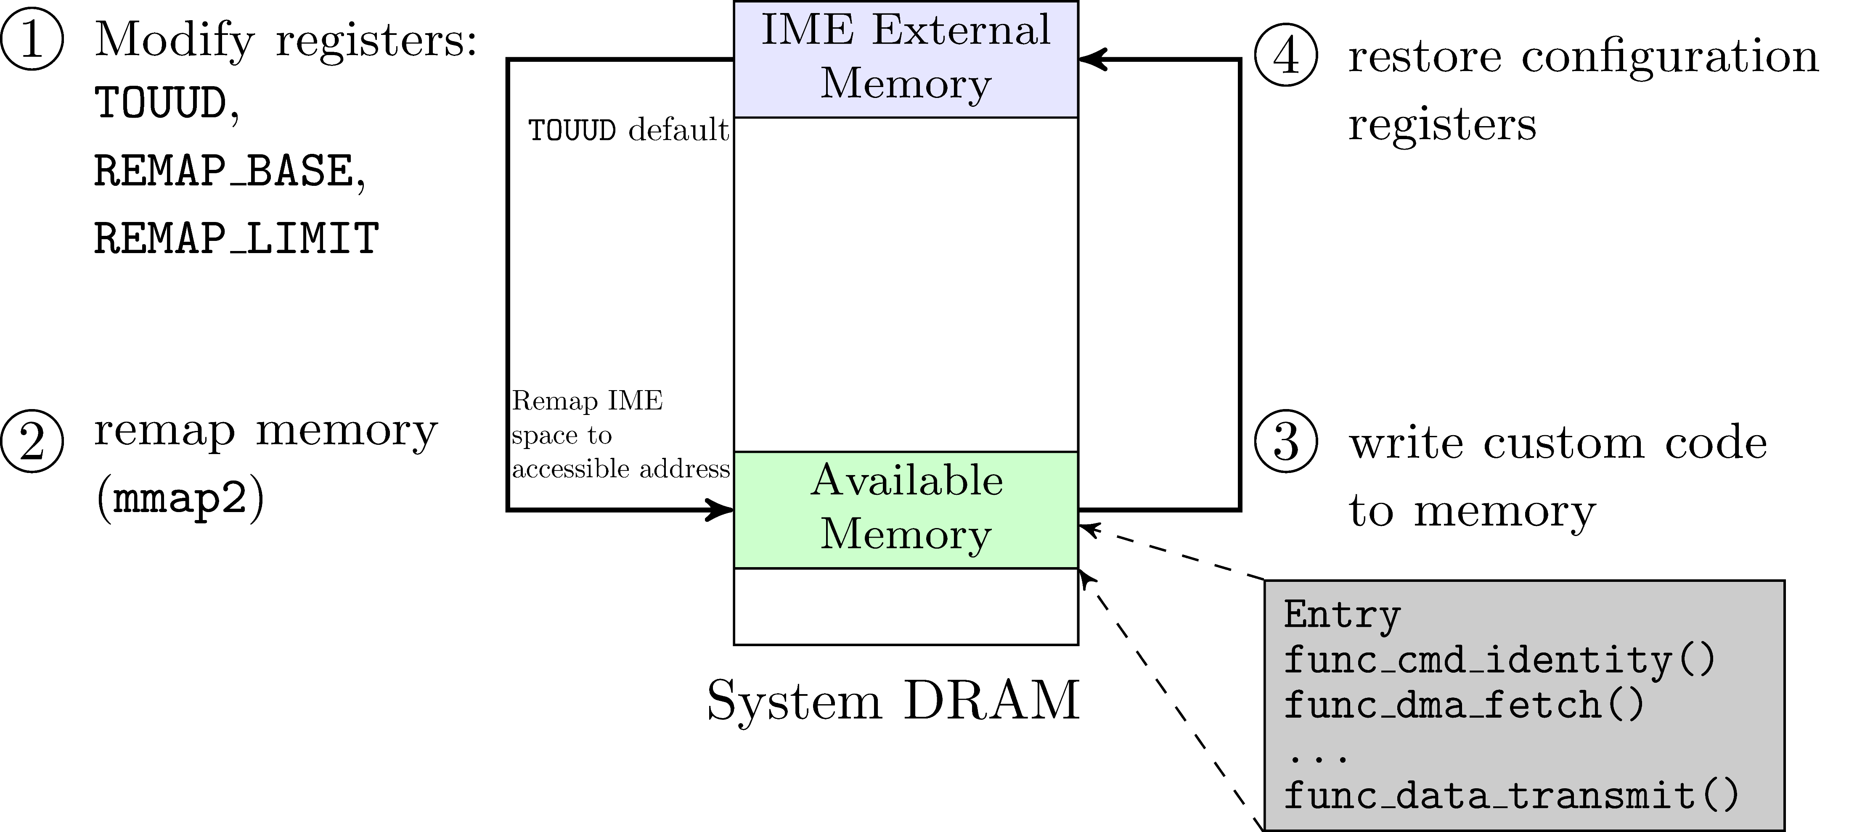
Preparing Target Machine (1) — Code Injection
The Process for introspection code injection in ME
Notes:
First, we need deploy each functional module in each machine. Especially in IME (since modules in remote machine can be regarded as an application), we need find a way to inject the code into ME runtime system.

Slide 22
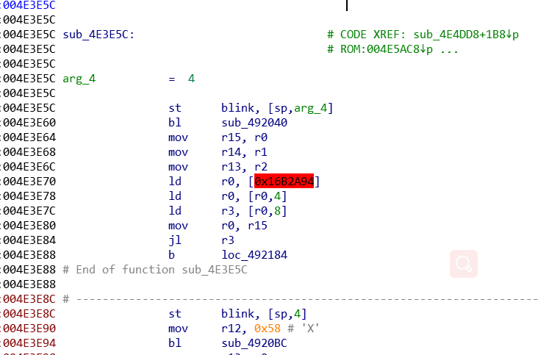
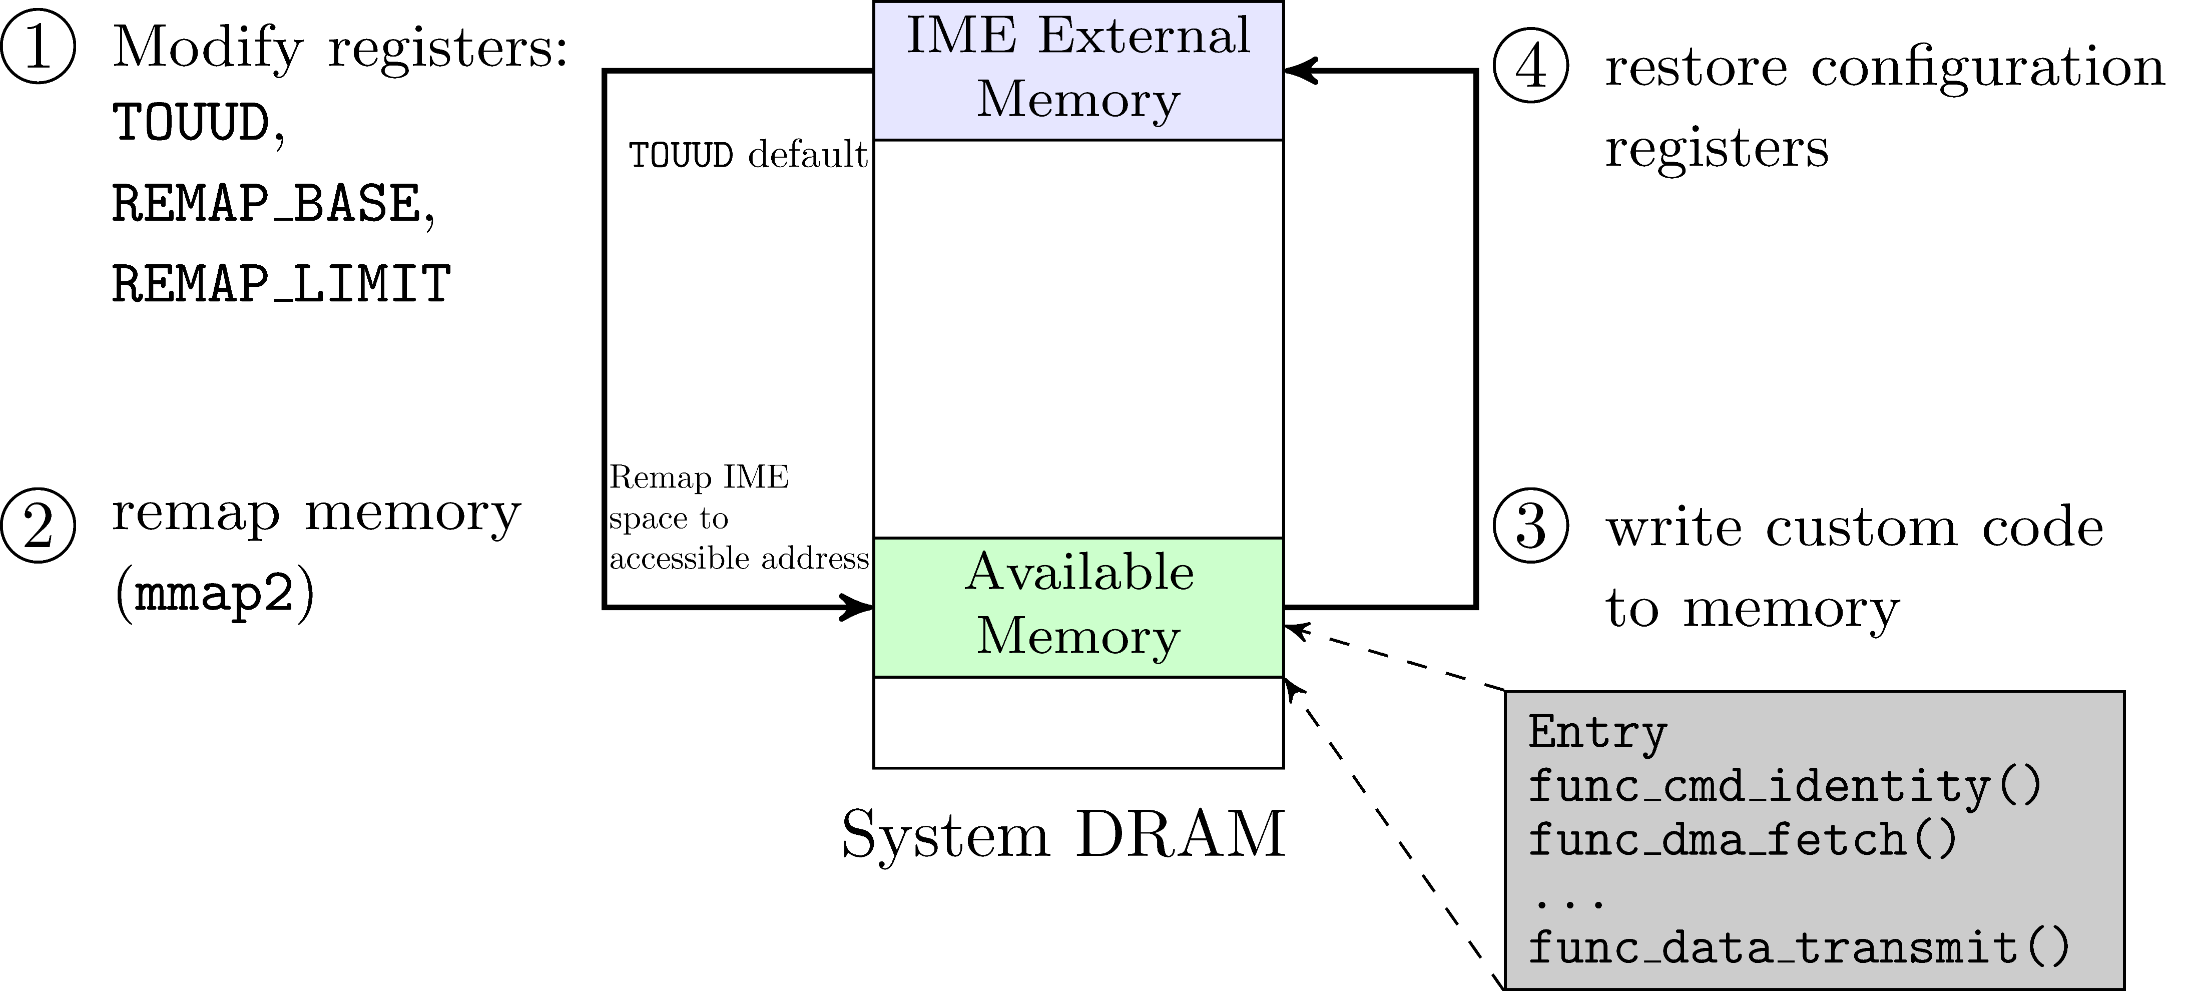
How to Inject the Introspection Code
Through Reverse engineering of the ME system code, we find the ideal function entry in which to inject the code.
Notes:
The way we refer the Wojtczuk‘s previous work about how to access the IME runtime system. Then with analysis the system instructions through reverse engineering, we choose an comfortable position to add the introspection code, and make sure it can be automatic or remote triggering.

Slide 23
Preparing Target Machine (2) — Stop Reusing Injection
Stop reusing the injection in ME: leveraging the Intel TXT to lock the related registers.
Notes:
People may able to reusing such injection to disable the Nighthawk. So, we need to stop the injection after deploying the introspection module in IME. Since the Injection is worked by changing the mapping related registers in chipset. The better way is to lock those registers which can be implemented by booting with Intel TXT.

Slide 24
Nighthawk Design & Implementation
Preparing the Target Machine
Target Host Reconnaissance
Measuring Integrity via Custom IME
Command from Remote Machine
Notes:
Then, to introspect the host, including Kernel, SMRAM and some other special attacks, we design to address corresponding memory data depending on the system memory allocation principle.

Slide 25
Target Host Reconnaissance (1) — General Case
The information including:
System call table : 0x1653100
Kernel _text: 0x1000000
kvm_intel: 0xf8bc7000
…
Once the host system initializes, we fetch those basic information.
Notes:
Then, before the checking operation, Nighthawk is engaged to get the target host memory through DMA-based fetching approaches.

Slide 26
Target Host Reconnaissance (2) — Special Case
To mitigate some attacks like ATRA, we leverage SMM to get the runtime CPU information after checking SMRAM.
Notes:
For some attacks like ATRA, the valid defense mechanism always need to know its runtime state, which contains the instant value of CPU register, page table scheduling, etc. To mitigate such attack through the Nighthawk, we leverage the SMM based agent to get those needed information, the agent should be verified by ME based modules before the reconnaissance.

Slide 27
Nighthawk Design & Implementation
Preparing the Target Machine
Target Host Reconnaissance
Measuring Integrity via Custom IME
Command from Remote Machine
Notes:
After we can address each corresponding memory, Nighthawk start to checking the host in time.

Slide 28
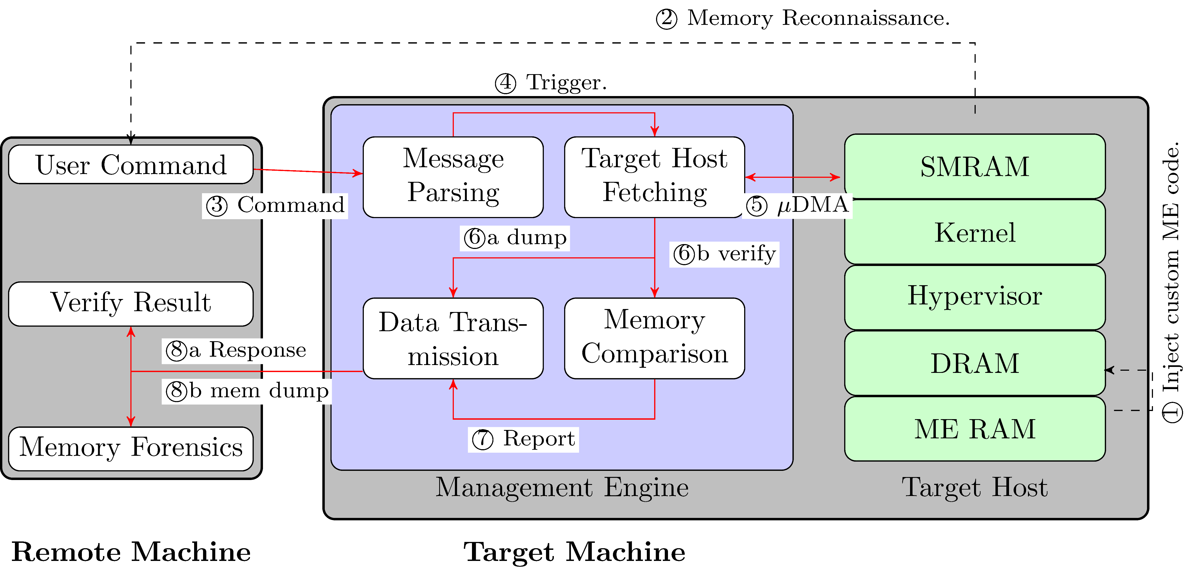
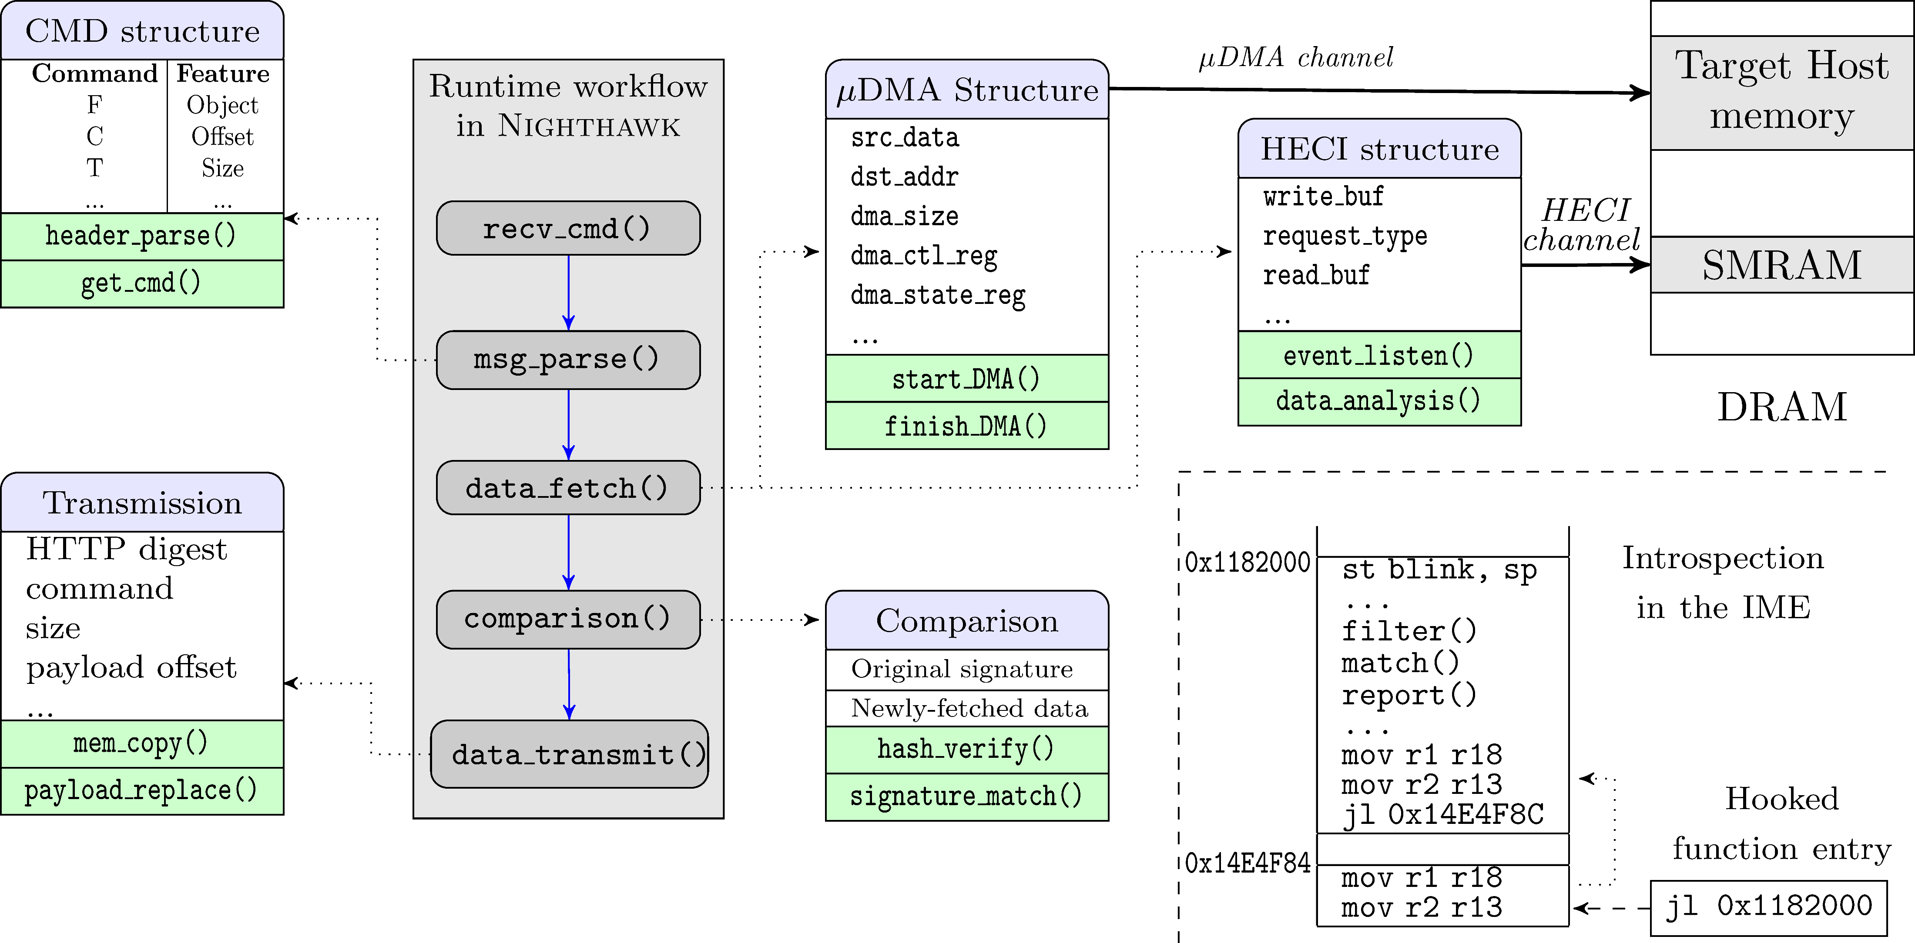
Measuring Integrity via Custom IME
Workflow of Introspection
Notes:
The right figure shows the workflow of Measuring Integrity via Custom IME. From receiving measuring command to sending packets to remote machine, each operations executed step by step in IME.

Slide 29
Nighthawk Design & Implementation
Preparing the Target Machine
Target Host Reconnaissance
Measuring Integrity via Custom IME
Command from Remote Machine
Notes:
Finally, we can design all operations in IME, but to make the introspection more useful, we can remote start the measuring instruction. Also, remote machine should be a more fast and reliable system to assist analyzing the host memory data, which makes a more precise checking.

Slide 30
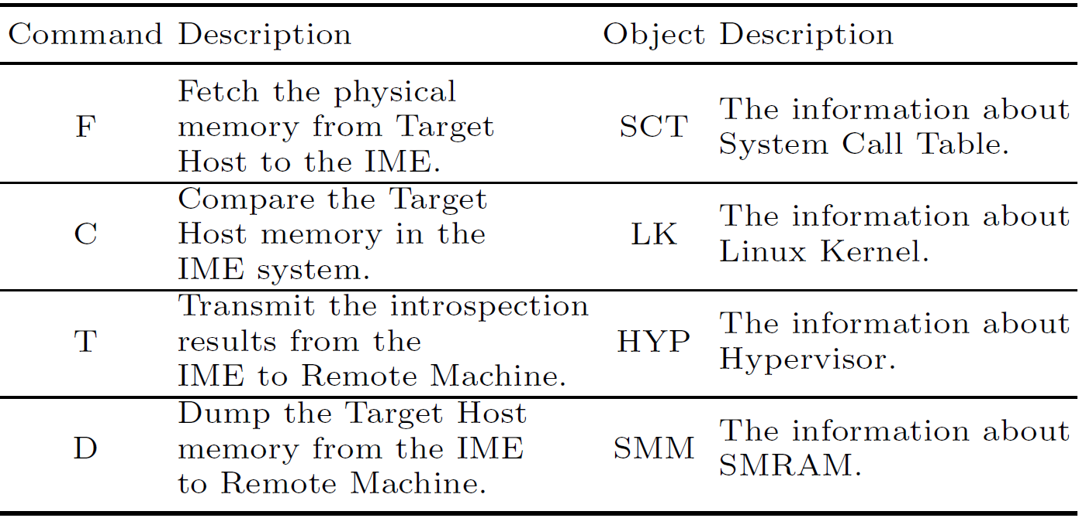
Command from Remote Machine
Notes:
The Command are constructed by a list of independently instructions. And a introspection operation can consist of one or more instructions to make a better checking.

Slide 31
Outline
Introduction and Background
Architecture of Nighthawk
Design and Implementation
Evaluation: Effectiveness and Performance
Conclusion
Notes:
The computer system may be attacked by kinds of virus or rootkits in different layers, the security mechanism designed in same layer as the attacks may lost its ability in a high probability.

Slide 32
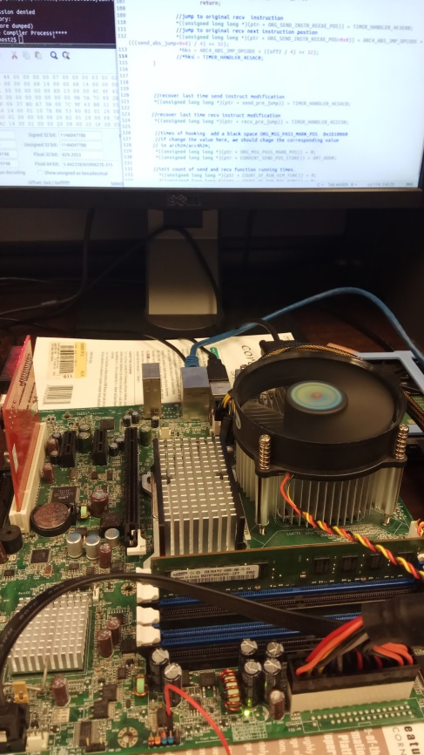
Evaluation
The test environment platform:
Intel DQ35JO motherboard with 3.0GHz Intel E8400 CPU, ICH9D0 I/O Controller Hub and 2GB RAM.
Intel e1000e Gigabyte network card for the network communication.
We use an earlier BIOS version (JOQ3510J.86A.0933) for injecting code into ME.
We run Ubuntu with the Linux kernel version 2.6.x to 4.x, along with KVM- and Xen-based Hypervisor.
Notes:
The information about test platform.

Slide 33
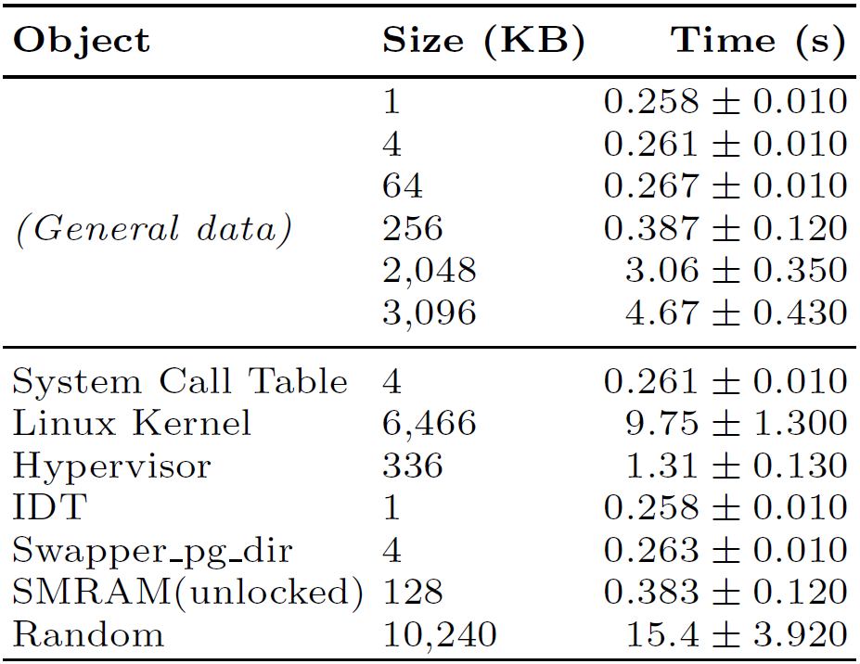
Effectiveness--General Attacks
Target Object and Attacks
To simulate the attacking environment, we use existing rootkits for OS kernel, SMM, etc., installed in the target system.
We manually modify the memory content in kernel, Xen, KVM and SMM modules.
Through experiments, all attacks illustrated in this table have been detected by Nighthawk
Notes:
For general scenes, including the attacks from OS kernel, Hypervisor, SMM, the test shows a good result of instropection.

Slide 34
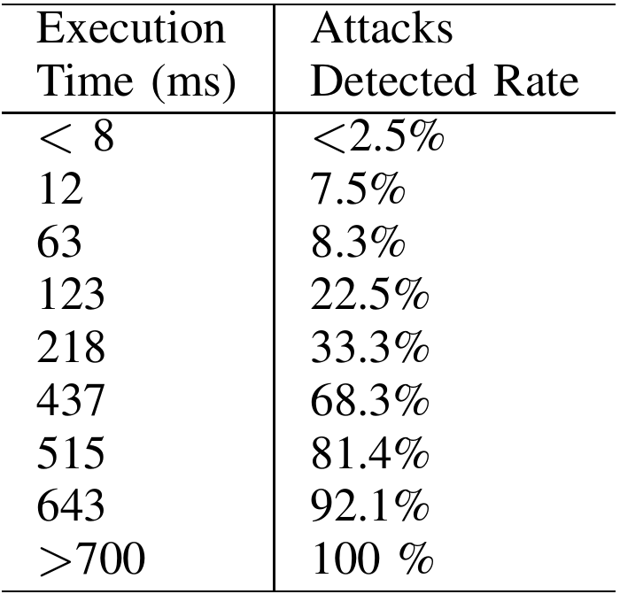
Effectiveness -- Mitigating Special Attacks
ATRA Detection
We detect ATRA by testing for Page Global Directory and CR3 changes
Transient Attacks Detection
We simulate a transient attack using a toorkit-modified rootkit that changes the pointer address of the system call table.
Our results in the table show that Nighthawk can detect transient attacks in real world.
Notes:
1 We use the CR3 value (acquired relying on SMM) to search for the corresponding physical page directory entry and page table entry via physical memory. By testing the Page Global Directory and CR3 changing under Kernel Page Table Isolation (KPTI) mechanism and IDT based attack. Our comparison results show that Nighthawk can detect the trace of ATRA.
The test result shows our system can validly mitigate the risks from such kind of attacks.

Slide 35
Performance Evaluation
DMA Fetching Overhead
Integrity Checking Overhead
Transmission Overhead
Notes:
To show the performance from the follow main three aspects: DMA fetching, Integrity checking, Data Transmission.

Slide 36
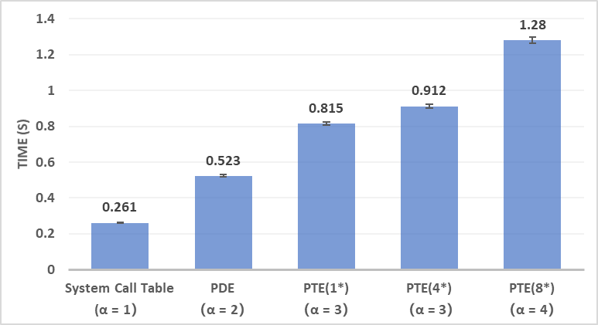
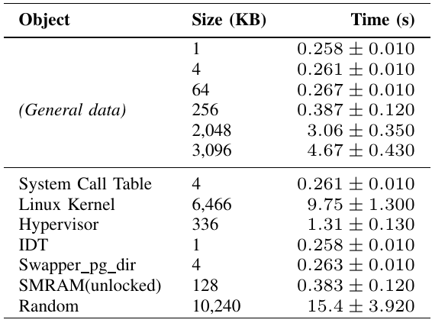
DMA Fetching Overhead
Time consumed by fetching data (Pages).
* represents the number of PTEs.
α represents accessing times.
Time consumed by DMA (User Cases ).
Fetching data from host memory to ME memory
Notes:
First, a target memory might be addressed in different types. Some can directly search the fixed page, some should be indirectly searched through PDE, PTE table. The left figure shows the DMA fetching time for different page accessing.
The right figure shows the total fetching time of each real target.

Slide 37
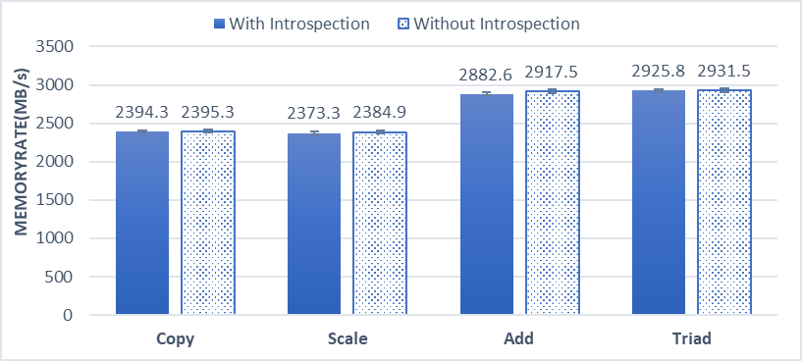
Memory Degradation Due To Introspection
With the benchmark test, the results show that Nighthawk has a very small performance impact to host.
Notes:
IME runs in independently environment without interrupting the host, the DMA –fetching will cause some memory searching confliction but the degradation are very small.

Slide 38
Integrity Checking Overhead
Time cost depends on the hash algorithm we choose.
-- For 4KB memory page, it takes 7.3ms for checking under SDBM hash.
Note that, for more complexity hash algorithm, e.g., sha1, it takes more time for checking.
Compared to the fetching time, the checking time is very lower.

Slide 39
Comparison for Checking Overhead
With the SDBM hash verification test, we found the computing performance is much lower than it is in Host. For example, comparing a 6.3MB data, 25s is needed in ME, and 10 ms in Host.
Main factor: ME CPU core has a significantly lower computational capability.
We develop a CPU speed testing program, and the experimental result shows that the ME CPU executes approximately 15 million instructions each second (Meanwhile, billions per second on regular CPUs).
Notes:
Compare to the host CPU, the IME executing time has a significate degradation, this because the IME CPU has the lower speed, and the test result verify that.

Slide 40
Transmission Overhead
For a small message(<1KB), takes 228ms on average to pass the data.
For a dumping data (i.e., > 64KB), we divide the data into multiple packets and transmit via multiple messages. e.g., 64KB data takes 4.9s.

Slide 41
Performance Evaluation Summary
Notes:
For each target, the figure shows the whole times cost in each introspection steps, and the result shows an acceptable performance.

Slide 42
Conclusion
Nighthawk—a transparent introspection framework
— Leveraging Intel ME
— High privilege: ring -3
— Small TCB
Attack scenarios
— Real-world attacks against OS kernels, type-I and type-II
hypervisors, and unlocked system management RAM
Introducing almost zero overhead

Slide 43
Thank you! Questions?
zhangfw@sustech.edu.cn
https://fengweiz.github.com/

