Slide 1
Towards Differential Testing of Similar Repairs
Tianyi Zhang, Miryung Kim
University of California, Los Angeles
Notes:
Hello everyone, my name is Tianyi and today I am going to talk about a differential testing framework to check the behavioral consistency of similar repairs on code clones.
(Can I assume the audience know code clones?)
This work is collaborated with my advisor Professor Miryung Kim.

Slide 2
Problem Statement
Code clones are common in modern software systems and they may share similar vulnerability
When making similar repairs to similar code, system administrators may want to have trust on the correctness of these repairs
This problem is exacerbated by a lack of tests. 46% of clone pairs are only partially covered by existing test suites.
Notes:
Let me start with the problem definition.
Code clones are highly similar code segments and they are pretty common in software systems.
Previous study shows that about 25% (a quarter of) code in modern software systems are consisted of clones.
When fixing a bug in one location, developers often have to apply similar repairs to all other similar locations to fix the same bug.
Manually inspecting the correctness of similar repairs is tedious and error-prone.
So system administrators and software developers may want to have some trust on the correctness of these similar repairs.
Unfortunately, inconsistent repairs often manifest themselves in strange and unpredictable ways: subtle programming mistakes such as a typo in a crucial location such as if condition or constants can dramatically alter the program behavior.
The situation is worsened by the fact that many code clones are not tested due to a lack of test cases.
Our empirical study shows that in 46% of pairs of clones, only one clone is tested but the other clone is not executed at all.
This is a broader problem in the context of automated software repair. Repair is assessed based on existing tests, and when an existing test suite is inadequate to check the correctness of repair, we cannot have high confidence on repair correctness.

Slide 3
A programmer applies similar edits to update the use of StringTokenizer to StringUtils.split in the Copy and Delete classes.
public class Copy extends Task{
private IncludePatternSet includes;
public void setIncludes(String patterns){
…
- StringTokenizer tok = new StringTokenizer(patterns, “,”);
- while(tok.hasMoreTokens()){
- includes.addPattern(tok.next);
- }
+ String[] tokens = StringUtils.split(patterns, “,”);
+ for(String tok : tokens){
+ includes.addPattern(tok);
+ }
…
}
}
public class Delete extends Task{
private ExcludePatternSet excludes;
public void setExcludes(String patterns){
…
- StringTokenizer tok = new StringTokenizer(patterns, “,”);
- while(tok.hasMoreTokens()){
- excludes.addPattern(tok.next);
- }
+ String[] tokens = StringUtils.split(patterns, “.”);
+ for(String tok : tokens){
+ excludes.addPattern(tok);
+ }
…
}
}
Copy.java
Delete.java
* The example is adapted from Apache Ant 1.9.6 for presentation purposes .
Notes:
Let’s look at an example from Apache Ant.
(We adapt a lot from the original code, e.g., renaming files, changing types, etc. And we made up the programming mistake to motivate the scenario. Should we really say it’s a case adapted from Apache Ant?)
StringTokenizer is a legacy class in Java 6 and its use is discouraged in new code.
So a programmer updates the use of StringTokenizer with another String split API in the copy class as well as the delete class.
But the programmer accidentally changes the string separator from comma to period in the right program.
Now the left program still splits string by comma but the right program starts splitting string by period which is a behavioral divergence.
Such a mistake is hard to recognize with manual inspection (red circles disappear)because it only changes one character in the right program compared with the left, and comma looks pretty like period.
Therefore this problem calls for an approach to detect such subtle programming mistakes and help programmers build confidence on the similar repairs.

Slide 4
Limitation of Existing Techniques
Existing clone inconsistency detection techniques do not detect behavioral inconsistencies between clones [Jiang et al., CBCD, SPA]
Existing differential testing or random testing techniques are not applicable to code clones [Geno, Diffut, Randoop]
Notes:
Static approaches such as SPA or Jiang et al. detect renaming mistakes or differences in control and data dependences in clones.
They do not examine syntactic differences in method calls and constant values.
In general, as they are static approaches, they cannot precisely detect runtime behavioral inconsistencies between clones.
Differential testing frameworks such as Geno and Diffut work with only well-defined interfaces at system or method level.
However, code clones are often arbitrary code segments within a method. So these differential testing techniques do not work with clones.
Random testing techniques such as Randoop cannot effectively construct complex data structures and method call sequences to test code clones.

Slide 5
Grafter: Automated Test Reuse and Differential Testing of Similar Repairs
We present a differential testing framework to reuse tests and assess the correctness of similar repairs on code clones via code transplantation.
public class Copy extends Task{
private IncludePatternSet includes;
…
String[] tokens = StringUtils.split(patterns, “,”);
for(String tok : tokens){
includes.addPattern(tok);
}
…
Success
Copy.java
Failure
testCopy
public class Delete extends Task{
private ExcludePatternSet excludes;
…
String[] tokens = StringUtils.split(patterns, “.”);
for(String tok : tokens){
excludes.addPattern(tok);
}
…
?
Delete.java
String[] tokens = StringUtils.split(patterns, “.”);
for(String tok : tokens){
excludes.addPattern(tok);
}
Notes:
To help software developers build confidence on similar repairs, we present a differential testing framework Grafter to reuse tests and detects behavior divergence caused by inconsistent repairs via code transplantation.
Back to the previous example, suppose the code clone in Copy.java, which is highlighted in the green color, is exercised by a test named testCopy.
However, its counterpart clone in Delete.java, which is highlighted in the yellow color and repaired inconsistently, is not tested by the existing test suite.
To check the correctness of the repair on Delete.java, our approach grafts the code snippet to Copy.java (click), and rerun the test (click).
Because the programmer accidentally replaced the separator from comma to period, the patterns string is not split correctly and therefore fails the test.

Slide 6
Grafter: Automated Test Reuse and Differential Testing of Similar Repairs
Our approach detects inconsistent repairs by exposing behavioral divergence between code clones.
public class Copy extends Task{
private IncludePatternSet includes;
…
String[] tokens = StringUtils.split(patterns, “,”);
for(String tok : tokens){
includes.addPattern(tok);
}
…
Copy.java
Success
testCopy
public class Delete extends Task{
private ExcludePatternSet excludes;
…
String[] tokens = StringUtils.split(patterns, “.”);
for(String tok : tokens){
excludes.addPattern(tok);
}
…
Delete.java
String[] tokens = StringUtils.split(patterns, “.”);
for(String tok : tokens){
excludes.addPattern(tok);
}
Failure
Notes:
In this way, our approach can detect the subtle programming mistakes in similar repairs by exposing behavioral divergence between code clones.
This technique is novel in the sense that we are the first technique to boost test coverage for code clones and to allow runtime behavior comparison between clones.

Slide 7
Clones may have variations in variable names, types, method call targets, etc. (Type II clones)
If (cert instanceof X509Certificate) {
XMLX509IssuerSerial certSerial =
new XMLX509IssuerSerial(
x509Serial.getDocument(),
(X509Certificate)cert);
…
If (cert instanceof X509Certificate) {
XMLX509SubjectName certSN =
new XMLX509SubjectName(
x509SubjectName.getDocument(),
(X509Certificate)cert);
…
Apache XML Security
Clones may include additional code insertions and deletions. (Type III clones)
if (f.isDirectory()) {
deleteDir(f);
} else if (deleteFiles && ! getFileUtils.tryHardToDelete) {
throw new BuildException (“Unable to delete file” …);
} else {
throw new BuildException (“Unexpected Error. File should not exist!”);
}
if (f.isDirectory()) {
deleteDir(f);
} else {
log(“Deleting ” + f.getPath());
if (!delete(f)) {
handle(“Unable to delete file” + …);
}
}
Apache Ant
Notes:
The challenge of this code transplantation or grafting is that code clones are often similar but not identical code fragments.
Therefore, these clones could have variations in variable names, types and method calls. Such clones are referred as Type II clones in Roy et al.’s well known clone taxonomy.
Some clones may have additional inserted and deleted code. Such clones are referred as Type III clones in Roy et al.’s taxonomy.
Simply grafting code without further adaptations will induce compilation errors and it’s hard to ensure the type safety during grafting.
Therefore we design several code transplantation rules to resolve compilation errors and propagate data between corresponding variables between two clones. I will talk more details in the next few slides.

Slide 8
Grafter Approach Overview
Clone Pair
A B
Test Suite
Variation Identification
Code Transplantation
Data Propagation
Differential Testing
Test | Clone A | Clone B
T1 | pass | fail
T2 | pass | pass
State | Clone A | Clone B
S1 | “string” | “string”
S2 | true | false
Test-level Comparison
State-level Comparison
Notes:
In general, our differential testing framework takes a pair of clones and an existing test suites as input.
It requires at least one clone in the clone pair to be exercised by the existing test suite so our differential testing framework can reuse the test on the other clone and compares their behaviors.
Our approach consists of four phases to reuse test and detect behavior divergence. I will explain details in each step in the next few slides.
At the end, our approach will report behavioral comparison results in terms of test outcomes and intermediate state values.

Slide 9
Grafter Approach Overview
Variation Identification
Code Transplantation
Data Propagation
Differential Testing
Name Variation
Type Variation
Method Call
Variation
Declare Variables
Transform Types
Declare Methods
Populate intermediate
input data to clone
Transfer intermediate
output back to test
Test Comparison
State Comparison
Notes:
In the first step, our approach identifies variations between two clones which may cause compilation errors after code transplantation.
To resolve the compilation errors caused by clone variations and produces compilable code, our approach applies five transplantation rules to declare variables, methods, and transform types.
In the next step, our approach inserts stub code to populate intermediate input data to the grafted clone and transfer the updated values back to the test for examination.
Our approach supports differential testing in two granularities.
The test-level comparison compares the test outcomes of reused test cases between two clones.
The state-level comparison compares the intermediate state values.
The test0

Slide 10
Step 1: Variation Identification
Variation Identification
Code Transplantation
Data Propagation
Differential Testing
public class Copy extends Task{
private IncludePatternSet includes;
public void setIncludes(String patterns){
…
String[] tokens = StringUtils.split(patterns, “,”);
for(String tok : tokens){
includes.addPattern(tok);
}
}
…
public class Delete extends Task{
private ExcludePatternSet excludes;
public void setExcludes(String patterns){
…
String[] tokens = StringUtils.split(patterns, “.”);
for(String tok : tokens){
excludes.addPattern(tok);
}
}
…
Notes:
I will illustrate each step with our previous example.

Slide 11
Step 1: Variation Identification
Variation Identification
Code Transplantation
Data Propagation
Differential Testing
public class Copy extends Task{
private IncludePatternSet includes;
public void setIncludes(String patterns){
…
String[] tokens = StringUtils.split(patterns, “,”);
for(String tok : tokens){
includes.addPattern(tok);
}
}
…
public class Delete extends Task{
private ExcludePatternSet excludes;
public void setExcludes(String patterns){
…
String[] tokens = StringUtils.split(patterns, “.”);
for(String tok : tokens){
excludes.addPattern(tok);
}
}
…
Notes:
In the first step, Grafter notices that two clones use fields with different names and types. The left clone uses a field named includes and in the type of IncludePatternSet, the right clone uses a field named excludes and in the type of ExcludePatternSet.

Slide 12
Step 2: Code Transplantation
Variation Identification
Code Transplantation
Data Propagation
Differential Testing
public class Copy extends Task{
private IncludePatternSet includes;
public void setIncludes(String patterns){
…
String[] tokens = StringUtils.split(patterns, “,”);
for(String tok : tokens){
includes.addPattern(tok);
}
}
…
public class Delete extends Task{
private ExcludePatternSet excludes;
public void setExcludes(String patterns){
…
String[] tokens = StringUtils.split(patterns, “.”);
for(String tok : tokens){
excludes.addPattern(tok);
}
}
…
String[] tokens = StringUtils.split(patterns, “.”);
for(String tok : tokens){
excludes.addPattern(tok);
}
Notes:
So simply grafting the right clone in place of the left clone (click) will cause an undefined identifier error because the field excludes is not declared in the left program.

Slide 13
Step 2: Code Transplantation
Variation Identification
Code Transplantation
Data Propagation
Differential Testing
public class Copy extends Task{
private IncludePatternSet includes;
+ private ExcludePatternSet excludes;
public void setIncludes(String patterns){
…
+ excludes = new ExcludePatternSet();
String[] tokens = StringUtils.split(patterns, “.”);
for(String tok : tokens){
excludes.addPattern(tok);
}
}
…
public class Delete extends Task{
private ExcludePatternSet excludes;
public void setExcludes(String patterns){
…
String[] tokens = StringUtils.split(patterns, “.”);
for(String tok : tokens){
excludes.addPattern(tok);
}
}
…
Notes:
To resolve this compilation error, our approach also grafts the field declaration statement of excludes.
Please notice that this newly declared field excludes in the left program is not initialized yet so our approach will also synthesize a statement to initialize its value with its default constructor.
Though the compilation error is resolved, we are not done yet.
Because in general, differential testing requires the input data or pre-state of two programs to be the same to make sure the soundness of the comparison result.
However, in this example, before executing the grafted clone, the program state of the field excludes is not the same with the corresponding field includes, which is referenced by the original clone in the left program.

Slide 14
Step 3: Data Propagation
Variation Identification
Code Transplantation
Data Propagation
Differential Testing
public class Copy extends Task{
private IncludePatternSet includes;
+ private ExcludePatternSet excludes;
public void setIncludes(String patterns){
…
+ excludes = new ExcludePatternSet();
+ excludes.set = includes.set;
String[] tokens = StringUtils.split(patterns, “.”);
for(String tok : tokens){
excludes.addPattern(tok);
}
+ includes.set = excludes.set;
}
…
public class Delete extends Task{
private ExcludePatternSet excludes;
public void setExcludes(String patterns){
…
String[] tokens = StringUtils.split(patterns, “.”);
for(String tok : tokens){
excludes.addPattern(tok);
}
}
…
Notes:
Therefore Grafter further inserts stub code to populate the field data from includes to excludes to make sure the grafted clone have the same prestate as the original clone.
Because the field includes and the field excludes have different types, we populate data between their fields instead of directly assigning includes’s value to excludes, which may cause a type casting error.
Grafter also transfers the updated value of the field excludes back to the field includes to make sure the updated value is examined by the test oracle.
Please notice that in the process of code transplantation and data propagation, we do not change a character within the grafted clone. So we presume the behavior of the grafted clone will remain intact after grafting.
Our technical merit here is to ensure the type safety during code transplantation and produce compilable code. In this way, we expand the test reuse capability for similar but not identical code fragments, even if these similar fragments are just arbitrary code within a method.

Slide 15
Example Clone Transplantation
Variation Identification
Code Transplantation
Data Propagation
Differential Testing
State | Copy.java | Delete.java
patterns | “src/*.java, test/*.java” | “src/*.java, test/*.java”
tokens | [“src/*.java”, “test/*.java”] | []
in(ex)cludes | <IncludePatternSet> <set> [“src/*.java”, test/*.java] </set> </IncludePatternSet> | <IncludePatternSet> <set> []</set> </IncludePatternSet>
Test | Copy.java | Delete.java
testCopy | pass | fail
Test-level Comparison
State-level Comparison
Notes:
The left clone passes testCopy but the right clone fails it because a comma separator was accidentally replaced with a period separator, so the string is split incorrectly in the right clone.
More precisely, the list of tokens is empty in Delete.java, diverging from the program state in Copy.java.
Here we also show that compared with test-level comparison, the state-level comparison can pinpoint on which variable the clones’ behavior differs and therefore help developers understand the root cause of the behavioral divergence.

Slide 16
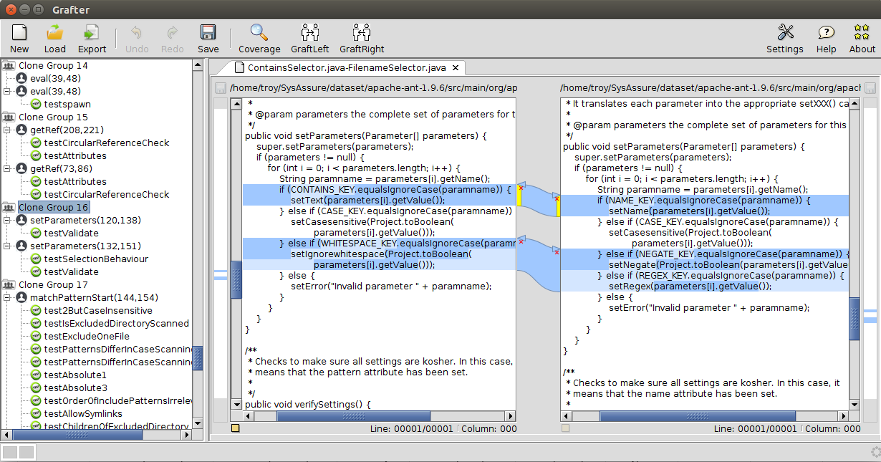
Grafter Screenshots
Our differential testing approach is implemented as a proof-of-concept tool called Grafter.
Notes:
Our approach is implemented as a proof-of-concept tool named Grafter.
Programmers can load code clones and their test cases into the tool and view their textual differences.
Programmers can also run and compare the behavior of clones as proposed.

Slide 17
Grafter Screenshots
Behavioral differences are represented in tables and highlighted for ease of investigation.
Notes:
The behavioral differences are represented in tables and highlighted in the red color for ease of investigation.
(In the test-level comparison table, the first column shows names of test cases. The second and third columns show whether each clone passes or fails the corresponding test case. The last column shows the comparison result. Green means both clones are consistent on this test and red means their test outcomes are different.
In the state-level comparison table, the first and third columns show the name of corresponding variables referenced by code clones, and the second and fourth columns show the values of variables in the format of XML. )

Slide 18
Evaluation Dataset
Our dataset contains 52 pairs of similar but not identical clones from 3 open source projects.
Subject | Version | Description | Clone Pair
Apache Ant | 1.9.6 | A software build framework | 18
Java APNS | 1.0.0 | A Java client for Apple Push Notification service (APNs) | 7
Apache XML Security | 2.0.5 | A XML signature and encryption library | 27
Notes:
Our dataset contains 52 pairs of similar but not identical clones from 3 open source projects.
In our evaluation, we target “similar but not identical clones on purpose because grafting for identical code is trivial.
In particular, our dataset includes 38 Type II clones and 14 Type III clones.
Explain subject programs.
We select these programs as they are well-known projects and have also been selected by previous studies on code clones.

Slide 19
Research Questions
RQ1. What is Grafter’s transplantation capability?
RQ2. How does Grafter compare with a static clone-related bug finding approach by Jiang et al. in its ability to detect differences in clones?
RQ3. How robust is Grafter in detecting potential behavioral inconsistencies?
Notes:
In our evaluation, we investigated three research questions.
In the first research question, we want to see, out of 52 pairs of clones, how many pairs Grafter can successfully transplant and reuse test on.
In the second research question, we want to check whether Grafter is more sensitive to behavioral differences in code clones compared with a static approach by Jiang et al.
As Grafter is proposed to detect behavior inconsistencies, we systematically inject mutants into clone pairs as bugs and check whether Grafter is capable of detecting behavioral inconsistencies induced by these mutants.

Slide 20
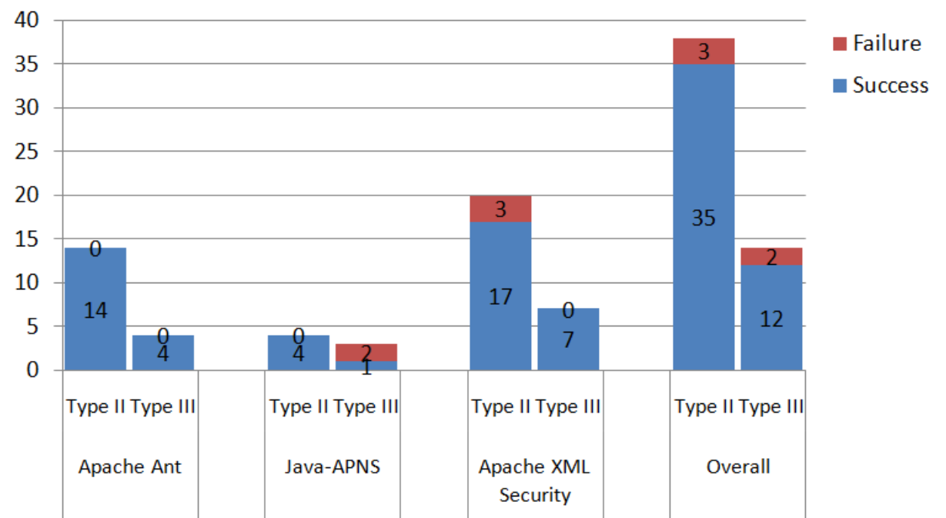
RQ1. Transplantation Success and Test Reuse Capability
Grafter successfully transplants 47 out of 52 pairs of clones and reuses tests on these 47 pairs of clones without inducing any compilation errors.
Notes:
So grafter successfully transplants 47 out of 52 pairs of clones in our dataset and reuses tests on these 47 pairs of clones without inducing any compilation errors.
In two pairs of Type III clones, grafter matches variables incorrectly when identifying variations between clones.
In 3 pairs of Type II clones, grafter fails to transform objects of different types because we made a conservative choice of only transforming hierarchically related types or structurally equivalent types to ensure the type safety of our approach.
(The transplantation failure on five pairs of clones shows that our transplantation rules are not complete and there are certain cases our approach cannot handle.)
But the fact that we can successfully reuse test in 90% cases is significant because currently there are no techniques that enable test reuse for similar but not identical clones.
In the context of software repair, this indicates that we can automatically expand test coverage for similarly repaired code.

Slide 21
Jiang et al.’s Clone Inconsistency Detection
Jiang et al. detect three types of syntactic inconsistencies between clones.
if (cmd_type == READ_M2){
msgbuf[xa_count*3] = 0;
msg(DBG_XA1, “xa head: %s\n”, msgbuf);
}
for (i = 0; i < response_count; i++) {
msgbuf[i*3] = 0;
msg(DBG_SQ1, “cc_ReadSubQ: %s\n”, msgbuf);
}
Example 1. Control Construct Inconsistency
if (length >=9 && strncmp (buffer, “EESOXSCSI”, 9) == 0) {
buffer += 9;
length += 9;
… }
if (length >=11 && strcmp (buffer, “CUMANNASCSI2”) == 0) {
buffer += 9;
length += 9;
… }
Example 2. Control Predicate Inconsistency
if (l_stride != NULL) {
mps_cdiv_q (X1, X1, l_stride->value);
if (l_stride != NULL) {
mps_cdiv_q (X1, X1, r_stride->value);
Example 3. Renaming Mistake
Notes:
We choose a static approach by Jiang et al. as the baseline of our comparison.
Jiang et al. detect three types of syntactic inconsistencies between clones, as shown in the three examples.
In the first example, the left clone is enclosed by a if statement while the right clone is enclosed by a for statement. Therefore they have inconsistent control flow dependencies.
In the second example, though both clones are in if branches, the if conditions are different. So these two clones are executed under inconsistent conditions.
In the third example, the right clone does a null checker on the variable l_stride, but then uses r_stride, which is actually a renaming mistake.

Slide 22
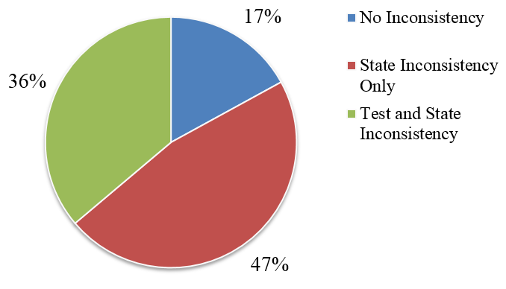
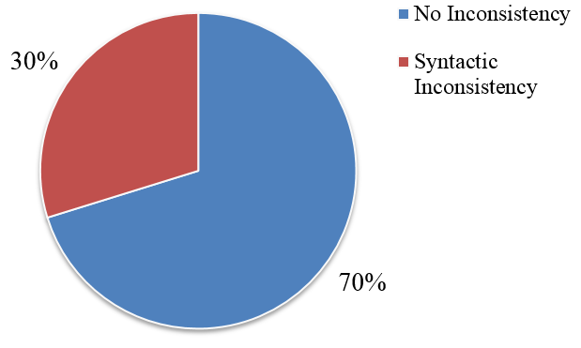
RQ2. Behavioral Difference Detection
Grafter exposes behavioral differences in 83% clone pairs while Jiang et al. detect syntactic inconsistency in 30% clone pairs only.
Grafter
Jiang et al.
Notes:
Grafter detects behavioral differences in 83% clone pairs while Jiang et al. detect syntactic inconsistencies in 30% clone pairs only.
（In particular, Grafter exposes test-level differences in 36% clone pairs and state-level differences in 83% clone pairs.）
This result shows that Grafter is more sensitive to behavioral differences than the static approach by Jiang et al.
(It is not surprising because Grafter actually runs code clones and compares their behavior while Jiang et al. is a static approximation about behavior differences between clones.)

Slide 23
RQ2. Behavioral Difference Detection
Grafter’s State-level Comparison
22
Grafter’s Test-level Comparison
Static Approach by Jiang et al.
9
8
6
Distribution of Inconsistencies Detected by Grafter and Jiang et al.
Notes:
This venn diagram presents a different view of our result.
It shows that grafter’s state-level comparison is more sensitive to behavior differences than both Grafter’s test-level comparison and Jiang et al.,
We also want to clarify that grafter’s test-level comparison did not detect some inconsistencies due to the insufficiency of test cases.
This result shows that our differential testing approach could complement a static approach by revealing fine-grained runtime differences.
(Please notice here we are not claiming that the more differences we detect, the better. Because under some circumstances, behavioral differences between similar code could be intended by programmers or may not interesting to programmers.
For example, we observe in one clone pair, one clone has an additional logging statement compared with its counterpart clone. Grafter’s state-level comparison detects the logging behavioral inconsistency by comparing the logger objects. Jiang et al. detect the extra log statement as a renaming mistake. However, Grafter’s test comparison does not expose a test outcome difference because the test oracle does not check the log behavior the program. In general, logging is usually for the development purpose and differences in logging behavior is often considered “harmless” in practice. So the logging behavioral differences may not be interesting to programmers. )

Slide 24
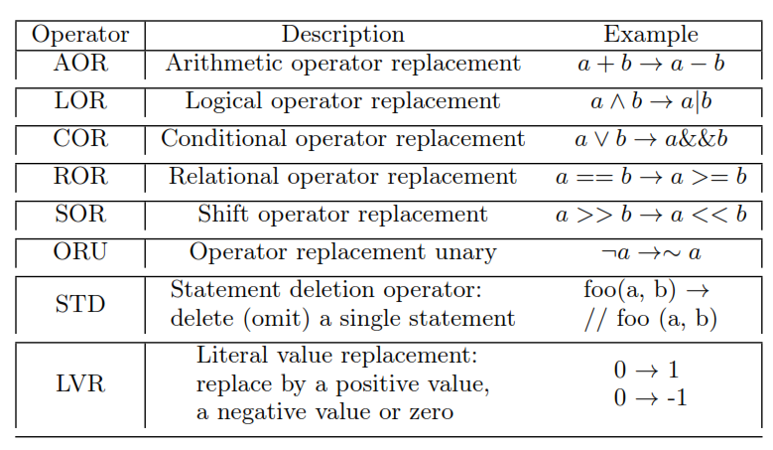
RQ3. Robustness
We systematically injected 361 mutants as artificial bugs on 30 pairs of clones with no existing test behavioral differences
We compare its bug detection capability with a static approach by Jiang et al.
Notes:
Now our goal is to demonstrate that Grafter can help detect potential inconsistencies in a robust manner.
Therefore we design a mutation experiment. We systematically injected 361 mutants as artificial bugs on 30 pairs of clones with no existing test behavioral differences .
We use an existing mutation analysis framework Major to inject 8 kinds of mutations. Here shows a mutation example.
Before injecting the mutant, both programs check whether the input parameter is null in the first if condition.
After mutating, the left clone checks whether the local variable type is not null, which is inconsistent with the right clone.
So our goal here is to check whether Grafter is capable of exposing the behavioral difference caused by this mutant.
Our hypothesis is that our tool must be sensitive to notice these behavior inconsistencies when we artificially injectmutation bugs.

Slide 25
RQ3. Robustness
public void setType(String type) {
if ( type == null && type.length() == 0){
this.type = null;
} else {
URI tmpType = null;
try {
tmpType = new URI(type);
} catch (URISyntaxException ex) {
…
}
this.type = tmpType.toString();
}
}
public void setEncoding(String encoding) {
if (encoding == null && encoding.length() == 0){
this.encoding = null;
} else {
URI tmpEncoding = null;
try {
tmpEncoding = new URI(encoding);
} catch (URISyntaxException ex) {
…
}
this.encoding = tmpEncoding.toString();
}
}
type != null
Mutation Example from Apache XML Security
Notes:
Now our goal is to demonstrate that Grafter can help detect potential inconsistencies in a robust manner.
Therefore we design a mutation experiment. We systematically injected 361 mutants as artificial bugs on 30 pairs of clones with no existing test behavioral differences .
We use an existing mutation analysis framework Major to inject 8 kinds of mutations. Here shows a mutation example.
Before injecting the mutant, both programs check whether the input parameter is null in the first if condition.
After mutating, the left clone checks whether the local variable type is not null, which is inconsistent with the right clone.
So our goal here is to check whether Grafter is capable of exposing the behavioral difference caused by this mutant.
Our hypothesis is that our tool must be sensitive to notice these behavior inconsistencies when we artificially injectmutation bugs.

Slide 26
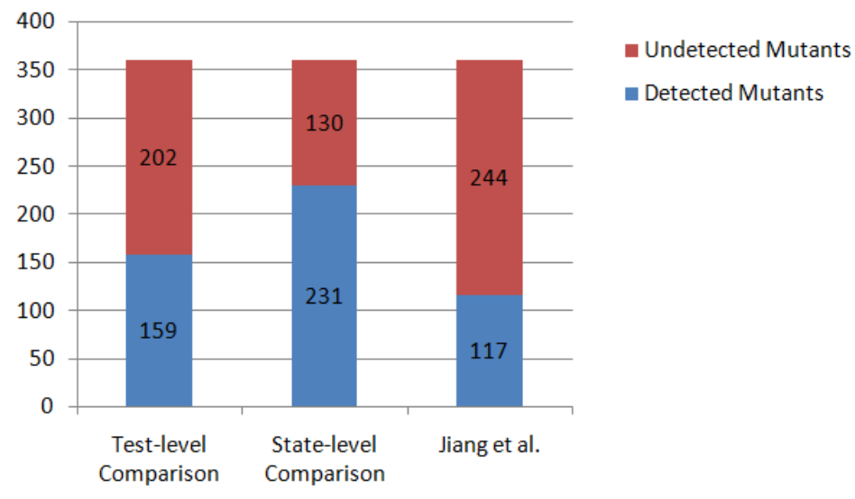
RQ3. Robustness
Grafter detects 36% more mutants using the test-level comparison and almost 2X more mutants using the state-level comparison compared with Jiang et al.
Notes:
So grafter detects 36% more mutants using the test-level comparison and almost twice more mutants using the state-level comparison.
Therefore our hypothesis is correct --- grafter is indeed more effective in revealing behavioral inconsistencies than a static approach.

Slide 27
Future work
We will investigate how the idea of Grafter can applied to different pilot systems such as APMRover and ArduCopter.
We will investigate how to automatically port similar checkers (e.g., input validation, error handling) between different pilot systems to improve the robustness of pilot systems
Notes:
Currently Grafter works with code clones from the same project.
In the next step, we want to investigate its capability to detect behavioral divergence across different pilot systems such as APMRover and AdruCopter.
We will investigate the feasibility of automatically porting similar checkers (e.g., input validation, error handling) between different pilot systems to improve the robustness of pilot systems
-----------------------------------------------------------------------------
For example, suppose the pilot systems for land rover and quadcopter have some similar code. If a repair is applied in the pilot system for land rover and a similar repair is applied to the pilot system of quadcopter, we want to guarantee the consistency of these similar repairs by cross-checking their correctness using Grafter.
We observe a lot of repairs on small pieces of code clones in the Ardupilot system. This small pieces of code clones are recognized as micro-clones recently in academia. Such similar, small repairs involve a lot of manual labor to fix. An inconsistent edit or missing edit can alter the program behavior significantly. I am envisioning an interactive recommendation system that can detect and port such small repairs across micro-clones.

Slide 28
Q&A

Slide 31
RQ3. Robustness
We systematically injected 361 mutants as artificial bugs on 30 pairs of clones with no existing test behavioral differences
We compare its bug detection capability with a static approach by Jiang et al.
public void setType(String type) {
if ( type == null && type.length() == 0){
this.type = null;
} else {
URI tmpType = null;
try {
tmpType = new URI(type);
} catch (URISyntaxException ex) {
…
}
this.type = tmpType.toString();
}
}
public void setEncoding(String encoding) {
if (encoding == null && encoding.length() == 0){
this.encoding = null;
} else {
URI tmpEncoding = null;
try {
tmpEncoding = new URI(encoding);
} catch (URISyntaxException ex) {
…
}
this.encoding = tmpEncoding.toString();
}
}
type != null
Apache XML Security
Notes:
Now our goal is to demonstrate that Grafter can help detect potential inconsistencies in a robust manner.
Therefore we design a mutation experiment. We systematically injected 361 mutants as artificial bugs on 30 pairs of clones with no existing test behavioral differences .
We use an existing mutation analysis framework Major to inject 8 kinds of mutations. Here shows a mutation example.
Before injecting the mutant, both programs check whether the input parameter is null in the first if condition.
After mutating, the left clone checks whether the local variable type is not null, which is inconsistent with the right clone.
So our goal here is to check whether Grafter is capable of exposing the behavioral difference caused by this mutant.
Our hypothesis is that our tool must be sensitive to notice these behavior inconsistencies when we artificially injectmutation bugs.

Slide 33
RQ3. Behavioral Inconsistency Detection Robustness
We injected 302 mutants on 17 pairs of clones with existing test behavioral differences and evaluate whether Grafter is capable of detecting additional behavioral divergence or convergence induced by mutants.
Grafter detects 165 mutants using test-level comparison and 201 mutants using state-level comparison while Jiang et al. detect 85 mutants.
In particular, we observe further behavioral divergence exposed by additional test cases in 61 mutants (e.g., previously both succeeded now one succeeds but one fails) and behavioral convergence in existing test cases in 104 mutants (e.g., previously one succeeded and one failed but now both fail).
Notes:
Remove this slide

Slide 34
@Test
public void testCopy(){
Task copyTask = FileUtils.createTask(FileUtils.COPY);
… other code to set up the task …
copyTask.setInclude(“src/*.java, test/*.java”);
JobHandler.fireEvent(copyTask);
assertTrue(checkFileCopied());
}
The setExcludes method in the Delete class is not exercised by the existing test suite so regression testing is not able to detect the bug.

