Slide 1
Generating Novel Reflectance Functions
Adam Brady

Slide 2
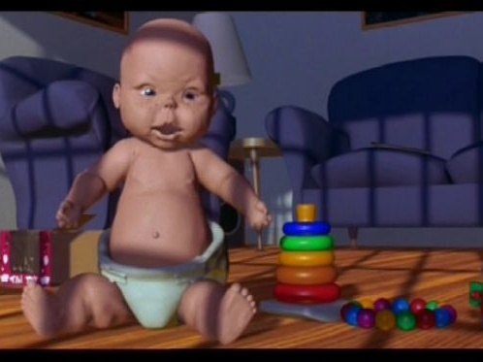

Slide 3
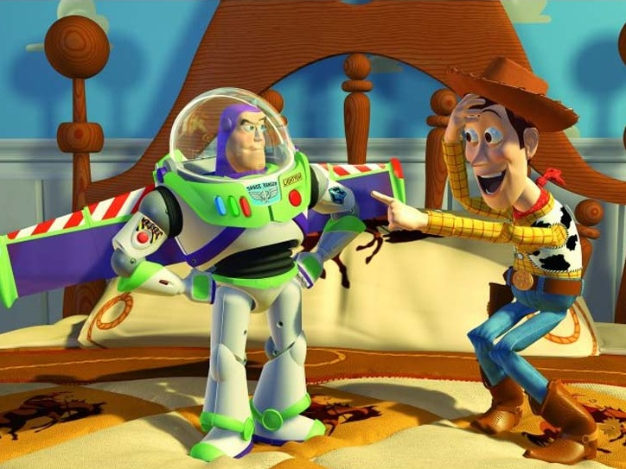

Slide 4
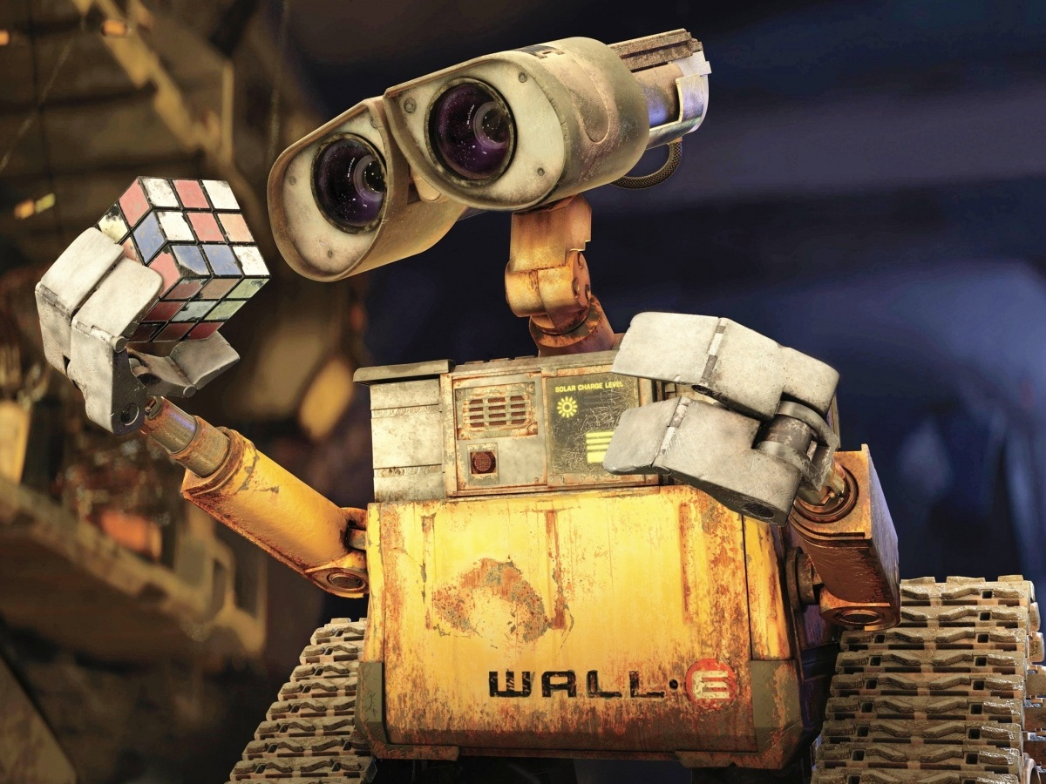

Slide 5
?

Slide 6
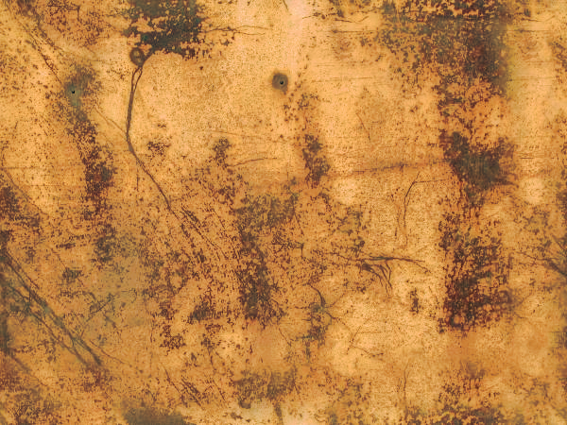

Slide 9
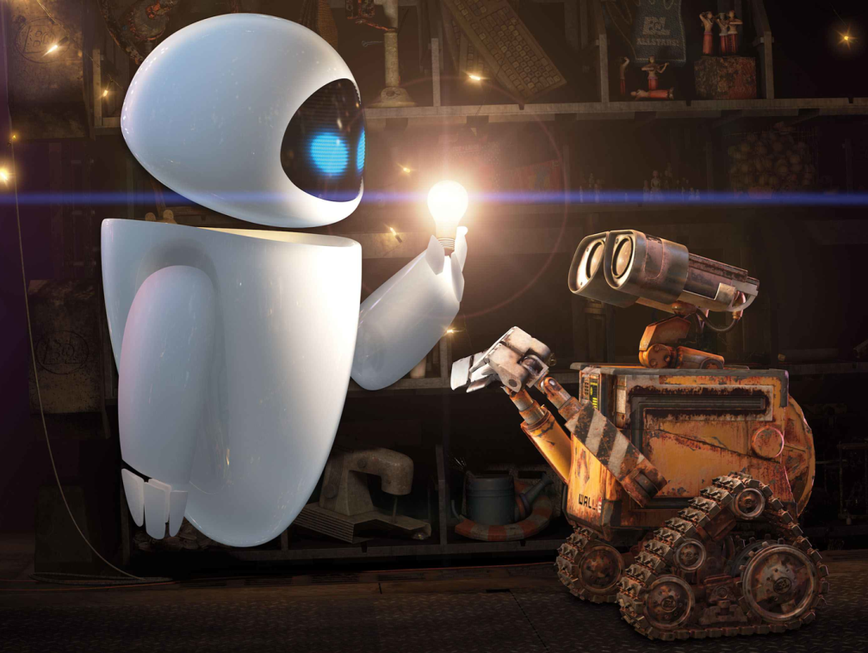
?

Slide 12
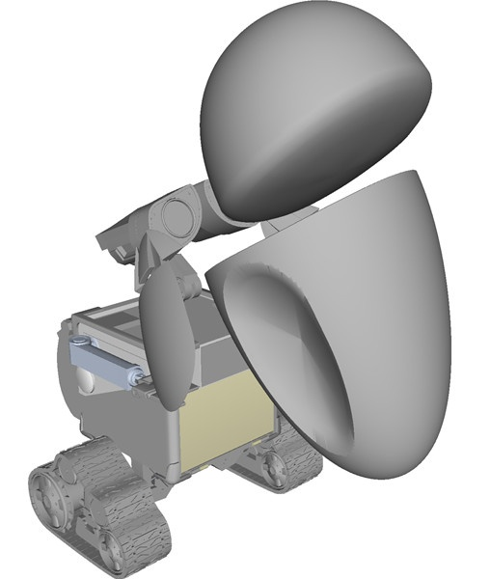
…

Slide 13
?

Slide 14
Materials are More Than Color
When light strikes a surface, it scatters
Realistic rendering depends on how this reflectance is distributed.

Slide 15
Formalizing Reflectance
We model material reflectance using a
Bidirectional
Reflectance
Distribution
Function
…or BRDF
The BRDF defines the fraction of incoming light reflected along an outgoing direction

Slide 16
How Do Artists Use BRDFs?

Slide 17
How Do Artists Use BRDFs?

Slide 18
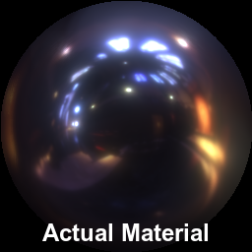
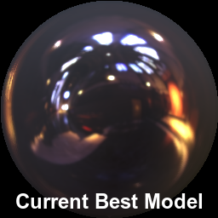
…but these models can’t accurately capture many real world materials

Slide 19
Why should we care?
Modern CGI movies frequently rely on stylizing even “photorealistic” scenes
Mask material inaccuracies

Slide 21
Why should we care?
Modern CGI movies frequently rely on stylizing even “photorealistic” scenes
Mask material inaccuracies
Better BRDFs can save time & money
Less time spent tweaking poor models

Slide 22
Why should we care?
Modern CGI movies frequently rely on stylizing even “photorealistic” scenes
Mask material inaccuracies
Better BRDFs can save time & money
Less time spent tweaking poor models
Modeling real materials is even more important in other domains

Slide 23
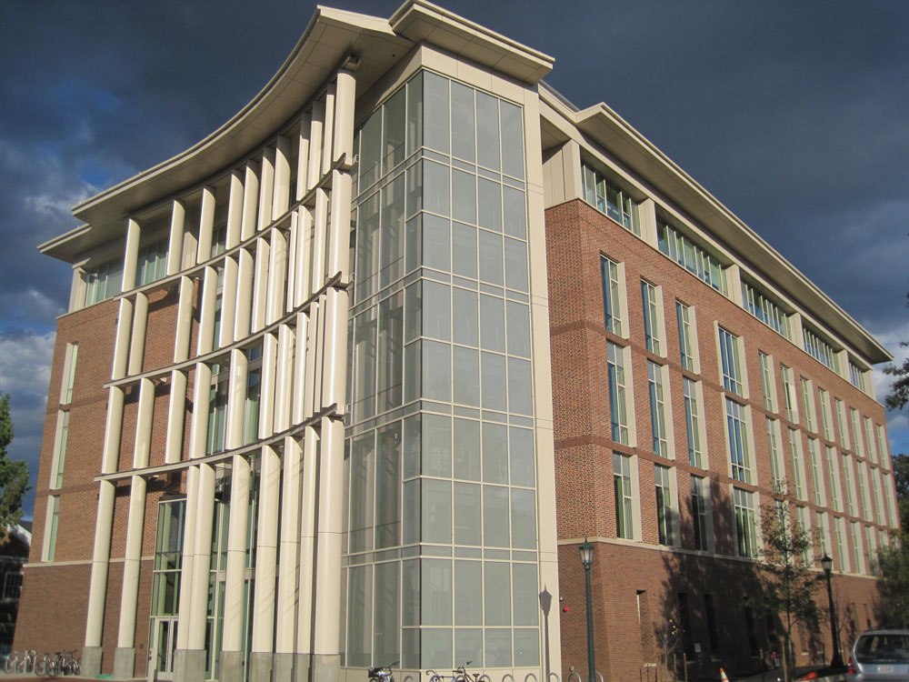

Slide 24
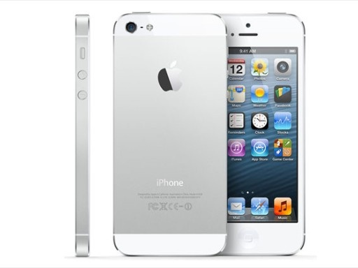

Slide 25
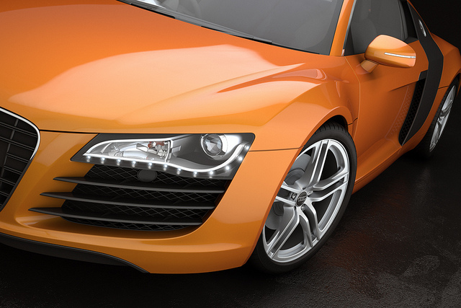

Slide 26
Project Goal:
Make Better BRDFs!

Slide 27
How are BRDFs produced?
Two different strategies exist, but each has limitations
Define the BRDF as a continuous, analytic math expression
Measure discrete samples of the BRDF and record as a big table

Slide 28
Strategy 1: Analytic BRDF
Think hard, write an adjustable equation
fit observations or approximate physics

Slide 29
Analytic BRDF Issues
Finding fundamental approximations of the natural world is hard
Very few analytic BRDFs exist
Simplifying assumptions limit accuracy:

Slide 30
Strategy 2: Measured BRDF
Measure a BRDF using a gonio-reflectometer
Store this as a big lookup table

Slide 31
Problems with Measured BRDFs
The table is HUGE
Millions of samples needed
Data only describes one material
Doesn’t offer insight into similar materials

Slide 32
We Need a Better Way
Analytic BRDFs are compact, general, and adjustable…
But inaccurately model real materials
Measured data is accurate..
But HUGE and static

Slide 33
We Need a Better Way
Analytic BRDFs are compact and contain adjustable parameters…
But can be inaccurate for real materials
Measured data is accurate..
But HUGE and static
Solution:
Create new analytic BRDFs that
better model measured BRDF data

Slide 34
Project Outline
Create way to generate new analytic BRDFs
Devise an error metric that evaluates how well a new BRDF matches a measured BRDF
Use heuristic search to find new, better BRDFs using our similarity metric

Slide 35
Insights
How to create new analytic BRDFs?

Slide 36
Insights
How to create new analytic BRDFs?
Current analytic BRDFs roughly approximate most materials

Slide 37
Insights
How to create new analytic BRDFs?
Current analytic BRDFs roughly approximate most materials
Solution: Modify existing analytic BRDFs

Slide 38
Insights
How to create new analytic BRDFs?
Current analytic BRDFs roughly approximate most materials
Solution: Modify existing analytic BRDFs
How to measure error?

Slide 39
Insights
How to create new analytic BRDFs?
Current analytic BRDFs roughly approximate most materials
Solution: Modify existing analytic BRDFs
How to measure error?
Ultimate goal is accurate rendering

Slide 40
Insights
How to create new analytic BRDFs?
Current analytic BRDFs roughly approximate most materials
Solution: Modify existing analytic BRDFs
How to measure error?
Ultimate goal is accurate rendering
Solution: Measure error between two rendered images, each using a different BRDF

Slide 41
INPUT
Error: 0.4523

Slide 42
INPUT
Error: 0.4523
MUTATE

Slide 43
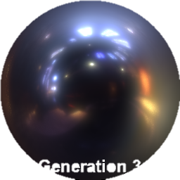
INPUT
EVALUATE FITNESS
Compare
Error: 0.4523
Error: ?
MUTATE

Slide 44
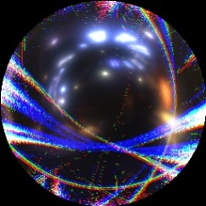
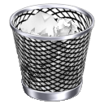
INPUT
EVALUATE FITNESS
Compare
Error: 0.9702
DISCARD
ACCEPT
Error: 0.4523
Error: ?
Error: 0.3201
MUTATE

Slide 45
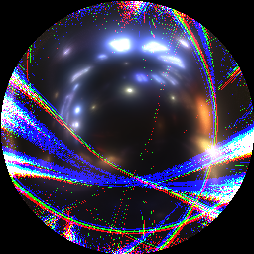
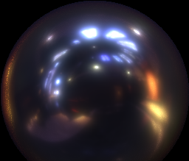
INPUT
EVALUATE FITNESS
Compare
Error: 0.9702
DISCARD
ACCEPT
Error: 0.4523
Error: ?
Error: 0.3201
Error: 0.012
MUTATE
OUTPUT

Slide 46
Implementing BRDF Creation
Represent new BRDFs as a list of expression-level edits to an existing BRDF expression
i.e., modify the abstract syntax tree of an analytic BRDF
Insert, Remove, Swap, and Replace nodes in the AST

Slide 47
Implementing Evaluation
Fit parameters for each new BRDF
We use a Nelder Mead Simplex Method
Guide search using BRDF error metric
Report residual error when search converges

Slide 48
BRDF Error Metric
Measure BRDF similarity using renders
Based on work by Pereira & Rusinkiewicz

Slide 49
BRDF Error Metric
Measure BRDF similarity using renders
Based on work by Pereira & Rusinkiewicz
Each render consists of:
A sphere (covers full range of $ω_{o}$)
A lighting environment (covers full range of $ω_{i}$)

Slide 50
BRDF Error Metric
Measure BRDF similarity using renders
Based on work by Pereira & Rusinkiewicz
Each render consists of:
A sphere (covers full range of $ω_{o}$)
A lighting environment (covers full range of $ω_{i}$)
Error is the L² norm over each light contribution when rendering the scene
This metric can be evaluated quickly on GPUs

Slide 51
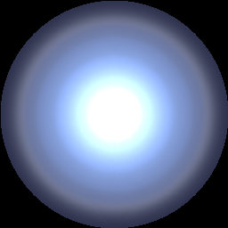
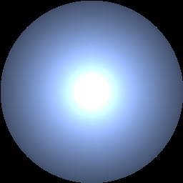

Slide 52
Putting it All Together
Iteratively create lots of analytic BRDFs
Fit each new BRDF to a set of target measured BRDFs
Find the BRDF that best fits all materials

Slide 53
Experiments

Slide 54
Experiments
Modify the Cook Torrance BRDF to better match two classes of materials
One BRDF for Metallic materials
One BRDF for Dielectric materials (plastics, acrylics, etc.)
Use measured BRDFs from the publicly available MERL BRDF database

Slide 55
MERL BRDF Materials
Metals
Dielectrics

Slide 56
Experiment Setup
Choose 20 materials from MERL
Learn using 4 diverse materials
Test against remaining 16 materials
Run search for 100 generations with a population size of 4096
Compare rendered images of best BRDF found with original Cook Torrance

Slide 57
Success Metrics
Accuracy:
Do renders using BRDF accurately match renders of measured BRDF?
Use a separate perceptual error metric

Slide 58
Success Metrics
Accuracy:
Do renders using BRDF accurately match renders of measured BRDF?
Use a separate perceptual error metric
Generality:
Can it represent similar materials not used in the initial search?

Slide 59
Success Metrics
Accuracy:
Do renders using BRDF accurately match renders of measured BRDF?
Use a separate perceptual error metric
Generality:
Can it represent similar materials not used in the initial search?
Tunability:
Can we manually adjust parameters and still get a useful BRDF?

Slide 60
New Metal BRDF

Slide 61
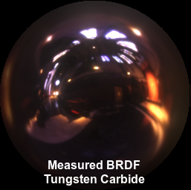
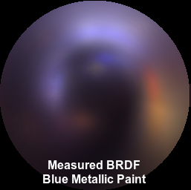

Slide 62
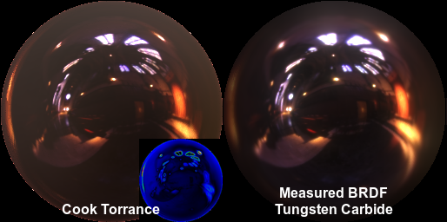
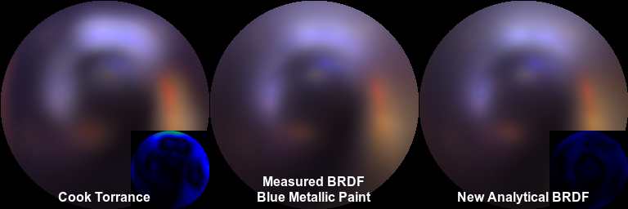

Slide 63
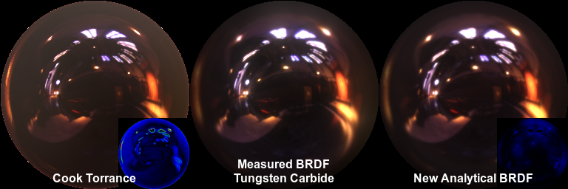

Slide 64
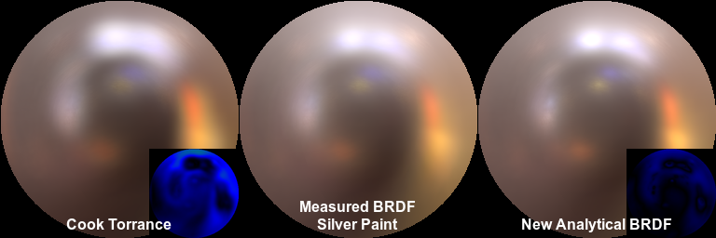
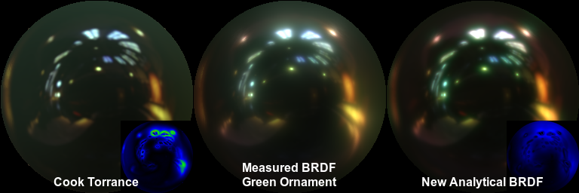

Slide 66
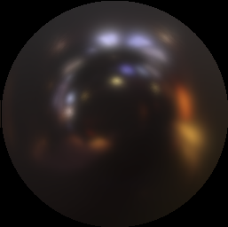

Slide 68
New Dielectric BRDF

Slide 69
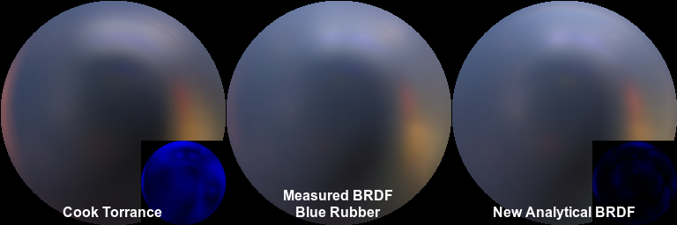
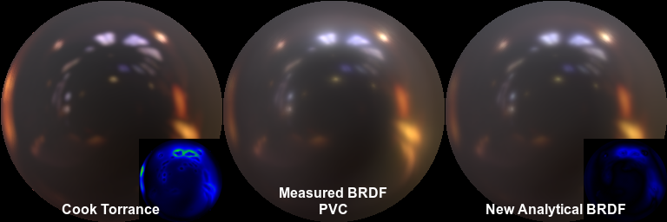

Slide 70
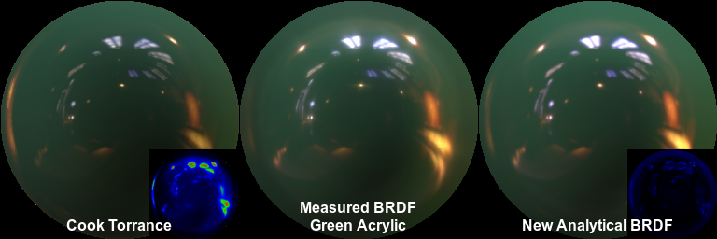
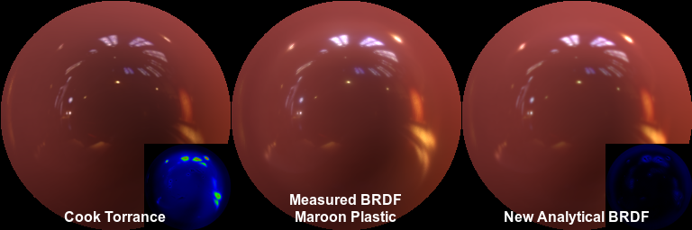

Slide 73
Conclusion
This new technique automatically synthesizes new BRDFs that are accurate, generalizable, and adjustable
For a set of 20 metal and 20 dielectric materials, our new BRDFs always outperform the best existing model

Slide 74
Questions?

Slide 75
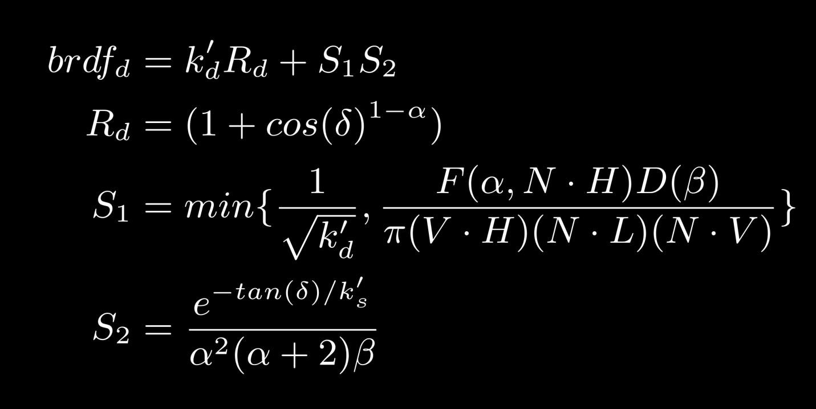
New Dielectric BRDF

Slide 76
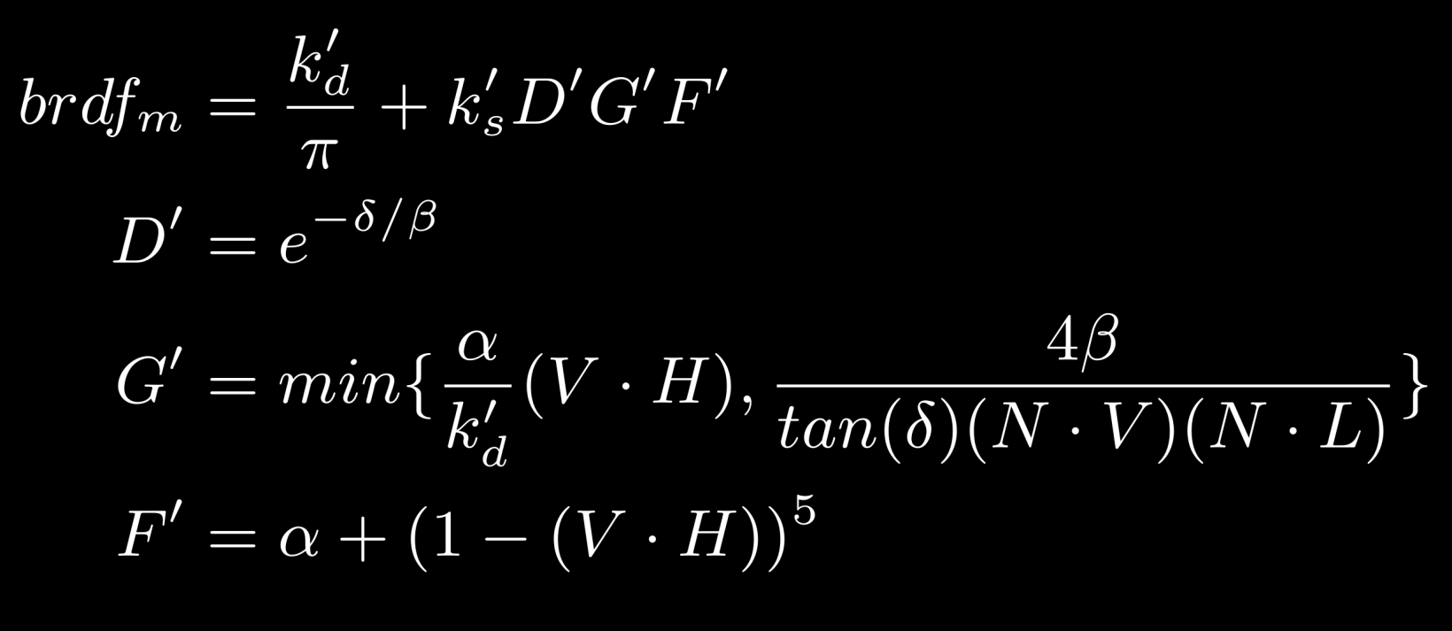
New Metal BRDF

