Slide 2

Decision Procedures for String Constraints
Pieter Hooimeijer

Slide 3

http://en.wikipedia.org/wiki/Osborne_1

Slide 4
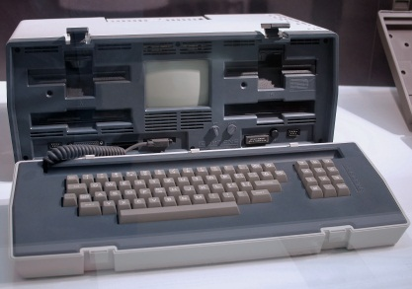
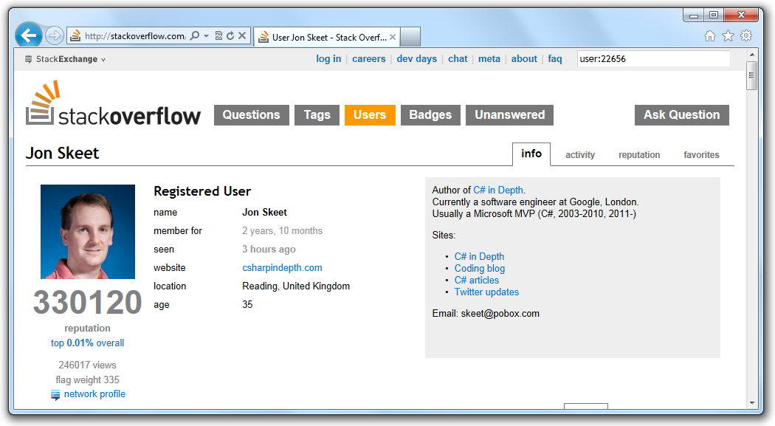

Slide 5
<img src='untrusted input'/>

Slide 6
What could
possibly go wrong?

Slide 7
<img src='untrusted input'/>
Attacker:
im.png' onload='javascript:...

Slide 8
<img src='untrusted input'/>
Attacker:
im.png' onload='javascript:...

Slide 9
<img src='untrusted input'/>
Attacker:
im.png' onload='javascript:...
<img src='im.png' onload ='j

Slide 10
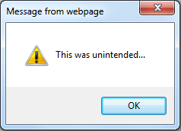
<img src='untrusted input'/>
Attacker:
im.png' onload='javascript:...
<img src='im.png' onload ='j

Slide 11


Slide 12
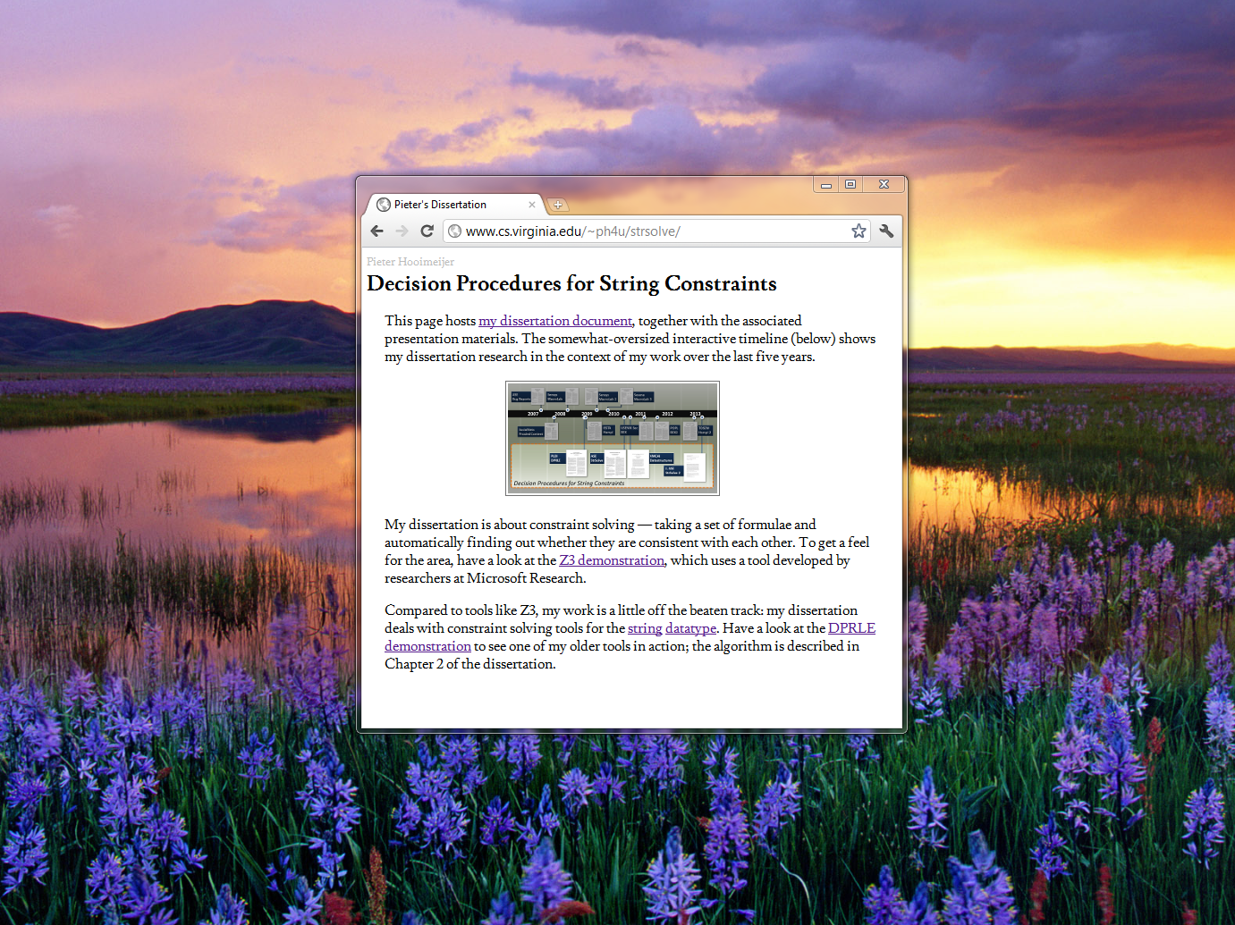
www.cs.virginia.edu/~ph4u/

Slide 13
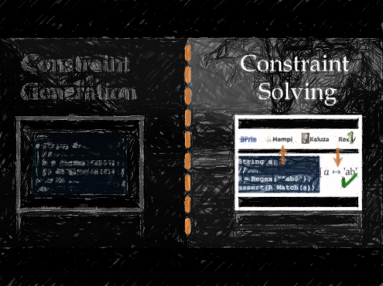
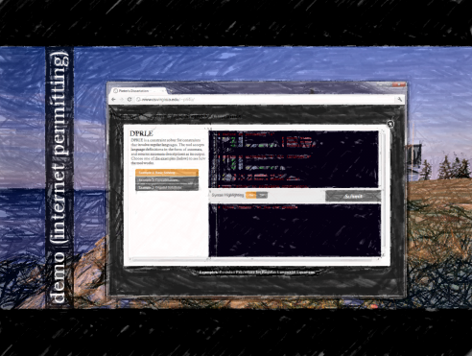
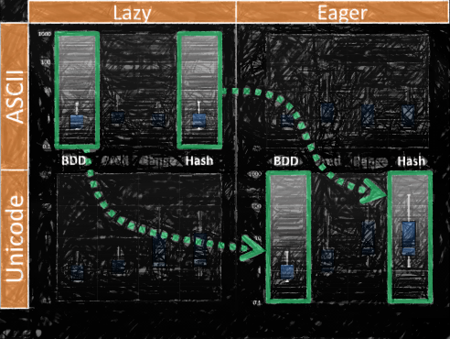
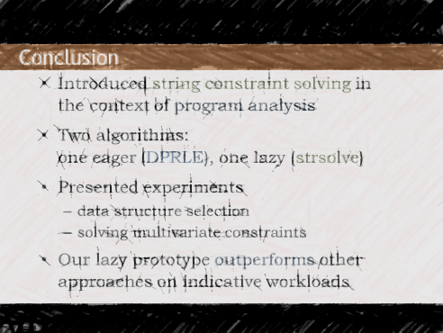
Talk Outline
Background
Building
Tuning
Conclusion

Slide 14
Talk Outline
Background
Building
Tuning
Conclusion

Slide 15


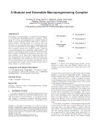
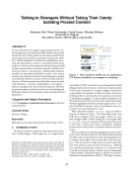
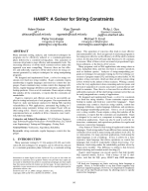
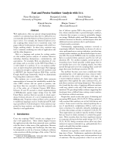
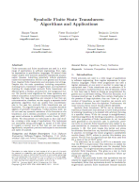
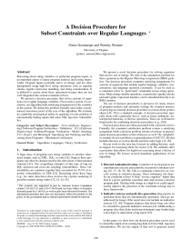
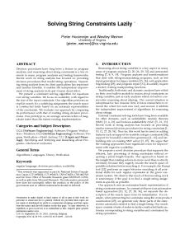
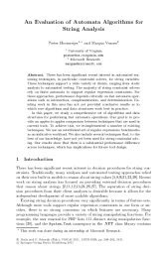
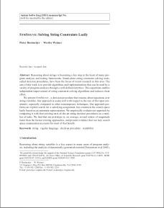
ASE
Bug Reports
Sensys
MacroLab
Sensys
MacroLab 2
Sesena
MacroLab 3
2007
2008
2009
2010
2011
2012
2013
SocialNets
Proxied Content
ISSTA
Hampi
USENIX Sec
BEK
POPL
BEK2
TOSEM
Hampi 2
PLDI
DPRLE
ASE
StrSolve
VMCAI
Data structures
J. ASE
StrSolve 2

Slide 16
ASE
Bug Reports
Sensys
MacroLab
Sensys
MacroLab 2
Sesena
MacroLab 3
2007
2008
2009
2010
2011
2012
2013
SocialNets
Proxied Content
ISSTA
Hampi
USENIX Sec
BEK
POPL
BEK2
TOSEM
Hampi 2
PLDI
DPRLE
ASE
StrSolve
VMCAI
Data structures
J. ASE
StrSolve 2
This Talk

Slide 17



Decision Procedures
Program analysis work frequently uses one of these:
They solve mathematical constraints
There is a standard input format

Slide 18
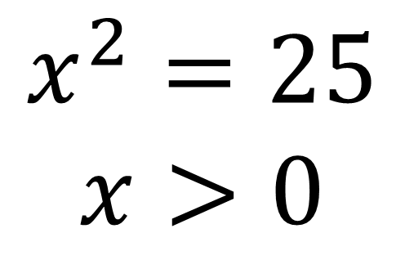
Example
$$x^{2}=25$$
$$x>0$$

Slide 19
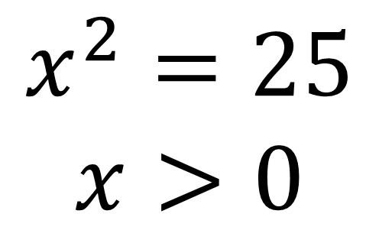

$$x^{2}=25$$
$$x>0$$
(declare-fun x () Int)
(assert (= (* x x) 25))
(assert (> x 0))
(check-sat)
(get-model)
✔
$$[ x↦\text{5}]$$

Slide 20
Motivation
Reasoning about strings is difficult:
  for programmers
  for automated tools

Slide 21


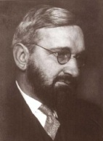
String Constraint Solvers
Hampi
Kaluza
Rex

Slide 22
Hampi
Kaluza
Rex
String a;
//...
R = Regex("^ab$");
assert(R.Match(a));
String a;
//...
R = Regex("^ab$");
R.IsMatch(a) = true;

Slide 23
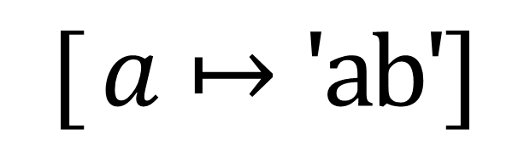
Hampi
Kaluza
Rex
String a;
//...
R = Regex("^ab$");
assert(R.Match(a));
String a;
//...
R = Regex("^ab$");
R.IsMatch(a) = true;
$$[ a↦\text{′}\text{ab}\text{′}]$$
✔

Slide 24
solvers
Hampi
Kaluza
Rex
String a;
//...
R = Regex("^ab$");
assert(R.Match(a));
String a;
//...
R = Regex("^ab$");
R.IsMatch(a) = true;
$$[ a↦\text{′}\text{ab}\text{′}]$$
✔
constraints
solution(s)

Slide 25
What should we model?

Slide 26
Example
How hard is regex
matching in Perl?

Slide 27
A: Just as hard as 3-SAT…
$istr = '^' . ('(x?)' x $V) . ".*;\n"
$ireg = '^' . ('(x?)' x $V) . ".*;\n"
. join('',
map {'(?:'
. join('|',
map { $_ < 0
? ('\\' . -$_ . 'x')
: ('\\' . $_ )
} @$_ )
. "),\n"
} @Clauses );
http://perl.plover.com/NPC/NPC-3SAT.html

Slide 28
Where do
constraints come from?

Slide 29
Code
String a;
// ...
R = Regex("^ab$");
if (R.IsMatch(a)) {
// ...
}

Slide 30
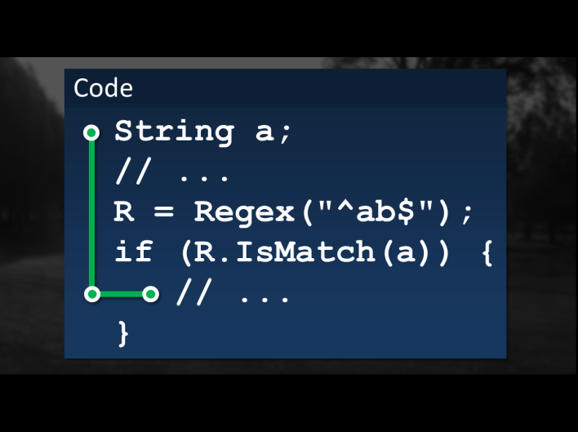
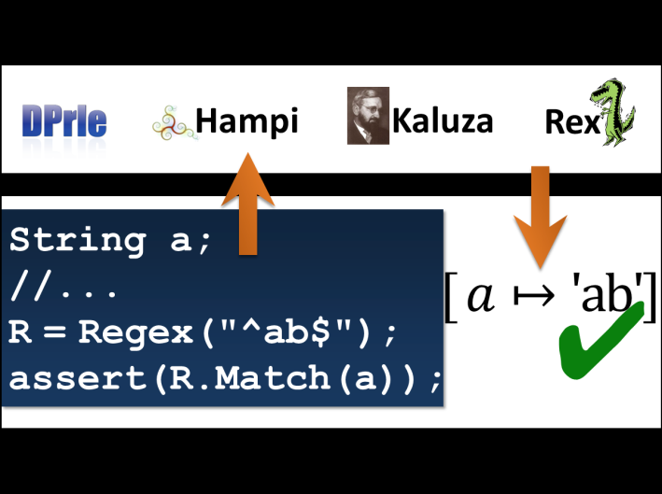
Constraint
Generation
Constraint
Solving

Slide 31
Constraint
Generation
Constraint
Solving

Slide 32
Talk Outline
Background
Building
Tuning
Conclusion

Slide 33
Chapter 2: Defining String Constraints
Contributions:
The definition of the regular matching assignments problem
An algorithm, its implementation, and correctness proof
An evaluation, applying (2) to a static analysis problem

Slide 34
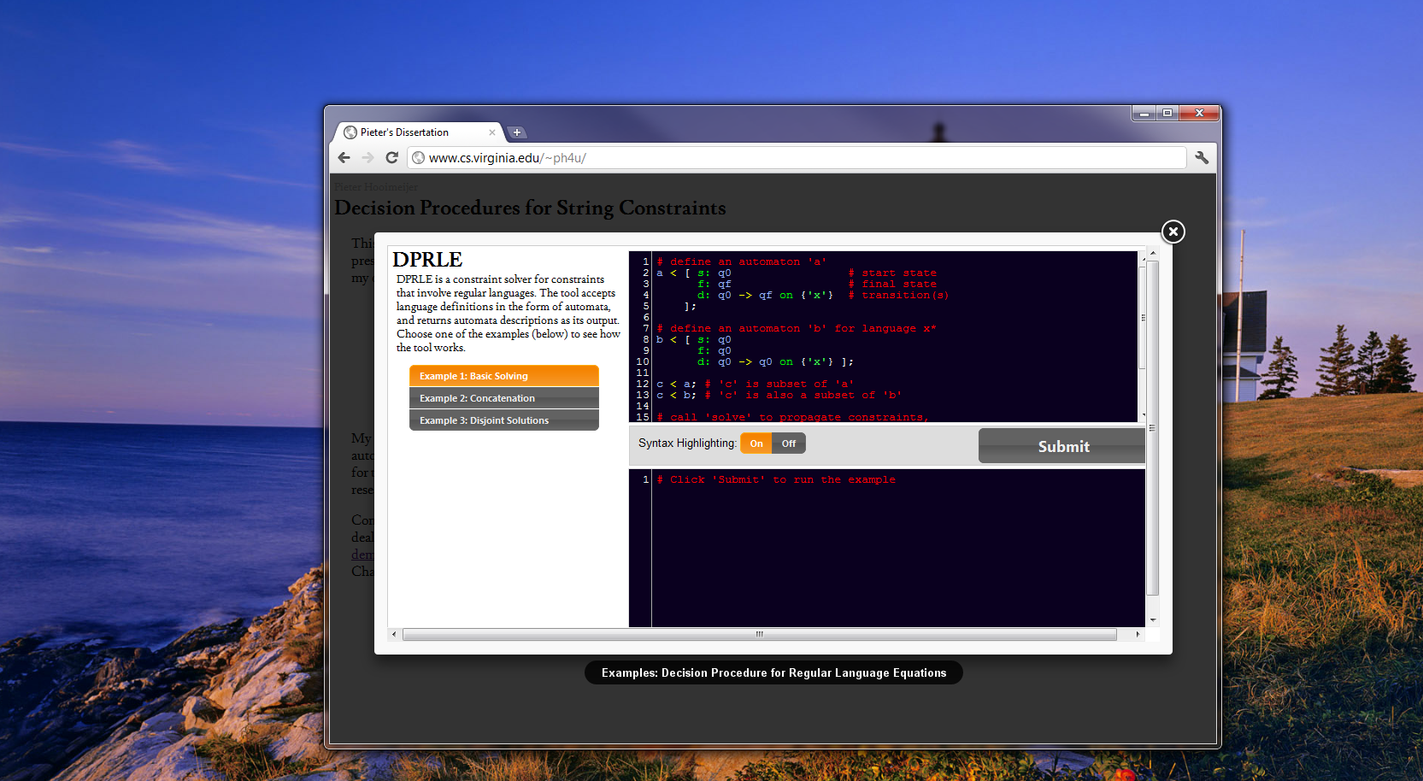
demo (internet permitting)

Slide 35
Evaluation
The Task:
  generate string inputs that exercise 17 known vulnera-bilities in 30,000 lines of PHP
Metric:
  running time

Slide 36
Results
Our constraint definition is sufficiently expressive to capture the constraints of interest
Wall-clock running time is between 0.01 seconds and 10 minutes

Slide 37
Talk Outline
Background
Building
Tuning
Conclusion

Slide 38
Chapter 3: Evaluating Data Structures
Contribution:
An apples-to-apples performance comparison of data structures and algorithms for automata-based string constraint solving

Slide 39
Motivation
Existing work provided tool-to-tool performance comparisons
Confounds: Performance gains may be due to external factors

Slide 40
The Framework
Based on Rex
Fixes external factors:
  front-end parser
  regex-to-automaton conversion
  implementation language
  search tree

Slide 41
Study Design
Tasks:
  automaton intersection
  automaton subtraction
Metric:
  running time

Slide 42
Character Sets
BDD
Pred
Range
Hash
binary decision diagrams
symbolic bitvector ranges in DNF
concrete set of character ranges
concrete set of individual characters

Slide 43


Task 1 (55x):
$$w∈L(a)∩L(b)$$
Task 2 (100x):
$$w∈L(a)∖L(b)$$

Slide 44
Eager
Lazy
Task 1 (55x):
$$w∈L(a)∩L(b)$$
Task 2 (100x):
$$w∈L(a)∖L(b)$$

Slide 45
Eager
Lazy
Task 1 (55x):
$$w∈L(a)∩L(b)$$
Unicode
Unicode
ASCII
ASCII
Task 2 (100x):
$$w∈L(a)∖L(b)$$
Unicode
Unicode
ASCII
ASCII

Slide 46
Results
Eager
Lazy
Task 1 (55x):
$$w∈L(a)∩L(b)$$
Unicode
Unicode
ASCII
ASCII
Task 2 (100x):
$$w∈L(a)∖L(b)$$
Unicode
Unicode
ASCII
ASCII

Slide 47
Lazy
Eager
ASCII
BDD Pred Range Hash
BDD Pred Range Hash
Unicode

Slide 48
Lazy
Eager
ASCII
BDD Pred Range Hash
BDD Pred Range Hash
Unicode

Slide 49
Chapter 4: Solving String Constraints Lazily
Contributions:
A novel (lazy) algorithm for solving multivariate string constraints
A comprehensive performance evaluation

Slide 50
Motivation
More scalable algorithms are more likely to see real use

Slide 51
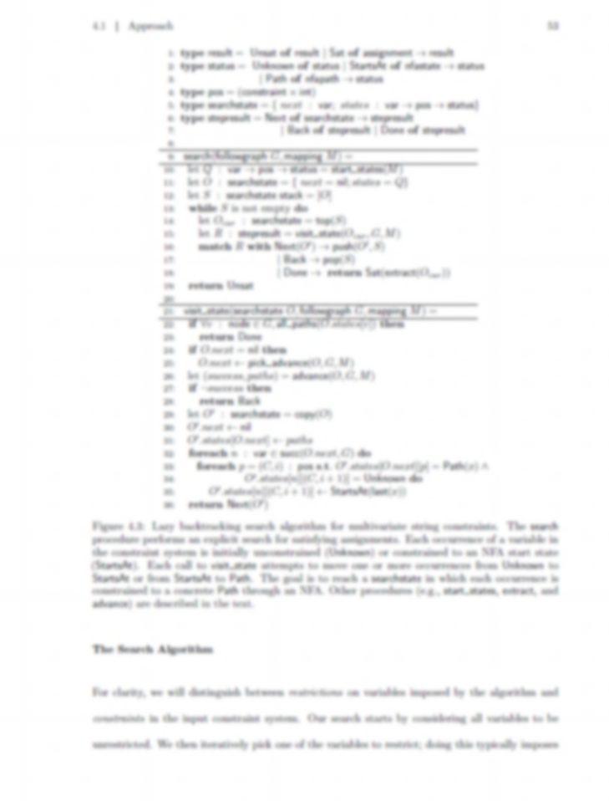
Approach
Eagerly construct a
high-level representation
of the search space
Explore the search space
lazily, adding restrictions
for one variable at a time

Slide 52
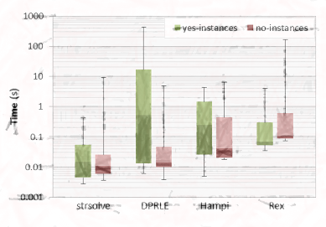
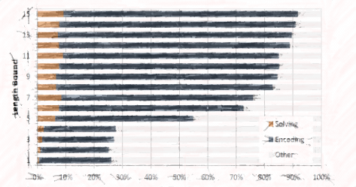
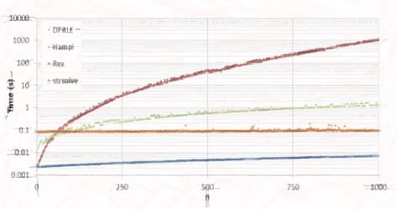
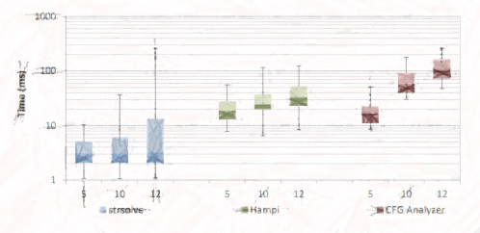
Evaluation
Long
Strings
CFG
Intersection
Difference
Hampi

Slide 53

Evaluation
Long
Strings
CFG
Intersection
Difference
Hampi

Slide 54
Hampi: Background
2007
2008
2009
2010
2011
2012
2013
SocialNets
Proxied Content
ISSTA
Hampi
USENIX Sec
BEK
POPL
BEK2
TOSEM
Hampi 2
PLDI
DPRLE
ASE
StrSolve
VMCAI
Data structures
J. ASE
StrSolve 2

Slide 55
Hampi: Background
2007
2008
2009
2010
2011
2012
2013
SocialNets
Proxied Content
ISSTA
Hampi
USENIX Sec
BEK
POPL
BEK2
TOSEM
Hampi 2
PLDI
DPRLE
ASE
StrSolve
VMCAI
Datastructures
J. ASE
StrSolve 2

Slide 56
Hampi: Architecture
Hampi
STP (bv)
MiniSAT

Slide 57
Hampi
encoding
STP (bv)
solving
MiniSAT

Slide 58
Experiment
Task:
  regex difference
  (same dataset as before)
Metric:
  proportion of wall-clock time spent solving

Slide 59
Results
15
10
5
1
Proportion of Running time

Slide 60
Results
15
10
5
1

Slide 61
Results
15
10
Proportion of Running Time
5
1

Slide 62
Evaluation
Long
Strings
CFG
Intersection
Difference
Hampi

Slide 63
Experiment
Task:
  intersect two regexes parameterized on n:
[a-c]*a[a-c]{n+1}
and
[a-c]*b[a-c]{n}
Metric:
  running time

Slide 64

Participating Tools
Hampi
Rex
Strsolve

Slide 65


Results
Hampi
Rex
Strsolve
n

Slide 66
Talk Outline
Background
Building
Tuning
Conclusion

Slide 67
Conclusion
Introduced string constraint solving in the context of program analysis
Two algorithms:
one eager (DPRLE), one lazy (strsolve)
Presented experiments
  data structure selection
  solving multivariate constraints
Our lazy prototype outperforms other approaches on indicative workloads

Slide 68
Thanks for stopping by!
www.cs.virginia.edu/~ph4u/

