Slide 1
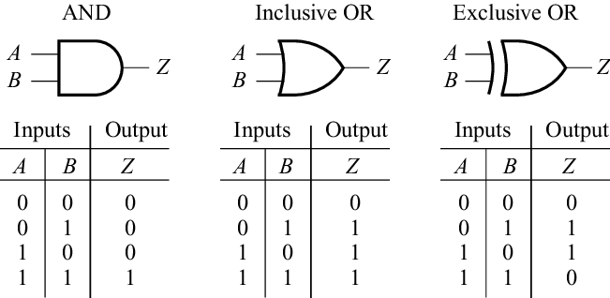
EECS 270 Fall 2020
Lecture 11 More on minimal sum-of-products
Kmaps

Slide 2
Informal algorithm
What we are going to do is circle groups of “1s” that are rectangles where each side is a power of 2 in length.
We never circle a rectangle that is part of a larger legal rectangle.
We only circle enough rectangles so that every 1 is circled.
Recall a square is special case of a rectangle.

Slide 3
K-map “rules”
Only circle adjacent cells (remember edges are adjacent!)
Only circle groups that are powers of 2 (1, 2, 4, 8, …)
Only circle 1-cells

Slide 4
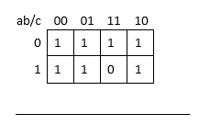

Slide 5
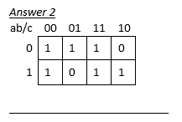

Slide 6
Terminology (1/3)
Notice that we are finding sum-of-products solutions.
Recall that a minterm is a product term that includes all of the functions variables exactly once.
The on-set of a function is the set of minterms that define when the function should evaluate to 1 (the minterms that have a 1 in the truth table.)
The off-set is the set of minterms that evaluate to zero.
An implicant of a function is a product term that evaluates to 1 only in places that function evaluates to 1.
The on-set of an implicant of a function is a subset of the on-set of the function.
Graphically, in a K-map an implicant is: ________________

Slide 7
Terminology (2/3)
An implicant covers those minterms that appears in its on-set.
What is the on-set of the function F(a,b)=a? ____________________
What minterms does that function cover? ______________________
Removing a variable from a term is known as expanding the term. This is the same as expanding the size of a circle on a K-map

Slide 8
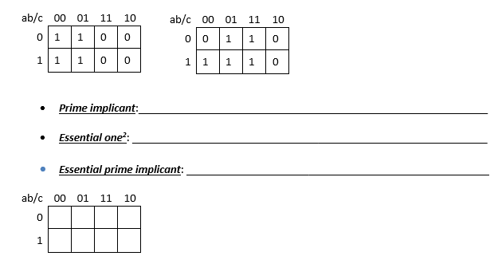
Terminology (3/3)

Slide 9
Covering
Space of all 2^{n} input
combinations (minterms)
= input combinations
for which g outputs 1
f
g
= input combinations
for which f outputs 1
f covers g
if f=1 whenever g=1
f ≥ g

Slide 10
Implicants
Space of all 2^{n} input
combinations (minterms)
= input combinations
for which g outputs 1
f
g
= input combinations
for which f outputs 1
= input combinations
for which h outputs 1
h
If g is a product term & g≤f,
Then g is an implicant of f.

Slide 11
Prime Implicants
Removing a literal from any product term (any implicant) makes it cover twice as many minterms.
Removing a literal “grows” the term
ex. 3 variables: ab’c covers 1 minterm ab’ ac each cover 2 minterms b’c
ab’
b’c
ab’c is an implicant of f.
f
ac
ab’c
Any way of removing a literal
makes ab’c no longer imply f.
So ab’c is a prime implicant of f.

Slide 12
Implicant: Any product term that implies a function F (i.e., if, for some input combination, product term P = 1, then F = 1 for the same input combination)
Prime Implicant: An implicant such that if one literal is removed, the resulting product term no longer implies F
Essential Prime Implicant: A prime implicant that covers a minterm that is not covered by any other prime implicants
These are only a few of the implicants of this function…
Theorem: The minimal SOP of a function is a sum of prime implicants and includes all essential prime implicants

Slide 13
More formal algorithm
Identify all prime implicants
Identify all essential ones.
Circle all essential prime implicants
Cover the remaining minterms using a minimal number of remaining prime implicants.
Notice that there may be more than one solution.
Also notice that the last step is a bit vague

Slide 14
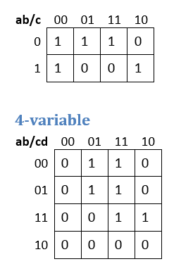
Examples

Slide 15
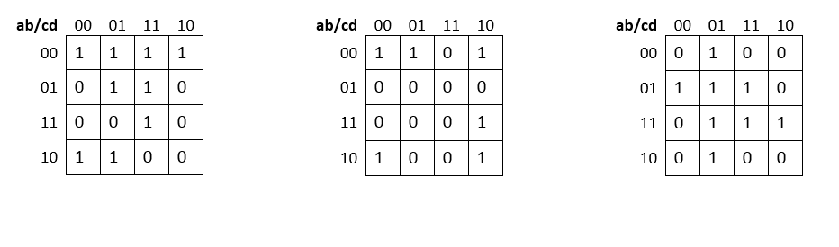
More examples

Slide 16
What’s left?
Don’t cares
5+ variable
Product-of-sums
Programmable techniques
Lots of practice.
More context. Remember this is only for 2-level logic…

Slide 17
