Slide 1
EECS 470
Adding a RoB
Lecture 7 – Winter 2024
Slides developed in part by Profs. Austin, Brehob, Falsafi, Hill, Hoe, Lipasti, Martin, Roth, Shen, Smith, Sohi, Tyson, Vijaykumar, and Wenisch of Carnegie Mellon University, Purdue University, University of Michigan, University of Pennsylvania, and University of Wisconsin.

Slide 2
Last time:
Covered branch predictors
Direction
Bimodal, local history, global, gshare, tournament
Address
BTB
RAS (briefly)

Slide 3
Warning: Crazy times coming
HW2 due on Friday 2/2 (tomorrow!)
Will do group formation and project materials on Tuesday 2/6.
Group formation will be done in class on Thursday 2/8
P3 is due on Sunday 2/9
It’s a lot of work (20 hours?)
Proposal is due on Tuesday 2/13
It’s not a lot of work (1 hour?) to do the write-up, but you’ll need to meet with your group and discuss things.
Don’t worry too much about getting this right. You’ll be allowed to change (we’ll meet the following Friday). Just a line in the sand. Will discuss on 2/6.
HW3 is due on Wednesday 2/14. No late homework. Answers posted right after it’s due!
Midterm is on Thursday 2/15 in the evening
Review session over that weekend (date/time TBA)
Q&A in class 2/15
Best way to study is look at old exams (posted on-line later this week)
20 minute proposal meetings on Friday 2/16 rather than lab

Slide 5
General speculation
Control speculation
“I think this branch will go to address 90004”
Data speculation
“I’ll guess the result of the load will be zero”
Memory conflict speculation
“I don’t think this load conflicts with any proceeding store.”
Error speculation
“I don’t think there were any errors in this calculation”

Slide 6
Speculation in general
Need to be 100% sure on final correctness!
So need a recovery mechanism
Must make forward progress!
Want to speed up overall performance
So recovery cost should be low or expected rate of occurrence should be low.
There can be a real trade-off on accuracy, cost of recovery, and speedup when correct.
Should keep the worst case in mind…

Slide 7
Precise Interrupts and branches via the Reorder Buffer
@ Alloc
Allocate result storage at Tail
@ Sched
Get inputs (ROB T-to-H then ARF)
Wait until all inputs ready
@ WB
Write results/fault to ROB
Indicate result is ready
@ CT
Wait until inst @ Head is done
If fault, initiate handler
Else, write results to ARF
Deallocate entry from ROB
Any order
MEM
IF
ID
Alloc
Sched
EX
CT
In-order
In-order
ROB
ARF
PC
Dst regID
Dst value
Except?
Head
Tail
Reorder Buffer (ROB)
Circular queue of spec state
May contain multiple definitions of same register

Slide 8
Reorder Buffer Example
ROB
Code Sequence
f1 = f2 / f3
r3 = r2 + r3
r4 = r3 – r2
Initial Conditions
- reorder buffer empty
- f2 = 3.0
- f3 = 2.0
- r2 = 6
- r3 = 5
regID: r8
result: 2
Except: n
regID: f1
result: ?
Except: ?
H
T
regID: r8
result: 2
Except: n
regID: f1
result: ?
Except: ?
regID: r3
result: ?
Except: ?
Time
H
T
regID: r8
result: 2
Except: n
regID: f1
result: ?
Except: ?
regID: r3
result: 11
Except: N
regID: r4
result: ?
Except: ?
r3
H
T

Slide 9
Reorder Buffer Example
ROB
Code Sequence
f1 = f2 / f3
r3 = r2 + r3
r4 = r3 – r2
Initial Conditions
- reorder buffer empty
- f2 = 3.0
- f3 = 2.0
- r2 = 6
- r3 = 5
regID: r8
result: 2
Except: n
regID: f1
result: ?
Except: ?
regID: r3
result: 11
Except: n
regID: r4
result: 5
Except: n
H
T
regID: r8
result: 2
Except: n
regID: f1
result: ?
Except: y
regID: r3
result: 11
Except: n
regID: r4
result: 5
Except: n
Time
H
T
regID: f1
result: ?
Except: y
regID: r3
result: 11
Except: n
regID: r4
result: 5
Except: n
H
T

Slide 10
Reorder Buffer Example
ROB
Code Sequence
f1 = f2 / f3
r3 = r2 + r3
r4 = r3 – r2
Initial Conditions
- reorder buffer empty
- f2 = 3.0
- f3 = 2.0
- r2 = 6
- r3 = 5
H
T
first inst
of fault
handler
Time
H
T

Slide 11
There is more complexity here
Rename table needs to be cleared
Everything is in the ARF
Really do need to finish everything which was before the faulting instruction in program order.
What about branches?
Would need to drain everything before the branch.
Why not just squash everything that follows it?

Slide 12
And while we’re at it…
Does the ROB replace the RS?
Is this a good thing? Bad thing?

Slide 13
ROB
ROB
ROB is an in-order queue where instructions are placed.
Instructions complete (retire) in-order
Instructions still execute out-of-order
Still use RS
Instructions are issued to RS and ROB at the same time
Rename is to ROB entry, not RS.
When execute done instruction leaves RS
Only when all instructions in before it in program order are done does the instruction retire.

Slide 14
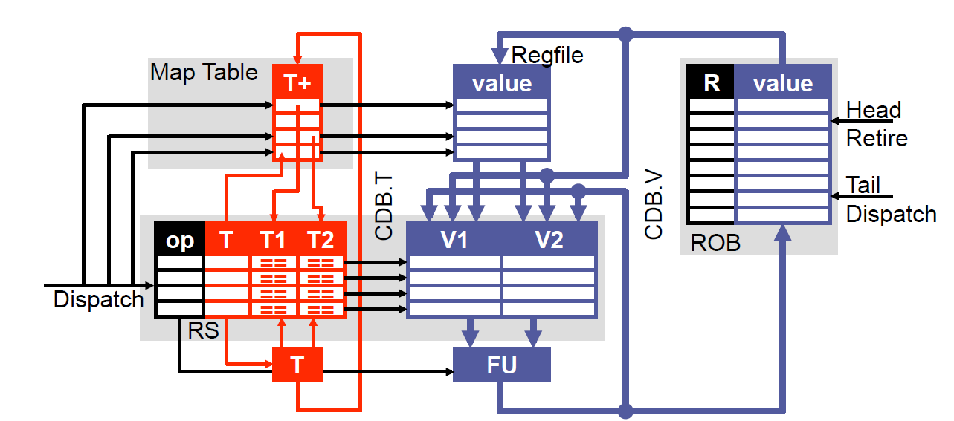
Adding a Reorder Buffer

Slide 15
Tomasulo Data Structures (Timing Free Example, “P6 scheme”)
CDB
T | V
Map Table
Reg | Tag
r0
r1
r2
r3
r4
Reservation Stations (RS)
T | FU | busy | op | RoB | T1 | T2 | V1 | V2
1
2
3
4
5
ARF
Reg | V
r0
r1
r2
r3
r4
Instruction
r0=r1*r2
r1=r2*r3
Branch if r1=0
r0=r1+r1
r2=r2+1
Reorder Buffer (RoB)
RoB Number | 0 | 1 | 2 | 3 | 4 | 5 | 6
Dest. Reg.
Value

Slide 16
Review Questions
Could we make this work without the RS?
If so, why do we do that?
Why is it important to retire in order?
Why must branches wait until retirement before they announce their mispredict?
Any other ways to do this?

Slide 17
More review questions
What is the purpose of the RoB?
Why do we have both a RoB and a RS?
Yes, that was pretty much on the last page…
Misprediction
When to we resolve a mis-prediction?
What happens to the main structures (RS, RoB, ARF, Rename Table) when we mispredict?
What is the whole purpose of OoO execution?

Slide 18
And yet more review questions!
What is the purpose of the RoB?
Why do we have both a RoB and a RS?
Misprediction
When to we resolve a mis-prediction?
What happens to the main structures (RS, RoB, ARF, Rename Table) when we mispredict?
What is the whole purpose of OoO execution?

Slide 19
When an instruction is dispatched how does it impact each major structure?
Rename table?
ARF?
RoB?
RS?

Slide 20
When an instruction completes execution how does it impact each major structure?
Rename table?
ARF?
RoB?
RS?

Slide 21
When an instruction retires how does it impact each major structure?
Rename table?
ARF?
RoB?
RS?

Slide 22
Topic change
Why on earth are we doing this?
Why do we think it helps?
Homework 2 problems 5 and 6 made the argument.
Only need to obey true data dependencies.
Huge speedup potential.

Slide 23
Optimizing CPU Performance
Golden Rule: t_{CPU} = N_{inst}*CPI*t_{CLK}
Given this, what are our options
Reduce the number of instructions executed
Reduce the cycles to execute an instruction
Reduce the clock period
Our first focus: Reducing CPI
Approach: Instruction Level Parallelism (ILP)

Slide 24
Why ILP?
Requirements
Parallelism
Large window
Limited control deps
Eliminate “false” deps
Find run-time deps
Vs.

Slide 25
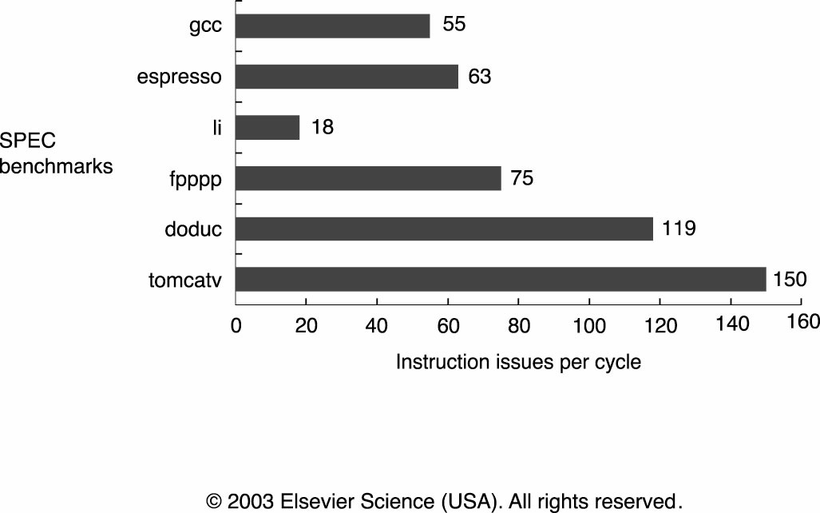
How Much ILP is There? (Chapter 3.10)

Slide 26
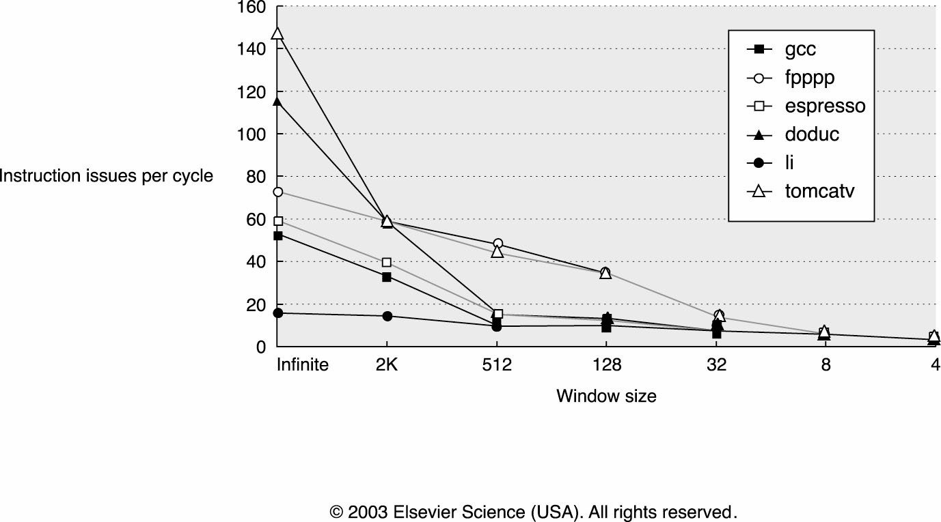
How Large Must the “Window” Be?

Slide 27
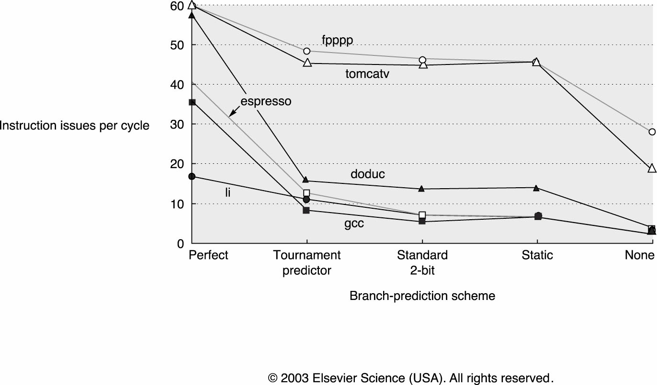
ALU Operation GOOD, Branch BAD
Expected Number of Branches
Between Mispredicts
E(X) ~ 1/(1-p)
E.g., p = 95%, E(X) ~ 20 brs, 100-ish insts

Slide 28
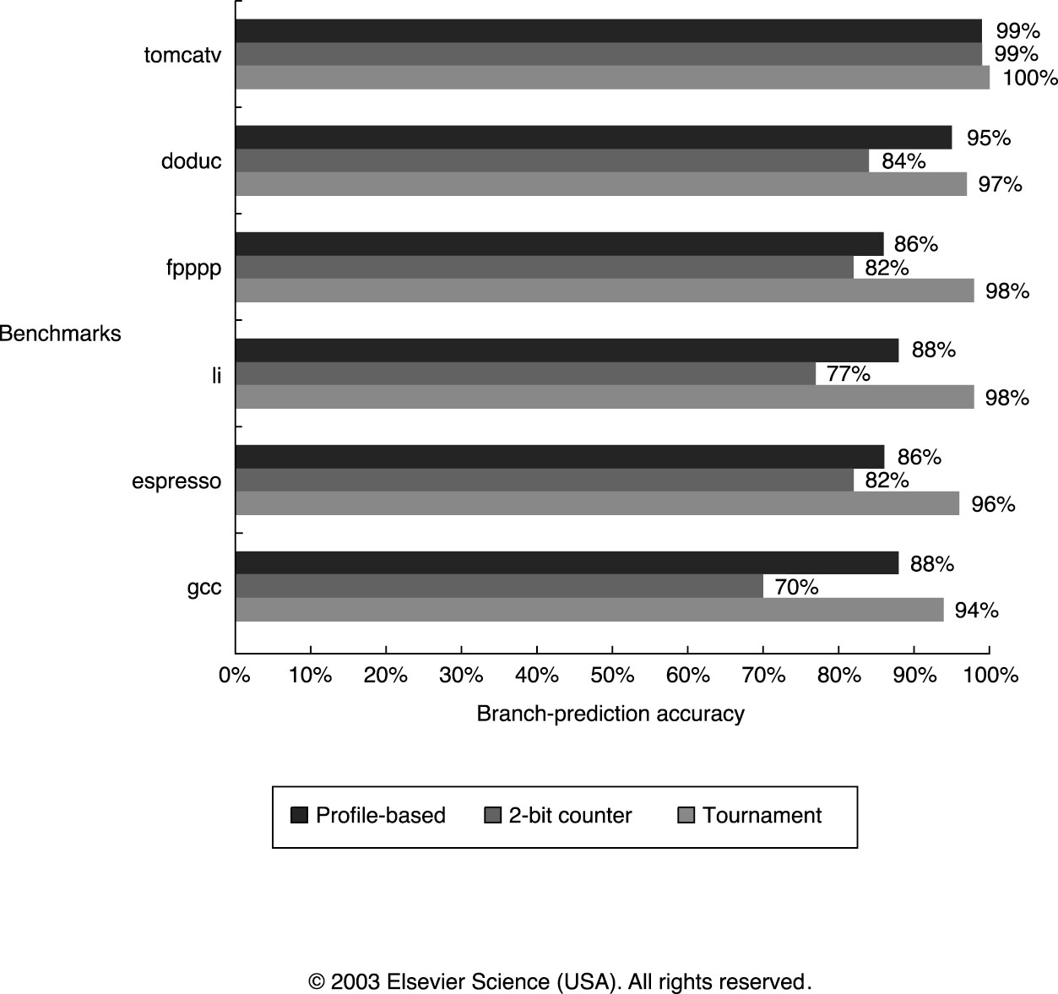
How Accurate are Branch Predictors?

Slide 29
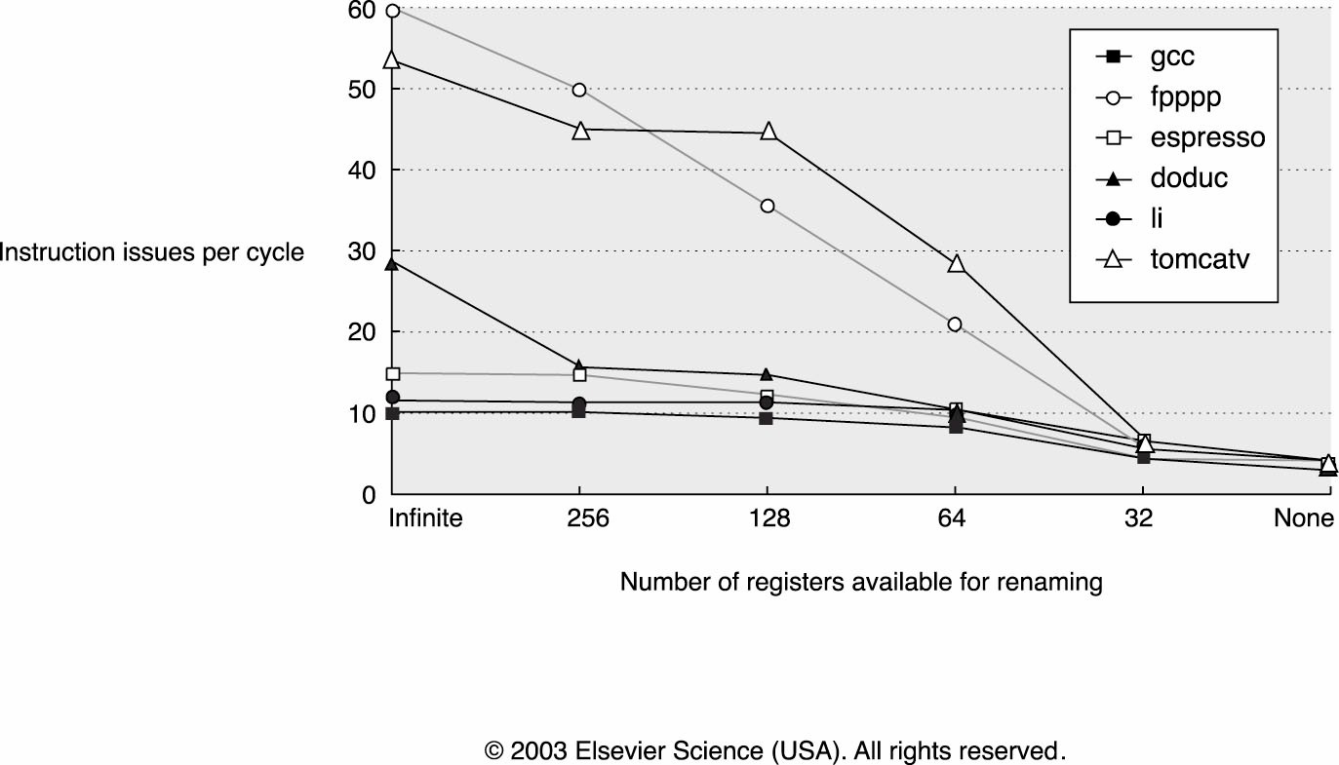
Impact of Physical Storage Limitations
Each instruction “in flight” must have storage for its result
Really worse than this because of mispeculation…

Slide 30
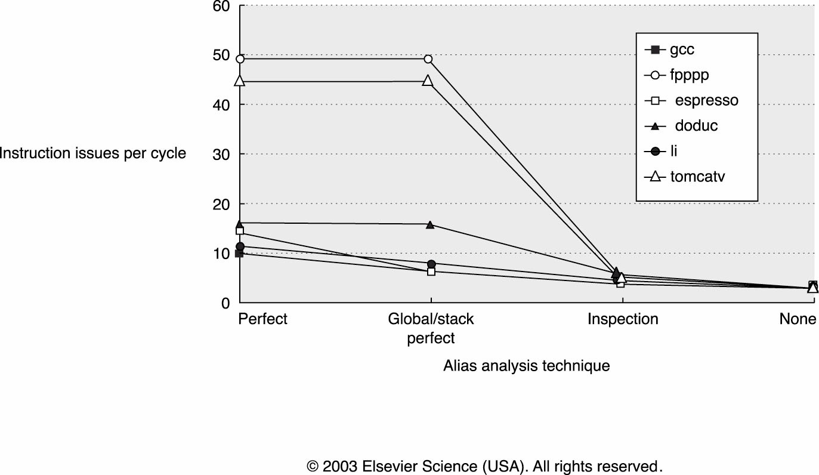
Registers GOOD, Memory BAD
Benefits of registers
Well described deps
Fast access
Finite resource
Memory loses these benefits for flexibility
*p = …
*q = …
… = *p
?

Slide 31
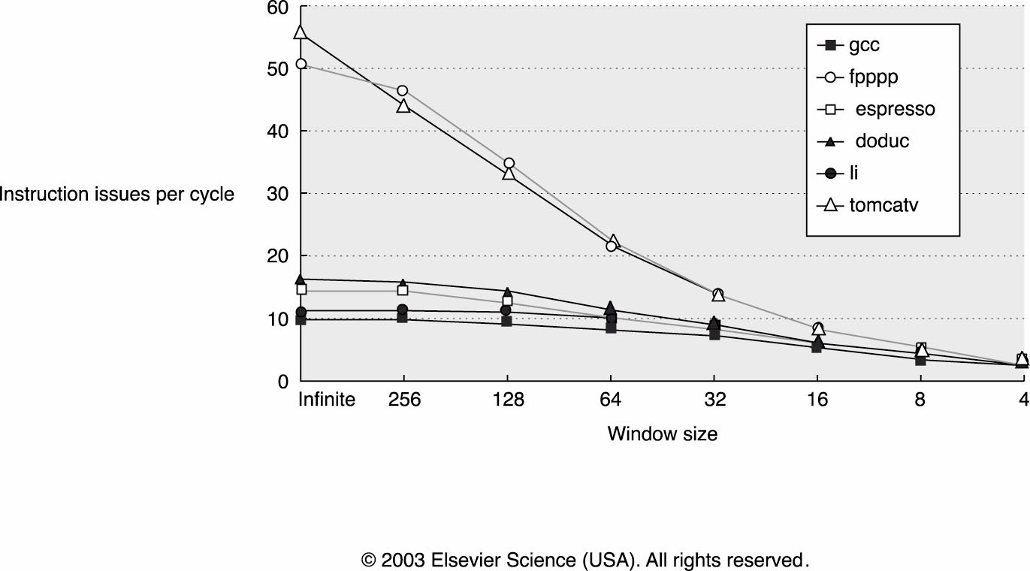
“Bottom Line” for an Ambitious Design

