Slide 1
EECS 470
Power and Architecture
Many slides taken from Prof. David Brooks, Harvard University and modified by Mark Brehob . A couple of slides are also taken from Prof. Wenisch. Any errors are almost certainly Mark’s.
Thanks to both!
Introduction

Slide 2
Outline
Why is power a problem?
What uses power in a chip?
Relationship between power and performance.
How can we reduce power?
Introduction

Slide 3
Why is power a problem in a μP?
Power used by the μP, vs. system power
Dissipating Heat
  Melting (very bad)
  Packaging (to cool → $)
  Heat leads to poorer performance.
Providing Energy
  Battery
  Cost of electricity
Introduction

Slide 4
Why worry about power dissipation?
Battery
life
Why is power a problem?
Thermal issues: affect cooling, packaging, reliability, timing
Environment

Slide 5
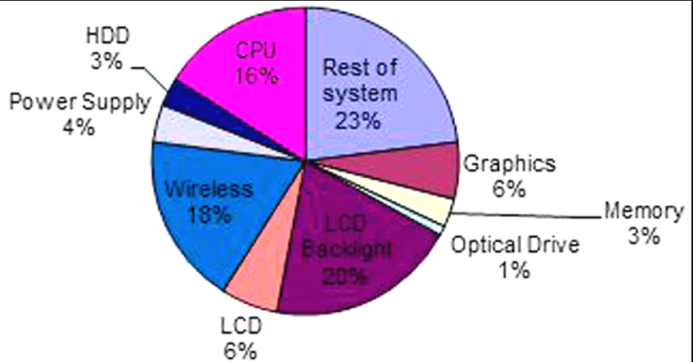
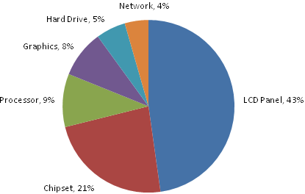
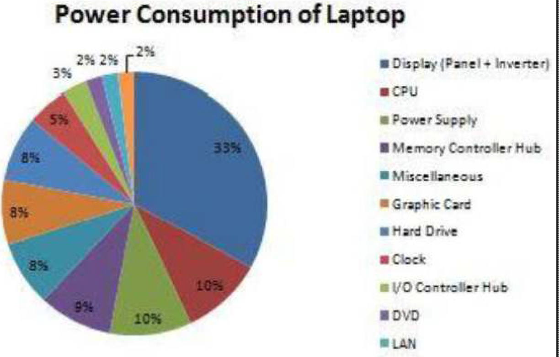
Where does the juice go in laptops?
Left, Microsoft, 2009.
Top Right, Samavat, 2011
Bottom Right, Kumar, Kumar, Taruna 2020

Slide 6
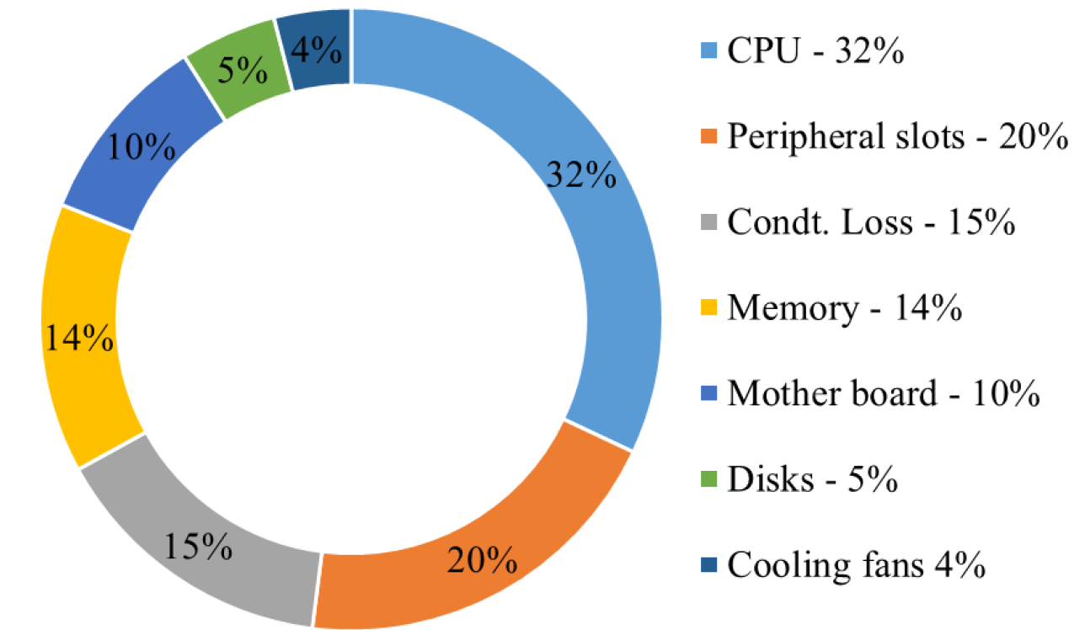
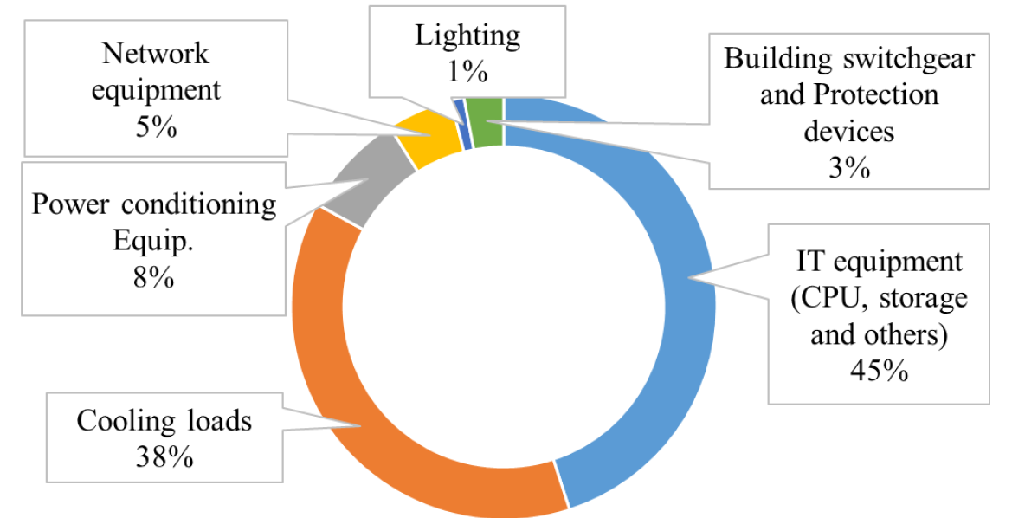
Servers and data centers?
Need whole-system
approaches to save energy
K.M.U. Ahmed et al.: A Review of Data Centers Energy Consumption
And Reliability Modeling

Slide 7
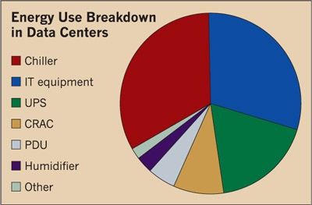
More data center
Data Centers are
about 1.5% of global
electricity use as of
2023
https://www.scientificamerican.com/
article/the-ai-boom-could-use-a-shocking-amount-of-electricity
Power usage effectiveness (PUE)
A PUE of 2.0 means that for every 2W of power supplied to
the data center, only 1W is consumed by computing equipment.
Values of around 2.9 are pretty common

Slide 8

A Paradigm Shift In Computing
IEEE Computer—April 2001
T. Mudge
Limits on heat extraction
Stagnates performance growth
Limits on energy-efficiency of operations
Era of High Performance Computing Era of Energy-Efficient Computing
c. 2000
Notes:
----Data points generated from the following processors
VAX-11/780
VAX-11/785
VAX 8700
Sun-4/260
MIPS M/120
MIPS M2000
IBM RS6000/540
HP PA-RISC, 0.05 GHz
Alpha 21064, 0.2 GHz
PowerPC 604, 0.1 GHz
Alpha 21064A, 0.3 GHz
Alpha 21164, 0.3 GHz
Alpha 21164, 0.5 GHz
Alpha 21164, 0.6 GHz
Alpha 21264, 0.6 GHz
Alpha 21264A, 0.7 GHz
Intel Pentium III, 1.0 GHz
AMD Athlon, 1.6 GHz
Intel Pentium 4, 3.0 GHz
AMD Opteron, 2.2 GHz
Intel Xeon, 3.6 GHz
64-bit Intel Xeon, 3.6 GHz

Slide 9
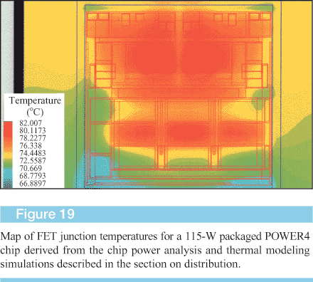
Spot Heat Issues in Microprocessors
Why is power a problem?

Slide 10
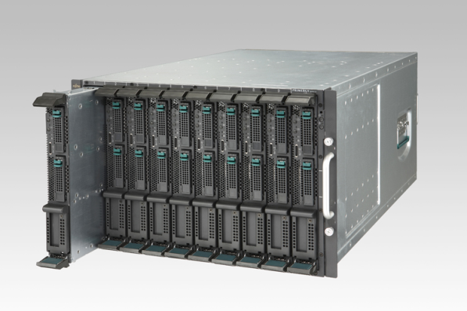
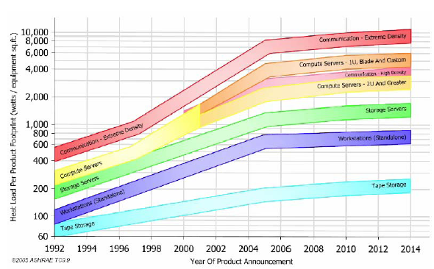
Why is cooling so costly? (1)
Server density increasing
Integration, disaggregation
reduce hardware costs
Need for high-BW interconnect
Data center floor space costs up to $15,000 /m²
Heat flux up to
500W per ft² floor space;
Racks draw 4 to 20kW each
Source: AHRAE 2006

Slide 11
Why is cooling so costly? (2)
Heat density drives cooling cost
Cooling power grows super-linearly with thermal load
Heat Generated
100W
250W
20kW
1MW
Power to Remove
5W
20W
2kW
1MW
Source: C. Patel, HP Labs
Servers’ 3-year power & cooling costs
nearing their purchase price

Slide 12
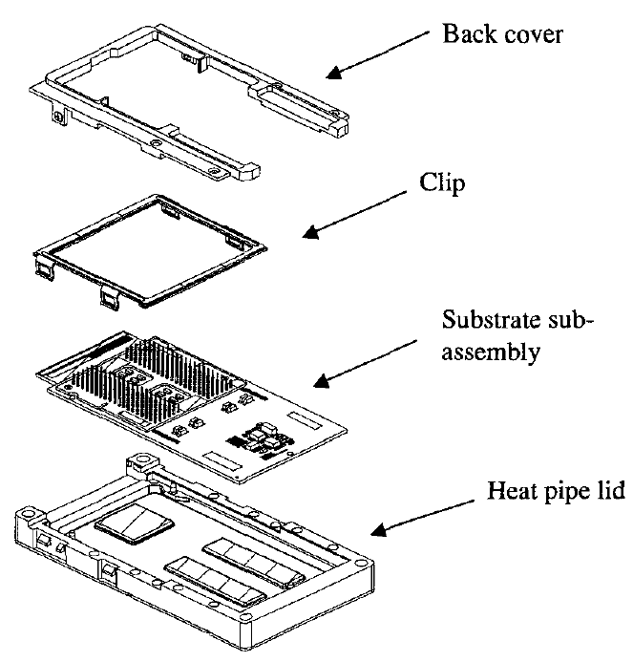
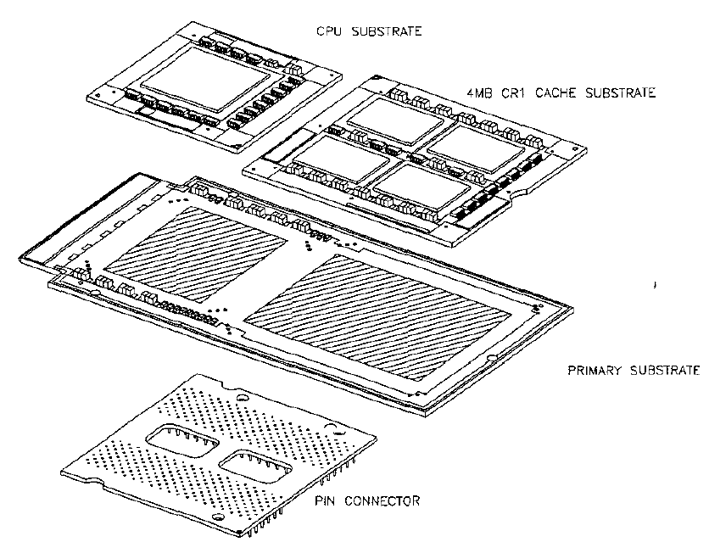
Intel Itanium packaging
Complex and expensive (note heatpipe)
Why is power a problem?
Source: H. Xie et al. “Packaging the Itanium Microprocessor”
Electronic Components and Technology Conference 2002

Slide 13
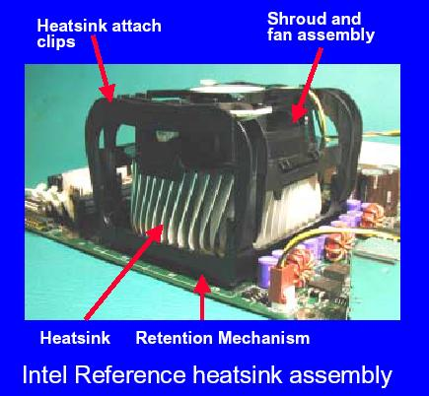
P4 packaging
Simpler, but still…
Why is power a problem?
From Tiwari, et al., DAC98
Source: Intel web site

Slide 14

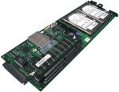





Power-Aware Computing Applications
Temperature/di-dt-Constrained
Energy-Constrained Computing

Slide 15
Environment
Environment Protection Agency (EPA): computers consume 10% of commercial electricity consumption
  This incl. peripherals, possibly also manufacturing
  A DOE report suggested this percentage is much lower (3.0-3.5%)
  No consensus, but it’s still a lot
  Total cost of electricity for gaming computers estimated at $10 Billion/year.
    http://newscenter.lbl.gov/2015/08/31/gaming-computers-offer-huge-untapped-energy-savings-potential/
Data center growth was cited as a contribution to the 2000/2001 California Energy Crisis
Equivalent power (with only 30% efficiency) for AC
Lap burn
Fan noise
Why is power a problem?

Slide 16
Power-Aware Needed across all computing platforms
Mobile/portable (cell phones, laptops, PDA)
  Battery life is critical
Desktops/Set-Top (PCs and game machines)
  Packaging cost is critical
Servers (Mainframes and compute-farms)
  Packaging limits
  Volumetric (performance density)
Why is power a problem?

Slide 17
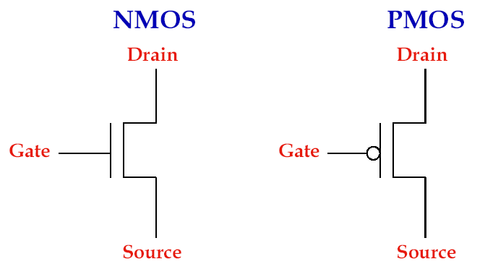
How CMOS Transistors Work
What uses power in a chip?

Slide 18
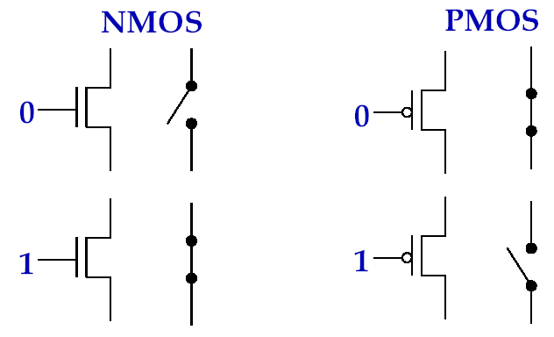
MOS Transistors are Switches
What uses power in a chip?

Slide 19
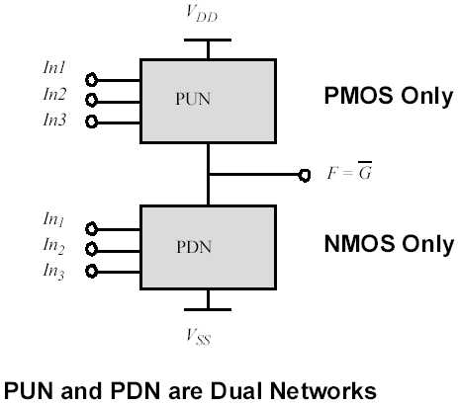
Static CMOS
What uses power in a chip?

Slide 20
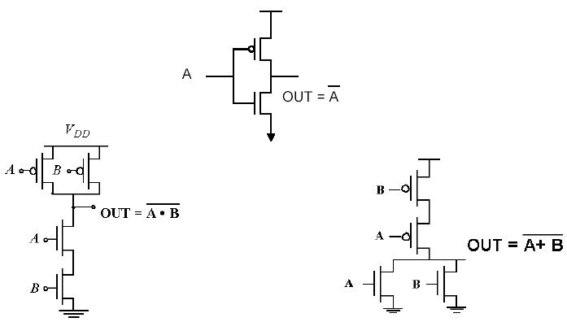
Basic Logic Gates
What uses power in a chip?

Slide 21
CMOS Water Analogy
Electron: water molecule
Charge: weight of water
Voltage: height
Current: flow rate
Capacitance: container cross-section
(Think of power-plants that store energy in water towers)
What uses power in a chip?

Slide 22
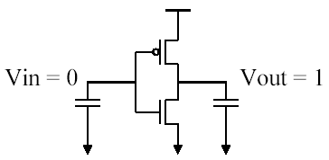
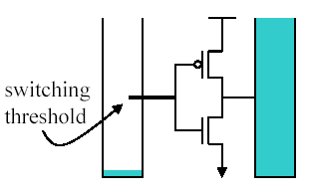
Liquid Inverter
Capacitance at input
  Gates of NMOS, PMOS
  Metal interconnect
Capacitance at output
  Fanout (# connections) to other gates
  Metal Interconnect
NMOS conducts when water level is above switching threshold
PMOS conducts below
No conduction after container full
Slide courtesy D. Brooks, Harvard

Slide 23
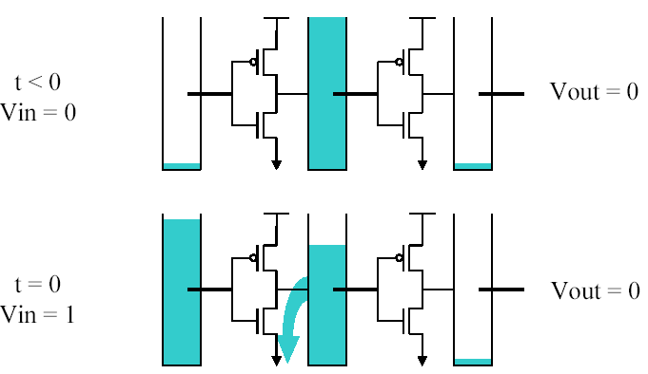
Inverter Signal Propagation (1)
Slide courtesy D. Brooks, Harvard

Slide 24
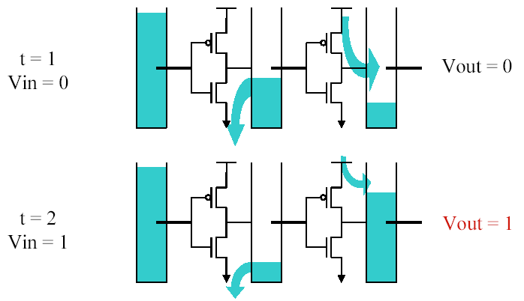
Inverter Signal Propagation (2)
Slide courtesy D. Brooks, Harvard

Slide 25
Delay and Power Observations
Load capacitance increases delay
  High fanout (gates attached to output)
  Interconnection
Higher current can increase speed
  Increasing transistor width raises currents but also raises capacitance
Energy per switching event independent of current
  Depends on amount of charge moved, not rate
What uses power in a chip?

Slide 26
Power: The Basics
Dynamic power vs. Static power
  Dynamic: “switching” power
  Static: “leakage” power
  Dynamic power dominates, but static power increasing in importance
Static power: steady, per-cycle energy cost
Dynamic power: capacitive and short-circuit
Capacitive power: charging/discharging at transitions from 0→1 and 1→0
Short-circuit power: power due to brief short-circuit current during transitions.
What uses power in a chip?

Slide 27
Dynamic (Capacitive) Power Dissipation
What uses power in a chip?
Data dependent – a function of switching activity

Slide 28
Capacitive Power dissipation
Capacitance:
Function of wire length, transistor size
Supply Voltage:
Has been dropping with successive fab generations
What uses power in a chip?
Power ~ ½ CV²Af
Clock frequency:
Increasing…
Activity factor:
How often, on average, do wires switch?

Slide 29
Lowering Dynamic Power
Reducing Vdd has a quadratic effect
  Has a negative (~linear) effect on performance however
Lowering C_{L}
  May improve performance as well
  Keep transistors small (keeps intrinsic capacitance (gate and diffusion) small)
Reduce switching activity
  A function of signal transition stats and clock rate
  Clock Gating idle units
  Impacted by logic and architecture decisions
What uses power in a chip?

Slide 30
Static Power: Leakage Currents
What uses power in a chip?
Subthreshold currents grow exponentially with increases in temperature, decreases in threshold voltage
  But threshold voltage scaling is key to circuit performance!
Gate leakage primarily dependent on gate oxide thickness, biases
Both type of leakage heavily dependent on stacking and input pattern

Slide 31
Lowering Static Power
Design-time Decisions
  Use fewer, smaller transistors -- stack when possible to minimize contacts with Vdd/Gnd
  Multithreshold process technology (multiple oxides too!)
    Use “high-Vt” slow transistors whenever possible
Dynamic Techniques
  Reverse-Body Bias (dynamically adjust threshold)
    Low-leakage sleep mode (maintain state), e.g. XScale
  Vdd-gating (Cut voltage/gnd connection to circuits)
    Zero-leakage sleep mode
    Lose state, overheads to enable/disable
What uses power in a chip?

Slide 32
Power vs. Energy
Power consumption in Watts
  Determines battery life in hours
  Sets packaging limits
Energy efficiency in joules
  Rate at which energy is consumed over time
  Energy = power * delay (joules = watts * seconds)
  Lower energy number means less power to perform a computation at same frequency
What uses power in a chip?

Slide 33
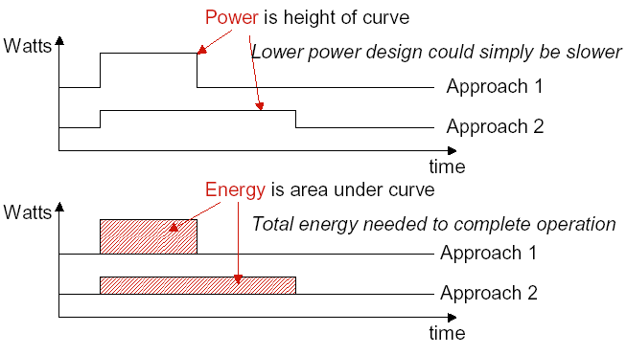
Power vs. Energy
What uses power in a chip?

Slide 34
Power vs. Energy
Power-delay Product (PDP) = P_{avg} * t
  PDP is the average energy consumed per switching event
Energy-delay Product (EDP) = PDP * t
  Takes into account that one can trade increased delay for lower energy/operation
Energy-delay² Product (EDDP) = EDP * t
  Why do we need so many formulas?!!?
  We want a voltage-invariant efficiency metric! Why?
  Power ~ ½ CV²Af, Performance ~ f (and V)
What uses power in a chip?

Slide 35
E vs. EDP vs. ED²P
Power ~ CV²f ~ V³ (fixed microarch/design)
Performance ~ f ~ V (fixed microarch/design)
(For the nominal voltage range, f varies linearly with V)
Comparing processors that can only use freq/voltage scaling as the primary method of power control:
  (perf)³ / power, or MIPS³ / W is a fair metric to compare energy efficiencies.
  This is an ED² P metric. We could also use: (CPI)³ * W for a given application
What uses power in a chip?

Slide 36
E vs. EDP vs. ED²P
Currently have a processor design:
  80W, 1 BIPS, 1.5V, 1GHz
  Want to reduce power, willing to lose some performance
  Cache Optimization:
    IPC decreases by 10%, reduces power by 20% =>
    Final Processor: 900 MIPS, 64W
    Relative E = MIPS/W (higher is better) = 14/12.5 = 1.125x
  Energy is better, but is this a “better” processor?
What uses power in a chip?

Slide 37
Not necessarily
80W, 1 BIPS, 1.5V, 1GHz
  Cache Optimization:
    IPC decreases by 10%, reduces power by 20% => Final Processor: 900 MIPS, 64W
    Relative E = MIPS/W (higher is better) = 14/12.5 = 1.125x
    Relative EDP = MIPS²/W = 1.01x
    Relative ED²P = MIPS³/W = .911x
What if we just adjust frequency/voltage on processor?
  How to reduce power by 20%?
  P = CV²F = CV³ => Drop voltage by 7% (and also Freq) => .93*.93*.93 = .8x
  So for equal power (64W)
    Cache Optimization = 900MIPS
    Simple Voltage/Frequency Scaling = 930MIPS
What uses power in a chip?

