Slide 1
Projects
(Finish up from last time)
What’s reasonable
What’s expected when

Slide 2
What is a reasonable project?
Required
  Entire embedded system with a realistic use
    Design allows for that realistic use (not an unusable prototype)
  Doable in the semester
  Design and population of a PCB with a processor (or maybe FPGA).
  Design and implementation of hardware interfaces
Suggested
  Not “barebones” programming
    Use RTOS, Linux, or something else
    Barebones might make sense if software fairly trivial
  Stay away from switching power supplies

Slide 3
Projects in the past:
Baby Monitor
What it does
  Watches for SIDS
  Sets alarm on board and wirelessly to base station if problem detected.
Main issues
  Easy to use
    Easy to place on baby correctly, easy to recharge, no complex interface
  Resilient
    Water-resistant, can be dropped, easily cleaned.
  Cheap
    Very low-cost target.
  Testing that it works
    Need baby?

Slide 4
Projects in the past:
Triathlon monitor
What it does:
  Monitor location, heart rate, and strides
  Display on watch, record to dump to PC later
Issues
  Weight
  Waterproof
  Getting data in (GPS, heart rate, strides)
  Getting data out (to watch, stored and to PC)

Slide 5
Projects in the past:
Bike helmet (Hail-met)
What it does:
  Bluetooth
    Voice, etc. Can make calls or listen to music
  Turn signals and tail light
  Basic heads-up display (signals, call info)
  Solar recharge
Issues
  Weight
  Waterproof
  Safety

Slide 7
Project dates next 30 days
Sept. 6th:
  Project ideas pdf turned in by 11pm (on Gradescope already)
Sept 7th:
  All ideas posted, hopefully by noon.
Sept. 8th^{th}:
  Forming groups 6:30-8:30pm (IOE 1610)
  Each person will have a chance to speak for about 30 seconds about what they’d like to do
  Wander around and form groups.
Sept. 16th:
  Draft proposal due (3% of project grade)
Sept 22nd
  Required meeting with staff to discuss proposal*
    No class that day.
  After meeting most groups can (and should) start ordering parts!
Sept 29th
  Formal proposal due. (12% of project grade).
*You should have met with various 473 staff members well before this!

Slide 8
Milestones: What are they?
What’s due?
Report to us about how things are going and some demonstrations.
What’s due:
  A short report (1-2 pages)
    Due a few days before the meeting
  Demonstrate to GSIs that you’ve meet your “objectively demonstrable” deliverables.
    Needs to be done the day before the meeting at the latest.
In general, these should take 30-60 minutes to write unless things are in really bad shape.
  There is a docx template you are to use.

Slide 9
Milestone 1
(Can start ordering parts on Sept 22nd after meeting)
Oct 13th
  Device interfaces designed and working
    Might need some refinement, but in good shape
  Prototype largely working
    Probably devboard (maybe breadboard, but avoid if possible!)
    Can talk to all devices via interfaces
    Can more-or-less do the task
  Have identified solutions to each major issue.
Started on PCB
  Perhaps just barely, but at least have patterns done

Slide 10
Milestone 1 Example: Baby
Have interface to GPS, flash (for storage), and variable resistor (for checking breathing) written useable.
Not yet sure on chest cavity movement of infant.
  Flash still a bit buggy—erasing not always working.
    Otherwise demonstrated
  GPS association working, (time is 3 minutes, but worst case probably acceptable for application)
    Demonstrated

Slide 11
Milestone 1 Example: Baby
Prototype on Arduino
  Each interface works
  When done together GPS (serial) interrupt messing with timer interrupt for resistor monitoring

Slide 12
PCB deadline
All PCBs must be ordered by Nov 1st
  Worst case, you need to respin the PCB later but we want them all out by this date.
    Depending on budget for PCB, should have back in 7-10 days.
  Should target earlier—hopefully most groups have PCB out by Oct 22nd

Slide 13
Milestone 2
November 15th
  PCB back and assembled, still may be debugging
  Prototype working though more testing planned
  Final plans for all “extras”
    Enclosure (if needed)
    Special documentation
    ?????

Slide 14
November 29th
Everything should be done, just final testing and debug of a largely working system.
Start on design expo things and final report by 12/2.
  Setup, poster, etc.
  Discussion in class about posters etc. on 12/1
  Get much of the report written before the expo.
Testing, testing, testing

Slide 15
Design Expo
December 8th
  Working and clearly presented demo
  Hopefully exciting
    Not all projects will be and that’s okay.
  Shirt and tie or equivalent required.

Slide 16
December 11th
Final report due.
  This report and the associated documentation is 15% of of your project grade.
  With the proposal document done, you have a solid starting point.

Slide 17
EECS 473
Advanced Embedded Systems
Lecture 3 and 4
An introduction to real time systems and scheduling
Chunks adapted from work by
Dr. Fred Kuhns of Washington University
and Farhan Hormasji

Slide 18
Announcements
HW0
  Due today at 11pm on gradescope
    I’ll have the pdf posted of everyone’s submissions on by Wednesday.

Slide 19
Group formation: Thursday night
1500 EECS from 6:30-8:30.
  Yes, that overlaps with lab for some of you.
    Sorry about that, but it’s really the only time that works.
    We expect to have some extra hours Wednesday morning. And we’ll be there late on Thursday.
    Please work with your lab partner to find a time that works.

Slide 20
Misc.
Lab 1 inlab/postlab due before your lab starts.
Lab 2 prelab due before your lab starts
  Really important in this case

Slide 21
Outline
Overview of real-time systems
  Basics
  Scheduling algorithms (RM, EDF, LLF & RR)
Overview of RTOSes
  Goals of an RTOS
  Features you might want in an RTOS
Learning by example: FreeRTOS
  Introduction
  Tasks
  Interrupts
  Internals (briefly)
  What’s missing?

Slide 22
What is a Real-Time System?
What is a RTS?
Real-time systems have been defined as: "those systems in which the correctness of the system depends not only on the logical result of the computation, but also on the time at which the results are produced";
  J. Stankovic, "Misconceptions About Real-Time Computing," IEEE Computer, 21(10), October 1988.

Slide 23
Soft, Firm and Hard deadlines
What is a RTS?
The instant at which a result is needed is called a deadline.
  If the result has utility even after the deadline has passed, the deadline is classified as soft, otherwise it is firm.
  If a catastrophe could result if a firm deadline is missed, the deadline is hard.
Examples?
Definitions taken from a paper by Kanaka Juvva, not sure who originated them.

Slide 24
Why is this hard?
Three major issues
What is a RTS?
We want to use as cheap ($$, power) a processor as possible.
  Don’t want to overpay
There are non-CPU resources to worry about.
  Say two devices both on an SPI bus.
  So often can’t treat tasks as independent
Validation is hard
  You’ve got deadlines you must meet.
    How do you know you will?
Let’s discuss that last one a bit more

Slide 25
Validating a RTS is hard
What is a RTS?
Validation is simply the ability to be able to prove that you will meet your constraints
  Or for a non-hard time system, prove failure is rare.
This is a hard problem just with timing restrictions
  How do you know that you will meet all deadlines?
    A task that needs 0.05s of CPU time and has a deadline 0.1s after release is “easy”.
    But what if three such jobs show up at the same time?
  And how do you know the worst-case for all these applications?
    Sure you can measure a billion instances of the program running, but could something make it worse?
      Caches are a pain here.
And all that ignores non-CPU resource constraints!
We need some formal definitions to make progress here…

Slide 26
Real-Time Characteristics
What is a RTS?
Pretty much your typical embedded system
  Sensors & actuators all controlled by a processor.
  The big difference is timing constraints (deadlines).
Those tasks can be broken into two categories¹
  Periodic Tasks: Time-driven and recurring at regular intervals.
    A car checking for a wall every 0.1 seconds;
    An air monitoring system grabbing an air sample every 10 seconds.
  Aperiodic: event-driven
    That car having to react to a wall it found
    The loss of network connectivity.
  ¹Sporadic tasks are sometimes also discussed as a third category. They are tasks similar to aperiodic tasks but activated with some
  known bounded rate. The bounded rate is characterized by a minimum interval of time between two successive activations.

Slide 27
Some Definitions
What is a RTS?
Timing constraint:
  Constraint imposed on timing behavior of a job: hard, firm, or soft.
Release Time:
  Instant of time job becomes available for execution.
Deadline:
  Instant of time a job's execution is required to be completed.
Response time:
  Length of time from release time to the instant the job completes.

Slide 28

Example Using the Definitions:
Periodic jobs
Consider a processor where you have two different tasks.
  We’ll call them τ₁ and τ₂.
  It is commonly the case that the period of a task is the same as the time you have to complete the task.
    So if τ₁ needs to run every 7 seconds, you just need to finish a given instance of τ₁ before the next one is to start.
Consider the following:
Assuming all tasks are first released at time 0:
  What is the deadline of the first instance of τ₁?
  What is the release time of the second instance of τ₁?
  What is the deadline of the second instance of τ₁?
Notes:
7, 7, 14.

Slide 29
Properties for Scheduling tasks
What is a RTS?
Priority
  If two tasks are both waiting to run at the same time, one will be selected. That one is said to have the higher priority.
Fixed/Dynamic priority tasks
  In priority-driven scheduling, assigning the priorities can be done statically (always the same) or they can be done dynamically (changing while the system is running)
Preemptive/Non-preemptive tasks
  Execution of a non-preemptive task is to be completed without interruption once it is started
  Otherwise a task can be preempted if another task of higher priority becomes ready

Slide 30
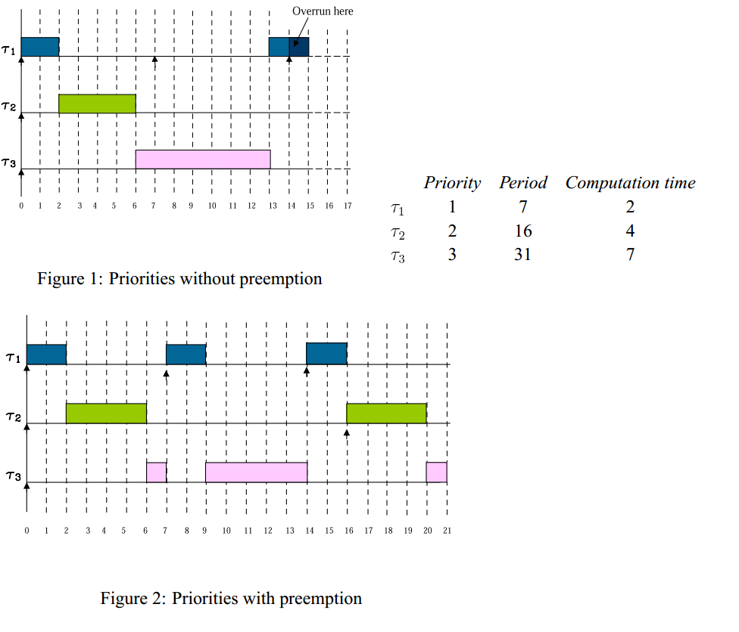
Preemption
What it is and how it helps
What is a RTS?
Task 1’s second instance misses its deadline!
Now add preemption:
All tasks are released at time 0.
Mohammadi, Arezou, and Selim G. Akl. "Scheduling Algorithms for Real-Time Systems." (2005)

Slide 31
Scheduling algorithms
A scheduling algorithm is a scheme that selects what job to run next.
  Can be preemptive or non-preemptive.
  Dynamic or static priorities
  Etc.

Slide 32
Two scheduling algorithms
Rate monotonic
(RM)
  Static priority scheme
  Simple to implement
  Nice properties
Earliest deadline first (EDF)
  Dynamic priority scheme
  Harder to implement
  Very nice properties

Slide 33
RM and EDF assumptions
No task has any non-preemptable section and the cost of preemption is negligible.
Only processing requirements are significant; memory, I/O, and other resource requirements are negligible.
All tasks are independent; there are no precedence constraints.
Notes:
These are not very realistic in that none of them are generally strictly true. But most of the time they are pretty good approximations.

Slide 34


Terms and definitions
Execution time of a task - time it takes for a task to run to completion
Period of a task - how often a task is being called to execute; can generally assume tasks are periodic although this may not be the case in real-world systems
CPU utilization - the percentage of time that the processor is being used to execute a specific scheduled task
  where e_{i} is the execution time of task i, and P_{i} is its period
Total CPU utilization - the summation of the utilization of all tasks to be scheduled

Slide 35
RM Scheduling
RM scheduling
It is a static-priority preemptive scheme involving periodic tasks only.
  Well, it mumbles about non-periodic tasks, but…
Basic idea:
  Priority goes to the task with the lowest period.
Mohammadi, Arezou, and Selim G. Akl. "Scheduling Algorithms for Real-Time Systems." (2005)

Slide 36
How well does RMS work?
RM scheduling
Surprisingly well actually.
  Let n be the number of tasks.
  If the total utilization is less than n(2^{1/n}-1), the tasks are schedulable.
    That’s pretty cool.
      At n=2 that’s ~83.3%
      At n=∞ that’s about 69.3%
  This means that our (extremely) simple algorithm will work if the total CPU utilization is less than 2/3!
    Still, don’t forget our assumptions (periodic being the big one)
Also note, this is a sufficient, but not necessary condition
  Tasks may still be schedulable even if this value is exceeded.
    But not if utilization is over 100% of course…
Scheduling Algorithms for Multiprogramming in a Hard-Real-Time Environment
http://igm.univ-mlv.fr/~masson/pdfANDps/liulayland73.pdf

Slide 37
What if the sufficiency bound is not met?
RM scheduling
Critical instant analysis
  The worst case for RMS is that all tasks happen to start at the exact same time.
    If RM can schedule the first instance of each such task, the tasks are schedulable.
With RM scheduling we can always jump to doing the critical instant analysis
Mohammadi, Arezou, and Selim G. Akl. "Scheduling Algorithms for Real-Time Systems." (2005)
Notes:
It may be that there is no critical instant when all tasks start. That’s unusual, but not impossible (say 2 tasks both with period 5 where the first instance of task 1 starts at time 2 and the first instance of task 2 starts at time 0. Not something we actually worry about!

Slide 38
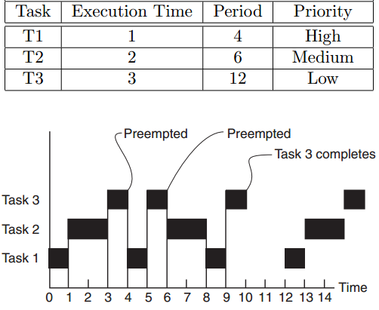
Example #1
RM scheduling
https://www.eecs.umich.edu/courses/eecs461/lecture/SWArchitecture.pdf

Slide 39
Example #2
RM scheduling
Task | Execution Time | Period | Priority
T1 | 1 | 3 | High
T2 | 1.5 | 4 | Low
Notes:
1/3+3/8=

Slide 40
Example #3
RM scheduling
Task | Execution Time | Period | Priority
T1 | 1 | 3 | High
T2 | 2.1 | 4 | Low

Slide 41
Example #4
RM scheduling
Task | Execution Time | Period | Priority
T1 | 1 | 2 | High
T2 | 2 | 5 | Low

Slide 42
Easy?
RM scheduling
Fixed priorities are pretty easy.
  Scheduler easy to write.
  Don’t have to worry about updating priorities
    Extra effort (Engineering and CPU)
    Could lead to thrashing

Slide 43
EDF Scheduling
EDF scheduling
Also called the deadline-monotonic scheduling algorithm
  a priority-driven algorithm in which higher priority is assigned to the request that has earlier deadline and a higher priority request always preempts a lower priority one.
Uses dynamic priority assignment in the sense that the priority of a request is assigned as the request arrives
  May have to update other tasks’ priorities (why?)
We make all the assumptions we made for the RM algorithm, except that the tasks do not have to be periodic
Same runtime complexity as RM scheduling if sorted lists are used
EDF is an optimal uniprocessor scheduling algorithm
Mohammadi, Arezou, and Selim G. Akl. "Scheduling Algorithms for Real-Time Systems." (2005)

Slide 44
EDF issues
EDF scheduling
Dynamic priorities
  When do you need to recompute priorities?
  How much time will you need to take?
    O(?)
When it fails
  Which tasks will be dropped is hard to predict.
    “This is a considerable disadvantage to a real-time systems designer.”
Representing wide variety of time scales can be tricky.
  Need to track how long until deadline, but some tasks may have deadline on the order of milliseconds, others hours or days.
Shared resources are tricky.
  Like priority inheritance problem for RM scheduling (covered shortly)
Wonderfully understated quote in green from Wikipedia.
Notes:
Only re-compute when new task is added or when current task stops. After all, the task with the ED won’t change.
Basically a linked-list of tasks sorted by deadline. Could use a tree or (better) a heap, but given the task list is usually pretty short and that heaps have to be

Slide 45
LLF (Least Laxity First) Scheduling
Other schemes
The laxity of a process is defined as the deadline minus remaining computation time
  In other words, the laxity of a job is the maximal amount of time that the job can wait and still meet its deadline
The algorithm gives the highest priority to the active job with the smallest laxity
While a process is executing, it can be preempted by another whose laxity has decreased to below that of the running process
  A problem arises with this scheme when two processes have similar laxities. One process will run for a short while and then get preempted by the other and vice versa, thus causing many context switches occur in the lifetime of the processes. (Thrashing)
The least laxity first algorithm is an optimal scheduling algorithm for systems with periodic real-time tasks
  Also useful with aperiodic tasks

Slide 46
round robin (no priorities)
Other schemes
Task | Execution Time | Period
T1 | 5 min | 1 hr
T2 | 0.6 sec | 1 sec

Slide 47
Optimal?
Finally…
An optimal real-time scheduling algorithm is one which may fail to meet a deadline only if no other scheduling algorithm could meet all of the deadlines.

Slide 48
Of course, this ignores a lot
Finally…
We’ve only worried about the CPU as a resource.
  What if one task is waiting on another to free a resource?

Slide 49
Waiting for a Serial Port
Say I’ve got two tasks that can write to a serial port (using printf()* let’s say).
  They are writing messages to a terminal.
  If one is in the middle of a message, I can’t preempt it with another that can/will write to the serial port.
    My message will be jumbled as one message hits the middle of the other.
This can happen with all kinds of resources including other ports (e.g. I2C, USB) and timers
  Common to have a shared data structure where if one task is writing, no task can use it.
    Why might someone else not be able to read?
*The standard version of printf is not “reentrant”. This is a good thing to know (and understand)
Notes:
Read issue: data structure may not be in a safe state. Consider a tree where it’s not a tree for part of an insertion.

Slide 50
How do we know to wait?
We use a variable.
  Any task that is going to use the locked resource (say serial port) checks that variable first.
  If that variable is a “0” we wait until it’s a “1”.
  Once it’s a “1”, we set it to “0” and then proceed to use the serial port.
  Once we’re done with the serial port, we set it back to a “1”.
The standard terminology for this is:
  The variable is called a “binary semaphore”
  Setting it to “0” is called locking. If it is a “0” we say the semaphore is locked.
  Setting it to “1” is called unlocking.
Anyone wanting to use the serial port is supposed to check the semaphore, and then lock it and unlock it in the same way.
  The code that needs to be locked is often called a “critical section”.

Slide 51
Let’s do this in C
Write code that uses
  a global variable “sem_serial” as the lock.
  Calls “printf()” to use the serial port
Notes:
while(!sem_serial); // wait until it’s available (using 1 as available and 0 as not). -- notice the ;
Sem_serial=0;
Printf(thingy);
Sem_serial=1;

Slide 52
Proposed answer
while(!sem_serial); // wait until it’s available
//using 1 as available and //0 as not. Notice the ;
sem_serial=0;
printf(thingy);
sem_serial=1;

Slide 53
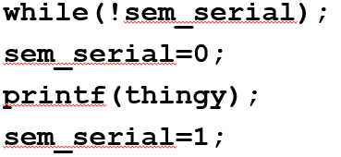
Problems with the code we wrote (1/2)
Now we generally need to be a bit more tricky than this.
  Imagine task “A” checks the semaphore and then, before setting the lock, gets preempted by another task “B” that locks the semaphore then A gets scheduled again.
    “A” will have passed the check and will proceed to use the serial port. So we need a way to prevent this from happening.
  Most processors have ways of dealing with that issue at the assembly level (test-and-set for example)
    Libraries that handle multiple tasks almost always include function calls that use those assembly-level instructions correctly.

Slide 54
Problems with the code we wrote (2/2)
The other issue is that our while loop is busy waiting.
  Say that task A is the high priority task. Task A and B both use the serial bus.
    B is running and locks the bus
    A preempts B.
    A will now wait in the loop until B finishes
      But A is higher priority, so B can’t run until A finishes. And A can’t run until B finishes.
        DEADLOCK!
Solution is that rather than a loop, we call a function and ask to lock the semaphore.
  If we don’t get the lock we give up control of the processor until the lock is available.
  Tricky to write
    Another reason to use libraries here rather than rolling your own!

Slide 55
Obligatory deadlock joke
Interviewer:
  "Explain deadlock and we'll hire you."
Me:
  "Hire me and I'll explain it to you."

Slide 56
But wait, there’s more!
We want some kind of semaphore_take() and semaphore_give() functions that handle the issues described
  Uses atomic operations like test-and-set to handle race conditions.
  The take function should cause the current task to give up the CPU
  The give function should check to see if anyone is waiting on the semaphore.
But that’s still not enough.

Slide 57
Priority Inversion
In a preemptive priority-based real-time system, sometimes tasks may need to access resources that cannot be shared.
  The method of ensuring exclusive access is to guard the critical sections with binary semaphores.
  When a task seeks to enter a critical section, it checks if the corresponding semaphore is locked.
  If it is not, the task locks the semaphore and enters the critical section.
  When a task exits the critical section, it unlocks the corresponding semaphore.
This could cause a high priority task to be waiting on a lower priority one.
  Even worse, a medium priority task might be running and cause the high priority task to not meet its deadline!
Some taken from Mohammadi, Arezou, and Selim G. Akl. "Scheduling Algorithms for Real-Time Systems." (2005)

Slide 58
Example: Priority Inversion
Low priority task “C” locks resource “Z”.
High priority task “A” preempts “A” then requests resource “Z”
  Deadlock, but solvable by having “A” sleep until resource is unlocked.
But if medium priority task “B” were to run, it would preempt C, thus effectively making C and A run with a lower priority than B.
  Thus priority inversion.

Slide 59
Solving it: Priority Inheritance
Finally…
When a high priority task sleeps because it is waiting on a lower priority task, have it boost the priority of the blocking task to its own priority.
  In general a mutex is a semaphore that is used for mutual exclusion.
There are other solutions
  For example, if there are only 2 priorities this can’t happen
  Windows has a rather interesting solution called “random boosting”

Slide 60
Net effect
Handling locks and preemption and all that is hard.
  It’s also fairly generic
    That is, you’re solving the same problem each time.
  So what you want is to just do it once.
    Or better yet, borrow code from someone else who is really good at this stuff.
  This is part of what an RTOS will generally provide.

Slide 61
Outline
Overview of real-time systems
  Basics
  Scheduling algorithms (RM, EDF, LLF & RR)
Overview of RTOSes
  Goals of an RTOS
  Features you might want in an RTOS
Learning by example: FreeRTOS
  Introduction
  Tasks
  Interrupts
  Internals (briefly)
  What’s missing?

Slide 62
Goals of an RTOS?
Well, to manage to meet RT deadlines (duh).
  While that’s all we need we’d like a lot more.
    After all, we can meet RT deadlines fairly well on the bare metal (no OS)
      But doing this is time consuming and difficult to get right as the system gets large.
    We’d like something that supports us
      Deadlines met
      Locks work
      Interrupts just work
      Tasks stay out of each others way
      Device drivers already written (and tested!) for us
      Portable—runs on a huge variety of systems
      Oh, and nearly no overhead so we can use a small device!
        That is a small memory and CPU footprint.

Slide 63
Detailed features we’d like (1/2)
Deadlines met
Interrupts just work
Ability to specify scheduling algorithm
Interrupts are fast
  So tasks with tight deadlines get service as fast as possible
    Basically—rarely disable interrupts and when doing so only for a short time.
Don’t need to worry about saving/restoring registers
  Which C just generally does for us anyways.
Interrupt prioritization easy to set.

Slide 64
Detailed features we’d like (2/2)
Locks work
Device drivers
High-priority waiting on locks give up the CPU until lower-priority tasks finish their critical section
Priority inheritance is done for us.
Clean interfaces to I2C, USB, SPI, timers, and whatever else our processor supports already written for us.
  Hopefully well tested and well documented.
In my experience, this is often the least likely thing to be 100% there.
  Mainly because much of the other stuff is easy to port.
  This is very processor specific.

Slide 65
Detailed features we’d like:
Tasks stay out of each others way
This is actually remarkably hard
  Clearly we need to worry about CPU utilization issues
    That is what our scheduling algorithm discussion was to address
  But we also need to worry about memory problems.
    One task running awry shouldn’t take the rest of the system down.
  So we want to prevent tasks from harming each other
    This can be key. If we want mission critical systems sharing the CPU with less important things we have to do this.
    Alternative it to have separate processors.
      $$$$
The standard way to do this is with page protection.
  If a process tries to access memory that isn’t its own, it fails.
    Probably a fault.
    This also makes debugging a LOT easier.
This generally requires a lot of overhead.
  Need some sense of process number/switching
  Need some kind of MMU in hardware
    Most microcontrollers lack this…
    So we hit some kind of minimum size.
Further reading on page protection (short) http://homepage.cs.uiowa.edu/~jones/security/notes/06.shtml

Slide 66
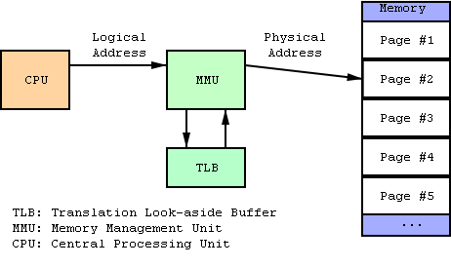
Aside: What is an MMU?
Memory Management Unit
  Tracks what parts of memory a process can access.
    Actually a bit more complex as it manages this by mapping virtual addresses to physical ones.
    Keeps processes out of each other’s memory.
Figure from Wikipedia

Slide 67
Portable
RTOS runs on many platforms.
  This is potentially incomputable with the previous slide.
  It’s actually darn hard to do even without peripherals
    For example I have spent 10 hours debugging a RTOS that had a pointer problem that only comes up if the pointer type is larger than the int type (20 bit pointers, 16 bit ints, yea!)
    Things like timers change and we certainly need timers.

Slide 68
Outline
Quick review of real-time systems
Overview of RTOSes
  Goals of an RTOS
  Features you might want in an RTOS
Learning by example: FreeRTOS
  Introduction
  Tasks
  Interrupts
  Internals (briefly)
  What’s missing?

Slide 69
Learning by example: FreeRTOS
Introduction taken from Amr Ali Abdel-Naby
  Nice blog:
    http://www.embedded-tips.blogspot.com

Slide 70

FreeRTOS Features
  Source code
  Portable
  ROM-able
  Scalable
  Preemptive and co-operative scheduling
  Multitasking
  Services
  Interrupt management
  Advanced features
Amr Ali Abdel-Naby@2010
Introduction to FreeRTOS V6.0.5

Slide 71
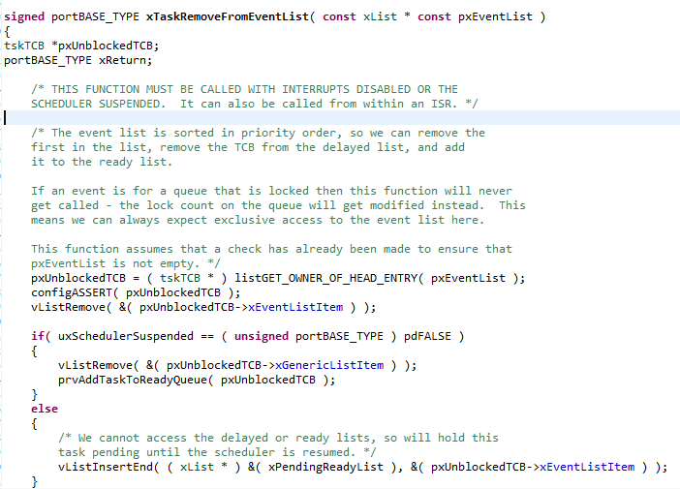
Source Code
  High quality
  Neat
  Consistent
  Organized
  Commented
Amr Ali Abdel-Naby@2010
Introduction to FreeRTOS V6.0.5

Slide 72





Portable
  Highly portable C
  24+ architectures supported
  Assembly is kept minimum.
  Ports are freely available in source code.
  Other contributions do exist.
Amr Ali Abdel-Naby@2010
Introduction to FreeRTOS V6.0.5

Slide 73

Scalable
  Only use the services you only need.
    FreeRTOSConfig.h
  Minimum footprint = 4 KB
  Version in lab on Pi is ~24 KB including the application and data for the OS and application.
    Pretty darn small for what you get.
    ~6000 lines of code (including a lot of comments, maybe half that without?)
Amr Ali Abdel-Naby@2010

Slide 74
Preemptive and Cooperative Scheduling
  Preemptive scheduling:
    Fully preemptive
    Always runs the highest priority task that is ready to run
    Comparable with other preemptive kernels
    Used in conjunction with tasks
  Cooperative scheduling:
    Context switch occurs if:
      A task/co-routine blocks
      Or a task/co-routine yields the CPU
    Used in conjunction with tasks/co-routines
Amr Ali Abdel-Naby@2010
Introduction to FreeRTOS V6.0.5

Slide 75
Multitasking
  No software restriction on:
    # of tasks that can be created
    # of priorities that can be used
    Priority assignment
      More than one task can be assigned the same priority.
      RR with time slice = 1 RTOS tick
Amr Ali Abdel-Naby@2010
Introduction to FreeRTOS V6.0.5

Slide 76
Services
  Queues
  Semaphores
    Binary and counting
  Mutexes
    With priority inheritance
    Support recursion
Amr Ali Abdel-Naby@2010
Introduction to FreeRTOS V6.0.5

Slide 77
Interrupts
  An interrupt can suspend a task execution.
  Interrupt mechanism is port dependent.
Amr Ali Abdel-Naby@2010
Introduction to FreeRTOS V6.0.5

Slide 78
Advanced Features
  Execution tracing
  Run time statistics collection
  Memory management
  Memory protection support
  Stack overflow protection
Amr Ali Abdel-Naby@2010
Introduction to FreeRTOS V6.0.5

Slide 79
Device support in related products
  Connect Suite from High Integrity Systems
    TCP/IP stack
    USB stack
      Host and device
    File systems
      DOS compatible FAT
Amr Ali Abdel-Naby@2010
Introduction to FreeRTOS V6.0.5

Slide 80
Licensing
  Modified GPL
    Only FreeRTOS is GPL.
    Independent modules that communicate with FreeRTOS through APIs can be anything else.
    FreeRTOS can’t be used in any comparisons without the authors’ permission.
Amr Ali Abdel-Naby@2010
Introduction to FreeRTOS V6.0.5

Slide 81
A bit more
System runs on “ticks”
  Every tick the kernel runs and figures out what to do next.
    Interrupts have a different mechanism
  Basically hardware timer is set to generate regular interrupts and calls the scheduler.
    This means the OS eats one of the timers—you can’t easily share.
OK, onto tasks!

Slide 82
Outline
Quick review of real-time systems
Overview of RTOSes
  Goals of an RTOS
  Features you might want in an RTOS
Learning by example: FreeRTOS
  Introduction
  Tasks
  Interrupts
  Internals (briefly)
  What’s missing?

Slide 83
Tasks
Each task is a function that must not return
  So it’s in an infinite loop (just like you’d expect in an embedded system really, think Arduino).
You inform the scheduler of
  The task’s resource needs (stack space, priority)
  Any arguments the tasks needs
All tasks here must be of void return type and take a single void* as an argument.
  You cast the pointer as needed to get the argument.
    I’d have preferred var_args, but this makes the common case (one argument) easier (and faster which probably doesn’t matter).
Code examples mostly from Using the FreeRTOS Real Time Kernel (a pdf book), fair use claimed.

Slide 84
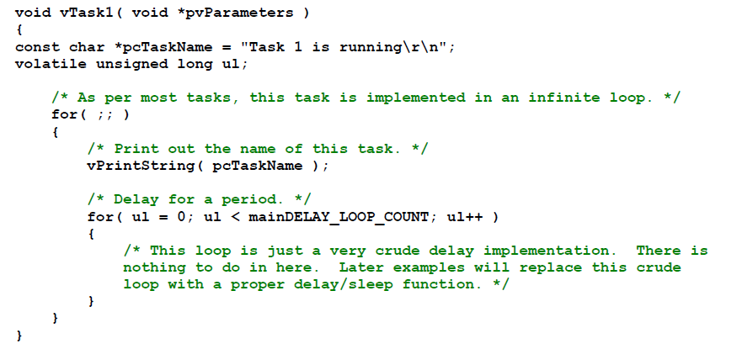
Example trivial task with busy wait (bad)

Slide 85
Task creation
portBASE_TYPE xTaskCreate(
pdTASK_CODE pvTaskCode,
const char * const pcName,
unsigned short usStackDepth,
void *pvParameters,
unsigned portBASE_TYPE uxPriority,
xTaskHandle *pvCreatedTask
);
Create a new task and add it to the list of tasks that are ready to run. xTaskCreate() can only be used to create a task that has unrestricted access to the entire microcontroller memory map. Systems that include MPU support can alternatively create an MPU constrained task using xTaskCreateRestricted().
pvTaskCode: Pointer to the task entry function. Tasks must be implemented to never return (i.e. continuous loop).
pcName: A descriptive name for the task. This is mainly used to facilitate debugging. Max length defined by tskMAX_TASK_NAME_LEN – default is 16.
usStackDepth: The size of the task stack specified as the number of variables the stack can hold - not the number of bytes. For example, if the stack is 16 bits wide and usStackDepth is defined as 100, 200 bytes will be allocated for stack storage.
pvParameters: Pointer that will be used as the parameter for the taskbeing created.
uxPriority: The priority at which the task should run. Systems that include MPU support can optionally create tasks in a privileged (system) mode by setting bit portPRIVILEGE_BIT of the priority parameter. For example, to create a privileged task at priority 2 the uxPriority parameter should be set to ( 2 | portPRIVILEGE_BIT ).
pvCreatedTask: Used to pass back a handle by which the created task can be referenced.
pdPASS: If the task was successfully created and added to a ready list, otherwise an error code defined in the file errors.h
From the task.h file in FreeRTOS

Slide 86
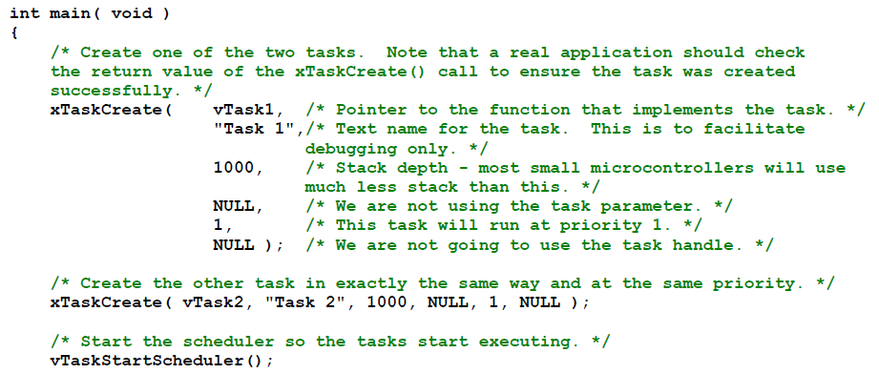
Creating a task: example

Slide 87
OK, I’ve created a task, now what?
Task will run if there are no other tasks of higher priority
  And if others the same priority will RR.
But that begs the question: “How do we know if a task wants to do something or not?”
  The previous example gave always wanted to run.
    Just looping for delay (which we said was bad)
    Instead should call vTaskDelay(x)
      Delays current task for X “ticks” (remember those?)
    There are a few other APIs for delaying…
Now we need an “under the hood” understanding

Slide 88
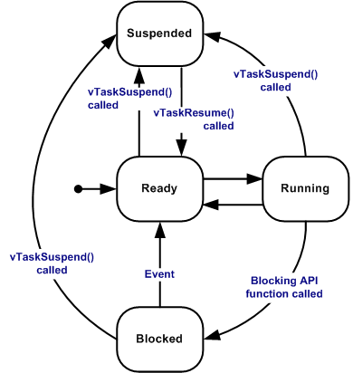
Task status in FreeRTOS
Running
  Task is actually executing
Ready
  Task is ready to execute but a task of equal or higher priority is Running.
Blocked
  Task is waiting for some event.
    Time: if a task calls vTaskDelay() it will block until the delay period has expired.
    Resource: Tasks can also block waiting for queue and semaphore events.
Suspended
  Much like blocked, but not waiting for anything.
  Tasks will only enter or exit the suspended state when explicitly commanded to do so through the vTaskSuspend() and xTaskResume() API calls respectively.
Mostly from http://www.freertos.org/RTOS-task-states.html

Slide 89
Tasks: there’s a lot more
Can do all sorts of things
  Change priority of a task
  Delete a task
  Suspend a task (mentioned above)
  Get priority of a task.
Example on the right
  But we’ll stop here…
void vTaskPrioritySet( xTaskHandle pxTask,
unsigned uxNewPriority );
Set the priority of any task.
pxTask: Handle to the task for which the priority is being set. Passing a NULL handle results in the priority of the calling task being set.
uxNewPriority: The priority to which the task will be set.

Slide 90
Outline
Quick review of real-time systems
Overview of RTOSes
  Goals of an RTOS
  Features you might want in an RTOS
Learning by example: FreeRTOS
  Introduction
  Tasks
  Interrupts
  Internals (briefly)
  What’s missing?

Slide 91
Interrupts in FreeRTOS
There is both a lot and a little going on here.
  The interface mainly uses whatever the native environment uses to handle interrupts
    This can be very port dependent. In Code Composer Studio you’d set it up as follows:
      #pragma vector=PORT2_VECTOR
      interrupt void prvSelectButtonInterrupt( void )
  That would cause the code to run on the PORT2 interrupt.
    Need to set that up etc. Very device specific (of course).

Slide 92
More: Deferred Interrupt Processing
The best way to handle complex events triggered by interrupts is to not do the code in the ISR.
  Rather create a task that is blocking on a semaphore.
    When the interrupt happens, the ISR just sets the semaphore and exits.
      Task can now be scheduled like any other. No need to worry about nesting interrupts (and thus interrupt priority).
      FreeRTOS does support nested interrupts on some platforms though.
  Semaphores implemented as one/zero-entry queue.

Slide 93
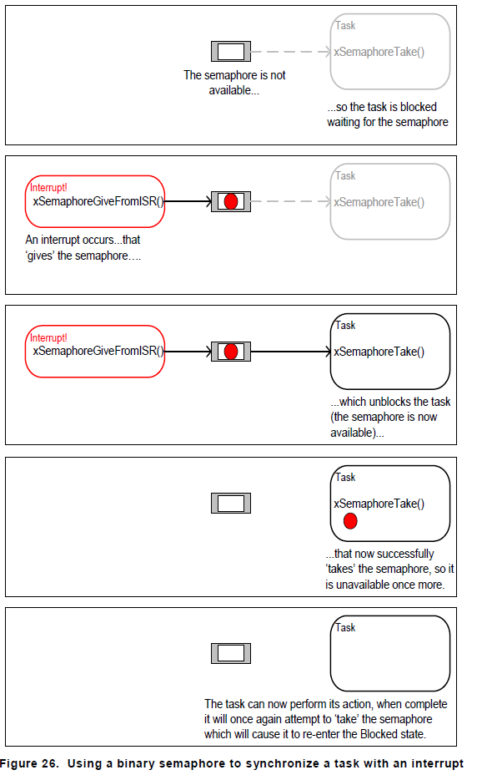
Semaphore example in FreeRTOS
Figure from Using the FreeRTOS Real Time Kernel (a pdf book), fair use claimed.

Slide 94
Semaphore take
xSemaphoreTake(
xSemaphoreHandle xSemaphore,
portTickType xBlockTime
)
Macro to obtain a semaphore. The semaphore must have previously been created.
xSemaphore A handle to the semaphore being taken - obtained when the semaphore was created.
xBlockTime The time in ticks to wait for the semaphore to become available. The macro portTICK_RATE_MS can be used to convert this to a real time. A block time of zero can be used to poll the semaphore.
TRUE if the semaphore was obtained.
There are a handful of variations.
  Faster but more locking version, non-binary version, etc.

Slide 95
Outline
Quick review of real-time systems
Overview of RTOSes
  Goals of an RTOS
  Features you might want in an RTOS
Learning by example: FreeRTOS
  Introduction
  Tasks
  Interrupts
  Internals (briefly)
  What’s missing?

Slide 96
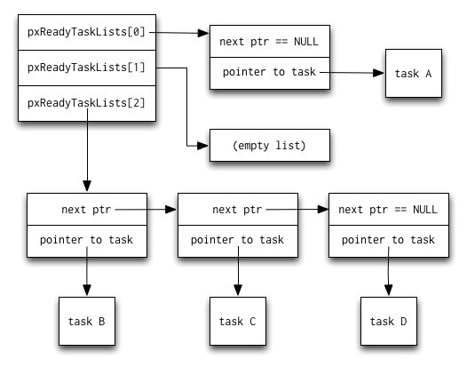
Common data structures
This figure and the next are from http://www.aosabook.org/en/freertos.html

Slide 97
