Slide 1
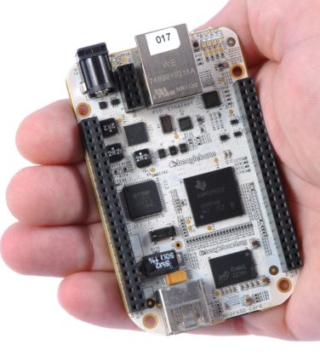
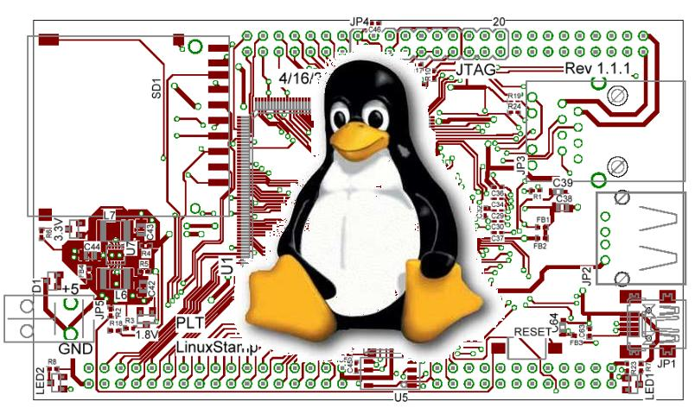
EECS 473 Advanced Embedded Systems
Lecture 5 Evaluation boards & GPL
Start on Linux (time allowing)

Slide 2
Outline
FreeRTOS finish up (10 minutes)
Off-the-shelf boards (20 minutes)
Why they are useful
An example
Copyright and the Gnu Public License (20 minutes)
What it is, and why it matters for embedded engineers
Start on Embedded Linux
Introduction only (if that) Details next lecture.

Slide 3
FreeRTOS
Finishing up

Slide 4
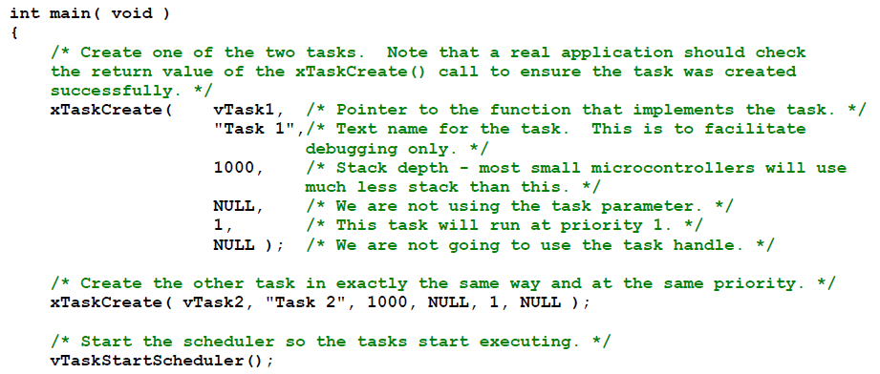
Creating a task: example

Slide 5
OK, I’ve created a task, now what?
Task will run if there are no other tasks of higher priority
And if others the same priority will RR.
But that begs the question: “How do we know if a task wants to do something or not?”
The previous example gave always wanted to run.
Just looping for delay (which we said was bad)
Instead should call vTaskDelay(x)
Delays current task for X “ticks” (remember those?)
There are a few other APIs for delaying…
Now we need an “under the hood” understanding

Slide 6
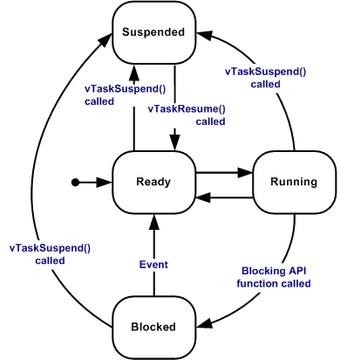
Task status in FreeRTOS
Running
Task is actually executing
Ready
Task is ready to execute but a task of equal or higher priority is Running.
Blocked
Task is waiting for some event.
Time: if a task calls vTaskDelay() it will block until the delay period has expired.
Resource: Tasks can also block waiting for queue and semaphore events.
Suspended
Much like blocked, but not waiting for anything.
Tasks will only enter or exit the suspended state when explicitly commanded to do so through the vTaskSuspend() and xTaskResume() API calls respectively.
Mostly from http://www.freertos.org/RTOS-task-states.html

Slide 7
Tasks: there’s a lot more
Can do all sorts of things
Change priority of a task
Delete a task
Suspend a task (mentioned above)
Get priority of a task.
Example on the right
But we’ll stop here…
void vTaskPrioritySet( xTaskHandle pxTask,
unsigned uxNewPriority );
Set the priority of any task.
pxTask: Handle to the task for which the priority is being set. Passing a NULL handle results in the priority of the calling task being set.
uxNewPriority: The priority to which the task will be set.

Slide 8
Outline
Quick review of real-time systems
Overview of RTOSes
Goals of an RTOS
Features you might want in an RTOS
Learning by example: FreeRTOS
Introduction
Tasks
Interrupts
Internals (briefly)
What’s missing?

Slide 9
Interrupts in FreeRTOS
There is both a lot and a little going on here.
The interface mainly uses whatever the native environment uses to handle interrupts
This can be very port dependent. In Code Composer Studio you’d set it up as follows:
#pragma vector=PORT2_VECTOR
interrupt void prvSelectButtonInterrupt( void )
That would cause the code to run on the PORT2 interrupt.
Need to set that up etc. Very device specific (of course).

Slide 10
More: Deferred Interrupt Processing
The best way to handle complex events triggered by interrupts is to not do the code in the ISR.
Rather create a task that is blocking on a semaphore.
When the interrupt happens, the ISR just sets the semaphore and exits.
Task can now be scheduled like any other. No need to worry about nesting interrupts (and thus interrupt priority).
FreeRTOS does support nested interrupts on some platforms though.
Semaphores implemented as one/zero-entry queue.

Slide 11
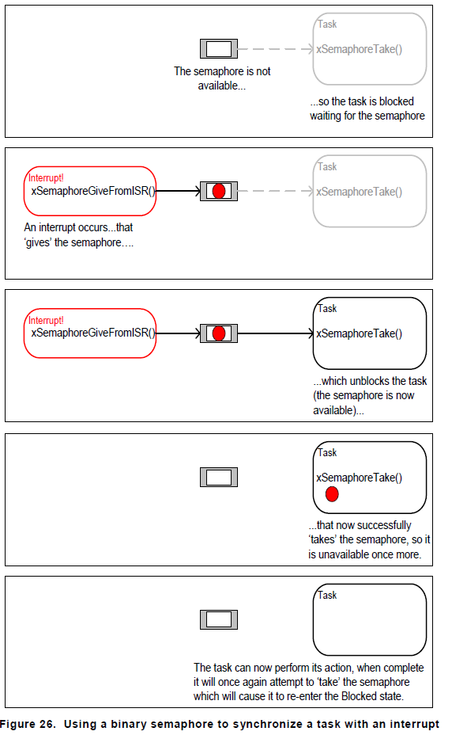
Semaphore example in FreeRTOS
Figure from Using the FreeRTOS Real Time Kernel (a pdf book), fair use claimed.

Slide 12
Semaphore take
xSemaphoreTake(
xSemaphoreHandle xSemaphore,
portTickType xBlockTime
)
Macro to obtain a semaphore. The semaphore must have previously been created.
xSemaphore A handle to the semaphore being taken - obtained when the semaphore was created.
xBlockTime The time in ticks to wait for the semaphore to become available. The macro portTICK_RATE_MS can be used to convert this to a real time. A block time of zero can be used to poll the semaphore. There is a way to make this indefinitely.
TRUE if the semaphore was obtained.
There are a handful of variations.
Non-binary version, etc.

Slide 13
Outline
Quick review of real-time systems
Overview of RTOSes
Goals of an RTOS
Features you might want in an RTOS
Learning by example: FreeRTOS
Introduction
Tasks
Interrupts
Internals (briefly)
What’s missing?

Slide 14
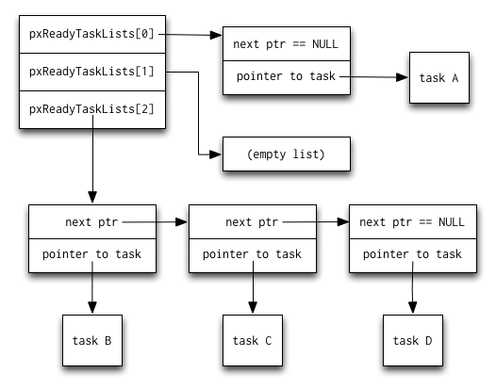
Common data structures
This figure and the next are from http://www.aosabook.org/en/freertos.html

Slide 15
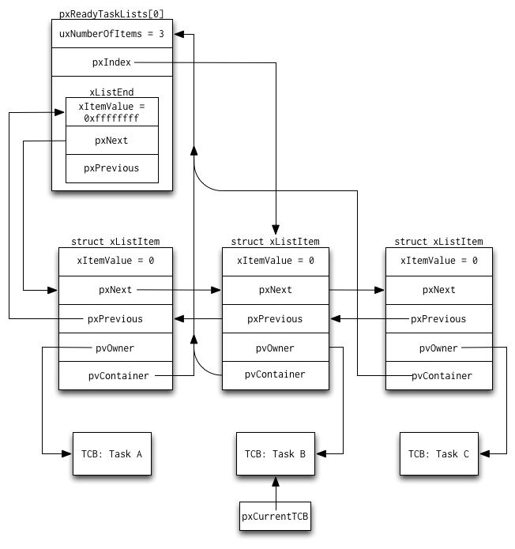

Slide 16
Off-the-shelf boards
Using them in 473

Slide 17
Designing an Embedded System
Off-the-shelf boards
There are a number of high-level choices for the “processor”
Micro-controller, SoC, desktop processor, FPGA etc.
But beyond that we’ve got to figure out what exactly we need.

Slide 18
How do we pick a platform?
Off-the-shelf boards
The very first question should almost always be “can I use an off-the-shelf solution?”
In this case, I mean a pre-built board.
Unless you have significant quantities, you are almost always better off with an existing board.
No engineering cost (to you)
(Hopefully) no testing or debugging phase
Well, some testing during evaluation…
But we’ll find we can almost never use a pre-built board.
Why not?

Slide 19
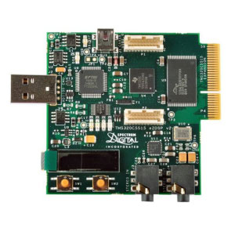
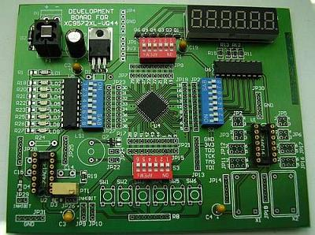
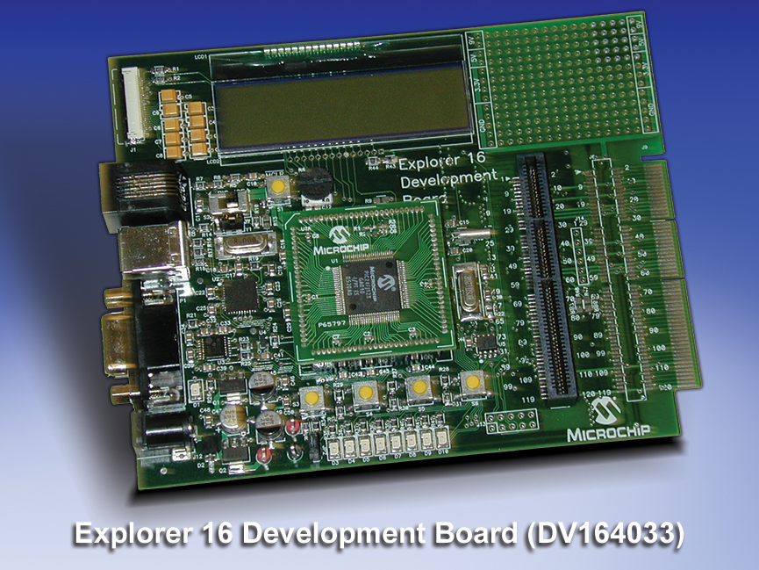
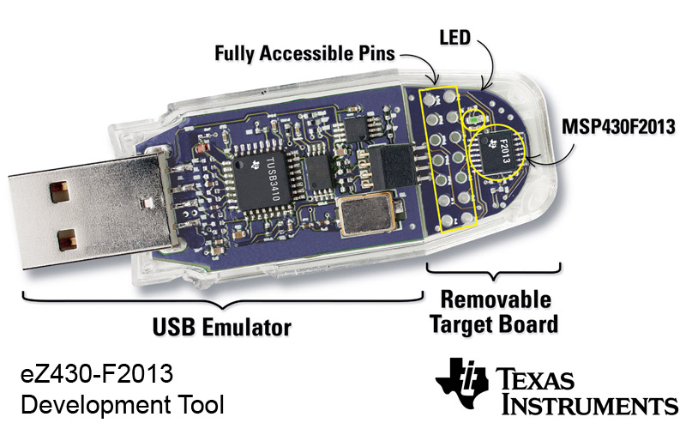
Development board, evaluation board etc.
Off-the-shelf boards
There are many “generic” boards that exist mainly to give developers the chance to evaluate and prototype devices.
The Actel board in 373 is an example.
If you are doing embedded development you really want to be able to use a dev. board to prototype where possible.
Nice to be able to get software up and running
Not to mention nice to learn you can’t do what you thought you could do!
Also nice because the schematics are often available to you.
Things like power supply design are done and tested!
Huge variety of these…

Slide 20
Personal Example:
Off-the-shelf boards
I was “specing” a board a few years ago. It needed to be:
Be able to mostly do the 270 labs
Switches, buttons, LEDs, FPGA with decent free software.
7-segment displays would be really nice.
2000+ gates, 100+ flip-flops
Ideally twice that or more
Cheap in quantity--$20 target price at 5,000 units.
No external wiring or power supply other than a USB cable.
First check is what’s out there…

Slide 21
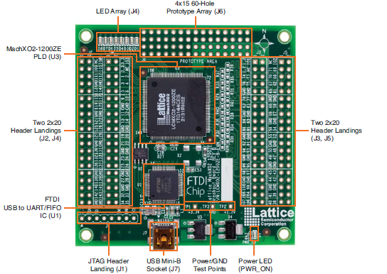
Market check
Off-the-shelf boards
Best I could find:
Digilent C-Mod
$22 in quantities of 1, has solid FPGA.
Basically no I/O, requires expensive programming cable.
Polmaddie2
Has traffic-light LEDs!, plenty of FPGA, only USB cable
$80 in quantities of 100, not enough I/O.
Asked around and found
MachXO2-1200ZE
Plenty of potential I/O (lots of headers), USB-only, $26 in quantities of 1 from Digikey (lots of potential for lower price), has LEDs.
No actual switches, 108 LUTs, price may be too much?

Slide 22
Even that board isn’t ideal
Off-the-shelf boards
But encouraging that I might be able to design one (or have one designed) that fits the specification.
Spend an extra dollar on the FPGA and probably get one more than large enough.
Switches/7-segment displays remarkably expensive.
Probably $3 in parts for what I want?

Slide 23
So…
Off-the-shelf boards
There may be a board out there that does what you need.
Even if price/form factor/power isn’t acceptable, still really useful for development!
Always look.
You’d rather develop on an existing board.
You’d also like to have it as a starting point.
And if quantities needed are low and the off-the-shelf boards have the needed size and power characteristics, you might just use the off-the-shelf board.

Slide 24
But…
All that said, you really want to start your design using a prebuilt board even if it isn’t your final solution.
You can do testing, develop code, and generally get things working.
You may also get a PCB design as a starting point
These folks are generally using the board to sell chips. They are often happy to have you copy their PCB work.
But read licenses and understand any restrictions they place on you.

Slide 25
How do you price out a custom board?
Good question.
Historically it’s been a tricky to do.
Honestly finding reasonable prices for parts is a pain
Digikey is not what you want to be looking at for any kind of large-ish run. Just costs too much.
PCB costs are a lot easier to figure out
Solid PCB costs
And manufacturing costs are really tricky.
Generally require a human to give you a quote and pricing seems fairly random.

Slide 26
PCB quotes
PCBs can be quite cheap.
When I started this class, costs were often close to $150 for 3 to 5 boards.
Now can be close to $20.
And even free in some cases
Talk to GSIs about vendors.

Slide 27
Manufacturing quotes
Turns out there are companies that give automatic quotes
Including PCB, parts and assembly.
https://circuithub.com was the first (AFAIK).
Sample board
An Arduino (with some extras, 16 vs 7 day ship)
1 board: $255 $653
10 boards: $50/each $86
100 boards: $21/each $28
1000 boards: $13/each N/A

Slide 28
Newer pricing
PCBs of “about” Arduino complexity
10: $440+ parts
100: $365+parts (huh?)
1000: $766+parts

Slide 29
Copyright, Copyleft, and Legal Issues

Slide 30
The basic copyright options
No license:
Without a license, the code is copyrighted by default. People can read the code, but they have no legal right to use it. To use the code, you must contact the author directly and ask permission.
Public domain:
If your code is in the public domain, anyone may use your code for any purpose whatsoever. Nothing is in the public domain by default; you have to explicitly put your work in the public domain if you want it there. Otherwise, you must be dead a long time before your work reverts to the public domain.
Text from https://blog.codinghorror.com/pick-a-license-any-license/, also includes a (too) terse summary of the common software licenses.

Slide 31
Linux?
A POSIX-compliant and widely deployed desktop/server operating system licensed under the GPL
POSIX
Unix-like environment (shell, standard programs like awk etc.)
Desktop OS
Designed for users and servers
Not designed for embedded systems
GPL
GNU Public License. May mean you need to make source code available to others.
First “copyleft” license.
Linux is licensed under GPL-2, not GPL-3.

Slide 32
GPL in three slides (1/3)
Background: legal issues
A licensee of GPL v2-licensed software can:
copy and distribute the program's unmodified source code
modify the program's source code and distribute the modified source
distribute compiled versions of the program, both modified and unmodified
Provided that:
all distributed copies (modified or not) carry a copyright notice and exclusion of warranty
all modified copies are distributed under the GPL v2
all compiled versions of the program are accompanied by the relevant source code, or a viable offer to make the relevant source code available
Largely taken from http://www.oss-watch.ac.uk/resources/gpl.xml

Slide 33
GPL in three slides (2/3)
Background: legal issues
Some points
If you don’t redistribute the code, you don’t need to share the source.
You can bundle software with GPL-ed software and not have to license the bundled software.
“Mere aggregations” aren’t impacted.
Loadable Kernel Modules are tricky though
Often we need device drivers for our application (we’ll be writing them later)
But they touch the Linux code in a non-trivial way.
There is some debate about if a LKM is an aggregation or a modification of the original kernel.
In general there are proprietary drivers out there and even open source groups that help support said drivers.
General theme:
Be sure you understand the law before you use software licensed under the GPL on a proprietary project.
Using gcc to compile or ddd to debug is fine, but when you are modifying the code of software licensed under the GPL you might be obligated to release your code.
Read (or at least scan): The Right to Read before the midterm.
https://www.gnu.org/philosophy/right-to-read.en.html

Slide 34
GPL in three slides (3/3)
Background: legal issues
GPL v3
Prevents using GPL on hardware that won’t run other code (“Tivoization”)
Though only for consumer hardware (IBM has a business model here?)
Addresses patents
Can’t sue for (software?) patent on code you release.
Lesser GPL
Mainly for libraries/APIs.
Makes it clear can use libraries in proprietary code without having to release proprietary code.

Slide 35
OK, one more
gcc is GPL v3
But has a runtime exception.
When you use GCC to compile a program, GCC may combine portions of certain GCC header files and runtime libraries with the compiled program. The purpose of this Exception is to allow compilation of non-GPL (including proprietary) programs to use, in this way, the header files and runtime libraries covered by this Exception.
Linux is GPL v2
Fear of limiting DRM and private keys keeps them away from v3.
There is a short preamble:
This copyright does *not* cover user programs that use kernel services by normal system calls - this is merely considered normal use of the kernel, and does *not* fall under the heading of "derived work".

Slide 36
Another common License: Creative Commons
These are basically a free configurable license.
Attribution (by)
Must give author credit
ShareAlike (sa)
Like GPL, they must distribute any changes.
NonCommercial (nc)
Only for non-commercial
NoDerivatives (nd)
Can’t make changes.
Idea is, someone smart wrote the words to do what you probably want to do.
You still hold ownership, so if they want a different license, they can come to you to negotiate.
Wikipedia is CC BY-SA
Creative Commons is generally a poor license for code but still used for that. See https://creativecommons.org/faq/
But quite useful for documentation and databases

Slide 37
MIT license
Permission is hereby granted, free of charge, to any person obtaining a copy of this software and associated documentation files (the "Software"), to deal in the Software without restriction, including without limitation the rights to use, copy, modify, merge, publish, distribute, sublicense, and/or sell copies of the Software, and to permit persons to whom the Software is furnished to do so, subject to the following conditions:
The above copyright notice and this permission notice shall be included in all copies or substantial portions of the Software.
(And then a disclaimer of liability)
Basically, just grants permission.
Can add to a closed-source product, etc.
More-or-less public domain with the disclaimer of liability being required in any place the code is used.

Slide 38
Fair use
Fair use lets you use copyrighted works
But in general there are guidelines for what you can use.
Four factors are:
the purpose and character of your use
Transformative or not (parody falls here)
the nature of the copyrighted work
Published/not published, factual works.
the amount and substantiality of the portion taken
The amount taken and the % taken both play a role.
the effect of the use upon the potential market
If you reduce the market for the original work, that’s a problem.
Fair use in code is tricky at best.
APIs sometimes fit here (see Oracle America vs. Google Inc.)
http://fairuse.stanford.edu/overview/fair-use/four-factors/

Slide 39
Start on Linux
Just some context
We’ll get to the stuff you need for lab 4 next time.

Slide 40
What is a kernel? (1/2)
Background
The kernel’s job is to talk to the hardware and software, and to manage the system’s resources as best as possible.
It talks to the hardware via the drivers that are included in the kernel (or additionally installed later on in the form of a “kernel module”).
This way, when an application wants to do something (say change the volume setting of the speakers), it can just submit that request to the kernel, and the kernel can use the driver it has for the speakers to actually change the volume.
This part taken from http://www.makeuseof.com/tag/linux-kernel-explanation-laymans-terms/

Slide 41
What is a kernel? (2/2)
Background
The kernel is highly involved in resource management.
It has to make sure that there is enough memory available for an application to run, as well as to place an application in the right location in memory.
It tries to optimize the usage of the processor so that it can complete tasks as quickly as possible. It also aims to avoid deadlocks, which are problems that completely halt the system when one application needs a resource that another application is using.
It’s a fairly complicated circus act to coordinate all of those things, but it needs to be done and that’s what the kernel is for.

Slide 42
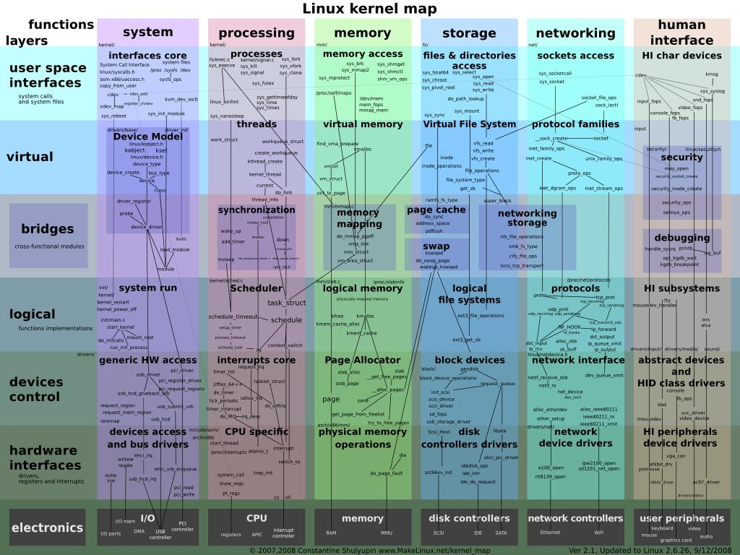

Slide 43
Linux Kernel history
Background: versions
3.0 isn’t a radical change from 2.6, instead a 2.6 upgrade was move to 3.0 for Linux’s 20th anniversary.
“So what are the big changes? NOTHING. Absolutely nothing. Sure, we have the usual two thirds driver changes, and a lot of random fixes, but the point is that 3.0 is *just* about renumbering…” [https://lkml.org/lkml/2011/5/29/204]
And 4.0 is more of the same.
http://www.itworld.com/article/2887558/linus-torvalds-bumps-linux-kernel-to-version-4x.html
I’d like to point out (yet again) that we don’t do feature-based releases, and that “5.0” doesn’t mean anything more than that the 4.x numbers started getting big enough that I ran out of fingers and toes.
Linus Torvalds
Figure from “Linux kernel version history” article on Wikipedia.

Slide 44
What version am I working with?
Background: versions
If running, use “uname” command
“uname -a” for all information
If looking at source
First few lines of the top-level Makefile will tell you.

Slide 45
How do I download and build the kernel?
Background: building
Use git.
Typing “make” with no target at the top-level should build the kernel.
Need gcc installed (no other compiler will do).
Should generate an ELF file called “vmlinux”
But lots of configuration stuff

Slide 46
Kernel configuration
Background: building
There is a file, “.config” which drives the build.
It determines the functionality (including cross-compling?) of the kernel.
Things like USB support, etc.
It is setup in any number of ways.
The default is to ask a huge number of questions.
There are editors and defaults you can use instead.
make defconfig should just do all defaults for example.
make help should give a solid overview of options
The .config file scheme has some problems.
It is easy to miss, as files that start with a “.” (dot) are hidden files in Linux ("ls -a" will show them)
It is easy to blow away.
make distclean will delete it for example…

Slide 47
Linux user basics--shell
Background: user basics
You have a shell which handles user commands
May just search for an executable file (application) in certain locations
Allows for moving data between those applications.
Pipes etc.
Is itself a programming language.
There are many of these (bash, sh, tcsh, csh, ksh, zsh)
Most have very similar interfaces (type application name, it runs), but the programming language part varies quite a bit.
Geek humor:
sh is called the Bourne shell, written by Stephen Bourne
bash, often treated as an upgrade to sh, is the “Bourne again shell”

Slide 48
Linux user basics—file systems
Background: user basics
Linux supports a huge variety of file systems.
But they have some commonalities.
Pretty much a standard directory structure with each directory holding either other directories or files.
Each file and directory has a set of permissions.
One owner (a single user)
One group (a list of users who may have special access)
There are three permissions, read, write and execute
Specified for owner, group, and world.
There are also links (hard and soft)
So rather than copying files I can point to them.

Slide 49
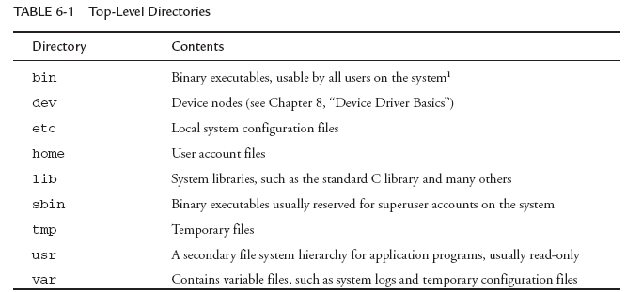
FHS: File System Hierarchy Standard
Background: FHS
There is a standard for laying out file systems
Part of this is the standard top-level directories

Slide 50
A “minimal” file system
Background: FHS

Slide 51
What makes a Linux install “embedded”?
Embedded Linux
It’s one of those poorly defined terms, but in general it will have one or more of the following
small footprint
flash files system
real-time extensions of some sort

Slide 52
Small footprint--Busybox
Embedded Linux—small footprint
addgroup, adduser, ar, ash, awk, basename, blkid, bunzip2, bzcat, cat, chattr, chgrp, chmod, chown, chpasswd, chroot, chvt, clear, cmp, cp, cpio, cryptpw, cut, date, dc, dd, deallocvt, delgroup, deluser, df, dhcprelay, diff, dirname, dmesg, du, dumpkmap, dumpleases, echo, egrep, env, expr, false, fbset, fbsplash, fdisk, fgrep, find, free, freeramdisk, fsck, fsck.minix, fuser, getopt, getty, grep, gunzip, gzip, halt, head, hexdump, hostname, ttpd, hwclock, id, ifconfig, ifdown, ifup, init, insmod, ip, kill, killall, klogd, last, less, linuxrc, ln, loadfont, loadkmap, logger, login, logname, logread, osetup, ls, lsmod, makedevs, md5sum, mdev, microcom, mkdir, mkfifo, mkfs.minix, mknod, mkswap, mktemp, modprobe, more, mount, mv, nc, netstat, nice, nohup, nslookup, od, penvt, passwd, patch, pidof, ping, ping6, pivot_root, poweroff, printf, ps, pwd, rdate, rdev, readahead, readlink, eadprofile, realpath, reboot, renice, reset, rm, rmdir, rmmod, route, rtcwake, run-parts, sed, seq, setconsole, etfont,sh, showkey, sleep, sort, start-stop-daemon, strings, stty, su, sulogin, swapoff, swapon, switch_root, sync, sysctl, syslogd, tail, tar, tee, telnet, telnetd, test, tftp, time, top, touch, tr, traceroute, true, tty, udhcpc, udhcpd, umount, uname, uniq, unzip, uptime, usleep, vi, vlock, watch, wc, wget, which, who, whoami, xargs, yes, zcat
A single executable that implements the functionality of a massive number of standard Linux utilities
ls, gzip, ln, vi. Pretty much everything you normally need.
Some have limited features
Gzip only does the basics for example.
Pick which utilities you want it to do
Can either drop support altogether or install real version if needed
Highly configurable (similar to Linux itself), easy to cross-compile.
Example given is around 2MB statically compiled!

Slide 53
Using busybox
Embedded Linux—small footprint
Two ways to play
Invoke from the command line as busybox
busybox ls /
Or create a softlink to busybox and it will run as the name of that link.
So if you have a softlink to busybox named “ls” it will run as ls.

Slide 54
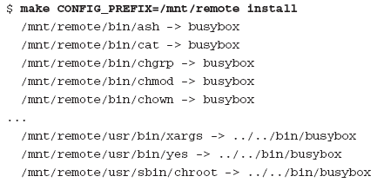
Links done for you
Embedded Linux—small footprint
Normally speaking, you’ll use the softlink option.
You can get it to put in all the links for you with “make install”
Be darn careful you don’t overwrite things locally if you are doing this on the host machine.
That would be bad.

Slide 55
System initialization
Embedded Linux—small footprint
Busybot can also be “init”
But it’s a simpler/different version than the init material covered above.
More “bash” like
#!/bin/sh
echo “Mounting proc”
mount -t proc /proc /proc
echo “Starting system loggers”
syslogd
klogd
echo “Configuring loopback interface”
ifconfig lo 127.0.0.1
echo “Starting inetd”
xinetd
# start a shell
busybox sh

Slide 56
BusyBox Summary
Embedded Linux—small footprint
BusyBox is a powerful tool for embedded systems that replaces many common Linux utilities in a single multicall binary.
BusyBox can significantly reduce the size of your root file system image.
Configuring BusyBox is straightforward, using an interface similar to that used for Linux configuration.
System initialization is possible but somewhat different with BusyBox
From Embedded Linux Primer, second edition

