Slide 1
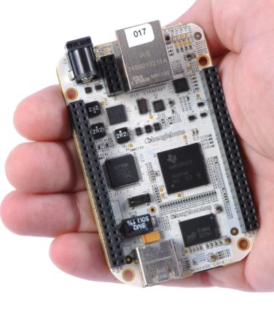
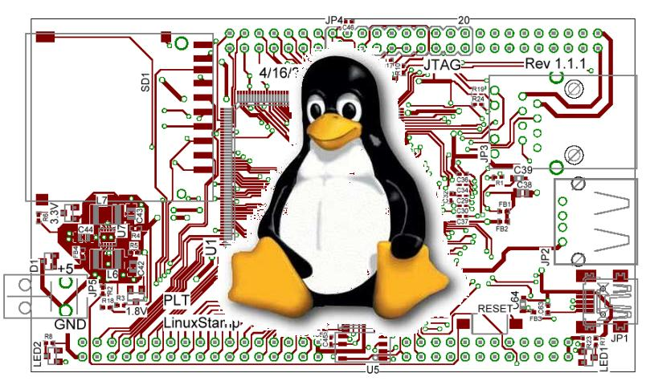
Finish Licensing & Embedded Linux Lectures 6 and 7

Slide 2
NOTE:
Be sure to register your RPi.
See Piazza post @59 (pinned)
Basically, bring your Pi to lab this week and register it or follow directions for doing it from home.

Slide 3
Copyright, Copyleft, and Legal Issues

Slide 4
The basic copyright options
No license:
Without a license, the code is copyrighted by default. People can read the code, but they have no legal right to use it. To use the code, you must contact the author directly and ask permission.
Public domain:
If your code is in the public domain, anyone may use your code for any purpose whatsoever. Nothing is in the public domain by default; you have to explicitly put your work in the public domain if you want it there. Otherwise, you must be dead a long time before your work reverts to the public domain.
Text from https://blog.codinghorror.com/pick-a-license-any-license/, also includes a (too) terse summary of the common software licenses.

Slide 5
Linux (common usage of the word)
A POSIX-compliant and widely deployed desktop/server operating system licensed under the GPL
POSIX
Unix-like environment (shell, standard programs like awk etc.)
Desktop OS
Designed for users and servers
Not designed for embedded systems
GPL
GNU Public License. May mean you need to make source code available to others.
First “copyleft” license.
Linux is licensed under GPL-2, not GPL-3.

Slide 6
GPL in three slides (1/3)
Background: legal issues
A licensee of GPL v2-licensed software can:
copy and distribute the program's unmodified source code
modify the program's source code and distribute the modified source
distribute compiled versions of the program, both modified and unmodified
Provided that:
all distributed copies (modified or not) carry a copyright notice and exclusion of warranty
all modified copies are distributed under the GPL v2
all compiled versions of the program are accompanied by the relevant source code, or a viable offer to make the relevant source code available
Largely taken from http://www.oss-watch.ac.uk/resources/gpl.xml

Slide 7
GPL in three slides (2/3)
Background: legal issues
Some points
If you don’t redistribute the code, you don’t need to share the source.
You can bundle software with GPL-ed software and not have to license the bundled software.
“Mere aggregations” aren’t impacted.
Loadable Kernel Modules are tricky though
Often we need device drivers for our application (we’ll be writing them later)
But they touch the Linux code in a non-trivial way.
There is some debate about if a LKM is an aggregation or a modification of the original kernel.
In general there are proprietary drivers out there and even open source groups that help support said drivers.
General theme:
Be sure you understand the law before you use software licensed under the GPL on a proprietary project.
Using gcc to compile or ddd to debug is fine, but when you are modifying the code of software licensed under the GPL you might be obligated to release your code.
Read (or at least scan): The Cathedral and the Bazaar before the midterm.

Slide 8
GPL in three slides (3/3)
Background: legal issues
GPL v3
Prevents using GPL on hardware that won’t run other code (“Tivoization”)
Though only for consumer hardware (IBM has a business model here?)
Addresses patents
Can’t sue for (software?) patent on code you release.
Lesser GPL
Mainly for libraries/APIs.
Makes it clear can use libraries in proprietary code without having to release proprietary code.

Slide 9
OK, one more
gcc is GPL v3
But has a runtime exception.
When you use GCC to compile a program, GCC may combine portions of certain GCC header files and runtime libraries with the compiled program. The purpose of this Exception is to allow compilation of non-GPL (including proprietary) programs to use, in this way, the header files and runtime libraries covered by this Exception.
Linux is GPL v2
Fear of limiting DRM and private keys keeps them away from v3.
There is a short preamble:
This copyright does *not* cover user programs that use kernel services by normal system calls - this is merely considered normal use of the kernel, and does *not* fall under the heading of "derived work".

Slide 10
Another common License: Creative Commons
These are basically a free configurable license.
Attribution (by)
Must give author credit
ShareAlike (sa)
Like GPL, they must distribute any changes.
NonCommercial (nc)
Only for non-commercial
NoDerivatives (nd)
Can’t make changes.
Idea is, someone smart wrote the words to do what you probably want to do.
You still hold ownership, so if they want a different license, they can come to you to negotiate.
Wikipedia is CC BY-SA
Creative Commons is generally a poor license for code but still used for that. See https://creativecommons.org/faq/
But quite useful for documentation and databases

Slide 11
MIT license
Permission is hereby granted, free of charge, to any person obtaining a copy of this software and associated documentation files (the "Software"), to deal in the Software without restriction, including without limitation the rights to use, copy, modify, merge, publish, distribute, sublicense, and/or sell copies of the Software, and to permit persons to whom the Software is furnished to do so, subject to the following conditions:
The above copyright notice and this permission notice shall be included in all copies or substantial portions of the Software.
(And then a disclaimer of liability)
Basically, just grants permission.
Can add to a closed-source product, etc.
More-or-less public domain with the disclaimer of liability being required in any place the code is used.

Slide 12
Fair use
Fair use lets you use copyrighted works
But in general there are guidelines for what you can use.
Four factors are:
the purpose and character of your use
Transformative or not (parody falls here).
the nature of the copyrighted work
Published/not published, factual works.
the amount and substantiality of the portion taken
The amount taken and the % taken both play a role.
the effect of the use upon the potential market
If you reduce the market for the original work, that’s a problem.
Fair use in code is tricky at best.
APIs sometimes fit here (see Oracle America vs. Google Inc.)
http://fairuse.stanford.edu/overview/fair-use/four-factors/

Slide 13
Start on Linux
Many figures and text in this section taken from Embedded Linux Primer, second edition
We (kind of) have on-line access to the book. Also http://freesoftwaremagazine.com/articles/drivers_linux/ is used a lot!

Slide 14
Two main tasks
Introduce Linux and in particular embedded Linux.
Pretty high-level.
Lots of material coming pretty quickly.
How to write device drivers for Linux.
Much more detailed
Pretty complex coding
Will do in lab 4.

Slide 15
Linux Introduction
Background
Kernel overview, legal issues, versioning, building, user basics, FHS, booting
Embedded Linux (common but not required attributes)
Small footprint (BusyBox)
Flash file system
Real time support
Warning: We are going to do this section very quickly indeed. There is a lot of stuff I want you to see. There is enough stuff in this section of this lecture for 20 hours of discussion. We don’t have that kind of time. Just going to lightly touch on some stuff.

Slide 16
Linux
The software commonly referred to as “Linux” is really a number of things glued together
The Linux Kernel
GNU tools (bash, ls, emacs, etc.)
Usually also
A package manager (dpkg, RPM, etc.)
A desktop environment (GNOME, KDE, etc.)
Linux distributions (“distros”)
Collections of the above tools (Debian, Red Hat, etc.)
These distros are often labeled as a “Linux-based OS”
The Kernel isn’t an OS by itself
The distros are
https://itsfoss.com/what-is-linux-distribution/

Slide 17
What is a kernel? (1/2)
Background: kernel
The kernel’s job is to talk to the hardware and software, and to manage the system’s resources as best as possible.
It talks to the hardware via the drivers that are included in the kernel (or additionally installed later on in the form of a “kernel module”).
This way, when an application wants to do something (say change the volume setting of the speakers), it can just submit that request to the kernel, and the kernel can use the driver it has for the speakers to actually change the volume.
http://www.makeuseof.com/tag/linux-kernel-explanation-laymans-terms/

Slide 18
What is a kernel? (2/2)
Background: kernel
The kernel is highly involved in resource management.
It has to make sure that there is enough memory available for an application to run, as well as to place an application in the right location in memory.
It tries to optimize the usage of the processor so that it can complete tasks as quickly as possible.
It also aims to avoid deadlocks.
It’s a fairly complicated circus act to coordinate all of those things, but it needs to be done and that’s what the kernel is for.

Slide 19
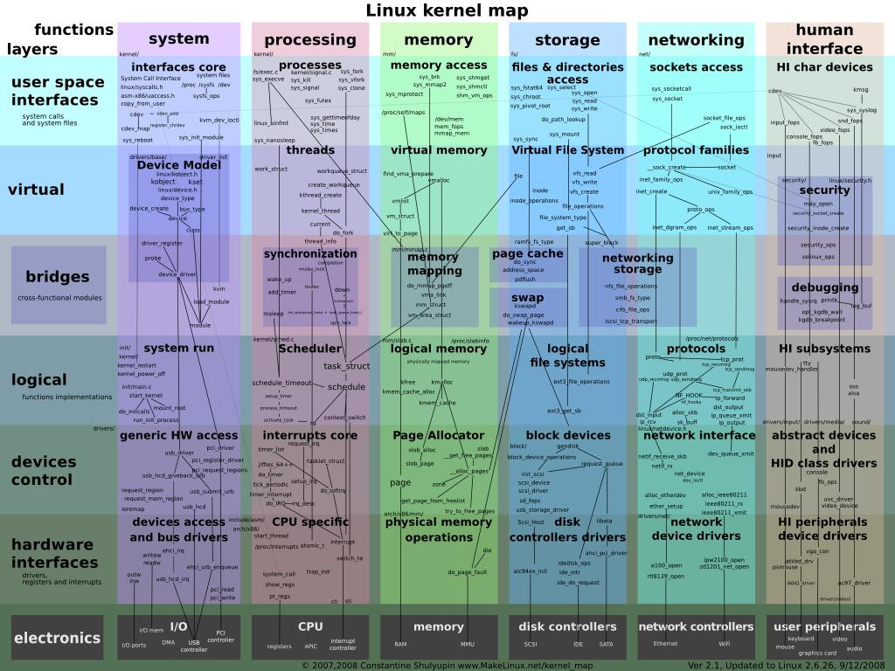
Background: kernel
Background: kernel

Slide 20
Linux kernel history
Background: Linux kernel versions
3.0 isn’t a radical change from 2.6, instead a 2.6 upgrade was move to 3.0 for Linux’s 20th anniversary.
“So what are the big changes? NOTHING. Absolutely nothing. Sure, we have the usual two thirds driver changes, and a lot of random fixes, but the point is that 3.0 is *just* about renumbering…” [https://lkml.org/lkml/2011/5/29/204]
And 4.0 is more of the same.
http://www.itworld.com/article/2887558/linus-torvalds-bumps-linux-kernel-to-version-4x.html
I’d like to point out (yet again) that we don’t do feature-based releases, and that “5.0” doesn’t mean anything more than that the 4.x numbers started getting big enough that I ran out of fingers and toes.
Linus Torvalds
Figure from “Linux kernel version history” article on Wikipedia.

Slide 21
What version am I working with?
Background: versions
If running, use “uname” command
“uname -a” for all information
If looking at source
First few lines of the top-level Makefile will tell you.

Slide 22
How do I download and build the kernel?
Background: building
Use git.
Typing “make” with no target at the top-level should build the kernel.
Need gcc installed (no other compiler will do).
Should generate an ELF file called “vmlinux”
But lots of configuration stuff

Slide 23
Kernel configuration
Background: building
There is a file, “.config” which drives the build.
It determines the functionality (including cross-compling?) of the kernel.
Things like USB support, etc.
It is setup in any number of ways.
The default is to ask a huge number of questions.
There are editors and defaults you can use instead.
make defconfig should just do all defaults for example.
make help should give a solid overview of options
The .config file scheme has some problems.
It is easy to miss, as files that start with a “.” (dot) are hidden files in Linux ("ls -a" will show them)
It is easy to blow away.
make distclean will delete it for example…

Slide 24
Linux user basics--shell
Background: user basics
You have a shell which handles user commands
May just search for an executable file (application) in certain locations
Allows for moving data between those applications.
Pipes etc.
Is itself a programming language.
There are many of these (bash, sh, tcsh, csh, ksh, zsh)
Most have very similar interfaces (type application name, it runs), but the programming language part varies quite a bit.
Geek humor:
sh is called the Bourne shell, written by Stephen Bourne
bash, often treated as an upgrade to sh, is the “Bourne again shell”

Slide 25
Linux user basics—file systems
Background: user basics
Linux supports a huge variety of file systems.
But they have some commonalities.
Pretty much a standard directory structure with each directory holding either other directories or files.
Each file and directory has a set of permissions.
One owner (a single user)
One group (a list of users who may have special access)
There are three permissions, read, write and execute
Specified for owner, group, and world.
There are also links (hard and soft)
So rather than copying files I can point to them.

Slide 26
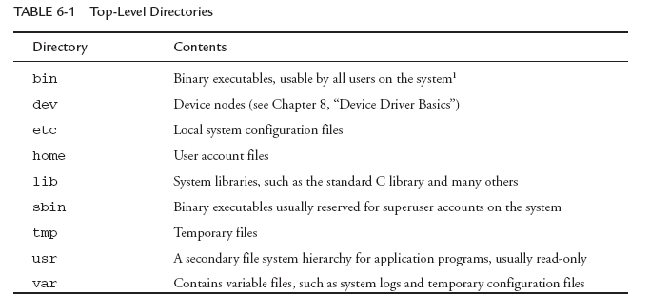
FHS: File System Hierarchy Standard
Background: FHS
There is a standard for laying out file systems
Part of this is the standard top-level directories

Slide 27
A “minimal” file system
Background: FHS
Busybox is covered later

Slide 28
Background: booting
Background: booting
Some circuit magic happens
Get clock running, reset registers etc.
Bootloader starts
Initialize devices such as I2C, serial, DRAM, cache, etc.
Starts the OS
Kernel starts
Might set up other things needed
Init gets called
Lots of stuff…
Note: there are some hidden slides that cover a bit more on this in the posted pptx.

Slide 29
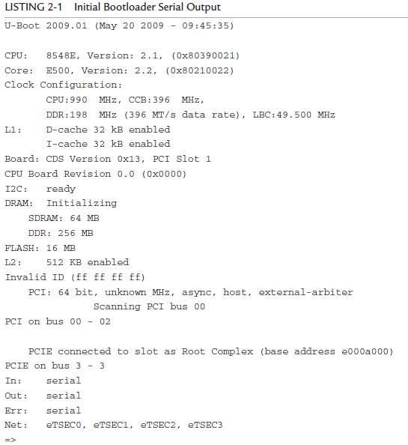
Background: booting
Notes:
uboot (Das U-boot) is common embedded bootloader. GRUB for mainstream Linux is most common.

Slide 30
Handoff from the Kernel
Background: booting
Kernel tries to start init.
Tries a few locations
Doesn’t return if successful, so first that succeeds is all that runs.

Slide 31
The init process
Background: booting
Init is the ultimate parent of all user-space processes.
Provides all default environment variables including PATH
Init uses a text file, /etc/inittab.
That file includes a number of “run levels” that are used to determine what init should do.
Halt, reboot, general-purpose multi-user, etc.

Slide 32
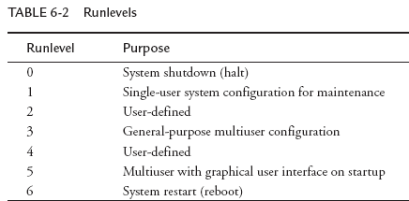
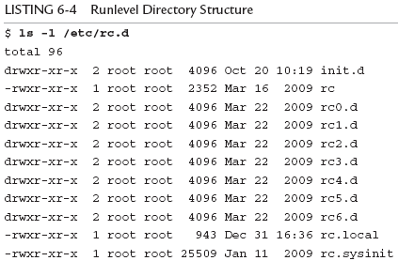
Init (continued)
Background: booting
rcN.d holds symlinks to start or kill each process
associated with that runlevel.
init.d holds the scripts for each service.

Slide 33
Outline
Background
Legal issues, versioning, building, user basics, FHS, booting
Embedded Linux (common but not required attributes)
Small footprint (BusyBox)
Flash file system
Real time support

Slide 34
What makes a Linux install “embedded”?
Embedded Linux
It’s one of those poorly defined terms, but in general it will have one or more of the following
small footprint
flash files system
real-time extensions of some sort

Slide 35
Small footprint--Busybox
Embedded Linux—small footprint
addgroup, adduser, ar, ash, awk, basename, blkid, bunzip2, bzcat, cat, chattr, chgrp, chmod, chown, chpasswd, chroot, chvt, clear, cmp, cp, cpio, cryptpw, cut, date, dc, dd, deallocvt, delgroup, deluser, df, dhcprelay, diff, dirname, dmesg, du, dumpkmap, dumpleases, echo, egrep, env, expr, false, fbset, fbsplash, fdisk, fgrep, find, free, freeramdisk, fsck, fsck.minix, fuser, getopt, getty, grep, gunzip, gzip, halt, head, hexdump, hostname, ttpd, hwclock, id, ifconfig, ifdown, ifup, init, insmod, ip, kill, killall, klogd, last, less, linuxrc, ln, loadfont, loadkmap, logger, login, logname, logread, osetup, ls, lsmod, makedevs, md5sum, mdev, microcom, mkdir, mkfifo, mkfs.minix, mknod, mkswap, mktemp, modprobe, more, mount, mv, nc, netstat, nice, nohup, nslookup, od, penvt, passwd, patch, pidof, ping, ping6, pivot_root, poweroff, printf, ps, pwd, rdate, rdev, readahead, readlink, eadprofile, realpath, reboot, renice, reset, rm, rmdir, rmmod, route, rtcwake, run-parts, sed, seq, setconsole, etfont,sh, showkey, sleep, sort, start-stop-daemon, strings, stty, su, sulogin, swapoff, swapon, switch_root, sync, sysctl, syslogd, tail, tar, tee, telnet, telnetd, test, tftp, time, top, touch, tr, traceroute, true, tty, udhcpc, udhcpd, umount, uname, uniq, unzip, uptime, usleep, vi, vlock, watch, wc, wget, which, who, whoami, xargs, yes, zcat
A single executable that implements the functionality of a massive number of standard Linux utilities
ls, gzip, ln, vi. Pretty much everything you normally need.
Some have limited features
Gzip only does the basics for example.
Pick which utilities you want it to do
Can either drop support altogether or install real version if needed
Highly configurable (similar to Linux itself), easy to cross-compile.
Example given is around 2MB statically compiled!

Slide 36
Using busybox
Embedded Linux—small footprint
Two ways to play
Invoke from the command line as busybox
busybox ls /
Or create a softlink to busybox and it will run as the name of that link.
So if you have a softlink to busybox named “ls” it will run as ls.

Slide 37
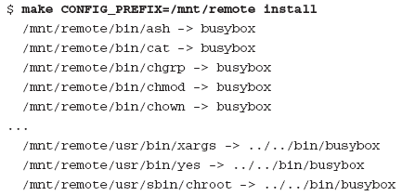
Links done for you
Embedded Linux—small footprint
Normally speaking, you’ll use the softlink option.
You can get it to put in all the links for you with “make install”
Be darn careful you don’t overwrite things locally if you are doing this on the host machine.
That would be bad.

Slide 38
System initialization
Embedded Linux—small footprint
Busybot can also be “init”
But it’s a simpler/different version than the init material covered above.
More “bash” like
#!/bin/sh
echo “Mounting proc”
mount -t proc /proc /proc
echo “Starting system loggers”
syslogd
klogd
echo “Configuring loopback interface”
ifconfig lo 127.0.0.1
echo “Starting inetd”
xinetd
# start a shell
busybox sh

Slide 39
BusyBox Summary
Embedded Linux—small footprint
BusyBox is a powerful tool for embedded systems that replaces many common Linux utilities in a single multicall binary.
BusyBox can significantly reduce the size of your root file system image.
Configuring BusyBox is straightforward, using an interface similar to that used for Linux configuration.
System initialization is possible but somewhat different with BusyBox
From Embedded Linux Primer, second edition

Slide 40
Outline
Background
Legal issues, versioning, building, user basics, FHS, booting
Embedded Linux (common but not required attributes)
Small footprint (BusyBox)
Flash file system
Real time support

Slide 41
Flash storage devices
Embedded Linux—flash filesystem
Significant restrictions on writing
data can be changed from a 1 to a 0 with writes to the cell’s address
0 to 1 requires an entire block be erased.
Therefore, to modify data stored in a Flash memory, the block in which the modiﬁed data resides must be completely erased.
Write times for updating data in Flash memory can be many times that of a hard drive.
Also very limited write cycles (100 to 1,000,000 or so) before wear out.
Wear leveling, conservative specifications generally make things okay.

Slide 42
Outline
Background
Legal issues, versioning, building, user basics, FHS, booting
Embedded Linux (common but not required attributes)
Small footprint (BusyBox)
Flash file system
Real time support
RT Linux patch
Other solutions

Slide 43
Real-time Kernel Patch
Embedded Linux—real time?
The patch had many contributors, and it is currently maintained by Ingo Molnar; you can find it at:
www.kernel.org/pub/linux/kernel/projects/rt/
https://ubuntu.com/blog/real-time-kernel-technical
Since about Linux 2.6.12, soft real-time performance in the single-digit milliseconds on a reasonably fast x86 processor is readily achieved
Some claim “nearly-worst-case” latency of 30us!

Slide 44
Features
Embedded Linux—real time?
The real-time patch adds a fourth preemption mode called PREEMPT_RT, or Preempt Real Time.
Features from the real-time patch are added, including replacing spinlocks with preemptable mutexes.
This enables involuntary preemption everywhere within the kernel except for areas protected by preempt_disable().
This mode significantly smoothes out the variation in latency (jitter) and allows a low and predictable latency for time-critical real-time applications.
The problem is…
Not all devices can handle being interrupted.
This means that with the RT patch in play you might get random crashes.

Slide 45
There are lots of other attempts and discussions about a real-time Linux
Embedded Linux—real time?
RTLinux
Wind River had something up and running for years.
Ended support in 2011.
Seems fairly restrictive.
Real Time Linux Foundation, Inc.
Holding workshops on this for 13 years.
http://lwn.net/Articles/397422/
Nice overview of some of the issues
Zephyr is an RTOS that is developed as part of the Linux Foundation.
Looks like a traditional RTOS.
Much more stuff (closer to a traditional OS)

Slide 46
Windows for IoT
A stripped down version of Windows with a focus on IoT issues.
Appears to be fairly popular.
Latest version appears to require 4 GB of RAM and 64 GB of storage.
Stripped-down version may get to 256MB RAM? It’s a bit unclear what you can really get to, but 4 GB is the official number.
Multiple versions all supported by Visual Studio.
Reasonable choice for things that are plugged in.
Remember, the best engineering solution isn’t always the best solution
What I mean is that the “best” solutions require a lot of engineering time and therefore $$$$.
Might be best to use this (programmers familiar with the environment, lots of stuff done for you) to reduce total cost even if the parts are more expensive.

Slide 47
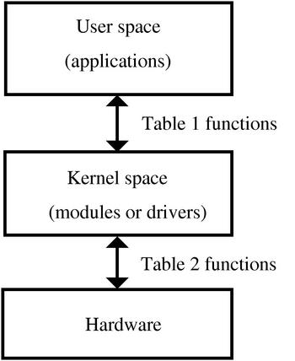
EECS 473 Advanced Embedded Systems
Linux device drivers and
loadable kernel modules

Slide 48
Linux Device Drivers
Overview
What is a device driver?
Linux devices
User space vs. Kernel space
Modules and talking to the kernel
Background
Example
Some thinky stuff
A fair bit of this presentation, including some figures, comes from
http://www.freesoftwaremagazine.com/articles/drivers_linux#
Other sources noted at the end of the presentation.

Slide 49
Linux Device Drivers
Overview
What is a device driver?
Linux devices
User space vs. Kernel space
Modules and talking to the kernel
Background
Example
Some thinky stuff

Slide 50
Device driver (Thanks Wikipedia!)
Overview
A device driver is a computer program allowing higher-level computer programs to interact with a hardware device.
A driver typically communicates with the device through the computer bus or communications subsystem to which the hardware connects.
When a calling program invokes a routine in the driver, the driver issues commands to the device.
Drivers are hardware-dependent and operating-system-specific.

Slide 51
Devices in Linux (1/2)
Overview
There are special files called “device files” in Linux.
A user can interact with it much like a normal file.
But they generally provide access to a physical device.
They are generally found in /dev and /sys
/dev/fb is the frame buffer
/dev/ttyS0 is one of the serial ports
Not all devices files correspond to physical devices.
Pseudo-devices.
Provide various functions to the programmer
/dev/null
Accepts and discards all input; produces no output.
/dev/zero
Produces a continuous stream of NULL (zero value) bytes.
etc.
crw-rw---- 1 root dialout 4, 64 Jun 20 13:01 ttyS0

Slide 52
Devices in Linux (2/2)
Overview
Pretty clearly you need a way to connect the device file to the actual device
Or pseudo device for that matter
We want to be able to “fake” this by writing functions that handle the file I/O.
So we need to associate functions with all the things we can do with a file.
Open, close.
Read, write.
Today we’ll talk about all that…

Slide 53
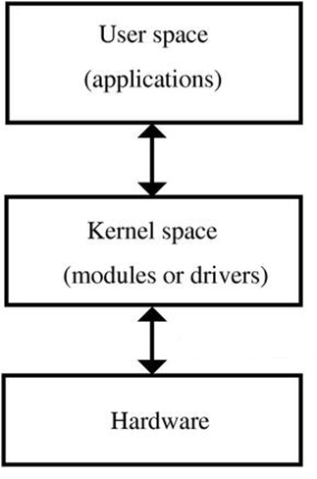
Kernel vs. User space
Overview
User Space
End-user programs. They use the kernel to interface to the hardware.
Kernel Space
Provides a standard (and hopefully multi-user secure) method of using and sharing the hardware.
Private function member might be a good analogy.
A lot of things are different here.
Many calls to the kernel can’t be made from the kernel.
E.g. malloc.

Slide 54
Linux Device Drivers…
Overview
What is a device driver?
Linux devices
User space vs. Kernel space
Modules and talking to the kernel
Background
Example
Some thinky stuff

Slide 55
Kernel and Kernel Modules
Modules
Often, if you want to add something to the kernel you need to rebuild the kernel and reboot.
A “loadable kernel module” (LKM) is an object file that extends the base kernel.
Exist in most OSes
Including Windows, FreeBSD, Mac OS X, etc.
Modules get added and removed as needed
To save memory, add functionality, etc.

Slide 56
Linux Kernel Modules
Modules
In general must be licensed under a free license.
Doing otherwise will taint the whole kernel.
A tainted kernel sees little support.
Might be a copyright problem if you redistribute.
The Linux kernel changes pretty rapidly, including APIs etc.
This can make it a real chore to keep LKMs up to date.
Also makes a tutorial a bit of a pain.
Though honestly it seems fairly stable over the last 5 years.

Slide 57
Creating a module
Modules
All modules need to define functions that are to be run when:
The module is loaded into the kernel
The module is removed from the kernel
We just write C code (see next slide)
We need to compile it as a kernel module.
We invoke the kernel’s makefile.
sudo make –C /lib/modules/xxx/build M=$PWD modules
This makes (as root) using the makefile in the path specified.
I think it makes all C files in the directory you started in
Creates .ko (rather than .o) file
Xxx is some kernel version/directory

Slide 58
Simple module
Modules
#include <linux/init.h>
#include <linux/module.h>
#include <linux/kernel.h>
MODULE_LICENSE("Dual BSD/GPL");
static int hello_init(void) {
printk("<1> Hello World!\n");
return 0;
}
static void hello_exit(void) {
printk("<1> Bye world!\n");
}
module_init(hello_init);
module_exit(hello_exit);
MODULE_LICENSE
Required.
Short list of allowed licenses.
Printk()
Kernel print.
Prints message to console and to log.
<1> indicates high priority message, so it gets logged.
Module_init()
Tells system what module to call when we first load the module.
Module_exit()
Same but called when module released.
Notes:
There's more than one way to do it

Slide 59
Modules: Listing, loading and removing
Modules
From the command line:
lsmod
List modules.
insmod
Insert module into kernel
Adds to list of available modules
Causes function specified by module_init() to be called.
rmmod
Removes module from kernel

Slide 60
lsmod
Modules
Module Size Used by memory 10888 0 hello 9600 0 binfmt_misc 18572 1 bridge 63776 0 stp 11140 1 bridge bnep 22912 2 video 29844 0

Slide 61
insmod
Modules
Very (very) simple
insmod xxxxx.ko
Says to insert the module into the kernel

Slide 62
Other (better) way to load a module
Modules
Modprobe is a smarter version of insmod.
Actually it’s a smarter version of insmod, lsmod and rmmod…
It can use short names/aliases for modules
It will first install any dependent modules
We’ll use insmod for the most part
But be aware of modprobe

Slide 63
So?
Modules
#include <linux/init.h>
#include <linux/module.h>
#include <linux/kernel.h>
MODULE_LICENSE("Dual BSD/GPL");
static int hello_init(void) {
printk("<1> Hello World!\n");
return 0;
}
static void hello_exit(void) {
printk("<1> Bye world!\n");
}
module_init(hello_init);
module_exit(hello_exit);
When insmod, log file gets a “Hello World!”
When rmmod, that message prints to log (and console…)
It’s not the name, it’s the module_init().

Slide 64
Modules?
Modules
There are a number of different reasons one might have a module
But the main one is to create a device driver
It’s not realistic for Linux to have a device driver for all possible hardware in memory all at once.
Would be too much code, requiring too much memory.
So we have devices as modules
Loaded as needed.

Slide 65
What is a “device”?
Modules: device review
As mentioned in the overview, Linux devices are accessed from user space in exactly the same way files are accessed.
They are generally found in /dev and /sys
To link normal files with a kernel module, each device has a “major number”
Each device also has a “minor number” which can be used by the device to distinguish what job it is doing.
% ls -l /dev/fd0 /dev/fd0u1680
brwxrwxrwx 1 root floppy 2, 0 Jul 5 2000 /dev/fd0
brw-rw---- 1 root floppy 2, 44 Jul 5 2000 /dev/fd0u1680
Two floppy devices. They are actually both the same bit of hardware using the same driver
(major number is 2), but one is 1.68MB the other 1.44.

Slide 66
Creating a device
Modules: devices
mknod /dev/memory c 60 0
Creates a character device named /dev/memory
Major number 60
Minor number 0
Minor numbers are passed to the driver to distinguish different hardware with the same driver.
Or, potentially, the same hardware with different parameters (as the floppy example)

Slide 67
Linux Device Drivers
Overview
What is a device driver?
Linux devices
User space vs. Kernel space
Modules and talking to the kernel
Background
Example
Some thinky stuff

Slide 68
A complete pseudo-device
Modules: single character memory example
We are going to create a pseudo-device that is just a single byte of memory.
Whatever the last thing you wrote to it, is what will be read.
For example
echo -n abcdef >/dev/memory
Followed by cat /dev/memory
Prints an “f”.
Silly, but not unreasonable.
It’s also printing some stuff to the log.
Not a great idea in a real device, but handy here.
Almost entirely from http://www.freesoftwaremagazine.com/articles/drivers_linux#

Slide 69
includes
Modules: single character memory example
/* Necessary includes for device drivers */ #include <linux/init.h> #include <linux/module.h> #include <linux/kernel.h> /* printk() */ #include <linux/slab.h> /* kmalloc() */ #include <linux/fs.h> /* everything... */ #include <linux/errno.h> /* error codes */ #include <linux/types.h> /* size_t */ #include <linux/proc_fs.h> #include <linux/fcntl.h> /* O_ACCMODE */ #include <asm/system.h> /* cli(), *_flags */ #include <asm/uaccess.h> /* copy_from/to_user */

Slide 70
License and function prototypes
Modules: single character memory example
MODULE_LICENSE("Dual BSD/GPL"); int memory_open (struct inode *inode, struct file *filp);
int memory_release (struct inode *inode, struct file *filp);
ssize_t memory_read (struct file *filp, char *buf, size_t count, loff_t *f_pos);
ssize_t memory_write (struct file *filp, char *buf, size_t count , loff_t *f_pos);
void memory_exit (void); int memory_init (void);

Slide 71
Setting up the standard interface
Modules: single character memory example
struct file_operations memory_fops = { read: memory_read, write: memory_write, open: memory_open, release: memory_release };
struct file_operations
memory_fops = {
.read = memory_read,
.write = memory_write,
.open = memory_open,
.release = memory_release
};
This is a weird bit of C syntax.
Initializes struct elements.
So “read” member is now “memory_read”
Technically unsupported these days?
gcc supports it though
dot notation is in the C99 standard.
But some kernel code still uses colon.

Slide 72
file_operations struct
Modules: single character memory example
struct file_operations {
ssize_t(*read) (struct file *, char __user *, size_t, loff_t *);
ssize_t(*write) (struct file *, const char __user *, size_t, loff_t *);
int (*ioctl) (struct inode *, struct file *, unsigned int, unsigned long);
int (*open) (struct inode *, struct file *);
int (*release) (struct inode *, struct file *);
int (*fsync) (struct file *, struct dentry *, int datasync);
int (*aio_fsync) (struct kiocb *, int datasync);
int (*fasync) (int, struct file *, int);
int (*lock) (struct file *, int, struct file_lock *);
ssize_t(*readv) (struct file *, const struct iovec *, unsigned long, loff_t *);
ssize_t(*writev) (struct file *, const struct iovec *, unsigned long, loff_t *);
ssize_t(*sendfile) (struct file *, loff_t *, size_t, read_actor_t, void __user *);
ssize_t(*sendpage) (struct file *, struct page *, int, size_t, loff_t *, int);
unsigned long (*get_unmapped_area) (struct file *, unsigned long, unsigned long,unsigned long,unsigned long);
};

Slide 73
file_operations: A few members
Modules: single character memory example
struct file_operations {
ssize_t(*read) (struct file *, char __user *, size_t, loff_t *);
ssize_t(*write) (struct file *, const char __user *, size_t, loff_t *);
int (*ioctl) (struct inode *, struct file *, unsigned int, unsigned long);
int (*open) (struct inode *, struct file *);
int (*release) (struct inode *, struct file *);
};

Slide 74
Set up init and exit Some globals
Modules: single character memory example
module_init(memory_init); module_exit(memory_exit); int memory_major = 60; char *memory_buffer;

Slide 75
memory_init
Modules: single character memory example
60, via global
Device name, need not be the same as in /dev
int memory_init(void) { int result; result = register_chrdev(memory_major, "memory", &memory_fops); if (result < 0) { printk("<1>memory: cannot obtain major number %d\n",
memory_major); return result; } /* Allocating memory for the buffer */ memory_buffer = kmalloc (1, GFP_KERNEL); if (!memory_buffer) { result = -ENOMEM; goto fail; } memset(memory_buffer, 0, 1); // initialize 1 byte with 0s. printk("<1> Inserting memory module\n"); return 0; fail: memory_exit(); return result; }
Name of file_operations structure.
Kmalloc does what you’d expect. The flag provides rules about where and how
To get the memory. See makelinux.com/ldd3/chp-8-sect-1

Slide 76
memory_exit
Modules: single character memory example
void memory_exit(void) { unregister_chrdev(memory_major, "memory"); if (memory_buffer) { kfree(memory_buffer); }

Slide 77
Open and release (close)
Modules: single character memory example
int memory_open (struct inode *inode, struct file *filp) { printk("<1> Minor: %d\n", MINOR(inode->i_rdev)); return 0; } int memory_release (struct inode *inode, struct file *filp) { return 0; }

Slide 78
Modules: single character memory example
ssize_t memory_read(struct file *filp, char *buf,
size_t count, loff_t *f_pos) {
/* Transfering data to user space */
copy_to_user (buf,memory_buffer,1);
/* Changing reading position as best suits */
if (*f_pos == 0) {
*f_pos+=1;
return 1;
} else {
return 0;
}
}
f_pos is the file position.
What do you think happens if you don’t change *f_pos?
copy_to_user copies to a location in userspace (the first argument) from kernel space (the second argument), a specific number of bytes. Recall virtual memory…

Slide 79
memory_write
Modules: single character memory example
ssize_t memory_write( struct file *filp, char *buf, size_t count, loff_t *f_pos) { char *tmp; tmp=buf+count-1; copy_from_user(memory_buffer,tmp,1); return 1; }

Slide 80
How do you set it up?
Modules: single character memory example
Make the module
make -C /lib/modules/2.6.28-16-generic/build M=$PWD modules
Insert the module
insmod memory.ko
Create the device
mknod /dev/memory c 60 0
Make the device read/write
chmod 666 /dev/memory

Slide 81
What did all that do?
Modules: single character memory example
We created a device that is just a single byte of memory.
Whatever the last thing you wrote to it, is what will be read.
For example
$ echo -n abcdef >/dev/memory
Followed by $ cat /dev/memory
Prints an “f”.

Slide 82
See also
https://www.apriorit.com/dev-blog/195-simple-driver-for-linux-os looks well done.
For 5.0
I’ve not double-checked it all

