Slide 1
EECS 473 Advanced Embedded Systems
Lecture 8:
Projects, PCBs and Power integrity

Slide 2
Project status updates
We will be having regular project status reports at the start of many classes starting Thursday
Half the groups will go each day.
Normally 60-90 seconds.
The purpose is to hear what others are doing, understand their issues, and maybe be able to provide help/ideas/part suggestions.
There will be about 4 of these total, each slightly different.
This Thursday and next Tuesday the topic will be “elevator pitch”
You’ll have ~2 minutes (longer than normal) to explain your idea.
Should include a bit of the why and the how.
Think of it as if you are trying to get a VC to fund your new start up.
Thursday: GROUP 1: Infineon, Braille Notes, Lap-trigger, Robotics , Smart Handle, Maize Toss, Scoreboard.
Tuesday: GROUP 2: Robot Arm, TGFKARW, Key Oracle, Canbats, Transcriber Glasses, Chess, Solar Cell.

Slide 3
What’s due project-wise?
Final proposal
Submit proposal on this Thursday.
We should have feedback by Wednesday night to all groups.
Be really really sure you’ve cleaned up your objectively demonstrable deliverables.
Written MS1 due on Friday 10/13*
Need show objectively demonstrable parts to one of the GSIs.
The parts in bold in Appendix B.
Need to happen by Wednesday 10/18 in the afternoon
Note: Exam is that night.
These shouldn’t take more than an hour to write up.
There will is a template on the website.
*Date is a day later than stated in the project handout/schedule.

Slide 4
Other things upcoming
Homework 1 coming out this week.
Due Wednesday 10/11
It will be a good review for the exam.
Won’t be graded before the midterm.
Midterm Wednesday 10/18 6-8pm
Expect 60-65% of grade to be short answer-type, the rest to be a design problem.
Generally people spend a bit more than 50% of the time on the design problem.
Old midterms posted.
Format largely the same.
You may notice some problems are often quite similar
After the midterm the next non-project thing due is HW2 on 12/5!
So after the midterm it’s all project other than lectures.

Slide 5
Ordering
At this point, you may start ordering things
Be aware that the budget is strict: $200/member.
Should not be buying things “off budget”.
Staying on budget is part of the project.
Should probably only be ordering dev boards, sensors, etc.
Two ways to order:
Preferred: Order on your own, get reimbursed.
Faster and more reliable.
Front your own money, if you lose receipts or order something really strange, could be a pain.
Talk with Cameron first. Use the sheet.
Order through the department
Slower, but don’t need to front your own money.
See me if this is your plan.

Slide 6
Now…
Introduce PCBs
Terminology and concepts
Do a review of basic circuits
Physics 240/EECS 215
Discuss power integrity

Slide 7
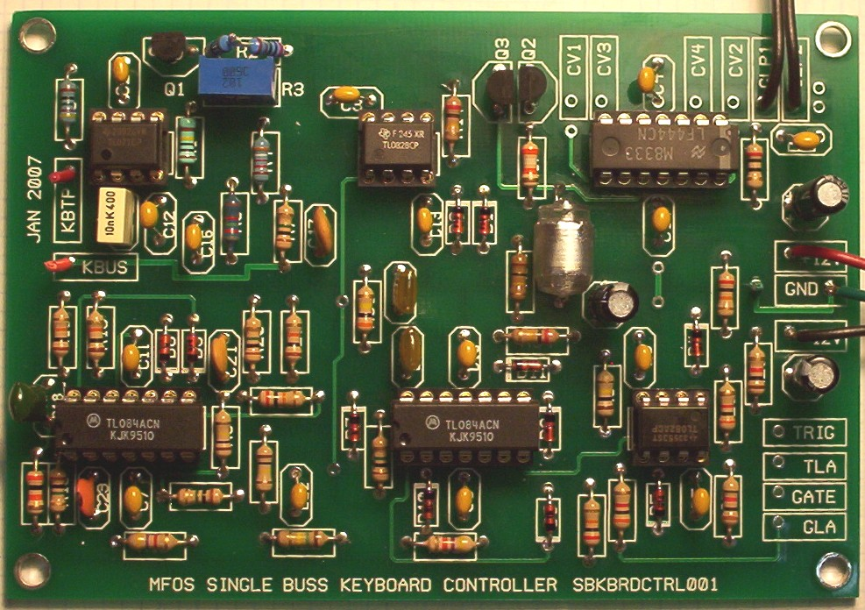
So you want to make a Printed Circuit Board…
PCBs – basic terminology
At the end of the day a PCB is just a set of wires that connect components.
But there are some issues
The wires have restricted dimensionality
The wires are very thin
So high resistance (as conductors go)
The board needs to include holes (or pads) for the devices.
You can’t easily change things once you build it.
http://www.linkwitzlab.com/Pluto/supplies-subw.htm,
http://www.musicfromouterspace.com/analogsynth/SINGLEBUSSKEYBOARD2007/SINGLEBUSSKEYBOARD2007.php

Slide 8
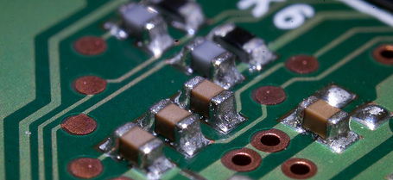
Basic Terminology
PCBs – basic terminology
The wires you are laying out are called “traces” or “tracks”
Inside of a given “layer” traces which cross are electrically connected.
If you have traces on both sides of the board, you are said to have two layers.
Through-hole: Having holes in the PCB designed to have pins put through the hole
Contrast with surface mount where device goes on top.

Slide 9
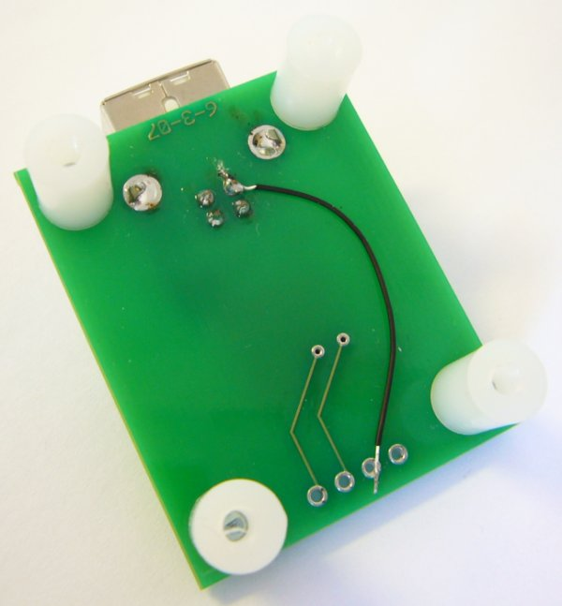
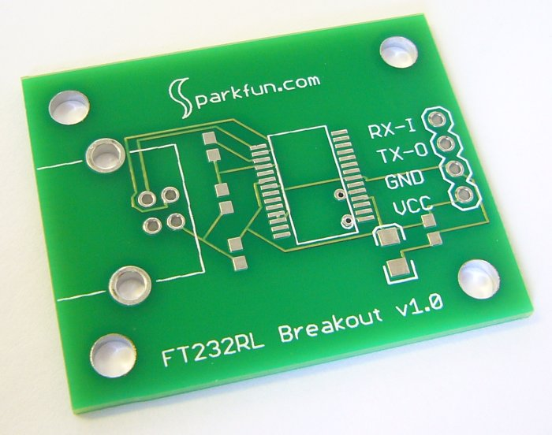
Parts of a PCB
PCBs – basic terminology
Copper
(pads & traces)
Silkscreen
(white)
Soldermask
(green)
Via
Bottom side
Drill holes

Slide 10
Vias
PCBs – basic terminology
Sometimes you need to connect two traces on two different layers.
To do this we use a via.
It is just a a plated through hole
Generally smaller than a through hole for a part.

Slide 11
Clearances
PCBs – basic terminology
There will be space between the traces, plated holes and each other.
You need to meet the requirement of the manufacturer.

Slide 12
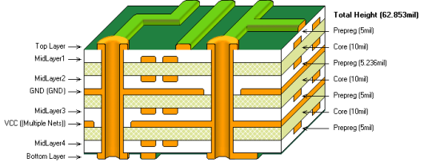
The layered construction of a PCB: A six layer board
PCBs – basic terminology
Figure from altium.com

Slide 13
So, how do I design a PCB?
PCBs – design steps
Create schematic
Place parts
Route interconnect
Generate files

Slide 14
Step 1: Create schematic
PCBs – design steps: schematic
The first thing you want is something that looks like a textbook circuit diagram. It just shows the devices and how they are connected.
Sometimes you will worry about pinouts here (say when working with a microprocessor maybe)
But usually you don’t
No notion of layout belongs here!

Slide 15
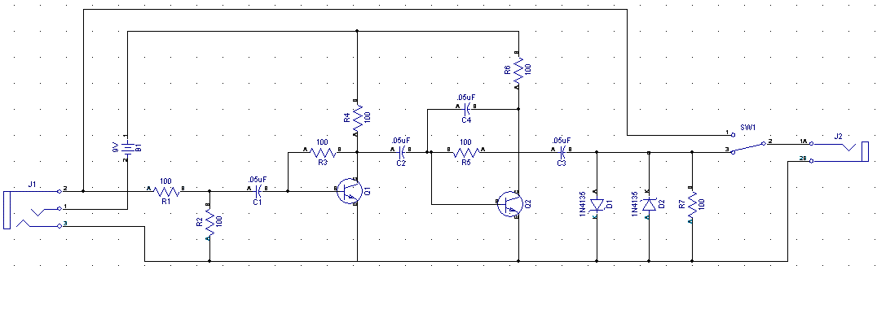
Example schematic
PCBs – design steps: schematic

Slide 16
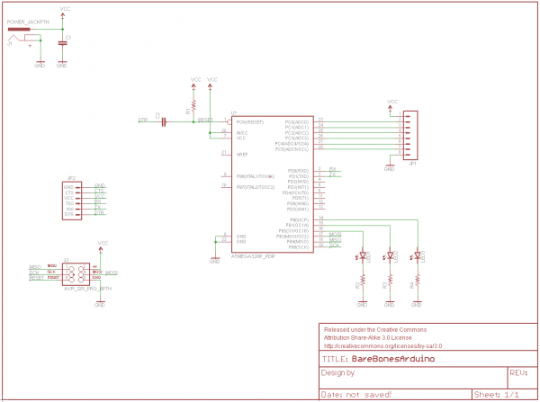
Another schematic
https://learn.sparkfun.com/tutorials/using-eagle-board-layout/all

Slide 17
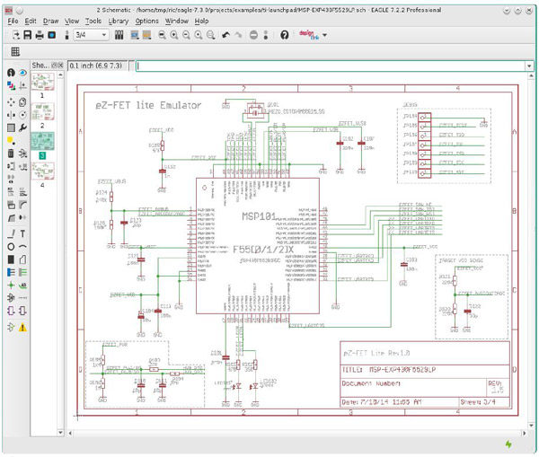
One more
https://www.pcbcart.com/article/content/EAGLE-PCB-design-tutorial.html

Slide 18
Why a schematic?
PCBs – design steps: schematic
In general it is drawn to be readable.
This is probably what your sketch on paper would look like.
You can find and fix bugs more easily here than the PCB layout.

Slide 19
Step 2: Place parts
PCBs – design steps: placement
You need to place the patterns on the board.
You need to not overlap them to that the components can actually fit on the board.
You want to leave room for the traces to connect everything.
This is very much an art form.
In fact you will find people who rant about “sloppy” or “unprofessional” placements.
Some tools will do this for you. No one seems to like them.

Slide 20
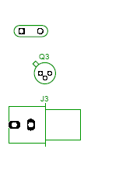
Patterns
PCBs – design steps: placement
Once you know what it is you want to build, you need to figure out how to lay it out on the board.
You need to know how big each piece is, and where the holes need to be placed.
Each device has a pattern which shows exactly that.
You will occasionally need to create a pattern.

Slide 21
Step 3: Route interconnect
PCBs – design steps: routing
A route is a connection between devices.
It may consist of multiple traces
There are design rules which include:
Minimum trace width
Minimum spacing between traces and holes
Minimum spacing between holes and holes.
These rules will vary by manufacturer.
Even better, units will vary by manufacturer!
Time for a brief aside…

Slide 22
Issues of measure
PCBs – an aside
PCB land uses some interesting terminology.
A “thou” is a thousandth of an inch.
A “mm” is a millimeter
A “mil” is a thousandth of an inch.
Thou is generally preferred over mil to avoid confusion, but most tools/vendors use mil.

Slide 23
Trace width
PCBs – an aside
In general most PCB manufactures seem to have trace-width minimums of 6-10 thous.
Most are willing to go smaller for a price.
A rule of thumb is to use a 50 thou minimum for power/ground and 25 for everything else.
This is to drop the resistance of the traces.
In general you are worried about heat dissipation
There are lots of guidelines for width/power but in general you are looking at:
A 10cm trace needs to be 10 thou wide if it will carry 1 amp.
5 amps at 10cm would require 110 thou.

Slide 24
Why do you want wide traces?
A narrow and long trace might create a fairly high resistance.
6 thou, 4 cm long, standard thickness trace at 50 degrees C is about 0.14 Ohms.
Not a lot, but at 1 Amp, you’re dropping 140mW on the wire and 0.14V.
Note: general recommendation lowest width for 1 Amp at 4cm is about 12 thou.
That drops 70mW and 0.07V.

Slide 25
Trace width continued
PCBs – an aside
The problem with wide traces is that they are hard to route.
In particular you might wish to go between pins of a device.
One solution is to be wide normally and “neck down” when you have to.
This is more reasonable than you think.
Think resistors in series.
But be careful of creating a “fuse” for high-current wires.

Slide 26
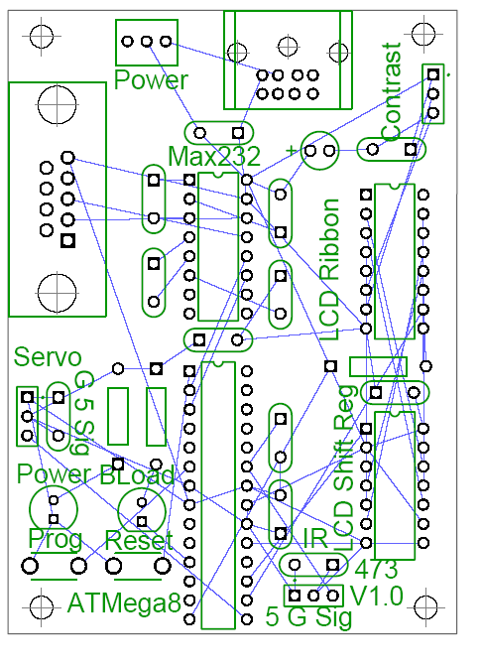
Rat’s nest.
PCBs – design steps: routing
A rat’s nest shows the placement of the devices and the connections but not the routing
Automatically generated for you.
Sometimes before placement, sometimes after
Varies by tool.

Slide 27
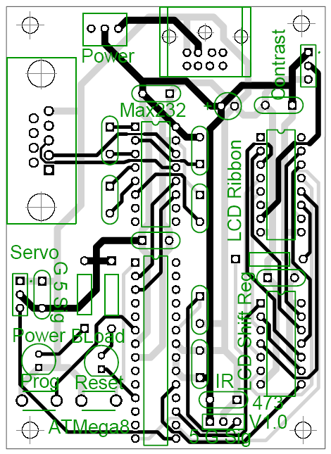
Routing for real
PCBs – design steps: routing
You can use an autorouter to route your traces
Some people hate these as the design will be “ugly”
Saves a lot of time.
Oddly, not as good as a person can do.
But much faster.
Still generally need to do some (or all) of the routing by hand
Very tedious...

Slide 28
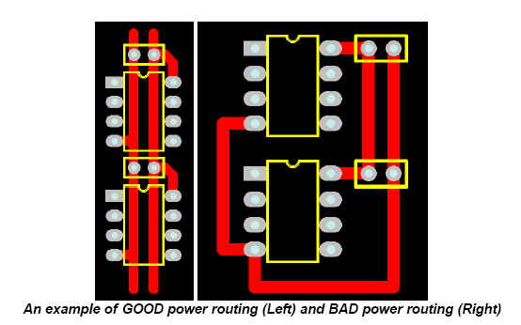
Routing quality
PCBs – design steps: routing
http://alternatezone.com/electronics/files/PCBDesignTutorialRevA.pdf

Slide 29
Step 4: Generate files
PCBs – design steps: generate files
Once the design is done, a set of files are generated.
Each file describes something different (e.g.)
Copper on a given layer
Silkscreen
Solder mask
Most files are in “Gerber” format
Human-readable (barely) ASCII format
Has commands like draw and fill.
Drill files are a different format called Excellon
Also human-readable (barely) ASCII with locations and diameters for the holes.
Generally you zip all these files up and ship them as a single file to the PCB manufacturer.
Often a good idea to include the design file(s) too.

Slide 30
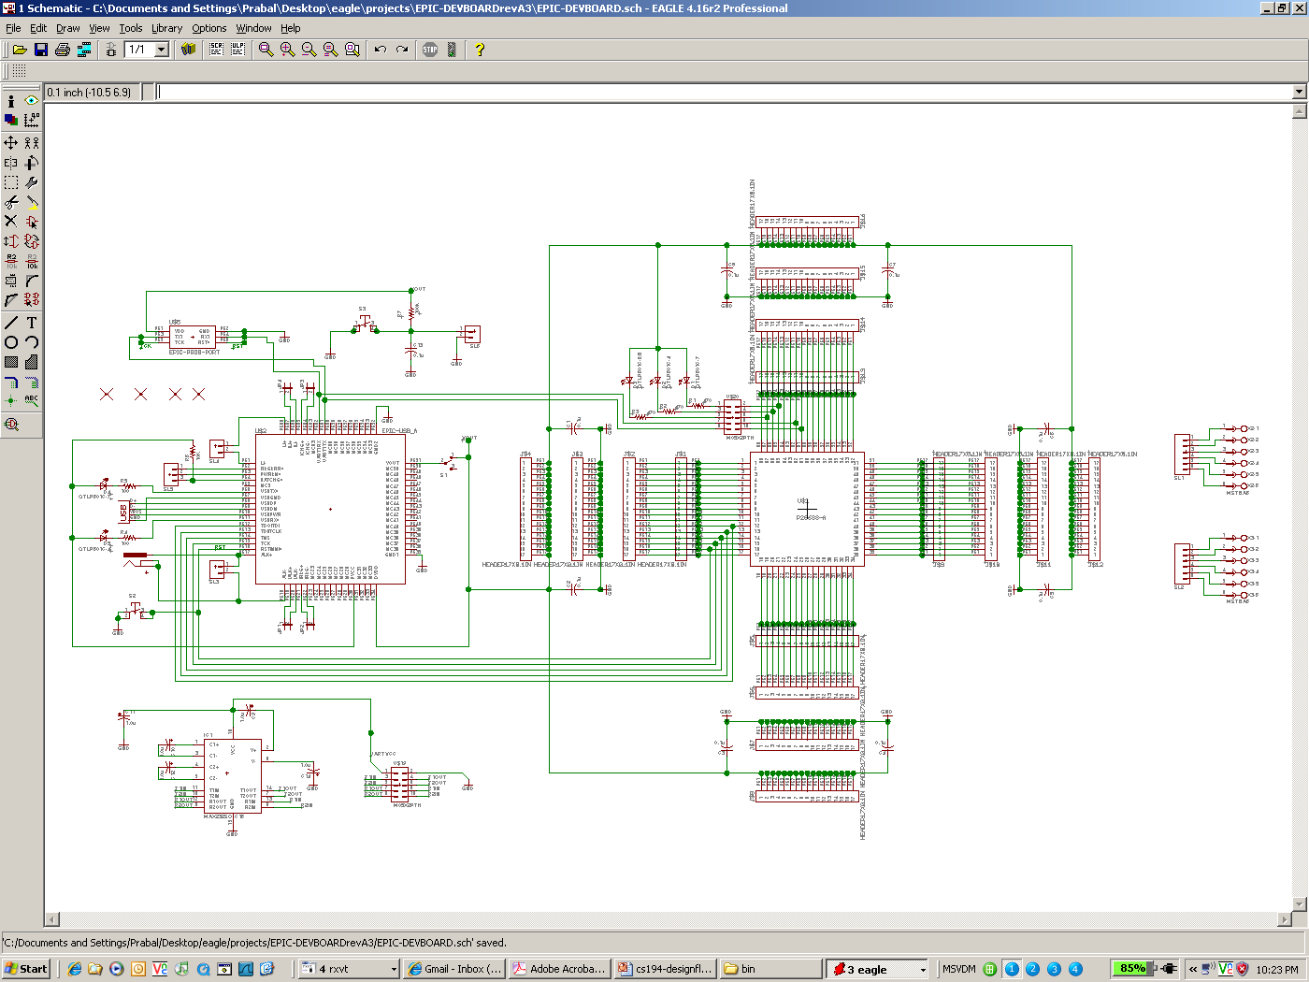
The schematic captures the logical circuit design
PCBs – closing example

Slide 31
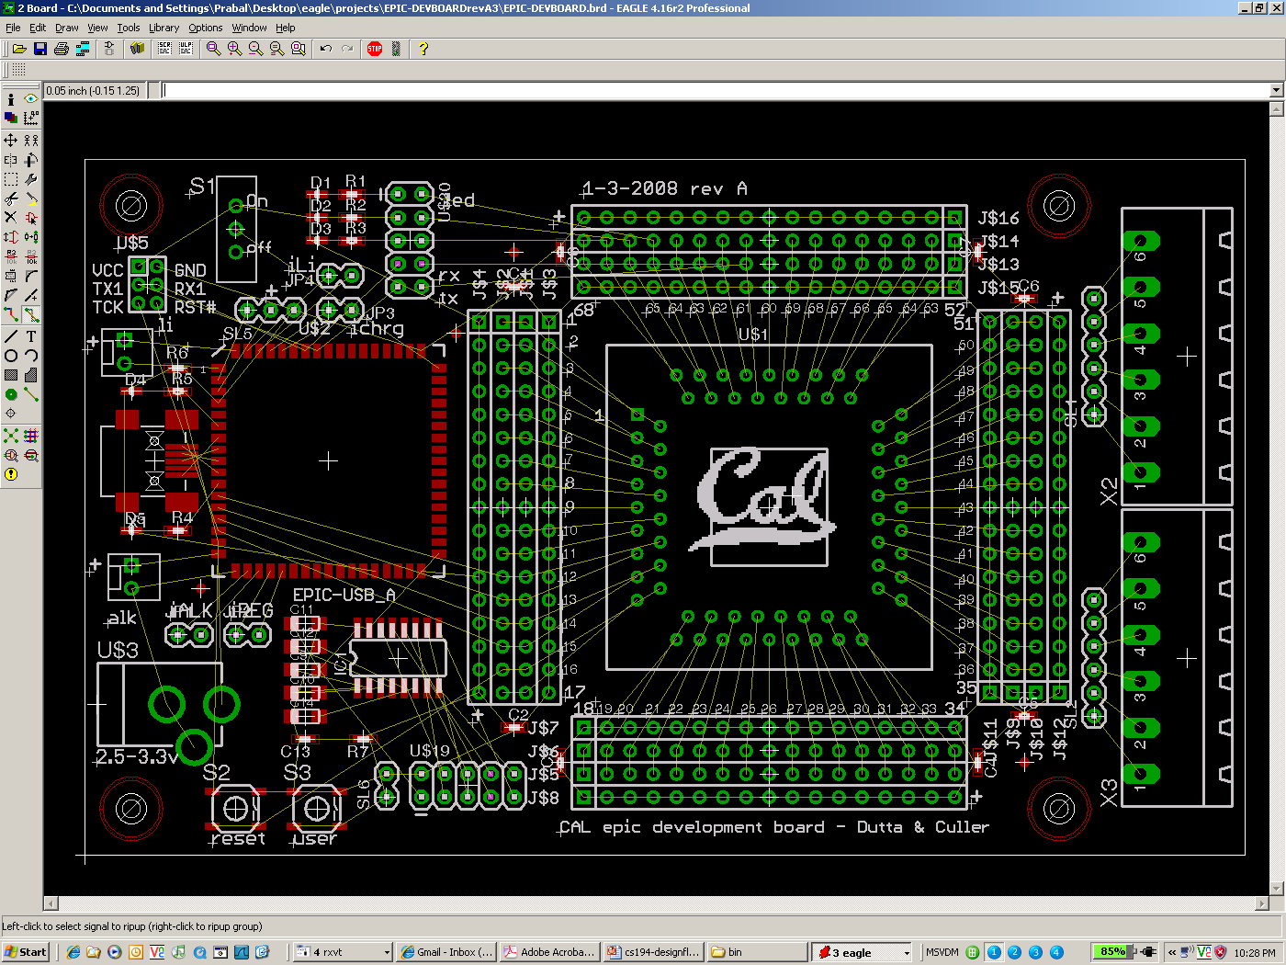
Floorplanning captures the desired part locations
PCBs – closing example

Slide 32
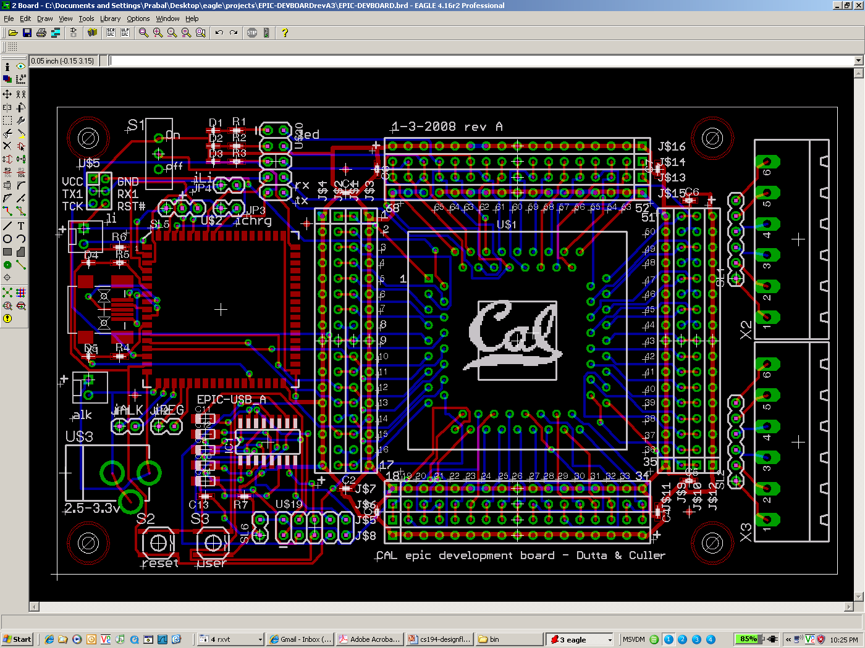
The auto-router places tracks on the board, saving time
PCBs – closing example

Slide 33
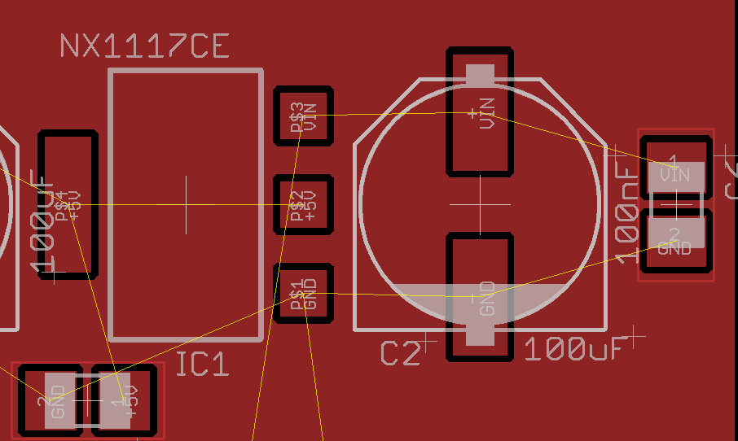
Example: Metal plane no name
Notes:
Not yet set to ground plane. Just metal.

Slide 34
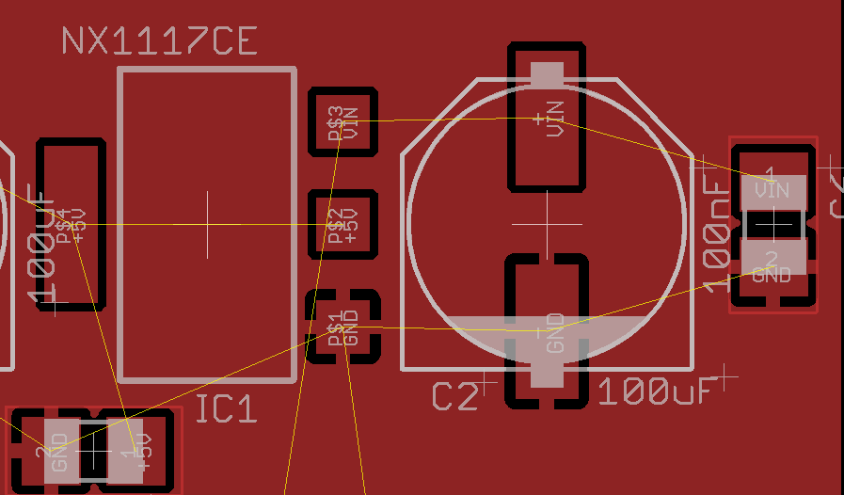
Changed name of plane to GND
Notes:
Make the polygon GND

Slide 35
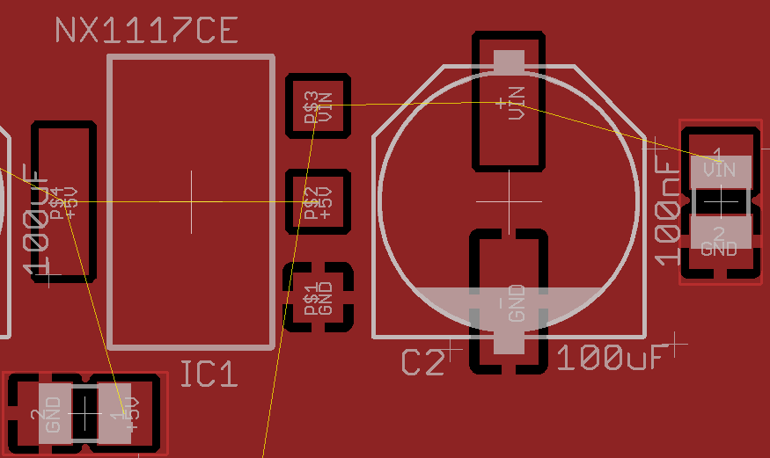
Ran “ratsnest” command

Slide 36
Much material taken from others:
PCBs –references
http://alternatezone.com/electronics/files/PCBDesignTutorialRevA.pdf
Very nice tutorial/overview
Seems to have strong viewpoint
http://www.goldengategraphics.com/pcgloss.htm
Some definitions taken verbatim.
Dr. Prabal Dutta
Wikipedia
And others where noted.

Slide 37
Some electrical issues related to the building of PCBs

Slide 38
High-speed PCB design issues
EE issues overview
There are a lot of electrical issues to deal with when working with high-speed PCBs.
Supplying power, storing energy and dissipating heat
Power supplies, batteries, and heat sinks.
Power Integrity (PI)
We need to be sure that we keep the power and ground at approximately constant values.
Signal Integrity (SI)
We need to make sure data on the wires gets there.
Electro-magnetic interference/compatibility (EMI/EMC)
We need to watch out for generating radio-frequency noise
The FCC is a bit picky about this.
We don’t want RF noise to interfere with us.

Slide 39
Outline
Background
Understanding power and energy
Current limits
EECS 215 “review/introduction”
On capacitors, inductors, resistors and impedance
Power integrity (PI)

Slide 40
Power!
Electric power is the rate at which electric energy is transferred by an electric circuit. The SI unit of power is the Watt. (Wikipedia)
Power (as opposed to energy), in-and-of itself is important in embedded system design.
For example there may be a limit on power draw from a given set of batteries.
That is, they can’t supply energy at more than a given rate.
Melting issues are power issues
Admittedly over time.

Slide 41
Power vs. Energy
Understanding Power and Energy
Power consumption in Watts
Determines battery life in hours
Sets packaging limits
Energy efficiency in Joules
Rate at which power is consumed over time
Energy = power * delay (Joules = Watts * seconds)
Lower energy number means less power to perform a computation at same frequency

Slide 42
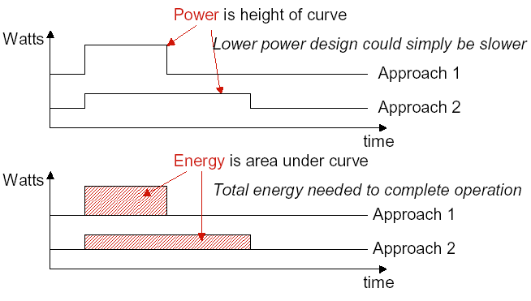
Power vs. Energy
Understanding Power and Energy

Slide 43
Current limits
Understanding Power and Energy
While most of you won’t be doing high-power work, sometimes you do have high-power motors, boards, or other things.
If you push too much current through a trace, it can melt.
Need to worry about “thermal runaway”
There are lots of formulas, but let’s do a chart version.
Assumes max temp you can deal with is 105 degrees C.

Slide 44
Minimum Trace width for a given current
Understanding Power and Energy
Example #1
Say you have 1 amp current and you don’t want to see a rise of more than 30 degrees C.
Your wire has a thickness of 0.0007 inches (fairly standard)
So you need a width of around 40 thou.
What is Example #2?

Slide 45
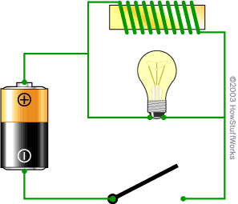
Background issue #1: Inductance
EECS 215/Physics 240 “review”
An inductor “resists the change in the flow of electrons”
The light bulb is a resistor. The wire in the coil has much lower resistance (it's just wire)
so what you would expect when you turn on the switch is for the bulb to glow very dimly.
What happens instead is that when you close the switch, the bulb burns brightly and then gets dimmer.
And when you open the switch, the bulb burns very brightly and then quickly goes out.
http://electronics.howstuffworks.com/inductor1.htm

Slide 46
Background issue #2: Capacitance
EECS 215/Physics 240 “review”
A capacitor resists the change of voltage
When you first connect the battery, bulb lights up and then dims
If you then remove the battery and replace with a wire the bulb will light again and then go out.
http://electronics.howstuffworks.com/capacitor1.htm

Slide 47
Background issue #3: Impendence
EECS 215/Physics 240 “review”
Impedance (symbol Z) is a measure of the overall opposition of a circuit to current, in other words: how much the circuit impedes the flow of current.
It is like resistance, but it also takes into account the effects of capacitance and inductance. I
Impedance is measured in ohms.
Impedance is more complex than resistance because the effects of capacitance and inductance vary with the frequency of the current passing through the circuit and this means impedance varies with frequency!
The effect of resistance is constant regardless of frequency.
http://www.kpsec.freeuk.com/imped.htm

Slide 48
Impedance vs frequency
Say you have a sine wave being driven over a device.
How does the impedance of each device vary with frequency?
Resistors have an impedance that is independent of frequency
Capacitors have a lower impedance as frequency goes up.
Inductors have a higher impedance as frequency goes up.

Slide 49
A look at impedance (with capacitors, inductors and resistors vs. frequency)
EECS 215/Physics 240 “review”
Notice the log scales!

Slide 50
Power Integrity
Power Integrity
In order to get digital electronics to work correctly, they need a minimum voltage differential.
If we get below that, the devices might
Be slow (and thus not meet setup times)
Lose state
Reset or halt
Just plain not work.
Even a very (very) short “power droop” can cause the chip to die.
In my experience, this is a really common problem.
Keeping power/ground constant and noise/droop free is “Power Integrity”

Slide 51
So?
Power Integrity
We need the Vcc/Ground differential to be fairly constant.
But rapid changes in the amount of current needed will cause the voltage to spike or droop due to inductance.
We basically want a “no-pass” filter.
That is we don’t want to see any signal on the Vcc/Ground lines.
The obvious thing?
“Add a capacitor”
That should keep the voltage constant, right?
The problem is we need to worry about a lot of frequencies AND capacitors aren’t ideal.

Slide 52
Lots of frequencies
Power Integrity
Even fairly slow devices these days are capable of switching at very high frequencies.
Basically we get drivers that have rise and fall times capable of going 1GHz or so.
This means we generally have to worry about frequencies from DC all the way to 1GHz.
Because our chip may be varying its draw at rates up to that fast.

Slide 53
Non-ideal devices.
Power Integrity
ESR is Effective Series Resistance
ESL is Effective Series Inductance
Ceff is the effective capacitance.
How does quantity effect these values?
Obviously impendence will be varying by frequency.

Slide 54
Other things can add to ESR/ESL
Power Integrity
Generally a bad solder job can make ESR/ESL worse.
Packaging has an impact
wires have inductance so surface-mount packages preferred
Pads can have an impact

Slide 55
Given the previous table..
Power Integrity

Slide 56
Removing the PCB…
Power Integrity

Slide 57
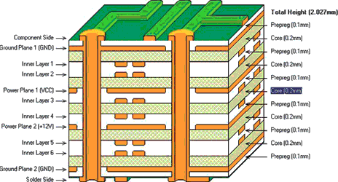
What is the PCB part?
Power Integrity

Slide 58
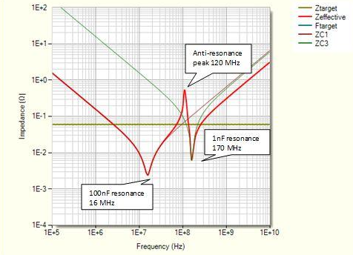
But wait…
Power Integrity
VRM
Voltage regulator module
bulk bypass (tantalum) and decoupling capacitors (ceramic).
These capacitors supply instantaneous current (at different frequencies) to the drivers until the VRM can respond.
However sets of different capacitors cause problems!
http://www.pcbdesign007.com/pages/columns.cgi? artcatid=0&clmid=65&artid=85396&pg=3&_pf_=1

Slide 59
Power Integrity (PI) summary
Power Integrity
Power integrity is about keeping the Vcc/ground difference constant.
This is hard because the devices that sink power do so in “pulses” due to their own clocks
Need caps to keep value constant
But parasitic ESR/ESL cause problems
So lots of them==good
Reduce ESR/ESL
Increase capacitance.
But anti-resonance can cause problems!
Need Spice or other tools to model.
Will do a bit of this next time

